Slide 1
The Compensation Commissioner for Occupational Diseases (CCOD)
Presentation to the Portfolio Committee on Health
Annual Performance Plan (2022/23)
29 March 2022
Slide 1

Slide 2
What we do?
Provide medical assessments (benefit medical examinations) for eligible current & ex-mineworkers for occupational lung diseases
Certification of claims by medical panels
Payments of pensions and claims for occupational lung diseases
Collect revenue (levies on risk shifts in controlled mines and works) for the Mines and Works Fund

Slide 3
Update
R1.16b (45%) paid to claimants over last 6 years; R2.56b over 24 years
43 362 claims (48% finalised over last 6 years;
90 684 claims over 24 years
Unqualified audit of 2019/20 financial statements
Slide 3

Slide 4
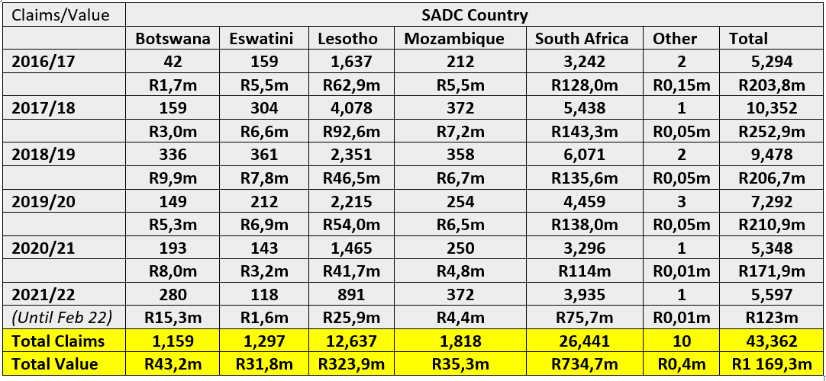
Number and value of claims finalised by Country*
(2016/17 – 2021/22)
*Unaudited

Slide 5
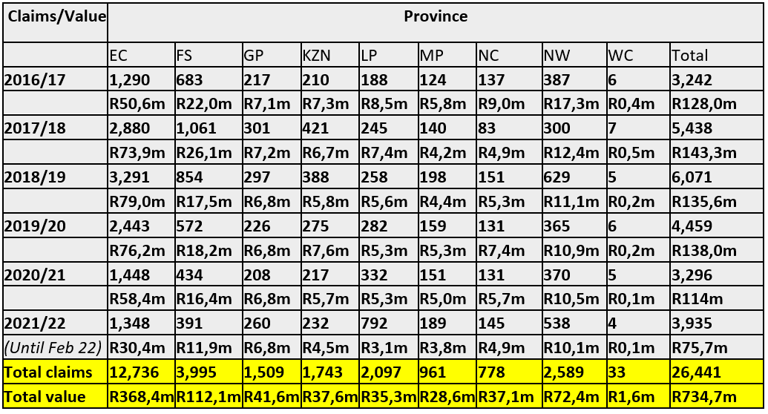
Number and value of claims finalised by Province*
(2016/17 – 2021/22)
*Unaudited

Slide 6
Highlights for 2021/22
Annual Report for 2017/18 submitted to parliament
2018/19 and 2019/20 (audits finalised, annual reports submitted for type-setting); 2020/21 (submitted to Auditor-General - audit in progress)
Business process (as at 28 February 2022)
455 certifications per month ~ 1 104 (2020/21)
509 claims finalised per month ~ 446 (2020/21)
Total Paid – R123m to 5597 claims ~ R172m to 5349 claims (2020/21)
Neighbouring countries – R47m to 1 662 claims ~ R58m to 2 052 claims (2020/21)

Slide 7
Personnel (31 December 2021)
Designation | Level | No. of Posts | Filled | Vacant
Commissioner | 14 | 1 | 1 | 0
Director | 13 | 2 | 1 | 1
Deputy Directors | 12 | 3 | 3 | 0
Assistant Directors | 10 | 3 | 2 | 1
Senior State Accountant (Finance) | 8 | 1 | 0 | 1
Senior State Accountant (Inspector) | 8 | 2 | 2 | 0
Senior Administration Officer | 8 | 1 | 0 | 1
Administration Officer | 7 | 2 | 2 | 0
Senior Administration Clerks | 7 | 1 | 1 | 0
Personal Assistant | 6 | 2 | 1 | 1
Senior Administration Clerk | 6 | 4 | 3 | 1
Administration / Finance Clerk | 5 | 21 | 17 | 4
Switchboard operator | 4 | 1 | 1 | 0
Cleaner | 3 | 1 | 0 | 1
Messenger | 3 | 1 | 1 | 0
Total |  | 46 | 35 | 11
Slide 7

Slide 8
Personnel (31 December 2021)
Level | African |  |  |  | Coloured |  |  |  | Indian |  |  |  | White |  |  |  | Total
 | M | D | F | D | M | D | F | D | M | D | F | D | M | D | F | D | M | D | F
14 |  |  |  |  |  |  |  |  | 1 |  |  |  |  |  |  |  | 1
13 | 1 | 1 |  |  |  |  |  |  |  |  |  |  |  |  |  |  | 1 | 1
12 |  |  | 3 |  |  |  |  |  |  |  |  |  |  |  |  |  |  |  | 3
10 | 1 |  | 1 |  |  |  |  |  |  |  |  |  |  |  |  |  | 1 |  | 1
8 | 2 |  |  |  |  |  |  |  |  |  |  |  |  |  |  |  | 2
7 | 3 |  |  |  |  |  |  |  |  |  |  |  |  |  |  |  | 3
6 | 2 |  |  |  |  |  |  |  |  |  |  |  |  |  | 2 |  | 2 |  | 2
5 | 5 |  | 12 |  |  |  |  |  |  |  |  |  |  |  |  |  | 5 |  | 12
4 |  |  | 1 |  |  |  |  |  |  |  |  |  |  |  |  |  |  |  | 1
3 | 1 |  |  |  |  |  |  |  |  |  |  |  |  |  |  |  | 1
Total | 15 | 1 | 17 |  |  |  |  |  | 1 |  |  |  |  |  | 2 |  | 16 | 1 | 19
Slide 8

Slide 9
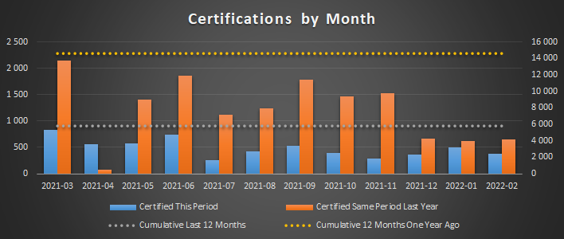
Certifications (2020/21 & 2021/22 (February 2022))
Slide 9

Slide 10
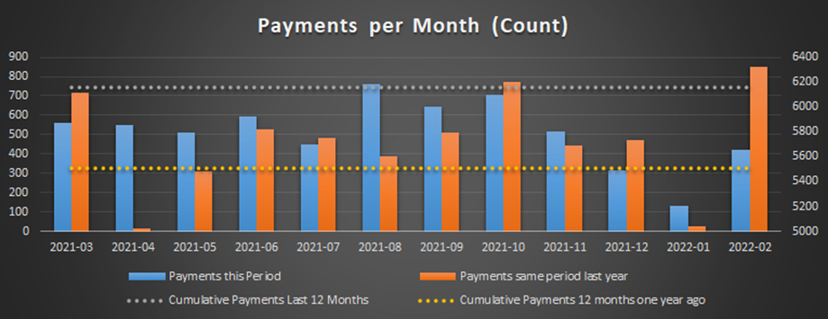
Payments from Fund (2020/21 & 2021/22 (February 2022))
Slide 10

Slide 11
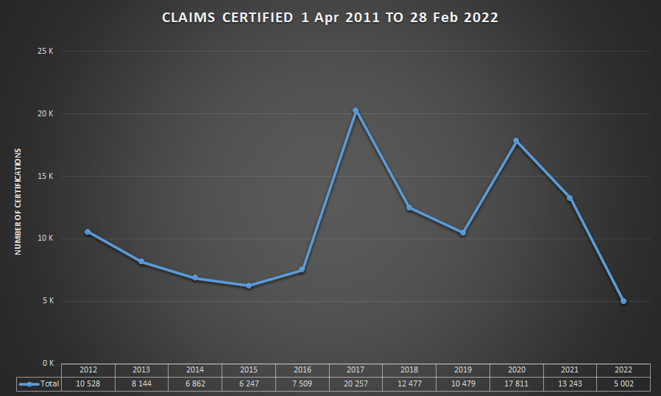
Claims certified (2011/12 to 2021/22 (February 2022))
Slide 11

Slide 12
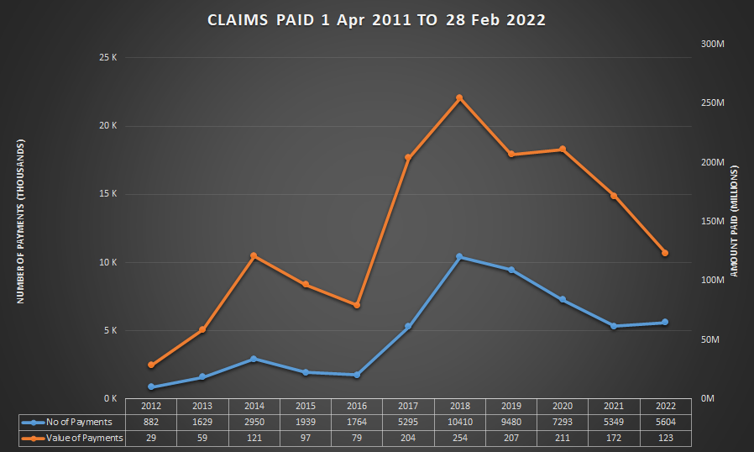
Claims paid (2011/12 to 2021/22 (February 2022))
Slide 12

Slide 13
Annual Reports / Financial Statements
Year | Action
2010-11 | Submitted to parliament
2011-12 | Submitted to parliament
2012-13 | Submitted to parliament
2013-14 | Submitted to parliament
2014-15 | Submitted to parliament
2015-16 | Submitted to parliament
2016-17 | Submitted to parliament
2017-18 | Submitted to parliament in December 2021
2018-19 | AFS formally submitted. Audit opinion obtained. Typesetting of annual report in progress
2019-20 | AFS formally submitted. Audit opinion obtained. Typesetting of annual report in progress
2020-21 | AFS formally submitted. Audit in progress
2021-22 | Live processing in place for the 2021/22 AFS ongoing

Slide 14
Annual Reports / Financial Statements
Confirmed legal status of the Mines and Works Compensation Fund (MWCF) by National Treasury
Application made to list the MWCF as a Schedule 3A entity (under Public Finance Management Act, 1 of 1999)
2019/20 Audit finalised
2020/21 Audit in progress

Slide 15
Controlled Mines & Works Register
968 controlled mines and works
Updated register with gazettes
Need to link with Department of Mineral Resources and Energy for mine closures
Special effort for completeness of revenue & completeness of register

Slide 16
Financial Performance of the Mines & Works Compensation Fund (31 March 2022)
R’ 000 | 2018/19 | 2019/20 | 2020/21* | 2021/22#
Tax (levy) | 305 000 | 114 531 | 107 002 | 120 000
Non-tax (interest) | 270 000 | 660 020 | 208 603 | 205 500
Transfers | 3 836 | 992 | 843 | 1 437
Total Revenue | 578 836 | 775 543 | 316 448 | 326 937
Expenses | 200 294 | 292 738 | 456 323 | 407 773
Surplus/ (Deficit) | 378 542 | 482 804 | (139 875) | (80 836)
*Unaudited
#Revised estimate

Slide 17
Financial Performance of the Mines & Works Compensation Fund (31 March 2022)
R’ 000 | 2018/19 | 2019/20 | 2020/21* | 2021/22#
Investments | 4 365 700 | 4 755 810 | 4 936 636 | 5 142 136
Receivables | 13 500 | 13 490 | 27 073 | 27 073
Cash and cash equivalents | 82 000 | 53 615 | 98 587 | 41 251
Total assets | 4 461 200 | 4 822 915 | 5 062 296 | 5 210 460
Accumulated surplus/(deficit) | 959 595 | 1 591 430 | 1 551 409 | 1 470 573
Trade and other payables | 15 250 | 110 014 | 116 832 | 118 832
Provisions | 3 486 355 | 3 121 471 | 3 394 055 | 3 621 055
Total equity and liabilities | 4 461 200 | 4 822 915 | 5 062 296 | 5 210 460
*Unaudited
#Revised estimate

Slide 18
Focus Areas in CCOD APP for 2022/23

Slide 19
Focus Areas - APP 2022/23
Submission of amendments to Occupational Diseases in Mines & Works Act, 1973
Maintenance of the database of controlled mines and works
Enhancing the claims management system
Submission of financial statements for 2021/22 for audit by the Auditor-General

Slide 20
Objectives – APP 2022/23
Objective | Indicator | Performance (2021/22) | Target (2022/23)
Submission of amendments to ODMWA to the Director-General of the National Department of Health | Report on the submission of amendments to the Director-General of the National Department of Health | The State Attorney noted that ODMWA needs repeal of the Act and consideration be given to integration of the compensation system or phased integration or rewriting ODMWA and possibility of a public entity model | Submission of amendments to ODMWA to the Director-General of the National Department of Health for a public entity model
Ensure the effective and efficient management of the CCOD | Report on updates of database of claims at the CCOD in terms of claims, payments, certifications and data exchange updates and/or additions | Master database updated for payments made, new claims and new certifications for the months April to December 2021. External data exchange from the CCMS system was updated during quarter three. | Master database updated for payments made, new claims and new certifications for the month before the 7th of the next month. External data exchange updates and/or additions to the master database once a quarter

Slide 21
Objectives – APP 2022/23
Objective | Indicator | Performance (2021/22) | Target 2022/23 (2021/22)
Ensure the effective and efficient management of the CCOD (Continued) | Report on the number of certifications finalised on the Mineworkers Compensation System per year | 31 Dec 21 : 4 377 28 Feb 22 : 5 255 | 13 200 (12 000)
 | Report on the number of benefit payments made by the CCOD (other than pension payments) | 31 Dec 21 : 3 884 28 Feb 22 : 4 443 | 7 600 (7 000)

Slide 22
Objectives – APP 2022/23
Objective | Indicator | Performance (2021/22) | Target 2022/23 (2021/22)
Ensure the effective and efficient management of the CCOD (Continued) | Report on the number of claims finalised by the CCOD (other than pensioners) | 31 Dec 21 : 5 054 28 Feb 22 : 5 597 | 8 470 (7 700)
 | Of all claims finalised in the period, what percentage were finalised within 90 days of receipt of all completed claim documents | 31 Dec 21 : 92% 28 Feb 22 : 90% | 70% (60%)

Slide 23
Objectives – APP 2022/23
Objective | Indicator | Performance (2021/22) | Target 2022/23 (2021/22)
Ensure the effective and efficient management of the Compensation Fund (Continued) | Percentage of controlled mines and works liable for payment of levies per the financial system paying levies to the CCOD | 31 Dec 21 : 82% | 80% of controlled mines and works paying levies to the CCOD (80%)
 | Report on the submission of annual reports of the CCOD to the Auditor General of South Africa | Submission of the 2019/20 and 2020/21 annual financial statements to the Auditor-General of South Africa. | Submission of the 2021/22 annual report to the Auditor-General of South Africa (2019/20 and 2020/21 submitted)

Slide 24
Objectives – APP 2022/23
Objective | Indicator | Performance (2021/22) | Target 2022/23 (2021/22)
Ensure the effective and efficient management of the Compensation Fund (Continued) | Report on the number of controlled mines and works inspected | 31 Dec 21 : 109 28 Feb 22 : 131 | 77 (77)

Slide 25
Financial Performance of the Mines & Works Compensation Fund (MTEF)
R’ 000 | 2021/22 | 2022/23 | 2023/24 | 2024/25
Tax (levy) | 120 000 | 125 000 | 128 000 | 130 000
Non-tax (interest) | 205 500 | 209 500 | 217 500 | 221 500
Transfers | 1 437 | 1 544 | 1 735 | 1 813
Total Revenue | 326 937 | 336 044 | 347 235 | 353 313
Expenses | 407 773 | 412 897 | 416 105 | 418 202
Deficit | (80 836) | (76 853) | (68 870) | (64 889)
(7.1%) growth over MTEF

Slide 26
Mines & Works Compensation Fund - Budget (MTEF)
R’ 000 | 2021/22 | 2022/23 | 2023/24 | 2024/25
Administration | 286 336 | 286 353 | 286 370 | 286 389
Pensioners | 1 437 | 1 544 | 1 735 | 1 813
Miners and Ex-miners | 120 000 | 125 000 | 128 000 | 130 000
Total | 407 773 | 412 897 | 416 105 | 418 202
0.8% growth over MTEF

Slide 27
Financial Performance of the Mines & Works Compensation Fund (MTEF)
R’ 000 | 2021/22 | 2022/23 | 2023/24 | 2024/25
Investments | 5 142 136 | 5 251 636 | 5 469 136 | 5 590 636
Receivables | 27 073 | 27 073 | 27 073 | 27 073
Cash and cash equivalents | 41 251 | 83 898 | 24 528 | 62 139
Total assets | 5 210 460 | 5 362 607 | 5 520 737 | 5 679 848
Accumulated surplus/(deficit) | 1 470 573 | 1 393 720 | 1 324 850 | 1 259 961
Trade and other payables | 118 832 | 120 832 | 122 832 | 124 832
Provisions | 3 621 055 | 3 848 055 | 4 073 055 | 4 295 055
Total equity and liabilities | 5 210 460 | 5 362 607 | 5 520 737 | 5 679 848
2.9% growth over MTEF

Slide 28
Explanation of planned performance over the medium-term period
Stabilise number of claims through interactions with social partners
Provision of Benefit Medical Examinations at One Stop Service Centres; use of mobile clinics and limited outreach activities – working with Tshiamiso Trust
Enhance revenue collection through inspections of controlled mines and works
Proposed amendments to ODMWA to cover costs of administration, medical examinations & health care
Actuarial valuation as at 31 March 2022

Slide 29
Voted Funds from Dept of Health – Actual Vs Budget 2020/21 (31 March 2021)
 | Budget R’ 000 | Actual R’ 000 | Available R’ 000 | % Spent
Compensation of Employees | 39 298 | 34 702 | 4 596 | 88%
Goods and Services | 15 389 | 19 391 | (4 002) | 126%
Transfers | 4 058 | 4 058 | - | 100%
Capital | 2 893 | 2 742 | 151 | 95%
Total | 61 638 | 60 893 | 745 | 99%

Slide 30
Voted Funds from Dept of Health - Budget (MTEF)
R’ 000 | 2020/21 | 2021/22 | 2022/23 | 2023/24
Compensation of Employees | 39 298 | 36 371 | 34 482 | 34 395
Goods and Services | 15 389 | 19 429 | 23 602 | 24 896
Transfers | 4 058 | 1 437 | 1 544 | 1 735
Capital | 2 893 | 3 415 | 3 620 | 7 388
Total | 61 638 | 60 652 | 63 248 | 68 414

Slide 31
Resource Considerations
Inadequacy of voted funds
Working with mining companies, trade unions and social partners to enhance operations and services
Register of controlled mines & inspections to ensure accuracy of revenue collection working with Dept of Mineral Resources & Energy
Criteria and timing of benefit medical examinations
Training of health professionals
Legal reform for new model of governance, management services and funding within a public entity

Slide 32
Thank You
Dr Barry Kistnasamy Compensation Commissioner Department of Health barry.kistnasamy@health.gov.za 072 220 0247
Slide 32

