Slide 1
Contents
IK Act, (No 6 of 2019) Presentation
Chapter 01
Chapter 01
Chapter 01
Chapter 01
Chapter 01
Chapter 01
Chapter 01
IK ACT PRESENTATION

Slide 2
PRESENTATION OUTLINE
Public Awareness on the IK Act
Biocultural Protocol
Regulations
SSDU
Migration of the registration system
Recognition of Prior Learning
Commercialisation
2

Slide 3
REGULATORY FUNCTION OF IK IN THE CONTEXT OF IK ACT
Sets out the processes for:
Access and conditions for use IK.
Management and protection of Rights (Intellectual Property).
Benefit sharing and compliance.
Transboundary arrangement.
National Competent Authority Function.
NATIONAL IKS OFFICE
REGULATIONS
REGISTRATION OF INDIGENOUS KNOWLEDGE
RPL
COMMERCIALISATION
3

Slide 4
Public Awareness on the IK Act 1/2
During the consultation period on the IK Act with the Select Committee on Communications and Public Enterprises, Department of Science and Innovation (DSI) was requested to embark on a vigorous public awareness campaign on the IK Act in languages of choice in communities.
To date, public awareness campaigns have been conducted in all nine provinces:
4

Slide 5
Public Awareness on the IK Act 2/2
No | Activity | Date | Duration | Responsibility
1 | Free State Public Awareness | September 2021 | 2 Weeks | DSI (Programme 4)
2 | Northern Cape Public Awareness | September 2021 | 2 Weeks | DSI (Programme 4)
3 | Eastern Cape Public Awareness | October 2021 | 2 Weeks | DSI (Programme 4)
4 | Western Cape Public Awareness | November 2021 | 2 Weeks | DSI (Programme 4)
5

Slide 6
Public Awareness on the IK Act 2/2
No | Activity | Date | Duration | Responsibility
1 | Free State Public Awareness | September 2021 | 2 Weeks | DSI (Programme 4)
2 | Northern Cape Public Awareness | September 2021 | 2 Weeks | DSI (Programme 4)
3 | Eastern Cape Public Awareness | October 2021 | 2 Weeks | DSI (Programme 4)
4 | Western Cape Public Awareness | November 2021 | 2 Weeks | DSI (Programme 4)
6

Slide 7
Biocultural Protocol 1/2
Biocultural Community Protocols (BCPs) are instruments that set out clear terms and conditions to governments and the private, research, and non-profit sectors for engaging with indigenous and local communities (ILCs) and accessing their local resources and knowledge.
They are developed through participatory decision-making processes within the communities and are based on communities’ customary norms, values and laws.
Before the regulations on the IK Act are implemented, BCPs should be in place to empower communities on how to engage with third parties.
7

Slide 8
Biocultural Protocol 2/2
To date DSI has conducted BCPs in the following provinces:
Mpumalanga – 3 communities
North West – 3 communities
Free State – 2 communities
Eastern Cape – 16 communities
Western Cape – 6 communities
Gauteng – 16 communities
Limpopo – 4 communities
Northern Cape – 5 communities
KwaZulu – Natal – 16 communities
8

Slide 9
Gallery on the campaigns
9

Slide 10
Gallery on the campaigns
10

Slide 11
Regulations
The rubric responsible for policy development commenced with the drafting of the regulations.
On 22 March 2020, the DSI’s Executive Committee noted the draft regulations.
On 10 March 2021 the DSI’s Executive Committee recommended that the Minister approves that DSI embarks on the consultation of the draft regulations.
On 12 August, the Minister approved that the Regulations be presented before the ESEID.
On 19 November 2021, ESEID approved that the regulations be presented to Cabinet.
To date the Minister has signed the Cabinet Memo for the regulations to be presented to Cabinet.
11

Slide 12
LEGAL PRESCRIPTS DRAFTED
NO: | ACTIVITY: | STATUS
1 | Prior Informed Consent | Done
2 | Benefit Sharing Agreements, Non Disclosure Agreements, Material Transfer Agreements | Done
3 | License Agreements | Done
4 | Application Forms, Registration forms, Community Resolution Forms | Done
12

Slide 13
Process – IK Act Regulations Project Plan 1/4
NO: | ACTIVITY: | DATE | DURATION | RESPONSIBILITY
1. | Draft Regulations | Ongoing | Ongoing | Prog 4/LSU
2. | Consultation on Regulations with Governance | 4th Quarter - 2020 | Done | LSU/Governance/Prog 4
3. | Present Regulations to EXCO | 1st Quarter - 2021 | Done | Prog 4/LSU
4. | Revise Regulations, if required | 1st Quarter - 2021 | Done | Prog 4/LSU
5. | Obtain Minister’s approval | 2nd Quarter - 2021 | Done | Prog 4/LSU
6. | Request opinion from OCSLA | 2nd Quarter - 2021 | Done | LSU
13

Slide 14
Process – IK Act Regulations Project Plan 2/4
NO: | ACTIVITY: | DATE | DURATION | RESPONSIBILITY
7. | Preparation of Cabinet Memo for permission for public consultation of the Regulations | 3rd Quarter- 2021 | Done | Prog 4/LSU
8. | DSI to present Regulations to Economic Sectors, Employment and Infrastructure Development (ESEID) cluster | 4th Quarter 2021 | Done | Prog 4/LSU
9. | Submission of Regulations to Cabinet for approval for public consultation | As per schedule of Cabinet meetings | Pending | Prog 4/LSU
10. | Arrange for translation of Regulations into +-2 nominated official languages | 4th Quarter - 2022 |  | Prog 4
14

Slide 15
Process – IK Act Regulations Project Plan 2/4
NO: | ACTIVITY: | DATE | DURATION | RESPONSIBILITY
11. | Publication of draft Regulations in Gazette for public comments | 1st Quarter - 2022 | Min of 60 days | LSU
12. | Consolidation and analysis of public comment on Regulations and revision of the Regulations, where appropriate | 2nd Quarter - 2022 | +-30 days | Prog 4/LSU
13. | Submission of revised Regulations to EXCO | 3rd Quarter - 2022 |  | Prog 4/LSU
15

Slide 16
Process – IK Act Regulations Project Plan 2/4
NO: | ACTIVITY: | DATE | DURATION | RESPONSIBILITY
14. | Request approval of the Regulations from the Minister | 3rd Quarter - 2022 |  | Prog 4/ LSU
15. | Submit draft Regulations to Parliament | 3rd Quarter - 2022 |  | Prog 4
16. | Publication of the Regulations in the Government Gazette | 1st Quarter - 2023 |  | LSU
16

Slide 17
Special Service Delivery Unit 1/2
One of the critical provisions of the IK Act is the establishment of the National Indigenous Knowledge Systems Office (NIKSO) as a Special Service Delivery Unit. The main function of the office is the implementation of the IK Act.
DSI requested the Government Technical Advisory Council (GTAC), to conduct a feasibility study and a business case for NIKSO. Following the approval of the two documents by EXCO, on 25 February 2020, an interdepartmental committee meeting comprising DSI, DPSA and National Treasury was convened to consider the two reports.
The Committee recommended that DSI develop:
Funding Model for the SSDU
Service Delivery plan
17

Slide 18
Special Service Delivery Unit 2/2
Item | Responsibility | status
Feasibility Study | GTAC | Noted by DSI Exco
Business Case | GTAC | Noted by DSI Exco
Interdepartmental Committee | DSI, NT, DPSA | Meeting with recommendations held in February 2020
Funding Model | DSI | Tabled before EXCO for noting. EXCO noted with recommendations
Service Delivery Plan | DSI | EXCO noted with recommendations
18

Slide 19
REGISTRATION OF IK IN THE CONTEXT OF IK ACT
Serves the purpose of recording, preserving and protecting the knowledge of indigenous communities from exploitation.
Aims to ensure that the socio-economic benefits arising from the use of communal IK resources will flow back into the local communities who are the generators and custodians of this knowledge.
Registration of IK will be facilitated through the office of the Curator.
NATIONAL IKS OFFICE
REGULATIONS
REGISTRATION OF INDIGENOUS KNOWLEDGE
RPL
COMMERCIALISATION
25

Slide 20
Status Report (1/4)
Following the migration of the IK Registration System to the Data Intensive Research Initiative of South Africa (DIRISA) Infrastructure, data from IKS Documentation Centers was successfully synched to the Central System by 30 September 221.
The IK Registration System comprises sub-systems i.e., NIKSO Portal, National IKS Management System, Provincial IKS Documentation Centres (IKSDCs) and a Pharmacopoeia prior art system was tested in December 2021 to determine its public readiness. Currently preparing all systems to be to launched on 25 March 2022.
The NIKSO Portal is the gateway to the IK information and the Pharmacopeia holds prior art on published material on IK.
26

Slide 21
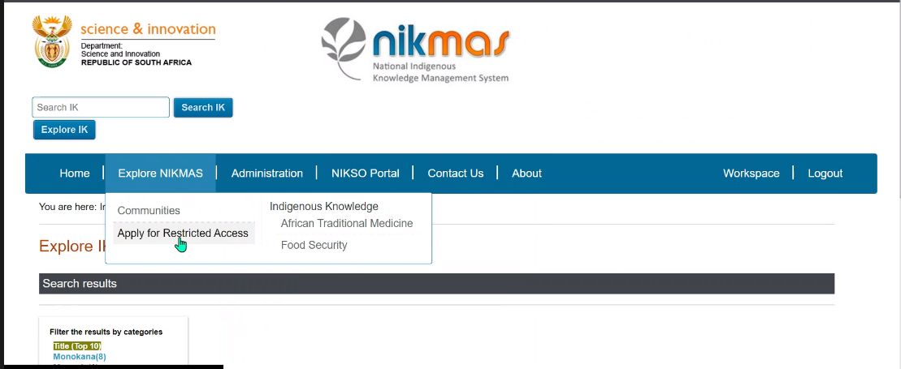
Status Report (2/4)
The National IK Management System (NIKMAS) drives a data-intensive research platform that store, curate, preserve, promote, develop and manage IK. The system was tested to determine it’s readiness for public access.
27

Slide 22
Status Report (3/4)
IK data from Provincial IKSDCs was quality assured in terms of its data quality, legal compliance and completeness of the IK claims and IK recordings.
Just over 2 000 IK holders, 10 000 claims and 3000 recordings quality assured and synched to IK Registration System central server.
IK Claims refers to a Catalogue constituting the community details, name and surname of the IK holders, their physical address, contact details, IK claims, its use and how they acquired that knowledge.
IK Recordings refers to full details of a catalogued claim.
28

Slide 23
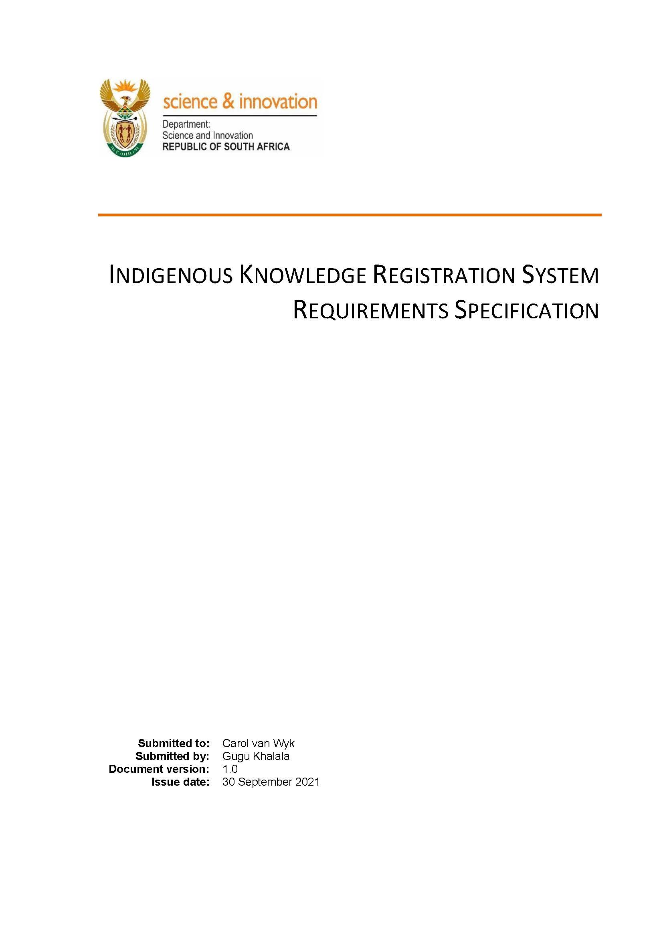
Status Report (4/4)
In September 2021, Software Requirement Specification document was approved that describe the IK Register to be developed in accordance to the IK Act. The Specification will be used to develop the IK Register component in terms of the business and technical functionality.
29

Slide 24
RECOGNITION OF PRIOR LEARNING (RPL)
Outlines the purpose of the accreditation of assessors, and sets out an application process
Provides for persons wishing to register their designation as an indigenous knowledge practitioner and be so certified and recorded in the Register of Designations
NATIONAL IKS OFFICE
REGULATIONS
REGISTRATION OF INDIGENOUS KNOWLEDGE
RPL
COMMERCIALISATION
30

Slide 25
COMMENCEMENT OF THE RPL PILOT IN 3 PROVINCES
Competency norms and standards aligned to South African Qualifications Authority (SAQA) completed in 3 categories– herbalist, diviner and traditional midwife for KwaZulu-Natal, North West, and Limpopo provinces.
The RPL pilot rollout in 3 Provinces aims to demonstrate the concept of certification against the developed competency norms and standards in real-life environment.
Results will be used to develop a national certification model in the Traditional Health and Practice Discipline of Competency in accordance to the IK Act No 6 of 2019.
The project target is to assess a total of 200 IK practitioners per province (KwaZulu-Natal, in North West and Limpopo) in 3 categories: herbalist, diviner and traditional midwife .
The certification assessment for KZN is expected to run from March to April 2022. Followed by North West and Limpopo.
31

Slide 26
STATUS OF RPL PILOT COMMENCEMENT : KZN
Pre-commencement milestones
31 January 2022
Mobilisation & Engagement with Traditional Leaders, Chairs and Secretaries of THP Organisations
Participant Recruitment:
1 to 28 February 2022
Issued Call for Applications for Certification of Competencies: 1 February 2022
Applications Pre-screening by
Secretariat: March 2022
Secretariat conduct pre-screening of applications (Oversight PTT)
District Engagement Commence: March to 31 April 2022
District 1: Harry Gwala
District 2: Umkhanyakude
District 3: Zululand
District 4: Ethekwini
Steering Committee
Reflect and Consolidate work conducted during District pilot process
May 2022
Stakeholder Engagement Workshop (tabling of Pilot Process Report)
May / June 2022
KZN RPL Pilot Report to Minister for endorsement
June 2022
32

Slide 27
STATUS OF RPL PILOT IMPLEMENTATION: NORTH WEST
Call for nominations to serve on Provincial Steering Committee published
Adjudication of
nominations recommend to Minister to endorse appointment
Appointment, induction and training of NW
Provincial Steering Committee
NW RPL Pilot Mobilisation and Engagement
Participant Recruitment
Pre-screening of applications
by RPL Secretariat
Commencement of District Engagement Rollout
NW RPL Pilot final Report to Minister for endorsement
33

Slide 28
Structures formulated
RPL Pilot Provincial Steering Committees
KwaZulu-Natal Province: Pilot Steering Committee for KZN comprising 13 traditional health practitioners (THP) appointed and endorsed by the Minister .
North West Province: Call for nominations to Serve on RPL Provincial Steering Committee in progress.
Pilot Task Team
Pilot Task Team serving as an advisory body to the RPL process nationally and provide monitoring oversight over RPL Pilot. The structure comprise representatives from the THP sector, Traditional Leadership, Academia and other government components.
Institutional Collaboration
Collaborating with DHET, South African Qualifications Authority (SAQA) and the Quality Council on Trade and Occupations in pursuance of developing IKS-based professional designation.
Continuous collaboration with the National and Provincial Houses of Traditional Leadership and THP Structures in 3 Provinces identified for Pilot programme.
34

Slide 29
RPL Prioriries
Formalise agreements between DSI, SAQA and QTCO
Piloting RPL in KwaZulu-Natal Province.
Piloting in North West Province
Piloting in Limpopo Province
Continuous engagement with various sectors of the society for proper interfacing of the developed competences.
Measuring the Value of RPL through (to) national identity and social cohesion.
35

Slide 30
COMMERCIALISATION
Innovation , incubation and product development
Provides for the facilitation and coordination by the NIKSO of all IK activities, which relate to the commercial utilisation of IK products, services and processes.
Affords the opportunity for any person who intends to use IK for commercial purposes to apply in the manner prescribed in the regulations for a licence authorising the use of that IK.
Provides procedures to enter into a licence agreement with the trustee of the relevant indigenous community for the use of that IK.
NATIONAL IKS OFFICE
REGULATIONS
REGISTRATION OF INDIGENOUS KNOWLEDGE
RPL
COMMERCIALISATION
36

Slide 31
Commercialisation
Innovation Cluster, chaired by the IK-Based Bio-Innovation Unit was launched as part of BioPANZA in November 2022. The DTIC and DSBD will assume their mandate in commercialisation of IK-based products.
IK-Based Bio-innovation Unit/Programme established at TIA and IDC to facilitate innovation, manufacturing and commercialisation of IK products.
African medicines framework for regulation of proprietary medicines near completion at SAHPRA.
The UFS awarded the TIA Platform status, and has commenced construction of cGMP facility for African medicines.
37

Slide 32
Commercialisation
Two African medicines supported for Phase 1 and 2 clinical trials research on Covid-19.
South Africa Chairs the WHO-AFRO's Regional Expert Committee of African medicines and infectious diseases.
Forty IK Holders (SMMEs) trained in IK-Based Entrepreneurship (Online CoachLab) Programme at the Innovation Hub.
Funding secured to construct a product development facility at UKZN and a HACCP compliant for Medical Cannabis production at CSIR.
38

Slide 33
Dankie Ha khensa Re a leboga Ro livhuwa Siyabonga Siyathokoza Thank you Enkosi

