Slide 1
LFWA briefing to Portfolio Committee on Mineral Resources and Energy. Friday 25th March 2022
The LFWA
Executive summary
Our experiences relating to Fuel Price increases
Alternatives and /or considerations in addressing the increases in Fuel prices

Slide 2
The LFWA
The LFWA is an Association not for gain
The strategic management of the affairs of the LFWA between annual General Meetings is vested in the Management Team made up of members.
The LFWA is a membership driven and funded Association
One of the roles of the LFWA is to facilitate understanding between stakeholders and the independent wholesalers – to share challenges and offer solutions
SA incorporated solutions
PM speak for and on behalf of the LFWA Management Team

Slide 3
Executive summary
To give context to todays briefing
The Moerane commission is as relevant todays as it was in 2006 (the need for strategic stocks)
The Energy White paper gives clear direction
The global changes have had a direct result on the changes to the Africa and in particular South African Liquid fuels industry
Regulation in South Africa has a specific need – The call for deregulation and the results of this must be clearly understood by all.
The different types of Wholesalers and the roles they perform is critical to the sustainability of the Liquid Fuels industry in SA
LFWA has been giving the same message to all stakeholders for more than 6 years

Slide 4
Overview - Global
Global changes
The Global liquid Fuels industry has / is undergoing a period of major / rapid transformation (this includes Refining changes), new thinking is needed to deal with this.
OPEC was for many years a stable cartel, there is current indications that this is no longer the case.
Oil wells getting deeper – Fracking and Gas becoming major substitutes – energy conservation becoming a global policy issue
The sharp changes in the price of crude oil over the last few years can be placed in the historical context – crude oil has been between $10 a barrel and $40 a barrel for 118 of the last 157 years – currently a huge spike due to geo-political issues
COVID-19 effect on economies created new Fuel Price scenarios
Global refining operations
Out of necessity new Refineries are getting larger, with better economies of scale and also giving the ability to meet demand for the new higher spec products. Smaller refineries across the world closing or becoming storage facilities (terminals) of finished product.
The market for refined products is expanding – Asia / India / China while in Europe and North America, regulations are driving demand for lighter, higher-quality, products with reduced Sulphur content.

Slide 5
Overview – Global Cont.
Global Traders
Have access to extensive global supply networks, they have efficient distribution networks of the new low emissions fuels that are being required at reasonable prices.
See Glencore ( Astron) and Trafigura ( PUMA)
Carbon emissions
The move to renewable energy/EV’s

Slide 6
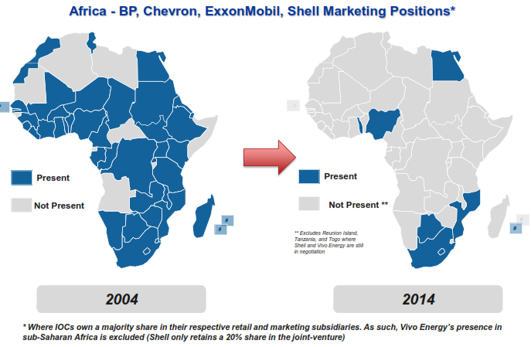
Africa The industry went through major changes in the past 2 decades -- Increasing imports and competition Most African refineries at risk for structural reasons ( scale and cost of compliance) African growth is expected to remain strong in the next 10 years ( growing middle class ,exponential growth ) “Short” supply environment will grow in S/S Africa unless significant investment made in refining – upgrade/clean fuels The age of IOC’s ( international Oil Companies ) is over in African downstream. ( big question ) ( Source DoE )

Slide 7
Overview – South Africa
Changes to the Global liquid fuels business added to the changes that were necessary in the South African liquid fuels industry have created an environment where regulatory adjustments need to be made to ensure the desired consequences of the Petroleum Product Amendment Act are realised.
Regulation in particular is about balancing the interests of different groupings of society and setting appropriate rules - the LFWA sees its role as fulfilling the role of constructive stakeholder engagement.
The role of the Regulator and the role of the Portfolio Committee on Mineral resources and Energy is critical in this regard.
The pace of transformation throughout the fuel value chain in South Africa has been slow, we believe that we must accept the responsibility for finding solutions that brings previously disadvantages South Africans into the Liquid Fuels Industry.
There is a growing need for physical infrastructure development that would improve strategic stocks in SA particularly if economic growth is so heavily relied upon.
The low levels of investment into infrastructure in the Non-Urban( rural/outlying areas) over the past 20 plus years is of great concern.

Slide 8
Overview – South Africa (contd.)
The Regulatory environment has a substantial influence in attracting Investors / Licensing has a critical role in this and needs a much stronger focus
Independent Wholesalers don’t have protection from regulated price like Fuel Retailers.
It is our intention in this discussion to offer some suggestions to these current Pricing models, always using the current agreed principals: Firstly “Transparent Cost to Serve the market” and secondly fair market related returns in servicing and investing in the non-retail related markets we serve.
It has been agreed that the move to a deregulated Liquid Fuels market will happen when relevant milestones have been achieved. environment where past models are no longer workable.
South African Refineries closures is of concern.
The locality of South Africa creates specific challenges (at least 3 weeks on the water) with the resultant price lags

Slide 9
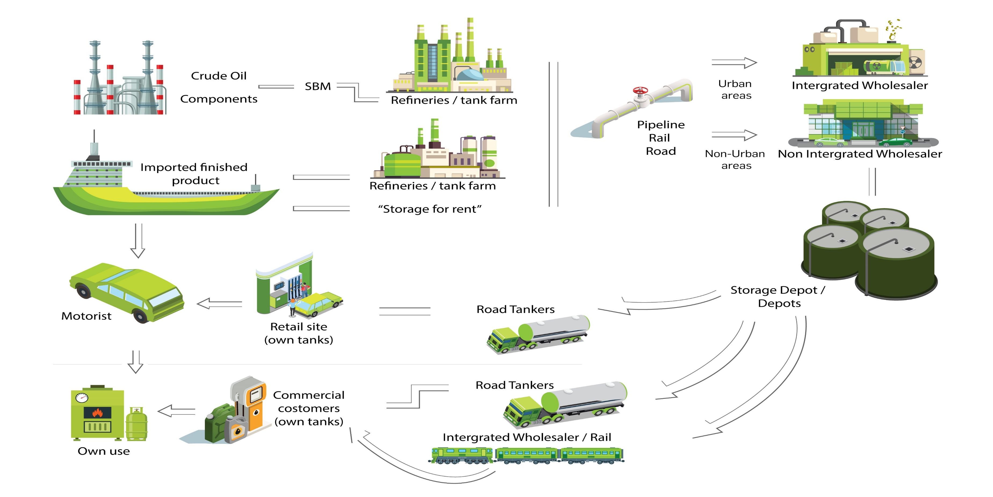
SA Value chain=Independent wholesalers need to take their rightful place

Slide 10
The wholesaling sector of the Liquid Fuels industry.
The Refining Wholesalers moving volume from a secondary distribution model using own transport to one in which Independent Wholesalers (IW’s) now do the distribution is supported and deemed vital. In fact, it can be proven just how more efficient the IW’s are however when analysing the actual costs of servicing this market there is an urgent need where a transparent real cost model in which a true wholesale list price can be established.
IW’s are substantial business entities, and we cannot stress enough the very significant impact on the South African Economy that the independent wholesalers have filled i.e., in the servicing of the commercial and retail markets that require small drop sizes and are removed from the urban centers.
It is safe to say that the current structures and business models that appear to be used by the Refining Wholesalers has evolved into a situation where it is safe to say that in the future, they will not be in the position to re-enter these markets.

Slide 11
Current situation
Presently there is a system that ensures that rural and poor communities pay the same amount for the transportation of petroleum products to their communities, and they pay the same amount for storage.
To allow this the pricing mechanism only recognizes one average price for secondary storage – handling and secondary transport.
This use of one average was workable when one company did all the transport from the refinery gate to the customer, (as over and under-recoveries typically balanced out without negatively affecting profits) however; the Oil majors (integrated Marketers) having experience in many countries around the world for many years, started a process of pulling out from the areas where the costs were above the level of recovery – (the new independent wholesalers filled this gap) -- and to keep all the business where the actual costs are below the cost recovery; this move has created two very different , separate economies in the downstream Liquid Fuels Industry.

Slide 12
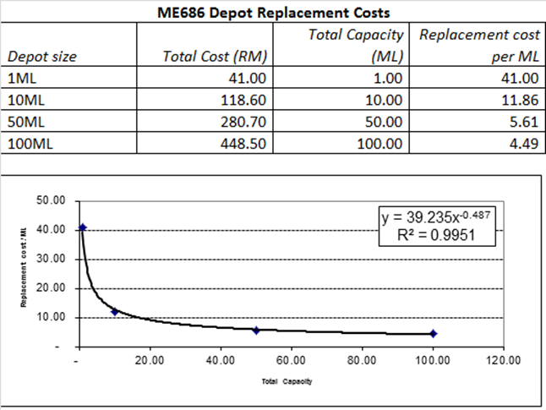
How are the two economies created ? Secondary storage 30,7 c/l Secondary distribution 17,94 c/l

Slide 13
Problems faced and exacerbated by fuel price increases
Experiences relating to Fuel increases
Storage and distribution cost recoveries, as reflected in petroleum product prices, are average of storage and distribution costs across the country whilst costs incurred by independent wholesalers are much higher than average.
Added to this as there is no flow through mechanism in the current pricing systems - the Oil majors in SA are the first receiver of margins. They in turn negotiate fixed discounts with the independents to service the non-profitable parts of the value chain, retaining margin to suit their own returns on investment.
Missing significant costs in the zone and secondary distribution margin calculations e.g., toll fees
Working capital availability and costs to fund higher prices
Understated margins - actual retail site volume throughput 196kl/month (2020) vs BSS 232kl/month
Regulatory lag – diesel price used for transport calculations (SD and Zone diffs) uses Oct previous year prices. Example 9C diesel price in Oct 2020 was R15,71 but actual expected to be + - R22,50 in April 2022 !!!!

Slide 14
Experiences relating to Fuel increases cont.
Most importantly, most people “not in industry” do not understand that when price of fuel goes up that Fuel Wholesalers and Retailers do not make more money i.e., the margins remain fixed in cpl but costs e.g., cash & card costs and working capital costs increase.
Any revisions that include attempts to remove the tax component from the WACC rate, do away with the Entrepreneurial Component or reduce the Weighted Average Cost of Capital (WACC) rate will lead to retailers and investors being severely impacted to such a degree that their businesses will be unsustainable. Retailers will only be left with cost recovery margins.
This will not be limited to retailers but will extend to all investors too i.e., Oil Companies, Independents, and any other investor in filling stations.
While we understand the public frustration, we need to ensure that suggested revisions to fuel prices do not have unintended consequences !!

Slide 15
Experiences relating to Fuel increases cont.
As the Price goes up & the Margin remain fixed the GP% reduces
If you take the Fixed Cost / % GP… you need to sell more to break even.
Salary increases: Bargaining Council 5-7% /Toll Increase 5-7%
Standing time at Refineries .. Stock out , Delays , Strikes , Protest Action
SASRIA went from R350 per month to R3500 pm per truck
Shortage of new vehicles & massive increases. New truck trailer combination cost +/- R5m..
Insurance in Transit Value from R400k to R 800 m per
New Entrants will fail

Slide 16
Alternatives and/or considerations in addressing the increases in Fuel price
Caution against a knee jerk reaction- need a much wider discussion (today)
Not only about pricing today – but also about sustainability of market participants
Refining to refined product imports - changes in industry substantial – not business as usual
Pricing model must reflect what is happening on the ground
If you are an import reliant economy - then the risk of Geo-political impacts is high
Without crude refining capacity then we are even more at the mercy of global markets

Slide 17
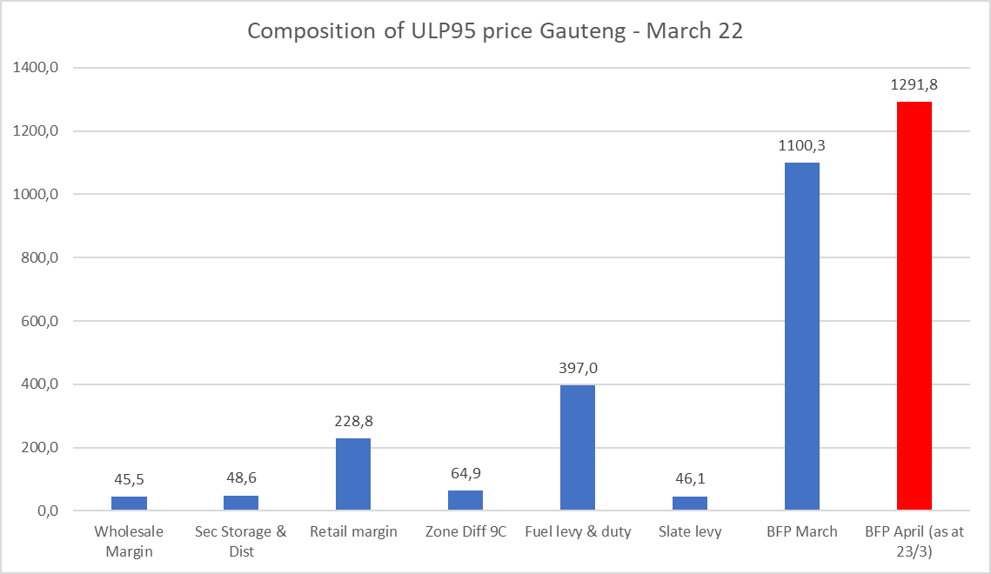
COMPOSITION OF THE RETAIL PRICE OF PETROL IN GAUTENG (Blue) AND THE EXPECTED INCREASE IN THE BFP PRICE (Red) IN APRIL MARGINS (Wholesale, SS, SD and Retail) ONLY MAKE UP 15% OF THE PUMP PRICE
15% of pump price

Slide 18
Alternatives and/or considerations in addressing the increases in Fuel price
The administered prices make up a small portion of the current petrol pump price and perceptions of a fuel margin revision of fuel retailers and other investors margins is incorrectly focused.
Much of the motivation behind these requests to review prices are based on the current spike in the fuel prices due to the Russian Ukraine war where we have seen crude prices at over $130 a barrel. It has already dropped to close to $110 a barrel but is up to +- $120 a barrel.
It is the Basic Fuel Price where all 2022 increases are.
Petrol 95 ULP Gauteng January 2022 March 2022 April 2022
Basic Fuel Price 903,47 1100,27 1291,80
Taxes – Levies 625,33 625,33 625,33
Administered Prices 387,84 387,84 387,84
Material solutions can therefore only rely on managing (a) BFP e.g., different sources of crude and refined product and (b) possibly Fuel Levies where recoveries are deferred until fuel prices are lower.

Slide 19
Solutions
Short Term – Price spike
SARS last year huge tax windfall (from resources) – off set against this windfall
Or set of rules for new slate
Medium Term
Fundamental changes to the pricing system are required.
Pricing Review -- A systemic review of the entire value chain (each part must be examined for their own specifics operational requirements and once this done that each section needs to be “ring fenced” to ensure that there is no damaging vertical integration)
Must engage

Slide 20
Thank you
Questions

