Slide 1
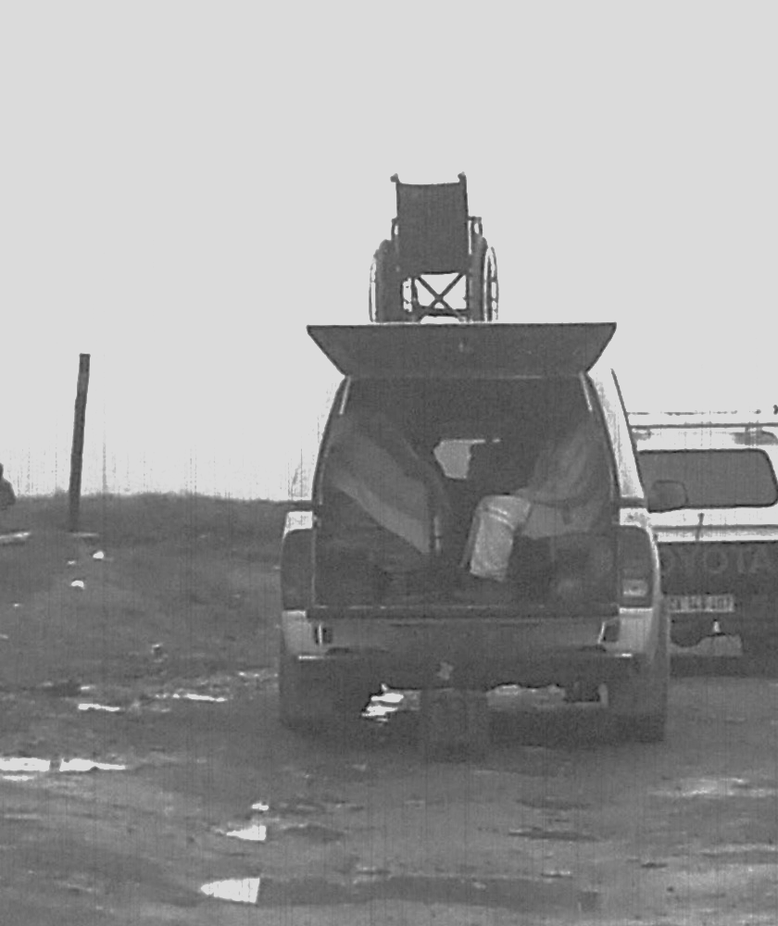
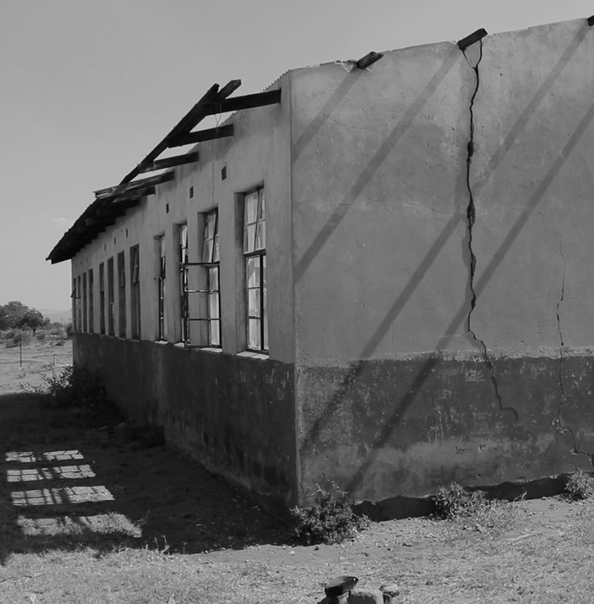
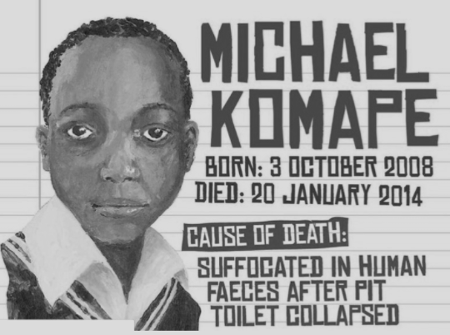
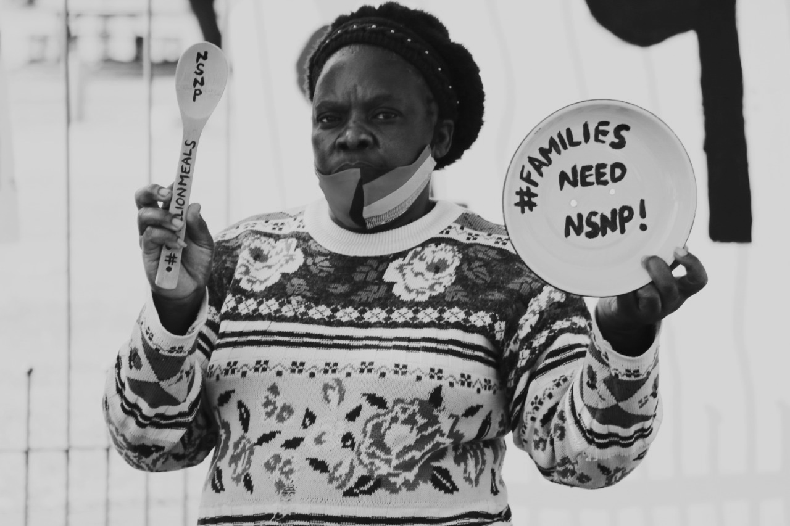
SECTION27 SUBMISSION TO THE SELECT COMMITTEE ON APPROPRIATIONS ON THE DIVISION OF REVENUE BILL
[B 6—2022]
Income Tax Exemption Reference Number: PBO 930022549. Nonprofit Organisation Registration Number: 055-382-NPO SECTION27, Non-Profit Company (2006/021659/08).
Board of Directors: Ms AL Brown (Acting Chairperson) Dr B Brink (Treasurer), Ms U Rugege (Executive Director), Ms N Seme, Mr N Spaull, Mr B Botha, Ms E Kelly, Justice J Froneman, Dr A Skelton, Ms S Kalla.
1st floor, South Point Corner, 87 De Korte Street, Braamfontein, 2001. PO Box 32361, Braamfontein, 2017. T +27 (0)11 356 4100 f +27 (0)11 339 4311 info@section27.org.za www.section27.org.za
By Matshidiso Lencoasa

Slide 2
Introduction
SECTION27 is a public interest law centre that works to advance the rights to basic education and access to healthcare services.
Our submissions on the 2022 DoRB are informed by the Constitutional injunction on the state to progressively realise the right of access to healthcare services and ensure quality basic education is available and accessible to all.
We submit that:
Significant real terms cuts to the provincial equitable share and certain conditional grants will impact both the availability and the quality of public health and education in South Africa.
The government has failed to justify these retrogressive measures nor taken adequate steps to mitigate the impact of these cuts on human rights

Slide 3
Introduction
SECTION27 proposes that Parliament:
Considers whether this Budget and Division of Revenue Bill will enable the provinces and municipalities to provide basic services, perform the functions allocated to them or strengthen the fiscal capacity and efficiency of the provinces and municipalities.
Insists that if cuts to social spending are made, they must be based on transparent and participatory human rights impact assessments that demonstrate that the reductions will not increase inequality and undermine people's right of access to quality basic education and healthcare services.

Slide 4
Gender Responsive Budgeting
The FCC recommended in its 2022/23 submission that the Budget must “address gender inequality through gender budgeting in the public sector”.
However, the Division of Revenue Bill and the accompanying explanatory memorandum barely mention gender and do not allocate grants in a gender responsive manner
Funding for the national Department of Women, Children and People with Disabilities has been slashed 11.9% on average each year over the MTEF
NCOP should monitor whether this will impact on the provinces.
Notes:
Last bullet: mention resulting in limited resources to redressing gender inequality and gender-based violence that plagues South African society.

Slide 5
Gender Responsive Budgeting
Recommendations:
Parliament to request a copy of the government’s plans for the medium term that reflects steps in advancing gender-responsive budgeting.
There should be engagement between government, Parliament and the public on what gender responsive budgeting should look like in the South African context
Parliament must insist on adequate resource allocation to gender empowerment programmes and for provinces in particular to implement the National Strategic Plan on Gender-Based Violence and Femicide to address the scourge of Gender-Based Violence.

Slide 6
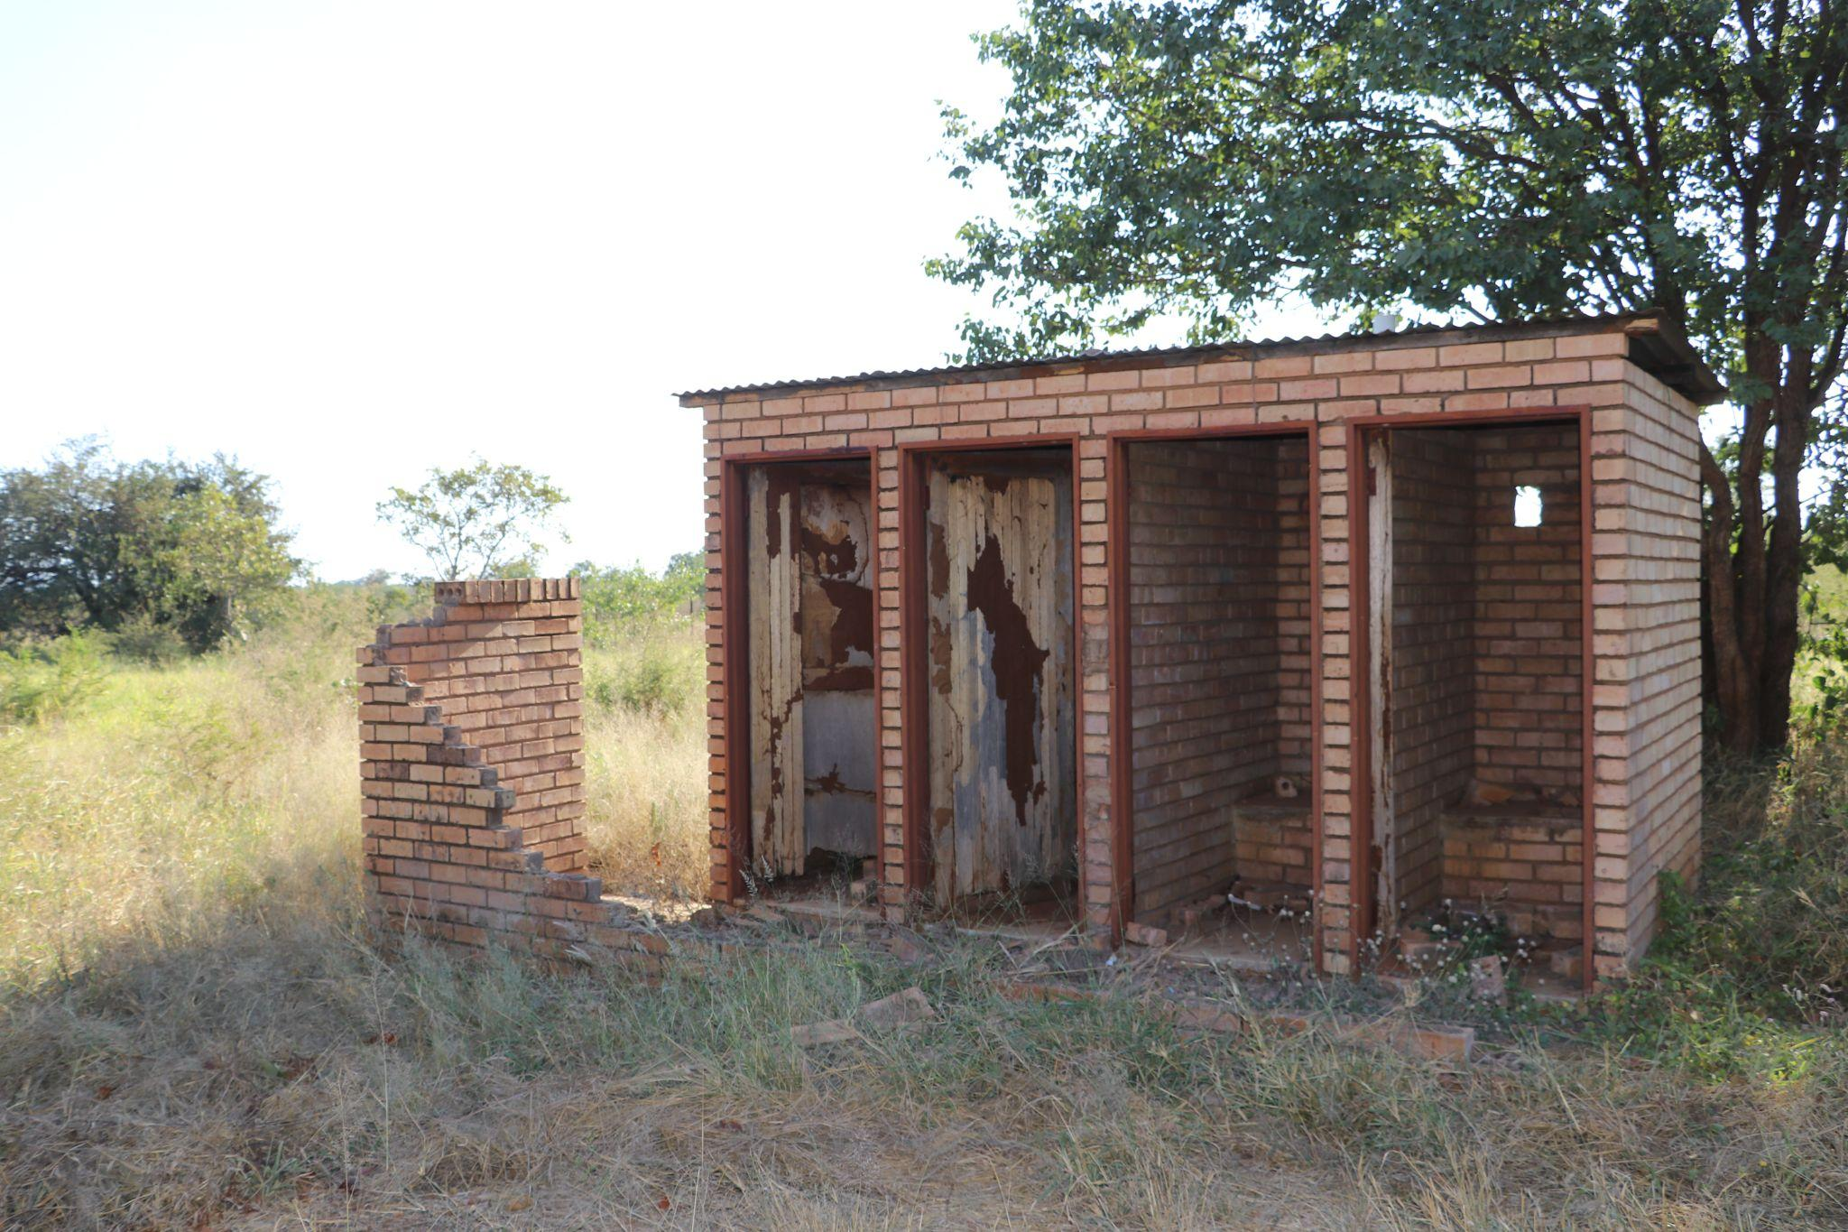
Basic education Conditional Grants
Unsafe, unlawful and undemolished pit toilets at a secondary school in Limpopo (April 2021)

Slide 7
Basic education Conditional Grants
Education Infrastructure Grant (EIG)
We welcome: increased allocations to the EIG of 4.5% over this MTEF, which matches CPI projections
Concerns:
nominal cuts to provinces with a pre-existing infrastructure crisis
Eastern Cape (2,1% cut in 2022/2023 year) despite the pit latrines and other unsafe school infrastructure
North-West (4,7% cut in 2022/2023 year) when more than three quarters of the province’s schools do not have libraries
Limpopo backlog: suspended public school infrastructure projects when funds were reprioritised for COVID-19 needs resulting in a backlog
Notes:
What works: The EIG budget has recovered fully from the cuts that were made to it in 2020/21 when EIG funds were reprioritised to support the Covid-19 response.

Slide 8
Basic education Conditional Grants
School Infrastructure Backlog Grant (SIBG)
Purpose of Grant: provides schools with water and sanitation and replaces schools constructed out of inappropriate materials such as mud
Concerns:
grant increases by 0.3% this year, far below CPI, and is then cut by 13.5% next year
The nominal cut to the EIG in the outer year of the MTEF is not supplemented by SIBG allocations
Recommendation: call for clarity on massive spending cut considering the backlogs
Notes:
Last bullet: mention resulting in limited resources to redressing gender inequality and gender-based violence that plagues South African society.

Slide 9
Basic education Conditional Grants
Early Childhood Development Grant
Concerns:
Only three provinces experience increases in the provincial equitable share in the ECD grant.
These increases are only marginal and below inflation over the medium term.
Once inflation has been factored in, the amounts allocated for ECD funding in most provinces are set to decrease.
Cuts aggravate burden of care on women – no gender responsive budgeting
Cuts to Western Cape and Mpumalanga - below 50% attendance
Notes:
Intro with this: Less money to subsidise ECD, to construct the low-cost ECD centres that government intends to pilot, and to maintain existing ECD centres to ensure they are conducive to learning

Slide 10
Basic education Conditional Grants
National School Nutrition Programme Grant (NSNP)
Purpose: improve the nutrition of poor school children to allow them to learn better by providing a free daily meal to learners
What works: commitment to providing 9 million learners with a nutritious meal each school day over the next 3 years
Concerns: increase does not consider the rising cost to feed children nutritious meals, as food price inflation remains higher than ordinary inflation. Price of average food basket increased by 8.6% between January 2021 and January 2022.
Recommendation: align the NSNP with the food price inflation rate

Slide 11
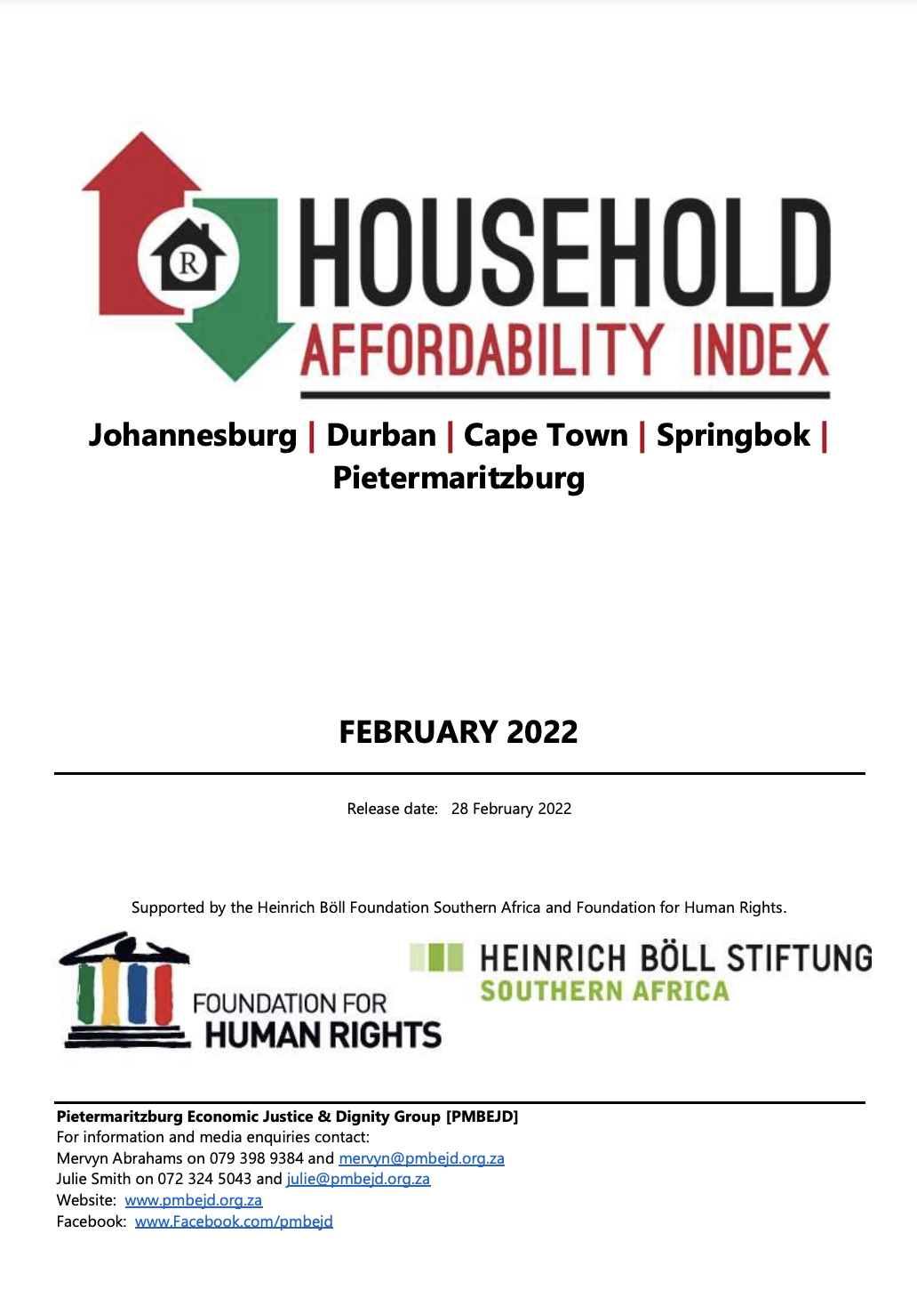
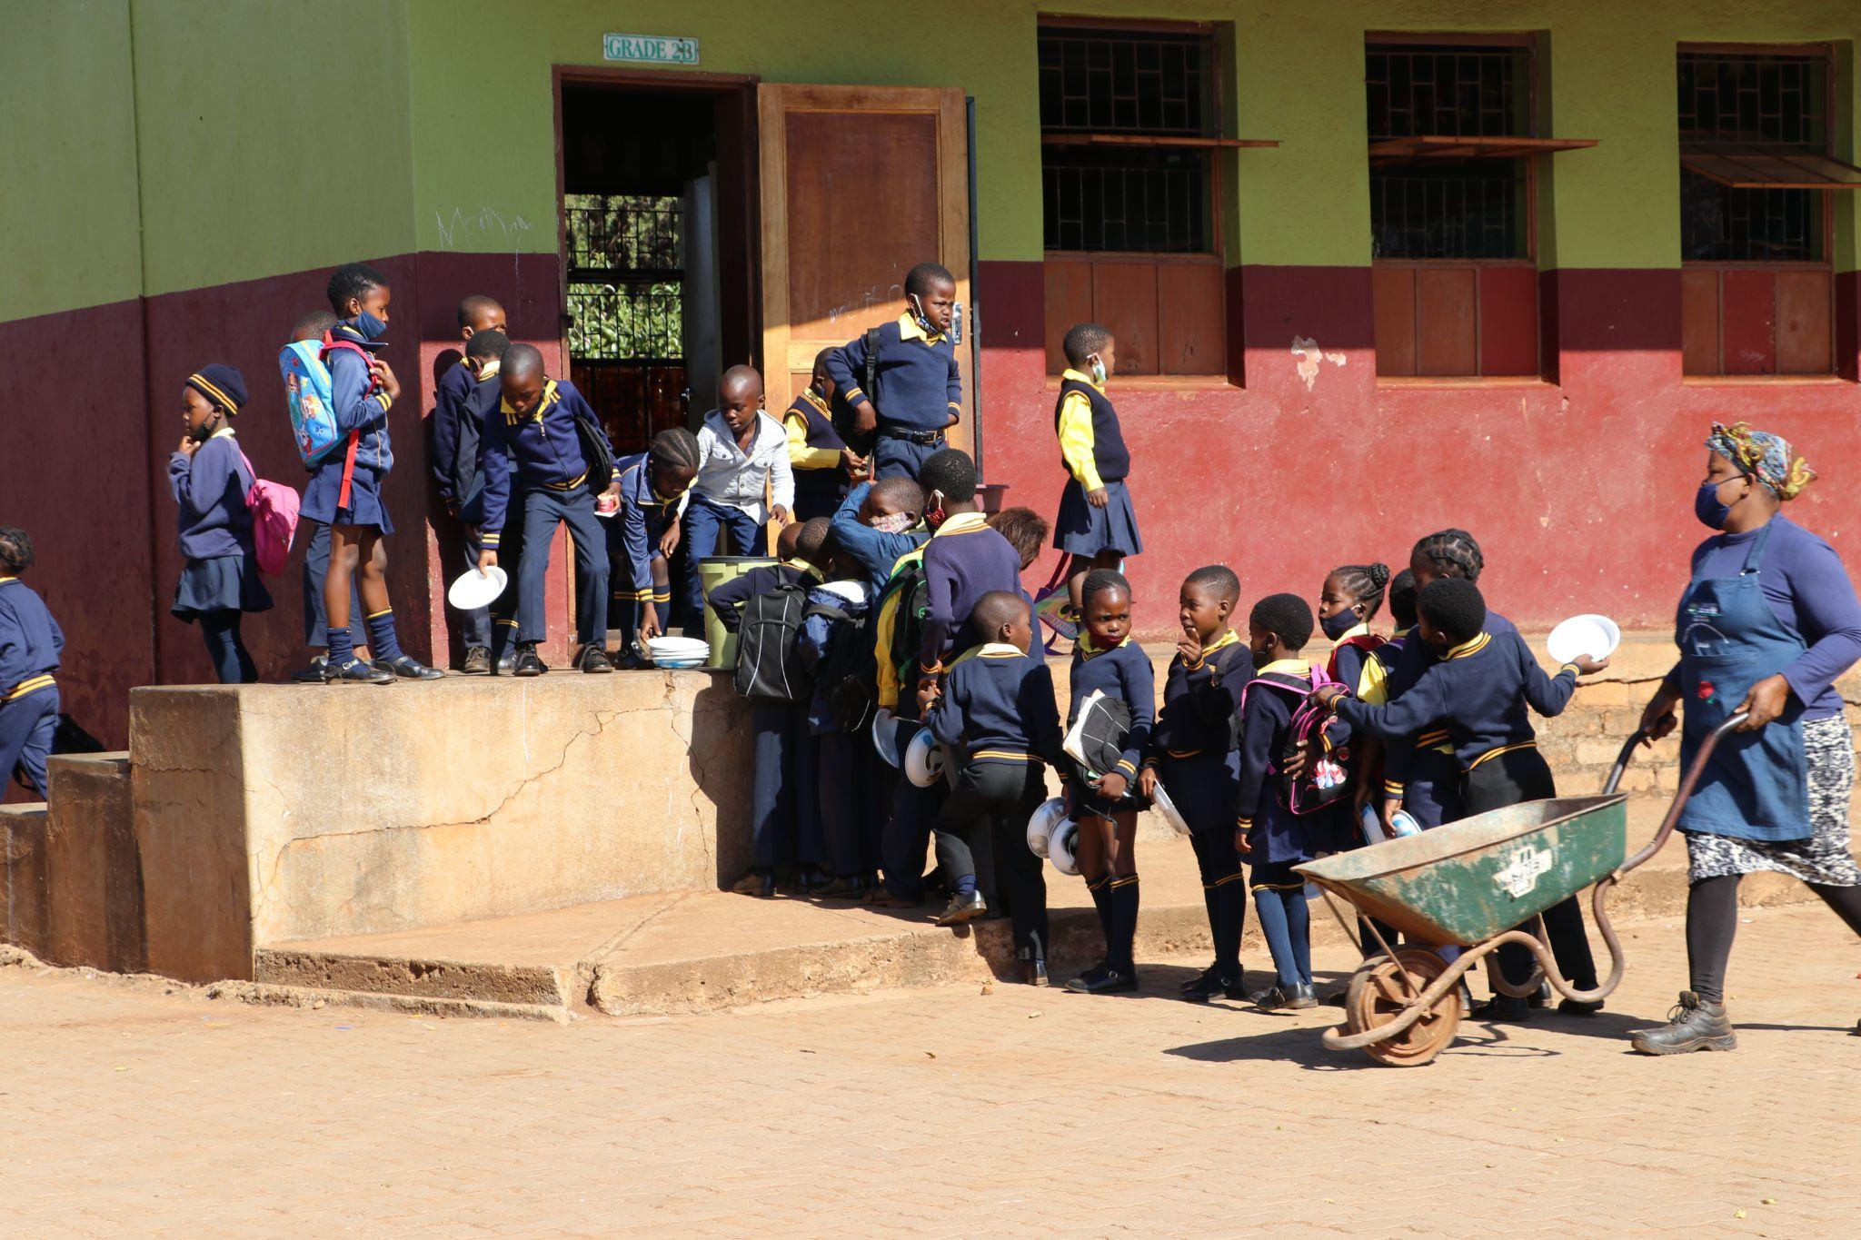
Basic education Conditional Grants
Learners queue for an NSNP meal at a primary school in Limpopo (April 2021). SECTION27 urges Parliament to consider the rising costs of food so that the quality of food and size of portions offered to learners are not compromised!
Recent research by the Pietermaritzburg Economic Justice and Dignity Group (PMBEJD) shows that the price of an average household food basket increased by 8.6% between January 2021 and January 2022.

Slide 12
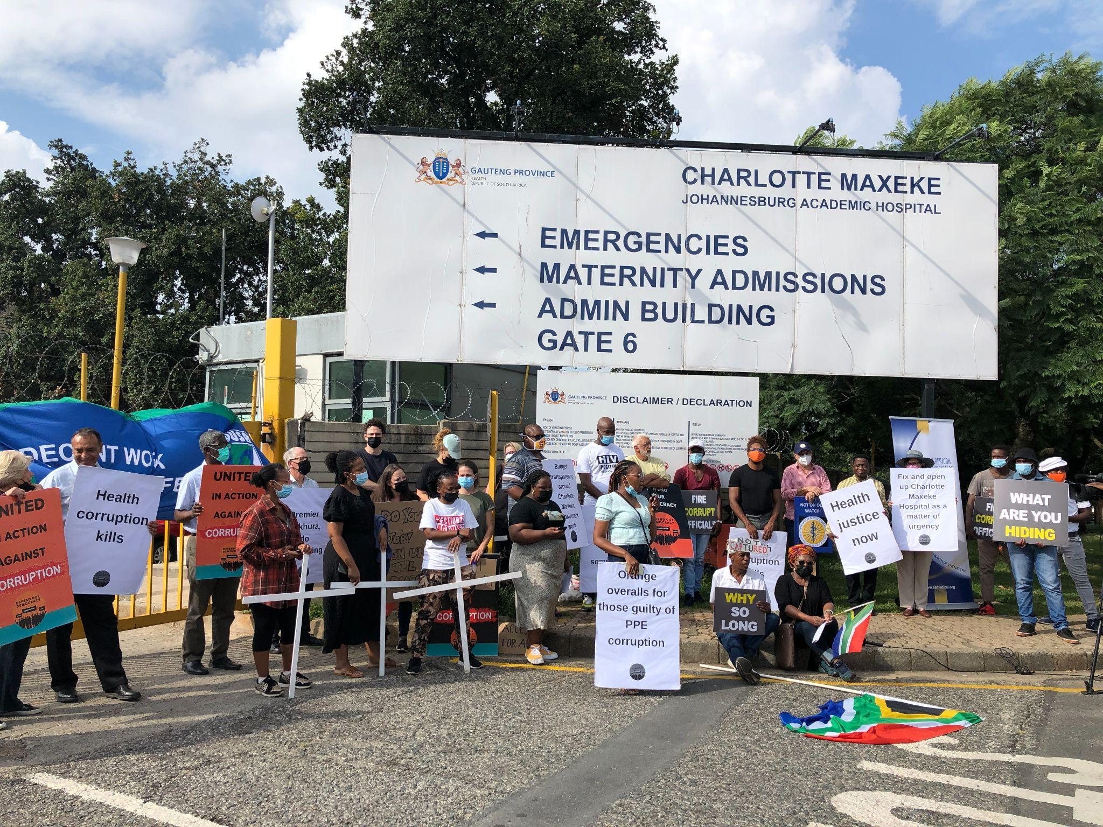
Health Conditional Grants
Civil society organisations picket outside Charlotte Maxeke Johannesburg Academic Hospital to urge the Gauteng Department of Health and hospital management to fully reopen and revitalise the facility (March 2022)

Slide 13
Health Conditional Grants
District Health Programmes Grant (DHPG)
Concerns: expected to fall by roughly 4,2% on average each year for the next three years, in real terms.
South African provinces faced disrupted access to prevention, care and testing for HIV/AIDS owing to the pandemic which resulted in a spike in infections
Treasury acknowledges that the target of 5.7 million people living with HIV remaining on treatment by the end of 2022 is “unlikely to be achieved”

Slide 14
Health Conditional Grants
COVID-19 Grant
What works: the health budget’s target to vaccinate 70% of the population by March 2023, including the R10.1 billion allocated to the vaccine rollout and R2.3 billion earmarked for purchasing additional vaccines provisionally in future.
Recommendation:
Accompany vaccine purchase with effort to make vaccine sites more accessible through extended opening hours and increased mobile units
Financial incentive to offset travel costs and make the process of vaccination easier
Public awareness and branding campaigns about the locations of vaccine sites to dispel some confusion that delays getting vaccinated.

Slide 15
Health Conditional Grants
Health Facility Revitalisation Grant
Purpose: improve and maintain 200 health facilities around the country over the medium term
Concerns:
cuts to all the provinces in 2022/2023, excluding the Northern Cape and the Western Cape
increases to these two provinces are not aligned with inflation, resulting in real cuts over the medium term
budget allocations may not meet the infrastructure backlogs in the provinces, which predate the COVID-19 pandemic.
Notes:
More, decrease to the allocation to the Eastern Cape of 1,9% over the medium term while the Eastern Cape Health Department continues to use mud clinics
Gauteng has seen cuts in the proposed allocation for health infrastructure, while its hospitals are in dire conditions. For example, Tembisa Hospital, which services three metros, needed more funding to provide more wards, as stated by Parliament’s portfolio committee on Health.
Although overall increase is linked with inflation, we are concerned that it is not linked to the rising costs of healthcare

Slide 16
SECTION27’s Recommendations
Parliament to request human rights impact assessments on areas of reduced allocations and budget cuts to enable the government to understand and take steps to mitigate the impact of austerity on socio-economic rights
Parliament to request National Treasury to evidence how the Division of Revenue Bill has adhered to section 214 of the Constitution and considered the FFC’s recommendation for gender-responsive budgeting
Parliament must demand that Treasury undertake an assessment of the short and long-term impacts that retrogressive budget decisions of recent years have had on human rights.

Slide 17
Thank you!
Contact Details:
e
lencoasa@section27.org.za
p
+27 71 631 6212
w
www.section27.org.za
1st floor, South Point Corner, 87 De Korte Street, Braamfontein, 2001. PO Box 32361, Braamfontein, 2017. T +27 (0)11 356 4100 f +27 (0)11 339 4311 info@section27.org.za www.section27.org.za
Income Tax Exemption Reference Number: PBO 930022549. Nonprofit Organisation Registration Number: 055-382-NPO SECTION27, Non-Profit Company (2006/021659/08).
Board of Directors: Ms AL Brown (Acting Chairperson) Dr B Brink (Treasurer), Ms U Rugege (Executive Director), Ms N Seme, Mr N Spaull, Mr B Botha, Ms E Kelly, Justice J Froneman, Dr A Skelton, Ms S Kalla.

