Slide 1
2021/22 Annual Performance Plan
Quarterly Performance and Financial Management Report for Quarter 3 of 2021/22
Portfolio Committee – 23 March 2022

Slide 2
OUTLINE OF PRESENTATION
Purpose of the presentation
Institutional arrangements
Constitutional mandate
Strategic Plan for the fiscal years 2020 to 2025
2021/22 APP – Quarterly Performance Report, Quarter 3
Financial Management Report, Quarter 3 of 2021/22 FY
Challenges
Concluding remarks

Slide 3
PURPOSE OF THE PRESENTATION
To present to the Portfolio Committee:
Quarterly Performance Report for Quarter 3 of 21/22 Financial year;
Financial Management Report for Quarter 3 of 21/22 Financial year;
Challenges encountered by the institution.

Slide 4
INSTITUTIONAL ARRANGEMENTS
THE BOARD
The Board is led by the Chairperson, and discharges its duties through the following committees:
Governance, Social and Ethics;
Audit, Risk and ICT;
Human Capital;
Ward delimitation and Boundary determination;
Research and Knowledge Management;
Finance.
ADMINISTRATION
The administration is led by the Chief Executive Officer, who is also the Accounting Officer. The Board has four programmes which are:
Administration;
Demarcation and Spatial Transformation Excellence;
Research, Spatial Information and Intelligence Development; and
Stakeholder Engagement.

Slide 5
THE BOARD’S CONSTITUTIONAL MANDATE
The Board’s constitutional mandate is primarily derived from sections 155(3)(b) and 157(4) of the Constitution of the Republic of South Africa, Act 108 of 1996.

Slide 6
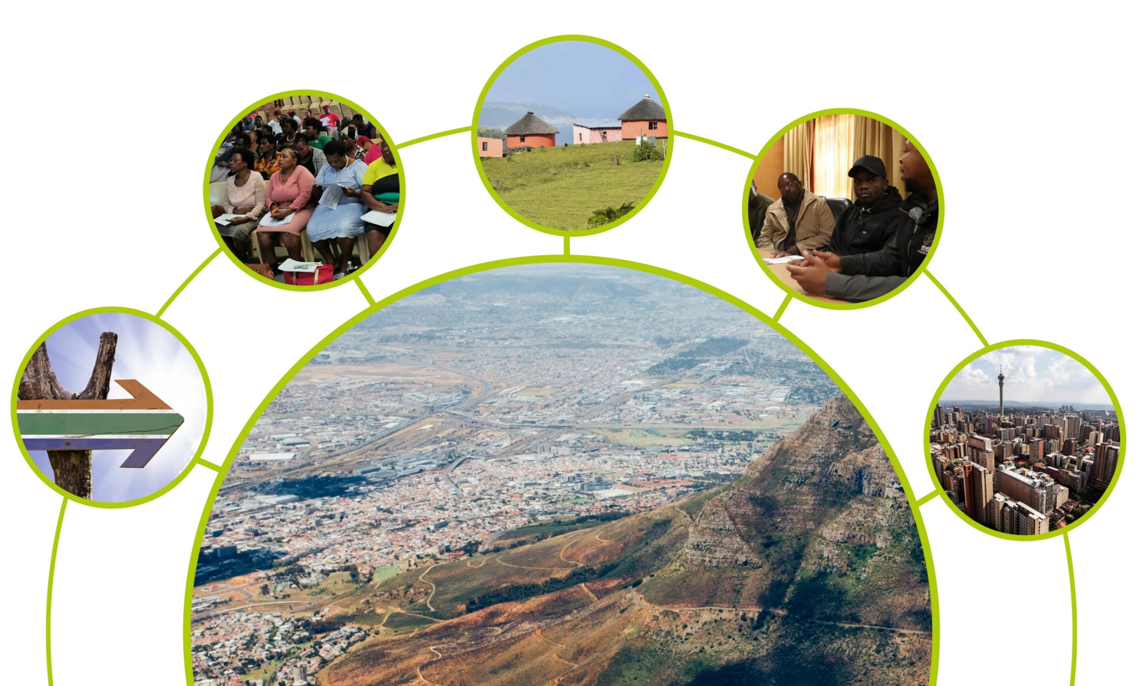
STRATEGIC PLAN FOR THE FISCAL YEARS 2020 TO 2025

Slide 7
OUR MISSION, VISION & VALUES
Our vision
Spatially transformed, just and sustainable communities
Our mission
To create spatial conditions for sustainable development and transformation of local communities through municipal and ward boundary demarcation; provide advisory services, and serve as a knowledge hub for stakeholders to promote socio-economic development, democratic participation, equality and access to services

Slide 8
BROAD STRATEGIC DIRECTION
Impact Statement | Develop democratic, spatially integrated and socio-economically sustainable communities
MTSF priority | Priority 4: Spatial integration, human settlement and local government
Outcome | Outcome indicator | Baseline | Baseline | Five-year target | Five-year target
Organisational excellence | Achieve level 5 on the corporate governance capability maturity model | Baseline to be determined | Baseline to be determined | Maturity level 5 achieved by 2025 | Maturity level 5 achieved by 2025
Well-defined municipal spaces | Ward and municipal boundaries demarcated | 257 municipalities; 4 392 wards | 257 municipalities; 4 392 wards | 4 468 wards delimited for 2021 local government elections Municipal boundary re-determination proposals considered by 2025 | 4 468 wards delimited for 2021 local government elections Municipal boundary re-determination proposals considered by 2025
Improved access to research and spatial information | Research and spatial information accessible | Disjointed and inaccessible information system | Disjointed and inaccessible information system | Research and spatial information accessible to stakeholders and the public by 2025 | Research and spatial information accessible to stakeholders and the public by 2025
Improved public and stakeholder participation | Increased number of education and awareness activities to reach stakeholders and the public | Baseline to be determined | Baseline to be determined | 80 public participation, education and awareness events activated/supported | 80 public participation, education and awareness events activated/supported

Slide 9
Annual Performance Plan for 2021/22
Quarterly Performance Report
Quarter 3
1 October to 31 December 2021

Slide 10
PROGRAMMES SUPPORTING IMPLEMENTATION OF STRATEGY
The implementation of the strategy is supported by four programmes:
Programme 1: Administration
Programme 2: Demarcation and spatial transformation excellence
Programme 3: Research, spatial information and intelligence development
Programme 4: Stakeholder engagement
Per programme, we have set the following number of outputs and indicators to achieve our envisaged outcomes for the 2021/22 financial year.
Prog | Outcome | Number of Outputs and indicators | Percentage
1 | Organisational excellence | 12 | 55%
2 | Well-defined municipal spaces | 3 | 13.5%
3 | Improved access to research and spatial information | 4 | 18%
4 | Improved public and stakeholder participation | 3 | 13.5%
TOTAL |  | 22 | 100%

Slide 11
Summary of Programme Performance for Quarter 3
 | Number of 2021/22 Annual Targets as per APP | Number of Quarter 3 targets | Achieved | Not Achieved | Partially Achieved
Prog 1: Administration | 12 | 6 | 6 | 0 | 0
 |  |  | 100% | - | -
Prog 2: Demarcation and spatial transformation excellence | 3 | 2 | 2 | 0 | 0
 |  |  | 100% | - | -
Prog 3: Research, spatial information and intelligence development | 4 | 3 | 2 | 0 | 1
 |  |  | 67% | - | 33%
Prog 4: Stakeholder engagement | 3 | 3 | 3 | 0 | 0
 |  |  | 100% | - | -
Total | 22 | 14 | 13 | 0 | 1
 |  |  | 93% | - | 7%

Slide 12
Summary of Programme Performance for Quarter 3

Slide 13
MEDIUM TERM PERFORMANCE TARGETS PROGRAMME 1: ADMINISTRATION
Purpose:
To ensure adequate and sustainable resources, capabilities and core competencies to aid the achievement of the MDB mandate. The intention over the next five years is to enhance best practice governance in administrative and financial control systems, capability and financially resourced, staffed and structured MDB with the required infrastructure to fully execute its mandate.
Output | Output indicator |  | Annual Target | Performance Progress
 |  |  |  | Quarter 3 Targets as per APP | Quarter 3 Actual Output | Reason for deviation
Implementation rate of Board resolutions | Percentage Board resolutions implemented | 1.1 | 100% | 100% | 100% | N/A
Committees and Board performance evaluated | Committees and Board self-performance evaluation | 1.2 | Committees and Board self-performance evaluation conducted | N/A | N/A | N/A
Reports on compliance with relevant legislation | Number of reports on monitoring and evaluation of compliance with relevant legislation submitted | 1.3 | 4 | 1 | 1 | N/A

Slide 14
MEDIUM TERM PERFORMANCE TARGETS PROGRAMME 1: ADMINISTRATION
Output | Output indicator |  | Annual Target | Performance Progress
 |  |  |  | Quarter 3 Targets as per APP | Quarter 3 Actual Output | Reason for deviation
Organisational performance review sessions conducted | Number of organisational performance review sessions conducted | 1.4 | 4 | 1 | 1 | N/A
ICT governance reports | Number of reports on ICT governance submitted | 1.5 | 4 | 1 | 1 | N/A
Vacancy rate of funded positions | Percentage vacancy rate of funded positions over the period monitored | 1.6 | 10% | N/A | N/A | N/A
Training interventions provided | Number of staff members provided with training interventions | 1.7 | 14 | N/A | N/A | N/A
AGSA report | Maintain the audit opinion expressed by AGSA | 1.8 | Unqualified audit opinion with no findings (clean) | N/A | N/A | N/A
Financial management reports | Number of financial management reports submitted | 1.9 | 4 | 1 | 1 | N/A

Slide 15
MEDIUM TERM PERFORMANCE TARGETS PROGRAMME 1: ADMINISTRATION
Output | Output indicator |  | Annual Target | Performance Progress
 |  |  |  | Quarter 3 Targets as per APP | Quarter 3 Actual Output | Reason for deviation
Strategic risk register | Annual strategic risk register developed | 1.10 | Develop annual strategic risk register by end March 2022 | N/A | N/A | N/A
Risk mitigation reports | Number of risk mitigation reports submitted | 1.11 | 4 | 1 | 1
Report on implementation status of audit recommendations | Percentage of audit action plan implemented | 1.12 | 100% | N/A | N/A | N/A

Slide 16
MEDIUM TERM PERFORMANCE TARGETS PROGRAMME 2: DEMARCATION AND SPATIAL TRANSFORMATION EXCELLENCE
Purpose:
To determine and re-determine municipal outer boundaries and delimit wards for all municipalities that qualify to have wards to enhance spatial justice, equality and efficiency, and deepen democracy and active citizenry.
Output | Output indicator |  | Annual Target | Performance Progress
 |  |  |  | Quarter 3 Targets as per APP | Quarter 3 Actual Output | Reason for deviation
Reports on preliminary analysis of municipal boundary re-determination proposals | Percentage of municipal boundary re-determination proposals, received by 31 March 2021 analysed | 2.1 | 100% | 30% | 30% | N/A
A multi-criteria decision support tool for municipal boundary re-determination | Develop a multi-criteria decision support tool for municipal boundary re-determination | 2.2 | Multi-criteria decision support tool for municipal boundary re-determination developed | N/A | N/A | N/A

Slide 17
MEDIUM TERM PERFORMANCE TARGETS PROGRAMME 2: DEMARCATION AND SPATIAL TRANSFORMATION EXCELLENCE
Output | Output indicator |  | Annual Target | Performance Progress
 |  |  |  | Quarter 3 Targets as per APP | Quarter 3 Actual Output | Reason for deviation
Reports on analysis of administrative and service areas in relation to municipal boundaries | Number of municipalities analysed in terms of administrative and service areas in relation to municipal boundaries | 2.3 | 213 | 53 | 53 | N/A

Slide 18
MEDIUM TERM PERFORMANCE TARGETS PROGRAMME 3: RESEARCH, SPATIAL INFORMATION AND INTELLIGENCE DEVELOPMENT
Purpose:
To establish and end-to-end integrated system for generating, processing, leveraging and managing spatial data, research, information and knowledge for informed and evidence-based decision-making and to provide proficient advisory service. This entails the development of strategic research, spatial data analysis and information development to facilitate innovation and access to spatial knowledge as a meaningful source for sustainable spatial transformation.
Output | Output indicator |  | Annual Target | Performance Progress
 |  |  |  | Quarter 3 Targets as per APP | Quarter 3 Actual Output | Reason for deviation
Integrated Spatial Knowledge Hub | Integrate MDB spatial data products into spatial knowledge hub | 3.1 | Integrate spatial data products into spatial knowledge hub | N/A | N/A | N/A
Norms and standards for municipal capacity | Number of reports compiled on minimum norms and standards for municipalities to perform its powers and functions | 3.2 | 7 | 2 | 2 | N/A

Slide 19
MEDIUM TERM PERFORMANCE TARGETS PROGRAMME 3: RESEARCH, SPATIAL INFORMATION AND INTELLIGENCE DEVELOPMENT
Output | Output indicator |  | Annual Target | Performance Progress
 |  |  |  | Quarter 3 Targets as per APP | Quarter 3 Actual Output | Reason for deviation | Corrective measures
Research reports | Number of research reports produced in line with Research strategy | 3.3 | 2 | 1 | 1 | N/A | N/A
Updated capacity assessment data available | Number of municipalities with updated capacity assessment data | 3.4 | 249 | 61 | 8 | Insufficient number of municipalities updated required data to planned level. | Continuous engagement with municipalities with outstanding data to update the required information.
Notes:
Continuous engagement with municipalities with outstanding data to update the required information.

Slide 20
MEDIUM TERM PERFORMANCE TARGETS PROGRAMME 4: STAKEHOLDER ENGAGEMENT
Purpose:
To increase the MDB’s effectiveness to deliver on its mandate and rally stakeholders to deepen awareness, understanding and knowledge of demarcation matters through coordinated consultations, meaningful stakeholders and public participation.
Output | Output indicator |  | Annual Target | Performance Progress
 |  |  |  | Quarter 3 Targets as per APP | Quarter 3 Actual Output | Reason for deviation | Corrective measures
Public awareness and education activities | Number of public awareness and education activities completed | 4.1 | 8 | 2 | 3 | More activities than planned were completed due to forthcoming demarcation processes. | None required
Stakeholder awareness and education activities | Number of stakeholder awareness and education activities completed | 4.2 | 8 | 2 | 2 | N/A | N/A

Slide 21
MEDIUM TERM PERFORMANCE TARGETS PROGRAMME 4: STAKEHOLDER ENGAGEMENT
Output | Output indicator |  | Annual Target | Performance Progress
 |  |  |  | Quarter 3 Targets as per APP | Quarter 3 Actual Output | Reason for deviation | Corrective measures
Media coverage | Number of items across print, electronic and broadcast media generated by MDB or arising from its work | 4.3 | 4 | 1 | 2 | N/A | N/A

Slide 22
Summary of Programme Performance

Slide 23
Financial Management Quarter 3 1 October to 30 December 2021

Slide 24
BACKGROUND
This report gives an indication that financial resources are being utilised according to approved budget to meet strategic objectives and to achieve planned targets.

Slide 25
ORGANISATIONAL EXPENDITURE ANALYSIS
The budget for the period under review was R45,906 million and expenditure of R43,099 million was incurred, resulting in a positive variance of R2,807 million or 6%.

Slide 26
ORGANISATIONAL EXPENDITURE ANALYSIS

Slide 27
ORGANISATIONAL EXPENDITURE ANALYSIS
The underspending of R475 thousand (2%) on Compensation of Employees (CoE) is due to the vacant position of Executive Manager: Corporate Services as well as cost of living increases that were supposed to be effected from 1 April 2021 for Senior Managers.
The underspending of R3,227 million (18%) on Goods and Services is mainly due to:
R1,894 million underspending is due to advertisements taking place in Q4.
R500 thousand underspending on internal audit reviews scheduled for Q4
R560 thousand on travel and accommodation is due to COVID-19 pandemic and more activities being conducted virtually.
R818 thousand is constituted by other differences that are less than R70 thousand
R898 thousand negative variance is due to depreciation and amortisation which are not budgeted for.

Slide 28
FINANCIAL PERFOMANCE PER BUSINESS UNIT

Slide 29
FINANCIAL PERFOMANCE PER BUSINESS UNIT
Finance unit has an underspending of R649 thousand (9%) which is largely due to the underspending in audit fees.
Core Operations unit has a savings of R366 thousand (4%) on travel and accommodation due to some work done remotely instead of travelling.
Research and Knowledge Management has savings of R109 thousand (5%) on travel and accommodation due to work done remotely instead of travelling.
Stakeholder and Media Management has underspent by R1,915 million (40%) due to activities e.g. SABC (R1,003 million), Community Radio Stations (R960 thousand), for promotion and advertisements that will only be finalised in Q4.

Slide 30
FINANCIAL PERFOMANCE PER BUSINESS UNIT
5. Corporate Services has underspent by R238 thousand (1%) which is mainly due to:
R377 thousand on compensation of employee is due to vacant positions of Executive Manager: Corporate Services and Senior Manager: HR and Admin.
R126 thousand savings on security services is due to the new contract that came in less than what was anticipated.
R572 thousand negative variance is due to the investigation of the allegations against the former CEO that was not budgeted for.
R119 thousand savings on travel and accommodation due to COVID-19 pandemic and most of the work being done remotely.
R276 thousand underspending on ISP hosting is due to provision that was made to cater for Cloud services costs. Cloud services contract started in November and is currently in implementation phase and is not yet fully operational.

Slide 31
REMAINING BUDGET FOR THE YEAR

Slide 32
REMAINING BUDGET FOR THE YEAR
The annual budget is R71,258 million with the expenditure of R43,099 million resulting in a positive variance of R28,159 million or 39% for the remaining period.
The following are in progress and will be expensed or committed by the end of the financial year:
Cloud Services project that is in progress;
Computer equipment approved in December and procurement process in progress;
Research of boundary redetermination cases, panel of experts tender in progress.
Advertisement and promotion for stakeholder engagement and awareness for municipal outer boundary re-determination process.

Slide 33
CHALLENGES
Challenges faced by MDB remains as follows:
The inadequate financial and human resources constraining the MDB to optimally fulfil its mandate.
Lack of regional representation continues to constrain the MDBs work, even more so under prevailing COVID-19 conditions.
Outstanding finalisation of the Demarcation Amendment Bill.
Dissatisfaction with the final wards in some areas, the MDB has continued to directly engage to share information on how decisions of the Board were reached.

Slide 34
CONCLUDING REMARKS
The CEO’s contract came to an end on 28 February 2022, the MDB is currently busy with the recruitment process scheduled to be concluded in due course.
The MDB has commenced with the municipal boundary re-determination process, details on this process will be shared with the committee as part of MDB’s tabling of its 2022/23 APP.
MDB appreciates the support and continuous guidance by the committee and wishes to indicate that it will continue to work closely with the committee.

Slide 35
Thank you
Physical Address:
Eco Origins - Block C1,
349 Witch-Hazel Street,
Centurion,
Pretoria, 0157,
South Africa
Postal Address:
Private Bag x123,
Centurion,
0046,
South Africa
Telephone:
+27 12 342 2481
Facsimile:
+27 12 342 2480
Website:
www.demarcation.org.za
Email:
info@demarcation.org.za
^{@MunicipalBoard}
^{Municipal Demarcation Board}
^{Municipal Demarcation Board}

