Slide 1
CRL Rights Commission
Presentation to the
Portfolio Committee on Cooperative Governance
and
Traditional Affairs
_____________________________________
QUATERLY PERFORMANCE REPORT
2021/2022 Annual Performance Plan
23 March 2022

Slide 2
Presentation Outline
Official Sign-Off
Part A: Third Quarter Performance Reporting
Purpose and Overview: Strategic Plan 2021 – 2025
Impact Statement, Programmes and Outcomes
Strategic Plan: Outcomes and Outcome Indicators
Our Vision, Mission and Values
Medium Term Strategic Framework (MTSF) Priorities
Overall Organizational Performance Against Quarterly Targets
Programme Performance against 2021/2022 Quarter 3 Targets
Programme 1: Administration – Organisational Development and Support Services ( ODSS)
Programme 2: Legal Service and Conflict Resolution (LSCR)
Programme 3: Public Engagement and Education (PEE)
Programme 4: Research and Policy Development (RPD)
Programme 5: Communication, Marketing, IT and Linkages (CMIL)
PART B: Human Resources and related matters.
PART C: Issues Raised by the Portfolio Committee and Traditional Affairs (CoGTA)

Slide 3
Official Sign Off
It is hereby certified that this report:
Conforms to the Performance Information Standard Operating Procedures
Accurately reflects the actual performance of all programmes or units
Has been verified by Programme Managers and the Chief Executive Officer
Signed by:
____________ 17/03/2022
Mr TE Mafadza Date
Chief Executive Officer
CRL Rights Commission

Slide 4
Part A: Purpose and Overview
To provide an overview of progress made in implementation of the predetermined performance targets as per the 2021/2022 Annual Performance Plan.
This report depicts the overall organizational performance for the period 1 October - 31 December 2021/2022 financial year
The report outlines actual achievements against planned quarterly targets for the third quarter as in APP 2021/2022

Slide 5
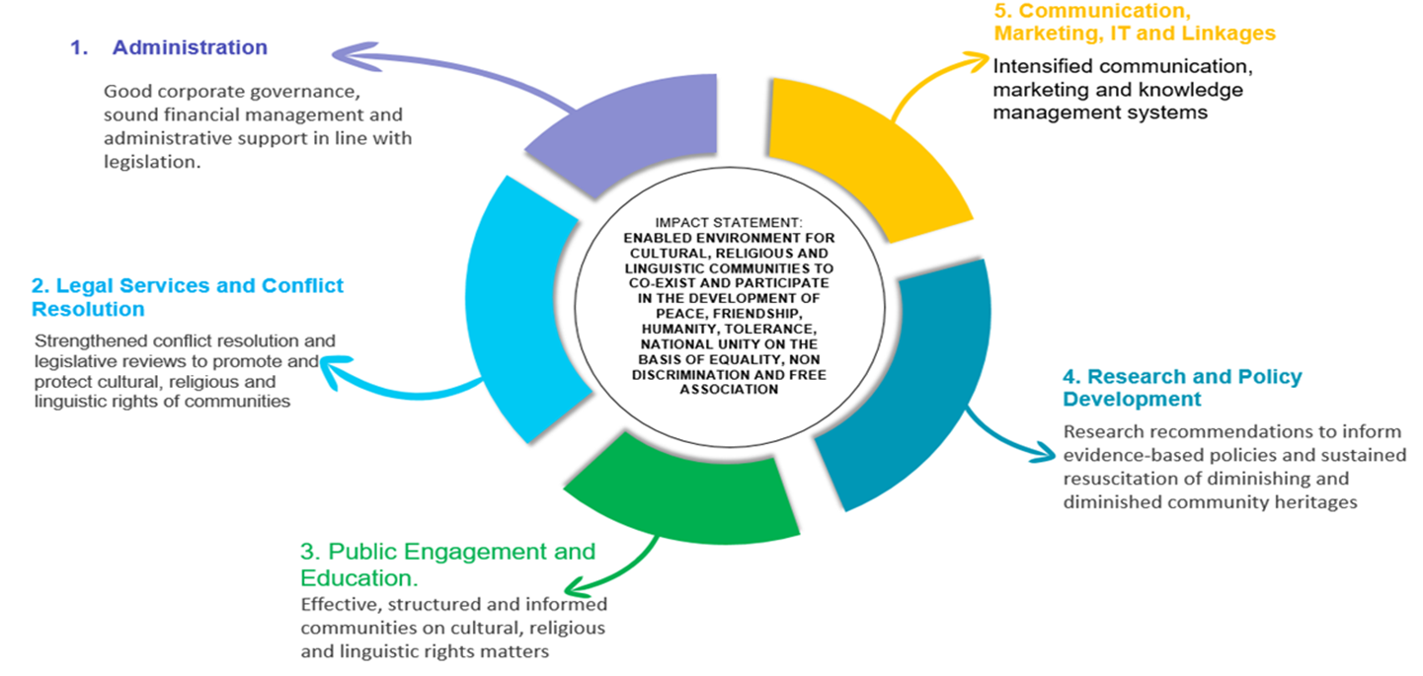
Strategic Plan 2021/2022 – 2024/2025 Impact Statement, Programmes and Outcomes

Slide 6
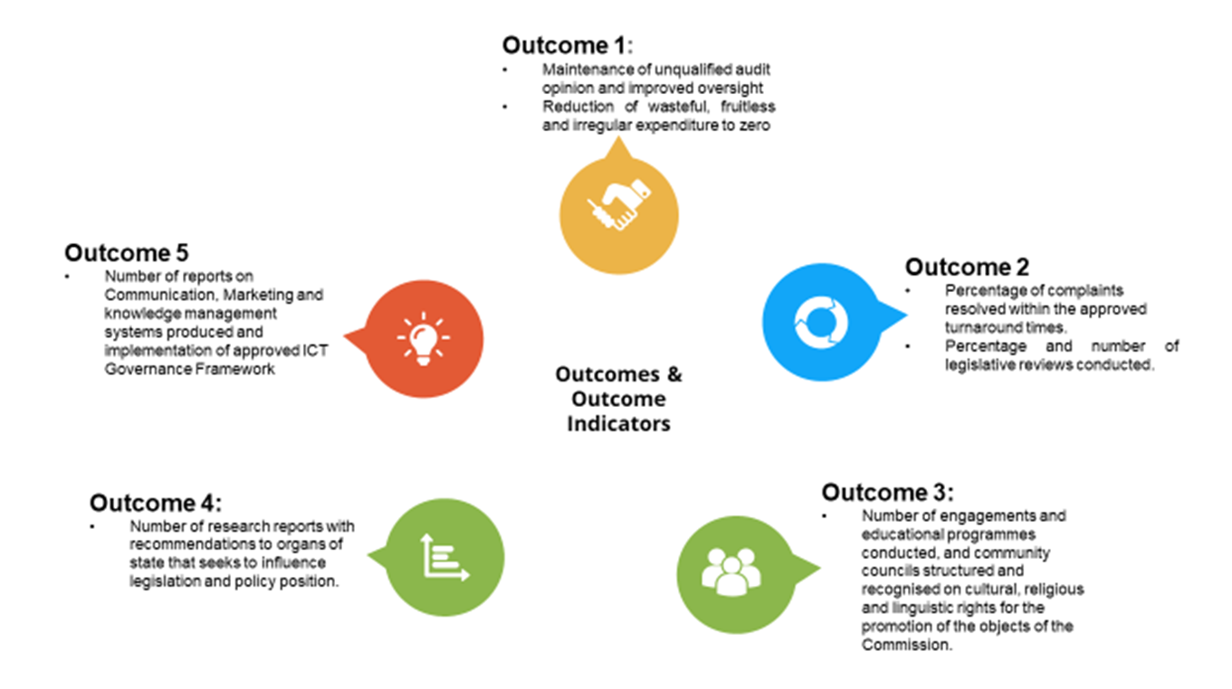
Overview Strategic Plan 2021/2022 -2024/2025 Outcomes and Outcome Indicators

Slide 7
MTSF Priorities
The Commission Subscribe to the following Medium Term Strategic Framework (MTSF)
Social Cohesion and Safe Communities
Better Africa and the World
A capable, Ethical and Developmental State

Slide 8
Our Mission, Vision & Values
VALUES | DEFINITION
Transparency | Committed in being open and honest in conduct at all times when embarking in organizational operations
Professionalism | Committed to uphold high standard in self-conduct, self-presentation and adherence to the workplace policies and procedures
Responsiveness | Committed to understand the organizational, contextual and job demands to ensure the provision of appropriate service, rendered on time in order to uphold the organizational mandate
Accountability | Committed to take full responsibility of decisions, conduct and actions in the workplace, and ensure to support and assist colleagues to uphold the same
Integrity | Committed to and firm adherence to the code of conduct and ethics as prescribed by the organizational policies and procedures
Impartiality | Committed to unbiased, fair play and conduct in all the dealings with colleagues, partners and other stakeholders in the workplace
Respect | Committed to actions of treating colleagues, partners and other stakeholders with appreciation and dignity at all times
Vision
Mutual Respect amongst diverse cultural, religious and linguistic communities
Mission
To foster rights of cultural, religious and linguistic communities to freely observe and practise their culture, religion and language

Slide 9
Overall Organisational Performance Against Set Targets – Q3: The table below reflects summary of the results regarding status of performance of all institutional programmes against planned targets
Programmes | Outputs indicators | Total number of targets for the 3rd quarter | Quarterly Targets fully achieved | Targets partially achieved | Target not achieved | Overall achievement in percentage
1: Administration | 8 | 8 | 6 | 1 | 1 | 75%
2: Legal Services | 3 | 4 | 2 | 0 | 2 | 50%
3: Public Engagement and Education | 3 | 3 | 3 | 0 | 0 | 100%
4: Research and Policy Development | 1 | 1 | 1 | 0 | 0 | 100%
5: Communication , Marketing and IT | 3 | 3 | 3 | 0 | 0 | 100%
Totals/Overall achievements | 18 | 19 | 15 | 1 | 3 | 78.94%

Slide 10
Summary of Result for all Programmes

Slide 11
Overall Performance Per Programme for the 3rd Quarter

Slide 12
Programme 1: Administration: Organisational Development and Support– Q3
Output indicators | Annual Targets | Quarterly Targets | Actual outputs | Reason for deviation | Corrective measure
Report and recommendations for increased oversight, reporting and evaluation and coordination | 8 recommendations made from plenary and oversight committee meetings held per annum | 2 recommendations made from plenary and oversight committee meeting held per annum | 2 recommendations made from plenary and oversight committee meeting held per annum | Target met | Not applicable
Number of quarterly performance reports reviewed per annum | 4 reviewed quarterly performance reports per annum | 1 reviewed quarterly performance report per quarter | 1 reviewed quarterly performance report reviewed | Target met | Not applicable
Number of quarterly financial statements reviewed per annum | 4 quarterly financial statements reviewed per annum | 1 quarterly financial statement reviewed | 1 quarterly financial statement reviewed | Target met | Not applicable
Number of quarterly internal audit reports per annum | 4 quarterly internal audit reports per annum | 1 quarterly internal audit report per quarter | Quarterly internal Audit report – In progress | Target partially met | Internal Auditor is finalising the Report

Slide 13
Programme 1: Administration – Q3 continued…
Output indicators | Annual Targets | Quarterly Targets | Actual outputs | Reason for deviation | Corrective measure
Percentage of workplace skills development plan implemented per annum | 100% of Workplace skills development plan implemented per annum | 25% of Workplace skills development plan implemented per quarter | 37.5% of the workplace skills development plan implemented | Target exceeded | Overachieved due to backlog for training in the organisation.
Percentage of queries on internal and external audit findings resolved annually | 100% of all queries on internal and external audit findings resolved annually | 100% of all queries on internal and external audit findings resolved annually | 94.44% of External Audit Findings have been resolved. 81.81% of Internal Audit Findings were resolved. | Target partially met | The remaining queries is in the process of being resolved.
Number of reports on implemented risk management strategy per annum | 4 reports on implemented risk management strategies per annum | 1 report on implemented risk management strategies per quarter | 1 report on implemented risk management strategy | Target met | Not applicable

Slide 14
Programme 3: Legal Services and Conflict Resolution – Q3
Output indicators | Annual Targets | Quarterly Targets | Actual outputs | Reason for deviation | Corrective measure
Percentage of complaints and requests handled per annum | 80% of new complaints handled annually | 80% of new complaints handled quarterly | 80% of new complaints handled | Target met | Not applicable
Percentage of Legal opinions and drafts in responses to all requests per annum | 100% response to all legal advice/opinion requests annually | 100% response to all legal advice/opinion requests quarterly | 100% response to all legal advice/opinion requests | Target met | Not applicable
Number and percentage of reviewed Bills before Parliament and on reviewed legislation that impact on cultural, religious and linguistic rights of communities as guided by the received complaints per annum | Review 100% of Bills before Parliament that impacts on the mandate of the CRL Rights Commission annually | Review 100% of Bills before Parliament that impacts on the mandate of the CRL Rights Commission per quarter | 0% of Bills before Parliament have been reviewed | Target not met -The unit checked on the parliament website this quarter and found that there are no new Bills that impacts on the Cultural, religious and linguistic rights of communities. | The Commission will continue monitoring the Parliamentary website.
 | 16 Reviewed municipal metropolitan By-Laws that impacts cultural, religious and linguistic rights of communities per annum | 4 Reviewed municipal metropolitan By-Laws: that impact cultural, religious and linguistic rights of communities per quarter | 3 reviewed municipal by-laws: 2 on Slaughtering of animals for cultural and religious purpose in Nelson Mandela Bay and Buffalo City Metropolitan municipalities, and one on Initiation School in Nelson Mandela Bay metropolitan municipality | Target partially met - only three municipal By-laws were reviewed. | Buffalo City Metropolitan Municipality does not have a By-Law or policy on Initiation School, therefore there was nothing to review on Initiation School in this municipality.

Slide 15
Programme 3: Public Engagement and Education – Q3 (Adjusted Report)
Output indicators | Annual Targets | Quarterly Targets | Actual outputs | Reason for deviation | Corrective measure
Number of engagements with communities on cultural, religious and linguistic communities conducted per annum | 25 engagements with communities on cultural, religious and linguistics rights of communities per annum | 6 engagements with communities on cultural, religious and linguistics rights of communities quarterly | 6 engagements with communities on cultural, religious and linguistics rights of communities | Target met | Not applicable
Number of public educational campaigns on cultural, religious and linguistic rights of communities conducted per annum | 20 public educational campaigns on cultural, religious and linguistic rights of communities conducted per annum | 5 public educational campaigns on cultural, religious and linguistic rights of communities conducted per quarter | 5 public educational campaigns on cultural, religious and linguistic rights of communities conducted | Target met | Not applicable
Updated established and maintained database of community organisation and institutions per annum | 1 updated maintained database of community organisation and institutions per annum | Updated and maintained database of community organisations quarterly | 1 Updated and maintained database of community organisations per quarter | Target met | Not applicable

Slide 16
The highlights of Public Engagement and Education Unit
Engagements with communities on promotion of rights of
Communities to develop their diminished heritages.
Limpopo in Thohoyandou (Makwarela), Senwabarwana (Inveraan – ga-Manaka) and Polokwane (Westernburg Communities) and also
Gauteng Province on the Promotion of Nama and N/uu Languages
Awareness Campaigns - on promotion of cultural, religious and linguistic rights of communities
Free State (Kroonstad, Senekal and Bothaville) Northern Cape (Warrenton, Ritchie and Riverton. Limpopo in ga- Mphahlele, Zebediele and Lebowakgomo.

Slide 17
Programme 4: Research and Policy Development – Q3
Output indicators | Annual Targets | Quarterly Targets | Actual outputs | Reason for deviation | Corrective measure
Number of research reports on cultural, religious and linguistic rights produced per annum | 4 research reports on cultural, religious and linguistic rights produced per annum | 1 research report on cultural, religious and linguistic rights produced per quarter | 1 research report on cultural, religious and linguistic rights produced per quarter | Target met | Not applicable

Slide 18
Highlights of Research and Policy Development Unit
The Research and Policy Development Unit during its data gathering phase on the issue of cultural rights and constitutional rights, organised a number of focus group meetings. These focus group meetings were composed of the CRL Rights Commission community councils, traditional leadership, religious leaders and cultural communities and cultural experts. The meetings were held in :
Cofimvava in the Eastern Cape with the Abathembu chiefs and community members
Majaneng in Hamanskraal with the Matebele a Lebelo tribal authority members and community members
Bushbuckridge in Mpumalanga with Kgosi Setlhare tribal authority members and community members
Lwandle in Western Cape with community members
Moletelo in Limpopo with the Moletelo Tribal Council members and community members

Slide 19
Programme 5: Communication, Marketing, IT and Linkages – Q3
Output indicators | Annual Targets | Quarterly Targets | Actual outputs | Reason for deviation | Corrective measure
Number of reports on Implemented internal and external communication strategy per annum | 4 reports on Implemented internal and external communication strategy per annum | 1 report on Implemented internal and external communication strategy quarterly | 1 report on Implemented internal and external communication strategy quarterly | Target met | Not applicable
Number of reports on maintained and upgraded infrastructure and implemented ICT Governance Framework per annum | 4 reports on maintained and upgraded infrastructure and implemented ICT Governance Framework per annum | 1 report on maintained and upgraded infrastructure and implemented ICT Governance Framework per quarter | 1 report on maintained and upgraded infrastructure and implemented ICT Governance Framework per quarter | Target met | Not applicable
Number of reports on activities on social media platform per annum | 4 reports of activities on social media platform per annum | 1 report of activities on social media platform per quarter | 1 report of activities on social media platform per quarter | Target met | Not applicable

Slide 20
Unpacking the CMIL Report
1 report on Implemented internal and external communication strategy entails among others the following:
Engagement with media houses on various programmes and projects of the Commission inclusive of the investigative hearings such as Kwasizabantu Christian Mission, Universal Church, death of initiates and other CRL projects,
Media statements: Some examples
Statement in supporting sign language as an official language
Statement about the KZN investigative hearings arising out of the July 2021 conflicts
Statement welcoming the high court decision to allow the Commission to continue its investigative hearings despite attempts by Bishop Steven Zondo to challenge them
Statement about the joint seminar with the South African National Deaf Association (SANDA) focusing on Sign language
Statement appealing to all stakeholders to work together in order to protect the lives of initiates

Slide 21
Unpacking the CMIL Report, continued…
Media Interviews related to the projects of the commissions, the KZN investigative hearings, the attack on Mama Jostina, the death of initiates.
Media enquiries related to abuses in religious spaces, deaths of initiates, deprivations of children adhering or practicing their African belief systems, attacks on some pastors or churches by municipal police, shortages of burial sites, some farmers refusing black mourners to access their farms,

Slide 22
Unpacking the CMIL Report, continued…
1 report on maintained and upgraded infrastructure and implemented ICT Governance Framework per quarter entails the following:
ICT Oversight Governance quarterly meeting
ICT projects that were undertaken e.g. vulnerability tests, penetrations tests, introduction of 365, new servers, windows upgrades, antivirus. licences, etc.

Slide 23
Unpacking the CMIL Report, continued...
Support applications - sage evolution password reset; backups; evolution upgrade for users.
Server maintenance and Email support, managing of accounts on active directory.
Monitoring the logs of all servers, Cybersecurity Phishing test done on 10 users, using Covid 19 template; Ensured all users have access to the network; continued support on VPN services in response to the Covid 19 challenges and impact;
Second Cybersecurity phishing test done on 17 users, using social media (Twitter) template; Monitored Firewall logs to guard against intrusion; servicing of the fire detector in the server room.

Slide 24
Unpacking the CMIL Report, continued…
1 report of activities on social media platform per quarter
Twitter and Facebook monitoring and updates focused largely on the hearings involving Zondo, KZN conflict/violence, death of Mama Jostina, challenges experienced by initiates, etc.
Facilitating live Facebook media broadcasts of the KZN hearings as well as updates on other work of the Commission.

Slide 25
Part B: Human Resources and related matters
1. Appointments
Temporary staff members were appointed. This also was meant to increase capacity in order to deal with some backlogs in some departments. The Appointments are as follows:
2 Public Engagement and Education Officers
1 Procurement Clerk
1 Legal Officer
1 Research Officer
1 Human Resources Officer

Slide 26
Human Resources continued...
2. Capability and Capacity Project
The process is at the job evaluation stage.
DPSA is also assisting the consultant to comply with public service requirements in terms of this process.
3. Disciplinary Hearings
There are two staff cases in progress.

Slide 27
Part B:
Fundraising for the Commission
Quotations stage - to invite suitable service providers for the placement of an advert. fundraiser to perform fund raising activities on behalf of the Commission.
The appointed fundraiser will compile a fundraising strategy for the approval by the Commission.
This will be concluded in the first quarter of the new financial year.

Slide 28
Part B Continued…
The Commission is reviewing its Communication and Marketing Strategy to sharpen and strengthen its utilisation and management of social media
The IT plan has been developed and approved to help improve ICT Infrastructure and to support IT function in the Commission.

Slide 29
Part B Continued…
The ICT plan entailed the development of ICT related policies (ICT Governance Framework, Patch Management Policy, Cyber Security Report and Policy, IT, Disaster Recovery Plan, Change Management Policy, User Account Management Policy) and strategic documents, improvement of the ICT infrastructure and the training of staff. The Commission is also working on providing more internal capacity for the IT unit.

Slide 30
Part B continued…
Amendment of the CRL Rights Commission Act:
The Commission has consulted with its Commissioners and requested that they send inputs for the amendment of the Act.
Inputs have been received and will be shared with Department of Cooperative Governance and Traditional Affairs to initiate the amendment.

Slide 31
Part B … Continued
Implementation of the District Development Model (DDM) by the CRL Rights Commission.
The Commission engaged in several meetings with the Gauteng Provincial Department of Cooperative Governance and Traditional Affairs (Cogta) on its drive to implement the DDM.
The Commission completed drafting a Memorandum of Understanding with the Department in which the two will partner in certain districts within Gauteng Province. Once the Gauteng Pilot project is completed the Commission will then focus on other provinces.
The Commission works closely with municipalities in other provinces regarding mobilisation of communities for outreach programmes as well as using their supplier database for service during the engagement with communities.

Slide 32
Conclusion
The above information summarises the third quarter report of the CRL Rights Commission for 2021/2022 Annual Performance Plan.
The Commission is still concluding some pending targets during the third quarter as we are about to close quarter four of the current Financial Year.

Slide 33
Thank you

