Slide 1
Q3 PERFORMANCE
2021/2022
(Oct ‘21 – Dec 21)

Slide 2
PRESENTATION OUTLINE
Environmental Context of Quarter 3
Legislative Requirements & 2021/2022 Approved APP
Non-financial Performance – Q3 - Dashboard
Non-financial Performance – Q3 - Key highlights
Recommendations

Slide 3
This is the final APP of the current strategy
SALGA Strategy 2017 to 2022
SALGA Strategy 2022 to 2027
APP
2017/18
APP
2018/19
APP
2019/20
APP
2020/21
APP
2021/22
APP
2022/23
APP
2023/24
APP
2024/25
APP
2025/26
APP
2026/27

Slide 4

ENVIRONMENTAL CONTEXT OF QUARTER 3
OCT – DEC ‘21
ELECTIONS
RESULTS
1ST COUNCIL MEETINGS (Metros & Local)
1ST MEETINGS (Districts)
PROVINCIAL CONFERENCES
NATIONAL CONFERENCE
9 Nov ‘21
10 - 23 Nov ’21
Within 14 Days of Results
24 Nov - 6 Dec ’21
Within 14 days of Local Councils
13 Jan - 16 Feb ’22
Within 90 Days of Elections
2-4 March ’22
Within 120 days of Elections
Gazetting of Election Results
1 Nov ‘21
Elections
Voter Registration Proclamation of Election Date | Declaration of Election Results | Establishment of new Municipal Council (Municipal Governments); Election of Office Bearers Induction of Councillors
31 Jan ‘22: APP & Budget Submission | 28 Feb ‘22: AOP FINALISED

Slide 5
Legislative Requirements
Section 52 of the Public Finance Management Act 1 of 1999 (as amended by Act 29 of 1999) states that a Schedule 3 Public Entity must submit to the accounting officer for a department... and the relevant treasury at least one month or another period agreed with the National Treasury…
  a projection of revenue, expenditure and borrowings …
  A corporate plan in the prescribed format covering the affairs of that public entity or business enterprise for the following three financial years…
NATIONAL TREASURY INSTRUCTION NOTE: 05 OF 2019/2020
To give effect to the Strategic Plan and Annual Performance Plan Framework Timeframes for submission and tabling of Strategic Plans and APPs as well as submission of the quarterly and annual reports
Public Entity deadline | 30-Apr | 31-Jul | 30-Oct | 31-Jan
Quarterly Report (Quarterly) | SALGA submit 4th Quarter on the implementation of the predetermined objectives to CoGTA and National Treasury | SALGA submit 1st Quarter on the implementation of the predetermined objectives to CoGTA and National Treasury | SALGA submit 2nd Quarter on the implementation of the predetermined objectives to CoGTA and National Treasury | SALGA submit 3rd Quarter on the implementation of the predetermined objectives to CoGTA and National Treasury

Slide 6
SALGA STRATEGY (2017 – 2022)
To promote high quality and reliable Service Provision and Infrastructure Investment
To support Regional Economic Strategies and effective Land Use Management approaches for economies of scale and social cohesion
To strengthen oversight and accountability
To modernise governance systems and processes
To develop and support the implementation of financial strategies for long term sustainability and viability of local government
To support innovative revenue enhancements strategies for local government
OUTCOME 4
An effective and efficient administration support service for SALGA programme delivery
OUTCOME 1
Municipalities with sustainable, inclusive economic growth underpinned by spatial transformation
OUTCOME 2
Good Governance & Resilient Municipal Institutions
OUTCOME 3
Financial Sustainability of
LG and Greater Fiscal Equity
To strengthen financial management systems and controls
To implement a sustainable Urban Development Programme
To strengthen LG’s role in Community Development and Social Cohesion
To promote sound and productive labour relation
To professionalise Local Government

Slide 7
2021-2022 Approved APP Targets
The priorities of this APP contribute to the strategic outcomes defined in the 2017-2022 Strategic Plan
OUTCOME 1
OUTCOME 2
OUTCOME 3
OUTCOME 4
Municipalities with sustainable, inclusive economic growth underpinned by spatial transformation
Good governance & resilient municipal institutions
Financial sustainability of local government & greater fiscal equity
An effective and efficient administration support service for SALGA programme delivery
20
20
6
16

Slide 8

NON-FINANCIAL PERFORMANCE AT A GLANCE

Slide 9
Overall Performance of Quarter 3 for 2021/2022
Quarter 3:
68% ‘(42 targets) is “In progress” indicating target are on track to be achieved;
11% (7 targets) are “lagging behind”;
19% (12 targets) has been “Achieved”; and
2% (1 target) was “not applicable” for the quarter.

Slide 10
TARGETS IN PROGRESS

Slide 11
TARGETS LAGGING BEHIND

Slide 12
Q3 PERFORMANCE HIGHLIGHTS
PRE-ELECTIONS SUPPORT
Local Government Transition Guidelines Developed and Workshopped (Roles & responsibilities, Handover Reports, etc)
Developed Generic Standing Rules and Orders – including amendments introduced by the Structures Amendment Act
National Workshop: Personal Financial Management for Councillors

Slide 13
Q3 PERFORMANCE HIGHLIGHTS
DURING ELECTIONS SUPPORT
Preparations for transition from old to new councillors & preparations for Inaugural Council Meetings
Coalition Government Framework to deal with:
What happens after a council is declared hung?
What is needed to promote stability during the life-cycle of the coalition?
Preparations for Integrated Councillor Induction Programme

Slide 14
Q3 PERFORMANCE HIGHLIGHTS
POST ELECTIONS SUPPORT
Direct Support to municipalities to convene the Inaugural Council Meetings
Direct Support to municipalities on Councillor Welfare and Support (Tools of Trade, exit from Pension Funds, remuneration)
2954 (35%) councillors were trained in the Integrated Councillor Induction Programme from 29 Nov – 10 December 2021

Slide 15
Q3 PERFORMANCE HIGHLIGHTS
Strategic Profiling
THEMATIC CALENDAR
LG TRANSITION CAMPAIGN
Increased awareness about local government (governance, mandate, powers & functions)
Created and increased awareness around service delivery of municipalities in the past 20 years
Showcase the value chain of municipal services
Created a repository of good news stories in local government
October - Transport Month,
November – 16 Days of activism against gender-based violence, Local government election month
December – World AIDS day

Slide 18

FINANCIAL PERFORMANCE AT A GLANCE

Slide 19
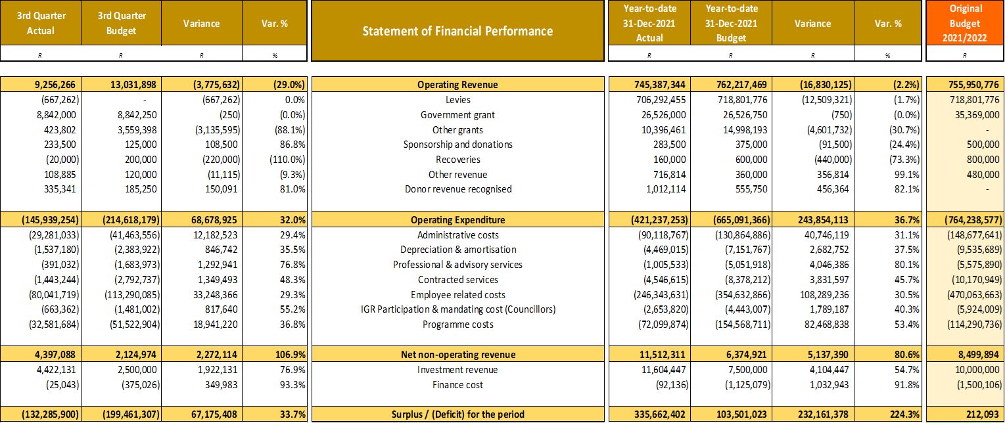
FINANCIAL PERFOMANCE

Slide 20
REVENUE
Surplus for Q3 R 335.6 million vs budget of R 103.5 million resulting in a positive variance of R 232.1 million.
Revenue is lagging behind by R16.8 million to:
  Budget vs Actual on levies – Levies based on revised Formula;
  The discounted levies fees during the year as municipalities took advantage of the early settlement discount;
  Executive Authority grant is on par with budget;
  Sponsorship revenue - Conferences being held in Q4;

Slide 21
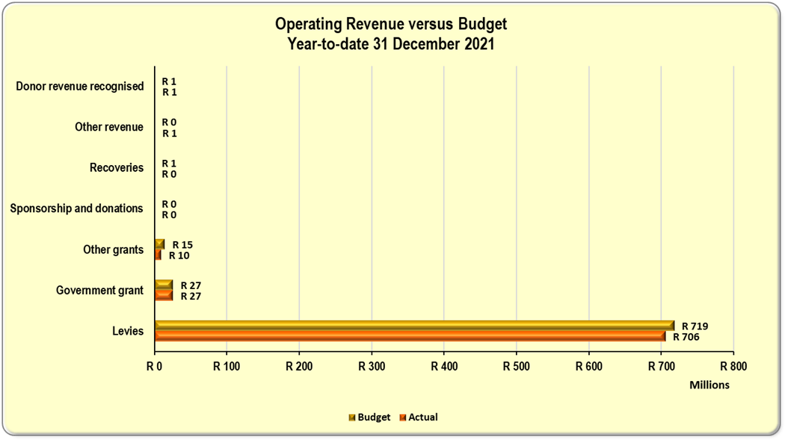
REVENUE (cont.)

Slide 22
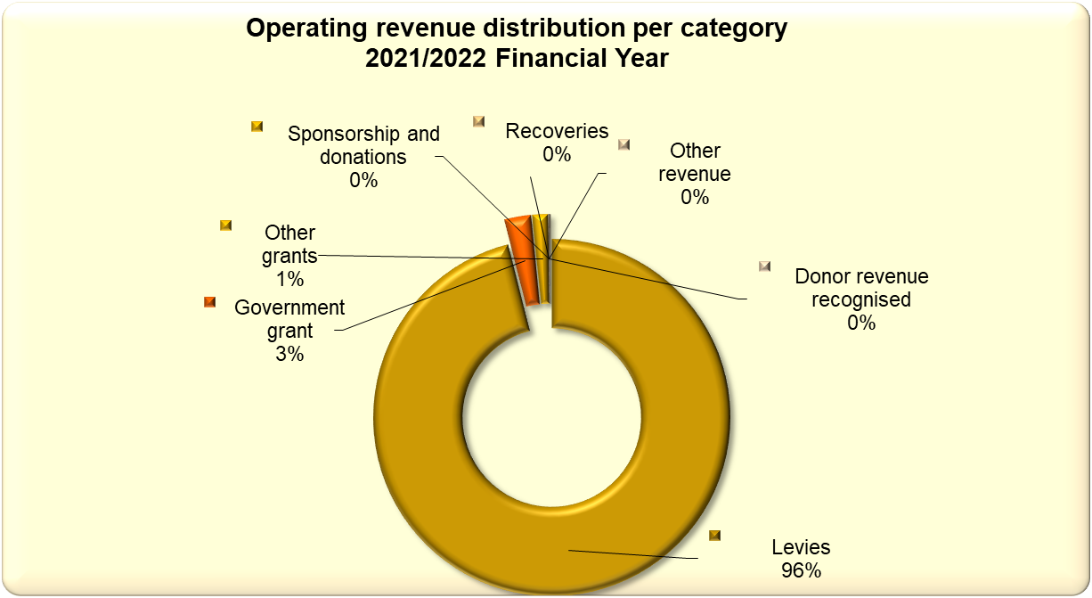
REVENUE MIX

Slide 23
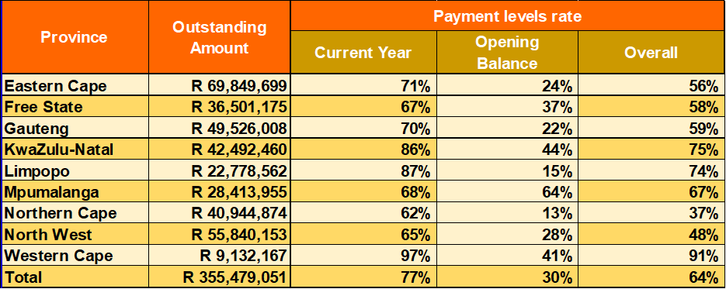
PAYMENT LEVELS
AMOUNT OUTSTANDING
Current Yr Levies – R718.6 m
Opening Balance – R266.6 m
AMOUNTS PAID TO DATE
Current Yr – R539.4 m
Opening Balance – R79.2 m
OVERRALL
Levies outstanding – R985.5 m
Collected – R618.4 m
Outstanding – R355.5 million
31 Dec 2021
Overall Rate 64%
Current Year Rate 77%
Opening Balance 30%
Overall Collections R618.4 million (R79.2 m – opening balance)
30 Sep 2021
Overall Rate 55%
Current Year Rate 68%
Opening Balance 20%
Overall Collections R528 million (R54 m – opening balance)

Slide 24
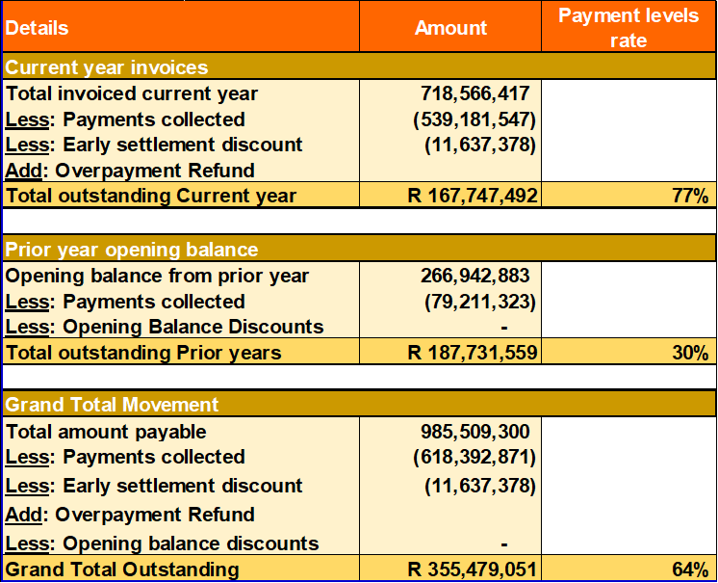
SUMMARY OF COLLECTIONS

Slide 25
EXPENDITURE
Operating Expenditure have a positive variance of R 243.8 million or 36.7 percent due to:
  Programme costs that are stilling taking place (ICIP, Conferences) in Q4;
  Client-facing programme work not taking place in the traditional form but virtually;
  Planned employee and related recruitment costs yet to take place.
  Organisation in general seen less spending due to the ongoing national lockdown and work-from home by many employees;

Slide 26
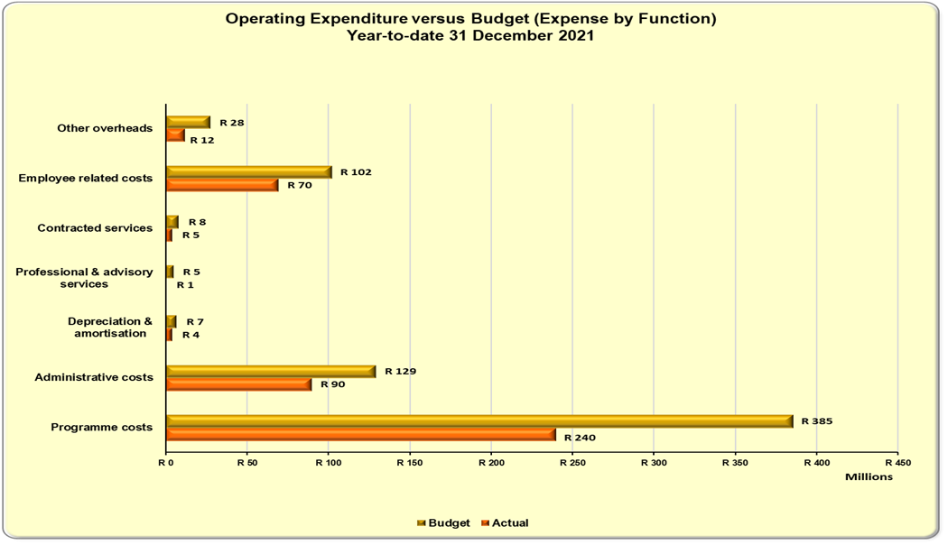
EXPENDITURE (cont.)

Slide 27
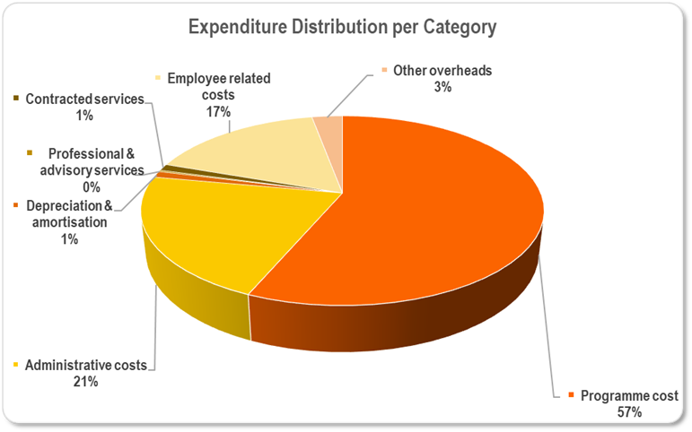
EXPENDITURE (cont.)

Slide 28
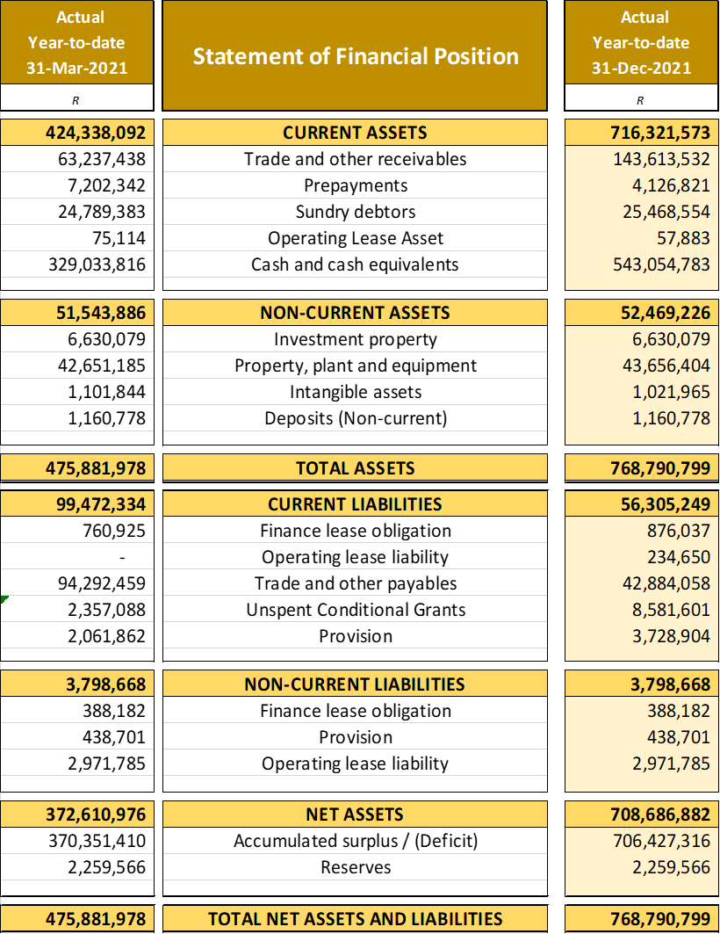
Cash balances sitting at R543 million; Debtors balance expected to decrease in Q4; Debtor collection is expected to improve in Q4 due to Conferences as municipalities aim to be “In Good Standing”. Number of municipalities entered into payment arrangements; Continuous engagements are being held and follow-ups are held in terms of encouraging payment arrangements.

Slide 29
RECOMMENDATIONS
It is Recommended that the PC COGTA:
Notes: the 3rd Quarter Performance report;
Notes: that the report was submitted to the Department of CoGTA and National Treasury, it was also uploaded onto the DPME online reporting system by 31 January 2022.

