Slide 1
SELECT COMMITTEE ON COOPORATIVE GOVERNANCE AND TRADITIONAL AFFAIRS 18 MARCH 2022

Slide 2
Nature of the Intervention
Mangaung Metropolitan Municipality adopted a voluntary Financial Recovery Plan in July 2018 but failed to implement it
Due to increasing failures in meeting its financial obligations, lack of compliance to legal requirements and deteriorating state of service delivery,
The Metro was placed under section 139(5)(a) & (c) by the Free State Provincial Government

Slide 3
Phases of intervention
Rescue Phase (8 – 12 months)
Stabilisation Phase (12 – 24 months)
Sustainability Phase 24 months and beyond)

Slide 4
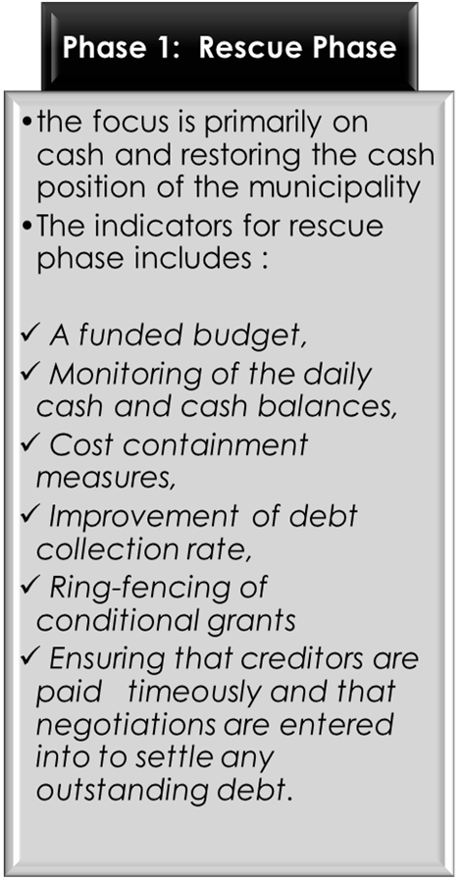
Focus of each Phase
Phase 2: Stabilisation Phase
Phase 3: Sustainability Phase
Focus on cash, finances and financial management
Service delivery, governance and institutional matters perpetuating the financial crisis in the municipality:
Design of a fit for purpose organogram,
Address the repairs and maintenance
Renewal of infrastructure for the water and electricity network to reduce non-revenue losses
Ensuring that the property valuation roll is updated and that all customers are billed according and other similar measures.
Focus on ensuring the implementation of good practice.
Include indicators that give effect to the long-term financial sustainability of the municipality.

Slide 5
Rescue Phase - Progress
Target | Progress | Strategy
Funded Budget | Achieved – Adjustment Budget (2019/2020); Budget(2020/2021); Budget (2021/2022) | N/A
Monitoring of cash and cash balances | Achieved – Lead Exco Rep and CFO monitor these daily | N/A
Cost containment measures | Partially achieved – Directorates still continue to commit on expenditure on items that could have been dispensed with | Consequence management is to be applied where the measures have not been applied as set
Improvement of debt collection rate | Not achieved | Revenue enhancement and credit control application is enforced; Intervention Team & CM and CFO to engage with business, various institutions and government departments; Constant engagement with communities through various media and mechanisms

Slide 6
Rescue Phase – Progress (Contd.)
Target | Progress | Strategy
Ring fencing of conditional grants | Achieved – Intervention Team monitors down payments from grants carefully and daily | Keep monitoring continuously
Ensuring that creditors are paid timeously and that negotiations are entered into to settle any outstanding debt | Partially achieved – average period of payment of creditors is well over 160 days, however large creditors such as DBSA, Standard Bank, ABSA have been paid timeously since intervention started | Intervention Team is considering integration of cash flow management with payment of creditors; Weekly meetings to be held with HODs to determine work to be done against invoices to be paid weekly; categorization of creditors and sequencing of payments

Slide 7
Rescue Phase – Progress (Contd.)
Target | Progress | Strategy
Unauthorised, Irregular, fruitless and wasteful expenditure | Partially achieved – significant reduction in UIFWE. Bulk of UIFWE is on non-cash items such as interest | Section 32 investigations are to be conducted; consequence management to be applied consistently
Repair of all visible water losses and sewer spillages | Not achieved – lack of tools of trade, lack of qualified technical and middle management staff, aging infrastructure, etc | Development of an implementable Water Conservation & Demand Management; provision of adequate resources inclusive of funding in the Engineering Services Directorate; progressive budgetary provision
Road maintenance by focusing on the fixing or potholes, kerbside maintenance, and other visible issues | Not achieved - lack of tools of trade, lack of qualified technical and middle management staff, aging infrastructure, etc | Provision of adequate resources inclusive of funding in the Engineering Services Directorate; progressive budgetary provision

Slide 8
Rescue Phase – Progress (Contd.)
Target | Progress | Strategy
Removal of solid waste and general cleanliness of open spaces | Not achieved – lack of tools of trade, lack of sufficient funds and other resources | Provision of adequate resources inclusive of funding; progressive annual budgetary provision
Ensure that governance and oversight committees are appropriately constituted, functional and that their capacity is strengthened | Achieved – MPAC and Audit Committee, section 80 Committee established and functional | N/A
Review the system of delegations | Achieved – Approved by Council | N/A

Slide 9
Rescue Phase – Progress (Contd.)
Target | Progress | Strategy
Audit committee is established to deal with the issues raised by the Auditor-General | Achieved – Audit Committee is functional and effective | N/A
Prioritise all litigation matters and update the litigation register | Achieved – litigation register updated regularly | N/A
Establish a disciplinary board to investigate and deal with issues of maladministration and fraud | Achieved – Board has been established and functional | N/A

Slide 10
Status of the Intervention Team
Intervention started in January 2020
5 members were appointed
Only 2 of those remained being Messrs Mofokeng and Mkaza
Mr Mofokeng left and Mr Mkaza was appointed as the Lead EXCO Representative
In May 2021 Messrs Mawonga and Ntoyi were appointed to join Mr Mkaza
The contract of Mr Ntoyi expires in May 2022 and that of Messrs Mkaza and Mawonga have been extended with three during which period the EXCO would consider extension for the whole year

Slide 11
Recent developments in Mangaung Metro and the impact
Key events & activities
Establishment of Metro Police
Court Action on appointments
Council meeting held on 26 January 2022
Impact of the Council resolutions

Slide 12
Establishment of Metro Police
The current developments emanate from the process followed in the attempt of establishing Metro Police for the municipality
The municipality resolved to establish Metro Police as far back as 2012
Comprehensive process was followed to secure the necessary approvals from all relevant authorities such as SAPS
Approvals were granted subject to suspensive conditions such as the numbers of members of the Metro Police, the expenditure that could be incurred for operations, etc.

Slide 13
Establishment of Metro Police (Contd.)
In 2020 the MEC for Police, Roads & Transport (Free State) gave the municipality approval to commence with the process of establishing the Metro Police – this was duly gazette
In the preparation of the budget for 2020/2021 Financial Year the budget for Public Safety was shifted to Metro Police to allow for the establishment process
The understanding then was that there would be no additional costs to be incurred, meaning the funds provided then would be kept as such and that the establishment process would be phased out throughout the Medium-Term Revenue & Expenditure Framework (MTREF)

Slide 14
Establishment of Metro Police (Contd.)
Preliminary processes were embarked upon, for instance procurement of all critical items for the launch as well as refurbishment of several buildings, branding of some fleet and placement and recruitment of personnel
In the placement and recruitment of personnel Council policies were not followed amongst which is the fact that personnel were appointed without the necessary authorization by the acting City Manager and concomitant ratification by the Lead Provincial EXCO Representative
This discrepancy came to the attention of the acting City Manager as well as NT and the Province (Free State)

Slide 15
Establishment of Metro Police (Contd.)
Given the serious financial challenges the municipality would be faced with NT wrote a letter to the acting City Manager advising that the process of establishment of the Metro Police should be suspended subject to certain conditions met amongst which was a detailed and comprehensive report on the entire process
Members of the public also weighed in on the matter and raised objections calling for the halting of the process
The Lead Provincial EXCO Representative cautioned the acting City Manager to heed the advice of NT and suspend the process
The process was suspended, and NT engaged with the acting City Manager, the Intervention Team and the Executive Management Team on this issue and it was unanimously agreed that the process be suspended

Slide 16
Establishment of Metro Police (Contd.)
Implications of the suspension of the process
All appointments made for Metro Police were to be rescinded by Court Order
All decisions taken in relation to the establishment of Metro Police were to be reversed, e.g., all branded vehicles were to be rebranded to the original brand
Traffic Officers who were now appointed as Metro Police were to revert to their original positions

Slide 17
Establishment of Metro Police (Contd.)
Court Action on appointments
The acting City Manager filed papers for the rescission of the appointments of the Metro Police personnel on 27 October 2021
The matter was heard on 30 November 2021
Judgement was delivered on 15 December 2021
The Municipality lost the case on technicality revolving around the appointment of Mr More as the acting City Manager
The acting City Manager lodged an appeal against the judgement given the financial and other implications of it on the municipality

Slide 18
Establishment of Metro Police (Contd.)
Court Action on appointments (Contd.)
The acting City Manager lodged an appeal against the judgement given the financial and other implications of it on the municipality
The Lead Provincial EXCO Representative also deposed a confirmatory affidavit on the matter especially with regards to the extension of acting of Mr More.
The Representative wrote to the MEC requesting for his intervention as there would have been a lacuna as from the 1st of November 2021 had his acting not been extended
Its critical to note that the acting City Manager filed for the rescission on 27 October 2021 meaning that the appointment by MEC is academic and of no consequence to the matter

Slide 19
Establishment of Metro Police (Contd.)
Council meeting held on 26 January 2022
At the meeting Council resolved as follows:
“(a) That Mangaung Metropolitan Municipality will not engage with the case number 5171/2021 any further and that the notice of appeal be withdrawn as the Municipality has never appeared before court, furthermore Mr Sello More continue to hand in his affidavit by 4th February 2022 as per court order,
(b) That Mr Sello More return to his position as the HOD: Fleet and Waste Management.
(c) That Council established the multi-party committee to investigate the events that led to the litigation and report back to Council within 21 days.

Slide 20
Establishment of Metro Police (Contd.)
Council meeting held on 26 January 2022
The multi-party committee will comprise of the following Councillors, namely:
Councillor CF Rampai | Councillor PL Seleke | Councillor BJ Viviers
Councillor D Leech | Councillor GJ Lipale | Councillor E Snyman van Deventer
Councillor JI Mokoena | Councillor KE van Der Ross | Councillor PS Twala
Councillor A Qai | Councillor PJ Rampai | Councillor Qondile Peter

Slide 21
Establishment of Metro Police (Contd.)
(d) That Mr Teboho Maine be appointed as the Acting City Manager effective from 26 January 2022 until the vacant position of the City Manager is filled but not exceeding a period of three months.”

Slide 22
Provincial Court Process
The MEC: COGTA filed an application for the a declaratory order on 04 February 2022
The Mangaung Metropolitan Municipality has also filed a notice to oppose the matter
It is expected that the case will be heard on 09 February 2022

Slide 23
Impact of the Council resolutions
Withdrawal of the appeal has huge financial implications for the municipality, to wit, legal costs, retrospective salary payments to illegally appointed Metro Police personnel, increase in projected expenditure of Council on Metro Police, etc.
All expenditure incurred thus far on the Case would be declared unauthorised, irregular, fruitless and wasteful expenditure
Increased financial obligations on the municipality thus defeating the objectives of the Financial Recovery Plan as per the current intervention in terms of Section 139(5)(a) & (c)
Need for budget adjustment to accommodate the additional costs required to cater for the Metro Police
Non-compliance with good governance and laws regulating Council activities
Outright political interference in administrative processes

Slide 24
Conclusion
It is critical to indicate that events of the past two months have caused political instability in the municipality
It has led to community organisations and formations to protest against the apparent deterioration of service delivery in their areas
Political instability and contestation has led to some unknown persons to storm into the Head Quarters of the municipality and attack employees on 07/02/2022
Similar or same group invaded the SCM building and forced employees to close down on the same day

Slide 25
Conclusion
It is also critical to note that this political instability has caused administrative paralysis and further deterioration in service delivery
Given this instability it is recommended that Section 139 (1)(b) of the Constitution of the Republic of South Africa, 1996 be invoked and applied with immediate effect.

Slide 26
Thank you

