Slide 1
DEPARTMENT OF EMPLOYMENT AND LABOUR
Strategic Plan 2020/25 and
Annual Performance Plan 2022/23
EMPLOYMENT AND LABOUR PORTFOLIO COMMITTEE
16 March 2022

Slide 2
TABLE OF CONTENTS
Introduction
The Department of Employment and Labour Programmes and Entities
The Department of Employment and Labour focus in the Medium
Term Strategic Framework (MTSF): 2020 – 25
4. Strategic Plan 2020 - 25
5. Annual Performance Plan (APP) for the Financial Year
2022/23

Slide 3
INTRODUCTION
- The Constitutional Mandate
- The Policy Mandate of the DEL
- Vision, Mission and Values of the DEL
Notes:
3

Slide 4
INTRODUCTION: THE CONSTITUTIONAL MANDATE OF THE DEPARTMENT OF EMPLOYMENT AND LABOUR
4
Section 9, to ensure equal access to opportunities.
Section 10, promotion of labour standards and fundamental rights at work.
Section 18, Freedom of association.
Section 23, To ensure sound Labour relations.
Section 24, To ensure an environment that is not harmful to the health and wellbeing of those in the workplace.
Section 27, To provide adequate social security nets to protect vulnerable workers.
Section 28, To ensure that children are protected from exploitative labour practices and not required or permitted to perform work or services that are inappropriate for a person of that child’s age or their well‐being, education, physical or mental health or spiritual, moral or social development is placed at risk.
Section 34, Access to courts and access to fair and speedy labour justice.

Slide 5
INTRODUCTION: THE POLICY MANDATE OF THE DEPARTMENT OF EMPLOYMENT AND LABOUR
5
Improved economic efficiency and productivity.
Creation of decent employment.
Promoting labour standards and fundamental rights at work.
Providing adequate social safety nets to protect vulnerable workers
Sound labour relations.
Eliminating inequality and discrimination in the workplace.
Enhancing occupational health and safety awareness and compliance in the workplace.
Give value to social dialogue in the formulation of sound and responsive legislation and policies to attain labour market flexibility for competitiveness of enterprises which is balanced with the promotion of decent employment

Slide 6
INTRODUCTION: VISION AND MISSION
6
Vision
The Department of Employment and Labour strives for a labour market which is conducive to investment, economic growth, employment creation and decent work.
Mission
Promote employment and regulate the South African labour market for sustainable economic growth through:
Appropriate legislation and regulations
Inspection and enforcement
Protection of worker rights
Provision of Employment Services
Promoting Equity
Provision of Social protection
Promotion of Social dialogue

Slide 7
INTRODUCTION: VALUES
7
Values
We shall at all times be exemplary in all respects:
We treat employees with care, dignity and respect
We respect and promote:
Client centred services
Accountability
Integrity and ethical behaviour
Learning and development
We live the Batho Pele Principles
We live the principles of the Department’s Service Charter
We inculcate these values through our performance management system.

Slide 8
PROGRAMMES AND ENTITIES
Notes:
8

Slide 9
DEPARTMENT OF EMPLOYMENT AND LABOUR PROGRAMMES AND ENTITIES
Administration: Ministry; Deputy Minister, Director General’s Office; Corporate Services (CS), Chief Operations Officer (COO), Chief Financial Officer (CFO)
2. Inspection and Enforcement Services (IES)
3. Public Employment Services (PES)
4. Labour Market Policy & Industrial Relations (LP&IR)
5. Unemployment Insurance Fund (Schedule 3A Public Entity): UIF
6. Compensation Fund (Schedule 3A Public Entity): CF

Slide 10
DEPARTMENT OF EMPLOYMENT AND LABOUR PROGRAMMES AND ENTITIES
Entities established in terms of various legislations and cabinet decisions to assist DEL in meeting its mandate include:
Commission for Conciliation, Mediation and Arbitration (CCMA)
National Economic Development and Labour Council (NEDLAC)
Productivity South Africa (PSA)
Supported Employment Enterprises (SEE)

Slide 11
DEPARTMENT OF EMPLOYMENT AND LABOUR SERVICE DELIVERY FOOT PRINT
Limpopo
- HQ and 2 Funds in Pretoria
9 Provincial Offices
125 Labour Centers
Mpumalanga
North West
Gauteng
Free State
KwaZulu Natal
Northern Cape
Eastern Cape
Western Cape
- Provide services at 30 Satellite Offices, 41 Thusong Service Centers and 447 Visiting points

Slide 12
STRATEGIC PLAN: 2020 – 25
Outcomes and Outcome Indicators
Notes:
12

Slide 13
DEPARTMENT OF EMPLOYMENT AND LABOUR AND MTSF OUTCOMES: 2020 – 25
In the Medium-term, the Department of Employment and Labour will contribute mainly to the following Medium Term Strategic Framework (MTSF) Priorities:
Priority 1: A Capable, Ethical and Developmental State
Priority 2: Economic Transformation and Job Creation
Priority 3: Education, Skills and Health
Priority 4: Consolidating the Social Wage through Reliable and Basic Services
Priority 5: Spatial Development, Human Settlements and Local Government
Priority 6: Social Cohesion, Safer Communities
Priority 7: A Better Africa and a Better World
*Priority 5 is not directly applicable to DEL although DEL participates in the District Development Model through Provincial Offices and Labour Centres

Slide 14
GOVERNMENT SERVICE DELIVERY PRIORITIES AND DEL IMPLEMENTING ENTITIES
GOVERNMENT PRIORITY | IMPLEMENTING BRANCH/ PUBLIC ENTITY
PRIORITY 1: A Capable, Ethical and Developmental State | Administration (DEL + PE)
PRIORITY 2: Economic Transformation and Job Creation | IES; PES; LP&IR SEE ; UIF; CF CCMA; Productivity SA ; NEDLAC
PRIORITY 3: Education, Skills and Health | IES; PES UIF; CF Productivity SA
PRIORITY 4: Consolidating the Social Wage through Reliable and Basic Services | IES UIF ; CF
PRIORITY 6: Social cohesion and safer communities | LP&IR
PRIORITY 7: A better Africa and a better World | LP&IR

Slide 15
IMPACT STATEMENT
Impact statement | A labour market which is conducive to decent employment

Slide 16
PRIORITY 1: CAPABLE, ETHICAL AND DEVELOPMENTAL STATE
Outcome | Outcome Indicator | Baseline | Five year target | Implementing Programme
1. Functional, Efficient and Integrated Government | 1.1 Reduction in the vacancy rate | 10% | Vacancy rate maintained at 8% or less | Administration (Corporate Services)
 | 3.1 Improve Information Security status of the department | n/a | 3 year Cybersecurity roadmap developed | Administration Corporate Services
 | 3.2 Legacy systems transitioned to modern integrated SAP Platform | n/a | All targeted legacy applications replaced by SAP4HANA as per the Roadmap | Administration Corporate Services

Slide 17
PRIORITY 2: ECONOMIC TRANSFORMATION AND JOB CREATION
Outcome | Outcome Indicator | Baseline | Five year target | Implementing Programme
2. More decent jobs created and sustained, with youth, women and persons with disabilities prioritised | 2.1 Number of jobs created per year through Job Summit agreement initiatives coordinated through the implementation of Jobs Summit framework agreements | New Indicator | Monitor and report on the target set by the Presidential Job Summit agreement (275 000 jobs created per year) | Labour Policy and Industrial Relations (LP&IR)
 | 2.2 Number of jobs created through the Presidential Comprehensive Youth Employment interventions Number of youth NEET absorbed in employment | New indicator | 1 million youth jobs by 2024 DEL: 256 050 (contributors PES: 190 000, SEE and Designated Groups: 1 000; UIF (LAP): 61 050; CF: 4 000) | Public Employment Services (PES)
 | 2.3 Employment Policy developed, consulted, piloted and implemented | New Indicator | Employment policy implemented by 2024 | PES
^{[1]} Labour Policy and Industrial Relations monitor the creation of jobs through the Jobs Summit.
^{[2]} Public Employment Services will monitor the creation of jobs through the Presidential Comprehensive Youth Employment Interventions.

Slide 18
PRIORITY 2: ECONOMIC TRANSFORMATION AND JOB CREATION
Outcome | Outcome Indicator | Baseline | Five year target | Implementing Programme
3. Investing for accelerated inclusive growth | 3.1 Compliance enforced with the Employment Equity Act through EEA inspections: which includes EE Procedural inspections, DG Reviews and Reassessments, and workplaces (designated employers) conducted per year | EEA inspections conducted in 2018/19 3 610 | The five year target is anticipated to be 18 420 workplaces inspected and transformed. (inclusive of 1 812 DG Reviews) | Inspection and Enforcement Services (IES)
4. Increased economic participation, ownership, access to resources, opportunities and wage equality for women, youth and persons with disabilities | 4.1. Compliance enforced with the National Minimum Wage Act and the Basic Conditions of Employment Act through the number of workplaces inspected per year | 172 229 NMWA only implemented on 1 January 2019 | The inspectors will visit 838 560 workplaces over the next five years | IES

Slide 19
PRIORITY 3: EDUCATION, SKILLS AND HEALTH
Outcome | Outcome Indicator | Baseline | Five year target | Implementing Programme
5. Safe and healthy work environment | 5.1 Compliance enforced with the Occupational Health and Safety legislation through the number of workplaces inspected per year | 23 027 | Year 1 = 23 844 – this target is for existing inspectors in FY 2020/21 4 x Years = 397 776 (2021/22-2024/25) This is what will be achieved in the next 5 x Years = 421 620 | IES

Slide 20
PRIORITY 4: CONSOLIDATING THE SOCIAL WAGE THROUGH RELIABLE AND BASIC SERVICES
Outcome | Outcome Indicator | Baseline | Five year target | Implementing Programme
6. Comprehensive social security coverage | 6.1: Compliance enforced with the UIA, UICA and COIDA through the number of Employer Audits conducted per year | 19 340 | Coverage for employees will improve with 131 580 employers visited over the next 5 years | IES

Slide 21
PRIORITY 6: SOCIAL COHESION AND SAFER COMMUNITIES
Outcome | Outcome Indicator | Baseline | Five year target | Implementing Programme
7. Equal opportunities, inclusion and redress | 7.1 Amendment of the Employment Equity Act | Employment Equity Act | Employment Equity Act amended, enacted and enforced by 2024 | LP&IR
 | 7.2 At least 2% annual increase in the representation of Africans in senior and middle management levels | Africans constituted 23.2% and 40.2% at senior and middle management levels as reported by designated employers in 2018 EE Reporting period (2018-2019 EE Annual Report (19th CEE Annual Report) | Set sector targets and monitor to achieve at least 50% of middle and senior management are African by 2024 | LP&IR

Slide 22
PRIORITY 6: SOCIAL COHESION AND SAFER COMMUNITIES
Outcome | Outcome Indicator | Baseline | Five year target | Implementing Programme
7. Equal opportunities, inclusion and redress | 7.3 Number of persons with disabilities employed increased annually with at least 1.5% of the total workforce reported by designated employers | Persons with disabilities constituted 1% of total workforce in both Public and Private sectors as reported in 2018 EE reporting period (2018-2019 EE Annual Report (19th CEE Annual | Set sector targets and monitor to achieve at least 2.5% of employed adults between the age of 15 and 65 will be persons with disabilities by 2024 | LP&IR
 | 7.4 Development of Income differential data collection tool (EEA4 form) for designated employers | New indicator | Income differential data collection tool (EEA4 form) for designated employers developed and implemented by 2022 | LP&IR

Slide 23
PRIORITY 7: A BETTER AFRICA AND A BETTER WORLD
Outcome | Outcome Indicator | Baseline | Five year target | Implementing Programme
8. A Better South Africa | 8.1 Country obligation to SADC and AU fulfilled | New indicator | 90% of obligations fulfilled | LP&IR
 | 8.2 Payment of South African contributions to international organisations (in which we are a member) in full and on time | New indicator | South Africa’s participation in international organisations is secured to advance national interest | LP&IR

Slide 24
ANNUAL PERFORMANCE PLAN: 2022/23
Outputs and Output Indicators Annual and Quarterly Targets
Notes:
24

Slide 25
ASSURANCE PROVIDERS
The APP 2022/23 was subjected to auditing by the AG and Internal Audit for:
Alignment to the Government priorities, MTSF, Minister’s Performance Agreement, Strategic plan, guidelines provided by DPME and NT
Compliance to the “smart” principle of indicators
Alignment of the budget to outputs

Slide 26
ANNUAL PERFORMANCE PLAN FOR THE FINANCIAL YEAR 2020/21
Programmes of the Department of Employment and Labour:
PROGRAMME 1: Administration
PROGRAMME 2: Inspections and Enforcement Services
PROGRAMME 3: Public Employment Services
PROGRAMME 4: Labour Policy and Industrial Relations

Slide 27
PROGRAMME 1: ADMINISTRATION
PURPOSE:
Purpose: Provide strategic leadership, management and support services to the department.
Notes:
27

Slide 28
ADMINISTRATION
Budget Allocation: R1 044 005 000
Output Indicator | Annual Target | Q1 | Q2 | Q3 | Q4
1.1 % Vacant funded posts maintained | Vacant funded posts maintained at 8% or less for every quarter | Vacant funded posts maintained at 8% or less for every quarter | Vacant funded posts maintained at 8% or less for every quarter | Vacant funded posts maintained at 8% or less for every quarter | Vacant funded posts maintained at 8% or less for every quarter
2.1 Gender responsive recruitment | 45% of SMS positions occupied by Women | - | 44% of SMS posts occupied by Women | - | 45% of SMS positions occupied by women
3.1 Improve Information Security status of the department | Appointment of Managed Information Security Service Provider | Service Provider appointed and Project plan developed | Security Environment Assessment report finalised | Implementation report on key controls finalised | Approved Cyber security Strategy and roadmap

Slide 29
ADMINISTRATION
Output Indicator | Annual Target | Q1 | Q2 | Q3 | Q4
3.2 Legacy systems transitioned to modern integrated SAP Platform | IES and PES systems replaced with SAP4HANA | - | IES and PES User acceptance testing finalised and signed off | IES and PES End User training finalised and signed off | SAP licence usage report for live applications
4.1 Ensure functionality of ethics structures and adequate capacity | Roll out of the Ethics Management Plan for the year | Roll Out of the Ethics Management Plan activities for Q1 | Roll Out of the Ethics Management Plan activities for Q2 | Roll Out of the Ethics Management Plan activities for Q3 | Roll Out of the Ethics Management Plan activities for Q4
4.2 Percentage resolution of reported incidents of corruption in the Department | 93% resolution of reported incidents by disciplinary and criminal interventions | 93% | 93% | 93% | 93%

Slide 30
ADMINISTRATION
Output Indicator | Annual Target | Q1 | Q2 | Q3 | Q4
5.1 Number of Annual Financial Statements (AFS) and Interim Financial Statements (IFS) compiled per year that comply with guidelines issued by the National Treasury | 1 AFS by 31 May, and 3 IFS 30 days after each quarter | 1 AFS by 31 May 2022 | 1 IFS by 31 July 2022 | 1 IFS by 31 October 2022 | 1 IFS by 31 January 2023
6.1 Percentage reporting of all detected Irregular and/or Unauthorised expenditure cases per financial year, to the Accounting Officer | 100% reporting of the detected occurrences | 100% reporting of the detected occurrences | 100% reporting of the detected occurrences | 100% reporting of the detected occurrences | 100% reporting of the detected occurrences
7.1 Percentage reporting of all detected Fruitless and Wasteful Expenditure cases per financial year, to the Accounting Officer | 100% reporting of the detected occurrences | 100% reporting of the detected occurrences | 100% reporting of the detected occurrences | 100% reporting of the detected occurrences | 100% reporting of the detected occurrences

Slide 31
KEY RISKS AND MITIGATION
Outcome | Key Risk | Risk Mitigation
Strengthen institutional capacity of the Department | Inability of modernisation programme to meet intended objectives | Business process re-engineering Business process mapping Stakeholder engagement
 | Structural deficiencies / inadequate organisational structure to service the department | Facilitate review of the existing Departmental structure Engage National Treasury to secure funding through the OCFO
 | Increase in vacancy rate | HR Audits to be conducted Reconciliation of approved structure and PERSAL information Monitoring of vacancy rate Advocacy sessions twice a year

Slide 32
PROGRAMME 2: INSPECTION AND ENFORCEMENT SERVICES (IES)
Programme purpose: Realise decent work by regulating non-employment and employment conditions through inspection and enforcement, to achieve compliance with all labour market policies.
Notes:
32

Slide 33
INSPECTIONS AND ENFORCEMENT SERVICES (IES)
Budget Allocation: R657 167 000
Output Indicator | Annual Target | Q1 | Q2 | Q3 | Q4
1.1 Number of employers inspected per year to determine compliance with employment law | 298 104 | 74 526 | 149 052 | 223 578 | 298 104
1.2 Percentage of non-compliant employers of those inspected served with a notice in terms of relevant labour legislation within 14 calendar days of the inspection | 95% | 95% | 95% | 95% | 95%
1.3 Percentage of non-compliant employers/ workplaces/ users received by Statutory Services settled out of Court or CCMA / referred for prosecution within 30 working days | 65% | 65% | 65% | 65% | 65%
1.4 Number of formal Advocacy sessions conducted per year to increase awareness of employment law | 4 x Seminars and 2 x conferences to be held | 1x Seminar | 1 x Seminar and 1 x conference | 1x Seminar | 1 x Seminar and 1 x conference

Slide 34
INSPECTIONS AND ENFORCEMENT SERVICES (IES) Inspections per Province
 | Annual | Q1 | Q2 | Q3 | Q4
Province | No of Inspections | No of Inspections | No of Inspections | No of Inspections | No of Inspections
EC | 31 884 | 7 971 | 15 942 | 23 913 | 31 884
FS | 26 628 | 6 657 | 13 314 | 19 971 | 26 628
GP | 61 236 | 15 309 | 30 618 | 45 927 | 61 236
KZN | 63 720 | 15 930 | 31 860 | 47 790 | 63 720
LP | 27 780 | 6 945 | 13 890 | 20 835 | 27 780
MP | 21 528 | 5 382 | 10 764 | 16 146 | 21 528
NC | 12 636 | 3 159 | 6 318 | 9 477 | 12 636
NW | 19 680 | 4 920 | 9 840 | 14 760 | 19 680
WC | 32 724 | 8 181 | 16 362 | 24 543 | 32 724
HO | 288 | 72 | 144 | 216 | 288
Total | 298 104 | 74 526 | 149 052 | 223 578 | 298 104

Slide 35
IES INSPECTIONS PER LEGISLATION
ANNUAL TARGET | EE | BCEA | OHS | EAS | COID | TOTAL
Eastern Cape | 300 | 19 980 | 8 808 | 1 624 | 1 172 | 31 884
Free State | 216 | 13 404 | 10 572 | 1 624 | 812 | 26 628
Gauteng | 924 | 36 600 | 18 708 | 3 604 | 1 400 | 61 236
Kwa-Zulu Natal | 636 | 34 836 | 24 504 | 2 344 | 1 400 | 63 720
Limpopo | 300 | 16 452 | 8 592 | 1 624 | 812 | 27 780
Mpumalanga | 300 | 13 224 | 5 568 | 1 624 | 812 | 21 528
Northern Cape | 216 | 6 360 | 3 624 | 1 624 | 812 | 12 636
North West | 216 | 10 920 | 6 288 | 1 444 | 812 | 19 680
Western Cape | 216 | 17 088 | 11 904 | 2 344 | 1 172 | 32 724
HO |  |  | 288 |  |  | 288
TOTAL | 3 324 | 168 864 | 98 856 | 17 856 | 9 204 | 298 104
Details of the quarterly breakdown per legislation and province are in the APP

Slide 36
KEY RISKS AND MITIGATION
Outcome | Key Risk | Risk Mitigation
Vulnerable Employees and others are protected through inspection and/or enforcement of labour legislation | Non-compliance by employers and users with labour legislation | Strengthening of sector specific advocacy by utilising various platforms at both the Provincial and National level. Improve the conducting of follow up inspections to strengthen monitoring in areas of noncompliance. Effective implementation of existing MOU’s. Establish and maintain partnerships in key sectors where there are no MOU’s. Provinces to commission Blitz inspections in targeted problematic or high risk areas. Improve on referring all employers who fail to comply with expired notices for prosecution. Strategic conference to be held
 | Unreliable performance information | Develop a SOP and or guidelines on quality assurance of performance information. Establish Quality assurance teams to handle performance information issues at various levels. Ensure that consolidated Improve on the utilisation of the Case Management System. Implement the strategy on transition from the manual to the Case Management System. Monthly performance Information submitted are accompanied by consolidated registers that are quality assured.

Slide 37
PROGRAMME 3: PUBLIC EMPLOYMENT SERVICES
Purpose: Assist companies and workers to adjust to changing labour market conditions.
Notes:
37

Slide 38
PUBLIC EMPLOYMENT SERVICES (PES)
Budget Allocation: R630 462 000
Output Indicator | Annual Target | Q1 | Q2 | Q3 | Q4
1.1 Number of work-seekers registered on Employment Services of South Africa per year | 850 000 | 195 500 | 408 000 | 603 500 | 850 000
2.1 Number of employment opportunities registered on the Employment Services South Africa per year | 105 000 | 26 250 | 52 500 | 78 750 | 105 000
3.1 Number of registered work-seekers provided with employment counselling per year | 240 000 | 57 600 | 124 800 | 177 600 | 240 000
4.1 Number of registered employment opportunities filled by registered work seekers per year | 55 000 | 13 750 | 27 500 | 41 250 | 55 000

Slide 39
PUBLIC EMPLOYMENT SERVICES (PES)
Output Indicator | Annual Target | Q1 | Q2 | Q3 | Q4
5.1 Number of partnerships agreements concluded with various stakeholders | 22 | - | - | - | 22
6.1 Number of policies developed and approved | 1 | - | - | - | 1

Slide 40
PUBLIC EMPLOYMENT SERVICES (PES) – Per Province
Number of work-seekers registered on Employment Services of South Africa per year
Province | Annual Target | Q1 | Q2 | Q3 | Q4
EC | 102 000 | 23 460 | 48 960 | 72 420 | 102 000
FS | 59 500 | 13 685 | 28 560 | 42 245 | 59 500
GP | 221 000 | 50 830 | 106 080 | 156 910 | 221 000
KZN | 144 500 | 33 235 | 69 360 | 102 595 | 144 500
LP | 59 500 | 13 685 | 28 560 | 42 245 | 59 500
MP | 68 000 | 15 640 | 32 640 | 48 280 | 68 000
NC | 34 000 | 7 820 | 16 320 | 24 140 | 34 000
NW | 51 000 | 11 730 | 24 480 | 36 210 | 51 000
WC | 110 500 | 25 415 | 53 040 | 78 455 | 110 500
Total | 850 000 | 195 500 | 408 000 | 603 500 | 850 000

Slide 41
PUBLIC EMPLOYMENT SERVICES (PES) – Per Province
Number of employment opportunities registered on the Employment Services South Africa per year
Province | Annual Target | Q1 | Q2 | Q3 | Q4
EC | 14 366 | 3 592 | 7 182 | 10 775 | 14 366
FS | 8 291 | 2 073 | 4 146 | 6 218 | 8 291
GP | 20 116 | 5 029 | 10 058 | 15 087 | 20 116
KZN | 16 580 | 4 145 | 8 290 | 12 435 | 16 580
LP | 11 052 | 2 762 | 5 526 | 8 289 | 11 052
MP | 8 843 | 2 211 | 4 422 | 6 632 | 8 843
NC | 6 411 | 1 603 | 3 206 | 4 808 | 6 411
NW | 7 184 | 1 796 | 3 592 | 5 388 | 7 184
WC | 12 157 | 3 039 | 6 078 | 9 118 | 12 157
Total | 105 000 | 26 250 | 52 500 | 78 750 | 105 000

Slide 42
PUBLIC EMPLOYMENT SERVICES (PES) – Per Province
Number of registered work-seekers provided with employment counselling per year
Province | Annual Target | Q1 | Q2 | Q3 | Q4
EC | 30 720 | 7 373 | 15 974 | 22 733 | 30 720
FS | 21 120 | 5 068 | 10 983 | 15 628 | 21 120
GP | 49 920 | 11 980 | 25 958 | 36 940 | 49 920
KZN | 30 720 | 7 373 | 15 974 | 22 733 | 30 720
LP | 23 040 | 5 530 | 11 981 | 17 050 | 23 040
MP | 28 800 | 6 912 | 14 976 | 21 312 | 28 800
NC | 13 440 | 3 226 | 6 989 | 9 946 | 13 440
NW | 19 200 | 4 608 | 9 984 | 14 208 | 19 200
WC | 23 040 | 5 530 | 11 981 | 17 050 | 23 040
Total | 240 000 | 57 600 | 124 800 | 177 600 | 240 000

Slide 43
PUBLIC EMPLOYMENT SERVICES (PES) – Per Province
Number of registered employment opportunities filled by registered work seekers per year
Province | Annual Target | Q1 | Q2 | Q3 | Q4
EC | 7 526 | 1 882 | 3 763 | 5 645 | 7 526
FS | 4 342 | 1 085 | 2 171 | 3 256 | 4 342
GP | 10 537 | 2 634 | 5 268 | 7 903 | 10 537
KZN | 8 685 | 2 171 | 4 342 | 6 513 | 8 685
LP | 5 789 | 1 447 | 2 895 | 4 342 | 5 789
MP | 4 632 | 1 158 | 2 316 | 3 474 | 4 632
NC | 3 358 | 840 | 1 679 | 2 519 | 3 358
NW | 3 763 | 941 | 1 882 | 2 822 | 3 763
WC | 6 368 | 1 592 | 3 184 | 4 776 | 6 368
Total | 55 000 | 13 750 | 27 500 | 41 250 | 55 000

Slide 44
KEY RISKS AND MITIGATION
Outcome | Key Risk | Risk Mitigation
Work seekers placed in work and learning opportunities | Insufficient placement of registered work-seekers in registered opportunities | Collaboration with the Presidency Programme Management Office, UIF, other departments and entities, the private sector and NGOs in providing a range of work seeker services Further developments on ESSA Online Services Establishment of Youth Centres and roll-out of 14 PES Mobile units Conclusion of strategic partnerships agreements with employers and institutions to use ESSA for recruitment Consultation on the National Employment Policy, sub-theme on National Labour Migration and amendments to Employment Services ActProvision of funding to entities assisting PES in employment promotion (SEE, Productivity SA, CF, NGOs, UIF)

Slide 45
PROGRAMME 4: LABOUR POLICY AND INDUSTRIAL RELATIONS (LP&IR)
Purpose:
Facilitate the establishment of an equitable and sound labour relations environment, support institutions that promote social dialogue;
promote South Africa’s interests in international labour matters,
conduct research, analysis and evaluation of labour policy and provide statistical data on the labour market.
Notes:
45

Slide 46
LABOUR POLICY AND INDUSTRIAL RELATIONS (LP&IR)
Budget Allocation: R1 280 451 000
Output Indicator | Annual Target | Q1 | Q2 | Q3 | Q4
1.1 Amendments to the Employment Equity Act promulgated and implemented per annum | EE Regulations published to implement the EE amendments by 31 March 2023 | N/A | N/A | N/A | EE Regulations published to implement the EE amendments by 31 March 2023
2.1 Annual EE Report and Public Register published per annum | 2021-2022 Annual EE report and Public Register published by 30 June 2022 | 2021-2022 Annual EE report and Public Register published by 30 June 2022 | N/A | N/A | N/A
2.2 Annual EE report and Public Register developed per annum | 2022-2023 Annual EE report and Public Register developed by 31 March 2023 | N/A | N/A | N/A | 2022-2023 Annual EE report and Public Register developed by 31 March 2023
2.3 Income differential data collection tool (EEA4 form) for designated employers developed per annum | No target for the year

Slide 47
LABOUR POLICY AND INDUSTRIAL RELATIONS (LP&IR)
Output Indicator | Annual Target | Q1 | Q2 | Q3 | Q4
2.4 Law and policy interventions developed to protect specific groups of workers who are particularly vulnerable to specific forms of gender-based violence per annum | No target for the 2022/23 financial year
3.1 National minimum wage reviewed and approved by the Minister of Employment and Labour by 31 March each year | Review of the National Minimum Wage level by 31 March 2023 |  |  | NMW investigation report published by 30 November 2022 | NMW reviewed and published to reflect new minimum wage rates by 31 March 2023
4.1 Percentage of collective agreements assessed and verified 31 March 2023 | 100% of collective agreements where parties are not representative assessed and verified within 120 working days of receipt by 31 March 2023 | 100% of collective agreements where parties are not representative assessed and verified within 120 working days of receipt by 30 June 2022 | 100% of collective agreements where parties are not representative assessed and verified within 120 working days of receipt by 30 September 2022 | 100% of collective agreements where parties are not representative assessed and verified within 120 working days of receipt by 31 December 2022 | 100% of collective agreements where parties are not representative assessed and verified within 120 working days of receipt by 31 March 2023

Slide 48
LABOUR POLICY AND INDUSTRIAL RELATIONS (LP&IR)
Output Indicator | Annual Target | Q1 | Q2 | Q3 | Q4
4.2 Percentage of collective agreements assessed and verified within 60 working days of receipt per annum | 100% of collective agreements where parties are representative assessed and verified within 60 working days of receipt by 31 March 2023 | 100% of collective agreements where parties are representative assessed and verified within 60 working days of receipt by 30 June 2022 | 100% of collective agreements where parties are representative assessed and verified within 60 working days of receipt by 30 September 2022 | 100% of collective agreements where parties are representative assessed and verified within 60 working days of receipt by 31 December 2022 | 100% of collective agreements where parties are representative assessed and verified within 60 working days of receipt by 31 March 2023
5.1 Percentage of labour organisations’ applications for registration approved or refused within 90 working days of receipt per annum | 100% of labour organisations’ applications for registration approved or refused within 90 working days of receipt by 31 March 2023 | 100% of labour organisations’ applications for registration approved or refused within 90 working days of receipt by 30 June 2022 | 100% of labour organisations’ applications for registration approved or refused within 90 working days of receipt by 30 September 2022 | 100% of labour organisations’ applications for registration approved or refused within 90 working days of receipt by 31 December 2022 | 100% of labour organisations’ applications for registration approved or refused within 90 working days of receipt by 31 March 2023

Slide 49
LABOUR POLICY AND INDUSTRIAL RELATIONS (LP&IR)
Output Indicator | Annual Target | Q1 | Q2 | Q3 | Q4
6.1 Progress reports on bilateral cooperation and multilateral obligations submitted to the minister annually | 2 Reports on the implementation of bilateral cooperation and multilateral obligations signed off by the Minister annually | 1 Annual implementation report submitted to the Minister for sign-off by 30 April 2022 |  | 1 Mid –term implementation report submitted to the Minister by 31 October 2022 for sign-off

Slide 50
LABOUR POLICY AND INDUSTRIAL RELATIONS (LP&IR)
Output Indicator | Annual Target | Q1 | Q2 | Q3 | Q4
7.1 Number of annual labour market trend reports produced on the impact of labour legislation per annum | 4 |  | 2 (1) Annual Labour Market Bulletin 2021/22 produced (2) Job Opportunity and Unemployment in the SA labour market 2021/22 produced |  | 2 (1) Annual Industrial Action report 2021 produced (2) Annual Administrative Statistics 2021 produced
8.1 Number of Research reports on the impact of labour legislation to the labour market produced per annum | 4 research reports completed by 31 March 2023 | 1 Draft report submitted. 1 Workplace survey completed 2 Data collection instruments completed (Internally Conducted Research). | 1 Final report completed. 1 Prevalence modelling completed Data collection commenced- 40% data collected (Internally Conducted Research). | Fieldwork data collection completed and 1st draft report submitted. 100% Data collection completed (Internally Conducted Research). | 3 research reports completed.

Slide 51
KEY RISKS AND MITIGATION
Outcome | Key Risk | Risk Mitigation
Promote sound labour relation | Insufficient Labour market research conducted in terms of monitoring the impact of legislation | Developing a Monitoring and Evaluation agenda which lists a number of research topics that would be outsourced and conducted over a period of 24 months Limit number of research that requiring tender procurement and increase procurement through RFQ Procure an online survey tool to facilitate more research conducted internally by departmental staff

Slide 52
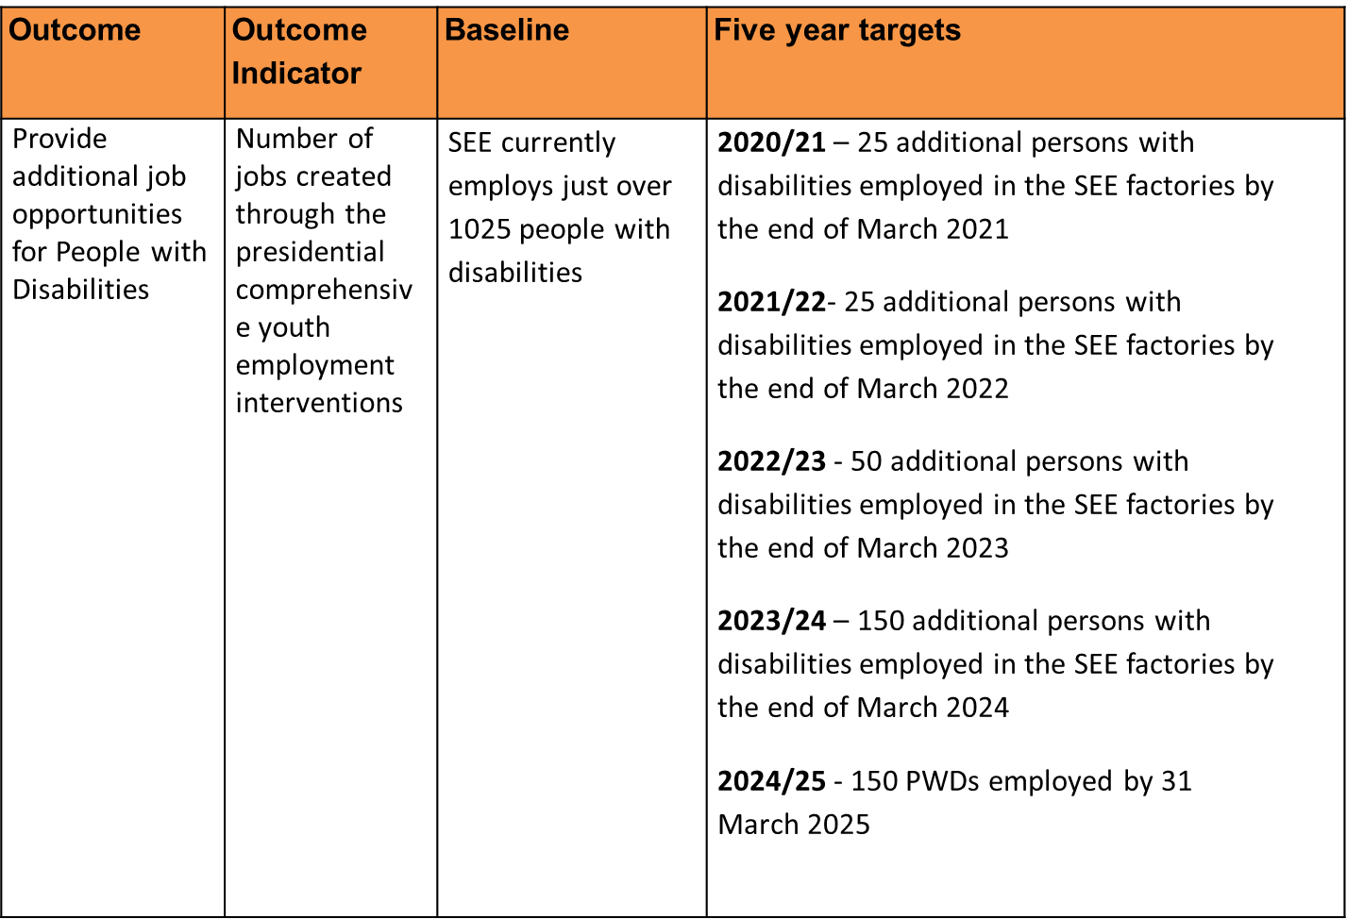
SEE STRATEGIC PLAN: 2020 - 2025

Slide 53
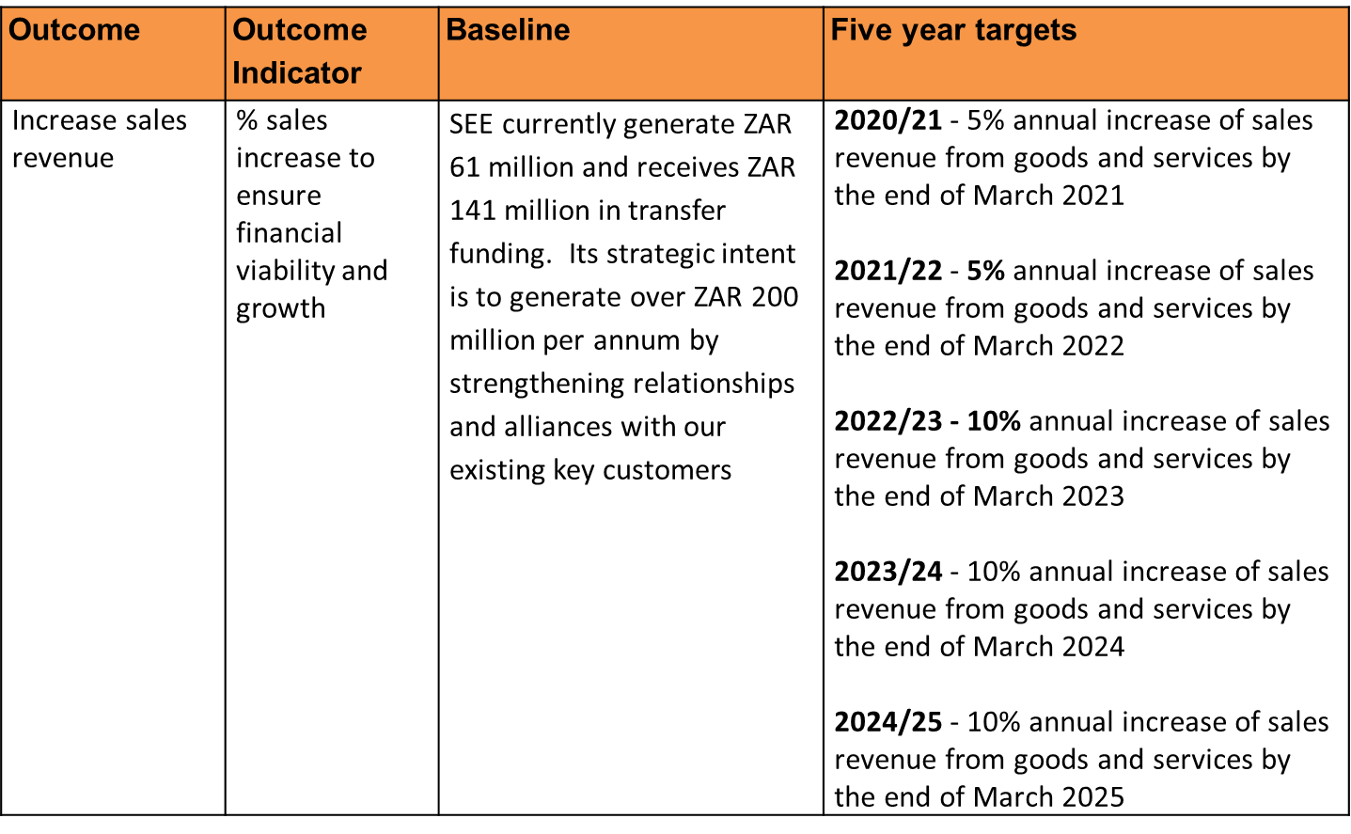
SEE STRATEGIC PLAN: 2020 - 2025

Slide 54
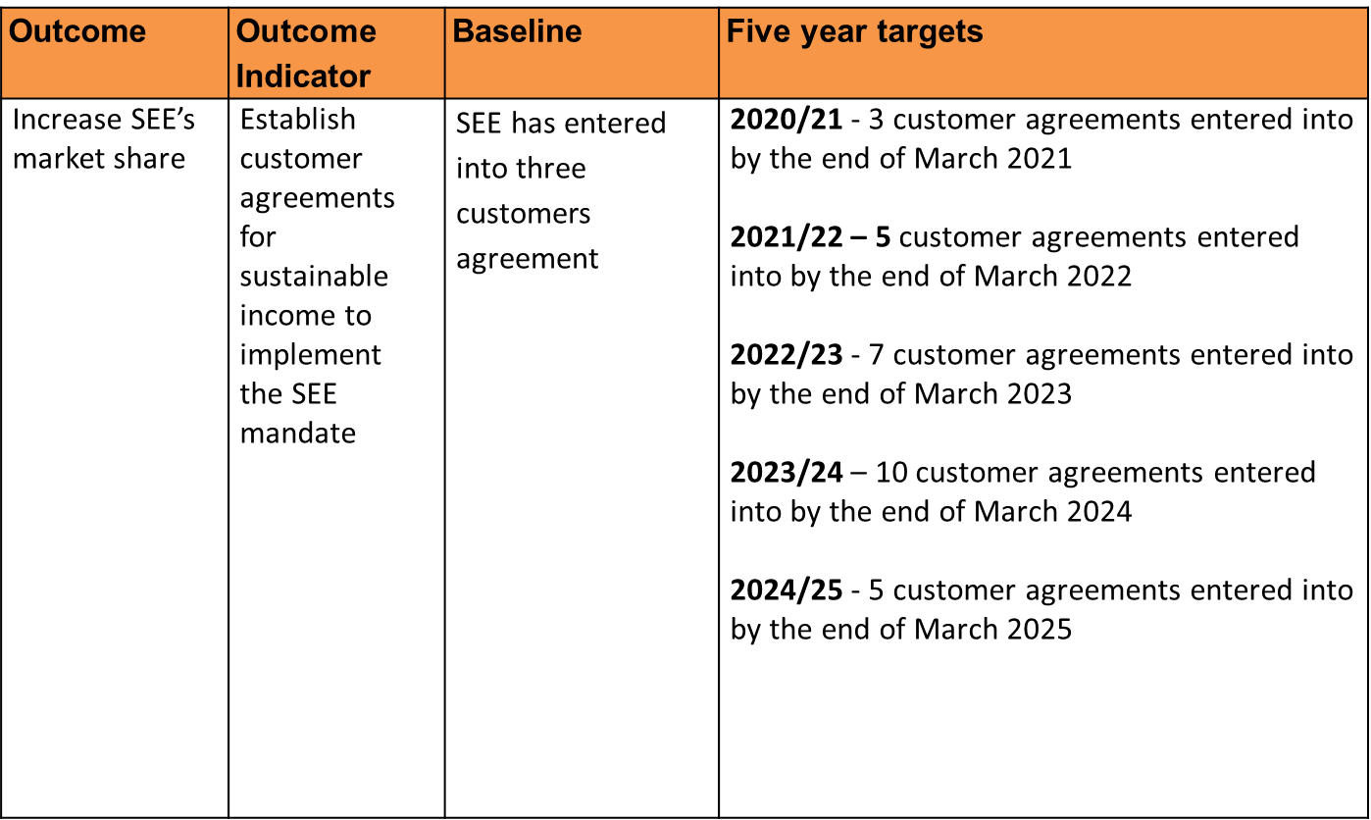
SEE STRATEGIC PLAN: 2020 - 2025

Slide 55
ANNUAL PERFORMANCE PLAN: 2022 - 2023
Output Indicator | Annual Target | Q1 | Q2 | Q3 | Q4
Number of people with disabilities employed at SEE by end of December | 50 additional PWDs employed in SEE factories by the end of March 2023 | N/A | N/A | 20 | 30
Percentage Annual Increase of goods and services by end of December | 10% annual increase in sales revenue by end of March 2023 | N/A | N/A | N/A | 10%
Number of customer agreements entered into annually | 7 customer agreements entered into by end of March 2022 | 1 | 3 | 5 | 7

Slide 56
SEE RISK MITIGATION PLAN: 2022-23
SEE’s KEY STRATEGIC RISK
INABILITY TO GENERATE WORK OPPORTUNITIES
Desired Outcome (“What”)
Risk Mitigation (“How“)
SEE STRATEGIC IMPERATIVES.
IMPROVED MARKETING
DEVELOP NEW INNOVATIVE PRODUCTS
7 NEW CUSTOMER AGREEMENTS
INCREASE SALES BY 10%
CREATE WORK OPPORTUNITIES FOR PEOPLE WITH DISABILITIES
TRANSITIONAL EMPLOYMENT OPPORTUNITIES
& EXTENDED EMPLOYMNT OPPORTUNITIES
Networking Partnerships Creating value
Enablers

Slide 57
DEPARTMENT OF EMPLOYMENT AND LABOUR
VOTE:
2022/2023
Notes:
57

Slide 58
BUDGET ALLOCATION: 2022/23
Programme | Audited outcomes |  |  | Voted (Main Appropriation) | Revised Estimate | Medium Term Expenditure Estimate
R-thousand | 2018/19 | 2019/20 | 2020/21 | 2021/22 |  | 2022/23 | 2023/24 | 2024/25
1 Admin | 804 917 | 871 069 | 854 004 | 1 003 867 | 1 025 979 | 1 044 005 | 1 030 432 | 1 076 709
2 IES | 549 211 | 560 597 | 499 431 | 657 167 | 638 358 | 657 167 | 638 358 | 667 030
3 PES | 542 817 | 605 630 | 598 398 | 935 396 | 993 157 | 935 396 | 993 786 | 649 467
4 LP&IR | 1 189 746 | 1 178 581 | 1 151 257 | 1 257 888 | 1 258 556 | 1 319 451 | 1 320 892 | 1 379 412
Total | 3 086 691 | 3 215 877 | 3 103 090 | 3 505 713 | 3 816 493 | 3 956 019 | 3 983 468 | 3 772 616
Economic Classification
Current Payments | 1 700 607 | 1 833 326 | 1 738 839 | 2 076 461 | 2 124 447 | 2 147 808 | 2 097 327 | 2 191 519
Comp of Emp | 1 149 681 | 1 253 327 | 1 224 273 | 1 375 657 | 1 440 093 | 1 430 813 | 1 378 647 | 1 440 561
Goods and Services | 550 926 | 579 999 | 514 566 | 700 804 | 684 354 | 716 995 | 718 680 | 750 958
Interest and rent on land | - | - | - | - | - | - | - | -
Transfers and Subsidies | 1 296 766 | 1 338 288 | 1 305 221 | 1 362 061 | 1 609 940 | 1 736 957 | 1 811 677 | 1 503 292
Prov and mun | 752 | 864 | 770 | 715 | 715 | 734 | 737 | 770
Dept agencies and acc | 1 103 547 | 1 121 383 | 1 047 734 | 1 128 971 | 1 366 971 | 1 490 324 | 1 564 015 | 1 244 508
Foreign gov and intern org | 20 278 | 17 585 | 19 557 | 28 467 | 28 467 | 29 214 | 29 327 | 30 644
Non-profit institutions | 167 877 | 190 325 | 231 045 | 203 498 | 210 691 | 216 260 | 217 170 | 226 922
Households | 4 312 | 8 131 | 6 115 | 410 | 3 096 | 425 | 428 | 448
Paym for capital assests | 87 909 | 43 145 | 58 961 | 67 191 | 82 106 | 71 254 | 74 464 | 77 805
Build and oth fix struct | 10 886 | 10 247 | 17 662 | 35 714 | 17 785 | 18 801 | 19 630 | 20 512
Machinery and equipment | 77 023 | 32 898 | 31 156 | 31 477 | 64 321 | 52 453 | 54 834 | 57 293
Softw and oth int ass | - | - | 10 143 | - | - | - | - | -
Paym for fin assets | 1 409 | 1 118 | 69 | - | - | - | - | -
Total | 3 086 691 | 3 215 877 | 3 103 090 | 3 505 713 | 3 816 493 | 3 956 019 | 3 983 468 | 3 772 616

Slide 59
Thank You…

