Slide 1
2021/22 AG(SA) Remedial Action Plan
16 MARCH 2022

Slide 2
PURPOSE
To present to the Portfolio Committee on Human Settlements, Progress Update on the Implementation of CSOS 2021/22 AG(SA) Remedial Action Plan, for noting.

Slide 3
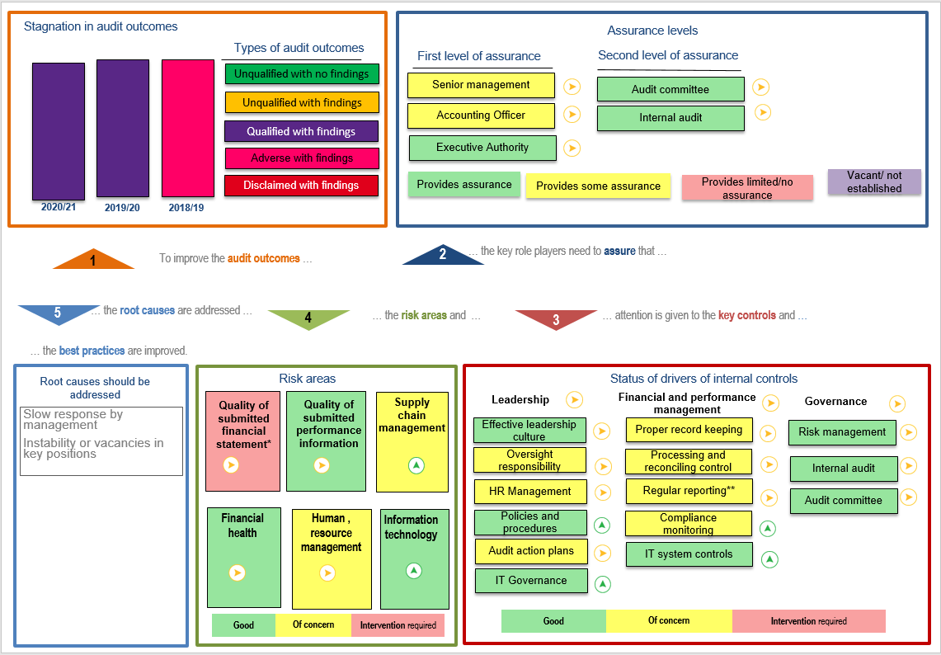
SUMMARY OF AUDIT OUTCOMES MANAGEMENT FINDINGS

Slide 4
AUDIT ACTION PLAN HIGH-LEVEL STATUS
Status of implementation | COMPLETED | IN PROGRESS/ONGOING | NOT YET STARTED
Total number of findings 26 | 13 | 9 | 4

Slide 5
Summary of findings in the management report
Matters affecting the audit report
Other important matters
Related party disclosure note
Commitment comparatives
Admin matters
Non-compliance with B-BBEE Act
Committee charters not reviewed.
Policies and procedures not updated on an annual basis
The AFS do not specify that the amounts were rounded-off
Inconsistencies identified on the APR
Board charter not reviewed
Actual achievement disclosed on the APR does not agree with achievement disclosed on the quarter 4 report.
Difference noted on calculated price score
Incomplete employee termination and appointment listing
Discrepancies on revenue and receivables from non-exchange transactions
Irregular, fruitless and wasteful expenditure.
Consequence management
Risk management disclosure note
Commitment disclosure note

Slide 6
Audit Action Plan In Progress/Ongoing
AUDIT FINDING | ACTION PLAN | PROGRESS TO DATE
Discrepancies on the revenue and receivables from non-exchange transactions | The CSOS to procure and implement the SAGE billing module to start the billing of the CSOS levy to schemes. Change the accounting policy by reassessing the interpretation in GRAP 23 following the advice received from National Treasury . Once the accounting policy is reviewed, ensure compliance and implementation. Obtain complete information from schemes through the amendment of form CS1. Management to confirm the completeness of the receivables balance as at year end as the recognition of receivables. | The CSOS has since procured the SAGE billing module to start the billing of the CSOS levy to schemes. Live Billing go Live took place on 14 February 2022 and process is ongoing. On track! A technical opinion has been sourced and in progress for the proposed changes to the accounting policy by reassessing the interpretation of GRAP 23 following the advice received from National Treasury, target date for completion is 31 March 2022. On track! The accounting policy is under review to ensure compliance and implementation. On track! The CS1 form has been amended, the Practise Directive has been issued in May 2021 on Registration of Schemes and submission of Annual Returns. On track! Management to confirm the completeness of the receivables balance as at year end as the recognition of receivable. Due 31 March 2022 | 31 December 2021

Slide 7
Audit Action Plan Progress Report
AUDIT FINDING | ACTION PLAN | PROGRESS TO DATE
The Risk Management note in the AFS is misstated | Management will ensure notes on the AFS are complete and appropriately agree with the registers on a quarterly basis. Current year audit finding has been implemented. | Remedial actions Implemented: notes on the AFS were completed and appropriately agrees with the registers on a quarterly basis. - DONE | Quarterly
Fruitless, Wasteful, and irregular expenditure disclosure notes are incomplete | Management will ensure notes on the AFS are complete and appropriately agrees with the registers on a quarterly basis. Current year audit finding has been implemented and resolved. The loss Control committee has been established to monitor and conduct assessments on identified Fruitless, Wasteful, and irregular expenditure. | AFS are complete and appropriately agree with the registers for Q3. Current year audit finding has been implemented and resolved. The Loss Control Committee has been established to monitor and conduct assessments on identified Fruitless, wasteful and irregular expenditure – the committee met on more than one occasion and process underway to deal with consequence management | 31 March 2022 Quarterly

Slide 8
Audit Action Plan: Progress Report
AUDIT FINDING | ACTION PLAN | PROGRESS TO DATE
Consequence Management | 1.&2 Remedial actions Implemented: made use of the NT GRAP checklist in reviewing completeness and accuracy of disclosure information to the Annual Financial Statements and current year findings completed Commitment listing reviewed for Q3 Management will implement appropriate consequence management procedures that will ensure that amongst others, management investigate any irregular, fruitless and wasteful expenditures identified through the recommendations of the Loss Control Committee and other disciplinary processes. | The Loss Control Committee convened on 30 July & 7 October 2021 to assess irregular, fruitless and wasteful expenditure identified by business. A Report containing recommendations on consequence management was submitted to CO & CFO on 30 September & 08 October 2021, respectively. The Committee was scheduled to sit again towards the end of the 3rd quarter. New independent members of the Loss control committee have been appointed by 1 March 2022, to ensure recommendations are implemented. | Quarterly
Commitment disclosure note is understated | Management will make use of the NT GRAP checklist in reviewing completeness and accuracy of disclosure information to the Annual Financial Statements. Management will also review on a quarterly basis the commitment listing and register to ensure completeness. | 1. Remedial actions Implemented: made use of the NT GRAP checklist in reviewing completeness and accuracy of disclosure information to the Annual Financial Statements and current year findings completed 3. Commitment listing reviewed for Q3 | 31 March 2022 Quarterly

Slide 9
Audit Action Plan: Progress Report
AUDIT FINDING | ACTION PLAN | PROGRESS TO DATE | TARGET DATE
Commitments- Intangible assets | Management will make use of the NT GRAP checklist in reviewing completeness and accuracy of disclosure information to the Annual Financial Statements. Current year audit finding has been implemented and resolved. Management will also review on a quarterly basis the commitment-Intangible listing to ensure completeness | 1. Remedial actions Implemented: made use of the NT GRAP checklist in reviewing completeness and accuracy of disclosure information to the Annual Financial Statements and current year findings completed 3. Commitment listing reviewed for Q3 – DONE | 31 March 2022
Non- compliance with B-BBEE Act and Regulations | Management will design a checklist that tracks all the compliance requirements CSOS need to consider relating to BBEEE requirements A service provider has been appointed to grade the CSOS in line with its compliance with the BBB-EE Act. | A compliance Universe has been developed and monitored continuously. Compliance to BBBEE will be included on the compliance Universe -DONE Service provider has been appointed and currently in progress with the verification process due for completion 31 March 2022 – DONE | 31 March 2022 31 December 2021
Committee Charters were not reviewed | Governance committee charters will be regularly reviewed and updated as per the legislation and policies. Documentary evidence of such reviews will be maintained and kept on file for audit reviews. | Board and Audit and Risk Charters were presented to the Board on 26 October 2021 for review approval. New Board reviewing these again – DONE | 31 March 2022

Slide 10
Audit Action Plan: Progress Report
AUDIT FINDING | ACTION PLAN | PROGRESS TO DATE | TARGET DATE
Commitments- Intangible assets | Management will make use of the NT GRAP checklist in reviewing completeness and accuracy of disclosure information to the Annual Financial Statements. | 1. Remedial actions Implemented: made use of the NT GRAP checklist in reviewing completeness and accuracy of disclosure information to the Annual Financial Statements and current year findings completed 3. Commitment listing reviewed for Q3 | 31 March 2022
Board charter was not reviewed | Governance committee charters will be regularly reviewed and updated as per the legislation and policies Documentary evidence of such reviews will be maintained and kept on file audit reviews. | The Board Charter was presented at the Board meeting on 26 October 2021 and was reviewed by the Board. New Board undertaking further reviews– Done | 31 March 2022
Difference noted on calculated price score | 1. Management will review the accuracy of price points calculations before the bid is awarded through an internal control process via internal audit ensure all recommendations and recalculations are corrected on BEC and BAC documents | Quarterly reviews are conducted as and when a bid is finalized through IA – Done | Immediately and on-going control at conclusion of bids before award

Slide 11
Audit Action Plan: Not Yet Started
AUDIT FINDING | ACTION PLAN | TARGET DATE
Related party disclosure note is not completed | Management will make use of the NT GRAP checklist in reviewing completeness and accuracy of disclosure information to the Annual Financial Statements. Due at the end of this Financial Year. | 1. 31 March 2022
Commitment- Misstatements | Management will make use of the NT GRAP checklist in reviewing completeness and accuracy of disclosure information to the Annual Financial Statements. In a case where the comparative differences are a result of a correction of prior period error, management will provide the relevant supporting documents and make the relevant disclosure in the correction of prior period error note. Due at the end of this Financial Year. | 1. 31 March 2022 2.31 March 2022
Operating lease liability misstated | Management will make use of the NT GRAP checklist in reviewing completeness and accuracy of disclosure information to the Annual Financial Statements. Due at the end of this Financial Year. | 1. 31 March 2022

Slide 12
Consequence management action steps in relation to irregular, fruitless and wasteful expenditure
ITEM | ACTION PLAN | PROGRESS TO DATE | TARGET DATE
Consequence Management | Management will implement appropriate consequence management procedures that will ensure that amongst others, management investigate any irregular, fruitless and wasteful expenditures identified through the recommendations of the Loss Control Committee and other disciplinary processes | The Loss Control Committee convened on 30 July & 7 October 2021 to assess irregular, fruitless and wasteful expenditure identified by business. A Report containing recommendations on consequence management was submitted to CO & CFO on 30 September & 08 October 2021 respectively. The Committee is scheduled to sit again towards the end of the 3rd quarter. Loss Control Report recommendations are being implemented and these will be shared with the ARC. One Executive had her contract terminated and one Manager has been demoted. 3 New independent members of the Loss control committee have been appointed by 1 March 2022, to ensure recommendations are implemented. | Monitored Quarterly

Slide 13
Overall Remedial Actions to address the 2021 Audit
Development of an audit action plan with remedial action and timelines to be monitored on a quarterly basis.
The National Treasury did not allow the CSOS to use the modified cash basis of accounting, however they recommended an alternative basis of accounting inline with GRAP – this is being pursued.
A revenue collection drive and strategy is underway to deal with the completeness of our database amongst the other projects already underway in the CSOS governance unit.
In the current financial year, the Entity continued with monthly reporting of planned targets against progress, this then allows for corrective measures identified to be implemented and followed up timeously before the end of the quarter.
Loss Control Committee instituted to deal with consequence management for irregular, fruitless and wasteful expenditure

Slide 14
RECOMMENDATION
It is recommended that the Portfolio Committee on Human Settlements note the CSOS 2021/22 AG(SA) Remedial Action Plan Progress Implementation.

Slide 15
Questions ?

Slide 16
Thank you

