Slide 1


PORTFOLIO COMMITTEE PRESENTATION
ON
THE AGSA REPORT ON COVID 19
15 MARCH 2022

Slide 2


PURPOSE
The purpose of the presentation is to brief the Portfolio Committee on the municipalities management of the Covid-19 Funds and the assistance provided by both departments to municipalities to implement the recommendations by the AGSA

Slide 3
INTRODUCTION
In response to the pandemic, the South African government announced a R500 billion fiscal support package in March 2020 to deal with the health crisis and its socio-economic consequences.
R23, 937 billion for emergency water supply, sanitation, food, shelter for the homeless, community services and basic services for indigent people in metros, district municipalities and local municipalities
The municipal disaster relief grant (MDRG) is a reserve grant that is only paid out in emergencies. A total of R151 million was paid on 8 May 2020 to assist non-metro municipalities with the increased cost of sanitation and other municipal services.
Municipalities in the Limpopo Province received a total allocation of R 14.5 Million

Slide 4
ALLOCATION OF COVID 19 RELIEF GRANT
Municipality | Allocation | Total Spent
Mopani District | R2 384 000.00 | R1 760 823.00
Greater Giyani | R 298 000.00 | R 298 000.00
Greater Letaba | R 298 000.00 | R 298 000.00
Greater Tzaneen | R 298 000.00 | R 298 000.00
Ba-Phalaborwa | R 298 000.00 | R 0.00
Maruleng | R 149 000.00 | R 149 000.00
Total | R3 725 000.00 | R 2 803 823.00

Slide 5
ALLOCATION OF COVID 19 RELIEF GRANT
Municipality | Allocation | Total Spent
Musina | R 447 000 | R 447 000
Thulamela | R 149 000 | R 149 000
Makhado | R 149 000 | R 149 000
Collins Chabane | R 298 000 | R 298 000
Vhembe District | R2 086 000 | R2 086 000
Total | R3 129 000 | R3 129 000

Slide 6
ALLOCATION OF COVID 19 RELIEF GRANT
Municipality | Allocation | Total Spent
Waterberg | R1 192 000.00 | R 460 000.00
Lephalale | R 298 000.00 | R 0.00
Thabazimbi | R 298 000.00 | R 298 000.00
Modimolle-Mookgopong | R 298 000.00 | R 298 000.00
Bela-Bela | R 179 000.00 | R 179 000.00
Mogalakwena | R 417 000.00 | R 417 000.00
Total | R2 682 000.00 | R 1 652 000.00

Slide 7
ALLOCATION OF COVID 19 RELIEF GRANT
Municipality | Allocation | Total Spent
Sekhukhune District | R 894 000.00 | R 894 000.00
Elias Motsoaledi | R 596 000.00 | R 561 217.56
Makhuduthamaga | R 298 000.00 | R 298 000.00
Fetakgomo-Tubatse | R 596 000.00 | R 596 000.00
Ephraim Mogale | R 596 000.00 | R 596 000.00
Total | R2 980 000.00 | R2 945 217.56

Slide 8
ALLOCATION OF COVID 19 RELIEF GRANT
Municipality | Allocation | Total Spent
Capricorn District | R 453 000.00 | R 96 090.00
Blouberg | R 358 000.00 | R 0.00
Molemole | R 358 000.00 | R 337 247.00
Polokwane | R 596 000.00 | R 596 000.00
Lepelle-Nkumpi | R 298 000.00 | R 298 000.00
Total | R2 063 000.00 | R1 327 337.00

Slide 9
FINDINGS FROM THE AGSA COVID 19 REPORT
Findings | Support provided
Poor public sector financial management controls | UIFWe reduction – LPT developed a tool to assist municipalities in monitoring and reporting the measures taken to reduce the UIFWe. A working session was held with municipalities to explain the objective of the template and provide guidance on the measures relating to legislative reporting requirements and measures to reduce such an expenditure in order to improve the financial state of affairs mSCOA – review the municipal transactions on mSCOA to determine whether municipalities are not transacting on items not budgeted for and that transacting is performed accurately and reporting is complete.

Slide 10
FINDINGS FROM THE AGSA COVID 19 REPORT
Findings | Support provided
Disregard for supply chain management legislation | Various MFMA Circulars issued on Covid-19 Procurement
An inability to manage projects effectively | Monthly MIG meetings
A lack of accountability | Training on the Municipal Financial Misconduct Regulation
Slow progress in getting initiatives off the ground | Support provided to municipalities on MIG spending

Slide 11
SUPPORT
mSCOA Circular 9 (June 2020) read together with Annexure of Budget Circular 99 provides guidance to municipalities on how to report on Covid-19 expenditure. Reporting should cover essential and emergency municipal services to address, prevent and combat the spread of Covd-19. The Circular was introduced to ensure proper monitoring and oversight on Covid-19 related expenditure.
Total of R151 million (nationally) reprioritised through Municipal Disaster Relief Grant for 2020/21 financial year.
Reported spending in line with MDG allocations:
  2019/20: Polokwane (R558 270)
  2020/21: Thulamela (R191 480)
Reporting misalignment and misclassification identified on this conditional grant. Accurate application of the fund segment by municipalities is the underlying factor for misalignments in this regard. NT issued mSCOA Circular 11 to provide guidance on accurate usage of the fund segment (December 2020).

Slide 12
SUPPORT
5 Categories of spending to be provided for:
General – Employee related costs, overtime, travel & subsistence, danger allowance, flu vaccine for staff, protective clothing, sanitation of offices.
Community and Social Services – Tankering of water, chemical toilets, food distribution, sanitation of public facilities, community awareness campaigns, preparation of cemetery sites.
Public Safety - Implementing roadblocks, monitoring of burial sites, monitoring informal settlements/ relocations, monitoring during social grant payments, provision for massive pauper burials, identification of specific mortuaries for COVID-19 related corpses, security.
Housing – Quarantine facilities, provision of water containers in informal settlements
Health – Costs of tracing, mobile testing stations, decontamination costs, covid_19 prevention inventory.
Weekly reporting doesn’t replace legislated and regulated reporting.

Slide 13
CONCLUSION
The province remains committed in our mandate to capacity municipality to run their own affairs

Slide 14
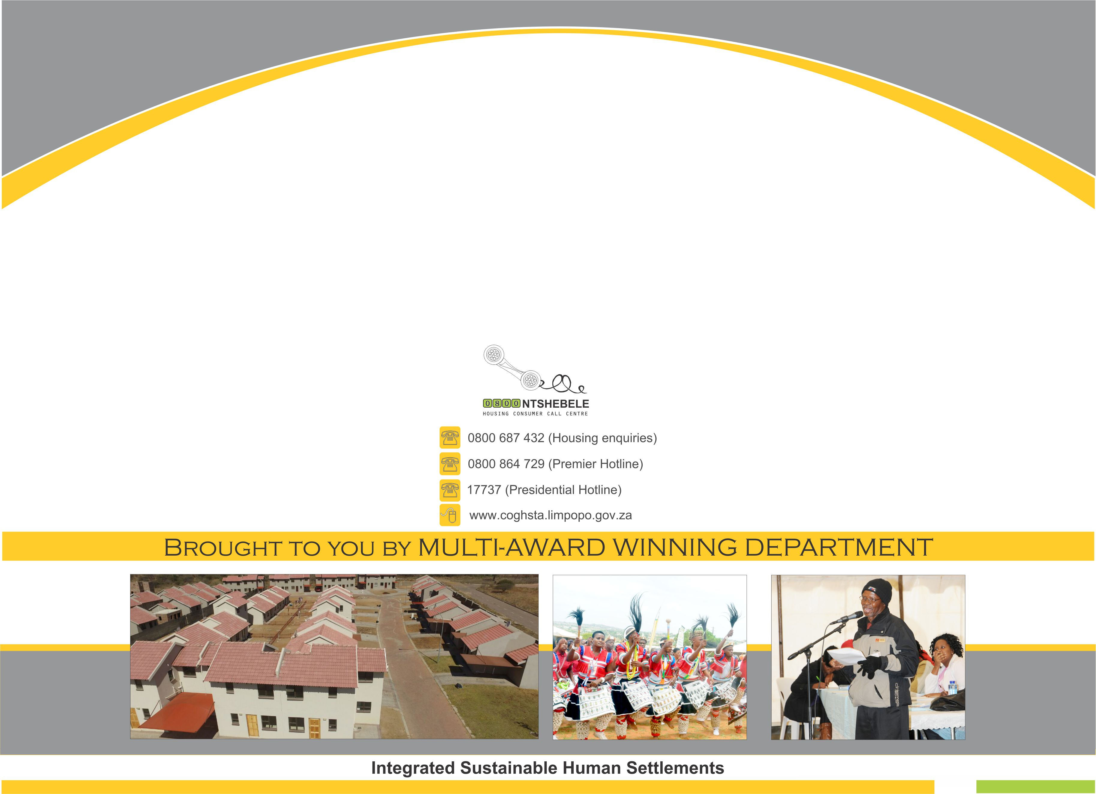
THANK YOU

