Slide 1
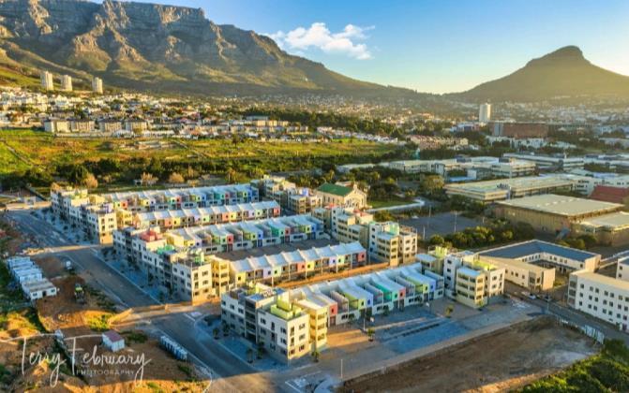

DISTRICT 6
REDEVELOPMENT
PRESENTATION TO THE PORTFOLIO COMMITTEE ON AGRICULTURE, LAND REFORM AND RURAL DEVELOPMENT– 15 MARCH 2022

Slide 2
PURPOSE:
To address the following:
Background to the District Six land restitution claim
Parties – Government
District 6 Groups
Milestone Achievements
Phase 3: Allocation Status Quo
Phase 3: Development
Phase 3: Challenges and Delays
Court order plan and current status thereof
Consultation with claimants
Way forward

Slide 3
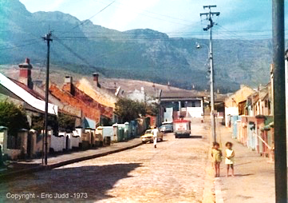
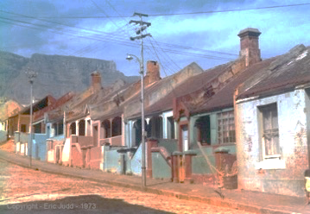
BACKGROUND
1.0 Background District 6 Land Claim
    The area known as District Six was located close to the Central Business District of Cape Town.
    As a result of the implementation of the Group Areas Act 77 of 1957 and the Community Board Act 3 of 1966, the people were forcibly removed.
    Some 66 000 people compromised the Community of District Six. The diverse community was predominantly resettled in the Cape Flats.
    The City of Cape Town as the registered owner of the land sought to exclude the land from being used for restitution purposes (in 1996).
    An application was brought to the Land Claims Court (LCC11/96) and an out of court agreement was reached.
    Through the mediation process, the District Six Beneficiary Trust was elected by the claimants to represent them.
    A Record of Understanding was entered into in 1998 between the claimant elected District Six Beneficiary Trust, the Department of Land Affairs and the City of Cape – recording to make available resources incl. financial, technical, community and human resources
    A Land Development Agreement was concluded in September 2000 and a Framework Agreement was entered into between the parties in November 2000 that the 40hectare land would be released for restitution purposes.
      The City to make designated land available for the development; transferred at no cost; and offer the bulk services;
      The Department of Public Works shall be approached for undeveloped state land;
      The then Department of Land Affairs shall make grant funding available.

Slide 4
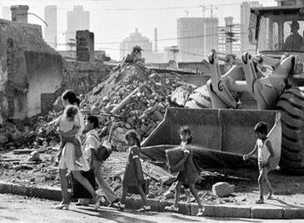
BACKGROUND
    At the cut-off date for lodgement of land claims, 2670 claims were lodged by former owners and tenants of District Six.
    Except for 110 claims that did not meet the requirements, all other claims conformed to the acceptance criteria in terms of the Restitution of Land Rights Act.
    The various options were introduced to the claimants and those who opted for restoration of land rights grouped their claims to participate in a single development of the 40 hectares of land.
    Since 2000: 14 Section S42D submissions were approved settling 2526 claims with 1274 initially opting for redevelopment. Owners and tenants were provided the same redevelopment settlement option.
    Grants to the value of R333m made available for the redevelopment of District Six; with an additional R351m approved in 2019.
    The District Six Beneficiary Trust was elected by the claimants and was registered as the Trust in 2001 (IT2131/2001) - The Trust was a signatory to the Record of Understanding and Settlement Framework Agreement.
    The Trust was appointed by the claimants as developers for Pilot Phases 1 and 2. It also facilitated the drafting of a Business Plan for the redevelopment of the entire site.

Slide 5

STATISTICS
Category | Number | Comments
Number of Claims Lodged | 2760 | Before the cut-off date 31 December 1998
Claims not Compliant | 110 | The claim does not meet the Requirement of the Act: Claimant failed to submit proof that they were forcibly removed as a result of racial laws or practices Compensation received at the time of dispossession was just and equitable in the circumstances Claims accordingly dismissed
Financial Compensation as preferred Restitution Settlement Option | 1449 | This number may change as people change option from redevelopment to financial compensation.
Redevelopment as preferred Restitution Settlement Option | 1201 | Claimants who opted for dwellings
Claimants allocated dwellings to date | 247: 139 for Pilots 1 and 2 and 108 in Phase 3 | Includes 108 Dwellings to be handed over to beneficiaries in 2022. To date 90 claimants have signed Settlement Agreements and 18 outstanding due to unresolved family resolutions and disputes.
Balance awaiting dwellings in the ensuing phases (Old Order Claims) | 954 | The no. may change as claimants change option from re-development to financial compensation.

Slide 6
PARTIES: GOVERNMENT
The parties involved in the project include, the Department of Agriculture, Land Reform and Rural Development, specifically the Commission on Restitution of Land Rights; Rural Development Branch, the Provincial Government and the City of Cape Town.
The City allocated land measuring approximately 42hectares for the redevelopment of District Six - the City is expected to contribute to the Bulk Infrastructure and Spatial Planning.
The Intergovernmental Technical Steering Committee (IGTSC) – comprising of all spheres of government meant to play an oversight role regarding the co-ordination of the redevelopment of District 6.

Slide 7
DISTRICT 6 REPRESENTATION
There multiple interests in the area and development of District 6:
District Six Reference Group which is the elected body (old order claims) – aimed at dealing with technical matters, communication and social integration.
District Six Working Committee represents mainly new order claimants who lodged between 1 July 2014 to 27 July 2016 but has representation of Old oder claims as well.
District Six Civic Organisation, who assist beneficiaries/returnees with social integration and community matters.
District Six Advocacy groups, who represents the interest of the then District Six home owners.
District Six Beneficiary Trust established by the claimants and facilitated the development of Phases 1 and 2.
The District Six Museum, who leads on the importance of heritage and memory making in the space of restitution and restoration.

Slide 8
MILESTONE ACHIEVEMENTS
Facilitating redevelopment of District Six, relevant agreements (Settlement Framework Agreement, Land Use Development Agreement and the Settlement Agreements with those returnees) were put in place, and both land and finance were made available to finalize the claims.
13 September 1998: District Six Beneficiary Trust, City of Cape Town and Department of Land Affairs concluded the Record of Understanding to give effect to their joint vision for all parties to fulfil their obligations. City of Cape Town committed 42 hectares of land, at no cost, to be returned to beneficiaries.
26 November 2000: Framework Agreement concluded in terms of section 42D of the Restitution Act for settlement of claims by the parties of a Tri-Partite Agreement, viz. District Six Beneficiary Trust, City of Cape Town and former Department of Land Affairs.
During the period 2000 to 31 December 2018, fourteen [14] Section 42D submissions were approved for D6 settling 2 526 claims of which 1201 claimants opted for redevelopment.
A total of R79 Million was paid to 1449 claimants as Financial compensation.
An initial R333 million was approved for the re-development in 2000 and a further R351 Million approved in 2019 Total of R684 Million.

Slide 9
MILESTONE ACHIEVEMENTS
Pilot phase 1 and 2 with a total of 139 dwellings were completed by the District Six Beneficiary Trust. 24 dwellings built in 2007 and 115 in 2013.
In 2022 another 108 dwellings will be handed over to identified claimants.
(An independent panel was appointed for the allocation of units in Phase 3).
The Department commissioned the Spatial Development Framework for District Six, that now forms the basis of the Local Spatial Development Framework for the area.
Continued support to the District Six Museum for the collection of objects and stories of the claimants that relate the story of dispossession.

Slide 10
PHASE 3: STATUS QUO ALLOCATION
Claimants were invited to apply to be considered for special needs for 108 units. 156 applications were received by the closing date 23 December 2020.
Applications were assessed by an Independent Selection Panel and there was an Appeal process. 42 Appeals were received and processed.
The criteria considered for special needs included those who were originally dispossessed, the aged, those with ill health status and the indigent.
Other claimants were selected from the official list in order of the date of lodgment, while consideration was also granted on humanitarian grounds.
Further consideration given to the demographics of the returnees.
The final 108 list was approved and the beneficiaries were invited to view the dwellings and allowed to accept or reject and wait for the ensuing phases.
To date 90 claimants have accepted the dwellings, 18 still dealing with power of attorneys and family disputes

Slide 11
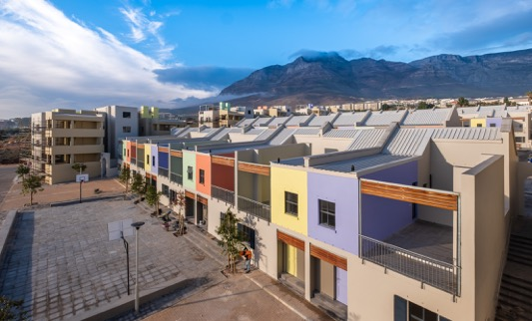
PHASE 3 DEVELOPMENT
Phase 3 was developed by the Department, appointed by the D6TT as “Developer”
Practical completion was achieved on the 18th of June 2021 - 108 units built on Site Q
The completion date of 15 December 2020 was extended to July 2021 due to delays
Delays caused by Covid lockdowns, inclement weather and commissioning of services by the City
The Department is in the process of obtaining occupancy certificates from the City prior to handover
Phase 3 (July 2021)
Site Q
± 100m²
108 units
R178 145 104-66

Slide 12

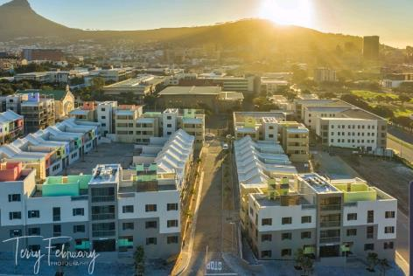
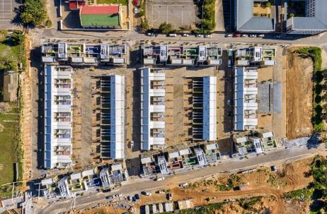
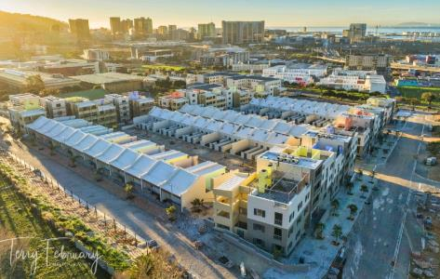
PHASE 3 DEVELOPMENT

Slide 13
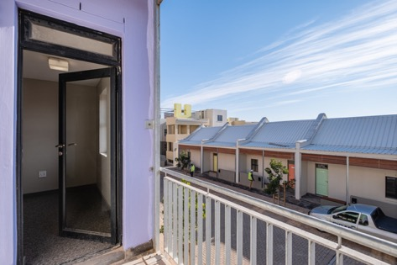
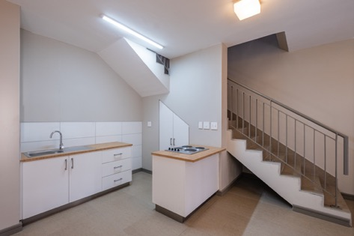
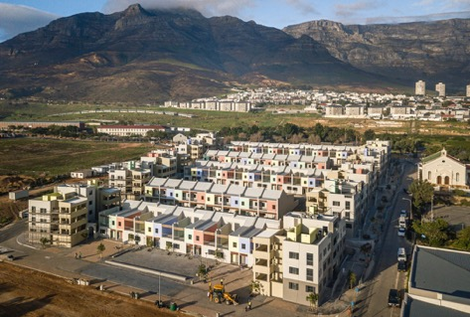
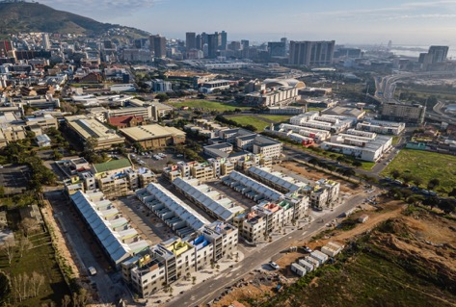
PHASE 3 DEVELOPMENT

Slide 14
CHALLENGES: ADMINISTRATIVE AND TECHNICAL DELAYS PHASE 3
LAND USE MANAGEMENT APPROVALS
The original land use management approvals were obtained in February 2015, which included Site Development Plan (SDP) and subdivision approvals. The approval of the General Plan (GP) was obtained in September 2018. These approvals were obtained quickly as a result of close collaboration and engagements at the time between the Department, the professional team, and the City of Cape Town.
By June 2021, construction was complete, and there was new challenges obtain building plan approval because the City of Cape Town no longer recognised the SDP, subdivision, and General Plan that had been approved in 2015 and 2018.
3 months, between January 2021 and March 2021, trying to get the City of Cape Town to recognise the development as public (as opposed to a privately managed development) and that the land is owned by National Government (despite the transfer taking place in 2020), which impacted on how the land use management issues were viewed and dealt with.
The building development management branch at the City, responsible for approving building plans and issuing occupancy certificates, would not approve building plans until a new Land Use Management process was completed and approved. The professional team had to prepare and submit a new Land Use application, including an amended subdivision layout and General Plan. This process was initiated on 01 July 2021 and concluded with the approval on 08 October 2021.

Slide 15
CHALLENGES: ADMINISTRATIVE AND TECHNICAL DELAYS PHASE 3
BUILDING PLAN APPROVAL
The significance of building plan approval is that it is a prerequisite to obtaining occupancy certificates. Land Use approvals are required before any building plans can be approved, and as described earlier, the Land Use approvals process had to be redone, and concluded in October 2021, at which point the City began considering building plans for approval.
The building plan submission and approvals process was challenging, because 58 separate applications had to be made via the City of Cape Town’s online portal. Each of the 58 applications comprised of several plans and forms. The City struggled to manage and coordinate the process effectively for 58 applications using their system, and it was agreed in early October 2021 that plans would be submitted in a phased approach to make the process more manageable.
The process for plan approval took approximately three months, and building plans were approved in batches between 12 October 2021 and 17 December 2021.

Slide 16
CHALLENGES: ADMINISTRATIVE AND TECHNICAL DELAYS PHASE 3
OCCUPANCY CERTIFICATION
Following building plan approval, the City building inspectors conducted inspections of all units, and found instances of non-compliance with the National Building Regulations. The City began issuing Permission to Use Letters, with conditions attached, requesting the rectification of non-compliances within a period of 12 calendar months. The inspections and letters did not specify exact locations or instances where the City found non-compliances, and the team had to survey the entire site to identify potential areas of concern. The Contractor was then instructed to rectify these and spent the months of January and February 2022 doing so.
The rectification work concluded at the end of February 2022, and the City inspectors were invited to reinspect the entire site, through a series of inspections between 21 February 2022 and 04 March 2022.
To date, the City has not provided any official feedback from these inspections but have recently suggested that the Department is not required to submit building plans for approval, are exempt from the National Building Regulations, and that the City will not be issuing Occupancy Certificates, which seem to suggest that the lengthy exercise undertaken by the team to redo the land use approvals process, prepare and submit fully detailed building plans and supporting documentation, conduct formal inspections with the City could have been substantially shorter process.
The Department does acknowledge that rectifying non-compliances was important and beneficial to the homeowners, but this could have been achieved through a much simpler and shorter process as opposed to the strict linear and sequential process with potentially unnecessary steps imposed by the City of Cape Town.

Slide 17
COURT ORDER
On the 26th of November 2018, Land Claims Court (LCC) handed down a declaratory order against the State (Minister, Commission and Presidency) for failing in their constitutional obligation to provide restitution to all claimants of District 6 and this therefore constituted a violation of the rights of the claimants to be restituted.
Judge Kollapen ordered the Minister to formulate a “reasonable plan and programme”
The plan must provide:
  An indicative conceptual layout for the redevelopment of District Six
  Specific details of how the plan is to be funded, including the budget to be allocated by the Respondents for the execution of the plan and the precise means by which extrinsic funding is to be secured;
  Estimated time frames for implementation of the plan
The Plan referred to was submitted to the LCC on the 17th of December 2019.
The Department committed to implement the revised programme over 2 phases, scheduled for completion within 4 years ending November 2025 at a cost of R1,87bn

Slide 18
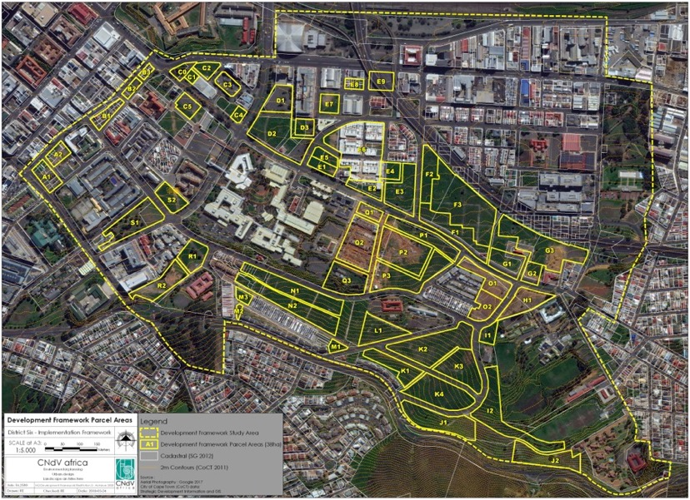
COURT ORDER PLAN

Slide 19
COURT ORDER PLAN

Slide 20
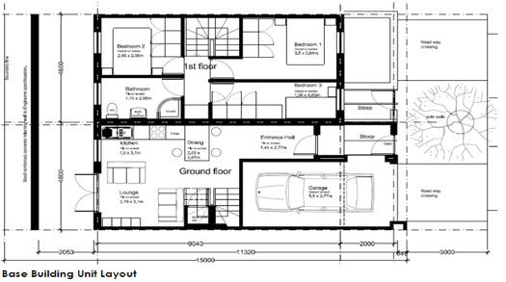
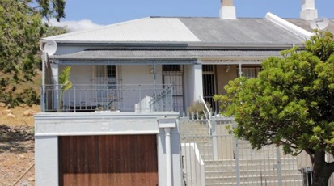
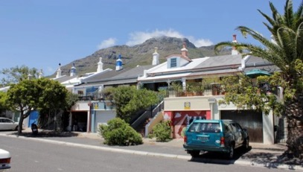
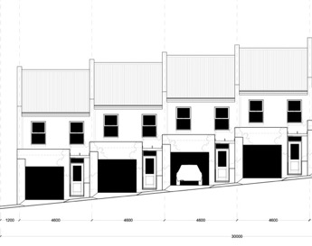
COURT ORDER PLAN

Slide 21
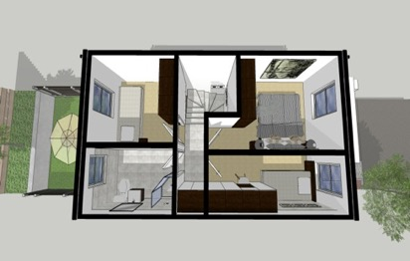
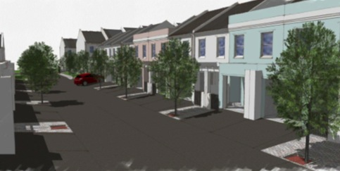
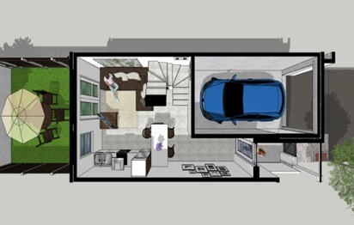
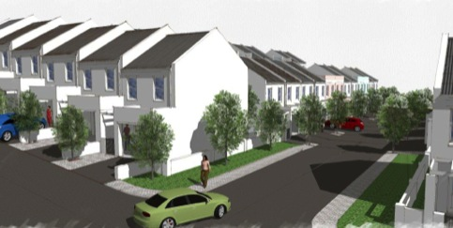
COURT ORDER PLAN
Figure 7.7 Unit typology - upstairs
Figure 7.8 Unit typology - downstairs

Slide 22
PROGRESS ON COURT PLAN
The COVID-19 pandemic has had a negative impact on the implementation of the Court Plan
The Department officially appointed the built environment professional consultant team : the D6-ADE Joint Venture by the 24th of November 2021(urban designers, architects, landscape architects, civil, structural, electrical and transport engineers, quantity surveyors, planners, and project managers).
Project meetings have commenced between the DALRRD technical team and the D6-ADE JV team.
The agreed approach is to counter the impact of COVID on the implementation of the District 6 Court Plan by fast tracking the implementation plan, and take all reasonable measures to expedite the project, to regain lost time.
The work on the next phases are in advance stages of design with a full time team of built environment professionals.
This project, named “District Six Build 1” entails the development of approximately 467 residential units and engineering services on four land parcels in District Six as follows:
    Phase 1 – Bulk sewer line upgrade along Hanover Street
    Phase 2 – 149 units on Parcel P
    Phase 3 – 173 units on Parcel N
    Phase 4 – 145 units on Parcel K2
These phases are intended to be developed simultaneously, and the unit quantities are subject to change as the site layouts are finalised.

Slide 23
CONSULTATION WITH CLAIMANTS ON DEVELOPMENT
The final Court Plan submitted by the Department to court on the 17th of December 2019 specifies a standard residential unit with a 4.6m wide (street frontage).
On 12 March 2020 D6RG made formal representations to the Minister outlining design changes they wished to be considered.
The Department’s technical team engaged with the professional team to conduct an exercise to cogently analyse the impact of the requested changes and its impact on Cost, Time and other aspects.
This exercise took place May 2020 and resulted in a comprehensive technical report which addressed unit design, the impact on the entire layout of the various land parcels under consideration; the increased cost to accommodate the changes and the expected impact on the project programme.
Consultation sessions were held with the D6RG in October 2020, were the report was unpacked in detail and the opportunity to ask questions and test alternate proposals to what was contained in the report.
On the 25th of November 2020 the D6RG and the Minister held a meeting to put on record their in-principle acceptance of option 4.1 as contained in the technical report for an increase in street frontage from 4.6m to 5.5m as a preferred option, resulting in both financial and time implications.

Slide 24
CONSULTATION WITH CLAIMANTS ON THE DEVELOPMENT
The Minister also agreed to the D6RGs request for logistical support in facilitating a meeting with the broader claimant community to communicate the resolution on the improved unit design.
The meetings were rolled out over a period of 14 sessions that commenced on the 24th of March 2021 and ended on the 24th of April 2021, strictly adhering to all Covid protocols. The sessions were well-attended with a total attendance of 478 claimants.
According to the D6RG outcome report received by the Department, the majority of claimants voted in favour of the improved unit design option 4,1.
The claimants who attended the sessions overwhelmingly endorsed the improved housing unit (96%) as agreed to in-principle by the D6RG.
The general mood observed during all the sessions was one of great optimism and expectation, with a new belief that Government will deliver on the amended improved housing plan (Option 4.1/ 5,5m frontage) and that the claimants will at last return to the District 6 within the next 3 and a half years - D6RG Chairperson

Slide 25
COMMUNICATION & WAY FORWARD
The Claimants are kept informed, through sms texts and emails of development processes and on any other relevant factor including meetings.
Our technical team (Engineer, Town Planner, Quantity Surveyor) are in continuous discussions with the City of Cape Town regarding the occupation certificates and building construction works.
Communicating with those families with disputes are to settle matters first in order for the Commission to allocate a unit.
The Commission will continue to verify the claimants in line with policy and update the claimant list.
The claimants are continually reminded to update the Commission of any changes – personal details, family matters, contact details, etc.
The returnees with concerns regarding structural issues of their dwellings built in phases 1 and 2 will again be visited and reminded of the builders liability period of 5 years and their own obligation to maintain their dwellings.
All new order claimants, reference number starting with “R” continue to receive six monthly updated correspondence on the status of their claims which currently have been interdicted by the Constitutional Court Order in the LAMOSA 1 and 2 matter.
DALLRD will continue to implement the LCC Kollapen order
Next Phases to be carried out concurrently on an accelerated construction plan.

Slide 26
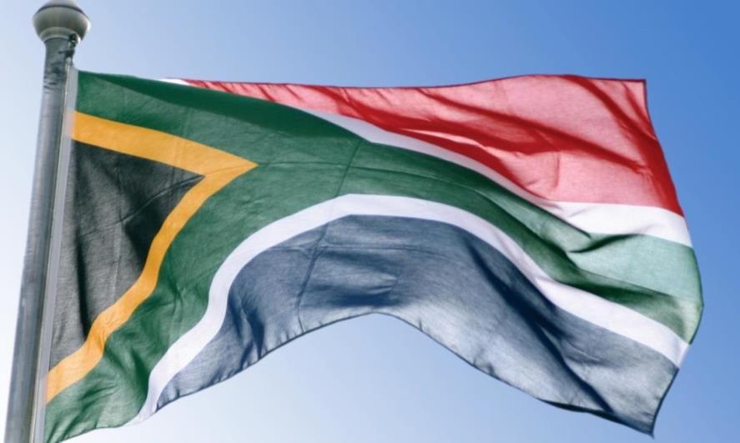
THANK YOU

