Slide 1
MANAGEMENT OF COVID – 19 FUNDS 15 March 2022

Slide 2
PRESENTATION OUTLINE
Purpose
Part A: Provision of Personal Protective Equipment
Part B: Informal Settlement Programme
Challenges And Interventions

Slide 3
1. PURPOSE
To present a report on the management of COVID-19 funds in the department.
The presentation is divided into to parts: PART A deals with provision of personal protective equipment while PART B deals with the projects identified for relief in informal settlements

Slide 4
2. PROVISION OF PERSONAL PROTECTIVE EQUIPMENT
The department allocated a total of R3 161 000 for Covid-19 response for the period 2019/2020, 2020/20221 and 2021/2022 financial years as per the table below:
FINANCIAL YEAR | BUDGET | EXPENDITURE
2019/2020 | R138, 000.00 | R138, 000.00
2020/2021 | R2, 031, 000.00 | R1, 974, 781.45
2021/2022 | R992, 000.00 | R342, 083.00
TOTAL | R3, 161, 000 | R2 454 864,45

Slide 5
2. PROVISION OF PERSONAL PROTECTIVE EQUIPMENT
The expenditure on Covid 19 was spent on items such as:
Cloth masks
70% alcohol hand sanitizer(s)
Bar soaps
Spray bottles
Automated hand sanitizer dispensers
Disinfection of offices
Internal Audit: There were no findings on the department’s part
Auditor General findings : There were no findings on the Department’s part

Slide 6
3. INFORMAL SETTLEMENT PROGRAMME
Subsequent to the declaration of COVID19 disaster by the President, the National Department of Human Settlements requested all Provinces to submit COVID19 Disaster response plan.
The Department submitted a Plan with eight informal settlements which are densely populated, with limited basic services.
Amongst the eight settlements, the Department prioritised Talana Hostel and Burgersfort extension 10 informal settlements for de-densification in order to adhere to the principles of social distancing and minimize the spread of COVID19. The list of eight identified informal settlements is on the slide below:

Slide 7
INFORMAL SETTLEMENT PROGRAMME
No | Municipalities | Settlement Names | Category | No. of Structures | Proposed Interventions | Progress
1. | Thabazimbi | Smash Block | B1 and C | 5000 | Water &Sanitation | Water tanks were delivered by DWS and installed
2. | Lephalale | Mamojela Park | B2 and C | 600 | Water & Sanitation | Water tanks were delivered by DWS and installed
3. | Lephalale | Steenbok Pan | B1 and C | 500 | Water & Sanitation | Water tanks were delivered by DWS and installed
4. | Fetakgomo-Tubatse | Burgersfort Ext 10 | B2 and C | 1500 | Partial Relocation, water and sanitation and construction of 152 TRUs | The project in progress

Slide 8
INFORMAL SETTLEMENT PROGRAMME
No | Municipalities | Settlement Names | Category | No. of Structures | Proposed Interventions | Progress
5. | Elias Motsoaledi | Masakaneng | B2 and C | 1200 | Water & Sanitation | Water tanks were delivered by DWS and installed
6. | Tzaneen | Talana Hostel | B2 and C | 120 | Partial relocation, additional water facilities and construction of 40 TRUs | 40 TRUs were completed by HDA and occupied Water tanks delivered by DWS and installed
7. | Elias Motsoaledi | Rossennekal B | C | 800 | Water & Sanitation | Water tanks were delivered by DWS and installed
8 | Bela Bela | Vingerkraal | B1 & C | 1000 | Water & Sanitation | Water tanks were delivered by DWS and installed
TOTAL |  |  |  | 10 720

Slide 9
INFORMAL SETTLEMENT PROGRAMME
The National Housing Code 2009, make provision for Emergency Housing Programme which provides temporary housing relief to households in distress as a first phase towards a permanent housing solution.
The programme applies in different conditions including households living in conditions that pose immediate threats to life, health and safety; and in situations of exceptional housing need and emergencies
The Human Settlements Department requested provinces to provide emergency interventions in line with Emergency Housing Programme based of the assessment made on each informal settlement .

Slide 10
INFORMAL SETTLEMENT PROGRAMME
Temporary Residential Units (Talana and Burgersfort) project was conceptualized along emergency housing principles with the aim of providing COVID19 emergency relief to the two communities community who live in a densely populated informal settlement.
Partial relocation and provision of transitional residential units to enable community to practice social distancing and reduce the spread of the virus was the suitable emergency relief.

Slide 11
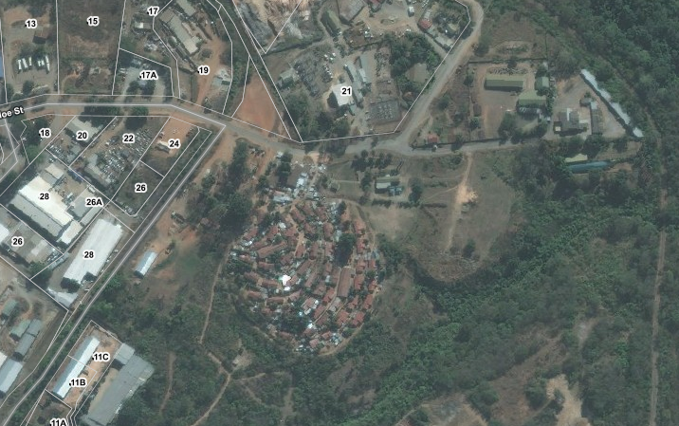
PROJECT LOCATITY
The Talana Hostel is located on the northern part of Tzaneen Ext 105, a newly approved township in the Municipality known as Hamawasha
Figure 1: Locality Map

Slide 12
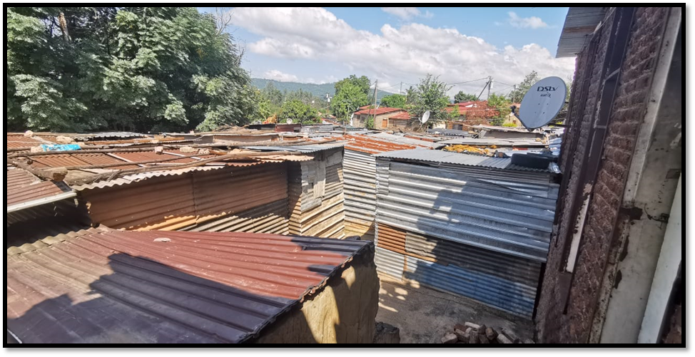
CONGESTED TALANA INFORMAL SETTLEMENT

Slide 13
PROJECT PROCUREMENT
The Department appointed the HDA on 08 May 2020 as an Implementing Agent for establishment of Transitional Residential Units (TRU’s) with the following scope of work:
Under-take stakeholder consultations for resource allocation and buy-in
Develop social compact
Assist Municipality to identify structures and people to be relocated
Under-take survey and site lay-out for orderly settlement
Procurement and erection of 40 transitional residential units
Relocation of 40 households to the Temporary Residential Area
The HDA appointed Aventino Group on the 18th May 2020 for the supply and installation of 40 TRU’s at Talana Hostel within Greater Tzaneen municipality at the National subsidy quantum of R 64 441.00/unit and the total costs of the project is R2, 577, 640.00.

Slide 14
PROJECT BENEFICIARY MANAGEMENT
The Municipality identified shacks that were overly congested, and located too close to one another. The process was done through the Ward Committee.
The list of names was compiled and sent to CoGHSTA for verification on the National Housing Subsidy System (HSS).
All the 40 beneficiaries qualify for a BNG house and will be allocated houses in the future project. Those who qualify to stay in the Community Residential Units (CRU) will also be considered for allocation on an upgraded Talana Hostel which is currently at feasibility stage.
The TRUs are for lease and not permanently allocated to them. The Department, Municipality and the occupants will sign the lease agreements.

Slide 15
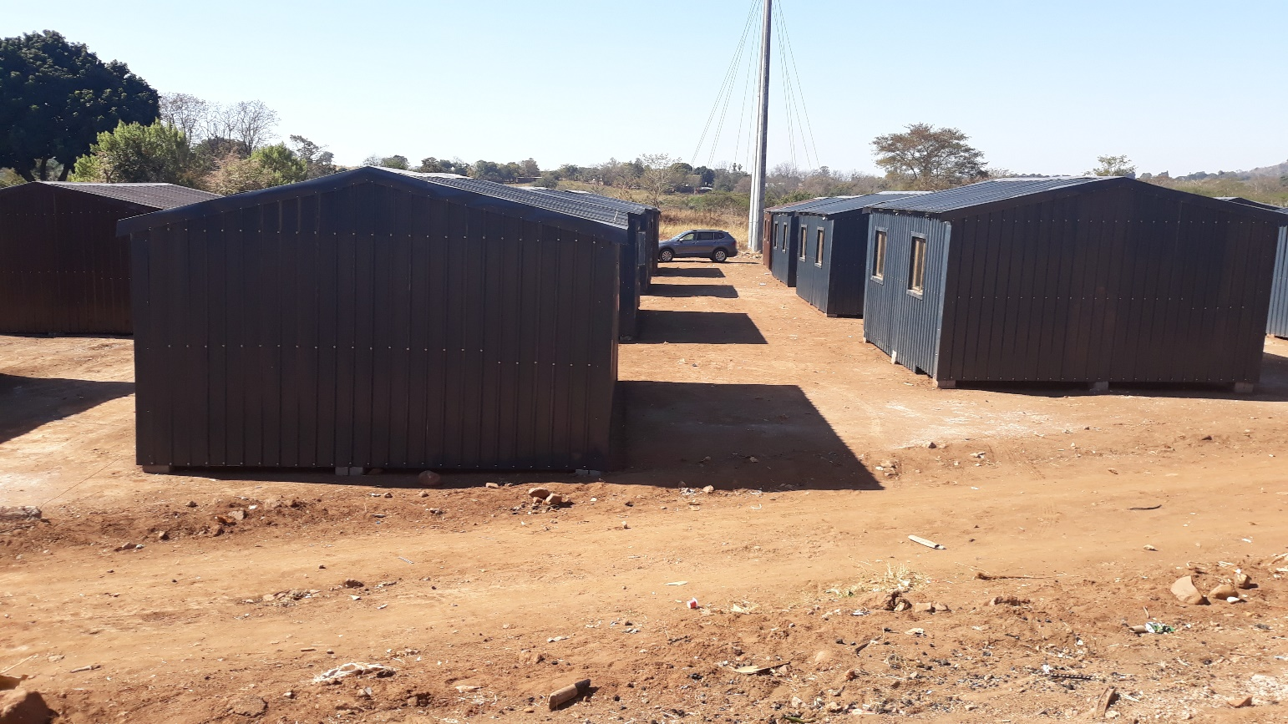
PROJECT PROGRESS
The Project is completed with 40 TRUs and handed over to the Municipality on the 31st July 2020 at a cost of R2, 577, 640.00.
Below figure is completed TRUs:

Slide 16
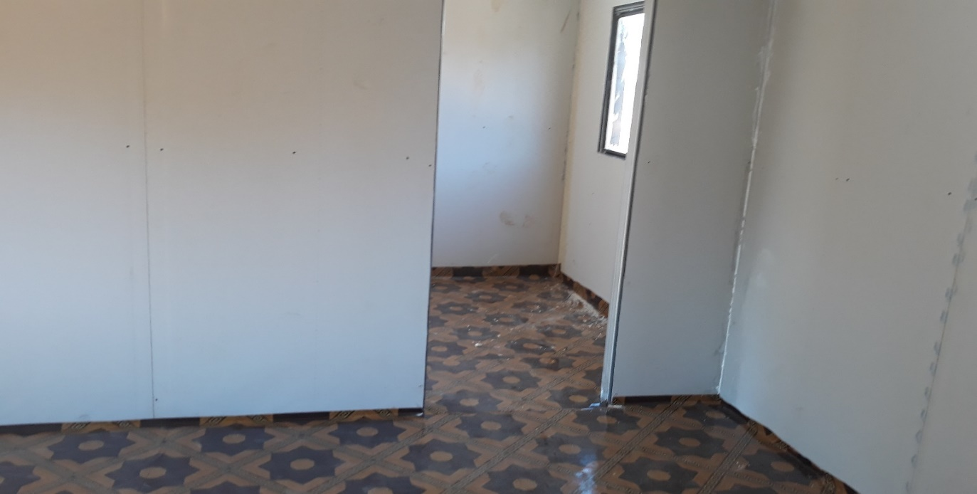
INTERIOR FINISHING

Slide 17
4. CHALLENGES AND INTERVENTIONS
CHALLENGES | INTERVENTION
The alleged poor quality of the TRUs Findings included: Platform; Foundations; Structural Stability; Compliance to SANS 517; Poor Workmanship | The Minister has commissioned an investigation through NHBRC. Remedial action proposed with new specifications.
Allegations of tender irregularity by the Implementing Agent (HDA) | SIU engaged in the investigations. Matter before law enforcement agencies.

Slide 18
THANK YOU

