Slide 1
PRESENTATION TO THE PORTFOLIO COMMITTEE ON HIGHER EDUCATION, SCIENCE AND INNOVATION
11 MARCH 2022

Slide 2
Progress in the implementation of the Audit Action Plan
Status of material irregularities
Turn-around strategy aimed at improving performance
Close-Out project
Procurement of new ICT system
NSFAS Funding for 2022 academic
CONTENTS

Slide 3
PROGRESS IN THE IMPLEMENTATION OF THE AUDIT ACTION PLAN

Slide 4
Progress in the implementation of the Audit Action Plan
In the previous audit cycle, AGSA issued 35 audit findings. 40% (14) completed, 60% (21) in progress. Most of the matters that are in process will be implemented by the end of the financial year
The implementation of the audit action plan is monitored at Board level and its sub-committees
Management has an established process of monitoring and closing audit findings which is reviewed by Internal Audit
Established audit steering committee
Preparation for the current audit cycle is under way
There is a workshop scheduled in March with the AGSA to reconfirm the business understanding and NSFAS Process as the AGSA has a fairly new team

Slide 5
Status of material irregularities
No material irregularities were issued in the previous audit cycle
The following matters remain open from the 2019/2020 audit cycle:
Disbursements in excess of contract value
After consultation with the NCR and legal opinion, NSFAS is considering the best option for the beneficiaries to sign the agreements
Collection of money owed by tertiary institutions
This matter is closely linked to the close out project, the process to determine amounts owing to or owed by institutions will be completed by 31 March and therefore recovery and settlement will continue
Interest not charged on loan accounts
In the previous year the entity managed to compute and record the interest adjustments in the Annual Financial Statements. In preparation for the next audit cycle the entity is planning a similar exercise

Slide 6
TURN-AROUND STRATEGY AIMED AT IMPROVING PERFORMANCE

Slide 7
Turn-around strategy aimed at improving performance
IMPROVEMENTS ON PERFORMANCE REPORTING
Quarterly performance reports
The institution reports on a quarterly basis on performance against its targets. This is to ensure that managers are working according to the plan and towards achieving the strategic goals of the organization. Quarterly reports provide progress updates on the implementation of the APP for a specific quarter
The Board sets the targets and monitor performance information on quarterly basis
Monthly performance reports
Furthermore, the performance of the entity is also monitored and tracked through the monthly reporting system to ensure that the organization meets its targets and to identify areas of under-performance on time in order to mitigate those challenges and come up with corrective measures to improve performance. Monthly reports provide progress updates on the implementation of the APP for Departments and Service units

Slide 8
Turn-around strategy aimed at improving performance cont.
Operational Plans
NSFAS has an Organisational Annual Operational Plan (AOP) that describes the activities and budgets for each of the output and output indicators in the Annual Performance Plan.
Furthermore, Departments have plans which are aligned to the APP and approved by the Heads of Departments. The Operational plans set out what each Department intends doing on a monthly basis to ensure that quarterly targets/outputs are met.
ICT SYSTEM
Enhancement of systems is ongoing. This is done in an effort of stabilizing the ICT environment in order to assist in the efficiency of the disbursement process

Slide 9
Turn-around strategy aimed at improving performance cont.
HUMAN RESOURCE INTERVENTIONS
Approved operational model
Approved Organisational structure
Costing the structure and filling of key vacancies
Signing individual performance agreements with all staff members
STAKEHOLDER ENGAGEMENT
The Board and CEO embarked on visits to institution of higher learning. The Board’s intention of these visits was to get closer to the matters “on the ground” by hearing directly from the management and the student leadership of institutions and, therefore, improve stakeholder relations with the ultimate view of informing student funding policy and criteria. The Board believes that engagements such as institution visits will stimulate a better understanding amongst stakeholders and improve their drive to serve students.
The CEO has continuous engagements with key stakeholders

Slide 10
CLOSE OUT PROJECT

Slide 11
Scope of the project
The objective of the close out project is to formally reconcile data between NSFAS and institutions to close out the 2017, 2018, 2019 and 2020 years. At a high level the process entails the following;
Matching registration data received from institutions to the approved funded list, NBA (Award amount) and Disbursed amounts (Phoenix) at student level.
Agreeing the cost of course of study to the disbursed amounts.
Agreeing the disbursed amounts to actual amount paid.
Resolving differences between NSFAS and Institutions.
Resolving issues between NSFAS and Institutions
Resolving Historical debt
The close out project covers the academic years 2017,2018,2019 and 2020 for all 50 TVETs and 26 Universities funded by NSFAS.

Slide 12
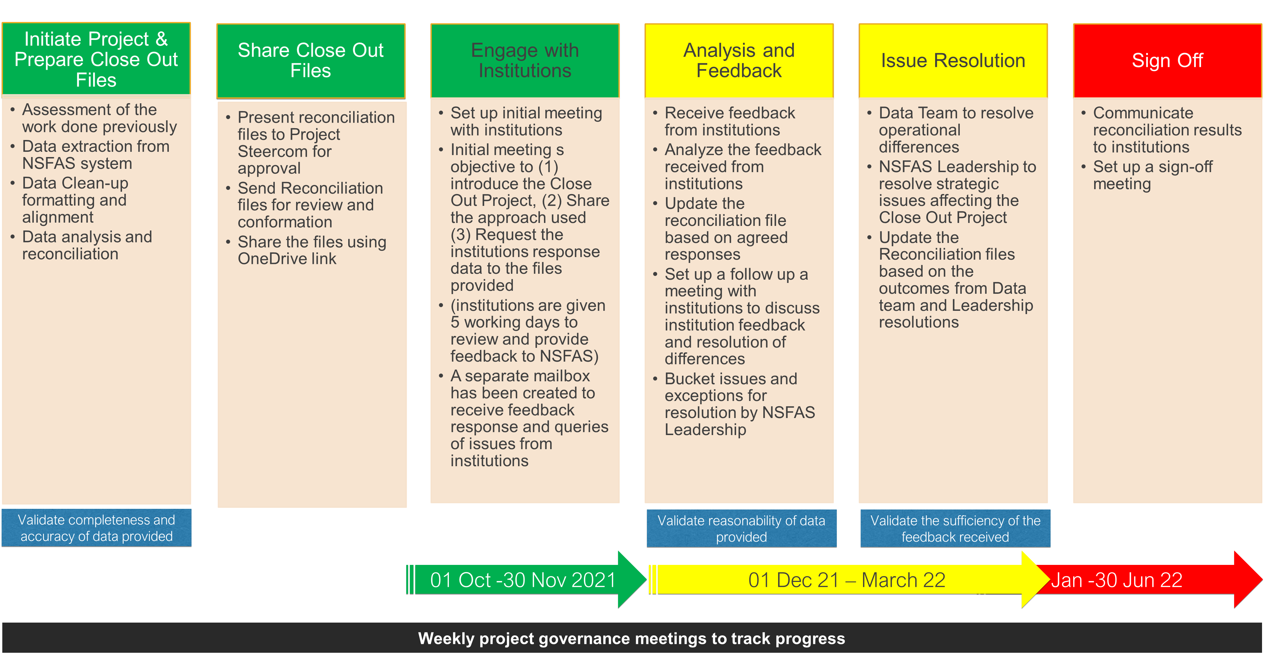
The close-out process

Slide 13
Overall Progress to date
The progress made in the Project this far is as follows:
Reconciliations based on NSFAS data completed for the 2017 – 2020 academic years.
All Reconciliation files shared with institutions via OneDrive.
26 out of 26 (100%) University institutions have provided responses to the files.
41 out of 50 (82%) TVET have provided responses to the files discussed in the initial meeting.
Next step: Closing institutions. (by 31 March 2022)

Slide 14
Progress on Universities
The progress made in the Project this far is as follows:
Out of the 26 Universities;
22 have submitted claims data for all close out years (2017- 2020) and data has been analysed and issues bucketed. Issue resolution is in progress.
3 Universities (CPUT, DUT, SPU) have outstanding file for 2020 – This is due to a remittance an issue
Historical Debt (HD) has also been initiated to look at students outstanding debt in the Close Out years
Institutions have been requested to submit their HD claims
The DHET HD fund criteria is used to determine who qualifies or not
11 Institutions have submitted their 2017 and 2018 HD claims
he resumption of HD to be sent out to institutions

Slide 15
Progress on TVETs
Out of the 50 TVETs :
28 have submitted claims data for all close out years (2017- 2020) and data has been analysed and issues bucketed. Issue resolution is in progress and a priority files list has been developed and will be shared with internal staff to start working on the issues. Verification of issues from internal staff for institutions underway with few institution at an advanced stage.
12 have partially submitted.
9 Institutions have not submitted even after the legal letters were sent. Legal letters were sent in January 2022 to all non-responsive institutions. The data currently in our possession will be used to close out the project.
Non-responsive Institutions: Orbit FET College, Waterberg FET College, Motheo FET College, Sekhukhune FET College, Letaba FET College, Lephalale FAT College, King Hintsa College, Ingwe Public FET College and Ikhala Public FET College.of HD to be sent out to institutions

Slide 16
Procurement of new ICT system

Slide 17
Procurement of the new ICT system
NSFAS currently has administration budgetary constraints, as highlighted in previous communication to Parliament and the same has been communicated to DHET and the National Treasury. Given these budgetary constraints NSFAS had to opt for a phased implementation of its ICT strategy.
The following improvements have already been made:
Enhancement of the applications module to allow for real-time decisions
Implementation of inhouse appeals system
Processing of registration data
Calculating of allowances and related disbursements
To enable some of these improvements DHET has availed a budget of R65 million for NSFAS to fund some of these ICT improvements, although the budget is not sufficient to cover all the requirements
NSFAS is employing other mechanism to fast track the implementation of key modules such as requesting providers to develop these systems at risk.

Slide 18
Current systems
We have adopted a co-sourcing operational model. This allows us to dedicate resource to stabilize the current systems and have resources to focus on enhancements and new development
Current systems continue to have underlying issues

Slide 19
Key tools under development and to be developed
KEY SYSTEMS UNDER DEVELOPMENT/BEING ACQUIRED
Enhancement of the application module to ensure efficiency and real time funding decision for all applicants, including value added services to students
The student accommodation portal – accreditation, grading, link students to accommodation and direct payment
Direct disbursement to students through fin tech providers
KEY SYSTEMS TO BE DEVELOPED/ ACQUIRED
ICT infrastructure refresh
Direct integration with institutions and third parties
Bursary and loan management system
Accounting system
Learning material online platform
Enhancement of the call entre management system including the use of AI
Single view for the call centre

Slide 20
FUNDING FOR 2022 ACADEMIC YEAR

Slide 21
2022 Funding Status

Slide 22
2022 Appeals
Stakeholders called for NSFAS to manage appeals centrally for both continuing and new students
A new appeals portal was rolled in 2022 and went live on 3 February 2022
Teething system glitches were experienced.
To manage the risk of registration closing out before students could obtain funding decisions, NSFAS shared details of students who appealed with institutions so that universities and TVET college could manage the risks at institutional level. The system has since been restarted and is now processing appeals accurately for most of the students.
The system issues have now been addressed and NSFAS is busy with evaluation of appeals and issuing funding decisions.

Slide 23
2022 Appeals
radio
27 % of the appeals have been approved, 51% still under evaluation (some of these required resubmission of supporting documents), 20% were either withdrawn or duplicates, 2% were rejected.
Notes:
The difference between received and synchronized is as a result of a problem that NSFAS experienced with the DHA verification process. NSFAS is in the process of resolving this issue. Once done the applications will be synchronized.
The case management functionality was made available to the team two and a half months later than expected. NSFAS has obtained the services of an external service provider to assist in addressing the backlog in case management.

Slide 24
2022 funding
There was a budget shortfall of approximately R10 billion. Availability of funding was confirmed towards the end of January leading to:
Delay in issuing of funding decision – While NSFAS had been ready with the provisional funding list
Delay in issuing funding guidelines. There is a close link to availability of funding to the funding guidelines. NSFAS had completed the consultative process in December.
NSFAS no longer has cash reserves, these were depleted with the 2020 extended academic year and is such is no longer in the position to provide advances to institutions, particularly universities.
In the current academic cycle this was exacerbated by the fact that the allocation of R3,2 billion of the 2021 budget shortfall has not yet been received from the National Skills Fund. We are currently engaging with the DHET to fast track this
There was some available budget in the TVET and such we were able to advance 20% of tuition allocation to colleges.
There is a fundamental timing issue of when NSFAS receives its allocation to when institutions start their academic program, leading students not receiving allowance on time thus creating instability at institutions. For future academic years NSFAS is preparing a cashflow projection to discuss with the DHET and NT to assess the possibility of receiving its funding allocation earlier to align to institutional academic programs.

Slide 25
THANK YOU

