Slide 1
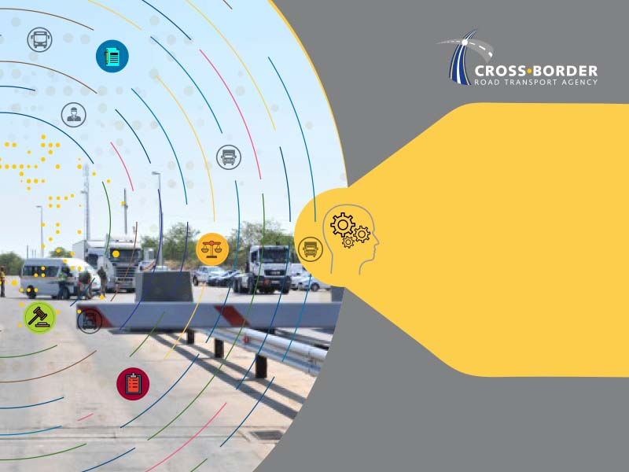
Brief to the Select Committee on Transport
Annual Report 2020/2021
9 March 2022

Slide 2
TABLE OF CONTENTS
C-BRTA Mandate, Vision and Mission
Core Functional Areas and Organisational Structure
Operating environment
Problem and impact statements
Organisational Performance – March 2020/21
Social Responsibility Initiatives
Annual Financial Statements – March 2020/21
Audit Outcomes
Conclusion

Slide 3
MANDATE, VISION & MISSION
Cross-Border Road Transport Agency
Facilitating unimpeded cross-border movements
Liberalising market access in the cross-border transport sector
Regulating competition to balance supply and demand
Reducing operational constraints and addressing corridor bottlenecks
Strengthening public sector capacity
Empowering cross-border
Operators to maximize business opportunities
  As per the Cross-Border Road Transport Act (Act No. 4 of 1998) as amended.
  Vision:
  To be the leading economic cross-border road transport regulator facilitating unimpeded flow of goods and people across the African continent.
  Mission:
  To drive an integrated African continent through excellence in cross-border road transport economic regulation, law enforcement, advisory and facilitation of unimpeded flow of goods and people.
3
Notes:
Our mandate includes the following:
Improving unimpeded flow of cross-border road transport with a view to enhance intra and inter-regional trade, regional integration and socio-economic development in SADC region.
Liberalising market access with a view to create more business opportunities and enhance productivity in the cross-border road transport sector.
Regulating competition with respect to cross-border road passenger transport, in order to effectively balance the supply and demand of transport services .
Reducing operational constraints with a view to improve operational efficiency, productivity, and reducing the cost of doing cross-border business to operators.
Strengthening public sector capacity with a view to enhance delivery of key movement programmes and enabling the country to strategically respond to regional matters.
Empowering cross-border operators with a view to enable them to maximise business opportunities and improve operational efficiency.

Slide 4
NDP & SADC PROTOCOL
NATIONAL DEVELOPMENT PLAN | SADC PROTOCOL ON TRANSPORT COMMUNICATION & METEOROLOGY
Chapter 4 of the NDP identifies transport as one of the key economic infrastructures required for: Enhancing economic development by bridging geographic distances affordably, reliably and safely; Economic development by supporting transportation of goods, facilitating regional trade and regional integration; Aggressive expansion of trade and investment underpinned by the development of hard infrastructure, unlocking trade systems and enhancing performance of supply chains; Reducing red tape, corruption and delays at border posts. Chapter 7 of the NDP also requires South Africa to harmonize border policies with regional trading partners. | Article 3.5 provides institutional framework and enables member states to facilitate unimpeded access and travel between territories of member states; Article 5.2 requires harmonisation of road transport policy which provides for equal treatment, non-discrimination, reciprocity, fair competition to cross-border transport operators; Article 5.3 requires each country and the region collectively to introduce measures to liberalise cross-border market access policies in respect of cross-border carriage of goods; Article 5.4 requires member states to conclude bilateral or multilateral agreements for regulation of cross-border road transport operations; and Article 5.5 requires member states to ensure domestic measures shall conform to regional policies and coordinate their efforts in this regard.
4

Slide 5
OTHER LEGISLATIVE PRESCRIPTS
DOMESTIC |  | REGIONAL
National Land Transport Act |  | Southern African Customs Union (SACU) MoU
National Road Traffic Act |  | Trans Kalahari Corridor (TKC) MoU
Dangerous Goods Act |  | East African Community (EAC)/ Common Market for Eastern and Southern African (COMESA)/ Southern African Development Community (SADC) Tripartite Free Trade Agreement
Tourism Act |  | African Continental Free Trade Agreement (AfCFTA)
 |  | Bilateral Road Transport Agreements (Signed with Malawi, Mozambique, Zambia and Zimbabwe)
5
Notes:
SACU MoU: Consist of RSA, Botswana, eSwatini and Lesotho and provide for the facilitation and maintenance of effective road transport arrangements and in particular equitable share in road transportation with a vie of supporting trade in the Customs Union
TKC MoU: Consist of RSA, Botswana and Namibia and was established with a view to improve regional trade and economic development through efficient transportation and the need to eliminate constraints and non-tariff barriers
Transport Agreements: with Malawi, Mozambique, Zambia and Zimbabwe and provides for cooperation and coordination , facilitation and regulation of cross-border road transport movements
NLTA: Provide for the need for operators intending to undertake cross border road transport operations to have a cross-border permit and regulate cross border road transport movements with regard to 2km radius requirement. This delimits local and inter-provincial operators from operating within 2km radius of a border post
NRFA: Provides for road traffic matters which shall apply uniformly throughout the Republic and govern licencing and operations of motor vehicles, vehicle road worthiness, driver licensing and fitness
Tourism Act: C-BRTA regulate access to the commercial tourism transport market for RSA operators conducting operations across the borders

Slide 6
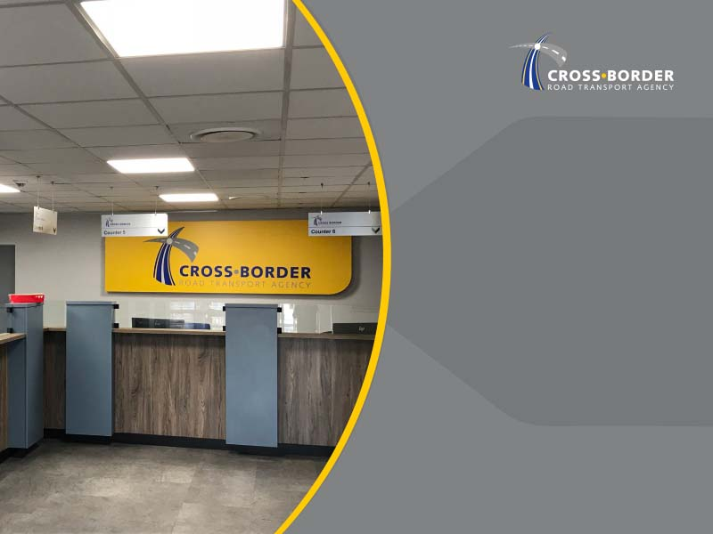
  Core Functional Areas and Organisational Structure

Slide 7
CORE FUNCTIONAL AREAS
Regulatory | Responsible for the issuing and managing processes pertaining to cross-border permits
Law Enforcement | Monitoring carriers’ adherence to the law by carrying out law enforcement operations
Facilitation | Developing partnerships with SADC counterparts and fostering positive relationships aimed improving transport facilitation and development of trade among SADC countries
Advisory | Monitoring and counteracting any restrictive measures that may be implemented by other member states in the SADC region and advising the Minister of Transport on regional transport imperatives and challenges.
7

Slide 8
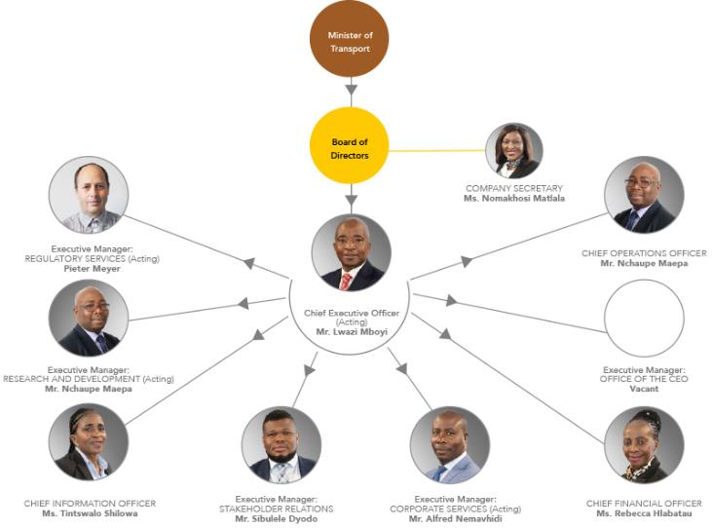
ORGANISATIONAL STRUCTURE
8

Slide 9

  Operating Environment

Slide 10
OPERATING ENVIRONMENT
Table of Contents
There are 53 land border posts between South Africa and neighboring countries
Nineteen (19) designated as commercial border posts (will be 20 with the recent decision to declare Kosi Bay a commercial border);
There are 4 border posts that carry significant volume of commercial traffic: Beitbridge, Lebombo, Maseru and Skilpadshek (listed by traffic volume);
These border posts are located in the busiest corridors linking South Africa to the SADC region namely the North-South Corridor, Maputo/ N4 Corridor and Trans-Kalahari Corridor;
Key role players at border posts are:
  DHA (Immigration/ Border Management Authority);
  SARS (Customs);
  SAPS (Border Police);
  Environment, Forestry and Fisheries;
  Agriculture, Land Reform and Rural Development
  DOH (Port Health); and
  State Security Agency.
10

Slide 11
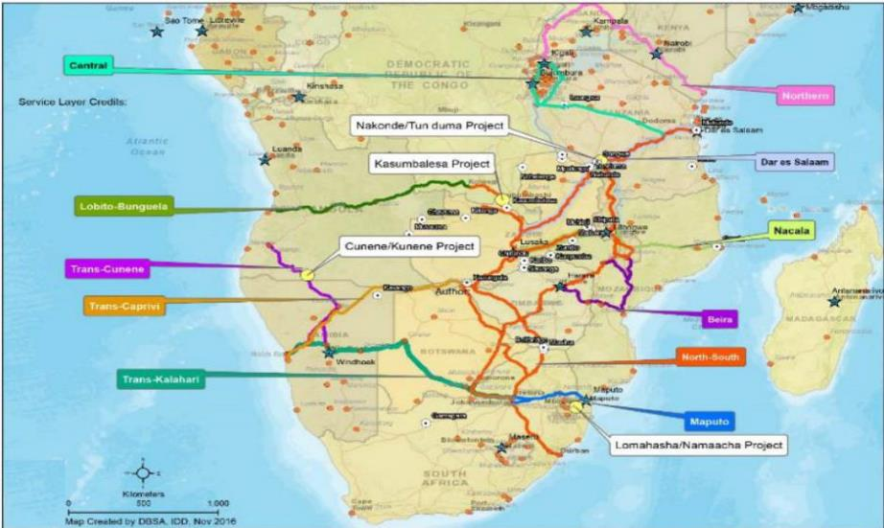
CROSS BORDER ROUTES AND BORDER POSTS
11

Slide 12
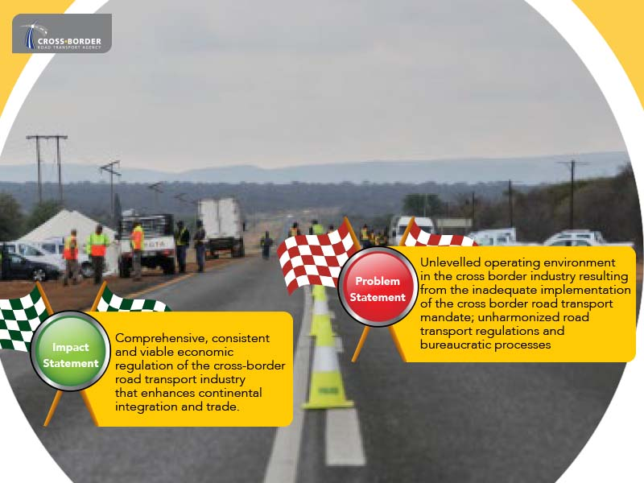
PROBLEM AND IMPACT STATEMENTS
Heading goes here

Slide 13
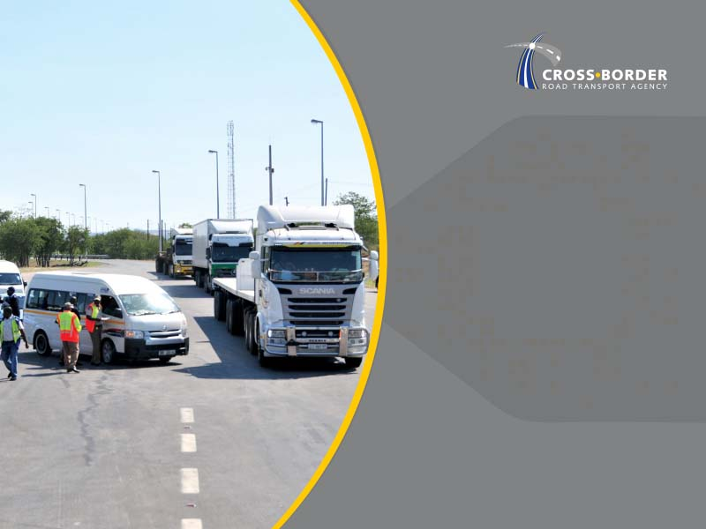
  Organisational Performance

Slide 14
PROGRESS MADE TOWARDS ACHIEVEMENT OF OUTCOMES
OUTCOMES | FIVE-YEAR TARGETS | PROGRESS MADE TOWARDS ACHIEVEMENT OF OUTCOMES
Enhanced regulatory regime by implementing quality regulation | Implemented Operator Compliance Accreditation System (OCAS) | On-going development of OCAS. Registration module developed and piloted and the module refined with outcomes of the pilot. IT OCAS system being developed in the current financial year.
Improved compliance to cross border road transport regulation | Implemented smart law enforcement | Acquired and deployed smart law enforcement tool in the form of a smart law enforcement vehicle. Vehicle is fitted with a Number Plate Recognition System (APNR) which is used to collect intelligence. Enables cross referencing of vehicle registration with various data bases (CBRTS, ENATIS & SAPS circulations). Piloted through deployment at Beitbridge (next to the Musina TCC) and at multiple points along the Lebombo Border Post. On-going deployment in the current financial year.
14
Notes:
Notes:
Take into account the foreign count parts if this introduction of Smart law is intended for all
The purpose of this is to improve compliance looking at both internal and external parties
Outcome indicator: Add “smart law enforcement”
The intelligence gathered will guide law enforcement to do their job better
This can be add in the rational of outcomes and on the technical indicator descriptor
Revisit

Slide 15
PROGRESS MADE TOWARDS ACHIEVEMENT OF OUTCOMES
OUTCOMES | FIVE-YEAR TARGETS | PROGRESS MADE TOWARDS ACHIEVEMENT OF OUTCOMES
Safe and reliable cross border road transport | Implemented cross border road safety strategy | Agency developed a Cross- Border Road Safety Strategy which serve as a roadmap towards achieving safe and reliable cross-border road transport operations. Strategy outlines various road safety programmes for on-going implementation.
Harmonized economic regulations | 90% compliance to cross border road transport policies | The Agency chairs a Cross Border Road Transport-Regulators’ Forum and developed the Forum’s Workplan with focus on harmonizing the region. 70% implementation of the C-BRTF workplan was achieved, which contained amongst other activities relating to institutional arrangements and coordination of Route Management Groups, Road Transport Law Enforcement, Road Transport and Trade facilitation and Passenger Regulation.
15
Notes:
Notes:
Take into account the foreign count parts if this introduction of Smart law is intended for all
The purpose of this is to improve compliance looking at both internal and external parties
Outcome indicator: Add “smart law enforcement”
The intelligence gathered will guide law enforcement to do their job better
This can be add in the rational of outcomes and on the technical indicator descriptor
Revisit

Slide 16
PROGRESS MADE TOWARDS ACHIEVEMENT OF OUTCOMES
OUTCOMES | FIVE-YEAR TARGETS | PROGRESS MADE TOWARDS ACHIEVEMENT OF OUTCOMES
Increased participation by historically disadvantaged individuals | 5% increase in the number of participating target groups freight & tourism cross border road transport industry: Women = 3%, Youth = 2% and People with disabilities = 1% | Database on the participation by HDI’s in cross-border freight and tourism operations was determined to enable professional measurement of progress made towards transformation of the cross-border road transport industry.
Fair operating environment for cross border road transport operators; | Implemented cross border road transport charges | Developed a Cross-Border Pricing Model that would be used for determining the cross-border charges that would be levied on foreign commercial cross-border transport operators. On-going engagements with the various stakeholders including DoT and National Treasury on the levying of cross-border charges .
16
Notes:
Notes:
Take into account the foreign count parts if this introduction of Smart law is intended for all
The purpose of this is to improve compliance looking at both internal and external parties
Outcome indicator: Add “smart law enforcement”
The intelligence gathered will guide law enforcement to do their job better
This can be add in the rational of outcomes and on the technical indicator descriptor
Revisit

Slide 17
PROGRESS MADE TOWARDS ACHIEVEMENT OF OUTCOMES
OUTCOMES | FIVE-YEAR TARGETS | PROGRESS MADE TOWARDS ACHIEVEMENT OF OUTCOMES
Functional and reliable cross border road transport trade facilitation information | Functional cross border road transport trade facilitation information platform | Conducted research on several cross-border matters and produced research reports with recommendation for implementation by relevant role-players. Amongst these reports are the Comparative Assessment of Cross Border Trade Volumes and Values, Annual State of Cross-Border Operations, Economic Impact Assessment Report for the Trans Kalahari Corridor and various Country Profiles. Target of establishing a platform that would serve as a repository for various research documents was not achieved in the year under review, however the process of developing the platform is underway and will kick off with a wealth of information that will be uploaded once it is established.
17
Notes:
Notes:
Take into account the foreign count parts if this introduction of Smart law is intended for all
The purpose of this is to improve compliance looking at both internal and external parties
Outcome indicator: Add “smart law enforcement”
The intelligence gathered will guide law enforcement to do their job better
This can be add in the rational of outcomes and on the technical indicator descriptor
Revisit

Slide 18
PROGRESS MADE TOWARDS ACHIEVEMENT OF OUTCOMES
OUTCOMES | FIVE-YEAR TARGETS | PROGRESS MADE TOWARDS ACHIEVEMENT OF OUTCOMES
Viable cross border road transport economic regulator | Implemented new revenue streams Functional iCBMS | The Agency drafted the Cross-Border Law Enforcement Training Curriculum as part of its efforts towards the establishment of a Cross-Border Training Academy. The draft curriculum on the training of law enforcement inspectorates will be enhanced for accreditation by the relevant training authorities. The Agency continued with the development of the Integrated Cross-Border Management System. Although the development of the system could not be finalized in the financial year ended March 2021, a progress has been made with respect to its development and the system is expected to be operational in the 2021-22 financial year.
18
Notes:
Notes:
Take into account the foreign count parts if this introduction of Smart law is intended for all
The purpose of this is to improve compliance looking at both internal and external parties
Outcome indicator: Add “smart law enforcement”
The intelligence gathered will guide law enforcement to do their job better
This can be add in the rational of outcomes and on the technical indicator descriptor
Revisit

Slide 19
PROGRESS MADE TOWARDS ACHIEVEMENT OF OUTCOMES
OUTCOMES | FIVE-YEAR TARGETS | PROGRESS MADE TOWARDS ACHIEVEMENT OF OUTCOMES
Viable cross border road transport economic regulator | Implemented organisational practice and culture strategy Implemented 100% of communication strategy | An implementation plan was developed and approved to guide the implementation of various culture enhancement initiatives. Various initiatives were implemented in line with the plan. Initiatives that fell short of implementation in the financial year ended March 2021 were carried through to the next financial year. An integrated communication strategy was developed to serve as a roadmap to enhance the C-BRTA brand and visibility.
19
Notes:
Notes:
Take into account the foreign count parts if this introduction of Smart law is intended for all
The purpose of this is to improve compliance looking at both internal and external parties
Outcome indicator: Add “smart law enforcement”
The intelligence gathered will guide law enforcement to do their job better
This can be add in the rational of outcomes and on the technical indicator descriptor
Revisit

Slide 20
PERFORMANCE OVER 5 YEAR PERIOD
20

Slide 21
C-BRTA’s ANNUAL ORGANISATIONAL PERFORMANCE
66.67% of the predetermined targets (8 out of 12 targets) for the financial year were achieved
21

Slide 22
2020/21 PERFORMANCE PER PROGRAMME
22

Slide 23
2020/21 PERFORMANCE AGAINST APP TARGETS
Achieved Targets
PROGRAMME | OUTPUT INDICATOR | ANNUAL TARGET | ACTUAL ACHIEVEMENT
REGULATORY SERVICES | 1.1. Developed and implemented Operator Compliance Accreditation System (OCAS) | Refined OCAS registration module | OCAS registration module piloted and refined.
LAW ENFORCEMENT | 2.1. Efficient smart law enforcement | Piloted smart law enforcement vehicle | Smart Law Enforcement vehicle piloted at two (2) border posts.
 | 2.2. Developed and implemented C-BRTA road safety strategy | Approved C-BRTA road safety strategy | Cross-Border Road Safety Strategy developed and approved.
23

Slide 24
2020/21 PERFORMANCE AGAINST APP TARGETS
Achieved Targets
PROGRAMME | OUTPUT INDICATOR | ANNUAL TARGET | ACTUAL ACHIEVEMENT
FACILITATION | 3.1. Percentage implementation of harmonised cross border road transport policies | Implemented 20% of the SADC Protocol and other agreements on cross border related matters | Implemented 70% of the SADC Protocol and other agreements on cross border matters through the CBRT-RF
 | 3.2. Number of participating target groups in the freight and tourism cross border road transport industry | Established baseline of participating target groups in the freight and tourism cross border road transport industry | Baseline of the participating target groups in the freight and tourism cross border road transport industry established
 | 3.3. Developed and implemented cross border road transport charges model | Developed cross border road transport charges pricing model | Cross-Border Road Transport Charges Pricing Model developed and submitted to the DoT and the National Treasury
24

Slide 25
2020/21 PERFORMANCE AGAINST APP TARGETS
Achieved Targets
PROGRAMME | OUTPUT INDICATOR | ANNUAL TARGET | ACTUAL ACHIEVEMENT
ADMINISTRATION | 5.4 Developed and implemented Integrated Communication Strategy | Implemented approved Integrated Communication Strategy | Implemented the approved Integrated Communication strategy
 | 5.5. Implemented COVID 19 response plan initiatives | Monitored implementation of COVID 19 response plan | Monitored the implementation of the COVID- 19 response plan during the financial year.
25

Slide 26
2020/21 PERFORMANCE AGAINST APP TARGETS
Unachieved Targets
PROGRAMME | OUTPUT INDICATOR | ANNUAL TARGET | REASON FOR NO-ACHIEVEMENT
RESEARCH AND ADVISORY | 4.1. Developed and implemented cross border road transport and trade facilitation information platform | Established information platform | Target not achieved due to delays in the procurement processes experienced early in the financial year. Delays were experienced in the first quarter under strict Covid-19 lockdown. Bid evaluation process was subsequently finalized and the platform is being developed.
ADMINISTRATION | 5.1. Implemented strategy on commercialised information | Approved Curriculum | Inability to attract a suitable service provider, and consequently the curriculum could not be developed for approval by the relevant authority. Various recovery strategies are being pursued towards the development of the curriculum.
26

Slide 27
2020/21 PERFORMANCE AGAINST APP TARGETS
Unachieved Targets
PROGRAMME | OUTPUT INDICATOR | ANNUAL TARGET | REASON FOR NO-ACHIEVEMENT
ADMINISTRATION | 5.2 Implemented cross border management system | Operational iCBMS (Online and front office permits issued via new iCBMS) and integrated platform implemented | The target could not be achieved due to contractual and performance challenges with regard to the appointed service provider. The contract was subsequently terminated. As at the end of the financial year, resources were appointed to finalize phase one of the development of the system for go-live in the new financial year.
 | 5.3. Implemented culture enhancements initiatives | Implemented prioritised culture initiatives | Target not achieved as some planned training interventions could not be rolled-out for some employees. The training plan was negatively impact by Covid-19 restrictions. The learning and development interventions were prioritized for the new financial year.
27

Slide 30
STATISTICS: BUS PERMITS
Permits issued for bus operations decreased by 65.7% during the year under review, down from 1 810 to 620. Hereto follows a statistical overview of the bus permits issued per country.
COUNTRY | 2019/20 | 2020/21 | % MOVEMENT
Botswana | 164 | 07 | (95.7)
Democratic Republic of Congo | 6 | 0 | (100)
Lesotho | 149 | 02 | (98.6)
Malawi | 131 | 216 | 64.9
Mozambique | 257 | 82 | (68.1)
Namibia | 41 | 21 | (48.8)
Eswatini | 50 | 07 | (86)
Zambia | 42 | 08 | (80.9)
Zimbabwe | 970 | 277 | (71.4)
Total | 1 810 | 620 | (65.7)
30

Slide 33
LAW ENFORCEMENT STATISTICS
Work Activity | 2020/21 | 2019/20 | Difference | % Movement
Vehicle Inspections | 210 046 | 317 413 | (107 367) | (34%)
Prosecutions | 11 900 | 25 611 | (13 711) | (54%)
33

Slide 34
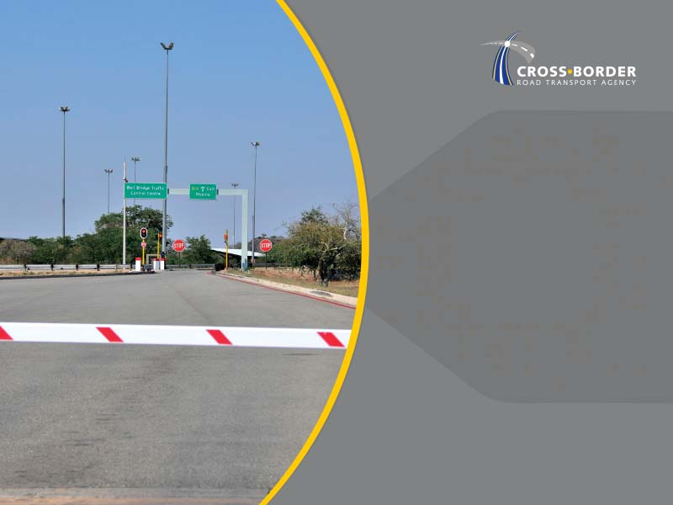
Social Responsibility Initiatives
Notes:
Note:
Problem statement – resulting in vs resulting from inadequate

Slide 35
SOCIAL RESPONSIBILITY
The Agency did not pursue most of its social responsibility projects due to Covid-19 restrictions and its impact on operations.
The Agency undertook the following social responsibility initiatives during the year under review:
  Four empowerment/information sharing sessions were held in partnership with Tsogo Youth Programme for the youth of Limpopo, North West, KwaZulu-Natal and Gauteng.
  Facilitated TETA Women in Transport Mentorship sessions in partnership with AWISCA/Sincpoint.
  Held planning engagements with some border towns on the Schools’ Corporate Social Investment Project to be undertaken in the next financial year.
35

Slide 36
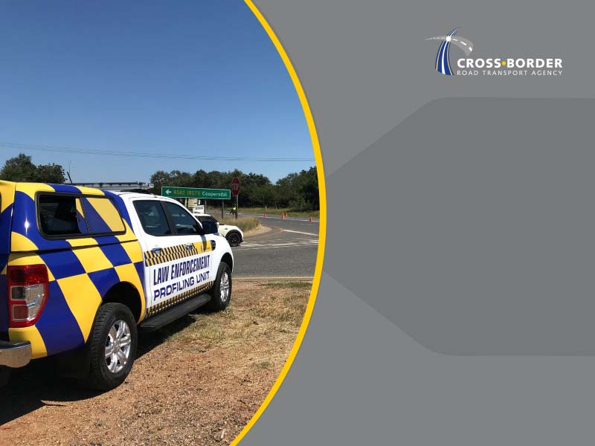
  Annual Financial Statements
  March 2021
Notes:
Notes:
Facilitating of unimpeded flow vs facilitation

Slide 37
STATEMENT OF FINANCIAL POSITION
37

Slide 38
STATEMENT OF FINANCIAL POSITION
Total Assets:
  36.43 overall increase in Total assets in 2020/2021.
  44.84% increase in Cash and Cash Equivalents due to surplus made.
  13.6% increase in Non-current Assets mainly due to development of iCBMS system as well as purchase of IT equipment.
  Liquidity of 6:1 in current year (4:1 in 2019/2020).
Total Liabilities:
  3.73% overall decrease in Total Liabilities in 2020/21.
  28.63% decrease in Exchange Payables due to less expenditure and cost containment measures implemented during the COVID-19 lockdown beginning on 23 March 2020.
  100% increase in Operating Lease Liability in 2021 due to accrued lease payment arising from new lease of buildings.
38

Slide 39
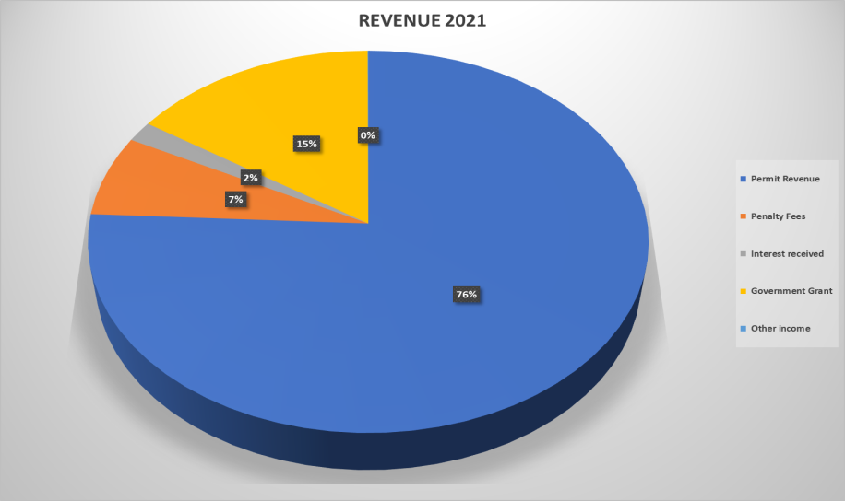
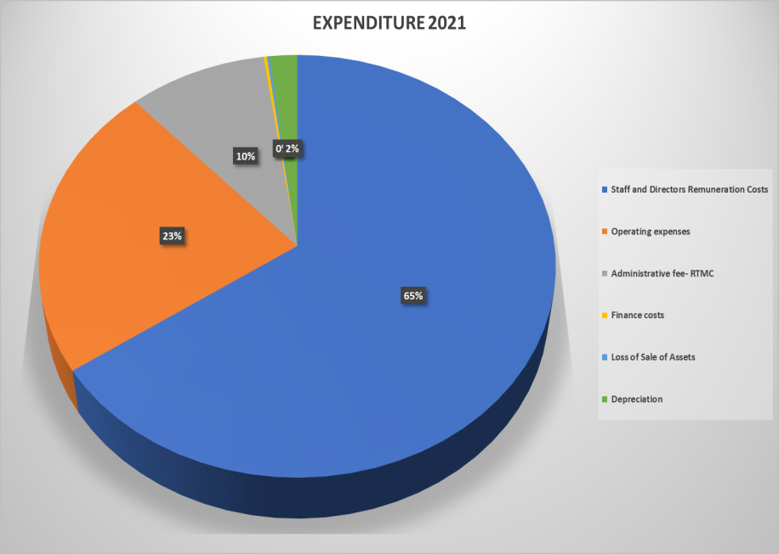
STATEMENT OF FINANCIAL PERFORMANCE -2020/21
39

Slide 40
STATEMENT OF FINANCIAL PERFORMANCE-2020/21
Revenue:
  5.46% overall decrease in Revenue outcomes due to the impact of COVID 19 on cross-border operations.
  10% decrease in permit revenue due to COVID-19.
  65.16% decrease in Penalty income due to reduced RTMC operations as a result of COVID 19 on cross-border operations, ameliorated by a once-off Government Grant of R 38.5 million.
Expenditure:
  15.23% overall decrease in Expenditure.
  19.04% decrease in in operating expenses due to cost cutting measures implemented by management in 2020/2021, mainly relating to travel and accommodation as well as consulting services.
  57.01% decrease in Administration Fees to RTMC due to reduced RTMC operations as a result of COVID 19 on cross-border operations.
  40

Slide 41
Programme 5: MTEF Targets
No. | Outcome | Outputs | Output Indicators | Estimated Performance 2021/22 | Annual Target
 |  |  |  |  | 2022/23 | 2023/24 | 2024/25
5.6 | Improved governance and strengthened control environment | Adequacy of responses to Parliamentary questions | Percentage responses to Parliamentary questions within stipulated timelines | 100% responses to Parliamentary questions | 100% responses to Parliamentary questions | 100% responses to Parliamentary questions | 100% responses to Parliamentary questions
5.7 |  | Resolution of reported incidents of corruption | Percentage resolution of reported incidents of corruption | 95% resolution of reported incidents of corruption | 95% resolution of reported incidents of corruption | 95% resolution of reported incidents of corruption | 95% resolution of reported incidents of corruption
5.8 |  | Ethics Committee report | Ethics committees established and operationalised | Ethics Committees operationalised | Ethics Committees operationalised | Ethics Committees operationalised | Ethics Committees operationalised
AUDIT OUTCOMES

Slide 42
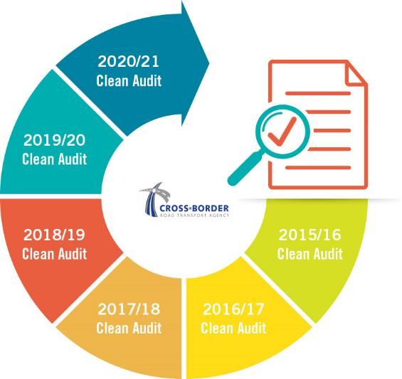
AUDIT OUTCOMES
The Agency has achieved a Clean Audit for the past six financial years
42

Slide 43
AUDIT OUTCOMES 2020/21
Conclusion on Annual Financial Statements | AFS present fairly, in all material respects, the financial position of the Agency, its financial performance and cash flows for the year ended March 2021. Restatement of the corresponding figures for March 2020 – to recognize annual compliance fee for five-year permit holders in accordance with GRAP 3 (Accounting policies, Changes in Accounting Estimates and Errors).
Conclusion on pre-determined objectives | There were no material findings on the usefulness and reliability of reported performance information selected for audit purposes.
Conclusion on Compliance with legislation | No material findings on non-compliance with applicable key legislation.
43

Slide 44
Conclusion
Notes:
Note:
Problem statement – resulting in vs resulting from inadequate

Slide 45
CONCLUSION
Despite operating under the COVID-19 environment, the C-BRTA registered notable achievements towards the attainment of the Agency’s legislative mandate and set objectives, maintaining a clean administration for the sixth consecutive year.
The C-BRTA will continue to pursue its strategic goals to meaningfully contribute to the socio-economic development of South Africa, the SADC region and the African continent through cross-border transport trade facilitation to enhance regional integration.
45

Slide 46
