Slide 1
SA POST OFFICE
Performance for Quarter 2
As at 30 September 2021

Slide 2
Contents
Overview
Financial Performance
KPI Performance Summary
KPI Performance Overview
KPI Detail Performance

Slide 3
Overview – Q2 2021/22
Q2 has remained extremely challenging with economic recovery remaining sluggish, negatively impacting SA Post Office revenue and business recovery.
Expenditure continues to outstrip revenue by R726m (47%)
Revenues of R813m for Q2 - R409m (33%) below budget, contributing to cash deficits
Expenditure target of R1 732m for Q2 achieved at R1 539m, below budget by R193m (11%)
Staff costs remain the key cost driver at R934m (61%) during Q2
Q2 net loss position of R591m against projected net loss of R366m, negative variance of R226m (62%)
15 KPIs measured only 3 KPIs achieving target, overall performance of 20%. Deterioration of 27% on performance from Q1.
Emergency declared following Data Centre power outages on 9 August 2021, critical hardware and systems were damaged, data restore and recoveries were initiated.
TPMS Third Party system seriously affected and only available in September 2021, significantly affecting Financial Services revenue

Slide 4
Overview – Q2 2021/22
Q2 crime related incidents increased YOY by 569 incidents (31%) to 1 818 incidents
Q2 crime related reported losses increased YOY by R12.4m (20%) to R62m.
Total of 15 443 employees (SAPO and Docex) reported at end Q2, reduction of 215 employees from Q1.
SASSA beneficiaries decreased by 60 728 beneficiaries in September 2021 to 7 527 678.
SASSA withdrawal transaction volumes for September 2021 was approximately 16.9 million transactions, only 2.2% at SAPO branches and 2.3% at CPPs.
Total of 155 789 beneficiaries paid through 1 595 CPPs at end of September 2021. Operations at CPPs restored following the social unrest experienced.
716 831 beneficiaries were paid SRD grants during September, an increase from August 2021 at 371 518 beneficiaries. Levels are substantially lower than the 2 million beneficiaries per month paid earlier during the FY.
Due to the power outages at Data Centre, the STB database was effected. No STB kits could be issued due to the system unavailability, affecting ASO targets. A manual process was implemented to ensure continuity on the DTT project.

Slide 5
Overview – Q2 2021/22
STB Database was restored by the end of September 2021, STB Dashboard and DTT invoices could not be provided from July 2021.
Continued leadership stability with GCEO, Ms Nomkhita Mona.
Initiatives continued during Q2 - reduction in the mail backlogs and carryovers, moratorium on procurement, only urgent items approved and review of stock at SCM in Silverton.
Part of emphasis to proactively and continuously communicate internally to employees and externally to stakeholders - communication committee established to ensure that the SA Post Office is top of mind, winning hearts and minds.
“Obsession with the Customer” and “Back to Basics” drive to ensure that the SA Post Office moves towards a responsive modern customer centric service organisation.
During September / October, a revised turnaround strategy towards building the Post Office of Tomorrow submitted to the DCDT.
A key component to the Post Office of Tomorrow – re-establishment of the Trust Centre, costed proposal has been received from SITA.

Slide 6
Financial Performance – Q2 2021/22
Revenue recovery slow and insufficient to meet all operating costs
Revenue shortfall contributes to monthly cash deficits to meet all liabilities
Net loss position of R591m for Q2, exceeding projected position by R226m

Slide 7
Revenue Performance – Q1/Q2 2021/22
Revenue for Q2 at R813.4m, marginally lower than Q1 revenue at R813.7m
Revenue performance at 33.5% below budget by R409m

Slide 8
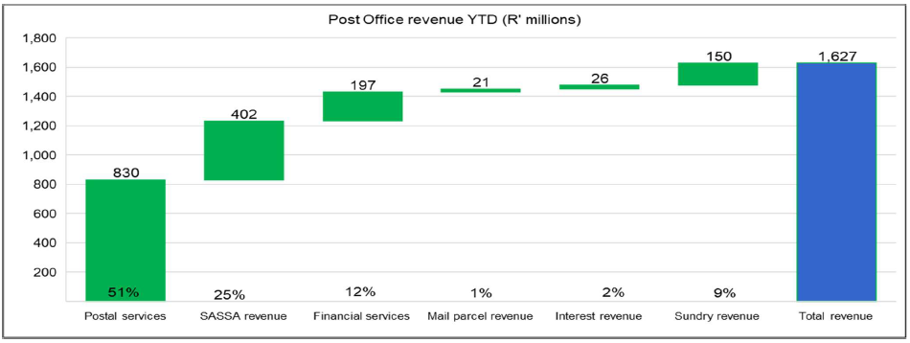
Revenue Performance – Q2 2021/22 YTD
Postal services remains the key revenue contributor

Slide 9
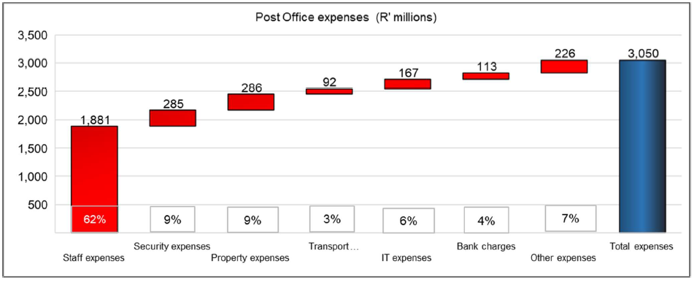
Expense Performance – Q2 2021/22 YTD
The key cost driver remains staff costs

Slide 10
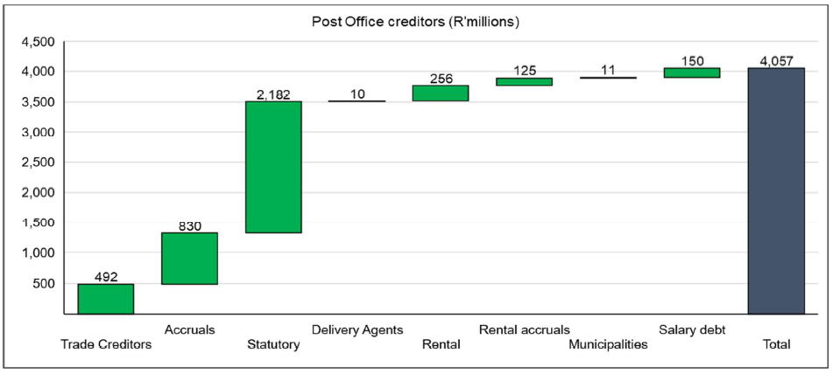
Creditors – Q2 2021/22 YTD
Excludes R2.2 billion owed to Postbank
The increasing liabilities and backlog in supplier payments threatens business continuity

Slide 11
Q2- Performance on Targets
3 KPIs
Corrective actions being implemented to improve Q3 Performance
12 KPIs
Decline in overall performance on KPIs to 20%, from 47% for Q1
Financial performance and recovery remains weak
Greater oversight to improve performance

Slide 12
KPI Performance Overview – Q2 2021/22
No. | Corporate Key Performance Indicator (KPI) | Annual Target | Q2 Target | Q2 Performance
 |  |  |  | Actual | Variance | % Achieved
1.1 | Attain the planned revenue target | 100% | 100% | 66.5% | (33.5%) | 67%
1.2 | Attain the planned expense budget | 100% | 100% | 88.9% | 11.1% | 89%
2.1 | Implement security upgrades and install equipment items at Post Office branches and Mail Centres | 1680 | 570 | 0 | -570 | 0%
2.2 | Optimisation of the Property Infrastructure (R’000) | 265,000 | 21,000 | 4,483 | (16,517) | 75%
3.1 | Resolution of customer complaints recorded at the call centre within 7 days | 100% | 100% | 74.0% | (26.0%) | 74%
3.2 | Improve customer satisfaction | 75% | Upgrade Customer Call Centre | Customer Call Centre Not Upgraded | (100.0%) | 0%
4.1 | Achieve the regulated Mail Delivery standard | 92% | 92% | 73.2% | (18.8%) | 80%
4.2 | Maintain system uptime at online Post Office branches | 98% | 98% | 93.9% | (4.1%) | 96%
4.3 | Rollout IPS equipment | 100% | No target | N/a | N/a | N/a
5.1 | Automation of Mail Centres | 100% | 50% | 48.2% | (1.8%) | 96%
5.2 | Launch digital solutions for products and services | 2 | No target | N/a | N/a | N/a
5.3 | Implement Omni-channel platform | 100% | 50% | 35.0% | (15.0%) | 88%
6.1 | Improve Employee satisfaction | 70% | Implement corrective actions for 25% of survey findings | 0% | Implement corrective actions for 25% of survey findings | 0%
6.2 | Improve productivity levels | 80% | Implement the productivity measurement model | Existing productivity model for Mail Centres & Depots being reviewed | Implement the productivity measurement model | 0%
6.3 | Implement BU strategic Initiatives | 100% | 50% | 66.0% | 16.0% | 132%
7.1 | Improve the Audit Opinion | Unqualified audit opinion | 50% of the material audit findings resolved | 0.0% | (50.0%) | 0%
7.2 | Provide inputs to the amendments of Postal Legislation (SAPO Act, Postal Services Act, Postbank Act, 4IR) | Inputs Submitted to Shareholder | Inputs Submitted to Shareholder | Inputs Submitted to Shareholder | 0.0% | 100%
TOTAL |  | 17 | 15 | 3 | 12 | 20%
Legend Performance - Achieved / Not Achieved
Not Achieved | Less than 100% | Achieved | Achieved 100%

Slide 13
KPI Performance – Q2 2021/22
Objective | Goal | KPI Ref | Key Performance Indicator | Q2 Performance
 |  |  |  | Target | Actual | Variance | Achieved/ | Actual Performance and Reason for Target Variance/Deviation | Mitigation and Recovery Plans
 |  |  |  |  |  |  | Not Achieved
1. Financial Sustainability | To be financially sustainable and | 1.1 | Attain the planned revenue target | 100% | 67% | -33% | Not Achieved | The revenue target for Q2 has not been has attained at R814 million (70%). The lower than projected revenue performance is due to the lingering effects of the Covid-19 lockdown and the associated business impact, increased customer migration to digital alternatives and transaction volumes, together with the weak financial position of the SA Post Office and suppliers not having been paid, thus withdrawing services, further impacting revenue generation. • Covid-19 lockdown and associated business slowdown • Customer migration and transaction volumes • Digital substitution • Lack of technology Investment • System and hardware instability • Tools of trade • Operational performance • Product offering • Stock levels • Closure of branches | • Account managers are focusing on maintaining existing clients whilst seeking new revenue streams. • Maintain and grow existing business, recover lost business where possible. • Focus on opening municipality accounts for the AARTO rollout • Improve stock levels to cater for demand • Delivery of mail is adhered to as per delivery standards • Activation of dormant Speed Services and CFG database is in progress through Sales support • Engagement of small courier companies for co-loading specifically focusing on B2B service • Calling all government Franking Machine and Messenger Services to upload their machine and to renew their contract • Working with Private Bag and Boxed for Government as to increase our revenue • DOT / AARTO - Increase in Hybrid Mail (Engagements underway to use eRegistered mail) • Warehousing and distribution of medication • eCommerce - parcel distribution and online transactions • Expand MVL offering and transactions • Fast-track DTT STB Subsidised Market • DTT STB Retailing – unsubsidised marketRegistration and Distribution for the DCDT • Digital Post-box/email • Electronic Mail and SMS
 |  | 1.2 | Attain the planned expense budget | 100% | 89% | 11% | Achieved | The expense budget for Q2 is R1 732 million and has been attained at R1 539 million (89%). Staff cost below budget by R175 million. Transport cost of R92 million includes costs of R46 million for vehicle leases and R24 million for fuel. IT costs below budget by R57 million. Security expenses of R285 million includes R168 million for SASSA CIT and R35 million for SASSA guarding. Bank charges of R113 million exceeds budget with R51 million. | Continued focus on prudent cost management together with cost saving initiatives: • Procurement contracts • Infrastructure as a Service • Last mile The freeze on procurement will be maintained, focusing on critical items only.

Slide 14
KPI Performance – Q2 2021/22
Objective | Goal | KPI Ref | Key Performance Indicator | Q2 Performance
 |  |  |  | Target | Actual | Variance | Achieved/ | Actual Performance and Reason for Target Variance/Deviation | Mitigation and Recovery Plans
 |  |  |  |  |  |  | Not Achieved
2. Optimised Assets and Infrastructure | Achieve a positive return on assets | 2.1 | Implement security upgrades and install equipment items at Post Office branches and Mail Centres | 570 | 0 | -570 | Not Achieved | The target of installing 570 security devices/equipment for Q2 was not met with 0 installations having taken place during Q2. The status of the security infrastructure upgrade program as reprioritised, remains challenged due to financial constraints being experienced. With the inability of being able to conclude the contracted installations, SA Post Office will not be able to reduce the intended Guarding and CIT costs, which once implemented, will apart from improving security at Branches, and bring about reduced costs for such services. | To prioritise those security measures that will apart of enhancing effective security at branches, bring about reduced costs pertaining to CIT and Guarding Services. Per directive of the GCEO due to current financial constraints, all further installations are to be suspended for 3 months – July to September 2021 (deployment to be reviewed mid-September 2021 depending on the availability of funding). Review / removal of annual target during mid-year budget adjustment period.
 |  | 2.2 | Optimisation of Property Infrastructure | R21m | R4.48m | -R16.5m | Not Achieved | During Q2, a saving of R4.48 million for rental expenses was generated due to the amalgamation / consolidation and closure of branches, however no initiatives were committed in terms of the revenue optimisation program and no sale of properties took place. Procurement process has delayed the rental income initiative | Bid Evaluation completed and recommendation to BAC. Assess all Company owned buildings that have potential for generating income

Slide 15
KPI Performance – Q2 2021/22
Objective | Goal | KPI Ref | Key Performance Indicator | Q2 Performance
 |  |  |  | Target | Actual | Variance | Achieved/ | Actual Performance and Reason for Target Variance/Deviation | Mitigation and Recovery Plans
 |  |  |  |  |  |  | Not Achieved
3. Customer and Communities First | Continued service provision in underserviced communities, improve customer experience at all point of presence & enhanced brand equity | 3.1 | Resolution of customer complaints recorded at the call centre within 7 days | 100% | 74% | -26% | Not Achieved | The target of 100% resolution of customer complaints within the required 7 days has not been attained, at 74% for Q2, a negative variance of 26% on target., due to: • Remedy server going down • Manual tracking of complaints • Lack of resources • Delayed implementation of the call centre management system • Lack of funding for the new call centre system • Poor delivery standards • Tracking errors since introduction of new system - in transit, incoming, not on system • Delayed feedback from BUs • Feedback accountability in BUs • Delays in approval of compensation to customer’s results in customers referring their complaints to ICASA • Branch related problems – attitude, general performance caused by parcel location, slowness of connection of parcels from province to province especially with internationally parcels. | Upgrade of the Customer Call Centre and Remedy system • Inclusion and involvement of the RGMs is gradually helping Customer Services with speedy feedback from the Regions • Administering of Regional Customer Services by Regional Management is assisting National Customer Services
 |  | 3.2 | Improve customer satisfaction level | Upgrade Customer Call Centre | 0% | Upgrade Customer Call Centre | Not Achieved | The Q2 target for the Customer Call Centre to be upgraded has not been achieved due to unavailability of funding for the upgrade | Upgrade of the Customer Call Centre is to be prioritised for funding.

Slide 16
KPI Performance – Q2 2021/22
Objective | Goal | KPI Ref | Key Performance Indicator | Q2 Performance
 |  |  |  | Target | Actual | Variance | Achieved/ | Actual Performance and Reason for Target Variance/Deviation | Mitigation and Recovery Plans
 |  |  |  |  |  |  | Not Achieved
4. Efficient Systems & Processes | Improved service delivery to all customers | 4.1 | Achieve the regulated Mail Delivery standard | 92% | 73% | -19% | Not Achieved | The performance for Q2 is at 73.16%, 18.84% below target, a small improvement from Q1 at 66% to Q2 at 73%, an increase of 7% quarter on quarter. Logistics now operating according to a new temporary schedule which is showing some improvement but still not achieving the standard as all routes do not run daily. Daily carry-overs in the Logistic arena cause a see-saw effect at Hubs when the mail arrives. Shortage of vehicles at certain times of the month is still problematic e.g. during SASSA payments. Some of the machines are not operational and parts are hard to come by, this effects the processing speed and productivity at DURMAIL, CAPEMAIL, WITSPOS and TSHWANEMAIL is especially affected by this. Awaiting parts inter alia belts, mother boards and ink. Volumes lodged especially dated mail is still very low -small sample sizes recorded when testing. Closure of Hubs, Depots Lobbies, Box Sections and Branches when positive cases of COVID-19 are detected for decontamination results in loss of time within the value chain. Some bicycle parts were delivered to SCM and regions have drawn stock but all the required spares are still not available. Certain Delivery Agents contracts were not renewed and we re-aligning these areas with Postmen and alternative delivery options. Shortage of staff at some work areas especially Postmen. Inclement weather affecting delivery. Additional vehicles have been withdrawn especially in Central Region. Maintenance on motor-bikes taken long due to payment issues to suppliers. | Increase sampling where possible when volumes increase. • Awaiting larger volumes to be lodged to ensure cost effective movement of mail. • Continues review of the time of collections and drop-offs at branches to see if the routes can be covered with less vehicles. • New route schedules for NLH have being agreed to and implemented which we now monitoring. • Sweep teams were introduced in the Delivery area to assist with reducing carry-overs. However this will be limited in October as additional vehicles are been extracted from the fleet. • Regional targets have been set for clearing of carry overs. • Continuously requesting Finance to pay suppliers that impact on the delivery standards, including delivery agents where we still have them. • Submitted critical positions to be filled for approval. • Management and support staff still assisting whenever possible to clear carry-overs.
 |  | 4.2 | Maintain system availability uptime at online Post Office branches | 98.00% | 93.92% | -4.08% | Not Achieved | The system availability uptime target of 98% for Q2 has not been achieved at 93.92%, a variance of 4.08% on target. • Data Centre power outages were experienced on 9 August 2021. • Suspension of Internet and VPN in July due to commercial challenges had a negative impact on the availability of Websites, Internet and Exchange. • Data centre power outages experienced in August 2021 had a negative impact on the availability of some of the systems. | Upgrade of Data Centre. Technology is in the process of reviewing the Top 10 applications based on new applications deployed and changes in business model (e.g. Postbank split) and where required, additional systems will be added for tracking purposes. A total of 1 270 of 1 329 sites have been fully commissioned with new equipment and upgraded connectivity, a 97% achievement of the network upgrade project. 59 sites remain to be completed of which with 26 are workable sites but require alternative solutions and 33 non-workable due to outstanding Landlord Approvals and viable infrastructure availability at remote sites.
 |  | 4.3 | Rollout of IPS equipment | No target

Slide 17
KPI Performance – Q2 2021/22
Objective | Goal | KPI Ref | Key Performance Indicator | Q2 Performance
 |  |  |  | Target | Actual | Variance | Achieved/ | Actual Performance and Reason for Target Variance/Deviation | Mitigation and Recovery Plans
 |  |  |  |  |  |  | Not Achieved
5. Business Modernisation and Digital Transformation Digital Transformation | Improved market relevance through business modernisation, digital transformation and increased customer access to digital services | 5.1 | Automation of mail Centres | 50% | 48.20% | -1.80% | Not Achieved | The target for Q2 has been not been achieved, with 23.6 million items machine sorted of the total of 46.5 million standard mail items. • Volumes for Durmail was updated and included for July 2021. This impacted the July figure as well as the YTD figure. | Management intervention is to be prioritised in order to optimise machine usage and increased machine throughput. • Purchasing of spare parts in progress – specification document completed. • Tracking of this KPI will ensure renewed focus to minimise manual sorting. • As part of broader Automation of Mail Centre program, research on Open Source IoT technology was initiated through Unisa as part of the broader design of internet of things.
 |  | 5.2 | Launch digital solutions for products and services | No target
 |  | 5.3 | Implement Omni Channel Platform | 50% | 35% | -15% | Not Achieved | The Q2 target at 50% has not been achieved with performance of 35% for Q2. Project status: Enterprise Application Integration and Modernisation. • A RFI has been published to gather industry and related input to enable SA Post Office to prepare a RFP. Await outcome of the RFI report. • SAPO in collaboration with Postbank implemented a new payment channel for SRD-350 which enables grant recipient to transact at various merchants (Pick & Pay, Checkers, and Boxer etc.). • SAPO went out on an RFP for eRegistered mail solution to enable a customer to submit electronic data or mail to the South African Post Office. • SAPO in collaboration with SITA, is in the process of implementing an electronic eRegistered mail service for the Infringement Notice to RTIA/RTMC Clients. • Sub-projects supporting the Omni-channel strategy. o E-Commerce Market Place – SA Post Office has identified the nop-Commerce solution for implementation. o Integration Platform and API Management - Upgrade of the Integration Platform and Migration of the Platform are in the planning stages. o Onboarding e-Commerce clients for Logistics -The following customers have been successfully integrated on IPS: Wish.Com, Mail Americas, Signature Mail, ICE, CNE. | • Enterprise Application Integration and Modernisation - Review the submitted RFI responses & submit report. • Sub-projects: o E-Commerce Market Place - Commence configuration of e-Commerce Market Place. o Integration Platform and API Management - Upgrade to the supported version of the Integration platform. Awaiting response from SITA with regard to Integration Platform as a Service. The estimated implementation date is anticipated in Q4 of 2021/22FY. This is dependent on procurement approval and availability of funding.

Slide 18
KPI Performance – Q2 2021/22
Objective | Goal | KPI Ref | Key Performance Indicator | Q2 Performance
 |  |  |  | Target | Actual | Variance | Achieved/ | Actual Performance and Reason for Target Variance/Deviation | Mitigation and Recovery Plans
 |  |  |  |  |  |  | Not Achieved
6. Culture of Excellence | Improved Organisational Performance, engaged and high performing employees | 6.1 | Employee satisfaction assessment | Implement corrective actions for 25% of survey findings | 0% | Implement corrective actions for 25% of survey findings | Not Achieved | The Q2 target for 25% of the findings of the previous Employee Satisfaction Survey (ESS) conducted during 2020/21FY to be implemented, has not been achieved. | From discussions had with Human Resources, they have requested that the KPI be removed as many of the findings of the ESS are not within their span of control. Review / removal of annual target during mid-year budget adjustment period.
 |  | 6.2 | Improve productivity levels | Implement the productivity measurement model | Existing productivity model for Mail Centres & Depots being reviewed | Implement the productivity measurement model | Not Achieved | The Q2 target was not achieved. Currently Operations uses a productivity model for Mail Centres and Depots. This is currently being reviewed with applicable productivity measures and standards and will be further enhanced to include a productivity management suite. | Review / removal of annual target during mid-year budget adjustment period.
 |  | 6.3 | Implement BU strategic initiatives | 50% | 66% | 16% | Achieved | The implementation of BU strategic initiatives is progressing well and the Q2 target has been attained. To date, 87 initiatives of a total of 131 initiatives (66%) are at various stages of implementation. | Group Strategy will actively drive and monitor the process of BU strategic initiative implementation.

Slide 19
KPI Performance – Q2 2021/22
Objective | Goal | KPI Ref | Key Performance Indicator | Q2 Performance
 |  |  |  | Target | Actual | Variance | Achieved/ | Actual Performance and Reason for Target Variance/Deviation | Mitigation and Recovery Plans
 |  |  |  |  |  |  | Not Achieved
7. Corporate Governance | Strengthened Organisational Governance, entrenched and consistently appliedGovernance principles in managing the organisation | 7.1 | Achieve an unqualified Audit Opinion | 50% of the material audit findings resolved | 0% | 50% of the material audit findings resolved | Not Achieved | The target for the resolution of material audit findings is 50% by end of Q2 and was not achieved as the audit process is currently still in process. The detailed Audit report from the AG is only expected during November 2021. The tracking process will only commence thereafter. | Once the detailed Audit report from the AG is received, resolution of material findings will need to be expedited to ensure the Annual target of 100% resolution of material audit findings is achieved. Work is still continuing with the aim of addressing the matters and improving the audit outcome for the 2021 financial year.
 |  | 7.2 | Provide inputs to the amendments of Postal Legislation (SAPO Act, Postal Services Act, Postbank Act, 4IR) | Inputs Submitted to Shareholder | Inputs Submitted to Shareholder | 0% | Achieved | The Q2 target has been achieved.

Slide 20
THANK YOU

