Slide 1
SA POST OFFICE
Performance for Quarter 1
As at 30 June 2021

Slide 2
Contents
Overview
Financial Performance
KPI Performance Summary
KPI Performance Overview
KPI Detail Performance

Slide 3
Overview – Q1 2021/22
The first quarter of this new financial year remains very challenging with the onset of the third wave of the Covid pandemic.
The economic recovery is sluggish with negative impacts on the SAPO revenue and business recovery.
This contributed to the escalated financial challenges faced by SAPO since monthly expenditure continue to outpace revenues.
The upward trend for SAPO is illustrate by the increase of 286 confirmed cases in June 2021. Covid-19 - Total confirmed cases is at 1 674 with recovery rate at 94.2%, fatalities at 48.
The crime related incidents as at the end of Q1 – 2021/2022 has peaked at 824 from the 411 reported in the prior year, a massive increase of 100%. The main contributor being violent crime (Armed robbery and business burglary) with 240 incidents in total.
A reduction of 114 employees between April and June 2021 bring the headcount to 15 658 employees at 30 June 2021.
The average carry-over per month has decreased from 2.97 million items as at end May to 2.12 million items as at end June.
JIMC reduced backlog of 2.1 million items in April to zero.
Service delivery standard improved to 66% during Q1.

Slide 4
Overview – Q1 2021/22
SASSA grant payments to 7.7 million beneficiaries during June 2021, 178 961 beneficiaries paid at 1600 Cash Pay Points.
Payment to 723 823 beneficiaries in June 2021 for Covid19 SRD payments of R350.
Total of 1 184 030 561 qualifying needy households registered nationally for BDM and a total of 628 572 STBs issued up to 30 June 2021
Organisational Performance has improved with 7 KPIs achieving target from the 15 measured, performance at 47%.
Greater oversight through the Business performance Committee to improve performance
Initiatives have been prioritised to stimulate revenue growth and reduce costs further – currently in implementation.
A greater focus by management to address the current financial challenges of SAPO.

Slide 5
Financial Performance - Q1 2021/22
Revenue of R814 million for the year to date is below the budget by R357 million (30%) with a year on year increase of R333 million compared to the previous year.
Expenditure of R1 511 million is below budget by R196 million (11%) with a year on year decline of R1 million.
Outstanding Statutory payments amount to R1 809 million.
A further R1 847 million is owed to creditors, rentals and accruals necessary in day to day operations and have impacted operations with numerous branches closed by landlords until payment is made.
In addition to the liabilities an amount of R2, 2 billion is owed to Postbank.
During the first quarter a net loss of R563 million was posted, which exceeded the target by R171 million but performed better than the lockdown period last year by R361 million.
The increasing net loss position has contributed to an accumulation of payment backlogs and overall liabilities.
The payment of the monthly employee’s salaries remains a challenge and continues to be managed on a month to month basis.

Slide 6
Financial Performance – Q1 2021/22
Revenue recovery slow and insufficient to meet all operating costs
Revenue shortfall contributes to monthly cash deficits to meet all liabilities
Net loss position of R563m for Q1, exceeding projected position by R171m

Slide 7
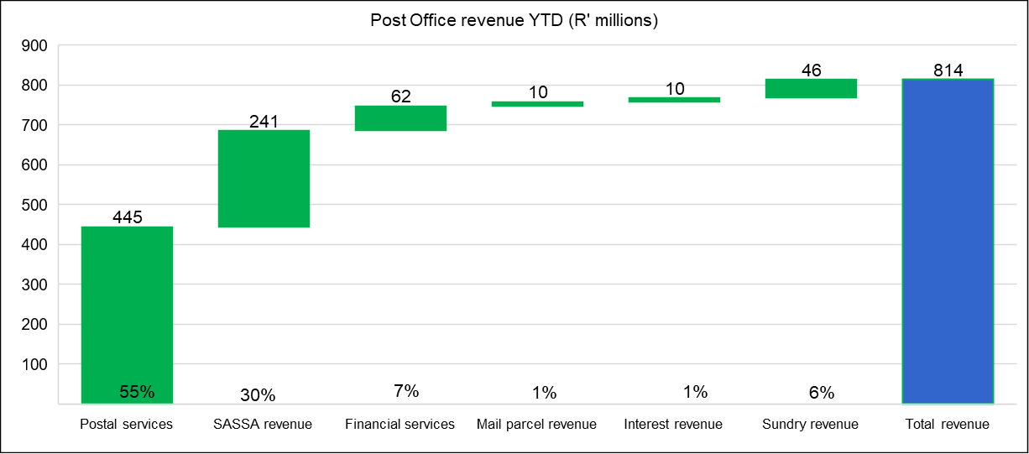
Revenue Performance – Q1 2021/22
Postal services remains the key revenue contributor

Slide 8
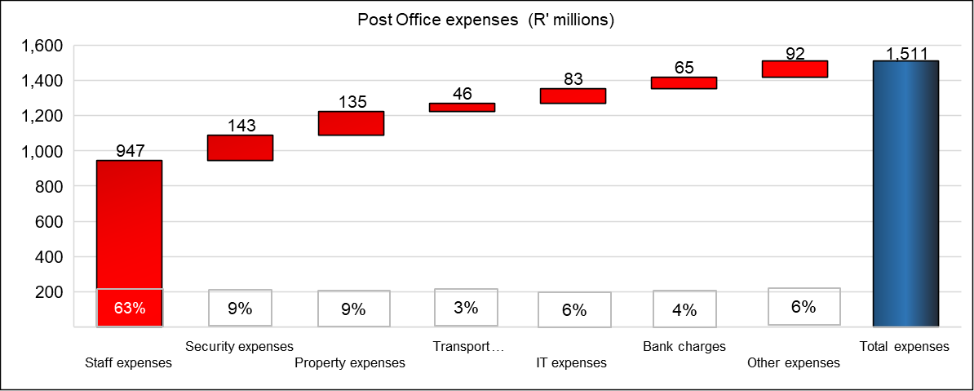
Expense Performance – Q1 2021/22
The key cost driver remains staff costs

Slide 9
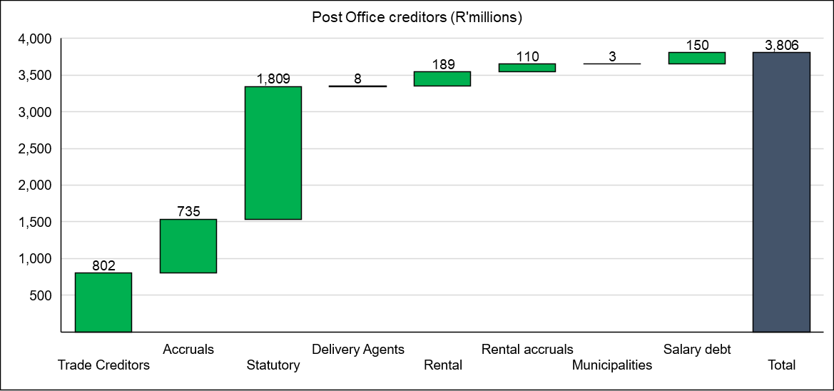
Creditors – Q1 2021/22
Excludes R2.2 billion owed to Postbank
The increasing liabilities and backlog in supplier payments threatens business continuity

Slide 10
Q1- Performance on Targets
7 KPIs
Corrective actions being implemented to improve Q2 Performance
8 KPIs
Overall performance on KPIs at 47% for Q1
Financial performance and recovery remains weak
Greater oversight to improve performance

Slide 11
KPI Performance Summary – Q1 2021/22

Slide 12
KPI Performance – Q1 2021/22
Objective | Goal | KPI Ref | Key Performance Indicator | Q1 Performance
 |  |  |  | Target | Actual | Variance | Achieved/ Not Achieved | Actual Performance and Reason for Target Variance/Deviation | Mitigation and Recovery Plans
1. Financial Sustainability | To be financially sustainable and achieve a positive net financial and cash position | 1.1 | Attain the planned revenue target | 100% | 70% | -30% | Not Achieved | The revenue target for Q1 has not been has attained at R814 million (70%). The lower than projected revenue performance is due to the lingering effects of the Covid-19 lockdown and the associated business impact, increased customer migration to digital alternatives and transaction volumes, together with the weak financial position of the SA Post Office and suppliers not having been paid, thus withdrawing services, further impacting revenue generation. Covid-19 lockdown and associated business slowdown Customer migration and transaction volumes Digital substitution Lack of technology Investment Tools of trade Operational performance Product offering | The immediate focus is the quick wins to assist claw back revenues to address critical cash flow challenges. Initiatives to address the revenue deviation include: The reduction in the mail backlogs and carryovers – service delivery improvement Key customer engagements Improved communication with customers and social media MVL Revenue – R1 Billion campaign Review of all Sales Contracts Sub 1kg parcels eCommerce – Wish.com / Mail America / Signature Mail / CN22 parcels / CNE cross border eCommerce platform (China) Digital Postbox/email Electronic Mail and SMS Sale of non-core properties identified Property infrastructure optimisation SITA collaboration Spaza shops and township economy
 |  | 1.2 | Attain the planned expense budget | 100% | 89% | 11% | Achieved | The expense budget for Q1 is R1 707 million and has been achieved at R 1 511 million (89%) of target. Staff cost below budget by R81 million (8%) Transport cost below budget by R35 million (43%) Property cost is below budget by R47 million (26%) IT costs below budget by R29 million (26%) Security services below budget by R47 million (43%) | Continued focus on prudent cost management together with cost saving initiatives: Procurement contracts Infrastructure as a Service Last mile The freeze on procurement will be maintained, focusing on critical items only.

Slide 13
KPI Performance – Q1 2021/22
Objective | Goal | KPI Ref | Key Performance Indicator | Q1 Performance
 |  |  |  | Target | Actual | Variance | Achieved/ Not Achieved | Actual Performance and Reason for Target Variance/Deviation | Mitigation and Recovery Plans
2. Optimised Assets and Infrastructure | Achieve a positive return on assets | 2.1 | Implement security upgrades and install equipment items at Post Office branches and Mail Centres | 870 | 40 | -830 | Not Achieved | The target of installing 870 security devices/equipment for Q1 was not met with 40 installations having taken place. The status of the security infrastructure upgrade program as reprioritised, remains challenged due to financial constraints being experienced. With the inability of being able to conclude the contracted installations, SA Post Office will not be able to reduce the intended Guarding and CIT costs, which once implemented, will apart from improving security at branches, and bring about reduced costs for such services. | To prioritise those security measures that will apart of enhancing effective security at branches, bring about reduced costs pertaining to CIT and Guarding Services Per directive of the GCEO due to current financial constraints, all further installations are to be suspended for 3 months – July to September 2021 (deployment to be reviewed mid-September 2021) Review of annual target during mid-year budget adjustment period.
 |  | 2.2 | Optimisation of Property Infrastructure | R5m | R8.75m | R3.75m | Achieved | The Q1 target of R5 million optimisation benefit was achieved at R8.7 million. During Q1, a saving of R8.7 million for rental expenses was generated due to the amalgamation /consolidation and closure of branches. | The process for the sale of properties to be fast-tracked. BSC meeting to be held on 4 June 2021 for the rental initiatives RFP was issued. Site briefing was held on 14 June 2021 with bidders. The bid process to be finalised. Other initiatives to assess all Company owned buildings that have potential for generating income.

Slide 14
KPI Performance – Q1 2021/22
Objective | Goal | KPI Ref | Key Performance Indicator | Q1 Performance
 |  |  |  | Target | Actual | Variance | Achieved/ Not Achieved | Actual Performance and Reason for Target Variance/Deviation | Mitigation and Recovery Plans
3. Customer and Communities First | Continued service provision in underserviced communities, improve customer experience at all point of presence & enhanced brand equity | 3.1 | Resolution of customer complaints recorded at the call centre within 7 days | 100% | 53% | -47% | Not Achieved | The target of 100% resolution of customer complaints within the required 7 days has not been attained, at 53% for Q1, a negative variance of 47% on target due to: Remedy server going down Manual tracking of complaints Lack of resources Delayed implementation of the call centre management system Lack of funding for the new call centre system Poor delivery standards Non-scanning of items Tracking errors since introduction of new system - in transit, incoming, not on system Delayed feedback from BUs Feedback accountability in BUs Delays in approval of compensation to customer’s results in customers referring their complaints to ICASA Branch related problems – attitude, general performance caused by parcel location, slowness of connection of parcels from province to province especially with internationally parcels. | Alternate arrangements are required to implement the call centre management system urgently – BCX to provide a technician to assist bring the system online. ACIO has requested a proposal and quote from SITA to perhaps run Remedy as a service. SITA is currently looking into this to submit a proposal for replacement of Remedy (SaaS) Inclusion and involvement of the RGMs is gradually helping Customer Services with speedy feedback from the Regions Administering of Regional Customer Services by Regional Management is assisting National Customer Services
 |  | 3.2 | Improve customer satisfaction level | Implement corrective actions for 25% of survey findings | - | Implement corrective actions for 25% of survey findings | Not Achieved | The Q1 target for 25% of the findings of the previous CSS conducted during 2020/21 FY to be implemented has not been achieved. Analysis of the CSS for 2020/21FY has been completed, however implementation of the findings has been delayed. | Implementation of the findings of the CSS. Review / removal of annual target during mid-year budget adjustment period

Slide 15
KPI Performance – Q1 2021/22
Objective | Goal | KPI Ref | Key Performance Indicator | Q1 Performance
 |  |  |  | Target | Actual | Variance | Achieved/ Not Achieved | Actual Performance and Reason for Target Variance/Deviation | Mitigation and Recovery Plans
4. Efficient Systems & Processes | Improved service delivery to all customers | 4.1 | Achieve the regulated Mail Delivery standard | 92% | 66% | -26% | Not Achieved | The performance for Q1 is at 66%, 26% below target. The Mail Delivery performance of 66.41% was recorded for June 2021 nationally, up by 3.98% from May 2021. Logistics only run National Line Haul routes when we have full loads or at least enough mail to ensure it is economically viable Daily carry-overs in the Logistic arena cause a see-saw effect at Hubs when the mail arrives More vehicles are been removed from the fleet. From a supplier point of view and hi-jacking’s in KZN Some of the machines are not operational and parts are hard to come by, this effects the processing speed and productivity, DURMAIL is especially affected by this During SASSA payments delivery vehicles are still been withdrawn and seconded to SASSA meaning no delivery in some areas for this 10 day cycle Volumes lodged especially dated mail is still very low -small sample sizes recorded when testing Closure of Hubs, Depots Lobbies, Box Sections and Branches when positive cases of COVID-19 are detected for decontamination results in loss of time within the value chain Some bicycle parts were delivered to SCM and regions have drawn stock but we still do not have all the required spares | Increase sampling where possible when volumes increase Awaiting larger volumes to be lodged to ensure cost effective movement of mail Time of collections and drop-offs at branches are been revised to see if the routes can be covered with less vehicles Sweep teams were introduced in the Delivery area to assist with reducing carry-overs Regional targets have been set for clearing of carry overs. Continuously requesting Finance to pay suppliers that impact on the delivery standards, including delivery agents where we still have them Submitted critical positions to be filled for approval There is a call for all management to assist whenever possible to clear carry-overs

Slide 16
KPI Performance – Q1 2021/22
Objective | Goal | KPI Ref | Key Performance Indicator | Q1 Performance
 |  |  |  | Target | Actual | Variance | Achieved/ Not Achieved | Actual Performance and Reason for Target Variance/Deviation | Mitigation and Recovery Plans
4. Efficient Systems & Processes | Improved service delivery to all customers | 4.1 | Achieve the regulated Mail Delivery standard | 92% | 66% | -26% | Not Achieved | Some of the Delivery Agents contracts were not renewed and we are re-aligning these areas with Postmen and alternative delivery options Shortage of staff at some work areas especially postmen A number of instances were reported of community unrest and TAXI violence which prevents staff from delivering mail On some days delivery could not take place due to the weather, and advise from the Weather Bureau saying staff should not be out during storms
 |  | 4.2 | Maintain system availability uptime at online Post Office branches | 98.00% | 99.35% | 1.35% | Achieved | The system availability uptime target of 98% for Q1 has been achieved at 99.35%. Reporting on the following systems: WRE (POS) Batch Servers SAP ERP TPMS (3rd Parties) Track and Trace SAPO Websites TWS (Tivoli Workload Scheduler) Exchange (E-Mail) UBS (Core Banking) Postilion Interchange Network availability uptime of 99.52% has also been achieved | Technology is in the process of reviewing the Top 10 applications based on new applications deployed and changes in business model (e.g. Postbank split) and where required, additional systems will be added for tracking purposes. A total of 1 270 of 1 329 sites have been fully commissioned with new equipment and upgraded connectivity, a 97% achievement of the network upgrade project. 59 sites remain to be completed of which with 26 are workable sites but require alternative solutions and 33 non-workable due to outstanding Landlord Approvals and viable infrastructure availability at remote sites.

Slide 17
KPI Performance – Q1 2021/22
Objective | Goal | KPI Ref | Key Performance Indicator | Q1 Performance
 |  |  |  | Target | Actual | Variance | Achieved/ Not Achieved | Actual Performance and Reason for Target Variance/Deviation | Mitigation and Recovery Plans
4. Efficient Systems & Processes | Improved service delivery to all customers | 4.3 | Rollout of IPS equipment | 100% | 50% | -50% | Not Achieved | The target to implement the required equipment was not met during Q1. The delay in acquiring the required equipment is due to the lack of funding. Printers purchased for Logistics and computers utilised from HR training for the IPS project. | Fast tracking of the RFQ process to be initiated, once funding is approved
5. Business Modernisation and Digital Transformation Digital Transformation | Improved market relevance through business modernisation, digital transformation and increased customer access to digital services | 5.1 | Automation of mail Centres | 25% | 46.7% | 21.7% | Achieved | The Q1 target of 25% was achieved at 46.7%. The Automation of mail Centres considers the number of ordinary mail / standard letters processed on mail sorting machines. Under-utilization of machines Volumes for Tshwane and Durmail could not be obtained for June 2021. | Inclusion of Tshwane and Durmail volumes for reporting purposes.
 |  | 5.2 | Launch digital solutions for products and services | No target

Slide 18
KPI Performance – Q1 2021/22
Objective | Goal | KPI Ref | Key Performance Indicator | Q1 Performance
 |  |  |  | Target | Actual | Variance | Achieved/ Not Achieved | Actual Performance and Reason for Target Variance/Deviation | Mitigation and Recovery Plans
5. Business Modernisation and Digital Transformation Digital Transformation | Improved market relevance through business modernisation, digital transformation and increased customer access to digital services | 5.3 | Implement Omni Channel Platform | 25% | 25% | - | Achieved | The Q1 target at 25% has been met with the API’s implemented for the International eCommerce. Project status Enterprise Application Integration and Modernisation - A RFI has been published to gather industry and related input to enable SA Post Office to prepare a RFP Sub-projects supporting the Omni-channel strategy E-Commerce Market Place – SA Post Office has identified the nopCommerce solution for implementation Integration Platform and API Management - Upgrade of the Integration Platform and Migration of the Platform are in the planning stages API’s done for parcel tracking and notification (Wish.com, Mail Americas and Signature Mail) | Enterprise Application Integration and Modernisation - Review the submitted RFI responses Sub-projects: E-Commerce Market Place - Commence configuration of e-Commerce Market Place. Integration Platform and API Management - Upgrade to the supported version of the Integration platform The estimated implementation date is anticipated in Q4 of 2021/22FY. This is dependent on procurement approval and availability of funding.
6. Culture of Excellence | Improved Organisational Performance, engaged and high performing employees | 6.1 | Employee satisfaction assessment | Implement corrective actions for 25% of survey findings | - | Implement corrective actions for 25% of survey findings | Not Achieved | The Q1 target for 25% of the findings of the previous Employee Satisfaction Survey (ESS) conducted during 2020/21FY to be implemented, has not been achieved due to delays. | Review / removal of annual target during mid-year budget adjustment period.

Slide 19
KPI Performance – Q1 2021/22
Objective | Goal | KPI Ref | Key Performance Indicator | Q1 Performance
 |  |  |  | Target | Actual | Variance | Achieved/ Not Achieved | Actual Performance and Reason for Target Variance/Deviation | Mitigation and Recovery Plans
6. Culture of Excellence | Improved Organisational Performance, engaged and high performing employees | 6.2 | Improve productivity levels | Analysis and development of productivity factors | Existing productivity model for Mail Centres & Depots being reviewed | - | Achieved | The Q1 target has been attained. Currently Operations used a productivity model for Mail Centres and Depots. This is currently being reviewed with applicable productivity measures and standards and will be further enhanced to include a productivity management suite. | Group Strategy have agreed to assist Human Resources with the development of the productivity model for the organisation. Centre of Excellence also to be approached for their assistance in this matter
 |  | 6.3 | Implement BU strategic initiatives | 25% | 65% | 40% | Achieved | The implementation of BU strategic initiatives is progressing well and the Q1 target has been attained. To date, 85 initiatives of a total of 131 initiatives (65%) are at various stages of implementation. | Group Strategy will actively drive and monitor the process of BU strategic initiative implementation.
7. Corporate Governance | Strengthened Organisational Governance, entrenched and consistently applied Governance principles in managing the organisation | 7.1 | Achieve an unqualified Audit Opinion | 25% of the material audit findings resolved | - | 25% of the material audit findings resolved | Not Achieved | The target for the resolution of material audit findings is 25% by the end of Q1 2021/22 and was not achieved as the audit process is currently still n process with the detailed Audit report from the AG only expected during August 2021. The tracking process will only commence thereafter. | Once the detailed Audit report from the AG is received, resolution of material findings will need to be expedited to ensure the Annual target of 100% resolution of material audit findings is achieved. Work is still continuing with the aim of addressing the matters and improving the audit outcome for the 2021 financial year.
 |  | 7.2 | Provide inputs to the amendments of Postal Legislation (SAPO Act, Postal Services Act, Postbank Act, 4IR) | No target

Slide 20
THANK YOU

