Slide 1
NEMISA
2021/22 Q1 Performance Report
Presentation

Slide 2
Strategic Focus
Impact statement:
Accelerated use of digital technologies to improve quality of life
Vision:
A world class innovative Skills Institute to ensure an empowered South African citizenry with 4IR capabilities.

Slide 3
Overall performance summary
We have achieved 15 of the 18 planned targets set for Q1; this implies that the organisation has achieved 83% of the set target.

Slide 4
Programme 1:Administration
Programme 1: Administration
No | Annual Target | Q1 Target | Achievement | % Targeted Progress | % Actual Progress | Year-to-date Achievement | Challenges | Corrective Action | Status
1.1.1 | Transformation and Change Strategy implemented | Progress Report on the Transformation and Change Strategy implementation plan | A progress report on the Transformation and Change Strategy implementation plan has been compiled | 25% | 25% | A progress report on the Transformation and Change Strategy implementation plan has been compiled | N/A | N/A | Achieved
1.1.2 | Upskilling staff with digital skills | Consultation with NEMISA Staff on digital skills training plan | Consultation with staff on digital skills plan has been conducted | 25% | 25% | Consultation with staff digital skills plan has been conducted | N/A | N/A | Achieved
1.1.3 | Organization structure and culture change report | Consultation between NEMISA and DCDT on organisational structure change | None | 20% | 0% | None | N/A | A meeting with DCDT is scheduled for Friday the 9 July 2021. | Not Achieved
1.1.4 | Reviewed curriculum of training programmes to align with the National Digital and Future Skills Strategy | Review training programmes to align to the National Digital and Future Skills Strategy on the future of work | Reviewed creative media training programmes to ensure alignment with the National Digital and Future Skills Strategy on the future of work | 20% | 20% | Reviewed creative media training programmes to ensure alignment with the National Digital and Future Skills Strategy on the future of work | N/A | N/A | Achieved

Slide 5
Programme 1:Administration
Programme 1: Administration
No | Annual Target | Q1 Target | Achievement | % Targeted Progress | % Actual Progress | Year-to-date Achievement | Challenges | Corrective Action | Status
1.1.5 | Research report on the future of work | Submit the proposed research agenda for approval to the Board | A research agenda for 2021/22 financial year has been submitted and approved by board | 25% | 25% | A research agenda for 2021/22 financial year has been submitted and approved by board | N/A | N/A | Achieved
1.2.1 | Content development increased to compliment the LMS | Progress report developed: Produce two productions for LMS content development. | Progress report developed and 1 production with 11 videos | 25% | 12,5% | Progress report developed and 1 production with 11 videos | N/A | A recovery plan is in place to ensure that production of identified courses happen | Not Achieved
1.2.2 | Create work experience for interns | 90% of interns are retained in the internship | 18 of 19 (96%)interns have been retained | 25% | 25% | 18 of 19 (96%)interns have been retained | N/A | N/A | Achieved
1.2.3 | Getting the OTT to run and improve | Increase in the number of users in the OTT | The number of used in the OTT platform increased by 86. There were 18 users in Q4 and currently there are 104 users | 25% | 25% | The number of used in the OTT platform increased by 86. There were 18 users in Q4 and currently there are 104 users |  |  | Achieved
1.2.4 | To expand the platform through partnerships | No planned target | - | - | - | - | N/A | N/A | N/A
1.2.5 | New controls are implemented and monitored to prevent recurrence of audit findings | 30% of the Audit findings are addressed and controls implemented. Preventative measures are implemented to manage risk of new findings | More than 30% audit findings addressed and control measures in the audit action plan have been implemented | 30% | 30% | More than 30% audit findings addressed and control measures in the audit action plan have been implemented | N/A | N/A | Achieved

Slide 6
Programme 2:Multi Stakeholder Collaboration
Programme 2: Multi-stakeholder Collaboration
No | Annual Target | Q1 Target | Achievements | % Targeted Progress | % Actual Progress | Year-to-date Achievement | Challenges | Corrective Action | Status
2.1 | 2 MoUs | No planned target | - | - | - | - | N/A | N/A | N/A

Slide 7
Programme 3: e-Astuteness Development
Programme 3: e-Astuteness Development
No | Annual Targets | Q1 Targets | Actual Achievement | % Targeted Progress | % Actual Progress | Year-To-Date Achievement | Challenges | Corrective Action | Status
3.1 | 60 000 citizens trained in basic digital literacy | 15 000 | 7 100 | 25% | 11,8% |  | Please see table 1 below | Please see table 1 below | Not Achieved
3.2.1 | 120 learners trained in creative media courses | No planned target | 103 leaners registered for creative media courses | - | - | 103 leaners registered for creative media courses | N/A | N/A | N/A
3.2.2 | 1 creative media course developed | 1 Creative media course specification investigated | Creative media course specification investigation has been completed and a concept document has been put in place | 30% | 30% | Creative media course specification investigation has been completed and a concept document has been put in place | N/A | N/A | Achieved
3.3 | 2750 citizens trained on specialist technologies | 500 | 697 | 18% | 22,7% | 697 | N/A | N/A | Achieved
3.4 | 800 employees within government departments and institutions participating in digital transformation advocacy and awareness campaigns | 200 | 200 | 25% | 25% | 200 | N/A | N/A | Achieved
3.5 | LMS implemented to support online digital skills roll out | The SOP and controls for content development and loading into the LMS are developed and approved and implemented. | The SOP have been developed, approved, and implemented | 25% | 25% | The SOP have been developed, approved, and implemented | N/A | N/A | Achieved

Slide 8
Programme 3: e-Astuteness Development
 | Outcomes | Challenges | Corrective actions
3.1 | Number of Citizens trained in basic digital literacy | Many participants only have low-end smartphones with limited memory and capacity to install or run the programs required. Lack of infrastructure to support the targeted population of the unemployed youth in rural and township areas to access online learning is a barrier to achieving the target. COVID 19 pandemic has also challenged plans to be revised thus impacting training outputs. | NEMISA is in discussions with potential partners to avail their facilities in townships and rural areas for the youth to access NEMISA has also applied for zero-rating of its LMS in order to increase access for online learning.

Slide 9
Programme 4:Knowledge for innovation
Programme 4: Knowledge for Innovation
No | Annual Target | Q1 Target | Achievement | % Targeted Progress | % Actual Progress | Year-to-date Achievement | Challenges | Corrective Action | Status
4.1 | 1 Hackathon hosted | Hackathon concept document submitted to board for approval | The concept document was submitted and approved by the board in Quarter 1 | 25% | 25% | The concept document was submitted and approved by the board in Quarter 1 | N/A | N/A | Achieved
4.2 | 1 Digital skills Summit hosted | Digital skills summit concept document submitted to board for approval | The concept document was submitted and approved by the board in Quarter 1 | 25% | 25% | The concept document was submitted and approved by the board in Quarter 1 | N/A | N/A | Achieved
4.3 | 1 Colloquiums hosted | Colloquium concept document developed and submitted to board for approval. | The concept document was submitted and approved by the board in Quarter 1 | 25% | 25% | The concept document was submitted and approved by the board in Quarter 1 | N/A | N/A | Achieved

Slide 10
Programme 5: Aggregation Framework
Programme 5: Aggregation Framework
No | Annual Target | Q1 Target | Actual Achievement | % Targeted Progress | % Actual Progress | Year-to-date Achievement | Challenges | Corrective Action | Status
5.1 | Evaluation and impact report developed | Quarterly Monitoring and evaluation report developed | Development of the quarterly monitoring and evaluation report has been completed | 25% | 25% | Development of the quarterly monitoring and evaluation report has been completed | N/A | N/A | Achieved

Slide 11
Institutional development
There was a total of 47 employees for the quarter.
The following appointment were made in the quarter :
Head of Training
Occupational levels | NO
Top Management (level 14- 15) | 3
Senior Management (level 13) | 4
Professional qualified (level 11-12) | 7
Skilled level (6-10) | 26
Semi-skilled (1-5) | 8
Total | 47

Slide 12
Smart Oversight Overview
Name | Position | Ordinary Board | In-Committee | Special Board
Ms Molebogeng Leshabane | Chairperson | 2 | 0 | 3
Ms Tobeka Buswana | Member | 2 | 1 | 3
Ms Nomonde Hlatshaneni | Member | 2 | 1 | 3
Ms Bongekile Filana | Member | 2 | 1 | 3
Mr Melvyn Lubega | Member | 2 | 1 | 3
Prof Christian Michael Adendorff | Member | 2 | 1 | 3
Mr Lionel Ricardo Adendorf | Member | 2 | 1 | 3
Mr William Trevor Rammitlwa | CEO | 2 | 1 | 3
Mr Jaruzelski Leonid Le Guma | ARC Chairperson | 2 | 1 | 3
Mr Thilivhali Archibald Ramawa | CFO | 1 | 0 | 0
Ms Kimberly Matlosa | Acting CFO | 1 |  | 1

Slide 13
Smart Oversight Overview
Name | Meeting Fees (R) | Retainer Fees (R) | Travel Claims (R) | Data Allowance (R) | Total (R)
Ms Molebogeng Leshabane | 126 720.00 | 5 280.00 | 0.00 | 2 550.00 | 134 550.00
Ms Tobeka Buswana | 43 296.00 | 3 960,00 | 0.00 | 2 550.00 | 49 806.00
Ms Nomonde Hlatshaneni | 45 408.00 | 3 960.00 | 0.00 | 2 550.00 | 51 918.00
Ms Bongekile Filana | 34 848.00 | 3 960.00 | 0.00 | 2 550.00 | 41 358.00
Mr Melvyn Lubega | 52 800.00 | 3 960.00 | 2 550.00 | 2 550.00 | 61 539.10
Prof Christian Michael Adendorff | 31 680.00 | 3 960.00 | 0.00 | 2 550.00 | 38 190.00
Mr Lionel Ricardo Adendorf | 52 800.00 | 3 960.00 | 0.00 | 2 550.00 | 59 310.00
Mr Jaruzelski Leonid Le Guma | 58 080.00 | 3 960.00 | 206.49 | 2 550.00 | 64 796.49
Total | 445 632.00 | 33 000.00 | 2 435.00 | 20 400 | 501 467.59

Slide 14
Financial Information
NEMISA posted a surplus of R629 277.62
NEMISA is in a good financial health situation.
The company liquidity is good.
Total debt to total assets ratio: 0.9:1

Slide 15
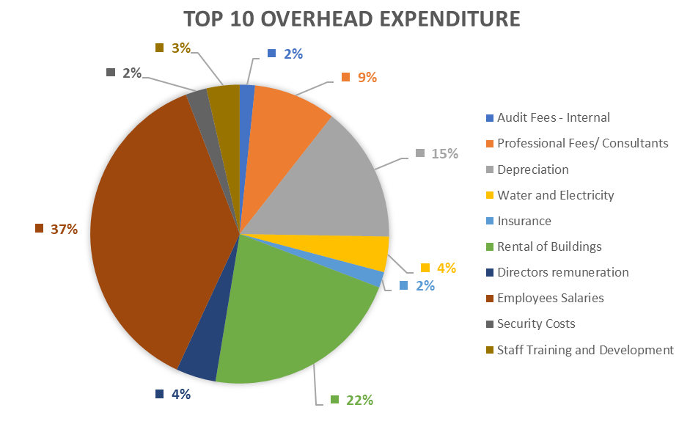
Financial Information
Top Ten Expenditure Overheads:
Overhead expenditure relates to administration expenses incurred. Employee salaries constitute 37%, representing most of the overheads spent on the Top 10 Overhead.

Slide 16
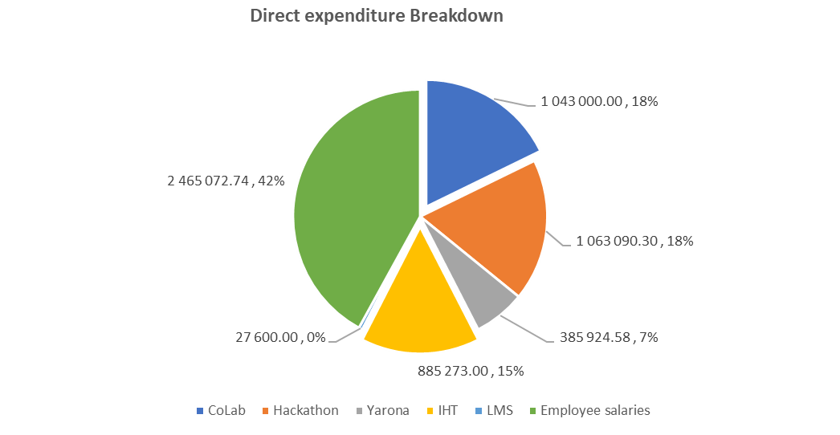
Financial Information
Direct Expenditure Overheads:
Direct expenditure relates to the training expenses in media courses, basic digital literacy training, 4IR related courses. Digital training provided by CoLab's constitutes 31% and Hackathon project, which is the majority of actual Direct expenditure

Slide 17
Thank you

