Slide 1


  NDA annual report (2020/21)
  PORtFOlio committee
  03 November 2021

Slide 2
PURPOSE
To present the Annual Report for the 2020/21 financial year, comprising of:
    Programme Performance Information (Part B); and
    Annual Financial Statements (AFS) for year ended March 31, 2021 (Part E).
    Audit outcomes for the 2020-21 financial year.

Slide 3
CONTEXTUAL ANALYSIS AND PERFORMANCE HIGHLIGHTS
The Covid-19 pandemic had an immense impact on the work of the NDA which resulted in the NDA revising its APP in order to align to the new reality of lesser in person engagements as a result of lockdown restrictions
The revision focused largely on reduction of targets and refinement of indicators to improve measurability and alignment to the Revised framework on planning
The NDA introduced a Covid-19 flagship programme called the Volunteer Programme in order to combat the dire effects of Covid-19
The NDA implemented the CARA Programme aimed at fighting the scourge of gender-based violence and femicide through funding of 312 CSOs to the value of R85, 6million.
The NDA implemented a hybrid model focusing on virtual and face to face engagement in an effort to limit the effects of movement restrictions on rendering capacity building interventions
The NDA collaborated with a range of stakeholders across the country to render integrated development interventions for the benefit of a number of communities and CSOs
The researches undertaken in the year under review together with the resultant dialogues have contributed immensely towards debate on development policy
The 2020-21 audit outcome of the NDA reflects an improvement on the 2019-20 audit outcome, relating to:
  Performance information;
  Detection of instances of non-compliance; and
  No material instances of non-compliance with SCM legislation.
Over the past 3 years, the NDA has achieved an UNQUALIFIED AUDIT OPINION WITH FINDINGS.
The AG did not identify any material findings on the usefulness and reliability of the reported performance information for Programme 2

Slide 4
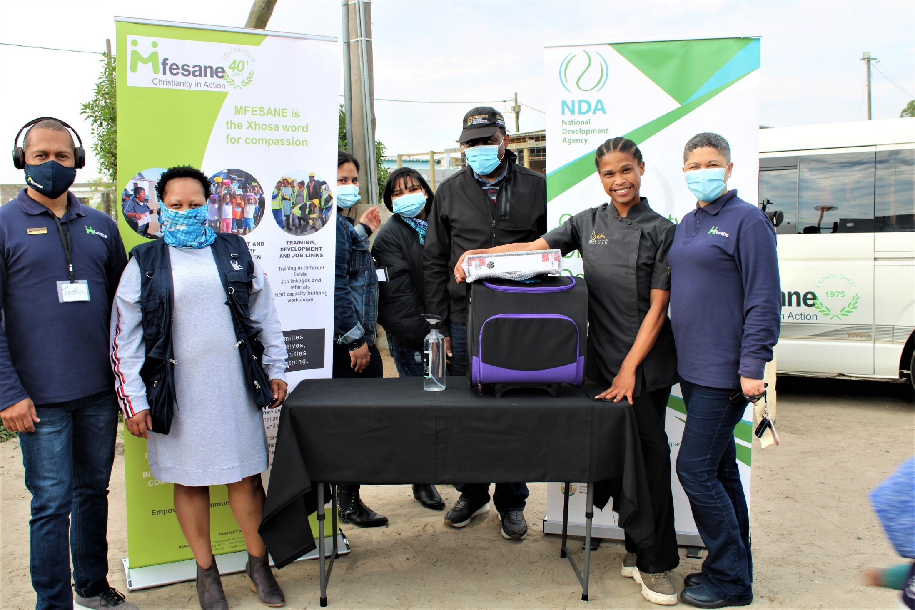
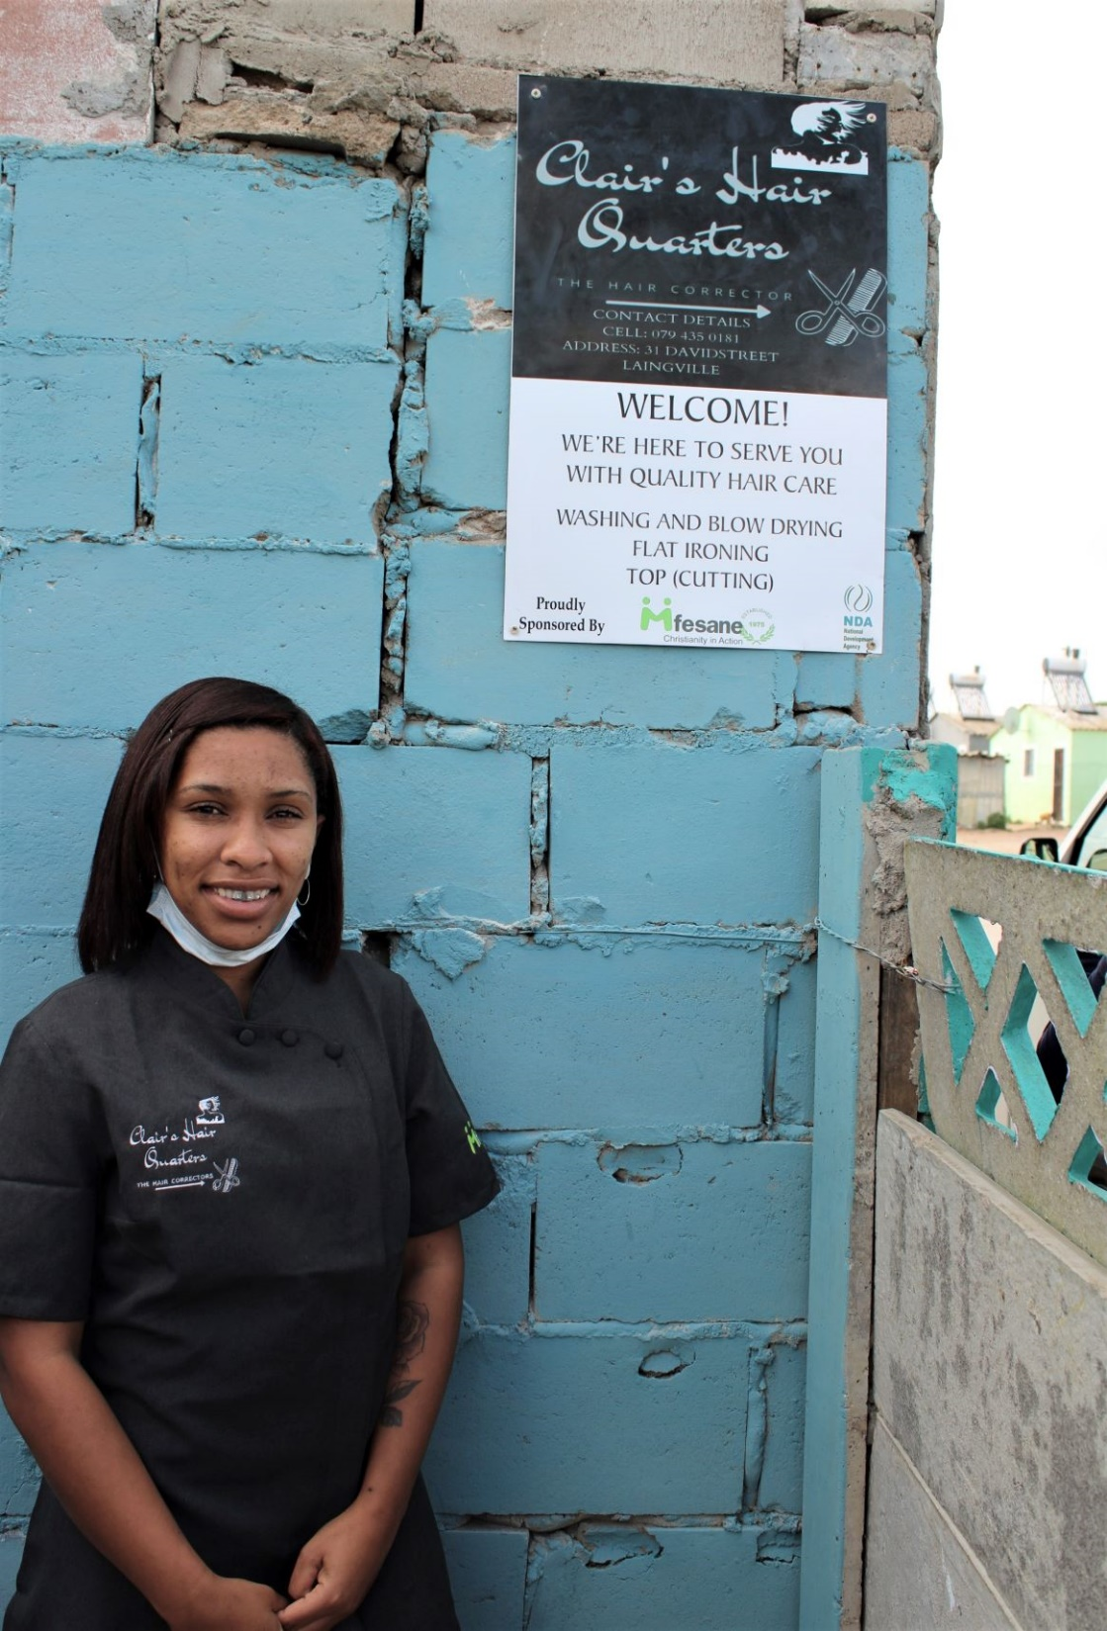
NDA SUPPORTED CSOS

Slide 5
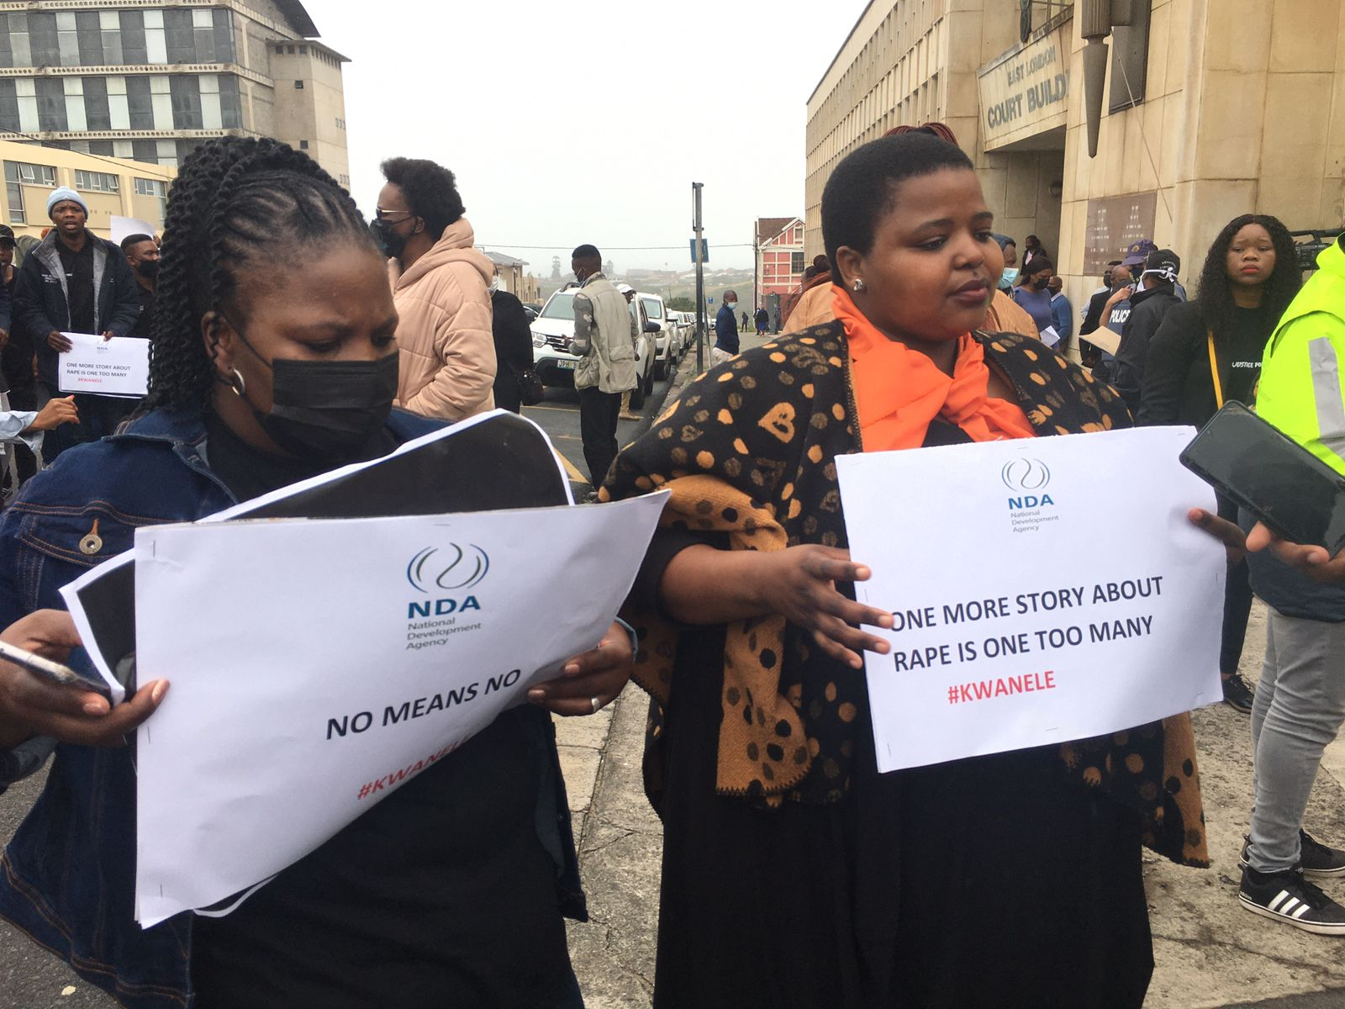
CAMPAIGN AGAINST GBV AND FEMICIDE

Slide 6
CONTEXTUAL ANALYSIS AND PERFORMANCE HIGHLIGHTS
The NDA implemented the Volunteer Programme as an emergency Covid-19 response programme over 9 months of the financial year, deploying 2049 volunteers across all provinces.
The programme focused mainly on:
  Covid-19 advocacy and ways to reduce transmission of the virus,
  Distribution of food parcels to vulnerable community members,
  Queue management support at SASSA offices in the administration of grant payments,
  Support of elderly and disabled persons, and
  Dissemination of Covid-19 information at hot spots as well as door-to-door within communities
R32 million of the 2020-21 approved budget was reprioritised by the Board, to:
  Fund PPE for volunteers
  Pay volunteer stipends, and
  CSO management fees for administration of the volunteers
The volunteers reached and interacted with over 211 171 households, distributed 73 581 food parcels to vulnerable households and assisted 171 289 people to apply for the Social Relief of Distress grant and the Department of Agriculture Disaster Relief Fund for small scale farmers.
R5,9 million worth of personal protective equipment (PPE) for staff and volunteers participating in the NDA funded volunteer programme
Of the spend of R5,9 million on PPE, R1,5 million was spent on direct procurement from 23 cooperatives operating across the country, R5,2 million was procured from emerging micro enterprises, and R2,3 million from youth-owned businesses

Slide 7
UPDATE ON NON-ACHIEVED DELIVERABLES
The NDA undertook a process identifying and determining historical Irregular, Fruitless and Wasteful expenditure for condonement by National Treasury. National Treasury declined to condone the total value of R96,1million resulting in the indicator not being achieved. This indicator has since been retained in the 2021/22 financial year and management has initiated a process of removal of such expenditure by the Board.
The NDA fell short of administering consequence management mainly due to lack of capacity in HR and Legal units. These units have since been fully capacitated with personnel in the 2021/22 financial year to fast track the implementation of consequence management. This indicator has been relegated to the Operational Plan
The Turnaround Strategy envisaged for approval by the end of the financial year was not achieved. The indicator has been carried over to the 2021/22 financial year. A Service Provider has since been appointed to undertake the NDA turnaround process. To date, numerous consultations have been held, and these consultations will inform the development of the APP, SP and Brand strategy, amongst others. The outcomes of the Turnaround process will also provide inputs into the NDA Act amendment process led by DSD.
The target of R100m on mobilisation of resources to fund CSOs development interventions was not achieved largely due to Covid -19 implications all sectors of the economy. The indicator was carried over to the 2021/22 financial year but the target was revised downward to R20m, mainly due to adverse economic conditions. To date a total of R17,5 million has already been raised in the first 2 quarters of the year.
The NDA continues to support the CSOs with income generation in the 2021/22 financial year, although this indicator has been relegated to the operations. A significant number of CSOs have been assisted with linkages to business opportunities to the value of R4,5 million.

Slide 8
PERFORMANCE INFORMATION

Slide 9
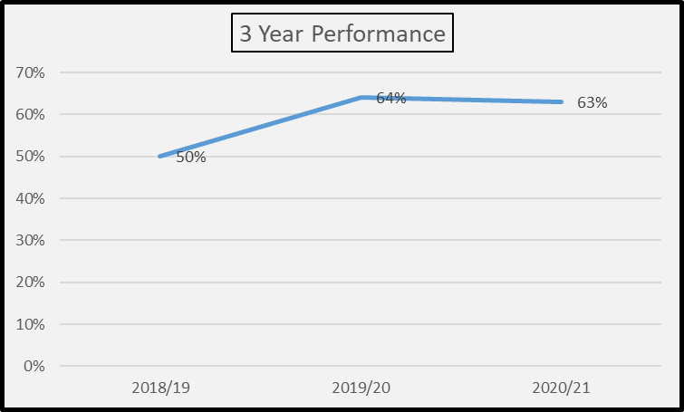
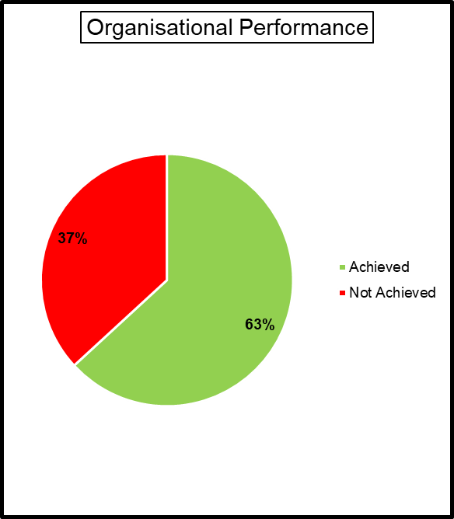
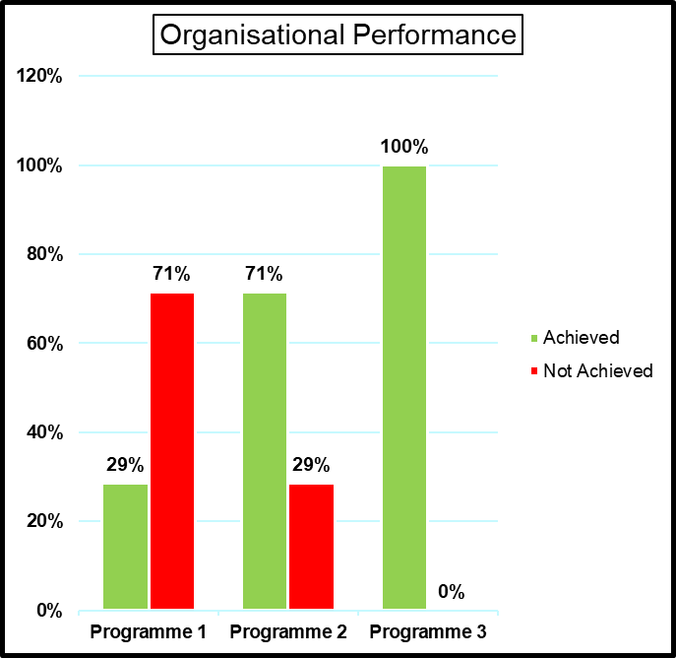
SUMMARY OF ORGANISATIONAL PERFORMANCE

Slide 10
Program 1: GOVERNANCE AND ADMINISTRATION
KPI 01 | Percentage (%) implementation of Consequence Management in relation to IFW cases
Object of Change | A change in NDA staff towards compliance to Institutional Policies, PFMA and National Treasury regulations by NDA staff |  | Impact | Improved governance and operational efficiency
Targets | Annual target | 80%
Achievement | (64%) – A total of 57 cases were identified and they were at various stages of implementation, including: Investigation; Disciplinary process; Debt Acknowledgement; Debt Recovery; and Debt Write-off.
Reason for deviation | The process of consequence management took longer than anticipated as it had to follow due process to avoid infringing individual’s rights. The other contributing factor to the slow pace of implementation of consequence management was the lack of capacity in both Legal and HR Units.
KPI 02 | Percentage (%) reduction of cumulative balance of IFW expenditure reported in the prior year annual Financial Statements
Object of Change | Reduction in instances of IFW expenses in the NDA |  | Impact | Reduction in the IFW expenditure
Targets | Annual target | 80%
Achievement | The performance is at 0% due to delayed condonation of IFW by National Treasury. On 11 November 2020, the NDA submitted a consolidated list of irregular expenditure, comprising 421 transactions and totalling R96,1 million for condonation by National Treasury. The condonation request of R96,1 million would have resulted in 66% reduction of the R145,9 million cumulative balance (as disclosed in the 2018/19 financial year).
Reason for deviation | The performance for KPI is highly dependent on the National Treasury’s decision to write-off the historical IFW expenditure incurred in the 2019/20 financial year.

Slide 11
Program 1: GOVERNANCE AND ADMINISTRATION
KPI 03 | Percentage (%) compliance to the NDA preferential procurement policy
Object of Change | Historically disadvantaged communities accessing economic opportunity |  | Impact | Economically uplifting communities that were historically disadvantaged by accessing economic opportunity which under normal conditions they could not compete
Targets | Annual target | 100%
Achievement | 100% compliance level has been achieved. NDA complied with the revised SCM Policy that was approved by the Board on 30 November 2020. The policy included the Preferential Procurement Policy. There has been compliance also with the previous and the 2017 PPPFA Regulations issued in terms of the PPPFA Act during all four quarters of the 2020/21 financial year.
Reason for deviation | None
KPI 04 | Amended NDA Act
Object of Change | Streamline the legal provisions within the NDA Act with that of PFMA by removing existing bottle-necks that affect the performance of NDA work |  | Impact | Improved governance and operational efficiency
Targets | Annual target | Position document on the NDA Act amendment
Achievement | Management developed the position document and presented it to the Board, but was not approved.
Reason for deviation | The Board advised that the position document should be delayed in order to align it to the NDA Turnaround Strategy to be undertaken in the 2021/22 financial year.

Slide 12
Program 1: GOVERNANCE AND ADMINISTRATION
KPI 5 | Approved NDA Turnaround Strategy
Object of Change | Repurpose the NDA programme in alignment with the NDA mandate and Government’s policy direction |  | Impact | Affect the NDA programme agenda for the next five years
Targets | Annual target | NDA Turnaround Strategy approved
Achievement | A concept document for the Turnaround Strategy was developed, presented to the Board and was approved.
Reason for deviation | Delays on the finalisation of the concept document was due to extensive consultation which delayed the procurement of service provider to undertake the Turnaround Strategy .
KPI 6 | Approved Employee Climate Survey framework
Object of Change | Increased staff morale and productivity |  | Impact | A commonly desired organizational culture linked to a strategy to attract and retain the employee to NDA / make NDA an employer of choice.
Targets | Annual target | Approved framework for Employee Climate Survey
Achievement | Employee Climate Survey Framework was developed, presented to EXCO and was approved.
Reason for deviation | None

Slide 13
Program 1: GOVERNANCE AND ADMINISTRATION
KPI 7 | Approved Brand Strategy
Object of Change | To improve NDA client experience, highlighting competitive advantage through programmatic performance |  | Impact | Enhance NDA’s brand reputation within key stakeholders understand and appreciate
Targets | Annual target | Draft Brand Strategy
Achievement | The Draft Brand Strategy Document was developed and presented to EXCO but was not approved.
Reason for deviation | The draft Brand Strategy was referred back for alignment with the NDA Turnaround Strategy to be undertaken in the 2021/22 financial year.

Slide 14
Program 2: CSO DEVELOPMENT
KPI 8 | Rand value of resources raised to fund CSOs development interventions
Object of Change | Institutional capacity to raise funds from alternative sources for grant funding of community interventions managed by CSOs |  | Impact | Increased and sustainable funding generated from alternative sources
Targets | Annual target | R100 million
Achievement | R15 785 000
Reason for deviation | The poor economic outlook affected the performance of the KPI. Potential donors reprioritized their resources towards the Covid-19 interventions.
KPI 9 | Number of strategic partnerships established
Object of Change | Effective and sustainable collaboration between Government, civil society, corporate and foreign entities in the advancement of community development work. |  | Impact | Established sustainable alternative resources of funds for grant funding, and having strong lobby group on policy affecting community development work
Targets | Annual target | 5
Achievement | 5 partnerships achieved: •MoU between NDA and NYDA •MoU between NDA and SASSA •A contract between NDA and DSD (CARA) •SLA between NDA and GPDoSD •MoU with SANPARKS
Reason for deviation | None

Slide 15
Program 2: CIVIL SOCIETY ORGANISATION DEVELOPMENT
KPI 10 | Number of integrated development initiatives coordinated
Object of Change | NDA will coordinate activities to link CSOs with the private sector CSI units which will create an enabling environment for the private sector to invest in CSOs |  | Impact | The community development work supported by the NDA has a buy-in from all stakeholders hence increasing the chances of community projects achieving the set goals.
Targets | Annual target | 9
Achievement | 9 integrated development initiatives were coordinated across provinces in areas such as sewing projects, food security and advocacy against GBV&F in communities.
Reason for deviation | None
KPI 11 | Number of Work opportunities created as a result of CSOs development interventions
Object of Change | Economically disadvantaged community members access work opportunities created through NDA supported programmes. |  | Impact | Improvement of the livelihoods of beneficiaries through increased income in households of mainly unemployed youth and women.
Targets | Annual target | 2000
Achievement | 2049 work opportunities were created through the NDA Covid-19 Volunteer Programme. The work opportunities were created equitably across the 9 province and with focus being placed on vulnerable and economically challenged communities. The programme was implemented through the CSOs supported through the NDA capacity building programme.
Reason for deviation | Target was met and exceeded due to partnership with other departments on the implementation of the volunteer programme.

Slide 16
Program 2: CSO DEVELOPMENT
KPI 12 | Value of increased CSO income generated as a result of NDA interventions
Object of Change | CSOs with increased and sustainable operational capacity to generate meaningful revenue streams from their programme activities |  | Impact | Increased and sustainable revenue streams from CSOs programme activities as a result of NDA programme support
Targets | Annual target | R24 000 000
Achievement | R3 270 171
Reason for deviation | The normal business activities of the CSOs were affected by Covid-19 lockdown restrictions
KPI 13 | Number of CSOs empowered through on-line and e-development interventions
Object of Change | CSOs that have acquired management and operational capacity to effectively manage their programme activities for community good |  | Impact | CSOs that have managed their programme operates effectively and in a sustainable way that has allowed community to benefit socioeconomically.
Targets | Annual target | 300
Achievement | 1114
Reason for deviation | The target was achieved and exceeded due to the readjustment of the risk levels in the last two quarters of the financial year, which allowed the contact (face-to-face) training.

Slide 17
Program 2: CSO DEVELOPMENT
KPI 14 | Percentage (%) disbursement of funds for grant funding
Object of Change | Exists a effective systems that manages grant funding operations |  | Impact | CSOs receive grant funding in a timely manner and in adherence to funding and relevant prescripts and contractual obligations
Targets | Annual target | 95%
Achievement | 100%
Reason for deviation | The target was surpassed by 5% due to improved budget utilization.

Slide 18
Program 3: RESEARCH
KPI 15 | Number of research publications that informed development practice on Government Priorities
Object of Change | To generate empirical evidence for enhanced development policy |  | Impact | Contributed towards the implementation of dialogues. Strengthened social partnerships through the engagement with the research findings
Targets | Annual target | 3 Research reports
Achievement | The NDA concluded 5 research studies, these studies were on the following research areas: Behaviour change and modification in the wake of COVID-19 – Policy implications for the Social Development Portfolio Strategies Requirements for transforming the civil society sector in South Africa Analysis of best practices in ECD centres in the Eastern Cape Province in the context of legislation and policy Creating capacities and building capabilities for the civil society sector in South Africa Creating Capacities and Building Capacities for CSO in SA
Reason for deviation | Two additional researches were undertaken. Behaviour Change Modification in the wake of COVID-19 and Analysis of ECD policy implementation in rural settings
KPI 16 | Approved Research and Evaluation agenda
Object of Change | To set out a framework for research and evaluation work to be undertaken by the NDA periodically. |  | Impact | The NDA has a defined framework that informs research and evaluation work to be undertaken in fulfilment of its secondary mandate.
Targets | Annual target | Approved Research and Evaluation agenda
Achievement | Research and Evaluation agenda approved by the Board. The research and evaluation agenda was approved after undergoing all the processes of development, quality assurance and approval. The agenda aims at supporting the government priority areas and also focuses on 4 areas relevant to the NDA mandate.
Reason for deviation | None

Slide 19
Program 3: RESEARCH
KPI 17 | Number of evaluation reports that contribute to development practice
Object of Change | NDA Evidence Based Evaluation results that guide and programme design and implementation |  | Impact | The NDA has a defined framework that informs research and evaluation work to be undertaken in fulfilment of its secondary mandate.
Targets | Annual target | 3 evaluation reports
Achievement | 3 (three) Evaluation Reports were completed during this period. They covered the following operational areas: People with disability income generation projects supporting and; ECD implemented by the resource and training organisation (RTOs). NDA CSO RAE-Volunteer Programme Final Report
Reason for deviation | None
KPI 18 | Number of external dialogues to engage on the NDA research outputs
Object of Change | To promote debates and dialogues on development policy, between stakeholders (public, civil society, private and academic sectors) |  | Impact | The dialogues and debates provide a platform for social partners to share the research outcomes and debate on development policy.
Targets | Annual target | 5 dialogues sessions
Achievement | 5 policy dialogue sessions were held via virtual platforms with partner research institutions. The dialogues were in the following areas: Creating capabilities and building capacities for the civil society sector in South Africa Food Security & Nutrition Dialogue – the impact of COVID-19 on food and nutrition security in South Africa. South Africa’s integrated approach to addressing poverty, inequality and exclusion. The impact of Covid-19 and lockdown on the ECD centers operations and teaching practices in KZN Experiences of ECD practitioners in implementing the programme relating to children`s responses, challenges and adaptions of the lessons in Social, Emotional and Learning (SEL)
Reason for deviation | None

Slide 20
Program 3: RESEARCH
KPI 19 | Number of times NDA research work is referenced
Object of Change | Demonstrate credibility and relevance of evidence produced by NDA research outputs in the field of development |  | Impact | Increased use of evidence in policy formulation and review by policy makers
Targets | Annual target | 5 NDA research work citations/referenced
Achievement | 9 citations/references made on NDA research published work, there citations were the following: Moreno et al (2018) Cross-Cross cultural perspectives of LGBTQ psychology from five different countries: Current state and recommendations. NDA work cited/referenced Magongo, B. (2016). Enhancing civil society participation in the South African development agenda: The role of civil society organisations. Parktown: The National Development Agency. The Impact of Income-Generating Projects on Stimulating the Development of Entrepreneurial Activities in Communities: The Holding Hands Case, published by the International Journal of Business and Economic Affairs (IJBEA) 1(1), 36-46 (2016). NDA work cited/referenced Magongo, B. (2013). Civil society participation in income- generating activities in South Africa. Faye et al (2020) A Review of the Results of Senegal's Response to the COVID-19 Pandemic Through State of Emergency and Curfew, Sumerianz Journal of Biotechnology, Vol. 3, No. 5, pp. 26-37. NDA work cited/referenced Magongo, B., 2020. "South Africa containment response to COVID-19 pandemic: Making consultation meaningful: Insights from a case study of the South African mental health policy consultation process. PLoS ONE 15(1): e0228281. ‘Religious live-streaming in response to coronavirus disease 2019 pandemic and the subsequent lockdown in South Africa’, Verbum et Ecclesia 41(1), a2120. https://doi.org/10.4102/ve.v41i1.212
Reason for deviation | The report by Bahuti Research Projects on Civil Society Funding mechanisms and HSRC report on Regulatory Frameworks Requirements For The South African Civil Society Sector both had 2 references each two NDA research work.

Slide 21
ANNUAL FINANCIAL STATEMENTS

Slide 22
2020-21 FINANCIAL POSITION - ASSETS
Cash holdings of R125,6m increased by R73,9m on prior year, mainly due to the balance of CARA funds (50,7m) awaiting disbursement once contractual conditions are met, UIF covid-19 stipend funds (11,4m), and cash held for committed operational and grant expenditure (R59m);
Receivables from exchange of R1,6m comprise mainly rental deposits held by lessors, with the Head Office lease in Parktown making up largest portion at R1,2m;
Receivables from non-exchange of R139k is mainly made up of staff debtors;
Property, plant & equipment comprises Computer Equip (5m), Furniture (1.1m), Office equip (689k);
Intangible assets comprise Ndzalama system (CSO database & IMS - R3,5m) and ERP system R22k

Slide 23
2020-21 FINANCIAL POSITION - LIABILITIES
Payables from exchange of R9,8m comprise Trade payables (8,4m), Operating lease liability (1,4m);
Payables from non-exchange of R6m comprise the UIF training programme covid-19 stipends accrual (5.8m), and staff creditors - (140.6k);
Provisions comprise the Bonus provision (5,9m);
Short-term employee benefits of R10,5m comprise the Leave provision (9,6m), 13 cheque accrual (804k);
Accrual for committed projects of R7,2m is made up of Volunteer programme accruals (4.9m), and Grant funded project accruals (2.2m). Reduced budget for grant funding has resulted in lower accruals;
Unutilised third party funds of R64,7m comprise funds from CARA (51,9m), SASSA (R1.6m), Anglo American (Kolomela mine - 552k), UIF (5m), Gauteng DSD (3,78m), DSD KZN (757k), DSD FS.

Slide 24
2020-21 FINANCIAL PERFORMANCE
NDA’s Total Revenue increased by R36,6m (15%), from R240,8m in 2020 to R277,5m in 2021. This is mainly due to CARA and other 3P funds recognised (R29,8m), and a R2,1 increase in interest income;
Total expenditure increased by R16,8m mainly due to the implementation of the CARA and Volunteer programmes;
Mandate expenditure increased by R40,3m, mainly due to the CARA programme and Volunteer Programme disbursements, offset by decreases in 3P funded capacity building (R16,1m) due to the suspension of the UIF training programme, and decreases in NDA funded capacity building (R6,9m), CSO Development costs (R5,6m), and Research studies (R1,3m) due to the Covid-19 budget reprioritization effected in June 2021;
Admin expenditure decreased by R23,5m mainly due to a reduction in travel & accommodation (R14,9m), General expenses (R8m), Audit fees (R1,7m), Operating leases of R925k, Consulting costs (R837k), IT communication (741k);
The NDA progressed from a net deficit position in 2020 of (R4,6m), to a net surplus position in 2021 of R15,1m.

Slide 25
2020-21 FINANCIAL PERFORMANCE - REVENUE
NDA’s 2020-21 transfer allocation was reduced by R8,3m from R224,5m to R216,2m;
Other grants of R54,8m represent third party funds recognized upon disbursement of funds according to contractual conditions, and has more than doubled on prior year revenue. These relate to CARA funds (R46m disbursed and recognised), Limpopo DSD (2,9m spent on capacity building), UIF training programme covid-19 stipend accrual (5.8m);
Other income relates to CARA management fees recognised (2,7m), Limpopo management fees (300k), R84.7k insurance recoveries, R49,7k project recoveries, and staff debtor recoveries of R220k;
Interest income of R2,9m represents a R2,1m increase on prior year interest earned, mainly due to higher cash holdings due to the CARA funds received from DSD.

Slide 26
2020-21 – MANDATE EXPENDITURE
Grant funding reduced by R5,6m due to covid-19 reprioritisation for the volunteer programme;
CARA programme – was a new programme in the 2020-21 FY, with disbursements of R46m.
Volunteer programme – new in the FY, with disbursements to CSOs and volunteers of R32m;
3rd Party funded capacity building relates to DSD Limpopo funds and UIF covid-19 stipend accrual;
NDA funded Capacity building costs reduced by R6,9m due to covid-19 reprioritisation for volunteer programme. Low activity due to lockdown restrictions. R1,8m reduction in travel related costs, R4m reduction in venue hire, R1,1m reduction in training manuals & participant travel costs;
Mobilisation & formalisation costs reduced by R5,6m due to covid-19 reprioritisation for volunteer programme. Activity was restricted due to lockdown restrictions. R3m reduction in travel related costs, and R1,4m reduction in ministerial events due to lockdown restrictions;
Research costs reduced by R1,3m due to covid-19 reprioritisation for volunteer programme;
Mandate staff costs reduced by R2m due reprioritisation of key posts, and postponement in the filling of non-key positions.

Slide 27
2020-21 – ADMIN EXPENDITURE
Travel costs reduced by R14,9m due to lockdown restrictions and reprioritization of the budget;
Audit fees reduced by R1,7m, as the interim audit was delayed by the AG. The main 2020-21 audit concluded on 31 August 2021, and most of the large invoices were processed after year end;
Consulting fees decreased due to a R1,3 reduction in legal fees;
Operating lease costs decreased by R925k, mainly due to office closures - GP, NC, WC provincial offices, Hazyview and Queenstown district offices;
IT communication costs reduced by R742k due to closure of certain offices;
Admin staff costs were R3,9m higher due to reprioritised compliance positions filled, as well processing of the 2018-19 bonus payment after it was approved by the Board;
General expenses decreased by R8m, due to a R1m reduction in travel management agency fees, R800k reduction in printing & stationery, R1,5m reduction in marketing & promotions, R1,2m reduction in office set-up costs, R700k reduction in workshops and conferences, R800k reduction in municipal charges, and a R500k reduction in catering and groceries.

Slide 28
2020-21 – COMMITMENTS
The NDA submitted to National Treasury, a request for retention of surplus funds to the value of R22,9 m for the 2020-21 financial year, in order to provide for its contracted and approved operational commitments.

Slide 29
2020-21 – FRUITLESS & WASTEFUL EXPENDITURE
Interest on late payments – R4,803;
Penalty on courier service cancelled late - R597;
Fruitless and Wasteful expenditure decreased by R175k, year on year, due to increased monitoring and compliance activities in the Finance Department.

Slide 30
2020-21 – IRREGULAR EXPENDITURE
Irregular expenditure of R29,47 million was incurred in the 2020-21 FY, mainly due to:
a. Volunteer programme (VP) extension not in line with approved delegations - R4,5m;
b. Grant funding to CSOs on the VP not in line with approved delegations – R22,4m;
c. Approval of prior year tenders not in accordance with approved delegations (R1,2m);
d. Non-compliance with SCM regulations (R1,3m).
2. There has been a R9,7m decrease in irregular expenditure on prior year;
3. The material irregular expenditure incurred in the prior year, relates to the UIF Training Programme expenditure of R23,2 million, where the training service provider, Regenesys, was appointed without following a competitive bidding process. There has been subdued progress in the investigation of this irregular transaction.

Slide 31
2020-21 – FINANCIAL VIABILITY

Slide 32
2020-21 AUDIT OUTCOMES

Slide 33
SUMMARY OF AUDIT OUTCOMES FOR THE PAST 3 YEARS
Over the past 3 years, the NDA has achieved an UNQUALIFIED AUDIT OPINION WITH FINDINGS. The 2020-21 audit outcome of the NDA reflects an improvement on the 2019-20 audit outcome, relating to performance information, detection of instances of non-compliance, and there were also no material instances of non-compliance with SCM legislation.
The AG did not identify any material findings on the usefulness and reliability of the reported performance information for Programme 2 – Civil Society Organisation Development, which is the main operational programme.
Effective and appropriate steps were also not taken to prevent irregular expenditure amounting to R29 471 760. The majority (92%) of the irregular expenditure was caused by payments on the Volunteer Programme, without the approval of the Board.

Slide 34
2020-21 STATUS OF RISK AREAS & INTERNAL CONTROL
The assurance provided by the accounting authority should be improved to provide necessary oversight over the key drivers of internal control.
The key risk areas of non-compliance with the PFMA as well as supply chain management legislation requires attention.
Although management has controls in place to detect and report on irregular expenditure, there are still non-compliance findings related to non-compliance with the PFMA, and SCM legislation.
Management did not adequately review compliance with operational policies and applicable legislation to prevent irregular expenditure.
Senior management must ensure that the internal controls are implemented by all officials and that consequence management is swiftly taken against transgressors.

Slide 35
STATUS OF ASSURANCE LEVELS – COMPARISON REFLECTING IMPROVEMENT OVER THE PAST 2 YEARS
2020-21 Audit Outcome
2019-20 Audit Outcome
1. There has been an improvement in the assurance provided by the Accounting authority, Audit committee and a significant improvement in the oversight by senior management.

Slide 36
STATUS OF RISK AREAS – COMPARISON REFLECTING IMPROVEMENT OVER THE PAST 2 YEARS
2020-21 Audit Outcome
2019-20 Audit Outcome
There has been an improvement in the quality of submitted performance information, and in the management of, and internal controls implemented in the supply chain operations, and information technology areas.
The NDA moved from a Disclaimer opinion on performance information in the 2019-20 FY, to no material findings on performance information in the 2020-21 FY, reflecting an improvement in the collation and validation of performance information, ensuring reliability of reported information.

Slide 37
IRREGULAR EXPENDITURE
Compliance with legislation, is summarised in the 2020-21 auditor’s report as follows:
Leadership did not sufficiently monitor the implementation of action plans to prevent the incurrence of irregular expenditure.
Management did not adequately review compliance with applicable legislation to prevent irregular expenditure.
R29,47 million of irregular expenditure was disclosed in note 29 to the 2020-21 annual financial statements, mostly related to non-compliance with the Grant Funding Policy and the NDA Act, related to the Volunteer Programme.
R39,18 million was disclosed in note 27 to the 2019-20 annual financial statements, mostly related to non-compliance with SCM legislation (competitive bidding processes, of which the UIF sub-contracting was the major contributor).
R18,1 million was disclosed in note 28 to the 2018-19 annual financial statements, mostly related to non-compliance with SCM legislation (tenders and RFQ’s, and mostly related to leases, internet services).
Management has put in place controls to monitor compliance of scm processes with legislation, detect and prevent irregular expenditure, and has employed measures to cancel recurring non-compliant contracts and replace these through processes compliant with SCM legislation. This has largely been achieved through the appointment of a compliance officer in the SCM unit in November 2020, and re-training of SCM staff and bid committee members to ensure strict implementation of SCM compliance controls.
Irregular expenditure disclosed in the financial statements must be investigated to determine whether any official is liable for losses incurred as a result of the irregular expenditure. Disciplinary steps must be taken against officials who caused or permitted the irregular expenditure, and losses incurred as a result must be recovered from the person liable.

Slide 38
FRAUD RISK FACTORS
The AG identified the following fraud risk factors that should be addressed to ensure that sufficient measures/controls are in place to prevent material misstatement due to fraud.
The non-compliance with SCM legislation increases the risk of fraud in procurement.
The allegations on misappropriation CSO funding increases the risk of fraud on disbursements made to the CSOs.

Slide 39
OVERALL MESSAGE
To improve the audit outcomes in the NDA, executives, senior management and the accounting authority should regularly assess and monitor key risk areas in the organisation, implement key internal controls to address those risks, and ensure there is independence and lack of conflict of interest between the various oversight structures. Additionally the Board delegations of authority and Board resolutions should be strictly applied. This will serve as the foundation for the following recommendations to improve the audit outcomes in the entity:
Improve on key controls to address the risk and fraud risk areas.
Monitor the implementation of audit action plans that are based on the audit findings and recommendations.
Prepare credible financial and performance reports regularly by ensuring that there are appropriate controls for transactions, maintaining proper records, validating information, and ensuring there is adequate management review of all information processed and reported in the NDA;
Officials should be held accountable for non-compliance with legislation resulting in irregular and fruitless and wasteful expenditure;
Investigations into allegations of misappropriation of CSO funding should be initiated and concluded.
Ongoing review and monitoring of compliance with contracts, policies and legislation should be strictly implemented and reported on.

Slide 40
CONCLUSION
It is proposed that the Portfolio Committee notes the Annual Report for the 2020/21 financial year, comprising mainly of the:
      Programme Performance Information;
      Annual Financial Statements (AFS) for year ended March 31, 2020; and
      Audit outcomes for the 2020-21 financial year.

Slide 41

Thank you
THANK YOU

