Slide 1
Finance Presentation for the Second Quarter ended 30 September 2021

Slide 2
Table of Contents
1. Introduction
2. Objective
3. Executive Summary
4. Revenue Collection
5. Actual Expenditure and Budget per project
6. Going Concern and Sustainability
7.Irregular Expenditure
8.Fruitless & Wasteful Expenditure
9.% of BBBEE spend
10.Recommendation

Slide 3
Introduction
FPB aims to have an integrated approach of its
finance and performance outcomes ensuring
compliance to all laws and regulations
CORPORATE GOVERNANCE.
FPB presents its second quarter financial
performance report for 2020/21

Slide 4
Objective
The aim of this report is to update the Portfolio Committee on FPB Q2 2021_22:
Revenue collection against budget;
Actual expenditure against budget;
Going concern and sustainability status; and
Percentage spent by FPB on BBBEE
procurement

Slide 5
Executive Summary
The Statement of Financial Performance (Income Statement) is a positive reflection of FPB’s ability to adequately plan and execute its operational deliverables. As at Q2 ended 30 September 2021:
Revenue:
Revenue of R55.9m (48%) has been collected against the annual budget of R116.7m.
The year to date revenue collection for the second quarter was under collected by R2.5m mainly as a result of online distribution fees and classification fees being under budget .
Expenditure:
Total expenditure excluding commitment is R47.0m (40%) and including commitment is R50.1m (43%) of the annual budget of R116.7m. The amount was spent on enabler and flagship projects.

Slide 6
Revenue Collection Report 30 September 2021

Slide 7
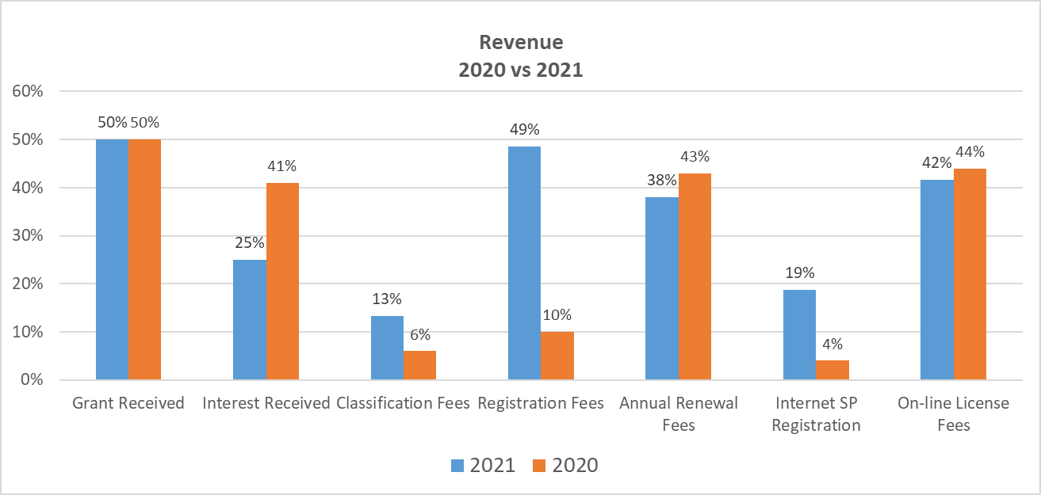
Revenue

Slide 8
REVENUE
Description | Actual YTD | Budget YTD | Var YTD | Annual Budget | % collected
Grant Received | 50 468 000 | 50 468 500 | -500 | 100 937 000 | 50%
Interest Received | 343 456 | 687 342 | -343 886 | 1 374 684 | 25%
Classification Fees | 450 638 | 1 695 728 | -1 245 091 | 3 391 456 | 13%
Registration Fees | 153 225 | 157 751 | -4 526 | 315 502 | 49%
Annual Renewal Fees | 123 034 | 161 919 | -38 885 | 323 837 | 38%
Internet SP Registration | 18 327 | 48 846 | -30 520 | 97 692 | 19%
On-line License Fees | 4 293 970 | 5 167 500 | -873 530 | 10 335 000 | 42%
Other Income | 46 564 | 0 | 46 564 | 0 | 0%
Total | 55 897 214 | 58 387 586 | -2 490 372 | 116 775 172 | 48%

Slide 9
Revenue Collection Report
Grant subsidy of R50.5m (50%) of annual budget of R100.9m was received to date from the Department of Communications and Digital Technologies. This represents 50% of the grant billed. The grant subsidy contributes to the sustainability of FPB as it accounts for 92% of the total revenue.
Classification fees of R451k (13%) of annual projected fees of R3.4m was billed and collected. The classification fees was under collected by R1.2m on a year to date budget and this is attributable to continued impact of covid 19 lockdown and less material submitted for classification in the second quarter. A downward adjustment will be considered in the mid term review.

Slide 10
Revenue Collection Report
Online regulation fees - FPB collected R4.3m (42%) against the annual projected revenue of R10.3m. In FY2021 for the full 12 months R4.4m was collected so on an actual basis the performance is pleasing.
Registration fees of R153k (49%) of the projected fees of R315k were collected. There was a variance against budget of R4k and the variance is not material.

Slide 11
Revenue Collection Report
Annual renewal fees of R123k (38%) against the annual budget of R324k has been collected. There is R39k under collection as a result of a timing difference on the projection.
Interest Income amounting to R343k (25%) against the annual budget of R1.3m was received to date from short-term investments made to date. The interest was under collected by R687k on a year to date and this is attributable to the prevailing lower interest rate environment.
48% of the annual revenue budget were collected of which the operational grant represents the highest proportion.

Slide 12
Actual Expenditure and Budget per strategic objective 30 September 2021

Slide 13
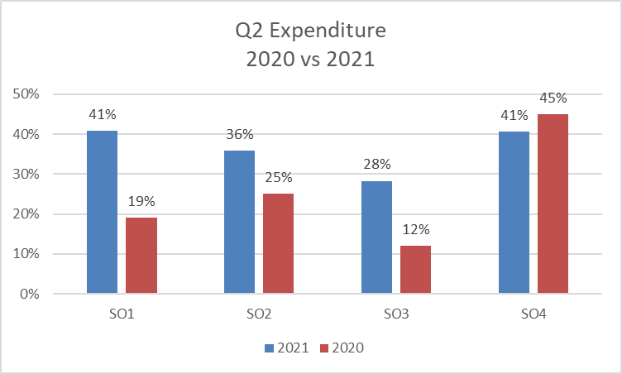
Expenditure per Project

Slide 14
Strategic Objective Expenditure
Project Category | Actual YTD | Commitment | Annual Budget | Available Budget | Q2 YTD% Curr. Year | Q2 YTD inc commitment | Q2 YTD% Prior Year ex commit
SO1: Effective Content Regulation aligned to the Constitution | 4 521 585 | 113 863 | 11 084 188 | 6 448 741 | 41% | 42% | 19%
SO2: Public Education and Stakeholder Partnering | 2 033 247 | 515 976 | 5 677 362 | 3 128 139 | 36% | 45% | 25%
SO3: Research & Development | 236 522 | 0 | 835 589 | 599 067 | 28% | 28% | 12%
SO4: Efficient and high performing organization | 40 244 219 | 2 391 479 | 99 178 035 | 56 542 337 | 41% | 43% | 45%
Grand Total | 47 035 573 | 3 021 318 | 116 775 174 | 66 718 283 | 40% | 43% | 41%

Slide 15
Expenditure Report
SO1 – Effective content regulation aligned to constitution.
R4.5m (42%) of the annual budget of R11.0m has been spent. We recorded an under expenditure of R1.1m (19%) against annual budget of R11.1m and this is attributable to the less material submitted by the distributor as a result of Covid 19 pandemic.
Reason for under expenditure
The reason for variance is largely due to covid 19 lockdown that resulted in lower classification fees paid, low costs on travel for compliance monitoring, catering and accommodation for workshops.
Project Category | Actual YTD | Budget YTD | Variance YTD | Variance % | Annual Budget | % of budget spent | % inc comm
SO1 | 4 521 585 | 5 583 761 | 1 062 176 | 19% | 11 084 188 | 41% | 42%

Slide 16
Expenditure Report
SO2 – Public education and stakeholder partnering
R2.0m (28%) of the annual budget of R5.7m has been spent to date. The public education and stakeholder was underspent on a year to date budget by R805k (28%)
Project Category | Actual YTD | Budget YTD | Variance YTD | Variance % | Annual Budget | % of budget spent | % inc comm
SO2 | 2 033 247 | 2 838 681 | 805 435 | 28% | 5 677 362 | 36% | 45%
Reason for variance
The reason for variance is largely due to zero expenditure on international travel as a result of pandemic and delay in the invoices for domestic travel as a result of timing.
The other reason relates to non appointment of a digital agency service provider as quotations received have been above threshold.

Slide 17
Expenditure Report
SO3 – Research and Development
R236k (43%) of the annual budget of R835k has been spent.
The variance on a year to date expenditure amounted to R181 (43%) of R418k year to date budget.
Project Category | Actual YTD | Budget YTD | Variance YTD | Variance % | Annual Budget | % of budget spent | % inc comm
SO3 | 236 522 | 417 794 | 181 272 | 43% | 835 589 | 28% | 28%
Reason for variance
The variance is mainly because of the delay on the research papers to be conducted as per the target.

Slide 18
Expenditure Report
SO4 – Efficient and high performing organisation
R40.2m (43%) excluding commitment against the annual budget of R99.2m has been recorded.
There was an under expenditure on a year to date budget of R9.3m (19% ) against the year to date budget of R49.5m
Project Category | Actual YTD | Budget YTD | Variance YTD | Variance % | Annual Budget | % of budget spent | % inc comm
SO4 | 40 244 219 | 49 589 017 | 9 344 797 | 19% | 99 178 035 | 41% | 43%
Reason for variance
The reason for variance relates to vacancies and the continued non implementation of budgeted salary increases as of end Q2.

Slide 19
Going Concern and sustainability 30 September 2021

Slide 20
FINANCIAL POSITION & CASH
Liquidity ratio (current assets to current liabilities)= 2.4 : 1 reflects that FPB can sustain its operation over the short-term (12 months);
Solvency ratio (total assets to total liabilities) = 3.1 : 1 reflects that FPB can sustain its operation over the long-term (more than 12 months);
Bank balance – 30 September 2021
Cash available – 37.5m
Current liabilities – (R27.1m)
Net cash - R10.4m

Slide 21
Payment of service providers

Slide 22
Irregular Expenditure
 | R
Opening Balance: 01 April 2021 | 2 127 626
Add: New | 0
Less: Condoned / adjustments | 0
Closing Balance as at 30 September 2021 | 2 127 626

Slide 23
Fruitless and Wasteful Expenditure
 | R
Opening Balance: 01 April 2021 | 3 553 167
Add: New | 0
Less: Recovered | 3 726
Closing Balance as at 30 September 2021 | 3 549 441

Slide 24
% BBBEE spend for Q2
Target - 75% of all transactions are awarded to companies with a BBBEE contribution level of 3 or lower and 35% of all transactions assigned to priority groups
All transactions = 93% achieved; target of 75%
Transaction assigned to priority groups= 48% achieved; target of 35%
Total of 9 Transactions (out of a total 20) were awarded to priority groups as follows:
Female = 3
Military veteran = 0
Youth = 6
Persons with disabilities = 0
= 9
Black males = 11
Other = 0
Total = 20

Slide 25
Thank You

