Slide 1
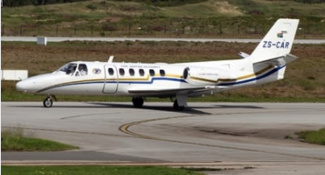
Fatal Accident ZS-CAR
Date: 8 March 2022
Presented by:
Mr Albert Phuti Morudi
Executive (Act): Accident and Incident Investigations

Slide 2
PRESENTATION OUTLINE
Purpose
The investigation
The findings
Cause & contributory factors
Recommendation
Questions

Slide 3
PURPOSE
The purpose of this presentation is to the Parliamentary Portfolio Committee on Transport (PCOT) on the findings following the investigation into a fatal accident (ZS-CAR) which occurred in Gearge Airport on 23 January 2020.

Slide 4
THE INVESTIGATION

Slide 5
THE INVESTIGATION
Purpose
In terms of the International Civil Aviation Organization (ICAO) Annex 13, Standard 3.1:
“The sole objective of the investigation of an accident or incident shall be the prevention of accidents and incidents. It is not the purpose of this activity to apportion blame or liability.”
Instituting or Delegating the investigation
ICAO Annex 13, Standard 5.1:
“The State of Occurrence shall institute an investigation into the circumstances of the accident and be responsible for the conduct of the investigation, but it may delegate the whole or any part of the conducting of such investigation to another State or a regional accident and incident investigation organization (RAIO) by mutual arrangement and consent. In any event, the State of Occurrence shall use every means to facilitate the investigation.”

Slide 6
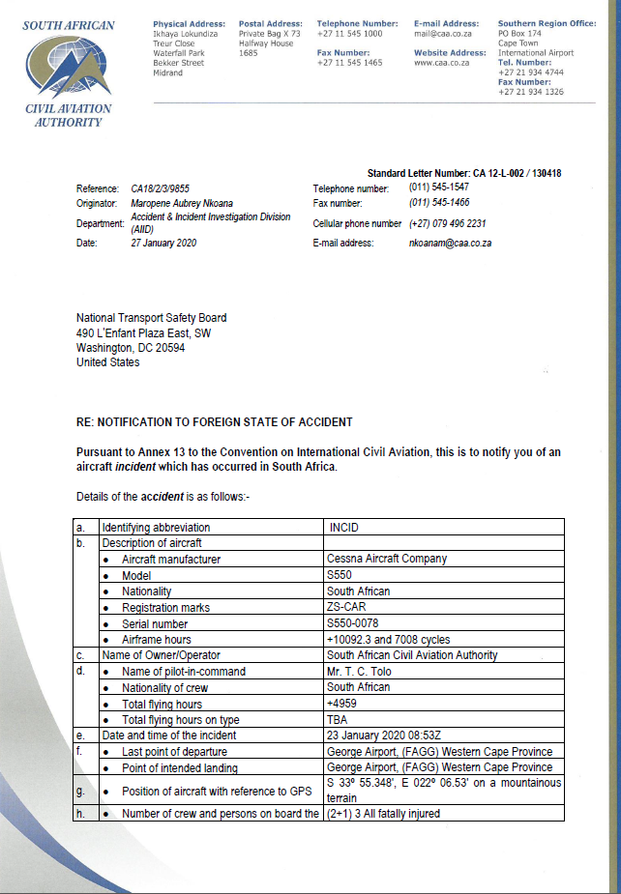
THE INVESTIGATION
PROCESS
1. Notification
In terms of the International Civil Aviation Organization (ICAO) Annex 13, Standard 4.1:
“4.1 The State of Occurrence shall forward a notification of an accident, a serious incident, or an incident to be investigated within the context of this Annex, with a minimum of delay and by the most suitable and quickest means available, to:
a) the State of Registry; (RSA)
b) the State of the Operator; (RSA)
c) the State of Design; (USA & Canada)
d) the State of Manufacture; (USA & Canada)
and
e) the International Civil Aviation Organization, when the aircraft involved is of a maximum mass of over 2 250 kg or is a turbojet-powered aeroplane.”
Each of the State and ICAO received a letter similar to the one below.

Slide 7
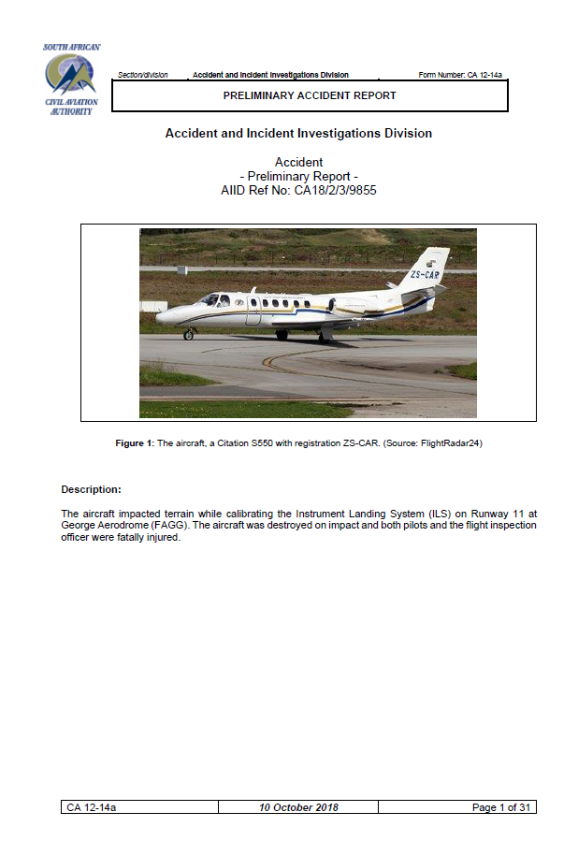
THE INVESTIGATION
PROCESS
2. Preliminary report
In terms of the International Civil Aviation Organization (ICAO) Annex 13, Standard 7.1 & 7.4:
“7.1 When the aircraft involved in an accident is of a maximum mass of over 2 250 kg, the State conducting the investigation shall send the Preliminary Report to:
a) the State of Registry or the State of Occurrence, as appropriate; (RSA)
b) the State of the Operator; (RSA)
c) the State of Design; (USA & Canada)
d) the State of Manufacture; (USA & Canada)
e) any State that provided relevant information, significant facilities or experts; (France) and
f) the International Civil Aviation Organization.”
“7.4 The Preliminary Report shall be sent by facsimile, e-mail, or airmail within thirty days of the date of the accident unless the Accident/Incident Data Report has been sent by that time. When matters directly affecting safety are involved, it shall be sent as soon as the information is available and by the most suitable and quickest means available.”
Each of the State and ICAO received a report similar to the one below.

Slide 8
THE INVESTIGATION
Preliminary report
The preliminary report was issued by Accident and Incident Investigations Division (AIID) within the 30 day requirement as sent to the states as required by ICAO Annex 13.
The preliminary report was issued with a recommendation for the Minister to delegate the investigation to another State due to the request from the victims families and the pressure from the industry.
During the preparation to delegate, the world was hit by the COVID 19 pandemic which lasted for the most of 2020 and the delegated State (Ethiopia) could not travel to RSA.
That resulted on RSA having to issue an Interim Statement on 23 January 2021 which is 12 months after the accident as required by ICAO Annex 13, Standard 6.6.

Slide 9
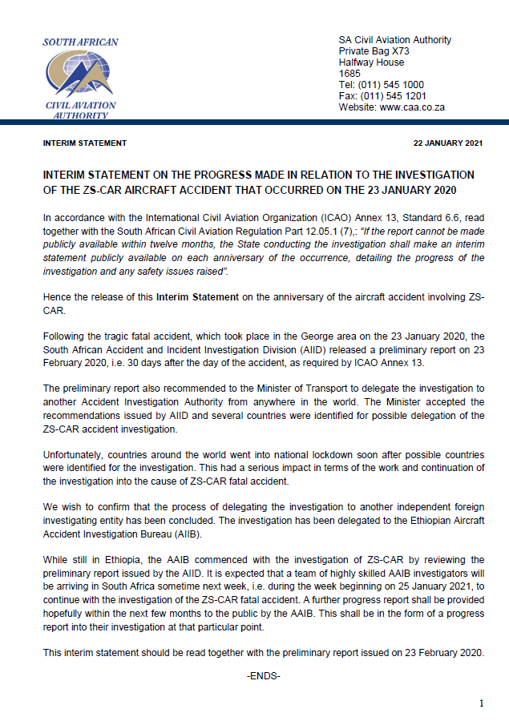
THE INVESTIGATION
PROCESS
3. Interim Statement
In terms of the International Civil Aviation Organization (ICAO) Annex 13, Standard 6.6:
“6.6 If the report cannot be made publicly available within twelve months, the State conducting the investigation shall make an interim statement publicly available on each anniversary of the occurrence, detailing the progress of the investigation and any safety issues raised.”
Each of the State and ICAO received a report similar to the one below.

Slide 10
THE INVESTIGATION
Investigation by Ethiopian Aircraft Accident Investigations Bureau (AAIB)
The AAIB arrived in RSA on 24 January 2021 and on 25 January 2021 AIID and AAIB entered into an Operational Agreement on the conduct of accident ZS-CAR in line with ICAO Annex 13, Standard 5.1.
The AAIB investigation was initiated on 25 January 2021 by reviewing documentations, conducting interviews (the SACAA, AIID, FIU, AMO and the victims families) and inspected the wreckage.
The team concluded the RSA phase of the investigation on 5 February 2021 and they left RSA on 6 February 2021. Regrettably, the lead investigator could not leave as he had contracted COVID 19 and he only left RSA on 26 February 2021.
The investigation continued with the drafting of the Draft Final Report in terms of ICAO Annex 13.

Slide 11
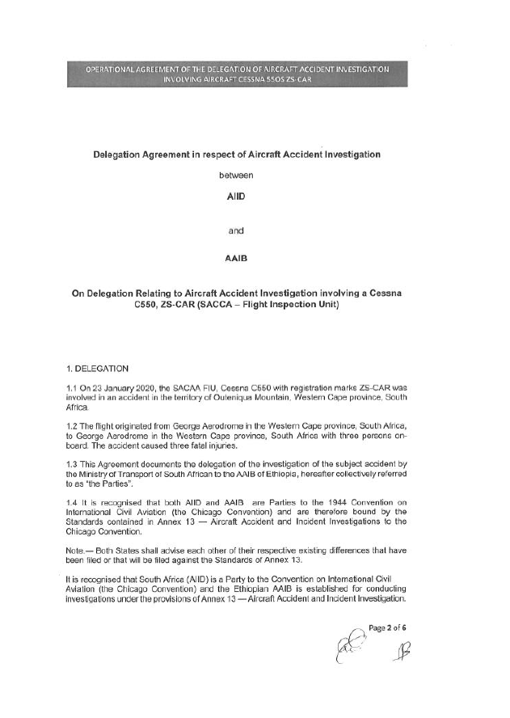
THE INVESTIGATION
PROCESS
4. Operational Agreement
In terms of the International Civil Aviation Organization (ICAO) Annex 13, Standard 5.1:
“5.1 The State of Occurrence shall institute an investigation into the circumstances of the accident and be responsible for the conduct of the investigation, but it may delegate the whole or any part of the conducting of such investigation to another State or a regional accident and incident investigation organization (RAIO) by mutual arrangement and consent. In any event, the State of Occurrence shall use every means to facilitate the investigation.”

Slide 12
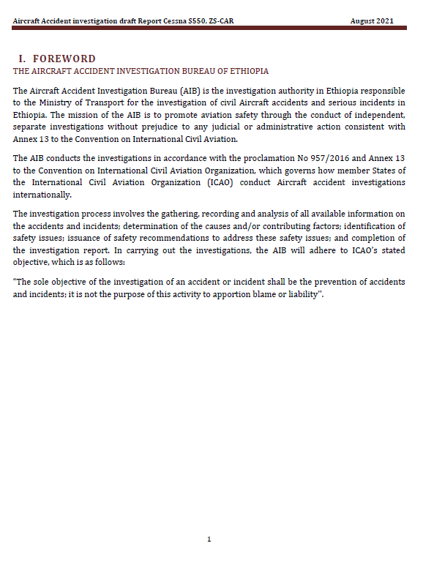
THE INVESTIGATION
PROCESS
5. Draft Final Report (Consultation)
In terms of the International Civil Aviation Organization (ICAO) Annex 13, Standard 6.3:
“6.3 The State conducting the investigation shall send a copy of the draft Final Report to the following States inviting their significant and substantiated comments on the report as soon as possible:
a) the State that instituted the investigation; (RSA)
b) the State of Registry; (RSA)
c) the State of the Operator; (RSA)
d) the State of Design; (USA & Canada)
e) the State of Manufacture; (USA & Canada)
and
f) any State that participated in the investigation as per Chapter 5.
Each of the State and ICAO received a report similar to the one below.

Slide 13
THE INVESTIGATION
Investigation by Ethiopian Aircraft Accident Investigations Bureau (AAIB)
6.3…If the State conducting the investigation receives comments within sixty days of the date of the transmittal letter, it shall either amend the draft Final Report to include the substance of the comments received or, if desired by the State that provided comments, append the comments to the Final Report. If the State conducting the investigation receives no comments within sixty days of the date of the first transmittal letter, it shall issue the Final Report in accordance with 6.4, unless an extension of that period has been agreed by the States concerned.”
The AAIB gave RSA an opportunity to comment on the Draft Final Report from August 2021 to 29 October 2021 before closing the investigation and issuing a Final Report in terms of ICAO Annex 13, Standard 6.4 in November 2021.

Slide 14
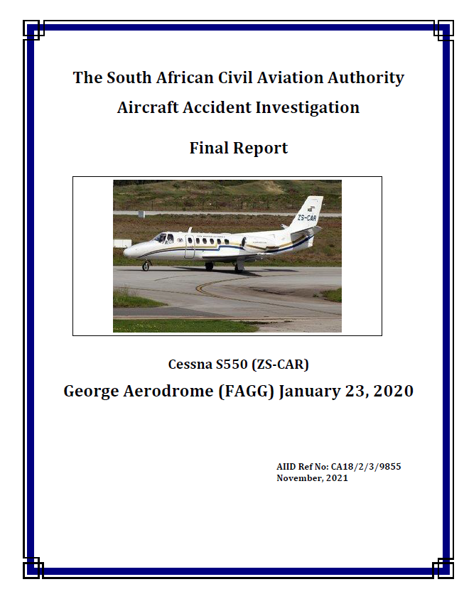
THE INVESTIGATION
PROCESS
6. Final Report
In terms of the International Civil Aviation Organization (ICAO) Annex 13, Standard 6.4:
“6.4 The Final Report of the investigation shall be sent with a minimum of delay by the State conducting the
investigation to:
a) the State that instituted the investigation; (RSA)
b) the State of Registry; (RSA)
c) the State of the Operator; (RSA)
d) the State of Design; (USA & Canada)
e) the State of Manufacture; (USA & Canada)
f) any State that participated in the investigation; (France)
g) any State having suffered fatalities or serious injuries to its citizens; and
h) any State that provided relevant information, significant facilities or experts.
Each of the State and ICAO received a report similar to the one below.

Slide 15
THE INVESTIGATION
Investigation by Ethiopian Aircraft Accident Investigations Bureau (AAIB)
6.5 In the interest of accident prevention, the State conducting the investigation of an accident or incident shall make the Final Report publicly available as soon as possible and, if possible, within twelve months.
7. Recourse
In terms of the International Civil Aviation Organization (ICAO) Annex 13, Standard 5.13:
“Reopening of investigation
5.13 If, after the investigation has been closed, new and significant evidence becomes available, the State which conducted the investigation shall reopen it. However, when the State which conducted the investigation did not institute it, that State shall first obtain the consent of the State which instituted the investigation.”

Slide 16
AAIB FINDINGS

Slide 17
FINDINGS
Findings issued by (AAIB) following the investigation into the accident ZS-CAR.
The PIC had been initially issued with an Airline Transport Pilot License (ATPL) on 20 December 2011. His last skills test was carried out on 24 January 2019 and his license was issued on the same day with an expiry date of 29 February 2020. He was also issued with a class 1 aviation medical certificate on 23 October 2019 with an expiry date of 31 October 2020.
The FO had been initially issued with a Commercial Pilot License (CPL) on 16 May 2014. Her last skills test was carried out on 15 March 2019 and her license was issued on the same day with an expiry date of 31 March 2020. She was in possession of a class 1 aviation medical certificate issued on 26 September 2019 with an expiry date of 31 July 2020;
The air traffic controller (ATC) had been initially issued with an Aerodrome Control Air Traffic Services license on 28 February 2003. His last skills test was carried out on 14 August 2019 and his license was issued on the same day with an expiry date of 13 June 2020;
The ATC was issued with a class 3 aviation medical certificate on 19 February 2018 with an expiry date of 28 February 2020 and was issued with level 6 language proficiency certificates on 28 March 2007;

Slide 18
FINDINGS
Findings issued by (AAIB) following the investigation into the accident ZS-CAR.
5. The aerodrome controller conducted last proficiency check on her aerodrome control license for FAGG and FAOR on 14 August 2019 and 8 July 2019, respectively;
The aerodrome approach controller had been initially issued with an Aerodrome Control Air Traffic Services license on 24 August 2007. His last skills test was carried out on 5 December 2019 and his license was issued on the same day with an expiry date of 4 December 2020;
The aerodrome approach controller was issued with a class 3 aviation medical certificate on 12 March 2019 with an expiry date of 31 March 2023. The aerodrome approach controller was issued with a level 6 language proficiency certificate on 20 August 2007. The Aerodrome Approach controller also did proficiency on approach control surveillance for FAGG on 26 April 2019 and had an expiry date of 25 April 2020;
The valid PPC is represented by the certificate from flight safety Textron Aviation Training, PIC proficiency check was expiring on 7 May, 2020;

Slide 19
FINDINGS
Findings issued by (AAIB) following the investigation into the accident ZS-CAR.
Proficiency check for unusual attitude recovery Simulator exercise was not found in PIC grade slip;
The aircraft was issued the initial Certificate of Airworthiness on 26 October 1986; the last Certificate of Airworthiness was reissued on 29 October 2019 with an expiry date of 30 October 2020;
The accident aircraft (ZS-CAR) was not maintained in accordance with regulation Part 43.02.8 whereby the FDR annual inspection was not conducted. Therefore, at the time of the accident, the Certificate of Airworthiness was rendered invalid;
The aircraft had been issued with a Certificate of Release to Service on 31 May 2019 with an expiry date of 31 May 2020 or 10227.7 airframe hours, whichever occurs first;
The aircraft was being operated under CAR 2011 Part 135, 171 was conducting an ILS calibration at the time of the accident;
The operator had been issued with an air operating certificate(AOC) number: CAA/G599D on 01 March 2019 with an expiry date of 28 February 2020;

Slide 20
FINDINGS
Findings issued by (AAIB) following the investigation into the accident ZS-CAR.
The South African AIID and FIU structured under the SACAA;
The PIC was considered as chief pilot and manager operation;
The PIC was designated by FIU in the case of line checks;
The aircraft experienced three incidents in the past twelve months namely: On 2 March 2019, engine No 1 throttle did not respond due to a damaged throttle cable. In the month of November 2019, the aircraft had two incidents of an oil smell and smoke in the cockpit that resulted in the operator and AMO electing to change engine No 1. Following the incident of 8 November 2019, the aircraft remained on the ground until 17 January 2020;
The ELT automatically activates during a crash and transmits the standard swept tone on 121.5 and 243.0 MHz It also transmits a 406 MHz encoded digital message to the COSPAS/SARSAT satellite system, which allows first responders to quickly and accurately identify not only where you are, but who you are as well, however there was no signal received from the emergency locator transmitter (ELT) on channel 121.5 MHz frequency following the accident (as watched by ATC);

Slide 21
FINDINGS
Findings issued by (AAIB) following the investigation into the accident ZS-CAR.
The accident aircraft was located by search and rescue within an hour after it was reported missing by the George Airport;
According to the FIU operations manual, the ILS calibration process should be carried out at 35° on either side of the runway centre line while maintaining 17NM DME arc. The height for the operation requires a flight at 2000ft AGL or obstacle plus 1000ft;
According to the FIU operations manual ILS operation was to perform a flight at 2000ft AGL or obstacle plus 1000ft, and the accident aircraft climbed to an altitude of 3900ft;
The last scheduled phase inspection was Phase 15, which was carried out on 13 August 2019 at 10035.0 airframe hours and there was no unscheduled maintenance during Phase 15 inspection. The aircraft had accumulated an additional 75 airframe hours in operation since the last phase check maintenance;
The AMO that carried out the last maintenance inspection on the accident aircraft was issued with an AMO approval certificate on 31 October 2019 with an expiry date of 31 October 2020;

Slide 22
FINDINGS
Findings issued by (AAIB) following the investigation into the accident ZS-CAR.
The AMO that carried out the last maintenance inspection on the accident aircraft was issued with an AMO approval certificate on 31 October 2019 with an expiry date of 31 October 2020;
The aircraft was not fitted with a CVR nor was it a requirement according to CAR 2011, Sub-Part 135.05.11 read together with SA-CATS 135.05.11;
Due to CAR 2011, Sub-Part 135.05.11 regulation not requiring the installation of the cockpit voice recorder (CVR) on the accident aircraft, the investigation team was unable to determine if TAWS was operational at the time of the accident;
The aircraft was fitted with FDR which was downloaded in France under the supervision of a RSA- IIC;
According to available graph FDR results, as the aircraft leveled off at 3900ft (QNH 1018), a rapid descent occurred, and the aircraft lost 1500ft in approximately 9 seconds;

Slide 23
FINDINGS
Findings issued by (AAIB) following the investigation into the accident ZS-CAR.
29. Where the aircraft at an altitude of 2400ft indicating that the aircraft was in a moderate recovery from a dive and low altitude, three seconds prior to impact, the aircraft nose pitch up increased from -32.50 to -17.5 degrees on a nose low attitude before impacting the terrain at 2192ft;
30. From FDR analysis, the crew may have entered to a characteristic of unusual attitude before commencing calibration flight and unable to come out from suspected unusual attitude;
The aircraft was equipped with TAWS, which provides a warning to the flight crew when approaching close to terrain. However, due to the regulation not requiring the fitment of the CVR to this aircraft, the investigation team was unable to determine if TAWS was operational at the time of the accident;
The FDR recording capacity was limited by the aircraft system and it was not possible to validate additional parameters, because the aircraft was only triggered with limited parameters;

Slide 24
FINDINGS
Findings issued by (AAIB) following the investigation into the accident ZS-CAR.
33. The operator did not conduct an annual FDR download on 8 January 2019 and 8 January 2020; as such, the operator was not in compliance with CAR Part 135.05.9 read together with SA-CATS 135.05.9 (4);
34. The ZS-CAR was returned to service on 17 January 2020 following serious incident that led to the damage of Class 1 component (Engine) and there were no records whether the aircraft was inspected prior to return to service as required by CAR Part 43.02.7 (6).This was in contravention of CAR Part 43.02.7 (6);
The installed FDR did not record nine (9) mandatory parameters required by CAR Part 135.05.9read together with SA-CATS 135.05.9, the operator did not conduct an annual mandatory inspection of the FDR and this was in contravention of CAR Part 135.05.9;
The ZS-CAR was installed with the FDR that did not meet the requirements of CAR Part 135.05.9 (1) and (2), therefore, the operator was in contravention of CAR Part 135.05.9;

Slide 25
FINDINGS
Findings issued by (AAIB) following the investigation into the accident ZS-CAR.
The ZS-CAR FDR annual inspection was not carried out, and the operator was in contravention of CAR Part 43.02.8 and CAR Part 135.05.9;
The FIU did not have a compliance officer and that was in contravention of CAR Part 171.01.2(1)(a);
Further evidence records show that the FIU Part 171 ESO approval had expired in 01 April, 2019 and they were only reissued with the approval on 5 November 2019.The FIU continued to provide electronic services (calibration of navigational aid) between April 2019 and 4 November 2019 without an approval, and this was in contravention of CAR Part 171.01.2 (1);
Based on the information provided by SAWS, at the time of the accident the mountain tops were obscured by clouds;
At the time of approach to FAGG the weather condition around the area was inclement; therefore they were not cleared to conduct VOR calibration. As a result, they decided to land and refuel the aircraft before commencing with the calibration of the Instrument Landing System (ILS) on Runway RWY 11 at FAGG;

Slide 26
FINDINGS
Findings issued by (AAIB) following the investigation into the accident ZS-CAR.
42. The elevation of the mountain which the aircraft impacted was at 2192ft at GPS coordinates 33°55’24” South, 22°06’30” East. According to the wreckage debris, the impact corresponded with the aircraft being at a shallow dive angle on an upslope terrain;
At 08:46:10 ATC advised that ZSCAR will be outside the TMA, to broadcast 124.2 for traffic below the TMA;
FAGG was operating under VFR by day at the time of the accident;
The aircraft was destroyed during the impact and all three occupants were fatally injured;

Slide 27
AAIB PROBABLE CAUSE

Slide 28
PROBABLE CAUSE
Probable cause issued by (AAIB) following the investigation into the accident ZS-CAR.
The crew lost control of the aircraft which resulted in significant loss of altitude; as they attempted to recover, they collided with the mountain. According to the SAWS report, there was significant cloud coverage below 1500 ft above ground level at the time of the accident as observed in the METARs. Mountain tops were obscured as seen on the Webcam. The aircraft route which is 17 N.M arc passes over the obscured mountains. From the limited FDR reading the aircraft attitude drastically changed into an unusual attitude when approaching the mountain area .This indicates that most probably, the pilot has entered into an unusual attitude during transition from VFR to IFR flight without preparation. The accident flight plan was VFR.

Slide 29
PROBABLE CAUSE
Contributory factors issued by (AAIB) following the investigation into the accident ZS-CAR.
The presence of low clouds at about 1500ft below above ground and obscured mountains with clouds;
The incapability of the crew to recover from unusual attitude; lack of supervision and disregard of the Civil Aviation Regulations requirements by the FIU (operator).
3. Overbanked and steep dive maneuver, unable to gain the required altitude before impact;
4. Lack of upset prevention and recovery technique (UPRT);

Slide 30
AAIB RECOMMENDATION

Slide 31
SAFETY RECOMMENDATIONS
Safety recommendations issued by (AAIB) following the investigation into the accident ZS-CAR.
The aircraft was not equipped with CVR and unable to record TAWS warnings during impact to terrain and other necessary communications between crew;
The AAIB recommends: that the SACAA considered installing CVR on aircraft flying for calibration purposes and other flights;
The FDR recording capacity was limited by the aircraft system and was not fit to record all required parameters for the accident aircraft;
The AAIB recommends: SACAA to ensure that operators install FDR's that record all mandatory parameters as required by the regulations. (eg. Part 135.05.10)

Slide 32
SAFETY RECOMMENDATIONS
Safety recommendations issued by (AAIB) following the investigation into the accident ZS-CAR.
The South African AIID is established under the SACAA with ministerial order consent and at the same time the FIU is also under the authority;
The AAIB recommends: the South African AIID should be an independent from State aviation authorities and other entities that could interfere with the conduct or objectivity of an investigation and conflict of interest;
FIU operation manual instructs the crew to fly IFR for all operations;
The AAIB recommends: The SACAA to conduct an in-depth review of FIU operations to ensure that the operator complies with the regulatory requirements; crew should be proficient in unusual attitude recovery according to the regulation.

Slide 33
Thank You for your attention!

