Slide 1
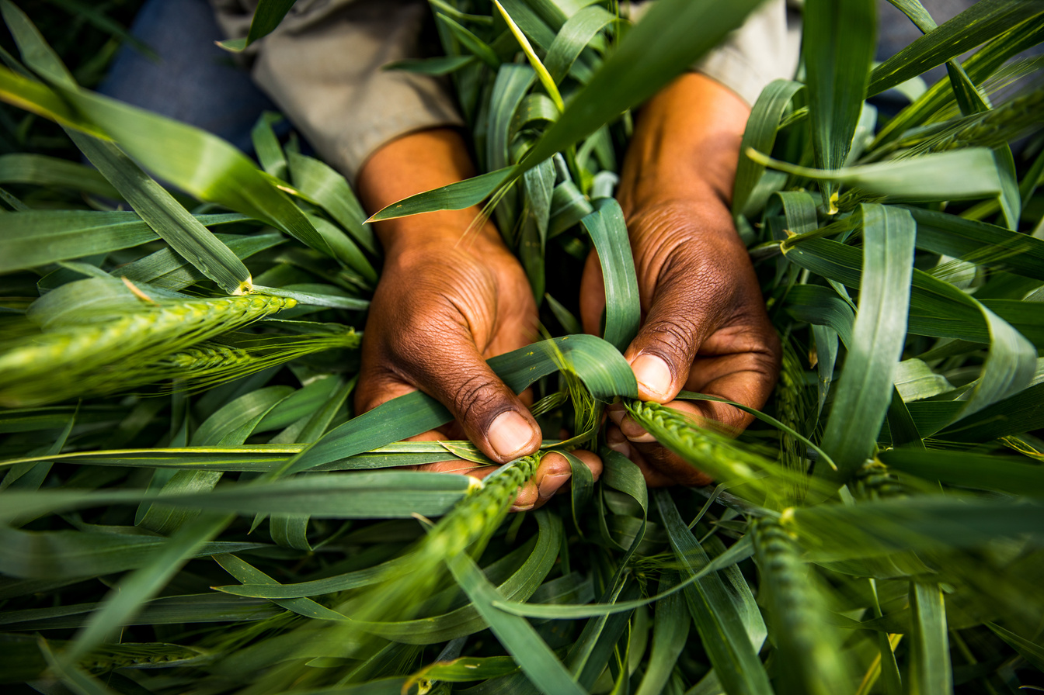
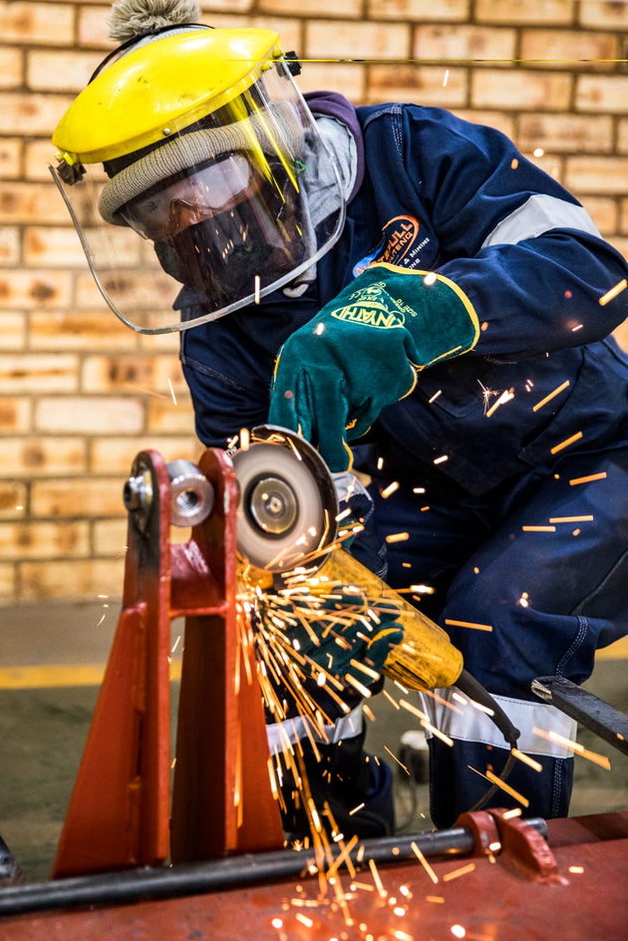
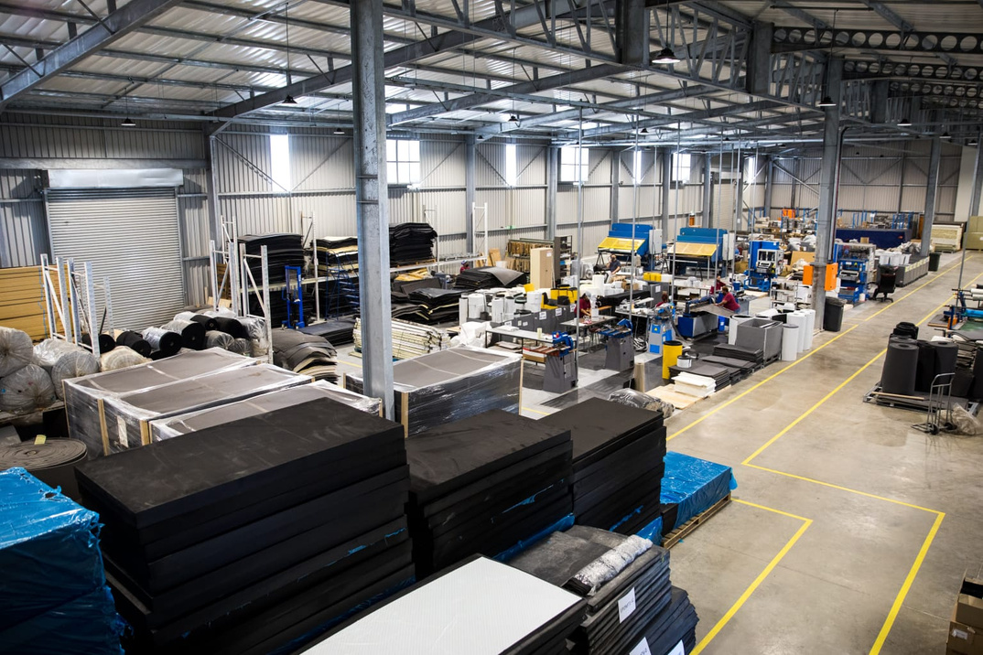
Analysis of the State of the Nation Address (SONA) 2022 on issues for Small, Medium & Micro Enterprises (SMMEs) in the Department of Small Business Development.
Portfolio Committee on Small Business Development
02 March 2022

Slide 2
Presentation Outline
1 | Purpose
2 | Introduction
3 | An Enabling Environment & Employment
4 | Reducing Regulatory Burdens
5 | Post Pandemic and Civic Unrest Support
6 | Youth Empowerment
7 | Women Empowerment
8 | Digital Economy
9 | Masterplans
10 | Agriculture Sector
11 | Green Economy
12 | District Development Model
13 | Recommendation

Slide 3
Purpose
To brief the Portfolio Committee on Small Business Development on analysis of the State of the Nation Address (SONA) 2022 on issues for Small, Medium & Micro Enterprises (SMMEs).
To detail how SMMEs issues are incorporated and budgeted for in the DSBD 2022/23 Annual Performance Plan and Operational Plan, together with its Entities (Seda and sefa).

Slide 4
Introduction
Government remain focused on the priorities that were identified in the SONA 2021/22 financial priorities:
Overcoming the COVID-19 pandemic,
Massive rollout of infrastructure,
Substantial increase in local production,
Employment stimulus to create jobs and support livelihoods, and
Rapid expansion of SA’s energy generation capacity.
To achieve this, President Cyril Ramaphosa, in his 20022 SONA committed “South Africa needs a new consensus. A consensus that is born out of a common understanding of our current challenging situation and a recognition of the need to address the challenges of unemployment, poverty and inequality. This should be a new consensus which recognizes that the state must create an environment in which the private sector can invest and unleash the dynamism of the economy.”

Slide 5
An enabling environment & employment
SONA Commitments: We have been taking extraordinary measures to enable businesses to grow and create jobs alongside expanded public employment and social protection. We all know that government does not create jobs. Business creates jobs. Around 80% of all the people employed in South Africa are employed in the private sector. The key task of government is to create the conditions that will enable the private sector – both big and small – to emerge, to grow, to access new markets, to create new products, and to hire more employees.
DSBD Response:
National Small Enterprise Act: To create an enabling environment for SMMEs and Co-operatives within which to operate, the Department has worked on a business case for the establishment of the Small Enterprise Ombuds Office through the amendment of the National Small Enterprise Act.
Reconfigure and introduce the Small Business Advisory Council, leverage on the existing Joint MinMec to partner with Provinces & ensure small business policy and programme alignment.
Implement the SMMEs and Co-operatives Funding Policy to ensure the improvement access to affordable finance for SMMEs and Co-operatives.
Accelerate the implementation of Township and Rural Entrepreneurship Programme (TREP), which is a dedicated programme to provide financial and/or non-financial support to the township and rural enterprises with emphasis on enterprises owned and managed by the designated groups (women, youth and persons with disabilities).

Slide 6
An enabling environment & employment - cont
DSBD Response:
To date, the Department has established working relationships with large retailers and wholesalers across the country to list and purchase the products manufactured by SMMEs.
More than 200 products produced by SMMEs and Co-operatives have been linked to domestic markets through these relations and simultaneously, the Department is creating independent markets in townships and towns for SMMEs and Co-operatives to trade their products.
To promote and encourage localisation in targeted sectors, DSBD in collaboration with the dtic, introduced the Small Enterprise Manufacturing Programme.
Financial support that is provided includes funding to purchase machinery and equipment for the various manufacturing sub-sectors that will be supported; Working capital for the various manufacturing sub-sectors that will be supported; and Funding for product accreditation, certification and testing.
The Department aims to establish six (6) business infrastructure in 2022/23 financial year through product markets at an estimated budget of R71.8 million in 2022/23 and R254.6 million over the MTEF.

Slide 7
An enabling environment & employment - cont
DSBD Response:
The Department will focus on finalisation and monitoring the implementation of the National Integrated Small Enterprise Development (NISED) Masterplan to ensure the delivery of an integrated targeted and effective support interventions aimed at promoting entrepreneurship as well as providing financial and non-financial support for qualifying small enterprises in order to realise increased contribution of SMMEs and Co-operatives to GDP and employment.
Provide business development support services (through Seda) to enable enterprises to access incentives offered to access new market, penetrate new markets, new products and hire more employees.
Sustain SMMEs and Co-operatives by linking them to markets through e-commerce platform.
Budget for 2022/23 Financial Year:
Business infrastructure: R 71 754 000
TREP: R700 000 000

Slide 8
Reducing regulatory burdens
SONA Commitments: “We are reviewing the Businesses Act – alongside a broader review of legislation that affects SMMEs – to reduce the regulatory burden on informal businesses. There are too many regulations in this country that are unduly complicated, costly and difficult to comply with. This prevents companies from growing and creating jobs. We are therefore working to improve the business environment for companies of all sizes through a dedicated capacity in the Presidency to reduce red tape. If we are to make progress in cutting unnecessary bureaucratic delays for businesses, we need dedicated capacity with the means to make changes. The red tape team will identify priority reforms, including mechanisms to ensure government departments pay suppliers within the required 30 days”.
DSBD Response:
The Department has set a target to ensure that 100% of valid creditors are paid within 30 days to reduce the mortality rate of SMMEs.
Review of the Businesses Act: The Department aims to provide for a simple and enabling framework for procedures for application of licensing of business by setting national norms and standards; and also, to repeal the Businesses Act, 1991.
The Businesses Act No. 71 of 1991 was transferred from the dtic to DSBD in October 2020.
Red-Tape Reduction Programme: to be implemented in partnership with Provinces, ensuring that the growth of SMMEs and Co-operatives is not hindered by the red-tape measures that exist in the system.
A Red-Tape Reduction Dashboard has been developed and is being piloted in three (3) districts.
Assessment review report of SMME regulatory impediments to reform will also be produced.
Budget for 2022/23 Financial Year: Forms part of the Goods and Services budget (R2.8 million) for the Chief Directorate: Ease of Doing Business.

Slide 9
Post Pandemic and Civic Unrest Support
SONA Commitments: This year, we are undertaking far-reaching measures to unleash the potential of small businesses, micro businesses and informal businesses. These are the businesses that create the most jobs and provide the most opportunities for poor people to earn a living. We have started discussions with social partners as part of the social compact process to review labour market regulations for smaller businesses to enable them to hire more people, while continuing to protect workers’ rights. A new, redesigned loan guarantee scheme is being introduced to enable small businesses to bounce back from the pandemic and civic unrest. This new bounce-back scheme incorporates the lessons from the previous loan guarantee scheme. It will involve development finance institutions and non-bank SME providers in offering finance, expand the types of financing available and adjust eligibility criteria to encourage greater uptake. The National Treasury is working with industry stakeholders to finalise the scheme and will provide details soon.
DSBD Response:
The Business Recovery Support Programme commenced in 2021/22 Q3 with a budget allocation of R300 million to accelerate business and economic recovery –
The budget was reprioritised from the Business Viability Scheme – targeting 150 small businesses predominantly in KZN and Gauteng provinces.
Non-financial support provided by Seda (Pre – and Post investment support).
As at Jan 2022, the Programme already committed R192.6 million for 195 deals – disbursed R123.5 million for 114 deals.
The programme closed for new applications at end of Sept 2021 – volume of applications received exceeded the available funds.
Lessons learned: The challenges in processing applications highlighted the levels of formalisation and compliance readiness of township and rural enterprises.
Seda continues to engage incomplete applicants; while sefa will continue with approvals and disbursements until end of 2021/22 financial year.

Slide 10
YOUTH EMPOWERMENT
SONA Commitments: The SAYouth.mobi platform for young work seekers to access opportunities and support now has more than 2.3 million young South Africans registered. Of these over 600,000 have been placed into employment opportunities. A revitalised National Youth Service will recruit its first cohort of 50,000 young people during the next year, creating opportunities for young people to contribute to their communities, develop their skills and grow their employability. The Department of Higher Education and Training will place 10,000 unemployed TVET graduates in workplaces from April 2022.
DSBD Response:
The Department will continue to prioritise the significant role of women, youth and persons with disabilities in the SMMEs and Co-operatives Sector.
The Department will increase participation of Youth, Women and Persons with Disabilities in domestic and international market, by finalising the guidelines for mainstreaming of Youth, Women, and Persons with Disabilities.
In addition, the Department, in its Technical Indicator Descriptions (TIDs) sets out these designated group targets (40% women, 30% youth and 7% PWDs) for the compliance and administrative; and programme, projects and incentives APP targets.
During 2022/23 financial year the Department aims to support 10 000 start-up youth businesses financially and/or non-financially.
Budget for 2022/23 Financial Year: R601 000 000

Slide 11
WOMEN EMPOWERMENT
SONA Commitments: “This year, we are intensifying the fight against gender-based violence and femicide through implementation of the National Strategic Plan on GBVF and other measures to promote the empowerment of women”.
DSBD Response:
The Department will introduce measures and to support the SMMEs and Co-operatives prioritises women, youth and persons with disabilities ensure Minimum 40% target for women, 30% for youth and 7% for persons with disabilities.
Advance the financial inclusion and business support for targeted groups.
2 000 women-owned businesses will be supported to register on international platform during the 2022/23 financial year.
1 000 of the designated products sourced from and produced by SMMEs and Co-operatives with a minimum target of 40% for Women;
500 SMMEs and Co-operatives linked to global market opportunities with a minimum target of 40% for Women.
Seda targets to support 1 600 women-owned enterprises with training, mentorship and coaching.
Seda targets to capacitate 6 400 women-owned enterprises in the township and rural areas with basic business training, business assessment and business interventions.
Through Seda, women-owned enterprises will be supported through productivity improvement programme, technological transfer assistance programme, export, exhibitions and trade facilitation.
Budget for 2022/23 Financial Year: R802 000 000 allocated for support of Women-owned enterprises.

Slide 12
DIGITAL ECONOMY
SONA Commitments: “One of the greatest constraints on the technological development of our economy has been the unacceptable delay in the migration of broadcasting from analogue to digital. The switch-off of analogue transmission has been completed in a number of provinces. As I announced in the State of the Nation Address last year, the other provinces will move to digital signal by the end of March 2022. As part of this process, government will continue to subsidise low-income households so that they can access a set-top box and make the switch to digital TV. Our communications regulator, ICASA, will commence with the auctioning of the high frequency communications spectrum in about three weeks from now. This will unlock new spectrum for mobile telecommunications for the first time in over a decade”.
DSBD Response:
The Department will modernise its business processes by developing the SMME Database to ensure effective and efficient service provisioning.
Encourage enterprises to participate in the digital economy. Department will continue participating in the Digital Economy Masterplan development.
Budget for 2022/23 Financial Year: R4 000 000

Slide 13
MASTER PLANS
SONA Commitments: “In the past year, we launched new master plans in the steel industry, furniture and global business services. Through these plans, business, government and labour are working together to increase production and create more jobs in the sector. In the clothing industry, a number of retailers have announced ambitious localisation sourcing plans”.
DSBD Response:
During 2022/23 financial year, the Department will focus on monitoring the implementation of the NISED Masterplan to ensure the delivery of an integrated targeted and effected support interventions aimed at promoting entrepreneurship as well as providing financial and non-financial support for qualifying small enterprises, using the life cycle approach.
The Masterplan will stipulate the measures that will be taken to execute the Graduation Model from informal businesses to competitive, sustainable and growing small enterprises that will contribute meaningfully to the GDP, job creation and inclusive growth.
Working closely with the dtic the Department is participating is analysing all masterplans to identify the role for SMMEs and Co-operatives in the implementation of Masterplans
Budget for 2022/23 Financial Year: Forms part of the Goods and Services budget (R2 200 000) for the Enterprise Development Programme.

Slide 14
Agriculture Sector
SONA Commitments: “The agriculture sector has also recognised the importance of supporting small-scale farmers and integrating them into value chains. Through the sugar master plan, the industry has provided R225 million to over 12,000 small-scale sugar cane growers as part of a R1 billion commitment to support black farmers. We will be expanding the provision of input vouchers and calling on other sectors to join this effort, so that we can collectively reach up to 250,000 small-scale farmers this year. None of our efforts to revive our economy will succeed if we do not tackle the scourge of corruption once and for all”.
DSBD Response:
The Department, through the sefa provides financial support for the SMMEs and Co-operatives in the Agricultural Sector.
The Department, through Seda, will provide business development support services.

Slide 15
Green economy
SONA Commitments: “Renewable energy production will make electricity cheaper and more dependable and will allow our industries to remain globally competitive. Investments in electric vehicles and hydrogen will equip South Africa to meet the global clean energy future. We will be able to expand our mining industry in strategic minerals that are crucial for clean energy, like platinum, vanadium, cobalt, copper, manganese and lithium. We also have a unique opportunity in green hydrogen, given our world-class solar and wind resources and local technology and expertise. All of these measures – from structural reforms to support for SMMEs, investments in infrastructure and the emergence of new sectors – will drive a turnaround in economic growth driven by the private sector growth over the coming years”.
DSBD Response:
Facilitate market opportunities for SMMEs and Cooperatives in the clean energy space.
Encourage enterprises to participate in the green hydrogen.
Avail funding opportunities for enterprises to participate in the green economy.
The Department together with its entities is engaging with the Department of Mineral Resources and Energy to identify opportunities for SMMEs and Co-operatives and develop appropriate interventions

Slide 16
District Development Model
SONA Commitments: “This year, we will continue with the implementation of the District Development Model. This Model brings all three spheres of government together with other social partners in every district to grow inclusive local economies and improve the lives of citizens. In particular, the DDM facilitates integrated planning and budgeting across spheres of government and improves integration of national projects at a district level. While there are many parts of the state that require much work, there are institutions that continue to serve the people of this country effectively and efficiently”.
DSBD Response:
During the 2022/23 financial year, the Department and its Agencies will implement 50 public engagement programmes within District Municipalities.
Support municipalities to develop implementable local economic development strategies.
Support projects that are in Integrated Development Plans.
Support municipalities to enable them to provide referral or business development support services to small businesses.
Budget for 2022/23 Financial Year: Communication and Marketing Budget of R2 800 000.

Slide 17
Recommendation
The Portfolio Committee on Small Business Development to note initiatives undertaken and planned by the Department of Small Business Development in response to the Commitments made by His Excellency President Ramaphosa during the State of the Nation Address 2022.

Slide 18
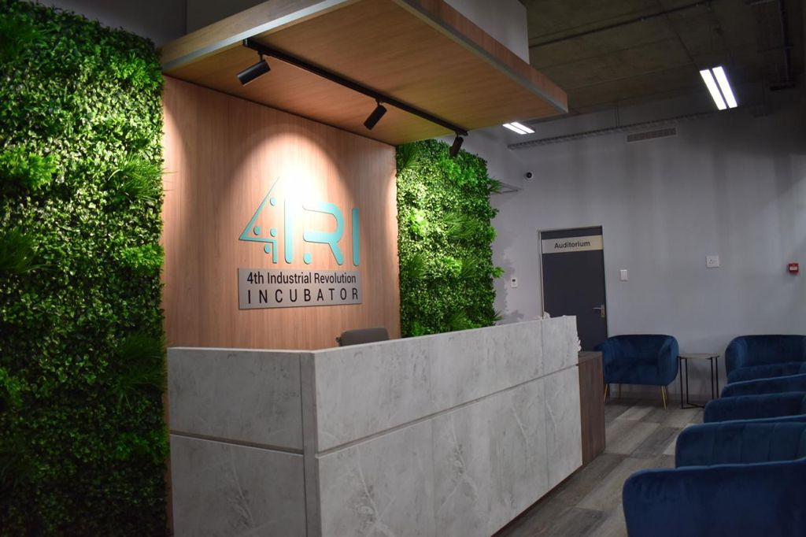
Thank You!

Slide 19
REACH OUT
Department of Small Business Development
77 Meintjies Street
Sunnyside
Pretoria
0001
+27 861 843 384
sbdinfo@dsbd.gov.za
www.dsbd.gov.za
Small Enterprise Development Agency
The Fields, Office Block A
1066 Burnett Street
Hatfield
Pretoria
0833
+27 12 441 1000
info@seda.gov.za
www.seda.org.za
Small Enterprise Finance Agency
Byls Bridge Office Park, Cnr Olievenhoutbosch Street & Jean Avenue, Building 14 , Block D 11 Byls Bridge Boulevard Highveld Extension 73 Centurion
0157
+27 12 748 9600
helpline@sefa.org.za
www.sefa.org.za

