Slide 1
DIRCO Briefing to the Portfolio Committee
The Constitutional Referendum in Tunisia and its implications for the future of the country
02 March 2022

Slide 2
OUTLINE
SOUTH AFRICAN FOREIGN POLICY APPROACH
GLOBAL ENVIRONMENT AND TRENDS
HISTORICAL BACKGROUND ON TUNISIA
CURRENT DYNAMICS / KEY DEVELOPMENTS
CONSTITUTIONAL REFERENDUM
REGIONAL AND INTERNATIONAL RESPONSES
SA BILATERAL RELATIONS WITH TUNISIA
RECOMMENDATIONS

Slide 3
SOUTH AFRICA’S FOREIGN POLICY APPROACH
Work towards an African continent that is peaceful, democratic, non-racial, non-sexist, united and prosperous and which contributes to a world that is just and equitable. South Africa pursues this policy vision, guided by the African values of Ubuntu.
Africa centric in approach.
Guidelines: The strategic focus of the Department of International Relations and Cooperation (DIRCO).
Seven MTSF priorities, with a focus on the seventh priority, "A Better Africa and World".
Global implementation environment.
This presentation will among others mainly focus on the constitutional referendum in Tunisia and its possible implications for the future of that country.

Slide 4
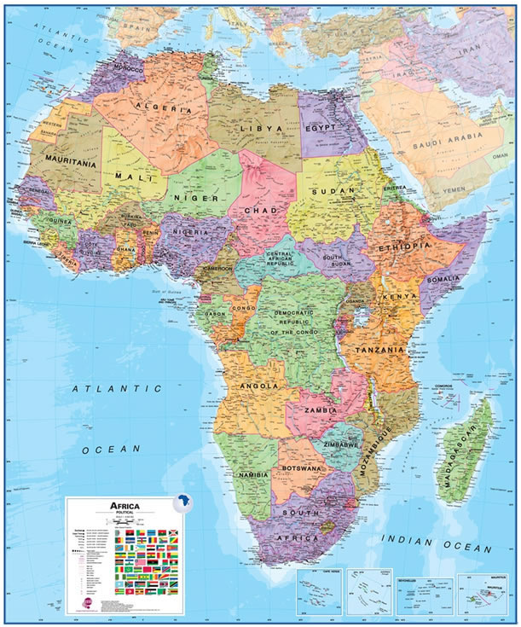
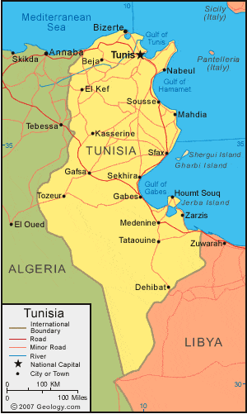
TUNISIA ON THE MAP

Slide 5
GLOBAL ENVIRONMENT AND TRENDS
The current global environment.
Emerging trends.
Multilateralism.
Conflict resolution.
The use of UNSC and the AU to promote peace, security and stability on the continent.

Slide 6
HISTORICAL DEVELOPMENTS - TUNISIA
Territory occupied, among others, by Roman and Ottoman empires.
Tunisian recorded history can be traced back to the presence of Amazighen (indigenous north Africans also referred to as Berber tribes) who inhabited the territory.
Phoenician and Cypriot settlers later occupied the coastal area.
It provided a vital shipping link for mercantile trade within the Mediterranean sea.
The city of Carthage became a centre of commerce, education and seat of political power for the various constituencies.
Became a French protectorate (Colony) in 1881. French subjugation of the inhabitants followed.
Resistance to French rule intensified from the earlier part of the 20th century.
In 1956 Tunisia became independent and the country was proclaimed a Republic.
Habib Bourguiba became the first President of independent Tunisia.
In 1987 a bloodless coup led by General Zine El Abidine Ben Ali removed President Bourguiba from power.

Slide 7
HISTORICAL DEVELOPMENTS – TUNISIA (cont.)
Coup heralded the beginning of the Ben Ali era.
In 1989 Ben Ali won Presidential elections and was re-elected in 1994, 1999, 2004 and 2009.
At the beginning of December 2010 Tunisian citizens led by the youth, began protesting against the authorities, especially around the deteriorating economic conditions.
The key issues underpinning the mass protests were unemployment, high food prices and energy prices.
Mass protests intensified (the Thawrat al-Karamah “Dignity” Revolution, also referred to in western media as the Jasmin Revolution). The President declared a state of emergency on 14th January 2011 and dissolved government.
On the same day, Ben Ali fled to Saudi Arabia. This resulted in the beginning of the so called Arab Spring.
Government led by interim President Moncef Marzouki installed from 2011-2014.
A new constitution was signed into law by Marzouki with the support of his Prime Minister Beji Cais Essebsi in 2014.

Slide 8
HISTORICAL DEVELOPMENTS – TUNISIA (cont)
In the December 2014 Presidential elections, Beji Caid Essebsi was elected as President.
Kais Saied was elected President of Tunisia in the 2019 presidential elections as an independent candidate.
Currently Tunisia continues to experience economic difficulties
Increasing stability challenges are exacerbated by threats posed by extremist groups in some parts of the country. The Covid-19 pandemic has also contributed greatly to the negative economic performance of the government.

Slide 9
CURRENT DYNAMICS / KEY DEVELOPMENTS
The President has declared his dislike of political parties and his view that they form part of the corrupt elite.
The President is conservative and has opposed attempts to modernise some of the institutions in Tunisia.
This has put him in direct conflict with the youth and most civil society groups.
Dynamics in Parliament (before its suspension) were characterised by fierce political battles between members supporting Saied and the majority Ennahda Movement and its allies, the Qalb Tounes Party and Al Karama Party.
Governance has been paralyzed due to factional battles.
The President is increasingly regarded as autocratic and not taking into consideration the views of stakeholders.
Authorities clamping down on opposition leaders and members of the judiciary through arbitrary arrests and detentions.

Slide 10
CURRENT DYNAMICS / KEY DEVELOPMENTS (cont)
Major crackdown on the media and non-governmental organisations, including the labour unions.
Increasing sporadic protests against the President in various cities and towns.
On 9 -10th February 2022, the Tunisian Judges Association called for the suspension of work across all courts in the country in protest.
Parliamentary Elections will be held on the 17th December, 2022.
The current political dynamics also take place within the context of a struggling economy.
Tunisia’s unemployment rate is at approximately 18%. Furthermore, the countries economy shrank by more than 8%.
Budget deficit stands at 11,4%.
Tunisia is currently in negotiations with the IMF and World Bank to be provided with loans to address some of its economic challenges.
The security situation throughout the territory remains stable despite threats by small extremist groups.

Slide 11
CONSTITUTIONAL REFERENDUM
On 25th July 2021 the President suspended the Parliament.
New Prime Minister appointed to lead a new cabinet.
President issued a decree proclaiming a constitutional referendum to be held on 25 July 2022.
The current constitution (2014) is highly contested and its efficacy is questioned by the President.
Objective of the Presidential rule by decree is claimed seems to be necessary to effect changes to the constitution and general governance.
The post-referendum (amended) constitution is likely to create a strong presidential system with wide ranging executive powers.
The President launched an electronic online platform of consultations on the forthcoming referendum in January 2022.

Slide 12
CONSTITUTIONAL REFERENDUM (cont)
However, opposition parties and civil society, stakeholders are calling for the holding of a National Dialogue on the matter of the referendum instead of the online electronic consultations.
The National Dialogue is envisaged to be broader in scope and would include all sectors of society.
Proponents of the national dialogue maintain that this would allow for a more comprehensive reflection and inputs on the possibility of any new constitution.
Major stakeholders, opposition parties, civil society organisations and labour formations have objected to the use of the online platform.
The current impasse will likely lead to a continued disagreements around how the consultations should unfold.
The further lack of involvement by representatives of the suspended parliament is a major shortcoming in the process.

Slide 13
CONSTITUTIONAL REFERENDUM (cont)
Scenarios
An impasse between the President and his opponents. The resultant stalemate would render the current process as illegitimate and could plunge the country into turmoil.
The President sticks to his timelines, adoptions a new constitution and completes legislative elections by the end of the year through negotiations and engagement with the opposition. This would be a best-case scenario.
The President does not make efforts to meaningfully engage the opposition and civil society, and the constitutional change and electoral process is derailed, and the military is needed to prevent violent protests or possible civil war. A military coup is a remote possibility at this stage but may be the last resort to maintain order and oversee a transitional phase to new elections. This would be a worst case scenario.

Slide 14
REGIONAL AND INTERNATIONAL REPSONSES
Neighbouring countries and the international community have maintained a generally positive and supportive approach.
Regional leaders are keenly aware of the need to respect sovereignty and non-interference in the domestic affairs of another state and therefore prefer to offer encouragement and support for the speedy move to elections and the adoption of the mechanisms and institutions for good governance.
In the case of the Arab League and the African Union (AU), there has not been any direct diplomatic intervention. The AU has urged the parties to engage in dialogue and noted its support for a return to the rule of law.
However, some Western countries have taken a stronger approach and have criticised and condemned what they regard as an attack by President Saied on democracy and constitutionalism in Tunisia. These include countries like Canada, France, Germany, Italy, Japan, the UK and the US.

Slide 15
SA BILATERAL RELATIONS WITH TUNISIA
Formal diplomatic relations between South Africa and Tunisia established in 1994.
Both countries have resident diplomatic Missions in Tshwane and Tunis respectively.
A Joint Bilateral Commission (JBC) was established in 1996. Held at Ministerial level. Last convened in 2008.
In the interim Ministerial visits were exchanged between the two countries.
In addition to visits by DIRCO Principals, South Africa undertook visits in sectors such as Trade and Industry, Science and Technology and Home Affairs.

Slide 16
SA BILATERAL RELATIONS WITH TUNISIA (cont)
In the area of trade and investment, one of the high-level visits led to the establishment of two joint committees tasked to expand trade and investment.
The committees identified areas such as agriculture, industrial products, agro processing, intellectual property rights, ICT and telecommunication and construction.
Technical expert met for consultations in areas of trade and investment, health, tourism, environmental affairs, arts and culture, and science and technology.
South Africa hosted a group of about 100 Tunisian doctors, who were deployed in various Provinces to assist with medical expertise.
DIRCO is preparing to revitalise the structured bilateral mechanism, the JBC with Tunisia, in order to boost bilateral cooperation.
Related engagement are continuing at the level of Senior Officials and interactions with the Tunisian Embassy in Tshwane.

Slide 17
RECOMMENDATIONS
Tunisia is an important county in North Africa that offers significant opportunities for SA in trade and investment. It is therefore important to strengthen the JBC.
Human resource capacity and skills development is important for both countries. SA and Tunisia can both benefit from shared education and training opportunities.
Sharing SA’s experience in inclusive constitution-building and possible inter-parliamentary cooperation may offer relevant opportunities for active assistance that could be explored.
As a commitment to strengthening relations, the promotion of people-to-people links are important. This can include promotional social events, arts and culture exchanges, and sports and educational cooperation.
Both countries should continue to work together to advance the African Agenda 2063 and a rules-based international system, anchored in multilateralism.

Slide 18
THANK YOU!

