Slide 1
PROGRESS UPDATE OF PC4IR STRATEGIC IMPLEMENTATION PLAN
February 2022

Slide 2
Background
‘The 4th Industrial Revolution is an era where people are using smart, connected and converged Cyber, Physical and Biological systems and smart business models to define and reshape the social, economic and political spheres.’ (PC4IR, 2020).
The convergence of these technologies brings about fundamental disruptions to our world and will have a crosscutting impact on all aspects of humanity. The President of the Republic of South Africa, his Excellency Cyril Ramaphosa, moved for South Africa not to be left behind in this global 4IR race.
To this extent; the President established the Presidential Commission on the Fourth Industrial Revolution (PC4IR), Cabinet approved the 30 January 2019, further announced in State of Nation Address (SONA) and with operational support that will be provided.

Slide 3
PROGRESS TO DATE
PC4IR REPORT
Apr 2020- Draft
Oct 2020 - Gazetted
01
Draft Consultative PC4IR SIP
ESIEID - Oct 2020
FOSAD MANCO - Nov 2020
Ministerial ESIEID - Nov 2020
05
02
PC4IR SIP M&E
Q4 2021/Q1 2022
M&E Key Programmes
Stakeholder Consultations
DCDT Internal - Feb 2021
DPME - Mar 2021
Departementst, Provinces & Prívate Sector - Feb-Jul 2021
Feedback Analysis Finalised - Aug 2021
Final Draft Submitted – Oct 2021
04
03
Submission PC4IR SIP
Nov 2021
Review for Priority Programmes

Slide 4
PC4IR SIP PURPOSE
Guide South Africa in identifying potential investment areas and opportunities towards ensuring that the country adequately responds to the fourth industrial revolution.
Provide a model for alignment that all spheres of government can work with towards 4IR implementation
To unify all government technological initiatives to drive digital transformation and position South Africa take advantage of the socio-economic opportunities presented by 4IR.
Assist all spheres of the public and private sectors to identify areas of collaboration and cooperation towards a 4IR-enabled South Africa.
Establish South Africa’s 4IR monitoring and evaluation framework to facilitate inclusivity that has an impact on society and to assist in the coordination of technological initiatives.

Slide 5
PC4IR SIP APPROACH
Establish an integrated, time-framed and actionable 4IR path for South Africa;
Create a criterion to identify existing and future 4IR programmes across different economic sectors and public institutions;
Identify the challenges within the high growth-potential economic sectors, public institutions and propose 4IR technological solutions that holds the potential to address these challenges;
Outline a collaborative structure for stakeholders to successfully deliver 4IR programmes;
Develop an approach for 4IR awareness and engagement to ensure the PC4IR SIP programmes are strategically and effectively communicated, coordinated, monitored, and evaluated;
Align the PC4IR SIP with South Africa’s existing key strategic developmental plans, primarily the NDP and the MSTF 2019–2024.

Slide 6
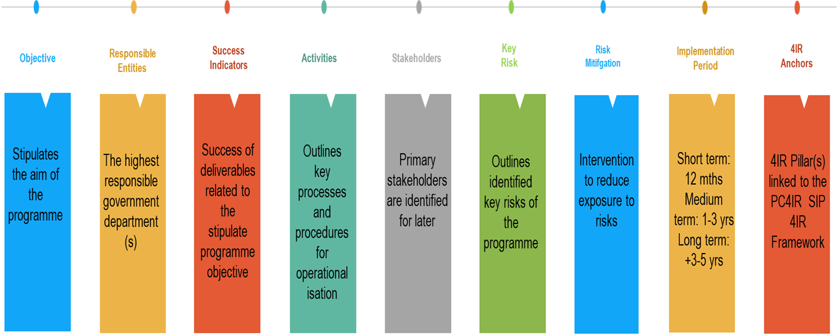
METHODOLOGY
Programme / Project: A programme or project needs to be identified first as an intervention under the PC4IR SIP Strategic Position/s: 4IR Enabling and Sustainability Precursors, Digital Infrastructure, Human Capital 4.0, Digitisation, Application of 4IR Technologies Private Sector, Innovation, Commercialisation and Internationalisation. Status: Each programme’s status will be determined as being: Operational = these are existing programmes, Advance = programmes that are almost live or policies that are on their final stage before implementation, On-going = process has started but not yet implemented/operational, Not started = programmes here will be those that are not started but critical. Futuristic = not started will be beneficial for the country but with low priority. PC4IR Recommendation: Specifies the PC4IR Report recommendation linked to the programme. Impact: estimated number of individuals that the programme / project plan to positively impact directly either economically or socially Project value: project investment/budget value Identified Beneficiaries: the identified beneficiaries for the programme of project

Slide 7
PC4IR SIP STRATEGY PRIORITIES
Outline 4IR framework & onboarding methodology
South Africa
4IR Readiness
Current & planned infrastructure
programmes
Skilling, reskilling & upskilling
SA 4IR, Implementation STRATEGY
4IR ENABLING & SUSTAINABILITY PRECURSORS
DIGITAL INFRASTRUCTURE
HUMAN CAPITAL 4.0
1
Vision
2
3
4
5
“South Africa will have a globally competitive, inclusive and shared economy with the technological capability and production capacity that is driven by people harnessing the Fourth Industrial Revolution to propel the country forward towards its social and economic goals.”
GOVERNMENT DIGITIZATION
SOUTH AFRICA INDUSTRY 4.0
INNOVATION, COMMERCIALIZATION & INTERNATIONALIZATION
COORDINATION, ENGAGEMENT & MONITORING
6
7
8
9
Coordination structure, monitoring & evaluation
Public sector 4IR implementation
Applying 4IR in key economic sectors
R&D and Markets

Slide 8
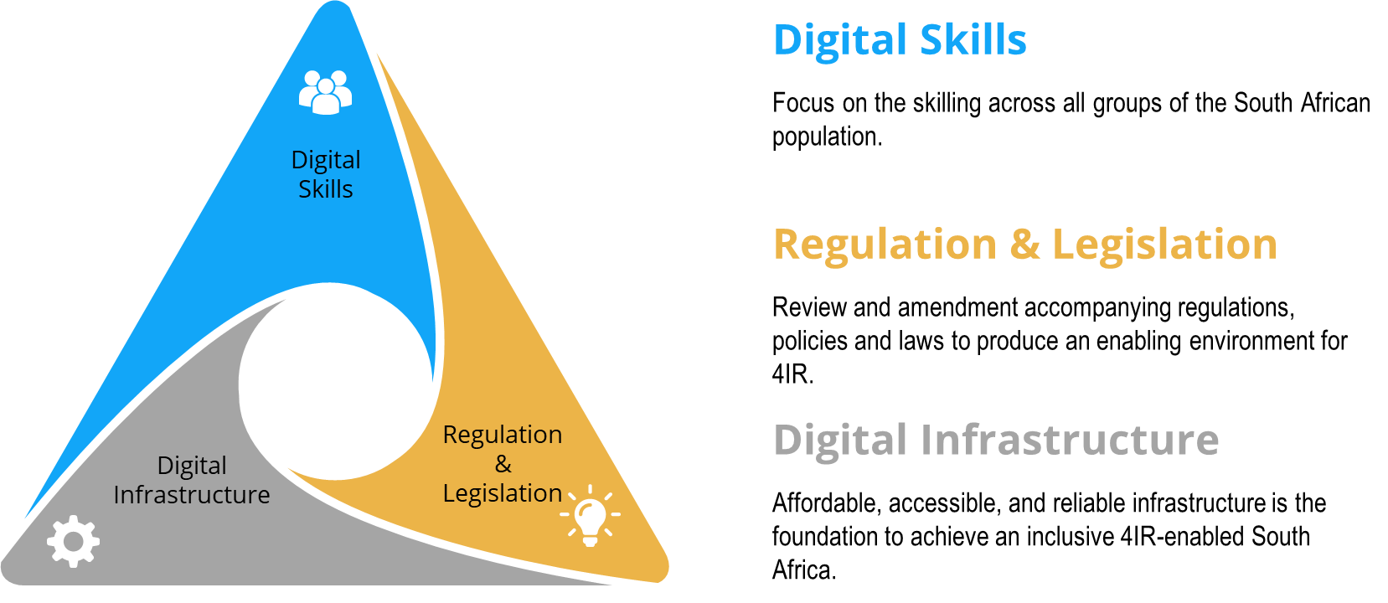
PRECURSOR SUMMARY

Slide 9
PC4IR KEY RECOMMENDATIONS WITH ALIGNED DCDT PRIORITY PROGRAMMES
1
Investment in human capital;
The establishment of an artificial intelligence (AI) Institute;
The establishment of a platform for advanced manufacturing;
To secure and avail data to enable innovation;
Incentivise future industries, platforms and applications of 4IR technologies;
Build 4IR infrastructure;
The review and amendment (or create) policy and legislation;
Establish 4IR Strategic Implementation Coordination Council
The National Digital and Future Skills Strategy; Align with Skills for Jobs Initiative; Device repairs.
AI Institute TOR finalised Launch Targeted Q1 2022/2023; DCDT lead development of the AI Blueprint for Africa, Africa 4IR Strategy and SADC BigData Framework .
Digitech Portal to profile local innovative products.
Accelerating the Digital Infrastructure : Rapid deployment, Broadband connectivity, Cloud Infrastructure, Obligations.
Accelerating Spectrum Policy: 5G and beyond, Re-farming 2g &3G, BDM, Manufacturing Spectrum, Services Spectrum.
Agile Policy Review : Digital Transformation Policy replace the ECA, Gov 5.0 Policy, Future of Broadcasting,
Stimulate Local Manufacturing : focus on Devices, Promoted Digital products, Focus on Innovation, Leverage demand through initiative such as accessible devices for learners.
2
3
4
5
6
7
8

