Slide 1
Presentation to the Portfolio Committee
1 March 2022
Financial Management Report Third quarter 2021/2022

Slide 2
Table of contents
A brief overview of the financial report of the CGE. Expenditure per programme
An overview of the CGEs management of income, expenditure, transfers, cash and assets, as well as the state of its financial management systems – achievements and challenges.
Indicate what the cost incurred has been for the CGE insofar as dealing with the impact of the COvid-19 on operations with specific reference to for e.g. cost incurred for PPE – how much has been spent, on what? for who?
Progress update on any investigations under way
Audit Action Plan and progress hereto

Slide 3
Overview
Financial Performance and Position

Slide 4
Overview of the CGE’s Financial Report
Figures to be read in context taking the following into consideration
For the financial year under review (2021/2022), National Treasury granted the Commission an Annual Budget of R91,4 million from an adjusted baseline of R78,6 million received in the prior year
The recorded budget increase of 16% (R12,8m) represents a restoration of the budget to nominal figures following significant budget cuts recorded in the previous financial year.
We anticipated that spending will materially increase in the current period when compared to the prior period, however this would be negatively affected by the delays in the filling of existing vacancies. The estimated number of vacancies is 23.
For the nine-month period ended 31 December 2021, the Commission incurred total expenditure of R 55,2m representing a 19% (R13,8m) underspending variance from a cumulative budget amount of R 68,5 m.
Management of cash- The CGE has a healthy balance sheet with a positive balance of R 28m.

Slide 5
(Financial Performance)
As at the end of the second quarter, the CGE had a budget allocation R 68,5m and has an underspending of R 13,8m. It is projected that the full budget will not be spent at the end of the financial year 2021/2022. The actual amount spent is R55,2m. The underspending has been ranked from highest to lowest contributor in underspending.
The underspending is mainly due to high number of vacancies that have not been filled. The underspending in relation to this line item is R 7,2m
Staff Training and development contributed by R 1,458 m in underspending of the CGE. This was due to decrease in the number of training sessions due to lockdown regulations.
Advertising, Promotion and Publicity resulted in underspending of R1,289m. There was anticipation that these costs will increase in line with the recruitment process. The delay in the recruitment process resulted in underspending on this line item.
Office Cleaning and Maintenance under-expenditure of R1,232 million contributes to surplus mainly because of COVID budget which was not spend as anticipated/provided and also that the staff had to work from home.
Report writing contributed by R 1,143 in the underspending of the CGE. We expect the spending to increase in the last quarter due to the expected finalization of the reports for the 2021/2022 .

Slide 6
Main Sources of underspending - YTD
Compensation of employees – R7,2 million
Training & Development – R1,4m due to lockdown restrictions in the main
Advertising and promotion– R1,289 m due to slow pace in the recruitment process.
Office cleaning & Maintenance – R1,232 m due to lockdown induced office utilisation (saving on water & lights, etc), lesser spending on PPE and related (as was provided with the annual adjustment budget)
Report writing & Publishing – R1,143 m Due to the fact that the report writing was still at the planning and implementation phase. We expect the expenditure to increase due to finalization of the report.

Slide 7
Expenditure by economic classification and Programme
Compensation of Employees Saving of R6.47 million due to vacancies across the establishment and the favourable effect from leave taken during December holidays
Goods & Services
R3,9 million under-spent due Lockdown imposed restrictions. (office overheads and time-lag on APP activities)
Core Service delivery and Commissioners ‘s programmes 69% of the spend - Obligations under the CGE Act, s8 & s11….These programmes also accounts for the bulk of the underspending (ytd)
Corporate services component is 31% of total spend. Depreciation charge is the key driver, spending gap under Goods and services

Slide 8
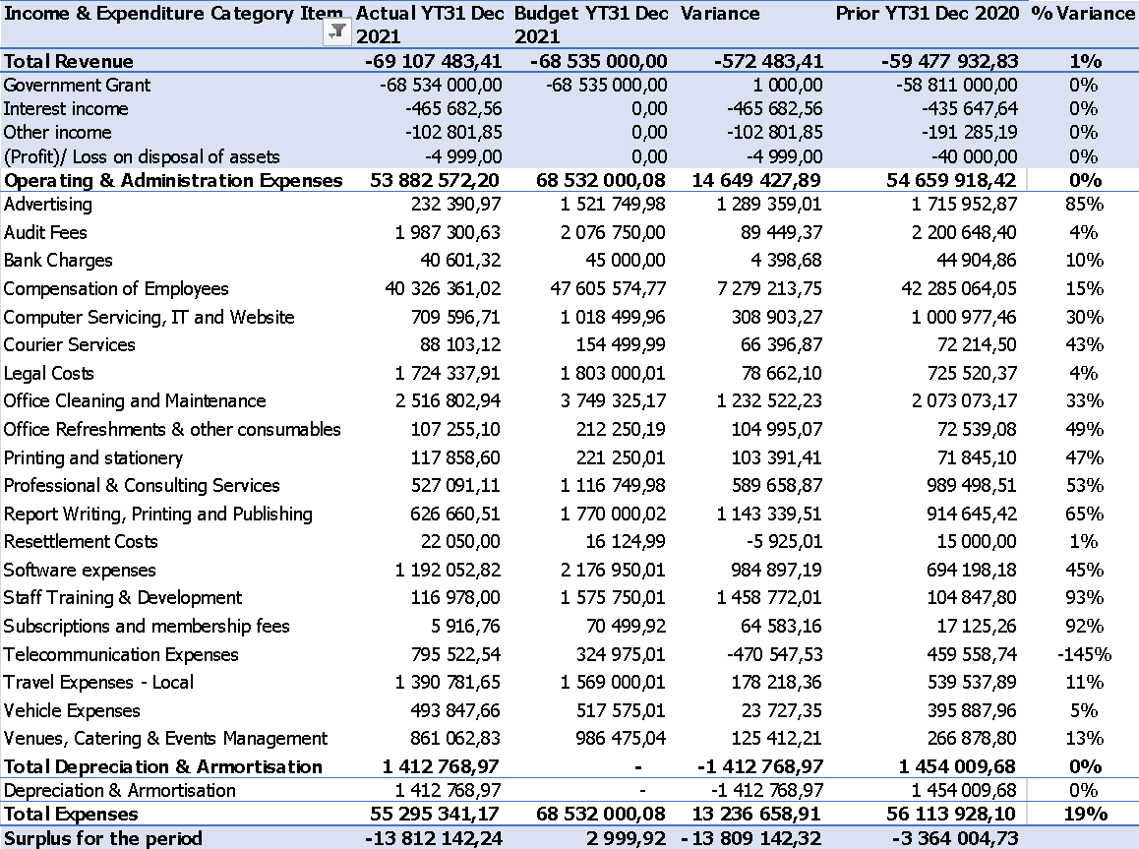
Comparative Income and Expenditure analysis – April to December 2021
The income of the CGE mainly consists of Grant income. The rest of the income is interest income earned on the positive bank balance.
There is continued underspending resulting from , the high vacancy rate, increasing attrition rate and the normal (but long) lead times in recruitment processes.

Slide 9
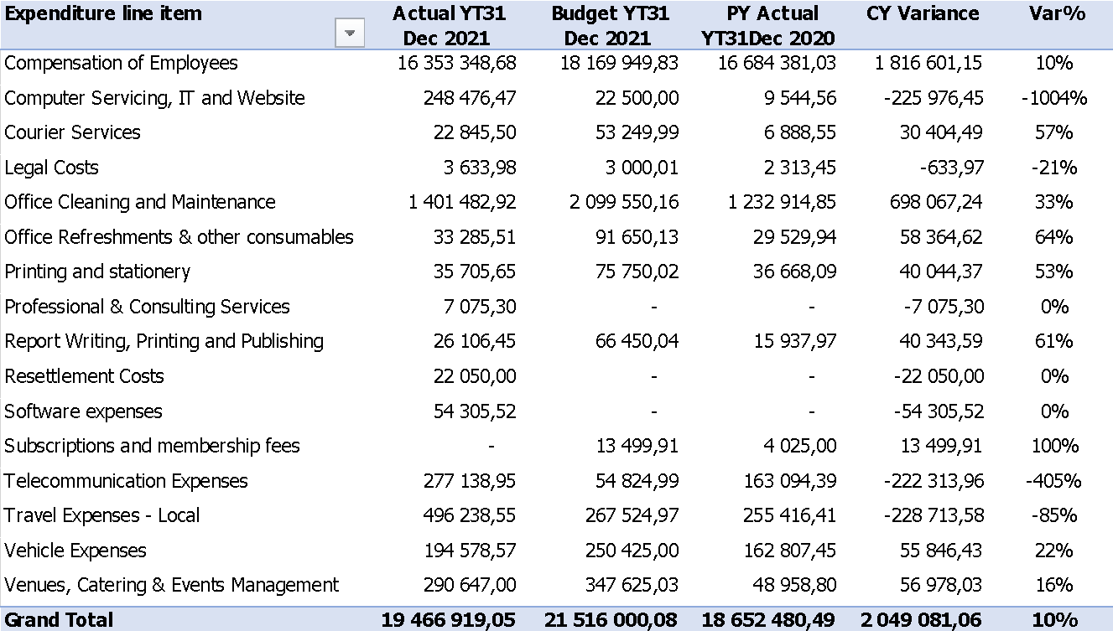
Provincial Offices X 9 (Consolidated)
Line Departments at Head Office
Budget and spending on Core is skewed to Provincial offices, rightfully as the main service delivery outlets of the CGE.
HQ provides strategic support in terms of policy and content required for effective implementation.

Slide 10
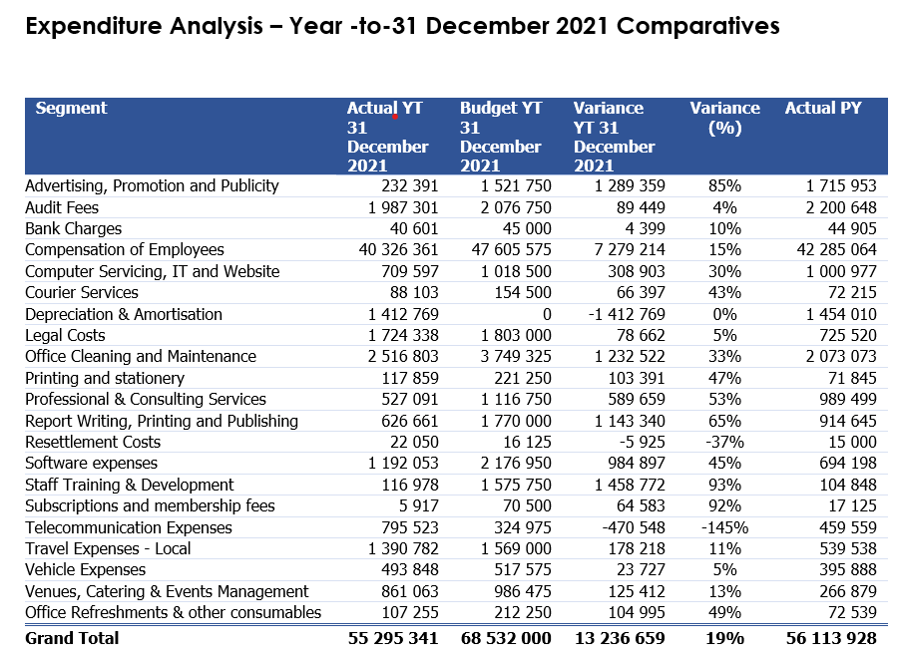
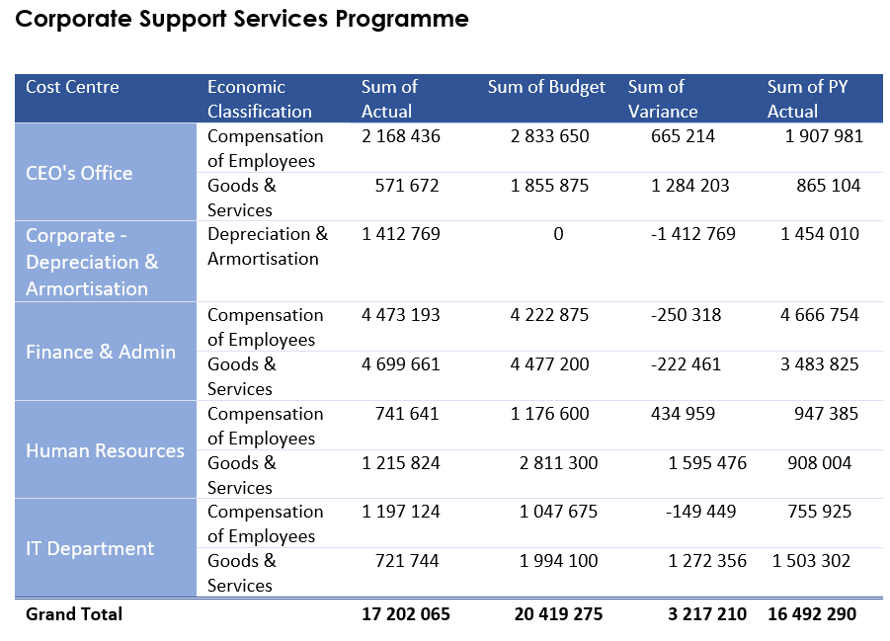
Corporate Services

Slide 11
Take-way……2 [Management of Assets and Liabilities]
CGE is a going concern
Solvency & Liquidity test is positive
There are sufficient cash resources to meet the obligations when they fall due
Asset management in order – physical verifications concluded and disposals on old vehicles concluded in line with prescripts

Slide 12
FINANCIAL MANAGEMENT SYSTEMS

Slide 13
Take-away from the Report……3 (Corporate Management)
SCM: Demand and Acquisition management – The Procurement plan is going according to plan and it is anticipated that by the end of 31 March 2022 the plan will be fully executed.
COVID spending on PPE has not been material in the current year. We had a contract for deep cleaning the offices. The contract expired in January and we are in the process of sourcing another supplier. The spending was incurred strictly in accordance with the prescripts of the law.
SCM Disposal Management – No assets disposed in the current financial year.
SCM Contract management – Contracts are reviewed on a regular basis. Vox remain an outstanding issue as previously reported.
SCM Logistics, facilities and fleet management – The standard of Office building are generally acceptable but for HQ, Mpumalanga office. Compliance to Protocols upheld generally with offices hygiene and health standard adhered to.

Slide 14
Litigation and claims
Sandile v CGE– matter closed in November 2020
17% Matter - litigation ongoing
Vox Telecoms – Internal investigation yet to be concluded
Maema v CGE – status of litigation unknown

Slide 15
Audit Action Plan
As at the end of the third quarter, CGE is 63% done on the completion action plan
It is anticipated that the plan may not be fully implemented by the end of the fourth quarter. The challenges result from the absence of Heads of departments who can lead in implementation of the Audit plans
The plan is to put new time frames for the actioning of the plan and delegate these to other Heads of departments.

Slide 16
Thank You
HAVE A GENDER RELATED COMPLAINT ????
REPORT IT TO
0800 007 709
Twitter Handle @CGEinfo Facebook: Gender Commission of South Africa

