Slide 1
SA Connect: Connecting Government and Communities
Broadband Connectivity
Portfolio Committee Presentation
Connecting the nation

Slide 2
Background
The South Africa Connect, which is the South Africa’s Broadband policy was adopted by Cabinet in December 2013,
Due to its scale and complexity, the programme was divided into two phases:
  Phase 1 as a pilot phase to provide 10Mbps (megabits per second) broadband services to 35 211 government facilities; and
  Phase 2 focused on connecting the remaining front-line government services. Due to the budget cuts in 2017, the scope of the work for Phase 1 was significantly reduced.
970 government facilities were then connected as part of Phase 1 and the remainder of the facilities will be included as part of Phase 2.

Slide 3
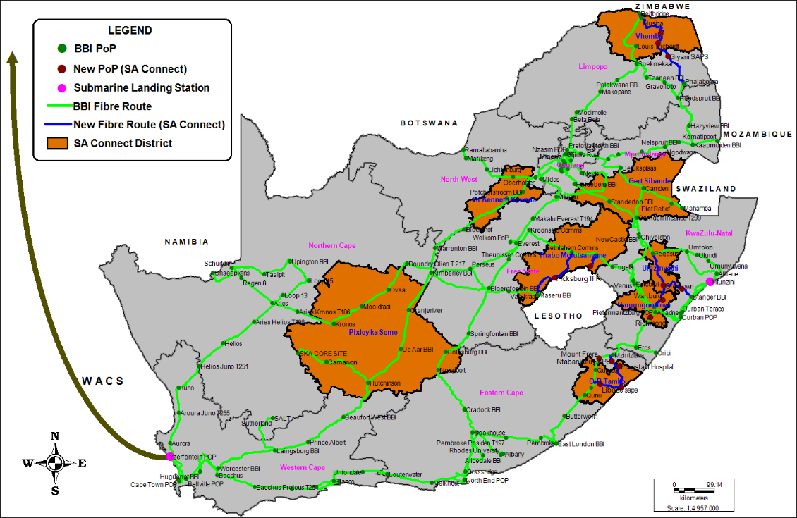
SA Connect Phase 1 – Coverage Districts
51
125
77
122
35
54
87
162

Slide 4
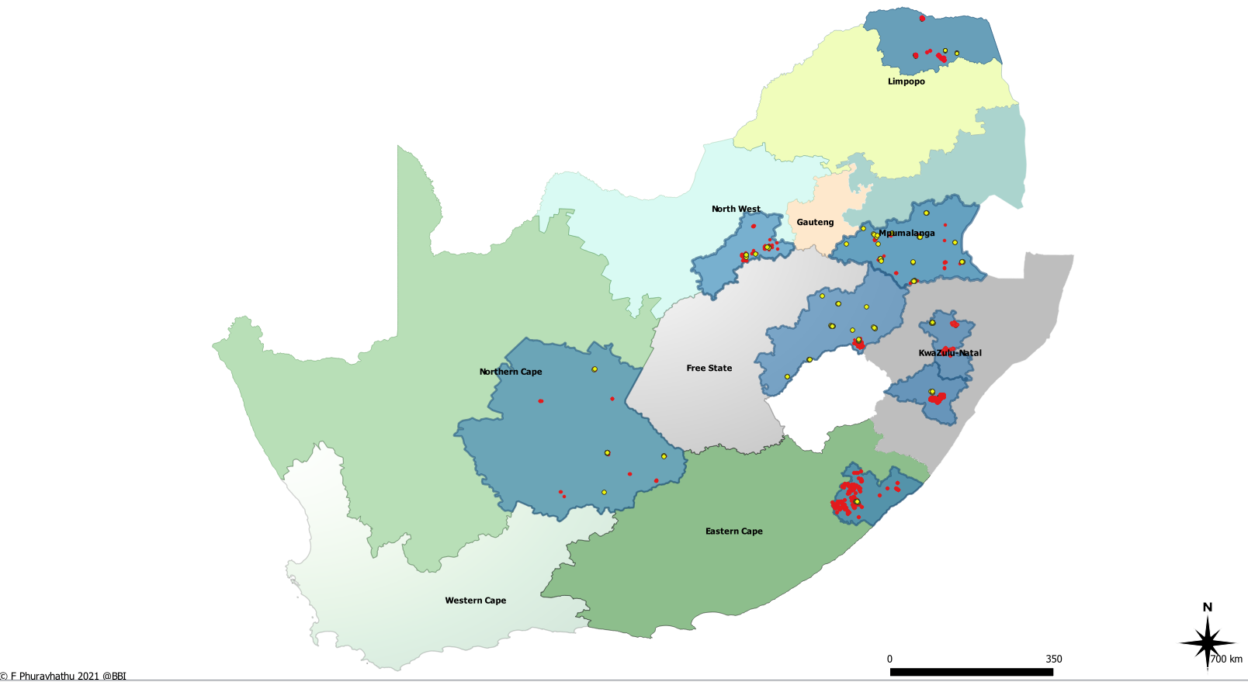
Phase 1 SA Connect Sites with SITA Upgrades
Zimbabwe
LEGEND
Vhembe
SA Connect Sites (Connected)
SITA Upgrade Sites
SA Connect District
Botswana
Mozambique
Dr Kenneth Kaunda
Gert Sibande
eSwatini
Thabo Mofutsanyane
Namibia
uMzinyathi
Lesotho
uMgungundlovu
District | Province | Phase 1A & 1B sites | SITA Upgrade sites | Total
Dr Kenneth Kaunda | NW | 125 | 11 | 136
Gert Sibande | MP | 77 | 71 | 148
OR Tambo | EC | 162 | 16 | 178
Pixley ka Seme | NC | 54 | 17 | 71
Thabo Mofutsanyane | FS | 122 | 48 | 170
uMgungundlovu | KZN | 87 | 54 | 141
uMzinyathi | KZN | 35 | 16 | 51
Vhembe | L | 51 | 24 | 75
Total |  | 713 | 257 | 970
Pixley Ka Seme
O.R.Tambo

Slide 5
SA Connect Phase 1 Connected Sites
713 facilities were completed under Phase 1 as per table.
  117 of the 713 sites are Health Facilities in 8 districts
District Municipality | School | Independent Schools | Health | Government | Thusong | Total
Eastern Cape | 131 | 8 | 22 | 0 | 1 | 162
Free State | 97 | 2 | 23 | 0 | 0 | 122
Mpumalanga | 62 | 1 | 14 | 0 | 0 | 77
North West | 21 | 102 | 2 | 0 | 0 | 125
Northern Cape | 1 | 14 | 38 | 1 | 0 | 54
Kwazulu Natal | 104 | 5 | 13 | 0 | 0 | 122
Limpopo | 44 | 2 | 5 | 0 | 0 | 51
Total | 460 | 134 | 117 | 1 | 1 | 713

Slide 6
SA Connect Ph 1 - SLA Monitoring and Maintenance
 | Phase 1A & 1B: Layer 2 services end-to-end performance for |  |  |  | January 2022
No. | District | Phase | District total | No. of services that met SLA | No. of services that missed SLA
1 | Dr Kenneth Kaunda | 1A, 1B | 125 | 118 | 7
2 | Gert Sibande | 1A, 1B | 77 | 70 | 7
3 | O.R. Tambo | 1A, 1B | 162 | 119 | 43
4 | Pixley ka Seme | 1A, 1B | 54 | 35 | 19
5 | Thabo Mofutsanyane | 1A, 1B | 122 | 91 | 31
6 | uMgungundlovu | 1A, 1B | 87 | 62 | 25
7 | uMzinyathi | 1A, 1B | 35 | 30 | 5
8 | Vhembe | 1A, 1B | 51 | 44 | 7
 | Total | 1A, 1B | 713 | 569 | 144
 |  |  |  | 80% | 20%

Slide 7
SA Connect Phase – Performance per ANP
 | Layer 2 services (end-to-end) monthly performance for |  |  |  |  | January 2022
No. | District | Phase | ANP | Total | No. of services that met SLA | No. of services that missed SLA
1 | DKK | 1A | Galela | 38 | 36 | 2
2 | DKK | 1B | Galela | 32 | 31 | 1
3 | DKK | 1A | Safricom | 32 | 28 | 4
4 | DKK | 1B | Safricom | 23 | 23 | 0
5 | GSB | 1A | Mavoni_J | 53 | 48 | 5
6 | GSB | 1B | Mavoni_M | 24 | 22 | 2
7 | ORT | 1A | Sentech_C | 15 | 5 | 10
8 | ORT | 1A | Sentech_S | 20 | 16 | 4
9 | ORT | 1B | Sentech_S | 46 | 19 | 27
10 | ORT | 1A | Singa Tel | 21 | 21 | 0
11 | ORT | 1B | Singa Tel | 60 | 58 | 2
12 | PKS | 1A | Sentech_C | 20 | 15 | 5
13 | PKS | 1B | Mavoni_M | 34 | 20 | 14
14 | TMF | 1A | TWK | 39 | 29 | 10
15 | TMF | 1B | TWK | 83 | 62 | 21
16 | UMG | 1A | 3H/ Mzansi | 34 | 27 | 7
17 | UMG | 1B | 3H/ Mzansi | 53 | 35 | 18
18 | UMZ | 1A | MTN | 22 | 18 | 4
19 | UMZ | 1B | Sentech_S | 13 | 12 | 1
20 | VHE | 1A | Thabure_mt | 19 | 15 | 4
21 | VHE | 1B | Thabure_th | 32 | 29 | 3
 |  |  |  | 713 | 569 | 144
 |  |  |  |  | 80% | 20%

Slide 8
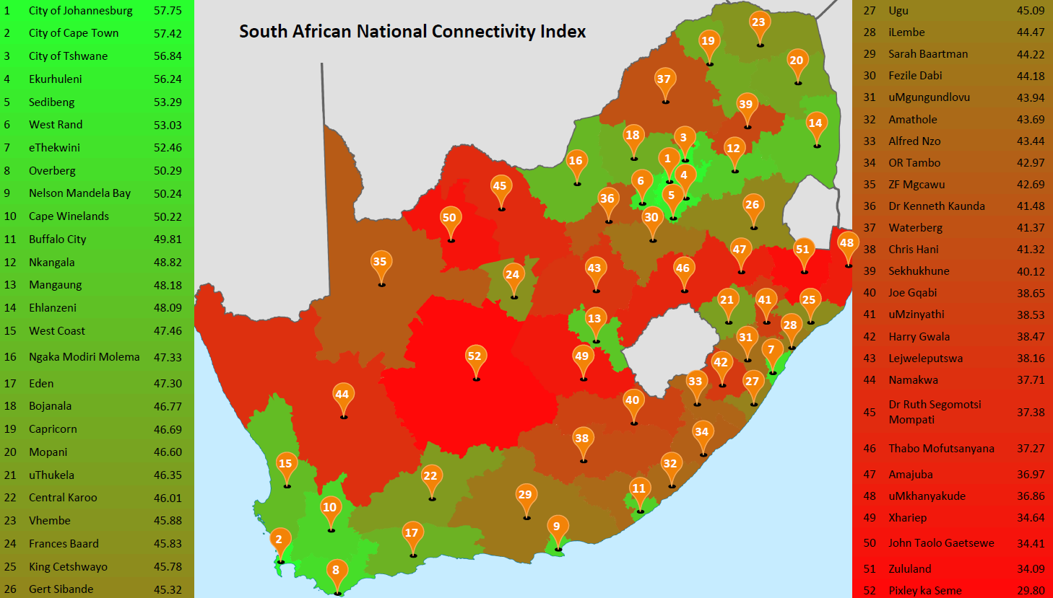

District Municipality Broadband Network Coverage – GAP Analysis
  IDC conducted a National Connectivity Index in 2018 and the percentage network coverage are reflected on the map below.
  The results show a huge the low broadband coverage in most municipalities, mainly in rural areas as indicated on the right info.

Slide 9
Cabinet Approval Update
Cabinet Approved the following Model for SA Connect Project:
The approved model is based on partnership between SITA, Broadband Infraco and Sentech, and includes other industry service providers for the implementation of the SA Connect Project Plan:
  The ICT industry will connect 18 036 schools, 3 873 health facilities and 8241 tribal authority sites within 36 months from date of licensing as part the social obligations in the new licensing regime of High Demand Spectrum.
  The SDIC (Sentech and BBI) in conjunction with existing ICT players will provide the infrastructure (including VSAT), to provide Communities and Households with Internet connectivity.
  SITA will provide and maintain connectivity to government sites through the current allocation of individual departments and its full mandate;

Slide 10
Revised Model
The revised model and implementation plan for the SA Connect Phase 2 proposes the following key interventions:
Electronic communications service providers licensed are obligated to connect 18 036 schools, 3 873 health facilities and 8241 tribal authority sites within 36 months from date of licensing.
The Department (DCDT) and ICASA are currently negotiating with the telcos who did not fulfil their social obligations from the 2014 licensing conditions to connect the 15 691 government sites, including 949 libraries and Thusong Centres, in line with the SITA mandate;
SITA will provide and maintain connectivity to government sites through the current allocation of individual departments and its mandate.
The connection of South African communities and homes to the internet will be facilitated by Broadband Infraco (BBI) and Sentech working with SITA and the ICT industry on an Open Access Principle. This will enable the access to the backbone infrastructure including base stations and Points of Presence
This partnership will enable small and emerging services providers such Internet Service Providers (ISPs), Wireless Access Service Providers (WASPs), Mobile Virtual Network Operators (MVNOs) and the ICT Mobile Network Operators (MNOs) to connect communities within 36 months.

Slide 11
Key Interventions
The SA Connect phase 2 plan proposes that the State should play a critical role in the provisioning of the ICT services to households in underserviced areas via the BBI, Sentech and SITA, and the broader ICT industry.
SITA will provide services to Government facilities based on existing initiatives totaling 14 742 sites and new services to 949 libraries and Thusong Centres, including the virtualisation of the government network to provide public commercial network.
BBI, Sentech and SITA will provide 840 Open Access Base stations and 33 539 community Wi-Fi hotspots to connect 5 830 208 households, through the WASPs, ISPs and MVNOs, as part of transforming the industry.
Engagements are under way with Eskom and Transnet to facilitated an expanded network access that could be used to strengthen both government and community network. Updates will be provided on developments once the model has been finalised. This, however, does not inhibit the implementation of SA Connect Phase 2.

Slide 12
IMPLEMENTATION PLAN
The key objective is to connect South Africans within 36 months, from April 2022 to March 2025 at a minimum speed of 5Mbps for households and 10Mbps for Government facilities including public schools and clinics.
The SA Connect target is to achieve 80% broadband access for all communities and government facilities over the next 3 years, with a minimum capacity speed of 10Mbps and 100 Mbps per second for high demand facilities. The rapid evolution of broadband technology means that these targets will be revised upwards, monitored and evaluated on an ongoing basis to determine if the targets need to be reviewed.
The DCDT will be responsible for the establishment of the governance framework (PMO) and terms of reference in consultation with the entities. The framework includes structures to ensure accountability and to unlock constraints as per lessons learnt from Phase 1 rollout.
Provinces and Departments will take the financial responsibility of maintaining and supporting the sites that will have been rolled out.

Slide 13
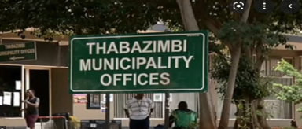
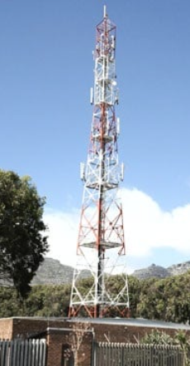
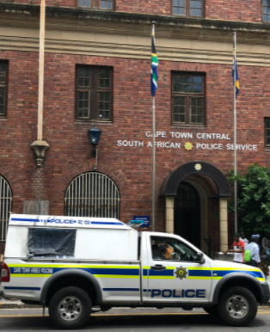
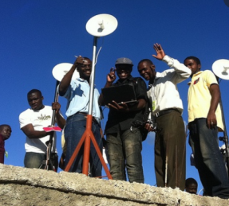
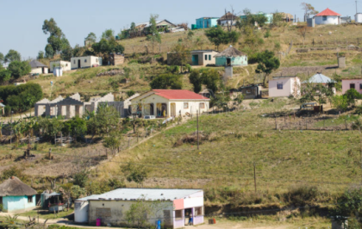

Diagram Overview
SITA provides connectivity to GVT sites via MNOs/SMMEs etc
NGN Core for SITA Services
SITA
ICT Telcos provide Broadband Services to schools, clinics, tribal centres via VSAT, Microwave and Fibre
SDIC & ICT Industry
Hot Spots via ISPs/MVNOs/SMME
Communities via MVNOs/SMME

Slide 14
Phase 2 Plans
Province | EC | FS | GT | KZN | LIM | MP | NC | NW | WC | Total
Schools | 4338 | 787 | 2048 | 4728 | 2890 | 1216 | 444 | 1320 | 1454 | 19225
Health | 1212 | 518 | 1409 | 1165 | 663 | 460 | 345 | 473 | 1213 | 7458
CommunityCentre | 30 | 29 | 200 | 274 | 21 | 39 | 29 | 35 | 129 | 786
CommunityService | 29 | 22 | 133 | 149 | 15 | 17 | 2 | 14 | 56 | 437
Post Office | 187 | 99 | 359 | 203 | 117 | 64 | 49 | 106 | 187 | 1371
Thusong Centre | 0 | 7 | 41 | 19 | 21 | 10 | 0 | 0 | 33 | 131
Government/MunicipalOffice | 229 | 81 | 439 | 163 | 112 | 134 | 139 | 131 | 357 | 1785
CorrectionalFacility | 28 | 25 | 17 | 14 | 6 | 16 | 13 | 13 | 37 | 169
Police Station | 177 | 80 | 139 | 148 | 77 | 49 | 64 | 67 | 149 | 950
Court | 47 | 33 | 64 | 41 | 18 | 30 | 28 | 21 | 44 | 326
TrafficDepartment | 26 | 36 | 106 | 41 | 13 | 39 | 25 | 28 | 88 | 402
Utility | 65 | 33 | 447 | 225 | 19 | 103 | 100 | 35 | 252 | 1279
InternationalBorderPost | 3 | 5 | 0 | 3 | 5 | 2 | 4 | 3 | 0 | 25
RailwayStation | 234 | 164 | 281 | 296 | 58 | 234 | 195 | 86 | 275 | 1823
ForestStation/ResearchStation | 20 | 2 | 50 | 26 | 4 | 46 | 2 | 5 | 23 | 178
FireStation | 17 | 14 | 66 | 34 | 13 | 19 | 5 | 18 | 51 | 237
Library | 70 | 68 | 179 | 144 | 14 | 37 | 62 | 26 | 200 | 800
TouristInformation | 52 | 46 | 40 | 59 | 22 | 30 | 32 | 17 | 137 | 435
Reservoir | 14 | 6 | 61 | 17 | 2 | 14 | 46 | 4 | 51 | 215
Stadium | 20 | 11 | 64 | 16 | 15 | 19 | 8 | 16 | 32 | 201
MilitaryStructure/Site | 3 | 4 | 37 | 2 | 17 | 10 | 7 | 16 | 23 | 119
TollPlaza | 0 | 5 | 86 | 38 | 12 | 4 | 0 | 11 | 6 | 162
Total | 6801 | 2075 | 6266 | 7805 | 4134 | 2592 | 1599 | 2445 | 4797 | 38514

Slide 15
FINANCIAL IMPLICATIONS
Total CapEx budget required is R2 527 157 135 (R2.53 billion) incl. VAT, to provide broadband infrastructure within the next 36 months. This is a major saving from the of 2021-2030 (and approximately R8.5 billion each subsequent year) in connectivity costs as well as an estimated R75 billion in device costs over the same period.
Existing budgets from line departments must be utilise for maintenance and extension of services provided by SITA.

Slide 16
High Level Roll Out Schedule
SITA | Year 1 | Year 2
 | Apr 2022 Mar 2023 | Apr 2023 Mar 2024
Budgeted Sites(SITA existing sites) | 2156 | 5030
SAPS - Migration sites | 815 | 1902
SITA Current Broadband projects | 1451 | 3388
Total Existing Sites | 4422 | 10320
SITA 949 new sites (Libraries / Thusong Centres) 100Mbps - 1Gbps | 284 | 665
Total New sites | 284 | 665
Total Planned for Y1 and Y2 | 4706 | 10985
Overall Total Number of Sites |  | 15691
  The rollout will be done in 36 months as per the table below and will be followed by network upgrade.
  The Telcos Industry will connect the Social Obligations over a period of up to 3 years
SDIC & ICT | Phase 2A: 5Mbps using existing terrestrial network and satellite services
 | Year 1 |  |  |  |  | Year 2 (Cumulative)
Scope | Households | Open Access Base-stations (Shared and new) | VSAT (Mountainous Area) | Schools and Clinics (ICT) | Tribal Community (ICT) | Household | Open Access Base-stations (Shared and new) | VSAT (Mountainous Area) | Schools and Clinics (ICT) | Tribal Community (ICT)
Eastern Cape | 286 872 | 41 | 176 | 1 605 | 424 | 956 241 | 138 | 586 | 5 342 | 1 414
Limpopo | 317 206 | 46 |  | 1 115 | 691 | 1 057 354 | 152 |  | 3 715 | 2 303
Free State | 115 206 | 17 |  | 256 | 33 | 384 020 | 55 |  | 842 | 111
KZN | 389 093 | 57 | 237 | 1 555 | 1 101 | 1 296 975 | 189 | 789 | 5 171 | 3 669
North West | 154 795 | 22 |  | 421 | 34 | 515 984 | 74 |  | 1 402 | 113
Mpumalanga | 154 958 | 22 |  | 450 | 175 | 516 525 | 74 |  | 1 499 | 582
Northern Cape | 67 486 | 10 | 68 | 67 | 10 | 224 952 | 32 | 225 | 220 | 33
Gauteng | 148 144 | 21 |  | 730 | 5 | 493 813 | 71 |  | 2 427 | 16
Western Cape | 115 303 | 17 |  | 408 | - | 384 344 | 55 |  | 1 307 | -
Total | 1 749 062 | 253 | 480 | 6 606 | 2 472 | 5 830 208 | 840 | 1 600 | 21 925 | 8 241
Notes:
Notes;
IDC works with Huawei on a yearly basis to produce the Huawei GCI (Global Connectivity Index). The GCI index is a study that benchmarks where a country stands within its journey to connectivity. This study highlighted the connectivity status of SA through provinces, cities, communities, businesses and institutions. The objectives of this study was:
To benchmark connectivity throughout SA in order to show levels of progress across key verticals
To demonstrate the role connectivity plays in economic development
IDC’s first National Connectivity Index study was performed in South Africa in 2017, across
9 provinces
52 municipalities
2,614 businesses
4,228 consumers

Slide 17







Integrated ICT Infrastructure
  The SDIC will apply the principle of non-duplication and integration of existing Government ICT infrastructure.
  This will include the aggregation of the digital infrastructure of non-ICT SOCs as depicted in the schematic below.
  The SDIC and ICT core network will be used to deliver broadband services for connecting government facilities to the SITA network.
Telcos including Telkom, MTN, Vodacom, Liquid
ISPs/ MVNOs including Major ISPs and SMMEs
Broadband Policy
National Broadband Infrastructure
NDP
SOC Collaboration and cooperation
National e-strategy
(Infrastructure)
To connect Government and Communities
State Owned ICT Network Infrastructure
Private Sector Telcos Network Infrastructure

Slide 18
Support and Maintenance Strategy
  Establish regional offices for a responsive network support.
    35 new offices to be established
    Setup SLA’s with Access Network Service Providers for maintenance provision.
  National Network Monitoring System which will integrate SA Connect facilities private partners and SOC.
    Upgrade the NOC (National Operating Centre’s ).
    Measure QoS (Quality of Service)
  Setup an Integrated Contact Centre to log network outages and faults.
    Provide real-time network status dashboard.
    Coordinate ticket opening, ticket resolve and closure.
  Capacity development for network life cycle supportability.
    Through training of technical expertise and expertise retention by ensuring active involvement.
    Strategic Outsourcing through framework agreement with highly skilled service providers
SITA
Layer 3
SDIC
Layer 2
Private Sector
Layer 2&3
SOC
Layer 2
NOC
Network Monitoring

Slide 19
Progress to Date
Provincial and Departmental engagements are in progress.
DCDT is following up on National Treasury in order for the roll out to start in earnest
Prioritization of sites to be rolled out is in progress in conjunction with DoH, DoE, COGTA, Provinces etc.
Propositions to ICASA have been submitted for the ICT Sector sites that must be connected via Social Obligation.
Policy changes for Rapid Deployment are in progress with draft submissions already made.
A proposal for the Consolidation of ICT budgets to prevent duplication of efforts is under way.
Engagements with Non-ICT SOCs (like Eskom, Transnet, PRASA etc.) are in progress in order to utilize existing infrastructure to prevent duplication.

Slide 20
End
Thank You

