Slide 1
Presentation to the Select Committee:
CIDB Annual Report 2020/21
23 February 2022

Slide 2
LAYOUT
Legislative Mandate
Strategic Goals
Context
  Programme Perspective
  Divisional Perspective
Programme Performance and Highlights
  Summary
  Other
Contribution to the Economic Recovery and Reconstruction Plan
Audit Outcomes
Financial Report

Slide 3
Legislative Mandate

Slide 4
LEGISLATIVE MANDATE
Strategic leadership to stimulate sustainable growth, reform and improvement of the construction sector
Sustainable growth and participation of the emerging sector in the industry
Improved performance and best practice
Uniform application of policy and ethical standards, construction procurement reform, improved procurement and delivery management
Monitoring and regulating the performance of the industry, including the Registration of Projects and Contractors
Note: Simplified Mandate

Slide 5
Strategic Goals

Slide 6
Strategic Outcome Orientated Goals
A transformed construction industry that is inclusive, ethical and contributes to a prosperous South Africa and the World
Inclusive growing construction industry
Innovative and thriving construction environment
Working in alliance
Reputable Regulator
Sound corporate governance

Slide 7
CONTEXT
Programme Perspective
Programme 1 – Administration
Programme 2 – Research and Development
Programme 3 – Construction Industry Regulations
Programme 4 – Construction Industry Performance
Programme 5 – Procurement and Development
Programme 6 – Provincial Offices

Slide 8
CONTEXT
Divisional Perspective
Chief Executive Office: CEO
Chief Operations Office: COO
Chief Financial Office: CFO
Chief Corporate Services Office: CCSO
Chief Information Office: CIO

Slide 9
Programme Performance:
Summary
31 March 2021

Slide 10
PERFORMANCE OVERVIEW
Targets 2020/21: 19
  Targets Achieved: 17
  Target Missed: 2
Overall Achievement: 89%

Slide 11
PROGRAMME PERFORMANCE
Programme | Targets | Achieved | Not Achieved
Administration | 5 | 4 | 1
Research and Development | 1 | 1 | 0
Construction Industry Regulations | 2 | 2 | 0
Construction Industry Performance | 2 | 2 | 0
Procurement and Development | 4 | 4 | 0
Provincial Offices | 5 | 4 | 1
TOTAL | 19 | 17 | 2

Slide 12
DIVISIONAL PERFORMANCE
Programme | Quarter 4 Targets | Achieved | Not Achieved
CEO | 1 | 1 | 0
CFO | 2 | 1 | 1
CIO | 1 | 1 | 0
CCSO | 1 | 1 | 0
COO | 14 | 13 | 1
Research and Development | 1 | 1 | 0
Construction Industry Regulation | 2 | 2 | 0
Construction Industry Performance | 2 | 2 | 0
Procurement and Development | 4 | 4 | 0
Provincial Office | 5 | 4 | 1
TOTAL | 19 | 17 | 2

Slide 13
PERFORMANCE INFORMATION
No | Programme | Output indicator | Addresses Transformation or Development | Planned Annual target | 2020/21 Actual Achievement
1 | Programme 1 | Number of fraud awareness workshops for staff | No | 1 | 1
2 |  | % System uptime | No | 90% | 98,28%
3 |  | % expenditure on BBBEE compliant suppliers | No | 88% | 94%
4 |  | % invoices paid within 30 days | No | 100% | 93%
5 |  | Number of stakeholder forums conducted | No | 1 | 1
6 | Programme 2 | Number of research studies conducted | Yes | 1 | 1
7 | Programme 3 | Number of revised registration criteria assessments performed | Yes | 1 | 1
8 |  | Number of non-registered projects identified against the RoP | No | 1 000 | 2 476
9 | Programme 4 | Number of industry monitoring and evaluations conducted | Yes | 4 | 4
10 |  | Number of reports on public sector expenditure | Yes | 1 | 1
11 | Programme 5 | Number of cidb-facilitated export promotion trade missions | Yes | 2 | 2
12 |  | Number of cidb business advisory framework developed | Yes | 1 | 1
13 |  | Number of TVET colleges participating in WorldSkills SA | Yes | 25 | 25
14 |  | Number of NCDP framework reviewed | Yes | 1 | 1
15 | Programme 6 | Number of client departments implementing contractor development | Yes | 20 | 0
16 |  | Number of grade 2 to 6 contractors provided with contractor development support | Yes | 256 | 283
17 |  | Number of learners offered experiential learners opportunities | Yes | 500 | 562
18 |  | Number of client departments capacitated on IDMS | Yes | 60 | 90
19 |  | % grades 1 to 9 contractors with compliant applications registered within 21 working days | No | 96% | 96%

Slide 14
Programme Performance:
Non-Achievements
31 March 2021

Slide 15
ADMINISTRATION
KPI Nr | Performance Indicator | Reason for Non –achievement
1.4 | % of invoices paid within 30 days | Target: 100%
 |  | Not Achieved 93% of invoices paid within 30 days. Reason for deviation Late confirmation of banking details by suppliers contributed to late payments. Remedial action Accounts payable procedure will be updated with the payments to be made at least weekly or as and when the need arises. To explore the automation of the payment days report and the reminders to be set up 5 days prior to the deadline.
A total of 1467 (93%) out of 1577 invoices received from service providers were paid within 30 days.

Slide 16
PROVINCIAL OFFICES
KPI Nr | Performance Indicator | Reason for Non –achievement
1.15 | Number of client departments implementing contractor development | Target: 22
 |  | Not Achieved 0 client departments implemented contractor development. Reason for deviation Due to a misalignment between the KPI and the method of calculation it was reported as not achieved. 22 client departments were capacitated but client capacitation does not require a signed MOU and due to the wording of the performance indicator it was determined as not achieved. Remedial action Review of project management approach will be done.

Slide 17
Other Performance Information and Highlights

Slide 18
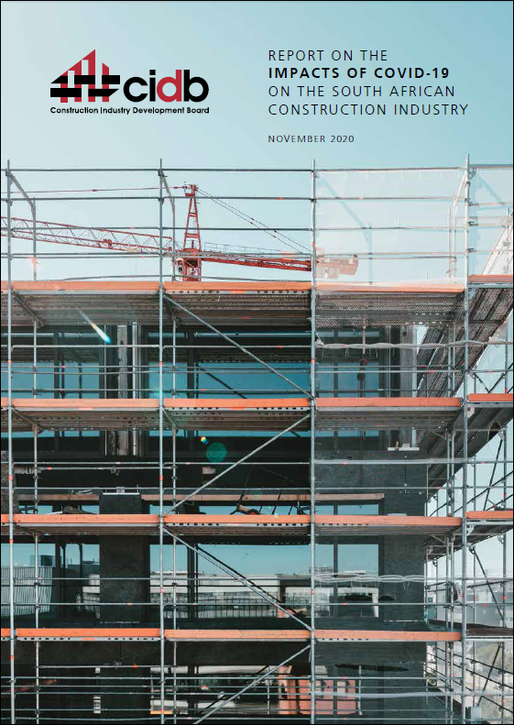
Study on Impact of Covid-19 on Industry
Support measures identified:
Fast-tracking of payments
Increase in government spending
Tax benefits
Fast-tracking of tender approval and awards
Payment of outstanding invoices
Follow-up study being conducted on the lockdown-related economic losses of construction companies.

Slide 19
National Stakeholder Forum (NSF)
The National Stakeholder forum (NSF) is mandated through the CIDB Act
The NSF serves as a platform for stakeholders to advise the Minister and the cidb on matters affecting the development of the construction industry
The NSF has been restructured into a smaller, more effective Forum
New Forum members appointed in February 2021
Issues raised are dealt with through focused workgroups, reporting to the full NSF, which then reports to Minister of PWI
The NSF enables the cidb to sharpen its contribution to industry development

Slide 20
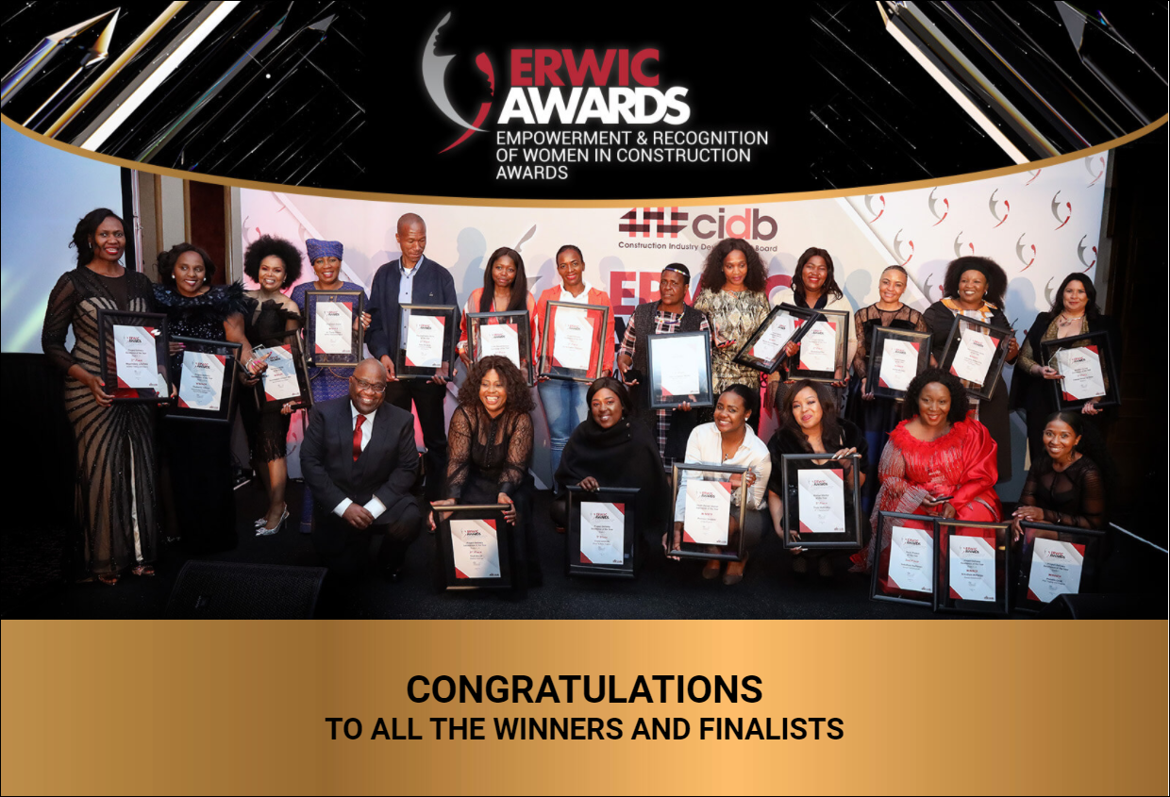
Recognition of Women in Construction (ERWIC) Awards
The cidb constituted the Empowerment and Recognition of Women in Construction (ERWIC) Awards with the first recognition ceremony held in August 2020
Serves to inspire women contractors and provide a platform for development

Slide 21
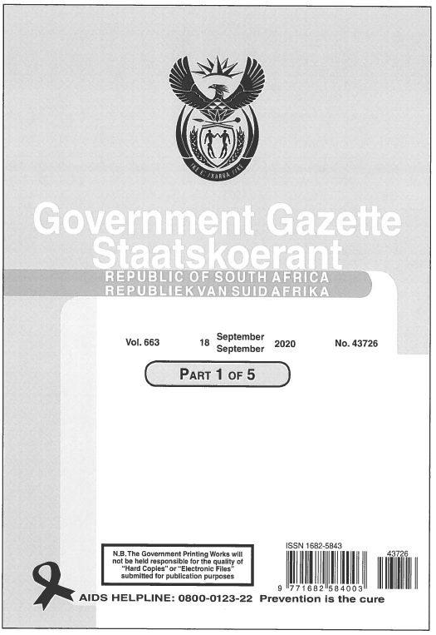
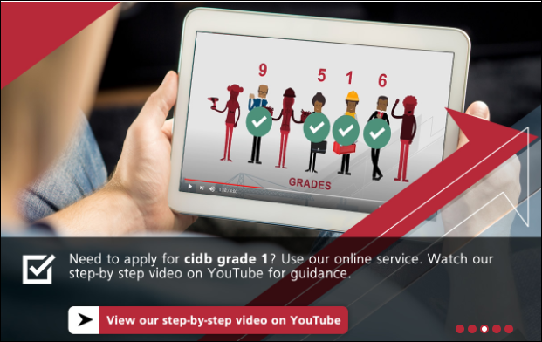
Other Developments in 2020/21
Best Practice Project Assessment Regulations
  (cidb B.U.I.L.D Programme, covered later) gazetted on 18 September 2020 (…detail covered later)
The cidb online contractor registration platform has gained momentum and reduces the admin burden on contractors when registering with cidb
  Going forward further elements of the registration process will be conducted online
The cidb has stabilised operations that were affected by the Covid-19 pandemic
90 client departments were capacitated on the Infrastructure Delivery Management System (IDMS)
National Contractor Development Programme improved to now include Grade 1 up to Grade 8 contractors.

Slide 22


Organisation and Employee Development
cidb underwent an Organisation Design process with implementation across the 2019/20 and 2020/21 years
The current phase of Organisational Development interventions include:
  Organisation Culture improvement; Leadership Development and Employee Development
cidb has an active bursary programme for employees
Employees are also supported through the cidb wellness programme

Slide 23
cidb Quarterly Industry Monitor
The cidb Construction Monitor: Supply and Demand is part of a suite of four quarterly cidb Construction Monitor publications covering:
  Quarter 1 - Supply and Demand
  Quarter 2 - Contractor Development
  Quarter 3 - Employment
  Quarter 4 - Transformation
Note: Reporting periods refers to calendar year quarters.

Slide 24
Supply and Demand - Infrastructure Spending: Public Sector
 | R million |  | R million |  | Contribution (%)
 | 2018/19 Budget | 2019/20 Budget | 2018/19 Expenditure | 2019/20 Expenditure | % spent in 2018/19 | % spent in 2019/20
National Departments | 15 924 | 15 337 | 13 416 | 13 836 | 84% | 90%
Provincial Departments | 61 721 | 60 833 | 60 623 | 61 020 | 98% | 100%
Municipalities | 65 863 | 61 723 | 48 548 | 37 992 | 74% | 62%
Public Entities | 20 574 | 18 714 | 22 565 | 16 121 | 110% | 86%
Public Private Partnerships | 5 912 | 5 641 | 4 929 | 5 637 | 83% | 100%
State-Owned Companies | 93 297 | 97 134 | 64 708 | 48 437 | 69% | 50%
Total | 263 291 | 259 382 | 211 859 | 183 042 | 80% | 71%
State-owned companies and public entities account for 44% of public infrastructure budget. Underspending by state-owned companies increased substantially in the 2019/2020 financial year. According to National Treasury, at the end of 2019/2020, state-owned companies had spent only 50% of their budget.

Slide 25
Supply and Demand - Infrastructure Spending: Municipal
Indicator | 2017/18 | 2018/19 | 2019/20
Budgeted capital expenditure (Rm) | 71 381 | 73 563 | 68 808
Actual capital expenditure (Rm) | 58 756 | 54 887 | 41 254
Actual capital expenditure as a % of budgeted capital expenditure | 82% | 75% | 60%
Number of metro's, municipalities, and district municipalities | 257 | 257 | 257
The slowdown in the construction economy is exacerbated by underspending of capital budgets. By the end of the 2019/2020 municipal financial year, municipal underspending stood at around R28 billion, around R17 billion contributed by metros. In 2019/2020, 243 out of 257 municipalities spent less than 40% of their budgets. The disruptions caused by the lockdown restrictions were large contributors but not the only ones.

Slide 26
B.U.I.L.D Programme
The cidb Best Practice Project Assessment Scheme has been renamed the B.U.I.L.D Programme
Project owners (infrastructure clients) will pay 0.2% of the value of their tender (up to a maximum of R2 million) as the B.U.I.L.D Fee, to activate the cidb development support strategy
Phased implementation of the B.U.I.L.D Programme with National Departments and Public Enterprises coming on board on 01 April 2021, private sector clients on 18 September 2021 and Provincial Departments and Metro’s at the start of the 2022/2023 financial year, District and Local Municipalities at the start of the 2023/2024 financial year
All contracts from Grades 7 to 9 are subject to the B.U.I.L.D Programme

Slide 27
B.U.I.L.D Programme
B.U.I.L.D Programme Objectives
Drive industry performance improvement and development through the application of cidb best practice standards
In the first phase the Standard for Enterprise Development and the Standard for Skills Development is applicable
The Standard for Enterprise Development establishes contract participation goals (CPGs) for targeted enterprises
The Standard for Skills Development provides for workplace training for interns and up-skilling employees in programmes that result in nationally accredited outcomes

Slide 28
B.U.I.L.D Programme
Benefits
  R8 billion of contracts will be directed to developing enterprises per year together with developmental support
  1 000 contractors will receive developmental support per year
  10% of the labour force on construction sites and in design offices will receive structured workplace skills training per year
  R450m spend on workplace training per year
  10 000 learning opportunities per year for FET learners/artisans
  1 500 learning opportunities for candidates

Slide 29
Transformation – Black-Owned Contractor Enterprises in Grades 7 to 9, 51%+
Targets
Five year target | 20/21 target | 20/21 Actual Performance
75% | 69% | 58%
Details of ownership of cidb-registered contractors nationally are given above for ownership control of 51% or more and for ownership control of 90% or more.
The construction industry –including professional service providers, contractors and materials suppliers – remains largely under-transformed
Lack of transformation in contractor ownership and access to work opportunities are particularly pronounced in grades 7 to 9.
There was a slight increase in the number of black-owned contractors from 2019Q2 to 2020Q2 across grades 2 to 9.

Slide 30
Transformation – Women-Owned Contractor Enterprises in Grades 2 to 9; 51%+
Targets
Five year target | 20/21 target | 20/21 Actual Performance
40% | 32% | 30%
Women ownership of 51% and above, was around 29% of all contractors in 2019Q2, showing a slight increase of 1% in 2020Q2.
The overall performance indicates that the women ownership has increased, but the pace is too slow.

Slide 31
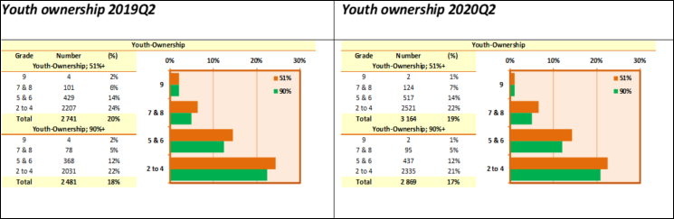
Transformation – Youth-Owned Contractor Enterprises Ownership across all Grades; 51%+
Targets
Five year target | 20/21 target | 20/21 Actual Performance
35% | 32% | 19%
For ownership of 51% and above, youth ownership was around 19% in 2020Q2 down by 1% since 2020Q1.

Slide 32
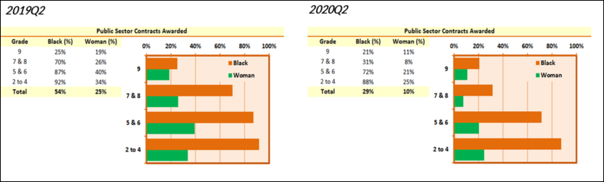
Transformation – Participation
Black-owned contractors (51% and more), who make up over 90% of registered contractors, accessed around 29% of public sector awards for 2020Q2, which is a significant decrease from the 54% of 2019Q2 period.
Of concern is that the percentages of work accessed in grades 7 and 8 decreased from 70% in 2019Q2 to 31% in 2020Q2.
CIDB Act (38 of 2000) is under review: Accelerate development and transformation through the Amendment Act, Provide for a client recognition scheme to promote improved technical capacity in order to drive accelerated infrastructure delivery; Increase private sector contribution to development and transformation.

Slide 33
Transformation – Participation
Similar conclusions can be drawn for women-owned contractors, who accessed around 10% of total public contract awards in 2020Q2, down from 25% in 2019Q2.
The reduction in grades 7 and 8 categories is the largest, as with black-owned contractors. Numbers of contracts awarded to women-owned contractors in the public sector have decreased across the board.
The decrease in numbers of work opportunities for black-owned companies is a cause of concern as it affects transformation.

Slide 34
Provincial Office Highlights
Province | Clients Capacitation on Infrastructure Delivery Management System (IDMS) | No of Contractors Capacitated on cidb Prescripts
KZN | 18 | 18
NC | 30 | 106
WC | 2 | 10
FS | 7 | 45
NW | 6 | 40
MP | 16 | 340
LP | 5 | 39
GP | 3 | 80
EC | 8 | 240
A partnership approach was used. In some provinces the capacitation was with District Municipalities for greater reach. In some cases the intervention was through provincial treasuries, while in others it was through partnerships such as with SANRAL.

Slide 35
Contribution to the Economic Recovery and Reconstruction Plan

Slide 36
Contribution to the Economic Recovery and Reconstruction Plan
Key Reform Action: Rebuild S.A. Construction Sector
Intended Outcome: Compliance to CIDB Prescripts, Transformation, Contractor and Skills Development, Job Creation
cidb B.U.I.L.D. Programme - Implementation underway. Client capacitation conducted across all provinces to drive enterprise and skills development.
Compliance to cidb prescripts - On the ground compliance monitoring underway. There were 2476 non-compliant sites identified for 2020/21. Revised compliance strategy developed and cidb capacity increased. Focus on high-impact targeting of selected client departments.
Contractor Development - NCDP Framework revised. Now covers grades 1 to 8. Training and assessment of contractors against the cidb Competence Standard for Contractors is applicable on Contractor Development Programmes.
Experiential Learning Opportunities – In the 2020/21 year over 500 learners were offered experiential learning opportunities.

Slide 37
Audit Outcome

Slide 38
AUDIT OUTCOME
The audit outcome of cidb has remained the same with an unqualified opinion, with findings in other areas.
The cidb objective is to obtain a clean audit in the 2021-22 financial year and beyond.

Slide 39
2020/21 AUDIT OUTCOME

Slide 40
Audit Outcome (Interventions)
Interventions | Progress
Align Internal Audit Plan with AG focus area to identify area prior AG audit | Internal audit plan has been aligned with the AG focus areas
Follow up, categorise the findings in terms of importance and track root cause of audit findings with Management on quarterly basis | The audit tracking list is part of the standard agenda item for EXCO and follow up Audit completed by the Internal Auditors
Key positions to be filled | The following key positions were filled COO CCSO COSEC (Position subsequently vacant)
Strengthening review process of performance information Quarterly information submitted by different units will be reviewed by different levels before submission to internal audit | Quarterly information submitted by business units will be reviewed by various levels before submission to internal audit
Report to the Audit Committee progress on addressing audit findings for oversight including root causes | Audit follow up completed by the Internal Auditors is reported to the Audit, Risk, and Governance Committee
Produce interim financial statement for audit purpose to identify non-compliance prior to external audit | The process for the interim financial statements will commence at the end of the second quarter

Slide 41
Financial Report
31 March 2021

Slide 42
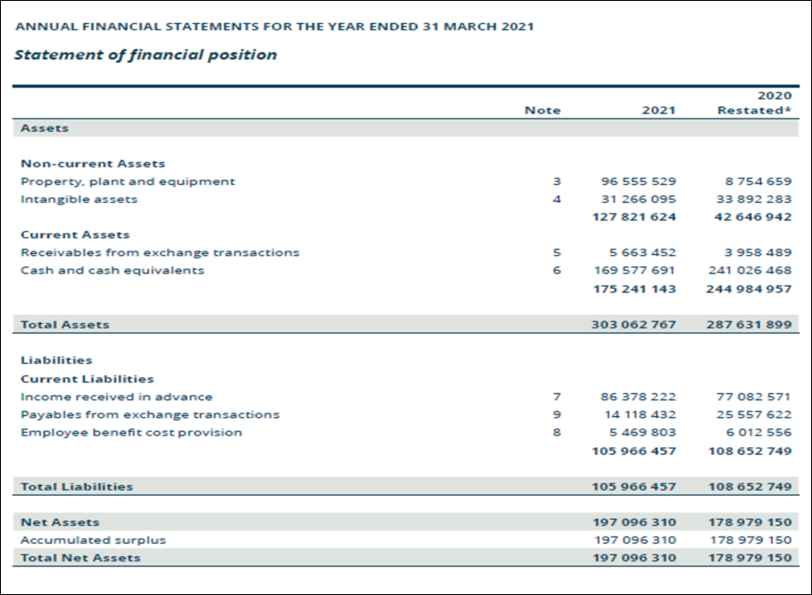

Slide 43
STATEMENT OF FINANCIAL POSITION
ANALYSIS
cidb has retained a healthy financial position with R169m positive cash resources.
A significant increase in expenditure was recorded on Property, Plant and Equipment (PPE) as a result of the new office building.

Slide 44
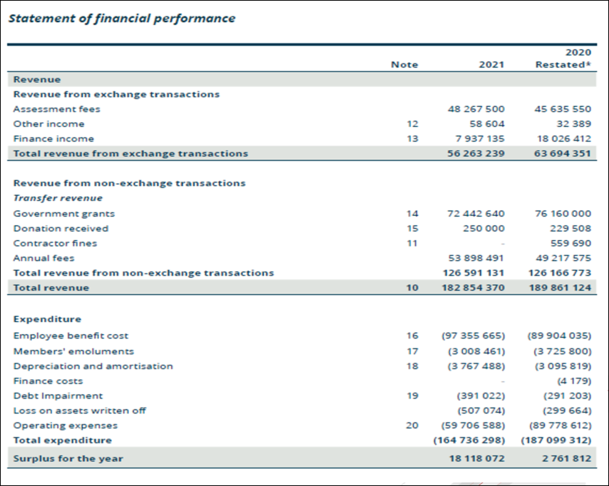

Slide 45
Statement of Financial Performance
Analysis
Increase in surplus for the year compared to the previous financial year mainly due to savings in expenditure
The decline in revenue was driven primarily by the impact of COVID-19, difficult construction industry trading environment and reduced return on investments on bank deposits (primarily due to reduced repo rate by the reserve bank in an effort to target inflation).
Employee costs increased due to some of the key positions being filled during the year.
Operating expenditure decreased by R30 million because of savings that were realised on IT expenditure, professional fees and travel expenditure during the year.

Slide 46
Remedial Action Across Key Priority Areas

Slide 47
Remedial Action – Key Priority Areas
No | Priority | Problem Statement | Intervention | Date
1 | Transformation | Inadequate contractor ownership profile (black, women and youth) | CIDB Act Amendment | DPWI process underway
 |  |  | CIDB Regulations Amendment review recommendation (Revise criteria while ensuring the risk management function is maintained) | 31 March 2022
2 | Access to Work | Inadequate client capacity to rollout infrastructure projects | Capacitate 80 client departments on Infrastructure Delivery Management System (IDMS) | 01 April 2021 to 31 March 2022
 |  |  | CIDB Act Amendment to provide for Client Recognition Scheme to promote technical capacity in client departments. | DPWI process underway

Slide 48
Remedial Action – Key Priority Areas
No | Priority | Problem Statement | Intervention | Date
3 | Enterprise and Skills Development | Inadequate opportunities for emerging contractors for development through support from main contractors; Insufficient access to workplace learning opportunities. | Implement CIDB B.U.I.L.D Programme | See below
 |  |  | Capacitate 36 client departments on implementing National Contractor Development Framework. | 01 April 2021 to 31 March 2022
CIDB BUILD PROGRAMME IMPLEMENTATION DATES
AS GAZETTED ON 18 SEPTEMBER 2020
National DPWI; National Gov. Departments; Public Entities; SIP Projects: 2021-22 financial year
Private Sector: 18 September 2021
Provincial Departments and Metro’s: 2022-23 financial year
District and Local Municipalities: 2023-24 financial year

Slide 49
Thank You

