Slide 1

Presentation on the National Health Insurance Bill to the Portfolio Committee on Health
in Parliament, South Africa
By the African National Congress
23 February 2022

Slide 2
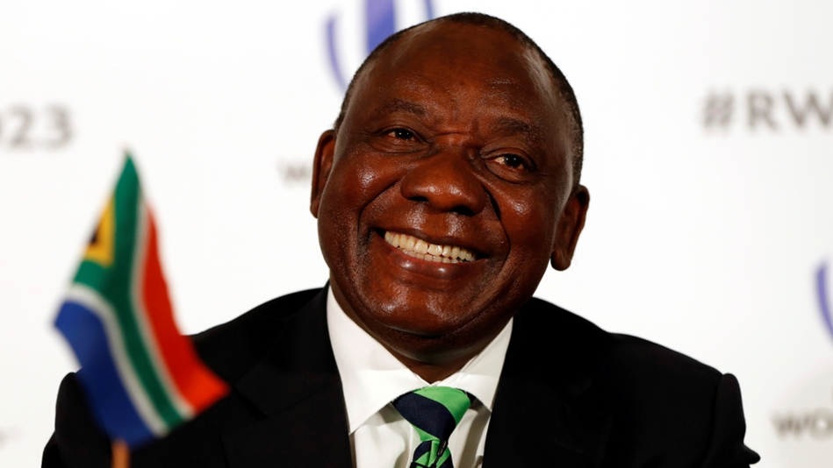
“The ANC reiterates its commitment to putting in place a quality system of national healthcare. We will expedite the implementation of the National Health Insurance through finalizing enabling legislation and putting in place the National Health Insurance Fund … All South Africans must be able to access quality health care based on need and not on their ability to pay or their overall socio-economic situation Government, for its part, will honor citizens’ commitment by ensuring that resources are well managed and efficiently deployed”.
Mr Cyril Ramaphosa,
President of the African National Congress and of the Republic of South Africa

Slide 3

STRUCTURE OF THE SUBMISSION
Introduction.
Executive Summary.
A long Road To Equitable Health.
A Path to Universal Health Care.
Why National Health Insurance for SA.
Affirming the ANC policy on the NHI.
Affirming principles of the White Paper on the NHI.
Specific Inputs on Chapters of the NHI Bill.
Responding to concerns by stakeholders and the public.
Lessons from two years of COVID-19.
Recommendations
Conclusion.

Slide 4

I. INTRODUCTION
The ANC affirms its commitment to the ideal enshrined in the 1955 Freedom Charter, an assertion of demands contained in the 1943 African Claims and the 1962 Road to South African Freedom which states that: “… A preventive health scheme shall be run by the state; free medical care and hospitalisation shall be provided for all, with special care for mothers and young children!”.
The ANC believes the National Health Insurance (NHI) Bill, 2019, when enacted will advance the implementation of the NHI towards Universal Health Coverage (UHC) for comprehensive access to quality, efficient and equitable health care for all in South Africa.
The NHI Bill when enacted will ensure will facilitate the realization of Health for All and prevent financial in the 2017 White Paper on the NHI and the Constitution of the Republic of South Africa, Act No. 108 of 1996 and the Bill of Rights which affirms the democratic values of human dignity, equality and freedom.

Slide 5
I. INTRODUCTION
ANC undertook extensive consultations on the NHI Bill amongst its members, supporters, various sectors and society at large.
There is overwhelming support for the long awaited NHI Bill with some recommended inputs.
This presentation includes reflections and relevant feedback received.

Slide 6
I. INTRODUCTION
Many South Africans across various sectors indicated that it is critical that South Africa’s two-tiered inequitable National Health System be integrated. The status quo of the two-tier system is not an option if the consensus on the Universal Health Coverage is to be realised.
Many South Africans expressed hope that the enactment of the NHI Bill will allow the implementation of a funding mechanism that will strengthen the fractured and fragmented health system into one accessible, good quality, efficient and equitable National Health System.

Slide 7
II. Executive summary
The ANC unequivocally supports the National Health Insurance (NHI) Bill that is before Parliament. The long awaited NHI Act is a necessary legal framework to transform and not reform the fractured, fragmented and inequitable National Health System, to strengthen the public and private sector as one - a unitary, nonracial, accessible, efficient, equitable, and good quality health system for all South Africans.
The ANC affirms its conviction that the envisaged NHI Act with the minor but important corrections and amendments from inputs made by many citizens and stakeholders consulted, will form a firm basis for the realization of Universal Health Coverage and the Constitutional ideals enshrined in the Bill of Rights.

Slide 8
II. Executive summary
The ANC supports the Bill on the establishment of a National Health Insurance Fund (‘‘Fund’’) and also its provisions that define powers, functions and governance structures of the Fund.
The ANC is committed to good governance at all levels led by a Board that is professional , charged with fiduciary accountability and with zero tolerance to corruption and unnecessary interference.
The role of the Minister should be that of leadership as the health policy custodian and to provide oversight over the execution of the mandate of the NHI Fund Board, as it is done for most entities and structures of the National Department of Health.
Additional safeguards include subjecting the NHI Fund Board to the oversight scrutiny of the Cabinet , Parliament and any other relevant institution such as the Auditor General. Most systems and processes that mitigate against corruption are in place.
Notes:
.

Slide 9
II. Executive summary
The ANC is fully convinced, after its global study of national health systems and their funding mechanisms, that proposals contained in the NHI Bill are appropriate for South Africa. Simply put, South Africa should design its own model closer to those of the UK , Cuba and Canada.
The best national health system, health service delivery and funding mechanism with excellent outcomes is that of Cuba, which is beyond our reach at this point in the history of our country.
The ANC is satisfied that the NHI Bill charts a good path towards the Universal Health Coverage (UHC) for South Africa, a state that will ensure that all citizens access good quality health care in every village, town and city without the risk of financial exclusion and/or hardship; and the attainment of United Nations Sustainable Development Goal 3 for Health which is “To ensure healthy lives and promote well-being for all at all ages”.
Notes:
.

Slide 10

THE DAWN AND LONG ROAD TO EQUITABLE HEALTH
III. THE LONG ROAD TO EQUITABLE HEALTH IN SA
The 1943 Africans Claim The 1944 National Health Service (Gluckman) Commission The 1954 Women’s Charter The 1955 Freedom Charter The 1962 Road to South African Freedom The 1994 Reconstruction and Development Program The 1994 ANC National Health Plan The 1996 Constitution of the Republic of South Africa The 1997 White Paper for the Transformation of the Health System in South Africa The 2008 ANC Policy on the NHI | The 2012 National Development Plan – Vision 2030 Africa Agenda 2063 The 2015 United Nations Sustainable Development Goals (SDGs) 2030 The 2017 White Paper on the NHI as the Official NHI policy The 2019 ANC National Election Manifesto The message from voices of the people, especially communities, civil society and the labour movement The 2019-22 consultations over the NHI Bill
MILESTONES
This Photo by Unknown Author is licensed under CC BY-SA-NC

Slide 11

IV. NHI: A PATH TO UHC!
National Health Insurance is a health financing system that is designed to pool funds and actively purchase services with these funds to provide universal access to quality, affordable personal health services for all South Africans based on their health needs, irrespective of their socioeconomic status.
NHI will be implemented through the creation of a single fund that is publicly financed and publicly administered.
The health services covered by NHI will be comprehensive and provided free at the point of care.

Slide 12
IV. NHI: A PATH TO UHC!
NHI will provide a mechanism for improving cross-subsidization in the overall health system.
NHI benefits will be comprehensive and in line with an individual’s need for health care without the risk of financial hardships.
Implementation of NHI is based on the need to address structural imbalances in the health system and to reduce the burden of disease.

Slide 13
IV. NHI: A PATH TO UHC!
The NHI is a uniquely South African healthcare financing mechanism, which is an important building block and an enabler of any health system.
The NHI is a critical path towards strengthening and unifying the health system and improving health access, equity and outcomes.
As the World Health Organisation states in its 2010 World Health Report, Health Systems Financing such as the NHI is the Path to Universal Health Coverage.

Slide 14
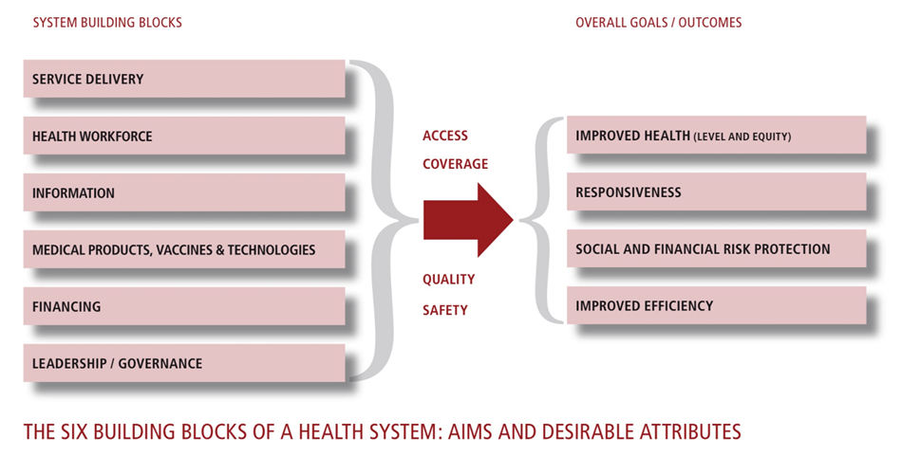
IV. NHI: A PATH TO UHC!
The World Health Organisation health system framework
FINANCING

Slide 15
The NHI is a financing mechanism and a strategy to move South Africa towards Universal Health Coverage (UHC).
It is intended to ensure that the use of health services does not result in financial hardships for individuals and their families.
It represents a substantial policy shift that will necessitate a massive reorganisation and unification of the current health system, both public and private sectors.
It is aimed at transforming the fragmented two-tiered health system, comprising of the public and private sectors, into a unified health system as envisaged by the 1997 White Paper for the transformation of the health system in South Africa.

Slide 16
V. WHY NHI FOR SA?
South Africa remains one of the most unequal societies in the world with a Gini-Coefficient of 0.63, our levels of inequality reflect an extremely polarized society, with a small elite, a large class of poor people, and a relatively small middle class.
To this day, historically disadvantaged South Africans hold fewer assets, have fewer skills and poorer health, are still more likely to be unemployed, and, if employed, earn lower wages.
It is in this context that logic dictates that everyone, especially the 86% which is the poor majority South Africans who make the bulk of our country’s work force required for economic growth and development, be provided with financial risk protection through Universal Access to healthcare.

Slide 17
V. WHY NHI FOR SA?
Three hospital groups, Netcare, Mediclinic and Life have a combined market share of 83% of the national South African private facilities market in terms of number of beds and 90% in terms of total number of admissions. Extreme high market concentration proves bargaining and control of cost difficult.
Highly concentrated supply market structures are generally conducive to overt and covert collusive conduct.
There are 16 medical scheme administrators in the market. Discovery Health and Medscheme account for 76% of the market based on gross contribution income (GCI), which makes the administrator market highly concentrated as well.

Slide 18
VI. Affirming the ANC policy on THE nhi
ANC RESOLUTIONS IN SUPPORT OF THE NATIONAL HEALTH INSURANCE
The ANC has been very consistent in its search for a sustainable solution to ensure that all the people of South Africa get equitable health services that are free at the point of care. These resolutions are reason enough for the ANC to emphasise to Parliament that our people can no longer wait for a law, namely the NHI Act, to provide a framework for the implementation of an equitable health financing mechanism to support and strengthen the country’s National Health System.

Slide 19
VI. Affirming the ANC policy on THE nhi
ANC SUPPORTS UNDERLYING PRINCIPLES BASED ON NHI POLICY
Health is a right; universal access for all . Free at the point of use and financial risk protection. Choice of a provider within the district. Mandatory contribution to pay, but according to ability to pay (social solidarity). Access to services on the basis of need. The state bears a constitutional obligation to provide access to health services. State is obliged to attend to the needs of those with the most urgent needs for health care. Funding of services is based on an assessment of needs. NHI will be publicly funded and administered.

Slide 20
VI. Affirming the ANC policy on THE nhi
ANC PRINCIPLES ON THE FUNDING OF THE NHI.
Allocations from general tax revenues and a dedicated health tax or mandatory financial contribution into a single NHI Fund. Requires progressive real increase in allocations for health. No one eligible will be allowed to opt out of the NHI. Contribution will be shared between employer and employee. Contribution will be progressively structured. Collected by the South African Revenue Services (SARS).

Slide 21
VII. Affirming the WHITE PAPER PRINCIPLES THE nhi
THE ANC AFFIRMS PRINCIPLES CONTAINED IN THE 2017 WHITE PAPER ON THE NHI.
Equitable access to health care (not based on ability to pay) in sufficient quantity and quality to effect positive health outcomes. Promoting and protecting health is essential to human welfare and sustained economic and social development. Health is a human right and cannot be commodified. Right to access health care. Social solidarity. Health care as a public good. Affordability. Efficiency. Effectiveness. Appropriateness.

Slide 22
IMPORTANT AREAS COVEREDBY THE NHI BILL
THE BILL COVERS THE FOLLOWING IMPORTANT AREAS:
Strengthening the National Health System. Quality of healthcare. Affordability. Phased implementation. Good governance of the NHI Fund. The role and responsibilities of the Minister of Health. Institutional arrangements. The role of private medical aid schemes. Financial matters and the role of the National Treasury. Transitional arrangements. Amendments of relevant laws.

Slide 23
VIII. Specific Inputs on Chapters of the NHI Bill
SUPPORT FOR THE SPECIFIC OBJECTIVES AND PRINCIPLES OF THE NHI BILL:
The ANC has consulted widely amongst communities, sectors, health professionals, youth, the elderly, employers, workers and experts and makes the following inputs that capture the aspirations of the millions of South Africans.
The ANC has also actively participated in Parliamentary hearings that have been taking place across the length and breadth of our country.
SUPPORT FOR THE PREAMBLE TO THE BILL.
The ANC supports the preamble to the Bill as this is aligned to the Constitution of South Africa. It states and mandates that there be redress of the past inequities, that health is a primary right of all citizens and further states that the government or state must ensure progressive realization of citizens to this right.

Slide 24
VIII. Specific Inputs on Chapters of the NHI Bill
SUPPORT FOR THE SPECIFIC OBJECTIVES AND PRINCIPLES OF THE NHI BILL:
The ANC has consulted widely amongst communities, sectors, health professionals, youth, the elderly, employers, workers and experts and makes the following inputs that capture the aspirations of the millions of South Africans.
The ANC has also actively participated in Parliamentary hearings that have been taking place across the length and breadth of our country.
SUPPORT FOR THE PREAMBLE TO THE BILL.
The ANC supports the preamble to the Bill as this is aligned to the Constitution of South Africa. It states and mandates that there be redress of the past inequities, that health is a primary right of all citizens and further states that the government or state must ensure progressive realization of citizens to this right.

Slide 25
VIII. Specific Inputs on Chapters of the NHI Bill
SUPPORT FOR THE SPECIFIC OBJECTIVES AND PRINCIPLES OF THE NHI BILL:
The ANC has consulted widely amongst communities, sectors, health professionals, youth, the elderly, employers, workers and experts and makes the following inputs that capture the aspirations of the millions of South Africans.
The ANC has also actively participated in Parliamentary hearings that have been taking place across the length and breadth of our country.
The ANC is satisfied that the Bill is constitutional, having witnessed the rigorous evaluation of constitutional implications of its underlying policy when that was processed through the Cabinet.
SUPPORT FOR THE PREAMBLE TO THE BILL.
The ANC supports the preamble to the Bill as it is aligned to the Constitution of South Africa. It states and mandates that there be redress of the past inequities, health is a primary right of all citizens and states that the government or state must ensure progressive realization of citizens to this right.

Slide 26
VIII. Specific Inputs on Chapters of the NHI Bill
CHAPTER 1: ON THE PURPOSE TO ESTABLISH AND MAINTAIN AN NHI FUND AND ITS APPLICATION.
The ANC supports the purpose of the Act and its application, in particular the following in the establishment of the NHI Fund:
A mandatory prepayment system with its principle of “mandatory contribution to pay, but according to their ability” to ensure social solidarity and sustainability of the NHI Fund.
The NHI Fund established and serving as a single-purchaser and single-payer fund.
Pooling of funds and strategic purchasing from accredited and contracted service providers.
The applicability of the Act and the compliance of the NHI Act with the Constitution of South Africa are supported. The ANC supports Clause 3 (5) of the Bill and believes that health is not a tradable commodity that must be subject to the rigour and dictates of the market. It believes in putting the people first and not profits. Therefore, NHI Fund health services must be exempt from the said Competition Act and Commission.

Slide 27
VIII. Specific Inputs on Chapters of the NHI Bill
CHAPTER 2: ACCESS TO HEALTH CARE SERVICES.
The ANC supports the population coverage, rights of users, healthcare services coverage and cost coverage as stated in the NHI Bill.
On Clause 4 (2), the ANC further proposes that the NHI Act must be explicit about the need for all, especially illegal immigrants, to comply with the provisions of all South African laws especially the South African immigration Act. Further, to enhance sources of revenue for the fund and to cover immigrants, the role of multilateral bodies such as the UNHCR and the African Renaissance Fund must be alluded to in the Act to ensure the sustainability and affordability of the NHI Fund. This must be added to Clause 49 of the Bill.
CHAPTER 3: THE NHI FUND
The ANC supports the proposals on the establishment of the NHI Fund as an autonomous public entity as contained in Schedule 3A of the Public Finance Management Act and proposals about the functions of the Fund and its power.

Slide 28
VIII. Specific Inputs on Chapters of the NHI Bill
CHAPTER 4: BOARD OF FUND.
The ANC supports the proposals on the establishment of the Board of the NHI Fund, its constitution, composition, powers and functions; conduct and disclosures of interest, procedures, remuneration and reimbursement. It further proposes that the Board of the NHI Fund operates independently and implements rules of good governance.
The ANC recommends that Clause 15 (3) of the NHI Bill and Act be enhanced to direct that the Board or its representatives and the Minister meet every six (6) months to share information, as the practical expression of the relationship of the Board and the Minister, who is the Executive Authority, and the Board which is the Accounting Authority.

Slide 29
VIII. Specific Inputs on Chapters of the NHI Bill
CHAPTER 5: CHIEF EXECUTIVE OFFICER OF FUND.
The ANC supports proposals on the CEO of the NHI Fund and recommends that the appointment of the CEO be made in line with governance practice stated in codes of good practice such as the King IV report. The Board should be appointed by the Minister and the Board in turn should appoint the CEO in consultation with the Minister of Health.
The ANC proposes that Clause 21 of the NHI Bill under Relationship of Chief Executive Officer with Minister and the Administration be expressed in clearer terms.
CHAPTER 6: COMMITTEES TO BE ESTABLISHED BY THE BOARD
The ANC notes and agrees with proposals about committees to be established by the Board of the NHI Fund.

Slide 30
VIII. Specific Inputs on Chapters of the NHI Bill
CHAPTER 7: ADVISORY COMMITTEES TO BE ESTABLISHED BY THE MINISTER.
The ANC supports the establishment of board structures and Ministerial committees within principles of technical competency, experience, accountability for performance and transparency and that an independent body without any conflict of interest or perverse incentive, prices or levels of remuneration for personal health services such as consultation fees and all healthcare benefits for all categories of health professionals and service providers in the National Health System including those who benefit from the NHI Fund.

Slide 31
VIII. Specific Inputs on Chapters of the NHI Bill
CHAPTER 8: GENERAL PROVISIONS APPLICABLE TO OPERATION OF FUND.
5.11.1 The ANC agrees with proposals on general provisions applicable to the operation of the fund and that in the finalisation of this Chapter of the NHI Act, which must focus on the integration of the private and the public sector, must clarify especially in discussions and enactment mechanisms pertaining to the development and maintenance of the National Health Information System, the role and place or location structurally of the District Health Management Office, contracting Unit of Primary Health Care. The Fund ICT system must be a fund management tool that is linked to the National Health Information system.
5.11.3 The ANC proposes that Clause 31 of the Bill be enhanced by adding the third responsibility of the Minister to 31(1) (b) integrating the annual and five-year health plans of the public sector and the private sector”. This five-year integrated country plan for the National Health System must ensure the successful implementation and maintenance of the Universal Health Coverage for all South Africans with the involvement of all sectors.

Slide 32
VIII. Specific Inputs on Chapters of the NHI Bill
CHAPTER 8: GENERAL PROVISIONS APPLICABLE TO OPERATION OF FUND.
The ANC fully supports Clause 33 of the Bill as it aimed at reducing fragmentation and creating a single funding pool based on the principles of social solidarity and income cross subsidisation.
To enhance the intended objectives of Clause 33, Clause 8 (2) (b) in Chapter 2 must be deleted as it allows for a duplicative environment that will by-pass the objective of establishing the NHI Fund as a single purchaser of comprehensive health care services .
Clause 34 of the Bill is supported as the Fund’s ICT system must be employed as stand-alone a fund management tool that is linked to the National Health Information system

Slide 33
VIII. Specific Inputs on Chapters of the NHI Bill
CHAPTER 9: COMPLAINTS AND APPEALS.
The ANC supports the proposal related to complaints and appeals.
CHAPTER 10: FINANCIAL MATTERS:
The ANC regards the NHI Bill as a Clause 76 Bill and not a Money Bill. It supports the sources of funds as stated in clause 48-51 of the Bill. As a point of emphasis, the Bill will achieve the pooling of current resources and factor in equity to cover all citizens comprehensively, attain efficiency and must be held accountable for effectiveness for outputs and outcomes.
The ANC proposes that sources of funds be “… the money currently available in the public and private sector for personal health services supplemented by money from the fiscus”. This will debunk the myth of extra-taxation.
The ANC supports the clauses on auditing and annual reports with clarification of the legal framework for the NHI Fund and medical aid schemes; and the retention and investment of funding allocations by the NHI Fund.

Slide 34
VIII. Specific Inputs on Chapters of the NHI Bill
CHAPTER 11: MISCELLANEOUS.
The ANC supports proposals on the repeal and amendment of legislation affected by the Act as reflected in Clause 58 of the Bill. It hereby calls upon those charged with the responsibility of this task to work diligently to avoid delays once the NHI Act is passed.
MEMORANDUM OF OBJECTS The ANC has noted matters addressed in the memorandum on the objects of the National Health Insurance Bill 2019 including compliance with Parliamentary processes. The ANC concurs that the Bill be tagged as a Section 76 Bill.

Slide 35
VIII. Specific Inputs on Chapters of the NHI Bill
CHAPTER 11: MISCELLANEOUS.
The ANC supports proposals on the repeal and amendment of legislation affected by the Act as reflected in Clause 58 of the Bill. It hereby calls upon those charged with the responsibility of this task to work diligently to avoid delays once the NHI Act is passed.
MEMORANDUM OF OBJECTS
The ANC has noted matters addressed in the memorandum on the objects of the National Health Insurance Bill 2019 including compliance with Parliamentary processes. The ANC concurs that the Bill be tagged as a Section 76 Bill.

Slide 36
IX. RESPONDING TO CONCERNS BY STAKEHOLDERS AND THE PUBLIC
The ANC has noted concerns raised by stakeholders, the general public, current owners, members and employees of medical aid schemes, service providers such as health professionals, provincial and local governments and the medical aid industry in the media and during consultations.
Of note is that very few of these concerns are about the translation of the NHI Bill int the Act, but that most of these concerns relate to current realities of services delivered by the private and the public sector. These include infrastructure, human resources, services and customer experiences which are good and bad in both sectors.
The ANC outside and inside government continues to attend to these concerns in line with its mandate and decisions of the 2019 Presidential Health Summit and Compact.

Slide 37
X. Lessons from two years of covid-19
The ANC has learned from the current COVID-19 local epidemic and the global pandemic the following:
The critical importance of maintaining South Africa epidemic-ready in terms of policies, programmes, human resources and infrastructure to ensure a well-functioning national health system, social development and economic growth.
The disease burden negatively impacts the number of lives covered by conventional medical aid schemes.
Fighting a deadly epidemic is a multi-faceted activity that demands implementation of programmes based on basic public health principles supported by good infection control and the use of appropriate vaccines plus the active involvement of other sectors beyond health.

Slide 38
X. Lessons from two years of covid-19
The ANC has learned from the current COVID-19 local epidemic and the global pandemic the following:
There are benefits and costs to the health sector in its intra-sectoral and intersectoral collaboration.
Some well intended programmes designed to promote access to COVID-19 testing resulted in the continued marginalization of the poor and disadvantaged.
Lack of vigilance has resulted with the introduction, sometimes randomly, of policy changes into the funding and delivery of health services which might have adverse effects on the implementation of the NHI.

Slide 39
XI. recommendations
The overall recommendation is that the Portfolio Committee and Parliament:
Note that the primary objective of the NHI and the NHI Bill is to strengthen the South African National Health System through an appropriate health funding mechanism that will require major changes and transformation especially the unification of the public and private sector.
Note the contents of the submission and presentation by the ANC especially its understanding of the Bill as the draft NHI Act aimed at providing the necessary framework for the establishment of the NHI Fund and the implementation of the NHI.
Note the response given to concerns of representatives of various sectors of the South African populace.
Note detailed recommendations that the ANC is tabling to the Parliamentary Portfolio Committee to assist expedite the passage of the Bill through the National Assembly with a view to urgent establishment of a people-centered NHI Fund, gradual and phased implementation of the NHI and full coverage of the entire South African citizenry, Black and White, poor and rich, with a view to attaining Universal Health Coverage and the NDP Vision 2030, Africa Agenda 2063 and UN Sustainable Development Goals (SDGs).

Slide 40
XI. recommendations
The overall recommendation is that the Portfolio Committee and Parliament:
Approves the NHI Bill, with minor amendments, as a transformation process that reaffirms health as a human right for all citizens and as a process to ensure the progressive access to this right by many who do not have access to good quality health services without the risk of facing financial hardships.
Approves the NHI Bill as a reaffirmation of health playing a critical role to improving the capabilities of the people of South Africa, their productivity and happiness.
Approves the NHI Bill as a sure enabler to attain the UHC as envisaged in the NDP Vision 2030, Africa Agenda 2063 and the United Nations Sustainable Development Goals.
Notes that the ANC believes that Parliament can give hope to South Africa that democracy can indeed continue to work for the wellbeing of all citizens equitably.

Slide 41
XI. Recommended nhi funding model
UNITED STATES | PROPOSED MODEL FOR SA | CANADA & UK | PROPOSED NHI | CUBA
Private funding model | Blended funding model | Dominant Public funding model | Dominant Public funding model | Public funding model
Private multi-payer system, with multiple public and private funders and insurers. A few public options. Private and public service providers. | Multiple public and private funders and insurers; and private and public service providers. | Single-payer fund Private service providers in Canada and private and public service providers in the United Kingdom | Central single-purchaser and single-payer fund with public and private | Health system financing and delivery of services are fully controlled and managed by the state
The worst model according to various research findings. NOT RECOMMENDED | This amounts to the continuation of the current status quo. NOT RECOMMENDED | The best model according to international good practice. RECOMMENDED | The model that is proposed for South Africa in the NHI Bill RECOMMENDED | Universal and free health services for all Cubans without any restrictions. BEYOND SA’s REACH.

Slide 42
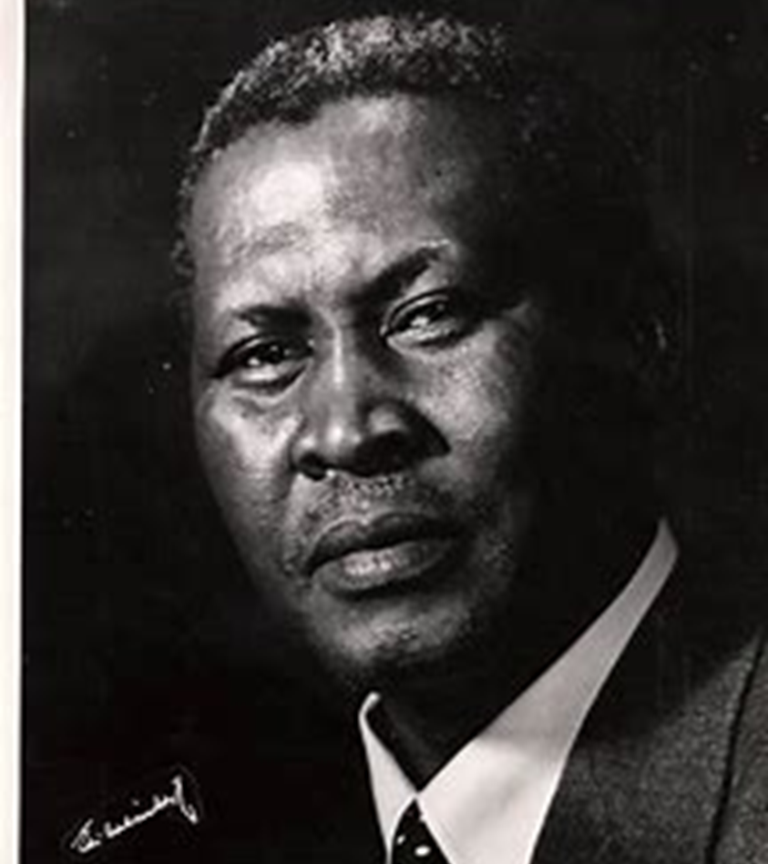
“I believe that here in South Africa, with all our diversities of colour and race; we will show the world a new pattern for democracy. There is a challenge for us to set a new example for all. Let us not sidestep this task!”
Chief Albert John Mvumbi Luthuli, President of the
African National Congress

Slide 43
XII. Conclusion
  The ANC supports the passage of the Bill through the Portfolio Committee and Parliament with minor amendments that will assist the country to establish the NHI Fund and implement the NHI or Universal Health Coverage funding mechanism to strengthen the National Health System in South Africa and to improve the NHI Bill as it is made into the law.
  The ANC is committed to executing its mandate of implementing the NHI and Universal Health Coverage financing with urgency. It also believes that health is not a commodity but a human right.
  The ANC hereby invites all South Africans to work together objectively and conscientiously as a nation leaving no stone unturned to ensure that this process of translating the NHI Bill into the NHI Act produces, as a matter of urgency, a very good legal and regulatory framework to strengthen our country’s National Health System that is made up of the public and private sector working collaboratively and equitably.

Slide 44
XII. Conclusion
The ANC reiterates that all steps that are being taken to process this NHI Bill are in pursuit of human rights and justice and in defence of freedom, as expressed in the Freedom Charter and the Constitution of the Republic of South Africa in the spirit of Mandela, the Congress Movement and freedom-loving South Africans.
The ANC is determined to get this Bill passed through Parliament, as an honour to the masses of our people, especially the poor, who have participated in many forums on the NHI and supported its underlying policy throughout from the time of tabling of the Green Paper on the NHI in 2011, through hundreds of gatherings over the years and to this moment today. Parliamentary hearings thus far have demonstrated that the majority of South Africans, urban and rural, rich and poor; and White and Black support most aspects of this draft law
.

Slide 45
XII. Conclusion
After extensive consultations over decades, the ANC applauds the government, especially the Executive for finalizing the policy aimed at strengthening and integrating the health system for the benefit of South African citizens, through the 2017 White Paper on the NHI and the tabling the Bill for the consideration by Parliament.
The ANC recommends that details of implementation and other operational matters must be attended to without any delays and be included in regulations of the NHI Act
The ANC hereby thanks the people of South Africa who are the main pillar of strength behind the NHI and the NHI Bill. We thank the committee and Parliament for this opportunity to table our submission. The ANC wishes the committee well in its further work on the NHI Bill.

Slide 46

THANK YOU!
African National Congress
Notes:
C

