Slide 1
Education
WCED BRIEF TO STANDING COMMITTEE ON EDUCATION
INFRASTRUCTURE
22 February 2022

Slide 2
All schools that are scheduled for replacement for the 2021/22 financial year including Swartland Municipality.
The following list of schools are all planned to be replaced/upgraded and either reached PC, are in construction or construction is eminent.
No. | Name School | District | Municipality | Phase
1 | Kwafaku PS | Metro South | City of Cape Town | PC
2 | Turfhall PS | Metro Central | City of Cape Town | PC
3 | P.C. Peterson PS | Cape Winelands | Stellenbosch | PC
4 | Harmony PS | Metro South | City of Cape Town | PC
5 | Willows PS | Metro Central | City of Cape Town | PC
6 | Perivale PS | Metro South | City of Cape Town | construction
7 | Panorama PS N2 | West Coast | Saldanha | construction
8 | Sunray PS | Metro North | City of Cape Town | construction
9 | Umyezo Wama Apile PS | Overberg | Theewaterskloof | construction

Slide 3
All schools that are scheduled for replacement for the 2021/22 financial year including Swartland Municipality.
The following list of schools are all planned to be replaced/upgraded and either reached PC, are in construction or construction is eminent.
No. | Name School | District | Municipality | Phase
10 | Chatsworth PS | West Coast | Swartland | construction
11 | De Waalville PS | Eden & Central Karoo | Hessequa | construction
12 | Dal Josaphat PS | Cape Winelands | Drakenstein | construction
13 | Cathkin SS | Metro Central | City of Cape Town | design
14 | Mvula PS | Metro South | City of Cape Town | design
15 | Nieuwoudt PS | West Cost | Matzikama | design

Slide 4
Budget allocated to the Department of Transport and Public Works for the replacement and maintenance of schools in the 2021/22 financial year including Swartland Municipality.
According to the adjustment budget, a total of R553.027million was allocated to DTPW for replacement and maintenance in 2021/22.
The replacement school sub-programme budget is R161.573million.
28 replacement school projects are listed over the MTEF as replacement schools allocated to DTPW in the IPMP. Only Chatsworth PS is in Swartland Municipality.
The preventative maintenance sub-programme budget is R391.454million.
151 preventative maintenance projects were allocated to DTPW in the IPMP of which 6 schools are located in Swartland Municipality, namely: Darling LS, Riverlands PS, Ruststasie PS, St. Michael’s PS, Wesbank SS and Swartland HS.

Slide 5
All schools that have been postponed for maintenance and or replacement due to COVID-19 epidemic.
Only in the previous 2020/21 financial year reprioritization of the infrastructure budget took place and the budget was cut to accommodate the reallocation of infrastructure funding towards COVID-19 PPE. The total budget cut in 2020/21 was 27% (R484.9million) of the original budget allocation of R1.74billion.
This cut had the effect of 19 new and replacement schools were delayed and 94 preventative maintenance projects from 2020/21 having to be delayed to 2021/22.
At adjustment budget stage a R192million was added back to the budget for specific maintenance projects as agreed between PT and DTPW.
No maintenance or replacement schools were specifically postponed in 2021/22 due to Covid 19 pandemic. Some preventative maintenance projects listed in the 2021/22 IPMP are delayed due to the framework contractor cancelation and re-advertisement.
The knock-on effect of budget cuts in previous financial years continues in 2021/22 with delayed projects from previous years only being completed in 2021/22 and projects originally planned for 2021/22 moving along to outer years.

Slide 6
Any additional information pertaining to infrastructure of schools outlined for the 2020/21 to 2021/22 financial years including Swartland Municipality.
The following list of new schools/upgrades and additions are in different stages of progress of implementation.
Project Name | Education District | Municipality | Phase
Stofland PS | Cape Winelands | Breede Valley | PC
Tulbagh HS | Cape Winelands | Witzenberg | PC
Moorreesburg HS | West Coast | Swartland | construction
Saldanha PS | West Coast | Saldanha | Construction
Sir Lowrys Pass SS | Metro East | City of Cape Town | Construction
Macassar PS Nr.2 | Metro East | City of Cape Town | Construction
Mfuleni HS | Metro North | City of Cape Town | tender
Happy Valley PS No.2 | Metro East | City of Cape Town | tender
Manenberg SOS | Metro Central | City of Cape Town | Tender
Napakade PS (phase 2) | West Coast | Swartland | tender
Graafwater PS | West Coast | Cederberg | Tender
Concordia PS | Eden & Central Karoo | Knysna | Design

Slide 7
Any additional information pertaining to infrastructure of schools outlined for the 2020/21 to 2021/22 financial years including Swartland Municipality.
The following list of expansion classrooms was also included in the IPMP 2021/22 and are at different stages of progress of implementation.
Mobiles
129 mobiles were delivered in 2021/22
173 mobiles are in progress of being delivered of which 105 is at existing schools and 7 are new schools.
Project Name | Education District | Municipality | Phase
Claremont HS | Metro Central | City of Cape Town | Tender
Gansbaai Academia | Overberg | Overstarnd | construction
Saldanha LS | West Coast | Saldanha | PC
Worcester Prep. | Cape Winelands | Breede Valley | Construction
Danie Ackerman PS | Metro East | City of Cape Town | Construction
RR Franks PS | Metro East | City of Cape Town | Construction
Lambert’s Bay HS | West Coast | Cederberg | Design

Slide 8
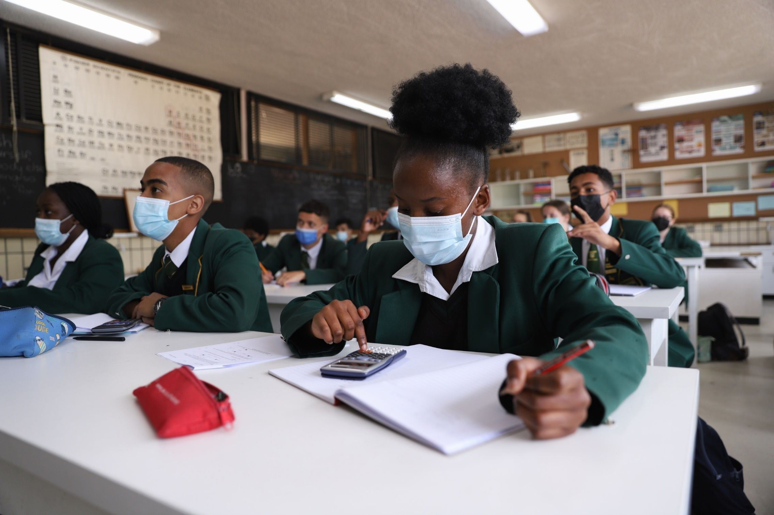
Quality Education
for every child
in every classroom
in every school
in the province.

