Slide 1

Presentation to the Portfolio Committee
QUARTER 2 PERFORMANCE REPORT PERIOD ENDED 30 SEPTEMBER 2021
22 February 2022

Slide 2
TABLE OF CONTENTS
  PART A
  Strategic Focus and Programme Achievements as per 2nd Quarter Performance Information Report
  PART B
  Departmental Performance Information
  PART C
  Governance submitted as Annexure
  PART D
  Human Resource Management Report
  PART E
  Financial Report
  END

Slide 3
BACKGROUND
We are presenting the 2nd Quarter Performance Report 2021/22 for the Department of Women, Youth and Persons with Disabilities (DWYPD).

Slide 4
OVERVIEW PERFORMANCE INFORMATION
Overall performance of DWYPD in relation to set Quarter 2 targets outlined in the 2021/22 Annual Performance Plan. Out of 35 targets planned, 30(86%) targets were achieved while 5(14%) were not achieved

Slide 5
PROGRAMME 1: ADMINISTRATION
Out of 6 targets planned for the second quarter of the 2021/22 financial year, Programme: Administration has achieved 5 targets (83%) and has not achieved 1 target (17%).

Slide 6
PROGRAMME 1 (ADMINISTRATION): 2nd QUARTER PERFORMANCE 2021/22
Output Indicator | Annual Target 2021/22 | Q2 Target | Q2 Actual Output | Performance Status (Green /Achieved Red/ Not Achieved) for Quarter 2 | Reason for Deviation | Corrective Measures
Sub-programme: Departmental Management
Unqualified audit opinion on Predetermined Objectives | Unqualified audit opinion on predetermined objectives | Unqualified Audit opinion on predetermined objectives | The department received an unqualified audit opinion on predetermined objective | Achieved | - | -

Slide 7
PROGRAMME 1 (ADMINISTRATION): 2nd QUARTER PERFORMANCE 2021/22
Output Indicator | Annual Target 2021/22 | Q2 Target | Q2 Actual Output | Performance Status (Green /Achieved Red Not Achieved for Quarter 2 | Reason for Deviation | Corrective Measures
Sub-programme: Financial Management
Percentage of invoices paid within 30 days | 100% payment of all valid invoices within 30 days | 100% payment of all valid invoices within 30 days | Out of 1033 invoices received, 1 033 invoices or 100% were paid within 30 days. July 2021 – All 298 invoices were paid within 30 days Aug 2021 – All 638 invoices were paid within 30 days Sept 2021 – All 97 invoices were paid within 30 days. | Achieved | No Deviation | None

Slide 8
PROGRAMME 1 (ADMINISTRATION): 2nd QUARTER PERFORMANCE 2021/22
Output Indicator | Annual Target 2021/22 | Q2 Target | Q2 Actual Output | Performance Status (Green /Achieved Red Not Achieved for Quarter 2 | Reason for Deviation | Corrective Measures
Sub-programme: Financial Management
Unqualified audit opinion on annual financial statements | Unqualified audit opinion on Annual Financial Statements | Unqualified Audit opinion on Annual Financial Statements | Obtained an Unqualified Audit opinion On Annual Financial Statements. | Achieved | None | None

Slide 9
PROGRAMME 1 (ADMINISTRATION): 2nd QUARTER PERFORMANCE 2021/22
Output Indicator | Annual Target 2021/22 | Q2 Target | Q2 Actual Output | Performance Status (Green /Achieved Red Not Achieved for Quarter 2 | Reason for Deviation | Corrective Measures
Sub-programme: Corporate Management
Percentage vacancy rate | Maintain a vacancy rate of less than10% annually | <10% | Vacancy Rate 4.2% | Achieved | None | None
Number of reports on the implementation of Human Resource Plan Year 1 | 3 reports on the implementation of Human Resource Plan Year 1 | 1 Report on the implementation of the Human Resource Plan Year 1 | Quarter 2 HR Planning Implementation Y1 Report produced. | Achieved | None | None

Slide 10
PROGRAMME 1 (ADMINISTRATION): 2nd QUARTER PERFORMANCE 2021/22
Output Indicator | Annual Target 2021/22 | Q2 Target | Q2 Actual Output | Performance Status (Green /Achieved Red Not Achieved for Quarter 2 | Reason for Deviation | Corrective Measures
Sub-programme: Corporate Management
Approved Master Information Technology Strategy and Plan (MITSP) | Approved Master Information Technology Strategy and Plan (MITSP) | Draft MITSP developed | None | Not Achieved | The draft MITSP is work in progress following the appointment of the Director IT | The development of draft MITSP will be prioritised following the appointment of the Director IT

Slide 11
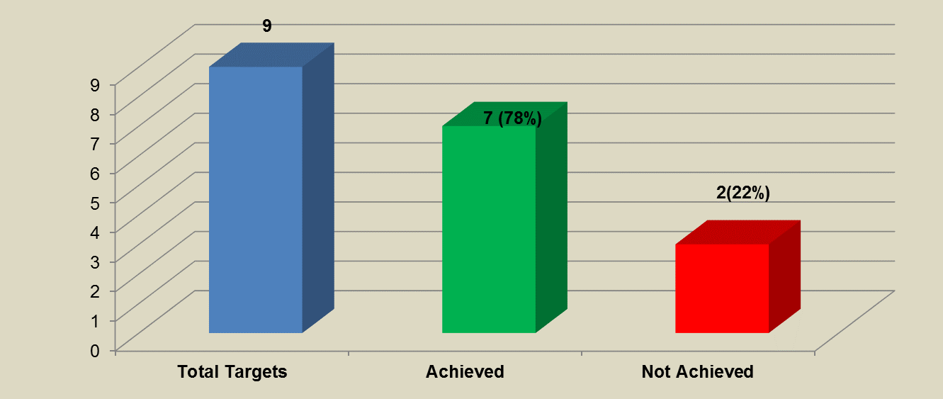
PROGRAMME 2 (STEE) :2nd QUARTER PERFORMANCE 2021/22
Out of 9 targets planned for the second quarter of the 2021/22 financial year, Programme 2, has achieved 7 targets (78%) while 32 targets (22%) were not achieved.

Slide 12
PROGRAMME 2 (STEE) :2nd QUARTER PERFORMANCE 2021/22
Output Indicator | Annual Target 2021/22 | Q2 Target | Q2 Actual Output | Performance Status (Green /Achieved Red Not Achieved for Quarter 2 | Reason for Deviation | Corrective Measures
Sub-programme: Economic Empowerment and Participation
Number of research reports on the development of the Socio economic empowerment index developed | 1 research report on the development of socio economic index developed | Inception report on the development of socio economic empowerment index developed. | ToR developed ToR Annexure A developed Bid Specification Committee Meeting | Not Achieved | The Inception report on the development of socio-economic empowerment index was not developed pending finalisation of SCM processes for Appointment of a service provider | SCM requested to prioritise the Appointment of a service provider.
Number of interventions to support economic empowerment, participation and ownership for women, youth and persons with disabilities implemented per year | 4 interventions to support economic empowerment and participation of WYPD implemented | 1 intervention to support economic empowerment and participation of WYPD implemented | Agriculture Value Chain Opportunities Workshop | Achieved

Slide 13
PROGRAMME 2 (STEE) :2nd QUARTER PERFORMANCE 2021/22
Output Indicator | Annual Target 2021/22 | Q2 Target | Q2 Actual Output | Performance Status (Green /Achieved Red Not Achieved for Quarter 2 | Reason for Deviation | Corrective Measures | Output Indicator
Sub-programme: Social Empowerment and Transformation
Number of progress report on implementation of Sanitary Dignity Implementation Framework by provinces produced | 4 progress reports on implementation of Sanitary Dignity Implementation Framework by provinces produced | 1 progress report on implementation of Sanitary Dignity Implementation Framework by provinces produced | 1 progress report on implementation of Sanitary Dignity Implementation Framework by provinces produced | Achieved | None | None | Approved Quarter 2 Performance Progress Report Submission approved by Minister

Slide 14
PROGRAMME 2 (STEE) :2nd QUARTER PERFORMANCE 2021/22
Output Indicator | Annual Target 2021/22 | Q2 Target | Q2 Actual Output | Performance Status (Green /Achieved Red Not Achieved for Quarter 2 | Reason for Deviation | Corrective Measures
Sub-programme: Social Empowerment and Transformation
Number of interventions to support social empowerment and , participation of women, youth and persons with disabilities implemented per year | 4 interventions to support social empowerment and participation of women, youth and persons with disabilities implemented | 1 intervention to support social empowerment and participation of women, youth and persons with disabilities implemented | The Terms of Reference and Procurement submission were developed. | Not Achieved | The appointment of the SCE is still underway. The finalisation and submission of the procurement submission in order to move on with the process of carrying out the actual evaluation study has been developed. The evaluation study will resume in the 3rd Quarter. | Finalisation of outstanding SCM processes.

Slide 15
PROGRAMME 2 (STEE) :2nd QUARTER PERFORMANCE 2021/22
Output Indicator | Annual Target 2021/22 | Q2 Target | Q2 Actual Output | Performance Status (Green /Achieved Red Not Achieved for Quarter 2 | Reason for Deviation | Corrective Measures
Sub-programme: Governance Transformation, Justice and Security
Number of departments monitored on the implementation of NSP GBVF | 12 national departments monitored on implementation of NSP GBVF 9 provincial departments and 4 municipalities plans monitored on the implementation of NSP GBV | 3 national departments monitored on implementation of the NSP GBVF 3 provincial departments monitored on the implementation of NSP GBVF of NSP GBVF | A report on three national departments monitored on implementation of the NSP on GBVF is in place. The departments monitored are Department of Basic Education, Department of Public Works and Infrastructure and The National School of Governance A report on findings of three provincial departments monitored on implementation of the NSP on GBVF is in place. The three departments that were monitored from KwaZulu-Natal Province are, Office of the Premier, Department of Social Development and Department of Health | Achieved | N/A | N/A

Slide 16
PROGRAMME 2 (STEE) :2nd QUARTER PERFORMANCE 2021/22
Output Indicator | Annual Target 2021/22 | Q2 Target | Q2 Actual Output | Performance Status (Green /Achieved Red Not Achieved for Quarter 2 | Reason for Deviation | Corrective Measures
Sub-programme: Governance Transformation, Justice and Security
Number of Rapid Response Teams established | 9 Rapid Response Teams established | 2 Rapid Response Teams Established | Report and attendance register for the meeting where the O.R. Tambo District Municipality GBVF Rapid Response Team (GBVF Forum) was established, is in place. Report and attendance register for the meeting where the Mnquma Local Municipality GBVF Rapid Response Team (GBVF Forum) was established, is in place | Achieved | None | None

Slide 17
PROGRAMME 2 (STEE) :2nd QUARTER PERFORMANCE 2021/22
Output Indicator | Annual Target 2021/22 | Q2 Target | Q2 Actual Output | Performance Status (Green /Achieved Red Not Achieved for Quarter 2 | Reason for Deviation | Corrective Measures
Sub-programme: Governance Transformation, Justice and Security
Comprehensive National GBVF Prevention Strategy approved | Comprehensive National GBVF Prevention Strategy approved | Consultation on the Draft Comprehensive National GBVF Prevention Strategy | Report on the consultations held on the Comprehensive National GBVF Prevention Strategy | Achieved | None | None

Slide 18
PROGRAMME 2 (STEE) :2nd QUARTER PERFORMANCE 2021/22
Output Indicator | Annual Target 2021/22 | Q2 Target | Q2 Actual Output | Performance Status (Green /Achieved Red Not Achieved for Quarter 2 | Reason for Deviation | Corrective Measures
Sub-programme: Governance Transformation, Justice and Security
NSP GBVF Monitoring and Evaluation Framework approved | NSP GBVF Monitoring and Evaluation Framework approved | Provincial Consultation on the draft NSP GBVF Monitoring and Evaluation Framework | Report on Provincial Consultations on draft NSP on GBVF Monitoring and Evaluation Framework | Achieved | N/A | NSP GBVF Monitoring and Evaluation Framework approved
Integrated Gender, Youth & Persons with Disabilities (GEYODI) Framework approved | Integrated Gender, Youth & Persons with Disabilities Framework approved | Consultation on the Draft Integrated Gender, Youth & Persons with Disabilities Framework Approved | Report on Consultation on the draft GEYODI Framework Updated Draft GEYODI Framework | Achieved | N/A | Integrated Gender, Youth & Persons with Disabilities (GEYODI) Framework approved

Slide 19
PROGRAMME 3: POLICY, STAKEHOLDER COORDINATION AND KNOWLEDGE MANAGEMENT
Out of 10 targets planned for the second quarter of the 2021/22 financial year, Programme 3, PSCKM have achieved 9 targets (90%), and 1 target was not achieved.

Slide 20
PROGRAMME 3 (PSCKM):2nd QUARTER PERFORMANCE 2021/22
Output Indicator | Annual Target 2021/22 | Q2 Target | Q2 Actual Output | Performance Status (Green /Achieved Red Not Achieved for Quarter 2 | Reason for Deviation | Corrective Measures
Sub-programme: Policy, Research and Knowledge Management
National gender policy framework reviewed | National gender policy framework reviewed | Development of SEIAS report | A draft SEIAS report developed. | Not Achieved | The development of the SEIAS Report was intensive and took longer than the planned period for completion which resulted in it not being able to be shared with the SEIAS Office in the Presidency for endorsement within Q2 itself. This will be completed in Quarter 3. | The Draft SEIAS report will be consulted with SEIAS Office in the Presidency for endorsement and finalised in Quarter 3

Slide 21
PROGRAMME 3 (PSCKM):2nd QUARTER PERFORMANCE 2021/22
Output Indicator | Annual Target 2021/22 | Q2 Target | Q2 Actual Output | Performance Status (Green /Achieved Red Not Achieved for Quarter 2 | Reason for Deviation | Corrective Measures
Sub-programme: Policy, Research and Knowledge Management
Regulatory framework for WYPD mainstreaming developed | Regulatory framework for WYPD mainstreaming developed | Draft WYPD mainstreaming framework developed | Draft WYPD mainstreaming framework developed | Achieved | None | None
Integrated Knowledge hub technical design developed | Integrated Knowledge hub technical design developed | Progress report on alignment of draft Hub model with government priorities | Progress report on alignment of draft Hub model with government priorities | Achieved | None | None

Slide 22
PROGRAMME 3 (PSCKM):2nd QUARTER PERFORMANCE 2021/22
Output Indicator | Annual Target 2021/22 | Q2 Target | Q2 Actual Output | Performance Status (Green /Achieved Red Not Achieved for Quarter 2 | Reason for Deviation | Corrective Measures
Sub-Programme: Policy, Research and Knowledge Management
Number of research reports produced on government priorities per year | 1 research report on government priorities produced | Inception report for the research on government priorities produced | Inception report for the research on government priorities produced- (research on salary gaps between women and men in the public service ) | Achieved | None | None
Number of reports on compliance of government commitments with international and regional instruments produced | 2 reports on compliance of government commitments with international and regional commitments produced | - | - | - | -

Slide 23
PROGRAMME 3 (PSCKM):2nd QUARTER PERFORMANCE 2021/22
Output Indicator | Annual Target 2021/22 | Q2 Target | Q2 Actual Output | Performance Status (Green /Achieved Red Not Achieved for Quarter 2 | Reason for Deviation | Corrective Measures
Sub-programme: Monitoring and Evaluation
Number of Progress reports on the implementation of the GRPBMEA Framework | Number of Progress reports on the implementation of the GRPBMEA Framework | - | - | - | - | -
Number of annual performance monitoring reports on government progress towards women’s empowerment and gender equality, youth development and promotion of the rights of persons with disabilities produced | 1 annual performance monitoring reports on government progress towards women’s empowerment and gender equality, youth development and promotion of the rights of persons with disabilities produced | One annual performance monitoring report produced | One Annual performance monitoring report on government progress towards women’s empowerment and gender equality, youth development and promotion of rights of persons with disabilities produced | Achieved | None | None

Slide 24
PROGRAMME 3 (PSCKM):2nd QUARTER PERFORMANCE 2021/22
Output Indicator | Annual Target 2021/22 | Q2 Target | Q2 Actual Output | Performance Status (Green /Achieved Red Not Achieved for Quarter 2 | Reason for Deviation | Corrective Measures
Sub-programme: Monitoring and Evaluation
Number of reports for the evaluation on empowerment of WYPD produced | 1 evaluation report on empowerment of WYPD produced | - | - | - | - | -
Sub-programme: International Relations
WYPD International Relations Strategy developed | WYPD International Relations Strategy developed | Draft WYPD IR Strategy consultation | Draft WYPD IR strategy consultation report on meetings held internally in DWYPD | Achieved | None | None

Slide 25
PROGRAMME 3 (PSCKM):2nd QUARTER PERFORMANCE 2021/22
Output Indicator | Annual Target 2021/22 | Q2 Target | Q2 Actual Output | Performance Status (Green /Achieved Red Not Achieved for Quarter 2 | Reason for Deviation | Corrective Measures
Sub-programme: International Relations
Number of international engagements on women, youth and persons with disabilities coordinated | 5 International engagements on women, youth and persons with disabilities coordinated | One International engagements on women, youth and persons with disabilities coordinated | Four (4) international engagements on women, youth and persons with disabilities coordinated 1) Report on participation in Indian Ocean Rim Association (IORA) Working Group on Women’s Economic Empowerment held on 22 July 2021 2) Report on participation at the G-20 conference on women’s empowerment held on 26 August 2021 3) Report on participation SADC Meeting of Ministers Responsible for Gender/Women ’s Affairs held from 25 – 26 August 2021 | Achieved | This is an overachievement as a result of the number of international engagements in which DWYPD participated in Q2 | None

Slide 26
PROGRAMME 3 (PSCKM):2nd QUARTER PERFORMANCE 2021/22
Output Indicator | Annual Target 2021/22 | Q2 Target | Q2 Actual Output | Performance Status (Green /Achieved Red Not Achieved for Quarter 2 | Reason for Deviation | Corrective Measures
Sub-programme: International Relations
Number of international engagements on women, youth and persons with disabilities coordinated | 5 International engagements on women, youth and persons with disabilities coordinated | One International engagements on women, youth and persons with disabilities coordinated | 4) Report on participation First High-Level Senior Officials Meeting between South Africa and Côte d'Ivoire held in Abidjan from 13 – 14 September 2021. | Achieved | This is an overachievement as a result of the number of international engagements in which DWYPD participated in Q2 | None

Slide 27
PROGRAMME 3 (PSCKM):2nd QUARTER PERFORMANCE 2021/22
Output Indicator | Annual Target 2021/22 | Q2 Target | Q2 Actual Output | Performance Status (Green /Achieved Red Not Achieved for Quarter 2 | Reason for Deviation | Corrective Measures
Sub-Programme: Stakeholder Coordination and Outreach
Stakeholder Management Framework developed | Stakeholder Management Framework developed | Internal consultation on draft Stakeholder Management Framework conducted | Report on internal consultation on the draft stakeholder management framework conducted | Achieved | None | None
Number of stakeholder engagements on the empowerment of women, youth and persons with disability conducted | 12 stakeholder engagements conducted | 3 stakeholder engagements conducted | Three (3) stakeholder engagements conducted 1) Report on the national women’s day commemoration 2) Report on the engagement with waste management sector and green economy collaboration on women’s economic empowerment between national treasury DWYPD, DTIC and DFFE 3) Report on the stakeholder engagement with SANTACO gender sensitization in the taxi industry | Achieved | None | None

Slide 28
PROGRAMME 3 (PSCKM):2nd QUARTER PERFORMANCE 2021/22
Output Indicator | Annual Target 2021/22 | Q2 Target | Q2 Actual Output | Performance Status (Green /Achieved Red Not Achieved for Quarter 2 | Reason for Deviation | Corrective Measures
Sub-Programme: Stakeholder Coordination and Outreach
Number of hybrid community mobilization initiatives on the rights of women, youth and person with disabilities coordinated | 4 hybrid community mobilisation initiative coordinated | 1 hybrid community mobilisation initiative coordinated | One hybrid community mobilization initiative conducted- the report on the collaboration with university of Pretoria on a women focused dialogue in honour of Charlotte Maanya Maxeke | Achieved | - | -

Slide 29
PROGRAMME 4: RIGHTS OF PERSONS WITH DISABILITIES (RPD)
Out of 6 targets planned for the second quarter of the 2021/22 financial year, Programme 4, RPD achieved all 6 targets (100%).

Slide 30
PROGRAMME 4 (RPD):2nd QUARTER PERFORMANCE 2021/22
Output Indicator | Annual Target 2021/22 | Q2 Target | Q2 Actual Output | Performance Status (Green /Achieved Red Not Achieved for Quarter 2 | Reason for Deviation | Corrective Measures
Sub-programme: Rights of Persons with Disabilities
Framework on Disability Rights Awareness Campaigns for Persons with Disabilities developed | Framework on Disability Rights Awareness Campaigns for Persons with Disabilities developed | Submission on the draft frameworks processed through DG clusters and cabinet. | Submission on Disability Rights Awareness-Raising Campaigns was approved by the DG to table and present the framework at the SPCHD DGs Cluster. The framework was presented and approved at the SPCHD DGs Cluster on the 08th September 2021 to be processed through to Cabinet. Framework on Disability Rights Awareness- Raising Campaigns was submitted to the Ministers Office for consideration and approval. The initial SEIAS were approved. The final SEIAS was submitted to the Presidency to issue a certificate for the policy framework. The Minister will be presenting the framework at the SPCHD Cabinet Committee in November Q3 2021. | Achieved | None | None

Slide 31
PROGRAMME 4 (RPD):2nd QUARTER PERFORMANCE 2021/22
Output Indicator | Annual Target 2021/22 | Q2 Target | Q2 Actual Output | Performance Status (Green /Achieved Red Not Achieved for Quarter 2 | Reason for Deviation | Corrective Measures
Sub-programme: Rights of Persons with Disabilities
Framework on Disability Rights Awareness Campaigns for Persons with Disabilities developed | Framework on Disability Rights Awareness Campaigns for Persons with Disabilities developed | Submission on the draft frameworks processed through DG clusters and cabinet. | Submission on Disability Rights Awareness-Raising Campaigns was approved by the DG to table and present the framework at the SPCHD DGs Cluster. The framework was presented and approved at the SPCHD DGs Cluster on the 08th September 2021 to be processed through to Cabinet. Framework on Disability Rights Awareness- Raising Campaigns was submitted to the Ministers Office for consideration and approval. The initial SEIAS were approved. The final SEIAS was submitted to the Presidency to issue a certificate for the policy framework. The Minister will be presenting the framework at the SPCHD Cabinet Committee in November Q3 2021. | Achieved | None | None

Slide 32
PROGRAMME 4 (RPD):2nd QUARTER PERFORMANCE 2021/22
Output Indicator | Annual Target 2021/22 | Q2 Target | Q2 Actual Output | Performance Status (Green /Achieved Red Not Achieved for Quarter 2 | Reason for Deviation | Corrective Measures
Sub-programme: Rights of Persons with Disabilities
Framework on Self representation for persons with disabilities developed | Framework on Self representation for persons with disabilities developed | Submission on the draft framework on Self Representation for persons with disabilities processed through DG Clusters and Cabinet | Submission on Self- Representation was approved by the DG to table and present the framework at the SPCHD DGs Cluster. The framework was presented and approved at the SPCHD DGs Cluster on the 08th September 2021 to be processed through to Cabinet. Framework on Self-Representation was submitted to the Ministers Office for consideration and approval. The initial SEIAS were approved. The final SEIAS was submitted to the Presidency to issue a certificate for the policy framework. The Minister will be presenting the framework at the SPCHD Cabinet Committee in November Q3 2021. | Achieved | None | None

Slide 33
PROGRAMME 4 (RPD):2nd QUARTER PERFORMANCE 2021/22
Output Indicator | Annual Target 2021/22 | Q2 Target | Q2 Actual Output | Performance Status (Green /Achieved Red Not Achieved for Quarter 2 | Reason for Deviation | Corrective Measures
Sub-programme: Rights of Persons with Disabilities
Reasonable accommodation framework developed | Reasonable accommodation framework developed | Reasonable accommodation framework developed | Cabinet approved Reasonable Accommodation framework on the 21 April 2021 as a guideline for putting measures in place that will ensure equitable access and participation by persons with disabilities in all government programmes. The Minister signed an official publication and gazetting of the reasonable accommodation framework on the 31st May 2021 to be published as a Ministerial notice in the government gazette. | Achieved | None | None

Slide 34
PROGRAMME 4 (RPD):2nd QUARTER PERFORMANCE 2021/22
Output Indicator | Annual Target 2021/22 | Q2 Target | Q2 Actual Output | Performance Status (Green /Achieved Red Not Achieved for Quarter 2 | Reason for Deviation | Corrective Measures
Sub-programme: Rights of Persons with Disabilities
Universal design and access framework developed | Universal design and access framework developed | Universal design and access framework developed | Cabinet approved the Universal Design and Access framework on the 21 April 2021 as a guideline for government- wide design of all programmes, policies, infrastructure, goods and services. The Minister signed an official publication and gazetting of the Universal Design and Access framework on the 31st May 2021 to be published as a Ministerial notice in the government gazette. The framework was not published because of undue delays by government printers | Achieved | None | None

Slide 35
PROGRAMME 4 (RPD):2nd QUARTER PERFORMANCE 2021/22
Output Indicator | Annual Target 2021/22 | Q2 Target | Q2 Actual Output | Performance Status (Green /Achieved Red Not Achieved for Quarter 2 | Reason for Deviation | Corrective Measures
Sub-programme: Rights of Persons with Disabilities
Number of reports on compliance with national/international obligations for rights of persons with disabilities developed | One status report on national/ international obligations on the rights of persons with disability produced | Draft status report on national/international obligations on the rights of persons with disability produced | Draft status report on national/international obligations on the rights of the persons with disability produced and approved by the Minister | Achieved | - | -
Number of analysis reports on draft Annual Performance Plans for national government departments analysed | One status report on Disability Inclusion in Departmental draft APPs for 2021-2022 | - | - | - | - | --

Slide 36
PROGRAMME 4 (RPD):2nd QUARTER PERFORMANCE 2021/22
Output Indicator | Annual Target 2021/22 | Q2 Target | Q2 Actual Output | Performance Status (Green /Achieved Red Not Achieved for Quarter 2 | Reason for Deviation | Corrective Measures
Sub-programme: Rights of Persons with Disabilities
Number of research reports on the inclusion of persons with disabilities produced | One research report on the inclusion of persons with disabilities produced | Research methodology and literature review and policy analysis conducted. | Research methodology and literature review and policy analyses conducted, approved by the minister(Cost of disability research study) | Achieved | - | -

Slide 37
PROGRAMME 5: NATIONAL YOUTH DEVELOPMENT
Out of 4 targets planned for the third quarter of the 2021/22 financial year, Programme 5, NYD have planned 4 targets and achieved 3 targets (75%) and 1(25%) target was not achieved.

Slide 38
PROGRAMME 5 (NYD):2nd QUARTER PERFORMANCE 2021/22
Output Indicator | Annual Target 2021/22 | Q2 Target | Q2 Actual Output | Performance Status (Green /Achieved Red Not Achieved for Quarter 2 | Reason for Deviation | Corrective Measures
Sub-programme: National Youth Development
Number of NYP implementation monitoring reports produced. | 2 NYP implementation monitoring reports produced | - | - | - | - | -
NYDA Amendment Bill refined | NYDA Amendment Bill submitted to Cabinet | NYDA Amendment Bill processed to Parliament | NYDA Amendment Bill not yet processed to Parliament Meeting held with the Office of the Chief State Law Advisors on 03 August 2021.Update Bill and Memorandum of objects produced and processed to OCSLA for final certificate. | Not Achieved | The Bill was approved by the Clusters during the Quarter under review. However, the Office of the Chief State Law Advisor was not able to issue the final certificate due to the hacking of their IT system. | Documents were submitted in hard copy in early September 2021. Follow ups are being be made, so that the Bill is processed to Parliament.

Slide 39
PROGRAMME 5 (NYD):2nd QUARTER PERFORMANCE 2021/22
Output Indicator | Annual Target 2021/22 | Q2 Target | Q2 Actual Output | Performance Status (Green /Achieved Red Not Achieved for Quarter 2 | Reason for Deviation | Corrective Measures
Sub-programme: National Youth Development
South African Youth Development Bill developed | South African Youth Development Bill developed and consulted | South African Youth Development Bill consulted | South African Youth Development Bill consulted | Achieved | N/A | N/A
Number of NYDA monitoring reports produced | 4 NYDA quarterly monitoring reports produced | 1 NYDA quarterly monitoring reports produced | 1 NYDA quarterly monitoring report produced | Achieved | N/A | N/A
Number of youth machineries convened | 4 youth machineries convened | 1 National youth machinery meeting convened | 1 National youth machinery meeting convened | Achieved | N/A | N/A

Slide 40
PART D: HUMAN RESOURCE MANAGEMENT REPORT
This presentation seeks to inform the Portfolio Committee on the cumulative status of Human Resources in the Department for the second quarter, covering the period 01 April to 30 September 2021.
The summarised report covers the following fields-
  Quarter 2 cumulative Human Resource Oversight report;
  status of vacant posts;
  service terminations;
  disciplinary matters; and
  achievements and challenges.

Slide 41
CUMULATIVE HUMAN RESOURCE OVERSIGHT
HR OVERSIGHT REPORT | Q1 | Q2 | Q3 | Q4
Approved posts | 138 | 143
Filled posts | 132 | 137
Funded vacancies | 6 | 6
SMS vacancies (number and %) | 4 | 5
 | 9.1% | 11.4%
Vacancy rate | 4.3% | 4.2%
Turnover rate | 1.5% | 3.5%
Representation of women in SMS positions | 52.5% | 51.3%
Representation of people with disabilities | 3.7% | 3.6%
Employees trained | 5 | 96
Signed Performance Agreements (number and %) | 36 | 36
 | 92.3% | 92.3%
Average number of day’s sick leave taken | 5.1 | 6.1
Average number of day’s annual leave taken | 14.6 | 15.4

Slide 42
STATUS OF VACANT POSTS: 30 SEPTEMBER 2021
Vacancy rate = 4.2%
1. DDG: PSCKM | Deferred to Jan 2022
2. Chief Director, Governance and Compliance, RPD | Deferred to Dec 2021
3. Chief Director, Stakeholder Coordination and Outreach | Deferred to Dec 2021
4. Director, Strategic Planning and Reporting | Deferred to Nov 2021
5. Administrative Secretary | Discretion of Minister
6. Senior Secretary, ODG | Deferred to Nov 2021

Slide 43
SERVICE TERMINATIONS: 30 SEPTEMBER 2021
Turnover rate = 3.5%
Nature of Termination | Number | % of Total Terminations
Dismissal | 1 | 20.0
Resignation | 4 | 80.0
Retirement | - | -
Transfer to other Public Service Departments | - | -
Contract expiry/termination | - | -
Death | - | -
TOTAL | 5 | 100,0

Slide 44
DISCIPLINARY MATTERS : 30 SEPTEMBER 2021
No financial misconduct was reported or investigated in 2021/22.
No employee on special leave.
No employee on precautionary suspension.
One (1) disciplinary hearing in process.
Six (6) disputes registered.
Two (2) disputes dismissed.

Slide 45
ACHIEVEMENTS AND CHALLENGES
As precursor to the redesign of the organisational structure, a revised budget programme structure for 2022/23 has been approved whereby the Department will report on four programmes, namely-
  Administration;
  Advocacy and Mainstreaming for the Rights of Women;
  Monitoring, Evaluation, Research and Coordination; and
  Advocacy and Mainstreaming for the Rights of Youth and Persons with Disabilities.
Vacancy rate of 4.2% is well below annual target of 10%.
All four (4) posts in GBVF Secretariat have been filled.
Implementation of HR Plan is being monitored by the HR Management Committee and reported to MANCO.
Note: additional CoE allocation through the AENE for Improvement of Service Benefits for Levels 1 to 12 and the GBVF Secretariat will be effected in Q3.

Slide 46
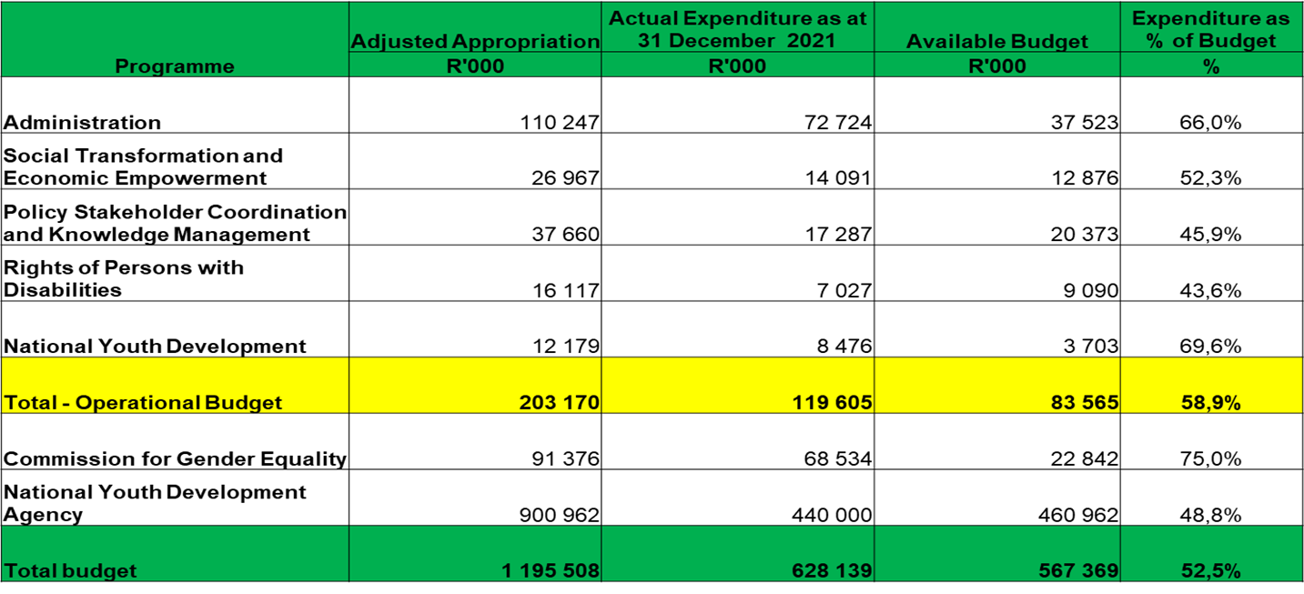
PART E: DEPARTMENTAL FINANCIAL REPORT – PER PROGRAMME

Slide 47
DEPARTMENTAL FINANCIAL OVERVIEW – ECONOMIC CLASSIFICATION

Slide 48
DEPARTMENTAL FINANCIAL OVERVIEW
DWYPD
The adjusted appropriation for the department is R763.5 million with actual expenditure of R469.9 million. The amount spent translate to 61.5%.
The adjusted operational appropriation for the programme is R201.2 million with actual of R74.2 million or 36.9%.
It must be noted that the additional funding as indicated in the allocation letter towards the Cost of Living Adjustment (COLA) and the NYDA will only be finalised once the Adjusted Appropriation Bill is passed.

Slide 49
DEPARTMENTAL FINANCIAL OVERVIEW - ADMINISTRATION
Administration 41.8%
The adjusted appropriation for the programme is R109.0 million with actual expenditure of R45.6 million or 41.8%. The reason for underspending in this programme is due to the following:
As part of the reprioritization that was done in the department, funds were shifted out of the core programmes to ICT for the procurement and payment of Microsoft licenses, Zoom licenses, implementation of the Microsoft license upgrades, SITA ICT SLAs, etc. These tasks are in progress and payments are made as and when they become due.
The department also procured 7 new pool vehicles in order to decrease the amount spend on car rentals for the protectors to the executives and assist with more vehicles to be used by departmental officials. The payment was done during Oct 2021.
As the COVID-19 restrictions were only eased during mid Sept 2021, spending will start to increase especially on travel as more physical events will be taking place.

Slide 50
OVERALL FINANCIAL PERFORMANCE – STEE
Social, Transformation and Economic Empowerment - 33.1%
The adjusted appropriation in this programme is R118.1 million, this allocation include an amount of R91.4 million earmarked for transfers to Commission for Gender Equality (CGE).
The adjusted operational appropriation for the programme is R26.8 million with actual of R8.8 million or 33.1% against the projected expenditure amounting to R16.6 million. The reasons for underspending on this programme is due to the following:
There is under expenditure under consultancy because UN Agencies provided technical experts to support the development of GBVF National Prevention Strategy and Monitoring and Evaluation Framework and plan. The budget for this project is reprioritised areas of spending pressure within this programme.
There is under expenditure under travel and subsistence because most meetings and workshops were held virtually in order to comply with level 4 and 3 shutdown requirements.
There is under expenditure under consumables because personnel spent less time in office due to the requirement for rotation in order to meet social distancing requirements posed by COVID 19 restrictions.

Slide 51
OVERALL FINANCIAL PERFORMANCE – PSCKM
Policy Stakeholder Coordination and Knowledge Management – 30.8%
The adjusted appropriation is R37.4 million for the programme with actual expenditure of R11.5 million or 30.8% against the projected expenditure of R20.0 million. The reasons for underspending on this programme is due to the following:
Vacant posts that exist in the programme
As part of the reprioritization that was done in the department, funds for goods and services were shifted out of the core programmes due to underspending because of level 4 and 3 shutdown requirements.
The Service provider for research report was only appointed in September 2021. Implementation is in progress and the expenditure will be realised from the third quarter.
The cost river is the evaluation report which is due in quarter four. the RFP was advertised and two bids received however this remained unsuccessful to the objective of the TOR. Currently re-advert is in progress to elevate this to a tender process hopeful it will attract more relevant bids. The process is still in the procurement stage and it is not certain on the appointment of the service provider and spending will improve once the SCM process is finalized and the project is in implementation stage.
COVID-19 Restrictions of Public gatherings and Engagements also had an impact on international trips. The reason for underspending is that engagements were conducted virtually.

Slide 52
OVERALL FINANCIAL PERFORMANCE – RPD
Rights of Persons with Disabilities – 28.4%
The adjusted appropriation is R16.0 million with actual expenditure of R4.5 million or 28.4% against the projected expenditure of R8.4 million. The reasons for underspending on this programme is due to the following:
Most of the commitments for the Rights of Persons with Disabilities will be incurred during the 3rd Quarter.
The Commitments have to do with the Monitoring and Evaluation Harmonisation process in 3rd Quarter
Further commitments are during the Disability Rights Awareness Month program which will also be implemented in during quarter three.

Slide 53
OVERALL FINANCIAL PERFORMANCE – NYD
National Youth Development – 31.2%
The adjusted appropriation in this programme is R483,0 million, this allocation include an amount of R471,0 million earmarked for transfers to National Youth Development Agency (NYDA).
The adjusted operational appropriation for the programme is R12,1 million with actual expenditure of R3.8 million or 31.2% of the projected expenditure amounting to R6.0 million. The reasons for underspending on this programme is due to the following:
The Commonwealth subscription payment of R1,5m is still outstanding. The expenditure will be realised in quarter three.
Staff meetings and stakeholder engagements are mostly held virtually. These include the:
  The UN ECOSOC Forum (April 2021);
  The majority of Youth Month activities were held virtually during June;
  NYP M&E Framework Validation workshop in July 2021;
  1st and 2nd quarter National Youth Machinery Forum meetings (May & Aug 2021);
  IBSA and BRICS Youth Forums (Aug 2021);
  Portfolio Committee meetings are also held virtually.

Slide 54
OVERALL FINANCIAL PERFORMANCE – ENTITIES
The expenditure for NYDA is in line with the approved cash flow projections

Slide 55
IRREGULAR, FRUITLESS & WASTEFUL EXPENDITURE AS AT 30 SEPT 2021
Irregular Expenditure
The department incurred irregular expenditure amounting to R187 220.00 as at 30 Sept 2021.
The R187 220.00 relate to a payment made for the provision of branding material for the Department that was identified as irregular expenditure after checking the supporting documents. The transaction is in relation to the 2020/21 financial year.
Fruitless and wasteful expenditure
The department did not incur fruitless and wasteful expenditure as at 30 Sept 2021

Slide 56
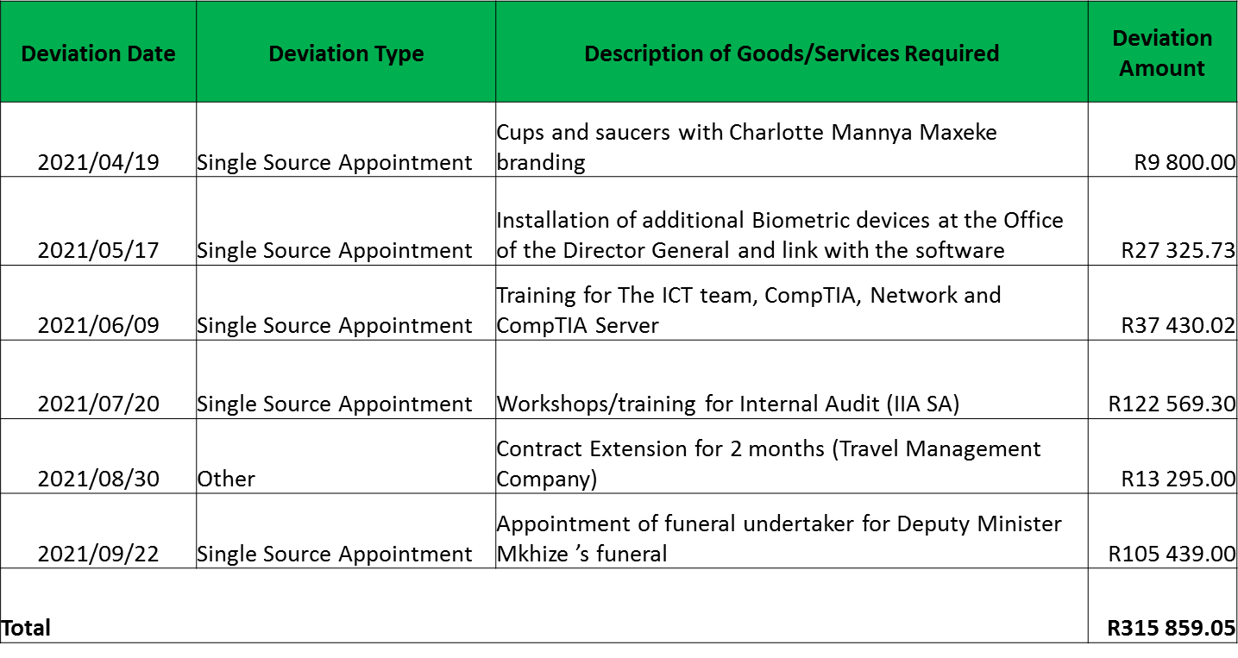
DEVIATIONS APPROVED AS AT 30 SEPT 2021

Slide 57
AUDIT ACTION PLAN – 2020/21 AS AT 30 SEPT 2021
2020/21 Findings
Unit | # of findings | # of findings cleared | # of findings in process of being addressed | # of findings not addressed yet
Finance | 3 | 3 | 0 | 0 | 100.0%
IA | 1 | 0 | 1 | 0 | 0.0%
SCM | 2 | 2 | 0 | 0 | 100.0%
HRM | 1 | 1 | 0 | 0 | 100.0%
Strat Man | 5 | 3 | 2 | 0 | 60.0%
ICT | 12 | 3 | 9 | 0 | 25.0%
Total | 24 | 12 | 12 | 0
 |  | 50.00% | 50.00% | 0.00%
The department developed the Audit Action Plan and it was approved by the Accounting Officer for implementation.
Most of the findings were addressed during the 2020/21 AGSA audit
The twelve findings in progress will be monitored quarterly though the Audit Steering Committee

Slide 58
Thank you

