Slide 1
Status of Waste Management in South Africa 18 FEBRUARY 2022

Slide 2
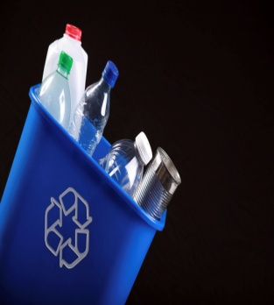
OUTLINE
Legislative Mandate
Strategic Policy Instruments
Waste Stream Notices, Norms and Standards and Regulations
National Waste Management Strategy 2020
Roles of National, Provincial and Local Government
Roles of Private sector (formal and informal)
Roles of Civil Society
Challenges Analysis and Opportunities
Conclusion

Slide 3
LEGISLATIVE MANDATE
The Constitution of the Republic of South Africa (Act 106 of 1998);
Section 24, A right to an environment that is not harmful to health and well being and to have the environment protected
SCHEDULE 4:
FUNCTIONAL AREAS OF CONCURRENT NATIONAL AND PROVINCIAL LEGISLATIVE COMPETENCE
PART A:
- Environment
SCHEDULE 5:
FUNCTIONAL AREAS OF EXCLUSIVE PROVINCIAL LEGISLATIVE COMPETENCE
PART B: The following local government matters to the extent set out for provinces in section 155 (6) (a) and (7)
- Refuse removal, refuse dumps and solid waste disposal

Slide 4
LEGISLATIVE MANDATE Cont.
National Environmental Management: Waste Act, 2008 (Act No. 59 of 2008) (NEMWA) in areas of concurrent function provides Minister with national responsibility and MEC to be responsible for policies in their provinces and municipalities to use their by-laws in the management of waste in their municipalities.
NEMWA and its Regulations also provides for Minister for National and MEC for Provincial responsibilities to implement sections of the regulations that relate to their specific areas or province.
NEMWA and its Regulations also provide for Municipal Council responsibility aligned to Municipal Systems Act, 2000 (Act no 32 of 2000) on local government responsibilities to implement specific sections in the respective jurisdiction.
The National Waste Management Strategy, 2020 (NWMS 2020) provide roles of different role-players including national government, provinces and municipalities.

Slide 5
STRATEGIC POLICY INSTRUMENTS
1st National Waste Management Strategy, 1999
2nd National Waste Management Strategy, 2012
3rd Third National Waste Management Strategy, 2020
Integrated Pollution and Waste Management Policy, 2000
National Waste Baseline Information Report, 2011
National State of Waste Report, 2018
National Environmental Management: Waste Act, Act 59 of 2008
(NEMWA)
National Environmental Management: Waste Amendment Act, Act 26 of 2014
Policy for the Provision of Basic Refuse Removal Services to Indigent Households, 2011

Slide 6
WASTE REGULATIONS
The following Regulations have been developed and implemented:
Waste Information, 2012
Waste Classification and Management, 2013
Residue Stockpiles and Residue Deposits, 2015
Plastic Carrier Bags and Flat Bags, 2003
Waste Tyre, 2017 – New process to amend the Regulations in line with the implementation of the tyre plan is underway
Prohibition of use Asbestos and manufacturing of Asbestos containing Materials, 2008
Exclusion of a waste stream or a portion of a waste stream, 2018
Import or Export of Waste, 2017
Extended Producer Regulations, 2020

Slide 7
WASTE NOTICES AND/OR PLANS
The following Notices have been developed and implemented:
Section 18 Notice for paper, packaging and some single use products
Section 18 Notice for electrical and electronic equipment
Section 18 Notice for lighting equipment
The following Plan is currently under development:
Section 29 Tyre Industry Waste Management Plan
The following Notices are currently under development:
Section 18 Notice for lubricant oils
Section 18 Notice for batteries
Section 18 for pesticides

Slide 8
WASTE NORMS AND STANDARDS
The following Norms and Standards have been developed and implemented:
Assessment of Waste Landfill Disposal, 2013
Domestic waste Collection, 2013
Disposal of waste to Landfill, 2013
Remediation of Contaminated Land and Soil quality in the Republic of South Africa, 2014
Storage of Waste, 2013
Extraction, Flaring or Recovery of Landfill Gas, 2013
Scrapping or Recovery of motor vehicles, 2013
Sorting, Shredding, Grinding, Crushing, Screening, Chipping or Baling of General Waste, 2017
The following Norms and Standards have been developed and are in the approval stage:
Organic Waste Composting, 2020
Organic Waste Treatment, 2022

Slide 9
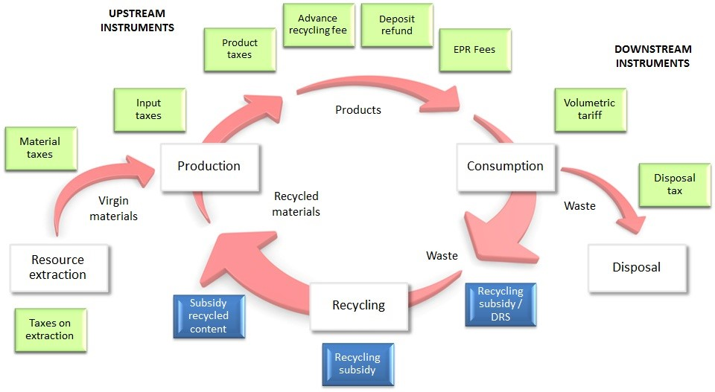
ECONOMIC INSTRUMENTS ALONG THE PRODUCT-WASTE VALUE CHAIN

Slide 10
NWMS 2020
NWMS is developed i.t.o Section 6 of Waste Act.
The NWMS is implemented over a period of five years.
The first NWMS on the NEMWA came into effect in 2012 and had 8 goals
The revision of 2012 NWMS was initiated in 2017
The revised 2020 NWMS was gazetted for implementation on 28 Jan 2021
All organs of state, holders of waste, civil, private sector are obligated to implement the strategy.

Slide 11
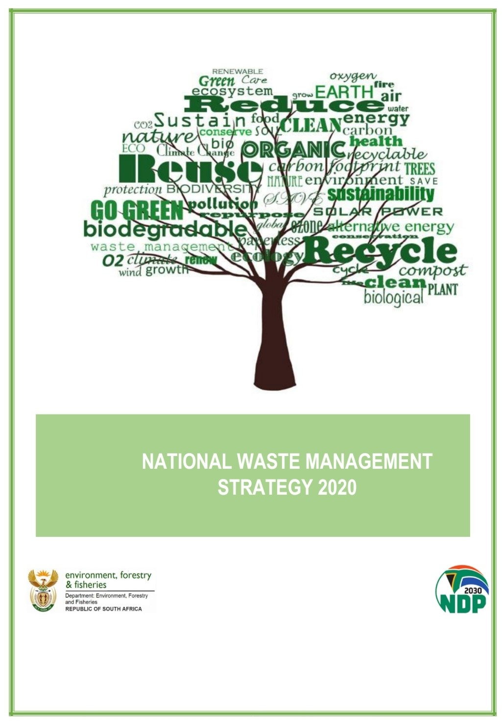
NWMS 2020
The strategy incorporate the waste hierarchy and circular economy in accordance with the following Three (3) Themes:
1. Waste Minimisation:
45% of waste from diverted from landfill within 5 years; 55% within 10 years; and at least 70% within 15 years leading to Zero-Waste going to landfill.
2. Effective and Sustainable Waste Services:
All South Africans to live in clean communities with waste services that are well managed and financially sustainable
3. Compliance, Enforcement and Awareness:
Mainstreaming of waste awareness and a culture of compliance with zero tolerance of pollution, litter and illegal dumping

Slide 12
ROLE OF NATIONAL GOVERNMENT
NEMWA
Set legislative and other measures to protect the environment from the impacts of waste. These measures include but not limited to; identifying products for extended producer responsibility, developing the regulations, norms and standards, National Waste Management Strategy, Waste Pickers Integration Guidelines, and Waste Recycling Enterprise Support Programme)
Prepare an integrated waste management plan (NWMS) for South Africa on 4R and others
Report on NWMS implementation
Approve Integrated Waste Management Plan (IWMP) annual reports
Set national norms and standards
Designate a Waste Management Officer
Declaration of priority waste
Licencing authority for hazardous waste facilities
Establish a waste information system

Slide 13
ROLE OF NATIONAL GOVERNMENT
NWMS
The DTIC and the NCPC -SA which have an interest in the socio- economic impact of EPR schemes and a critical role to play in promoting waste minimisation and the circular economy through cleaner production and industrial symbiosis, as well as an interest in industries associated with
The DTIC and SABS on standard setting, labelling and consumer awareness of products;
The DSI, the CSIR and Technology and Innovation Agency (TIA) in relation to Waste Research, Development and Innovation Roadmap (Waste RDI Roadmap).
The Department of Minerals Resources and Energy (DMRE), which has responsibility for regulation of Waste to Energy projects as they pertain to energy generation.
The Department of Agriculture which has responsibility for regulation of agriculture, is an important partner in the development and implementation of a strategy to reduce food losses and manage agricultural waste, which represents a significant volume of organic waste with beneficiation opportunities.

Slide 14
ROLE OF NATIONAL GOVERNMENT
NWMS
The Department of Health, which has responsibilities in relation to regulations around the food safety that potentially affect handling of food as a waste prevention measure, as well as regulations around Health Care Risk Waste.
The DBE which plays an important role in raising awareness around waste and recycling in schools through the school curriculum.
The DoT is responsible for regulating the transportation of goods and services and tracking and tracing transboundary waste.
The South African Police Service and National Prosecuting Authority (NPA) which have responsibilities in relation to supporting the investigation; and prosecution in terms of NEM: Waste Act.

Slide 15
ROLE OF PROVINCIAL GOVERNMENT
NEMWA
Prepare integrated waste management plan
Report on IWMP implementation
Set provincial norms and standards
Designate Waste Management Officer
Licencing authority for municipal solid waste facilities
Environmental Management Inspectorate that regulate provincial aspects of the NEM: Waste Act
May establish a waste information system

Slide 16
ROLE OF LOCAL GOVERNMENT
NEMWA
Prepare an integrated waste management plan for the Municipality
Reporting on IWMP implementation
Integrating IWMP with IDP
Provide services at an affordable price in line with Municipal Systems Act
Passing by-laws on waste services (removal, storage and disposal)
Designate a Waste Management Officer
Provide for receptacles/containers for recyclable waste
Responsible for the compliance and enforcement on the By-laws relation to pollution and waste.
Waste generators (through households)

Slide 17
ROLE OF PRIVATE SECTOR
Avoid the generation of waste, minimise the toxicity and amount of generated waste
Reduce, reuse, recycle and recover
Dispose waste in an environmentally sound manner
Prepare Industry Waste Management plan when called to do so
Establish or join an EPR scheme to fulfil 4R measures linked to prioritised products

Slide 18
ROLE OF INFORMAL WASTE SECTOR
Contribute to 4R and incl. collection of recyclable waste;
Register on National Registration Database for collection services and environmental benefits that aim to compensate waste collectors, reclaimers or pickers as part of EPR schemes and
Participate in integration processes of informal waste collectors, reclaimers and pickers into the post-consumer collection value chain.

Slide 19
ROLE OF CIVIL SOCIETY
Raise public awareness
Clean up campaigns advocacy
Improve the culture of compliance and raise civic duty on littering and illegal dumping matters
Advocacy on the role of vulnerable groups (women, youth and people living with disabilities) in waste management

Slide 20
CHALLENGES ON WASTE SERVICES
Integrated Waste Management Plans (IWMPs) are a key planning tool for Municipalities and Provinces to provide universal access of waste collection services. About 50% of Municipalities and Provinces have IWMPs.
Waste collection services in Metros range from 70% to just over 90% and the challenge is the informal settlements. Provinces which are mostly rural in nature have waste collection services below 60% as a result of traditional areas.
Waste collection services in traditional areas are just below 40% this is mainly caused by Municipalities having limited influence in those areas.
Average access to waste collection service across the country has remained steady at just over 70% over the years.
“Waste management suffers from a pervasive underpricing, which means that the costs of waste management are not fully appreciated by consumers and industry, and waste disposal is preferred over other options.” (DEA, 2011)

Slide 21
WASTE SERVICES IN METROS

Slide 22
PROVINCIAL STATUS WASTE SERVICES

Slide 23
Summary of Provinces and Municipalities with Integrated Waste Management Plans (IWMPs)
Province | PIWMP | Number of Municipalities | Number of Municipalities with IWMPs
North West | Yes | 22 | 8
Western Cape | Yes | 29 | 21
Gauteng | Yes | 11 | 3
Eastern Cape | No | 40 | 2
Mpumalanga | Yes | 20 | 17
Northern Cape | No | 26 | 5
Free State | No | 23 | 20
KZN | No | 55 | 31
Limpopo | Yes | 22 | 11

Slide 24
Municipal Landfill Sites Compliance
PROVINCE | Non-Compliant 0% to 49% | Partially Compliant 50% to 74% | Compliant 75% to 100% | Total landfills inspected between 2017/18 and Q1 2020/21 ( * total number of sites in brackets)
Eastern Cape | 26 | 4 | 4 | 34 (103)
Mpumalanga | 24 | 11 | 7 | 42 (only 28 licensed)
Gauteng | 7 (includes 4 unlicensed) | 5 | 12 | 24 (26)
Northern Cape | 17 | 0 | 0 | 17 (92)
North West | 13 | 4 | 1 | 18 (all 18 licenced and operational)
KwaZulu Natal | 13 | 9 | 8 | 30 (40)
Western Cape | 44 | 20 | 27 | 91 (154 including closed/under construction)
Limpopo | 17 | 11 | 7 | 35 (39 includes closed/under construction)
Free State | 6 | 2 | 0 | 8 (73)
TOTAL | 167 | 66 | 66 | 299 (573)

Slide 25
OPPORTUNITIES
Resource efficiency, sustainable consumption and production.
Job creation and GDP contribution from trading in waste and waste beneficiation.
Operation Phakisa: Chemicals and Waste Economy initiatives

Slide 26
PROGRAMMATIC INTERVENTIONS
Waste Minimisation
Circular Economy and EPR policy
2. Effective and Sustainable Waste Services
Refuse removal standards
Infrastructure and Financial support: MIG policy reform (yellow fleet intervention support)
Institutional, Planning and Technical support: Waste Flagship and IWMP development
3. Compliance, Enforcement and Awareness
Capacitate role players to monitor and enforce compliance
Good Green Deeds Cleaning Programme (EP)

Slide 27
CONCLUSION
Communication of the roles and responsibilities is critical in an ever changing environment.
Increasing and assigning responsibility for end-of-life management to producers (EPR schemes)
Integration and cooperation among the spheres of government on waste management covering institutional planning and implementation. MTSF Plan and Annual Work Plan for the Working Group 8 (Chemicals and Waste Management) MinTech structure that consider waste governance and coordination.
Building capacity of the role players to deliver on their mandate
Strengthening compliance and enforcement to address market failures that seem to create a perception of “cheap” landfilling.

