Slide 1
City of Tshwane
Metropolitan Municipality
Community & Social Development
Services Department
Progress on the redevelopment of Odi Stadium
18 February 2022

Slide 2
TABLE OF CONTENTS
Purpose
Update on ODI Stadium
Plans and funding requirements
Other funding models
Proposed way forward

Slide 3
PURPOSE
Appraise the Portfolio Committee on project
phases for the ODI Stadium project;
  - Phase 1 (Demotion)
  - Phase 2 ( Re-development)
Propose a way forward regarding funding and to deal with challenges of the stadium facility

Slide 4
BACKGROUND
PURPOSE OF THE UPGRADING:
The demolition of the existing multi-purpose Sport and Recreation Sport Stadium and the establishment of a new multi-purpose Sport facility that will comply to OHS-Act standards and requirements as set for facilities used for public gathering and recreation. The stadium needs to accommodate various sporting codes.

Slide 5
BACKGROUND
The stadium consists of an un-covered grand stand, secondary 4 rectangular, 2 small triangular stands and 20 floating stands, giving the stadium a seating capacity of approximately 50,000 seats.
The stadium includes a main soccer field, tartan athletics track, tartan field events , 2 change rooms, 4 sets of male/female ablutions, 4 kiosks, VIP lounge and seating, security room, referee room, press room, control room, admin offices, generator room, stores, several indoor sporting areas, 4 high mast and 4 ticketing offices.
Other facilities outside the stadium include combi-courts for tennis, basket ball, volley ball and 2 informal soccer training grounds.

Slide 6
BACKGROUND
Problem statement:
The stadium was transferred to Gauteng Province at the beginning of 2008 and later transferred to the City of Tshwane. The latter had to accept an asset which was an immediate liability.
The layout of the facility is not compliant to FIFA specifications and can therefore not be used for matches.
Specific design shortfalls and lack of maintenance over several years.
The option to demolishing the stadium is based on the assessment of the structural integrity of the stadium and the inter-dependent relation of the surrounding areas of development to compliment the existence of the stadium.

Slide 7
Project Description

Slide 8
Project Description

Slide 9
COMMUNITY CONSULTATION
It was recommended that a public participation process be undertaken regarding
the main stadium. Consequently, the participation meeting took place on Saturday,
7 September 2013.
The three options were explained in detail to the meeting. The three options were the following:
Option 1: Demolition of the stadium and rebuilding
Option 2: Retention of the stadium and upgrading
Option 3: Demolition of the existing stadium and conversion of the stadium into a multi-
purpose sport & recreational park
The Mayoral Committee of 22 January 2014 resolved on the majority decision by the community to convert Odi Stadium into a multipurpose sport and recreational park (Option 3).
The community consultation process will need to be repeated to make sure that their wishes are implemented.

Slide 10
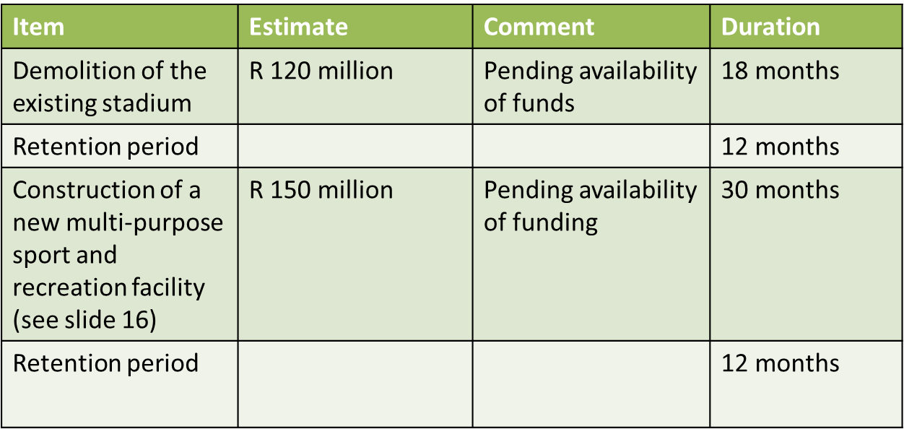
TIMELINES FOR
IMPLEMENTATION

Slide 11
RE-DEVELOPMENT
The proposed way forward to establish the new multi-purpose Sport and Recreation facility:
Demolition of the existing stadium
New grassed main field with floodlights, athletics track, security fencing and parking
Upgrade the existing 2 practice soccer fields in the precinct
Upgrade the existing multi-purpose courts in the precinct
Upgrade the existing indoor centre (precinct)
New public ablutions
New change rooms
New clubhouse

Slide 12
PLANS AND FUNDING REUIREMENTS
Following the PC visits, the CoT has engaged with DSAC and submitted a funding proposal to National Treasury (NT) under Budget Facility for Infrastructure (BFI)
By design, BFI is meant to fund projects between R1 and R3 billion, in sectors that include municipal infrastructure. In essence this means cost estimates for proposed upgrades must be meet a minimum threshold, and currently estimates are around R1,3 billion for HM Pitje and R270 million for ODI
DSAC supported this application by an endorsement letter
The application for funding was unfortunately not successful.

Slide 13
OTHER FUNDING OPTIONS
National Government funding option:
- 15% USDG for Sports Infrastructure (not successful)
Public Private Partnership option:
- To be explored as commercial development and creation of a commercial hub.
Tshwane internal funds
- The project has been included in the 10 year wish list for CoT but is pending approval of funds

Slide 14
CHALLENGES, PROPOSED SOLUTIONS & WAY-FORWARD
CHALLENGES
PROPOSED SOLUTIONS
Unavailability of funds to demolish existing stadium and redevelop a new multipurpose sport and recreation facility
Existing stadium has been declared unsafe and creates health and safety challenge. Lack of Tshwane resources to secure stadium
Explore funding applications to National Treasury, PPP options and Tshwane internal funding
Stadium previously fenced to keep intruders from entering - continuous challenge. Option to involve community participation to ensure safety

Slide 15
WAY FORWARD
The current financial situation of the City of Tshwane creates uncertain development opportunities towards the demolition and redevelopment of the facility.
The current unsafe facility is a big challenge due to a lack of internal resources and the option of external or private funds needs to be explored.
An additional new development concept can be looked into where a private investor can assist with funding to create a symbiotic commercial model that will benefit both private sector and the CoT

Slide 16
THANK YOU!

