Slide 1
Gauteng Department of Department of Sports, Arts, Culture and Recreation
DEMOLITION OF HM PITJE STADIUM
18 FEBRUARY 2022
PROGRESS REPORT

Slide 2
PURPOSE OF THE PRESENTATION
Provide status update on the progress to date
Highlight challenges and proposed solutions
Propose a way-forward

Slide 3
PHASE1: DEMOLITION (PROJECT INFORMATION)
IMPLEMENTING AGENT | GAUTENG DEPARTMENT OF INFRASTRUCTURE DEVELOPMENT
PROFESIONAL SERVICES PROVIDER | MMQS MACE
CONTRACTOR | MAZIYA GENERAL SERVICES
TYPE OF CONTRACT | NEC 3 ENGINEERING AND CONSTRUCTION CONTRACT
CONTRACT SUM | R 26 831 442,92 (Incl. VAT)
SITE HANDOVER DATE | 15 DECEMBER 2021
COMMENCEMENT DATE | 03 JANUARY 2022
CONTRACTUAL COMPLETION DATE | 03 JANUARY 2023

Slide 4
PHASE1: DEMOLITION (PROJECT IMPLEMENTATION PLAN)
THE DEMOLITION OF HM PITJE STADIUM – HIGH LEVEL IMPLEMENTATION PLAN
Stage | Description | Planned Start | Planned completion date | Actual
1 | Tender Advert | 01 October 2021 | 01 October 2021 | 01 October 2021
2 | Tender Closing | 18 October 2021 | 18 October 2021 | 18 October 2021
3 | Bid Evaluation | 19 October 2021 | 21 October 2021 | 25 October 2021
4 | Checking and approval of the evaluation by Probity Auditors | 21 October 2021 | 29 October 2021 | 02 November 2021
5 | Bid Adjudication | 04 November 2021 | 04 November 2021 | 08 November 2021
6 | Tender award | 11 November 2021 | 11 November 2021 | 12 November 2021

Slide 5
PHASE1: DEMOLITION (PROJECT IMPLEMENTATION PLAN)
THE DEMOLITION OF HM PITJE STADIUM – HIGH LEVEL IMPLEMENTATION PLAN
Stage | Description | Planned Start | Planned completion date | Actual
7 | Submission of performance bond (guarantees) and public liability insurances | 18 November 2021 | 18 November 2021 | 22 November 2021
8 | Signing of the contract | 23 November 2021 | 10 December 2021 | 15 December 2021
9 | Builder’s Holiday | 20 December 2021 | 31 December 2021 | 31 December 2021
10 | Site Establishment cont…(CLO interviews, local labor and subcontracting, acquisition of approvals) | 03 January 2022 | 31 January 2022
11 | Demolition | 01 February 2022 | 28 February 2022
12 | Crushing and leveling of the rubble and carting away of Steel reinforcement | 01 March 2022 | 30 June 2022
13 | Fencing of the site | 30 June 2022 | 03 January 2023
14 | Completion of the works | 03 January 2023 | 03 January 2023

Slide 6
PHASE1: DEMOLITION (CHALLENGES, PROPOSED SOLUTIONS & WAY-FORWARD)
CHALLENGES
PROPOSED SOLUTIONS
Purchase order creation delay which has a potential of attracting standing time
Encroachments
Create contract PO’s for the whole contract amount(s) and duration for all service providers involved to avoid further delays in payments
Continue with demolitions and other activities while the municipality is finalizing on how to deal with encroachments

Slide 7
PHASE 2:REDEVELOPMENT

Slide 8
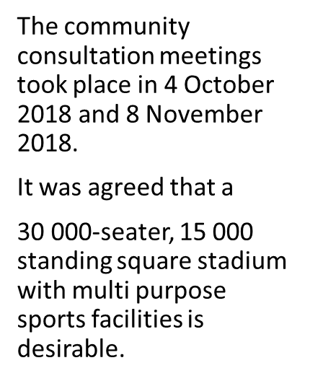
PHASE 2:REDEVELOPMENT

Slide 9
PHASE 2:REDEVELOPMENT

Slide 10
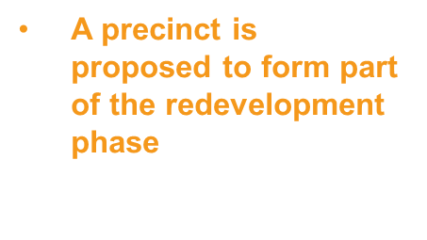
PHASE 2:REDEVELOPMENT

Slide 11
PHASE 2: REDEVELOPMENT (Progress To Date)
City of Tshwane(CoT) together with the Gauteng Provincial Department of Sports, Arts, Culture and Recreation (GDSACR) have requested funding for the redevelopment phase which was not granted
GDSACR is currently in consultation with stakeholders(i.e. Premier’s office, provincial and national treasury departments) to finalize a funding model which will be relevant for the redevelopment phase

