Slide 1

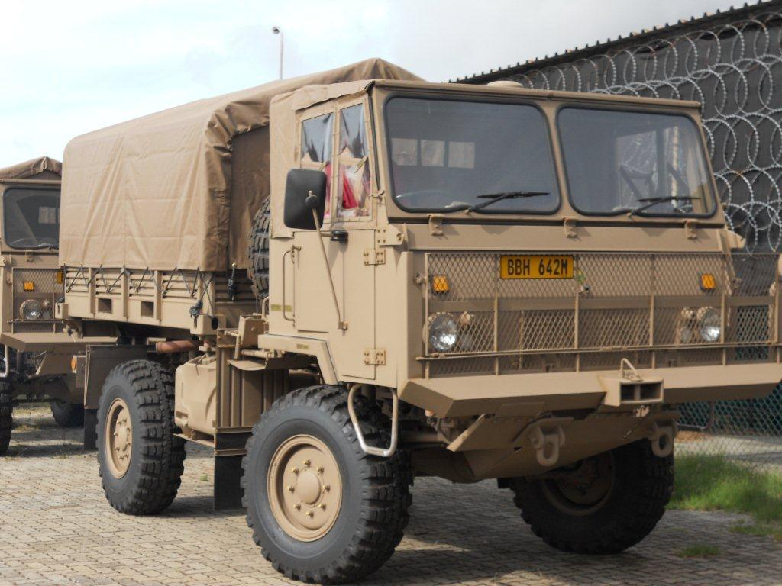
PRESENTATION TO THE PORTIFOLIO COMMITTEE ON DEFENCE AND MILITARY VETERANS
CONFIDENTIAL
PRESENTATION TO DATE: FEBRUARY 2022
CONFIDENTIAL

Slide 2
Projects: BIRO & HOTEL
CONFIDENTIAL
CONFIDENTIAL

Slide 3
PROJECT BIRO: INSHORE PATROL VESSELS
CONTRACT DATE : 11 January 2018
DELIVERY DATES :
• MMIPV 1571 : March 2022
• MMIPV 1572 : June 2023
• MMIPV 1573 : September 2024

Slide 4
PROJECT BIRO STATUS (1):
MMIPV 1571
Most of the hull Sea Trails have been concluded successfully and confirmed that the specified performance is exceeded.
International travel bans impacted on the conclusion of the combat system Sea Trails which has been re-scheduled to early February 2022.
MMIPV 1572
Fabrication of the 21 sections are 95% completed and outfitting thereof 90%.
Unit assembly is 78% complete.
Hull assembly is 75% complete.
33 of the 46 main equipment factory acceptance tests have been completed successfully.
MMIPV 1573
Fabrication of 8 of the 21 sections are in progress.
Section fabrication is 29% completed.
11 of the 46 main equipment factory acceptance tests have been completed.
Training
Final crew (systems training) commenced and will be completed in March 2022.
Spares: The first batches were ordered and delivery thereof are in progress.

Slide 5
PROJECT BIRO STATUS (2)
Schedule Risk: Low
Initial delivery dates were amended to cater for delays due to the pandemic and a request from the SAN to conduct final crew training at the contractors premises rather at the Naval Base as initially contracted.
Given the current vessel construction status it is expected that the 2nd and 3rd Vessels will be delivered ahead of schedule.
Risk of further delays is considered low and are not foreseen.
Financial Risk: Low
Sufficient funding has been availed to complete the project.
Future Maintenance Costs
Annual Operating and Maintenance cost for 3 MMIPVs is estimated at R80 million (2021/22 Rand Value).

Slide 6
PROJECT HOTEL STATUS (1):
Hydrographic Survey Vessel (HSV)
The construction of 10 out of the 10 Blocks for Hydrographic Survey Vessel (HSV) are completed.
Equipment installation has commenced. HSV training has commenced.
SAN Hydrographic office (SANHO)-99% complete
Hand-over process is complete.
Interim Support Phase has commenced.
Survey Motor Boats (SMB) is 99% complete
SMB1 hand over is complete and OT&E will commence.
Formal Qualification Reviews (FQR) are complete for SMB 2 and 3.
The two SMBs (2&3) will be placed into preservation & delivered with the HSV.
Observation
Option to order additional IPVs at the same price
The contractor extended the option to 11 July 2022

Slide 7
PROJECT HOTEL STATUS (2)
Sea Boats (SB) is 98% completed.
Sea Acceptance Trails are complete and SB will be placed into preservation & delivered with the HSV.
Schedule Risk: High
The Production Phase is inherently a relatively short period because only a single ship is being produced.
Armscor has approved the amendment to cater for the delays as a result of force majeure claims and Covid-19, and this should enable the contractor to recover lost time.
Financial Risk: Low
Project Hotel is fully funded.
Future Maintenance Costs
Annual Operating and Maintenance costs for the HSV is estimated at R50 million (2019/20 Rand Value).

Slide 8
PROJECT BIRO & HOTEL – ORDER INFORMATION
 | APPROVED FINANCIAL AUTHORITY (FA) VALUE | PURCHASE ORDER (PO) VALUE (excludes other costs i.e. ROE, Escalation, VAT) | PO PAID TO DATE
HOTEL SAS KT498702 | R2 738 711 231,00 | R1 850 184 701,58 | R1 219 243 580,13
Biro – Damen KT498729 | R3 632 581 773,00 | R2 471 132 880,00 | R1 401 004 729,26
8

Slide 9
Project: HOEFYSTER
CONFIDENTIAL
CONFIDENTIAL

Slide 10

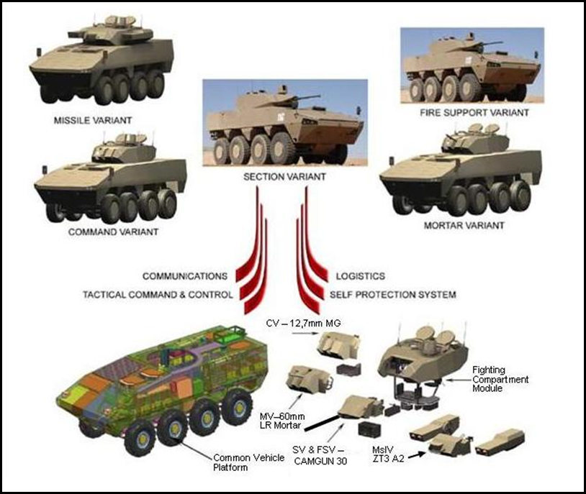
HISTORY
Project Description
Project HOEFYSTER is a capital acquisition project
The development, industrialisation and production of 264 infantry combat vehicles to replace the Ratel Infantry Combat Vehicles

Slide 11
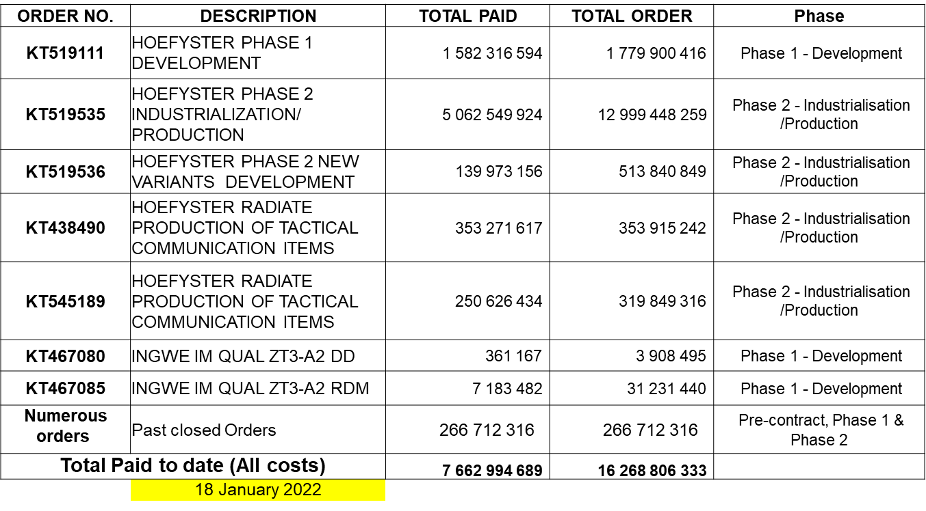
DISCUSSIONS:CHALLENGES
  Current total contract value: Approximately R 16 268 806 333 (Incl. Provision for ROE, escal and VAT) FY 2021 Rand value
  Value spent to date: R 7 662 994 689 (Including ROE, escalation and VAT).
11

Slide 12
CONTRACTUAL IMPLICATIONS
ADVANCE PAYMENTS MADE TO DENEL
An amount of about R1,4 billion in guarantees may be called up from the various banks.
The amounts which are covered by the Denel Corporate guarantees are at risk.
ORDER # | ADVANCE PAYMENT OUTSTANDING | ITEM # | GUARANTEES HELD BY | GUARANTEE AMOUNTS
KT519535 | R1 899 861 049 | 1 | ABSA | R469 339 247
 |  | 2 | FNB | R360 438 704
 |  | 3 | ESCROW | R169 018 465
 |  | 4 | Denel Guarantees | R552 537 309
 |  | 5 | GUARD RISK | R395 000 000
 |  |  | TOTAL | R1 946 333 725
KT519536 | R61 224 435 | 6 | Denel Guarantees | R61 248 789
 |  |  | TOTAL | R61 248 789
KT519111 | R46 135 245 | 7 | NEDBANK GUARANTEE | R48 291 162
 |  |  | TOTAL | R48 291 162
 | R2 007 220 729 |  | TOTAL AMOUNT OF GUARANTEES | R2 055 873 676

Slide 13
DISCUSSIONS: CHALLENGES
Various engagements between Denel and Armscor revealed the risks of Denel not being able to meet the contract;
  Armscor presented to the PDSC of the 19 November 2018 whereby these risks and possible alternatives were presented.
    Scenario 1 – Accept Denel’s request for extending project delivery to year 2026, waiving of penalties estimated to be about R500m(by the proposed date of year 2026), and absorbing of escalation costs(e.g. inflation, ROE) by DOD.
    Scenario 2 - DOD reducing the project scope in terms of quantities or number of variants.
    Scenario 3 – Seek an alternative contractor to work with Denel or replace Denel.
    Scenario 4 - Impose a cut-off target date of May 2019 for the completion of the design phase of the Section Variant (SV) Turret as an ultimatum after which, consider terminating the project.
  The PDSC proposed that there should be further engagement with the SA Army and various forums.
The outcome of the discussions and investigations resulted in following conclusions:
  Allow DLS to complete Phase 1 Development up to the PBL stage.
  The SA Army to defer Phase 2.
  Consequently to allow Armscor to terminate the Phase 2 Orders (except for the completion of the 4-off SV PPM L5).
  To ring-fence funds allocated for Phase 2 to be used by the SA Army for Operational Requirements.

Slide 14
RECOMMENDATIONS
Denel is not in a position to complete remaining work on Phase 1 due to:
  Insufficient capability, financial challenges, and obsolescence of critical subsystems.
  Project would be loss making to Denel.
Recommended option:
  Cancel the contract
  Call up the Bank Guarantees held by various banks (about R1.4bn)
  Implications:
    Recalling the guarantees may lead to the banks going after Denel and possibility of Denel liquidation
    Loss of sovereign capability to produce arms
Combat requirements:
  Funds from the cancelled contract could feasibly be re-channelled for the upgrading of the Ratel Combat Vehicle system (ICV) .
  These funds are from the bank guarantees (R1.4bn) and the current year allocation of R1.9bn. These funds will be constituted of the bank guarantees and the current year allocation of R1.9bn.

Slide 15
STATUS OF MAINTENANCE OF SAAF AIRFORCE FLEET
CONFIDENTIAL
CONFIDENTIAL

Slide 16
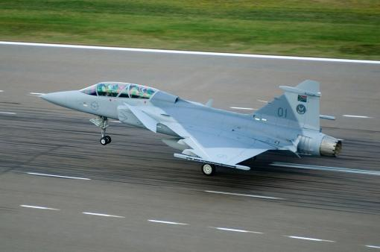
Maintenance Status by Denel and other service providers
  The status of maintenance of South African Airforce fleet by Denel and other service providers.
  C130 Product System Support contract expired on 31 December 2021 it has since been extended until 30 June 2022. Armscor has issued a Request For Bid and Denel has requested for the extension of the Request For Bid to allow them to respond to the bid;
  Oryx Product System Support contract expires on 31 March 2022 and it will be extended until 30 September 2022. Armscor has issued a Request For Bid and Denel has requested for the extension of the Request For Bid to allow them to respond to the bid;
  Rooivalk Product System Support contract expires on 31 March 2022 and will be extended until 30 September 2022. Armscor has issued a Request For Bid and Denel has requested for the extension of the Request For Bid to allow them to respond to the bid;

Slide 17
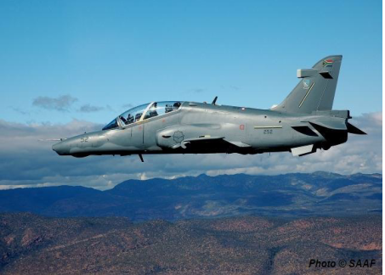
Maintenance status of South African Airforce Fleet by other service providers
  The Agusta 109 fleet Product System Support order expired on 31 December 2021. Evaluation of bids received is currently in process by Armscor.
  The Boeing Business Jet Product System Support contract is still valid until 31 March 2023.
  The Bk117 Product System Support contract expires on 31 March 2022.
  The C208 Product System Support order expired on 31 December 2021. The advertised Request For Bid closes on 4 February 2022. The order is expected to be placed in the new 2022/23 Financial Year (FY);
  The CASA fleet order expired on 31 Dec 2021. The advertised Request For Bid closes on 4 February 2022 but the Original Equipment Manufacture has requested an extension of the Request For Bid. The order is expected to be placed in the new 2022/23 Financial Year (FY);
  Currently no C47TP Contract: Armscor is currently busy with the procurement process to appoint a contractor;
  Falcon Fleet current Product System Support contract expires on 31 March 2022. The Request For Bid closes on 4 February 2022.. The order is expected to be placed in the new 2022/23 Financial Year (FY);

Slide 18
Maintenance status of SAAF Fleet by other service providers
  Hawk Fleet: The current Product System Support contract is valid until 30 August 2024;
  Gripen Fleet: Currently there is no Product System Support contract. The received offer from the Original Equipment Manufacture is beyond the budget of the South African Airforce. Armscor is in negotiation for the reduction of the price;
  King Air Fleet the Product System Support contract expires on 31 March 2022. Armscor is currently busy with the procurement process to appoint a contractor;
  Lynx Fleet the current Product System Support contract expires on 31 March 2023;
  PC7/12 Fleet the current Product System Support contract expires on January 2023.

Slide 19
Thank you

