Slide 2
DMRE & its entities Implementation Action Plan to address AGSA’s audit findings and recommendations
Mr Tseliso Maqubela
Acting Director General
Date: 15 February 2022

Slide 3
Presentation outline
Executive Summary
2020/21 Audit Outcome
Status on the implementation of Audit plan/resolution of AGSA Audit findings

Slide 4
DMRE’s EXECUTIVE SUMMARY

Slide 5
DMRE’s EXECUTIVE SUMMARY

Slide 6
DMRE’s EXECUTIVE SUMMARY

Slide 7
DMRE’s EXECUTIVE SUMMARY

Slide 8
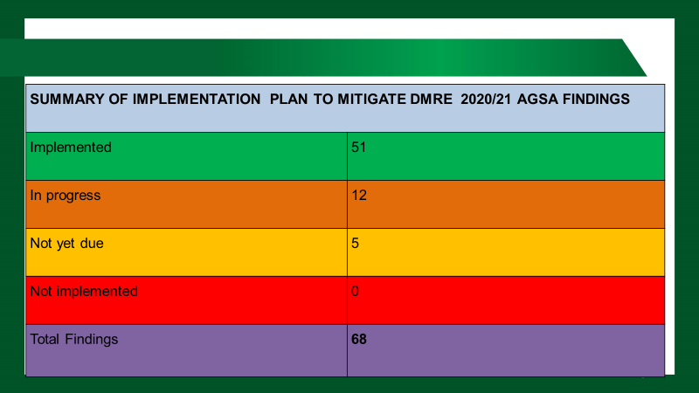
DMRE’s EXECUTIVE SUMMARY

Slide 9
SOE’S Executive summary
The department of Mineral Resources and Energy (DMRE) has oversight responsibilities over Eleven (11) public entities.
Two (2) of these entities (CEF group and NECSA Group) are classified under Schedule 2 and Nine (9) under Schedule 3 of (PFMA), respectively.
DMRE SOES
NECSA Group
CEF Group
NERSA
NRWDI
SANEDI
MINTEK
CGS
MHSC
NNR
SADPMR
SDT

Slide 10
SOE’S Executive summary
Research
MINTEK
CGS
Mining
MHSC
Regulator
NERSA
NNR
SADPMR
Energy
NECSA Group
CEF Group
NRWDI
SANEDI
SDT

Slide 11
2020/21 Audit Outcome
NRWDI
NECSA Group
CEF Group
CGS
MHSC
MINTEK
NERSA
NNR
SADPMR
SANEDI
SDT
Clean Audit
Unqualified with findings
Disclaimed with findings
Outstanding Audit
NRWDI has received consecutive clean audits
SADPMR regressed from a clean audit in 2019/20 to an unqualified with findings in 2020/21
NECSA group received another disclaimer while the CEF group audit is outstanding

Slide 12
2020/21 AGSA Audit
OF the 10 AG-audited Entities, 3 (NRWDI, SDT and SANEDI) HAD NO material errors
6 had material misstatements, which were subsequently corrected, HOWEVER NECSA,SADPMR and SDT CORRECTED SOME material findings
1 entity (NECSA)’s AFS were disclaimed BY AG

Slide 13
status as at 31 DECEMBER 2021
SOE | Not yet Due (ND) | Resolved (R) | Partially resolved (PR) | Unresolved (UR) | TOTAL
CGS | - | - | 2 | 3 | 5
MHSC | - | 24 | 19 | - | 43
MINTEK | - | 25 | 19 | - | 44
NECSA | - | 57 | - | 6 | 63
NERSA | - | 12 | 2 | - | 14
NNR | 4 | 6 | 2 | - | 12
NRWDI | - | 4 | - | - | 4
SADPMR | - | 11 | 24 | 4 | 39
SANEDI | - | 9 | 3 | - | 12
SDT | - | 19 | 2 | - | 21
TOTAL | 4 | 167 | 73 | 13 | 257
The report below focuses mainly on Unresolved findings as at end of Quarter 3 of 2020/21

Slide 14
Thank you

