Slide 1


ANNUAL REPORT
2020/21
Presented by: SITA Managing Director
To: Portfolio Committee on Communications
Date: January 2022

Slide 2

Committed to leveraging Information Technology (IT) as a strategic resource for government
Table of Contents
Annual Report Schedule
Part B: Performance Information
Part C: Governance
Part D: Human Capital Management
Part E: Financial Information
SITA ANNUAL REPORT 2021

Slide 3

PART
A
GENERAL INFORMATION

Slide 4


Committed to leveraging Information Technology (IT) as a strategic resource for government
Annual Report Schedule
Item | Description | Timelines
1 | Submit draft annual report to AG, DCDT and NT as per PFMA Act, 1999 and NT Regulations | 31 May 2021
2 | Submit draft annual report to AGSA for audit purpose | 31 May 2021
3 | Submit final annual report to AGSA for verification and certification | 30 July 2021
4 | SITA 22nd Annual General Meeting | 25 November 2021
5 | Submit approved electronic copy of annual report AG, DCDT and NT | 29 November 2021
6 | Submit approved electronic copy of annual report for tabling to Parliament | 30 November 2021
SITA ANNUAL REPORT 2021

Slide 5

PART
B
PERFORMANCE INFORMATION

Slide 6
Committed to leveraging Information Technology (IT) as a strategic resource for government
Performance Information: Overview
The 2020/2021 financial year being dominated by the disruptive Covid-19 pandemic created an ideal opportunity for SITA to enable government and its departments to operate seamlessly by making available digital platforms, developing e-services and providing readily available cloud capacity, all for the convenience of citizens.
In response to the SOC rationalisation process driven by the Shareholder, SITA continued to repurpose itself to deliver effective and efficient ICT services and drive digital transformation in government as per key focal areas namely; e-government, research and development, innovation, localisation, cyber-security, and IT service management.
Despite the tough economic climate SITA followed governments’ lead by quickly implementing cost containment measures and adjusting its budget, amongst other, thereby creating a financially resilient organisation.
The impact of the pandemic however, limited operational expenditure and the outlay of capital investments which inevitably affected the overall performance of the organisation.
The severe strain on the supply chain delayed the implementation of some digital transformation projects as well as affected external client service delivery resulting in a rise in customer service delivery complaints and escalations.
  As the pace of digital transformation accelerated SITA sequenced its priorities and strategic projects in order to advance government digital transformation to enable government service delivery as well as prioritised external client requests.
SITA ANNUAL REPORT 2021

Slide 7

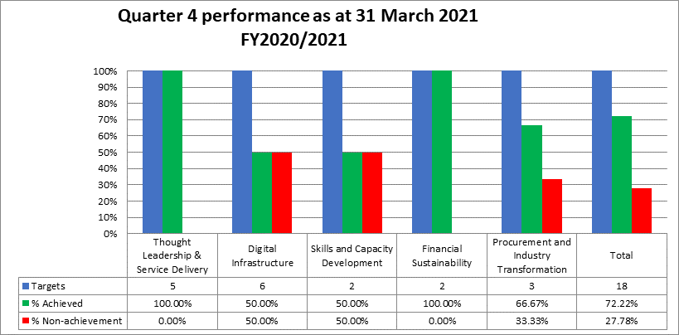
Committed to leveraging Information Technology (IT) as a strategic resource for government
Performance Information Overview…
SITAs’ preliminary annual performance results reflect an achievement of 72.22% on its
annual targets.
Key challenges underscored by the pandemic which resulted in this performance score
include the following reasons:
    Severe economic downturn and uncertainties which resulted in implementation of budget adjustments/cuts and cost containment measures that negatively impacted optimal implementation of planned initiatives;
    Extended time frames for tender processes aimed at ensuring fair and equitable time for submission of proposals within a business unusual environment;
    Increased volumes of procurement requests towards financial year-end and delays in the finalisation of requests due to remote working;
    Unreliable ICT budget data on government’s Business Accounting System i.e. information was not updated by government departments as finances were reprioritised due to Covid-19; this negatively impacted the determination of the actual increase in government market share on designated services and
    Cancellation of some tenders and bids as per SCM policy and processes and timeframes to finalise some bids / tenders which impacted project implementation progress.
SITA ANNUAL REPORT 2021

Slide 8

Committed to leveraging Information Technology (IT) as a strategic resource for government
Performance Information Overview…
While SITA did not achieve 100% performance on its predetermined objectives, the following key successes were registered:
  SITA commenced with the deployment of multiple e-government services and established its e-Government portal that serves as a single point of entry to government's electronic services. The portal currently has more than 55 e-services available.
  SITA successfully deployed two big data analytics use cases, one for SITA internal use as part of its supply chain efficiency programme and another within government in order to integrate data and systems.
  SITA reduced the backlog of DHET certificates which dated back to 1992 thereby supporting government service delivery, satisfying the needs of deserving candidates and silencing complaints which surfaced on multiple platforms.
  SITA was instrumental in enabling government during the pandemic i.e.
    seamless and secure communication remote access solutions services were provided to 8 336 officials (Government and SITA)
    provisioning and upgrade of connectivity to members of Cabinet
    upgrading of sites and maintaining over 5000 sites for government in order to ensure that remote working was enabled
    upgrading of Internet bandwidth (by 2.5 Gbps) for government
    increase of onsite/ remote access capability to over 7,500 users (from 4,826 users)
    provisioning of Video Conferencing tools to the Executive and Administration
    provisioning of LAN and Desktop support to the Executive and Administration
    24 x 7 x 365 customer service response which spanned the length and breadth of the country
SITA ANNUAL REPORT 2021

Slide 9

Committed to leveraging Information Technology (IT) as a strategic resource for government
Performance Information Overview…
  SITA established three digital platforms (i.e. Big Data Analytics Platform, Application Programming Interface Middleware Platform, and the Business Process Management Platform) thereby transforming itself into a platform-driven business.
  SITA supported localisation through enforcing the principle of 30% percent subcontracting of contracts that are > R30 million to Black EMEs and SMMEs; 40.67% of acquisition spend was registered through black entities on influenceable spend.
  SITA improved the security of government data assets through its Unified Communication (UC) capability; two service packages inclusive of product pricing were developed under the UC service category, namely video conferencing capability and UC solutions available through SITA contracts.
  SITA supported government's SA Connect project through upgrading of 249 sites bringing the total number of connected sites to 970 (713 new sites and 257 upgrade sites) since inception of the programme in the FY2018/2019 thereby improving connectivity and access of citizens and organisations to government services.
  SITA for the first time since inception managed to have 96% of its SLAs signed within the financial year period despite the adoption of remote working practices.
  SITA exceeded its planned target of 90% performance against measured contracted SLA metrics i.e. a performance level of 95.57% was registered thereby positively impacting the management of service-level expectations and contracts.
SITA ANNUAL REPORT 2021

Slide 10
Committed to leveraging Information Technology (IT) as a strategic resource for government
Programme 1: Thought Leadership and Service Delivery
The purpose of this programme is to provide well researched, tested innovative and secure solutions, products and services aimed at digitizing government to improving citizen’s experience of government services.
Output | Output Indicator | Actual achievement 2019/20 | Planned target 2020/21 | Actual achievement 2020/21 | Deviation from planned target | Reasons for variance
Contracted SLA metrics achieved | % performance against measured contracted SLA metrics | 95.40% performance against measured contracted SLA metrics | 90% performance against measured contracted SLA metrics | Achieved 96.18% performance against measured contracted SLA metrics | 6.18% | Normalisation / stabilisation of operations as more people are starting to return to the office.
Open innovation solutions commercialised | # of open Innovation solutions commercialised | 1 open Innovation solutions commercialised | 1 open innovation solution commercialised | Achieved 2 open innovation solutions | 1 | Clientele demand and digital tansformation journey provided opportunity to develop additional innovation solution.
XX
XX
XX
SITA ANNUAL REPORT 2021

Slide 11
Committed to leveraging Information Technology (IT) as a strategic resource for government
Programme 1: Thought Leadership and Service Delivery…
The purpose of this programme is to provide well researched, tested innovative and secure solutions, products and services aimed at digitizing government to improving citizen’s experience of government services.
Output | Output Indicator | Actual achievement 2019/20 | Planned target 2020/21 | Actual achievement 2020/21 | Deviation from planned target | Reasons for variance
Achieve growth in government market share | % increase in government market share | 24.6% increase in government market share | 10% increase in government market share on designated services (redefined baseline based on SITA’s 2019/2020 service portfolio in scope) | Not achieved -6.2% Although this reflects negative growth, the revenue in 2019/20 related to the market share scope was R4,965bn vs. the revenue in 2020/21 of R5,394bn. This reflects an 8.6% increase (R428,56m), year-on -year. | -16.2% | The accuracy of data related to the ICT budget (i.e. R10.75bn) from the government’s Business Accounting System was stated as a risk in the measure profile. All indications are that the ICT budget information has not been updated/changed by government departments as finances were reprioritise in response to the national COVID-19 pandemic. The ICT budget could also not be verified through National Treasury. It would be a challenging task, if at all possible, to verify through each national and provincial department.
SITA ANNUAL REPORT 2021

Slide 12
Committed to leveraging Information Technology (IT) as a strategic resource for government
Programme 1: Thought Leadership and Service Delivery…
The purpose of this programme is to provide well researched, tested innovative and secure solutions, products and services aimed at digitizing government to improving citizen’s experience of government services.
Output | Output Indicator | Actual achievement 2019/20 | Planned target 2020/21 | Actual achievement 2020/21 | Deviation from planned target | Reasons for variance
Digital platforms established | # of digital platforms deployed | - | Big Data Analytics platform in production and establish the Cloud IDE and Dev Ops platforms in production | 3 digital platforms deployed | None | No variance
Integration of government data and systems | # of use cases developed through the integration of government data and systems | - | 1 Big Data Analysis Use Case deployed | Achieved 2 Big Data Analytics use cases deployed | 1 | Demand from our clientele that necessitated response by delivering on additional requirements which relate specifically to the fact that government is seeing data as a strategic asset for evidence-based decision-making and appropriate policy interventions.
SITA ANNUAL REPORT 2021

Slide 13
Committed to leveraging Information Technology (IT) as a strategic resource for government
Programme 2: Digital Infrastructure
The purpose of this programme is to optimise and or build the required computing capability such as platforms, networks, storage etc. to enable the provisioning of digital services and solutions at increased availability, flexibility, scalability, predictability and security.
Output | Output Indicator | Actual achievement 2019/20 | Planned target 2020/21 | Actual achievement 2020/21 | Deviation from planned target | Reasons for variance
SA Connect sites connected | % SA Connect sites connected as per the government order (layer 3 connectivity) | 126.9% of SA Connect sites connected at bandwidth of 10 Mbps as per the government order | 100% SA Connect sites connected as per the government order (layer 3 connectivity) | Achieved 100% SA Connect sites connected at bandwidths of 10 Mbps as per government order (layer 3 connectivity) | None | No variance
Improve security of government data assets | Establish and operationalise Security Operations Centre Capability (SOC) | - | 100% implementation of planned activities for security operational centre capability | Not achieved 99.38% implementation of planned activities for security operational centre capability | -0.62% | The Bid award for SOC/SIEM has not been concluded as additional clarification information has been requested by EBAC to consider in the adjudication process and therefore the procurment process could not be finalised in time.
 | % implementation of unified communications capability | - | 100% implementation of unified communications capability for SITA | Achieved 100% implementation of planned activities for unified communication plan for SITA | None | No variance
SITA ANNUAL REPORT 2021

Slide 14
Committed to leveraging Information Technology (IT) as a strategic resource for government
Programme 2: Digital Infrastructure…
The purpose of this programme is to optimise and or build the required computing capability such as platforms, networks, storage etc. to enable the provisioning of digital services and solutions at increased availability, flexibility, scalability, predictability and security.
Output | Output Indicator | Actual achievement 2019/20 | Planned target 2020/21 | Actual achievement 2020/21 | Deviation from planned target | Reasons for variance
Modernisation Network - Software Defined Network (SDN) | Establishment and operationalization of the Software Define Network (SDN) capability | - | 100% Implementation of the planned activities for the Software Defined Network (SDN) capability | Not achieved 61% Implementation of the planned activities for the Software Defined Network (SDN) capability | -39% | The procurement process for the SDN took longer to conclude than anticipated due to incorporating the feedback received from Industry as well as their request to extend the closing date for the bid. The SDN procurement culminated in the cancellation of the bid.
On-boarding of clients to private on-premise of Cloud Foundation Infrastructure (CFI) | % of Cloud Foundation Infrastructure (CFI) capacity utilised | - | 100% Cloud Foundation Infrastructure (CFI) capacity utilised | Not achieved 90.42% Cloud Foundation Infrastructure (CFI) capacity utilised | -9.58% | The biggest contributor to this is the delayed take-on of the GPG workload. GPG delayed to finalise the earmarked workload even though the proposal was signed and GOs for the migration issued.
SITA ANNUAL REPORT 2021

Slide 15
Committed to leveraging Information Technology (IT) as a strategic resource for government
Programme 2: Digital Infrastructure…
The purpose of this programme is to optimise and or build the required computing capability such as platforms, networks, storage etc. to enable the provisioning of digital services and solutions at increased availability, flexibility, scalability, predictability and security.
Output | Output Indicator | Actual achievement 2019/20 | Planned target 2020/21 | Actual achievement 2020/21 | Deviation from planned target | Reasons for variance
Modernise data centre facilities | # of data centres facilities modernised | - | Completed the following upgrade in line with tier 3 requirement: (a) Uninterruptable power supply (UPS) (b) Fire suppression (c) Access control systems | Not achieved Completed the following upgrades in line with tier 3 requirement: (a) Uninterruptible power supply (UPS) – not completed (b) Fire suppression - not completed (c) Access control systems - not completed | -56.70% | Only 43.30% implementation against data centre facilities modernization plan was achieved due to some of these reasons: (a) Strategic direction in consolidation and rationalization of our Data Centers, due to usage patterns, and huge capital requirements for their upgrades. (b) Focus on creating a Hyperscale Data Centre capability for government. (c) Unsuccessful tender processes for electrical upgrades and fire suppression.
SITA ANNUAL REPORT 2021

Slide 16
Committed to leveraging Information Technology (IT) as a strategic resource for government
Programme 3: Skills and Capability Development
The purpose of this programme is to develop, build and or buy the required digital skills and capability to enable the strategic drive to digitise government while building a culture of performance, accountability, corruption free and consequence management.
Output | Output Indicator | Actual achievement 2019/20 | Planned target 2020/21 | Actual achievement 2020/21 | Deviation from planned target | Reasons for variance
Employees trained against the workplace skills plan (WSP) with focus on digital skills | % of employees trained against the workplace skills plan | 79.5% of employees trained against the workplace skill plan | 60% of employees trained against the workplace skills plan | Achieved 81% of employees trained against the workplace skills plan | 21% | Due to COVID-19 and lockdown the demand for Microsoft Teams course (technical) to support our customers with the use of virtual platforms to conduct meetings increased and HCM prioritised the requests for the training to build capability for SITA to deliver the service effectively to our clients High demand for cloud-related training courses, which is a key deliverable for SITA to our clients
Digital and ethical culture developed | % implementation of the Culture Plan | - | 100% implementation of planned activities as per Culture Plan | Not achieved 54.34% implementation of planned activities as per Culture Plan | -45.66% | Budget constraints COVID-19 challenges
SITA ANNUAL REPORT 2021

Slide 17
Committed to leveraging Information Technology (IT) as a strategic resource for government
Programme 4: Financial Sustainability
The purpose of this programme is to ensure effective and efficient financial management and commercial awareness in investment decisions to ensure financial growth and sustainability.
Output | Output Indicator | Actual achievement 2019/20 | Planned target 2020/21 | Actual achievement 2020/21 | Deviation from planned target | Reasons for variance
Improved EBITDA | % EBITDA | R130.8m (EBIT) | R84.3m | Achieved R582m | R497.7m | There was a substantial savings (and non-spending) under cost of sales mainly in IT infrastructure, NGN core and CFI cloud, where less than anticipated costs translated into a positive increase in profitability. Additional revenue materialised from DOD mainframe revenue that was not budgeted for and for which there were no costs incurred in the current financial year.
Improved net collection rate | % net collection rate | 87% net collection rate | 80% net collection rate | Achieved 85.40% net collection rate | 5.40% | Continuous engagement and follow up with customers done on a monthly basis. A process to clean up the debtors’ book in order to ensure that resources focuses on valid and collectable debt.
SITA ANNUAL REPORT 2021

Slide 18
Committed to leveraging Information Technology (IT) as a strategic resource for government
Programme 5: Procurement and Industry Transformation
The purpose of this programme is to advance transformation of the ICT sector to stimulate economic growth, development of local ICT content and radically
transforming the procurement capability towards the reduction of unemployment and poverty alleviation, supporting skills development and promoting fair,
equitable, transparent and cost-effective procurement services.
Output | Output Indicator | Actual achievement 2019/20 | Planned target 2020/21 | Actual achievement 2020/21 | Deviation from planned target | Reasons for variance
Procurement awards made within targeted customer timeframes | % of procurement awards completed within the targeted turnaround times | 27.04% of tender awards completed within the targeted turnaround times | 75% of procurement awards completed within the targeted turnaround times | Not achieved 56.50% of procurement awards completed within the targeted turnaround times | -18.50% | Increase in the number of procurement request coming towards financial year-end and delays in the finalisation of requests which were caused by remote working.
Improved procurement turnaround times from SITA repetitive procurements | # of transversal contracts implemented | - | 5 transversal contracts implemented | Achieved 5 transversal contracts implemented | None | No variance
Increased acquisition spend through black SMME entities on influenceable spend | % of ICT acquisition spend through black SMME entities | 9.71% of ICT acquisition spend through black SMME entities on influenceable spend | 40% of acquisition spend through black SMME entities on influenceable spend | Achieved 40.67% of acquisition spend through black SMME entities on influenceable spend | 0.67% | There was an increase on “black SMME” spend during the financial year
SITA ANNUAL REPORT 2021

Slide 19

PART
C
GOVERNANCE

Slide 20
Committed to leveraging Information Technology (IT) as a strategic resource for government
Governance
As at 01 April 2021, the Board comprised of an interim chairperson, the executive caretaker and the chief financial officer, as appointed by the shareholder representative in terms of Section 10(1)(c)(iv) of the SITA Act, Act no 88 of 1998, as amended (Department of Communications and Digital Technologies).
Compliance with the Protection of Personal Information Act 4 of 2013 (POPIA) was a significant focus area which saw SITA developing controls to ensure that it fully responds to requirements by 1 July 2021.
A compliance risk management plan (CRMP) was developed in response to the findings of the Auditor General on non-compliance related the PFMA which line management can reference in maintenance and embedding of their standard operating procedures.
SITA prioritised the management of fraud risk as per the PFMA and fraud-related regulations, with the Executive Caretaker officially launching the 2020 SITA Fraud Awareness Week, which coincided with the International Fraud Awareness Week that was observed globally from 15 – 21 November 2020.
SITA prides itself in upholding the highest standards of conduct, ethical practice and good governance; SITAzens achieved a 99.7% declaration rate which is a further improvement on the previous financial year declaration rate of 98.7% and is indicative of greater commitment to upholding company policy.
SITA ANNUAL REPORT 2021

Slide 21
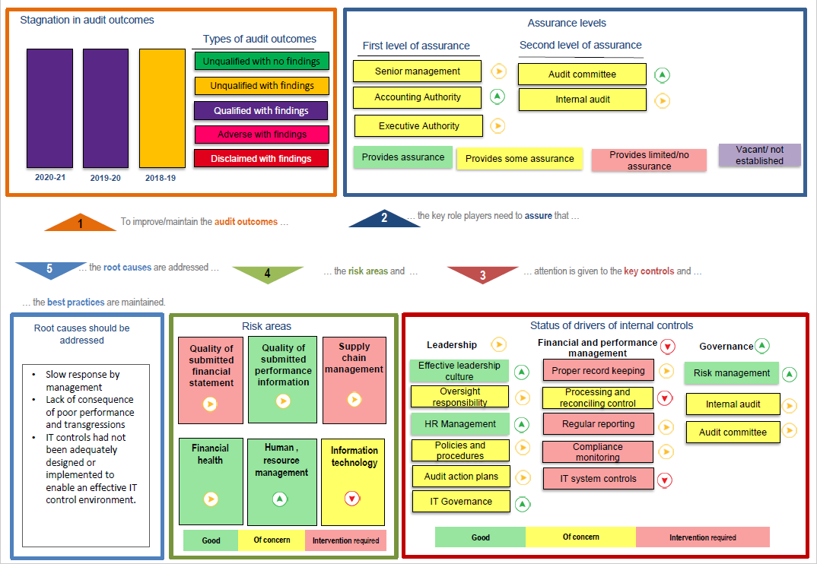
Summary of 2020/21 financial year AG audit outcomes

Slide 22
Committed to leveraging Information Technology (IT) as a strategic resource for government
Summary of 2020/21 financial year AG audit outcomes
SITA received a financially qualified audit report with findings on compliance with applicable legislation. The following areas remain as root causes for the qualification:
Useful Life and Impairment Assessment of Property, Plant and Equipment (PPE)
Useful Life and Impairment of Intangible Assets
Incorrect Calculation of Commitment Balances (new finding)
SITA ANNUAL REPORT 2021

Slide 23
Summary of 2020/21 Financial Year Audit Action Plan
CFO has been recalled from secondment as Interim MD of Post Bank, and an additional Senior Manager position in Finance has been filled, to beef up financial management capacity.
PPE and Intangible Assets:
  Appointment of a service provider to assist
    Due to significant judgements involved and the uncertain nature of useful life and impairment assessments, a service provider is necessary to provide an independent evaluation of judgement applied by Management.
    This will also assist with capacity due to the late finishing of the audit and will also assist with the technical write-ups and documentation of processes follow to compensate for the “desktop approach” followed by the AG.
  Lines of business will “verify” and sign off on useful lives.
Incorrect Calculation of Commitment Balances (new finding):
  A project to reduce manual accruals are in progress.
  More quality reviews will be implemented to review the linking of manual accruals to purchase orders and to manage the completeness thereof.
Late finalisation of the audit
  The AG has been requested to start the audit of high risk items earlier (in the previous year many months lapsed before any feedback on high risk areas was received).
  The AG has been requested to “spread” Request for Information (RFI’s) and queries issued to avoid a flood of RFI’s and audit queries received at the end of the audit. A service provider will also assist with responses should the AG decide to issue a flood of audit queries within a short space of time.
A detailed audit action plan has been developed for all risk areas and are being tracked by Internal Audit.
SITA ANNUAL REPORT 2021

Slide 24

PART
D
HUMAN CAPITAL MANAGEMENT

Slide 25
Committed to leveraging Information Technology (IT) as a strategic resource for government
Human Capital Management
SITA continued to repurpose itself in alignment to the rationalisation process of state-owned companies (SOCs) which was triggered in the previous financial year.
SITA implemented a fit for purpose organisational structure filling almost all its executive level positions by the end of the financial year which is aimed at optimising its resource capacity to deliver on the strategy and mandate as well as enhance integration across its value chain for improved organisational efficiencies.
SITA implemented an effective employee wellness strategy, covering all health and safety legislative requirements to ensure a safe and healthy work environment – the Agency particularly implemented various programmes to support and motivate employees to continue to perform optimally regardless of Covid-19 pandemic challenges.
In response to accelerated pace of digital transformation SITA launched its digital culture programme to motivate its workforce to focus on building core and relevant competencies that will ably support government digital transformation.
SITA implemented its workplace skills plan and successfully trained 1451 of its employees in order to develop their skills and competencies to match SITA’s organisational capability requirements and career development and succession management strategies.
SITA also provided a number of bursaries to internal and external youth, including people with disabilities while through the SITA internship and learnership programme a number of interns were appointed in response to the South African Government’s priority on job creation.
SITA ANNUAL REPORT 2021

Slide 26

PART
E
FINANCIAL INFORMATION

Slide 27
Committed to leveraging Information Technology (IT) as a strategic resource for government
Financial Targets and Achievements
The EBITDA target has been achieved mainly due to the following: -
There was a substantial savings (and non-spending) under cost of sales mainly in the IT Infrastructure, NGN Core and CFI Cloud, where less than anticipated costs translated into a positive increase in profitability.
As well as savings and non-spending on OPEX. This is due to the company wide cost containment measures that were implemented as well as savings related to COVID-19 restrictions being in place.
Additional revenue materialised from DOD (Mainframe revenue) that was not budgeted for and for which there was no costs incurred in the current financial year.
SITA ANNUAL REPORT 2021

Slide 28
Committed to leveraging Information Technology (IT) as a strategic resource for government
Statement of Financial Performance
SITA ANNUAL REPORT 2021

Slide 29
Committed to leveraging Information Technology (IT) as a strategic resource for government
Statement of Financial Position
SITA ANNUAL REPORT 2021

Slide 30
Committed to leveraging Information Technology (IT) as a strategic resource for government
Statement of Financial Position (Continued)
SITA ANNUAL REPORT 2021

Slide 31
Committed to leveraging Information Technology (IT) as a strategic resource for government
Irregular, Fruitless and Wasteful Expenditure (IFWE)
  During 2020/21 financial year, SITA reported R820million (R560m continuing from prior years, and only R260m detected in current year) of irregular expenditure and R18.6million fruitless and wasteful expenditure. In addition to the this, R1.5billion was incurred in the previous years and condoned.
Irregular Expenditure from the prior year mainly relates to access links as a result of a complicated engagement module and the volume of the contracts to be managed. An action plan to simplify the engagement model has been developed and is in the process of being implemented.
SITA ANNUAL REPORT 2021

Slide 32

THANK
YOU
Committed to leveraging Information Technology (IT) as a strategic resource for government
SITA ANNUAL REPORT 2021

