Slide 1

Festive Season 2021/22 Preliminary
Presentation by: RTMC

Slide 2
Presentation Content
Road Safety Interventions
Law Enforcement Interventions
Vehicle and Driver population
Overall Festive Season Statistics
Major Crashes
Discussion

Slide 3
Presentation Content
Road Safety Interventions
Law Enforcement Interventions
Vehicle and Driver population
Overall Festive Season Statistics
Major Crashes
Discussion

Slide 4
Introduction
This report provides an overview of the Road Safety, Law Enforcement interventions that were conducted by the Provinces, RTMC, other Roads Entities in partnership with Stakeholders during the 2021/22 Festive Season
With the RTMC providing the overall framework and focus area, the formulation of this document was initiated in September 2021 - whereby the technical committees of the National Road Safety Steering Committees (NRSSC) (RTEC and LETCOM) were presented with the technical information to guide the planning of the stakeholders for this Festive Season.
Under review are Road Safety Education activities conducted from the 01 December 2021 – 31 December 2021.

Slide 5
Road user groups
Road Safety Education interventions were directed during festive season at:
Drivers
Passengers
Pedestrians
Fatigue
Drunk driving
Distracted driving
Dangerous driving
Seatbelts
Child restraints
Visibility
Drunk walking
Jaywalking

Slide 6
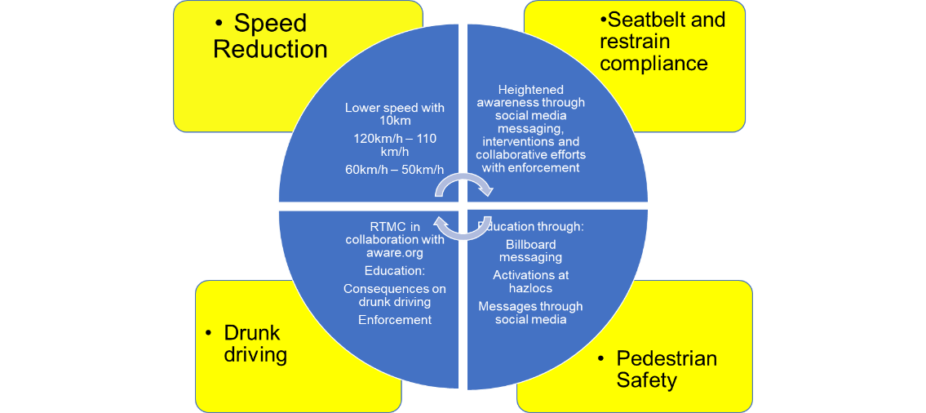
Focus areas

Slide 7
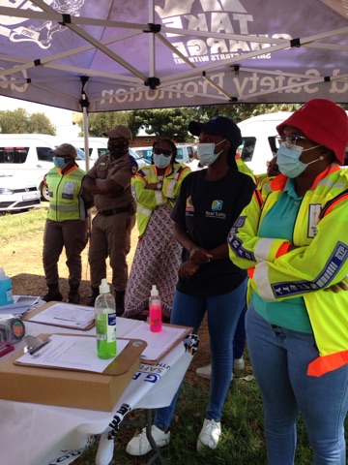
Highlights
1. Launch of Festive season in Bloemfontein
The launch was preceded by a number of build – up activities:
a) Community Road Safety Engagements in and around Bloemfontein
b) Distell at Shell Garage, Bloemfontein
c) Road blocks around Bloemfontein
2. Trans Kalahari Corridor Secretariat (TKCS), “Thank a driver” campaign, which took place on the 9 December 2021 at Swartruggens, North West. The campaign focussed on freight drivers. The campaign was done in collaboration with Namibia Transport, RTMC, RTIA, North West Road Safety, North West Law Enforcement, NTP, RTMC Road Safety, Coca Cola, Municipality.

Slide 8
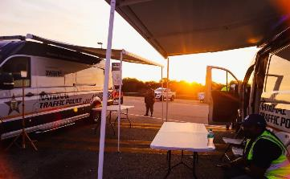
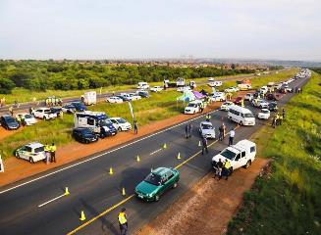
Highlights continue
3. Road Safety campaign, N1 Maubane
Minister Fikile Mbalula led a Road Safety and Law Enforcement operation on the night of 21 December 2021.
The focus was on driver fitness and roadworthiness of vehicles
4. Road Safety and Law Enforcement operation on 22 December 2021 on R80, Soshanguve.
The operation served the purpose for the Minister to release the preliminary statistics. The focus of the operation was on roadworthiness of vehicles and driver fitness. Road Safety Education also targeted pedestrians at the nearby Soshanguve Crossing Mall

Slide 9
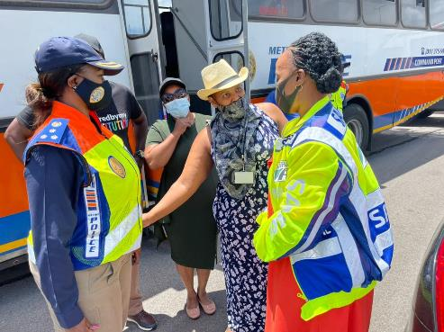
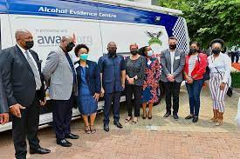
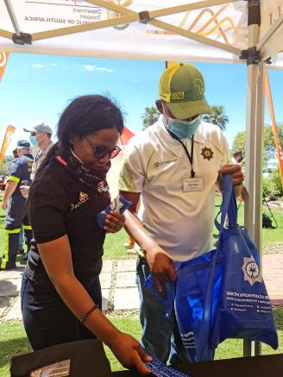
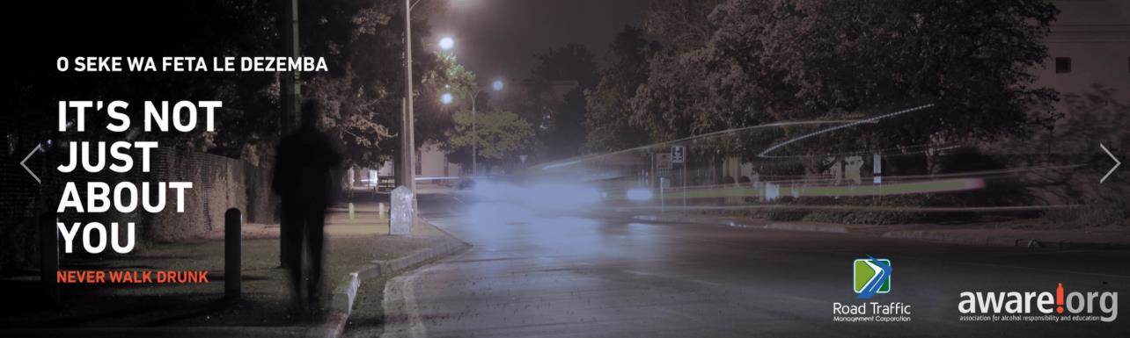
Partnerships with other private sector Corporations

Slide 10
Summary of Road Safety activities
Below is a summary on the number of Road Safety activities conducted per Province
Province | Number of Road Safety activities conducted
Mpumalanga | 20
Eastern Cape | 106
KwaZulu Natal | 64
Free State | 17
Western Cape | 31
North West | 28
Gauteng | 25
Limpopo | 29
Total | 320
A total of 320 Road Safety activities were conducted from 1 December – 31 December 2021

Slide 11
Types of interventions
The types of interventions conducted included:
Taxi rank interventions, with specific attention to long distance taxis
Awareness interventions at malls, Engen garages, Total Energies, bus depots. Petro Ports, Ultra Cities along National routes
Fatigue management at Road blocks
Weighbridge interventions directed at freight
Hazloc Roadside interventions
Exhibitions
Road blocks
Faith based gatherings
Clinics
Radio and TV Commercials promoting Road Safety

Slide 12
Impact of Covid-19 on Road Safety
Timeframe | Alert Level
21 September 2020 – 28 December 2020 | 1
29 December 2020– 28 February 2021 | 3
1 October 2021 – 29 December 2021 | 1
30 December 2021 – To date | 1 (without the midnight curfew)
COVID-19 had a positive impact of road crash fatalities in 2020, resulting in 9 961 deaths during the calendar year. Furthermore, its impact in 2021 was largely influenced by the imposed lockdown regulations, which reduced road traffic volumes
With the alert level been on 1 and the curfew restrictions been lifted, increased traffic volumes were observed which resulted in an increase in road crashes and fatalities.
In comparison the 2021/22 Festive Season had more fatalities per crash vs the previous year (120 fatalities per 100 crashes vs. 130 fatalities per 100 crashes)

Slide 13
Presentation Content
Road Safety Interventions
Law Enforcement Interventions
Vehicle and Driver population
Overall Festive Season Statistics
Major Crashes
Discussion

Slide 14
Law Enforcement Performance as at 20 Dec 21
Law Enforcement Performance | 2020 | 2021 | Variance
K78 Roadblocks | 2 937 | 651 | -2 286
No. of Vehicles Stopped | 1 379 191 | 1 472 163 | 92 972
Notices issued | 245 763 | 264 690 | 18 927
Vehicles Discontinued | 7 309 | 4 251 | -3 058
Vehicles impounded | 3 386 | 4 073 | 687
Arrests | 4 144 | 6 169 | 2 025

Slide 15
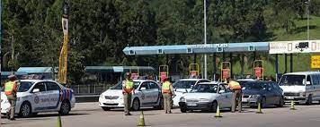
Vehicles stopped and checked

Slide 16
Number of notices issued

Slide 17
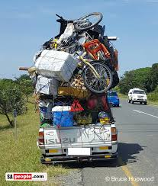
Number of discontinued vehicles

Slide 18
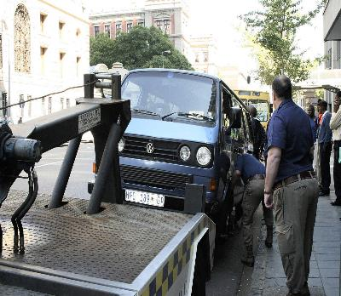
Number of vehicles impounded

Slide 19
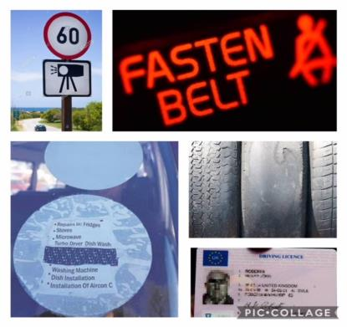
Law Enforcement top 5 (five) offences
Offences | 2020 | 2021 | Variance
Speed | 32 999 | 35 358 | 2 359
Driving without fasting seat belt | 21 715 | 21 431 | -284
Driving without licences | 14 645 | 22 766 | 8 121
Unlicensed vehicles | 26 671 | 28 779 | 2 108
Worn out tyres | 12 858 | 12 488 | -370

Slide 20
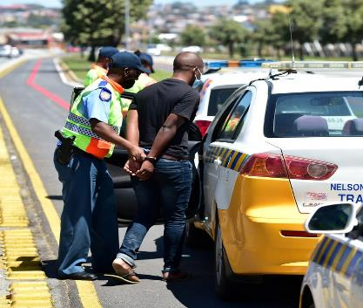
Arrests
Offences | 2020 | 2021 | Variance
Drunken Driving | 1 630 | 1 586 | -44
No driving licenses | 47 | 53 | 6
Speed | 865 | 605 | -260
Overload Goods | 21 | 21 | 0
Overload Passengers | 11 | 0 | -11
Inco, Rec. & Neg | 125 | 273 | 148
Permits / Operating licenses | 158 | 723 | 565
Warrants Executed | 916 | 1 335 | 419
False Documentation | 53 | 213 | 160
Other Arrests | 318 | 1 360 | 1 042
Totals | 4 144 | 6 169 | 2 025

Slide 21

Highest speed arrests
Date of Arrest | Province | Location/Route | Actual Speed | Speed Limit | Bail granted/Not granted
3-Dec-21 | FS | N1 Parys | 208km/h | 120km/h | R5 000
10-Dec-21 | FS | N3 Warden | 190km/h | 100km/h | R4 000
16-Dec-21 | LIM | N1 Tobias (Mokopane) | 225km/h | 120km/h | R3 500
18-Dec-21 | FS | N6 Rouxville | 200km/h | 100km/h | R5 000
19-Dec-21 | FS | N6 Rouxville | 191km/h | 100km/h | R2 000

Slide 22
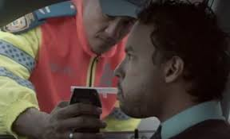
Highest alcohol arrests
Date of Arrest | Province | Location/Route | Alcohol readings | Gender | Bail granted/Not granted
16-Dec-21 | KZN | N2 North Bound Winklespruit | 1.95mg/1000ml | Male | Unknown
22-Dec-21 | GP | Victoria & Norman Str (Johannesburg) | 2.43mg/1000ml | Male | Unknown
24-Dec-21 | GP | Pretoria & Claim Str (Johannesburg) | 1.80mg/1000ml | Male | Unknown
01 -Jan- 22 | LIM | Tshakhuma (Makhado) | 1.87mg/1000ml | Male | Free Bail
08-Jan- 22 | GP | Pretoria & Claim (Johannesburg) | 2.22mg/1000ml | Male | Unknown

Slide 23
Observations
Travelling pattern has changed dramatically, as road users use alternative routes as opposed to the routes where operations are taking place. The other reason for chance is due to DMA, curfew times and industry closing
Coordination on three spheres of government is still lacking behind
Different KPIs set for three spheres of Law Enforcement i.e, crime (Metros), local authorities( combination of crime and traffic) and provinces (traffic)
This festive season was characterized by unpredictable weather conditions resulting not only in operations being cancelled but also in more visible patrolling taking place. The weather conditions also affected the road user patterns.
Plans are excellently designed, however, monitoring and supervision is a challenge
Limitation of the 30% threshold on overtime vs the 24/7 shift system.
Due to limited resources available within National Traffic Police, it is not possible for NTP to be deployed in all provinces, but focal points becomes 5 critical provinces
Addressing of the human Majority of major fatal crashes resulted due to the human element (87%) with 4 of the major accident caused by either tyre bust (Overload / worn tyres) or faulty brakes.

Slide 24
Proposed way forward
Supervision and monitoring must be strengthened during implementation
Strategic alignment pertaining to KPIs specific to traffic Law Enforcement and implementation of National Traffic Code
Deployments should be expanded to cater to alternative routes
Overtime planning should be catered during pre-operational planning and approval
More patrolling focusing on moving violations

Slide 25
Presentation Content
Road Safety Interventions
Law Enforcement Interventions
Vehicle and Driver population
Overall Festive Season Statistics
Major Crashes
Discussion

Slide 26
Registered Vehicles in South Africa
31 Dec 2020 to 31 Dec 2021
12,698 million to 12,957 million
Increased by 2,04%

Slide 27
Distribution of vehicles per province – Dec. 2021

Slide 28
Month on month vehicle volume changes

Slide 29
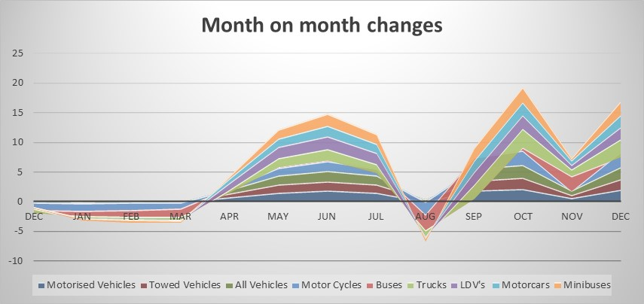
Month on month vehicle volume changes

Slide 30
Driver population figures have grown marginally across the platform

Slide 31
Presentation Content
Road Safety Interventions
Law Enforcement Interventions
Vehicle and Driver population
Overall Festive Season Statistics
Major Crashes
Discussion

Slide 32
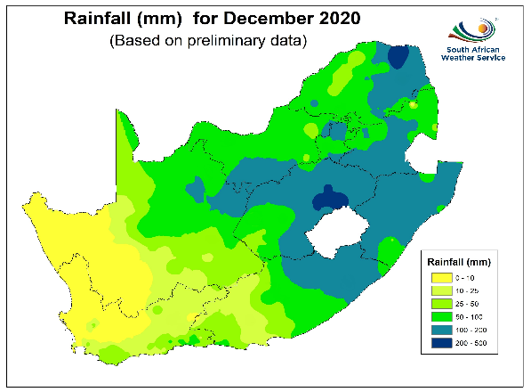
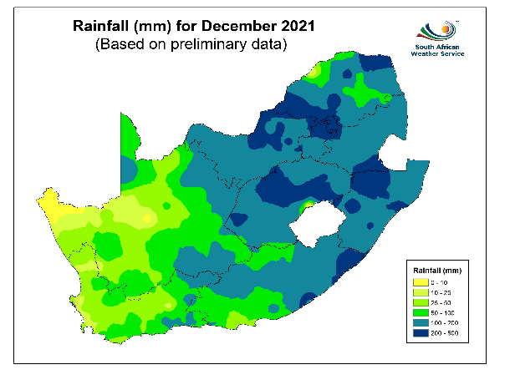
Rainfall in mm and % for the month of December

Slide 33
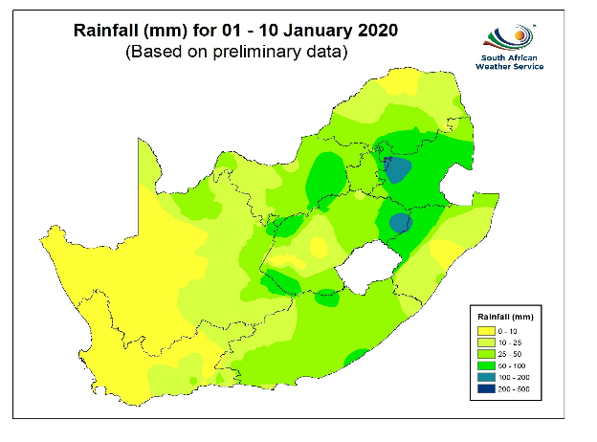
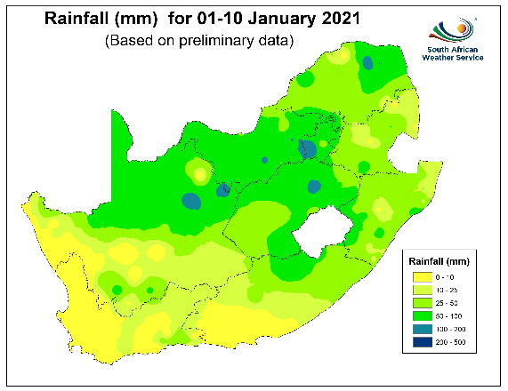
Rainfall in mm and % for the month of January

Slide 34
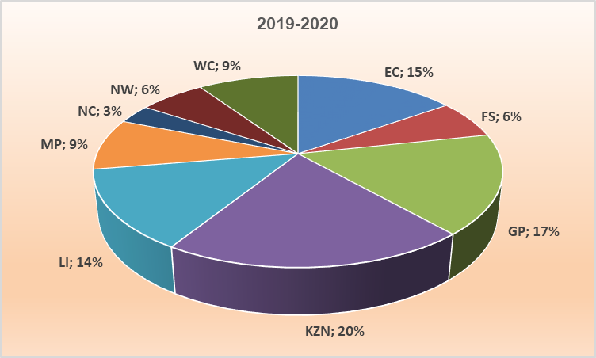
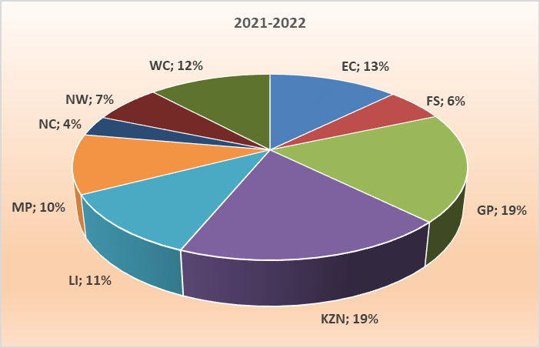
Fatal Crashes distribution per province

Slide 35
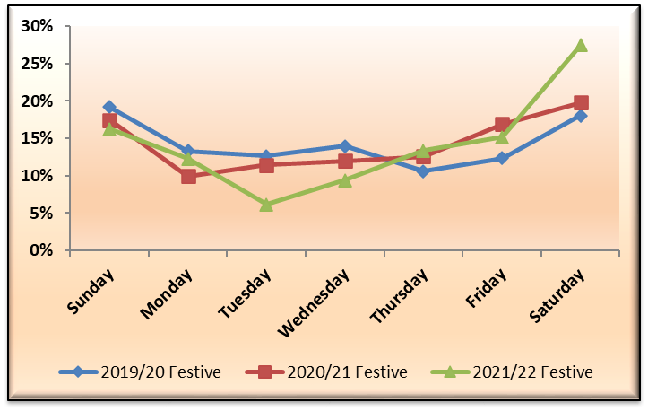
Percentage distribution of fatal crashes per day

Slide 36
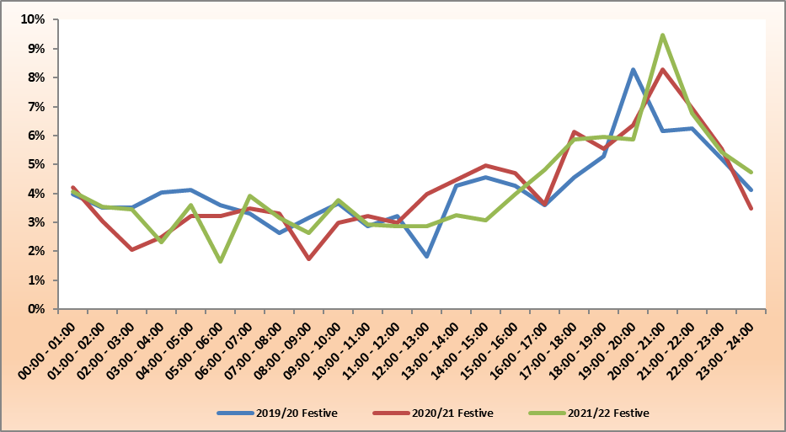
Percentage distribution of fatal crashes per time of day

Slide 37
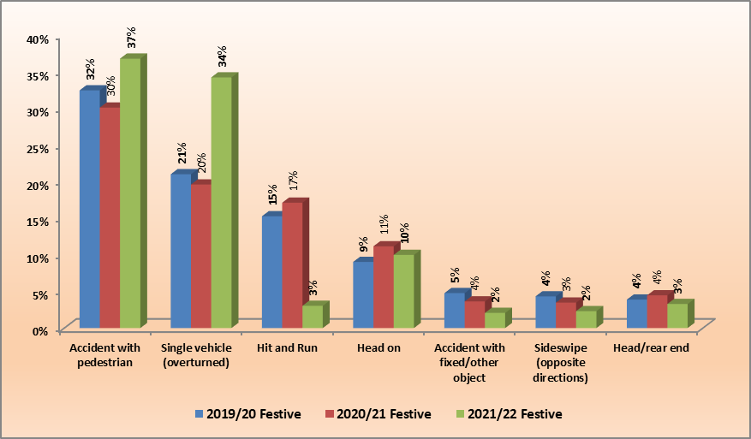
Percentage distribution of fatal crashes per crash type

Slide 38
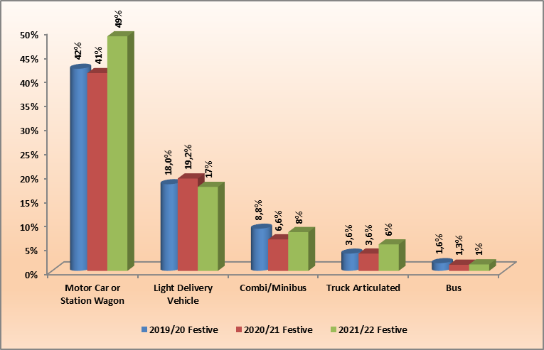
Percentage distribution of fatal crashes per vehicle type

Slide 39
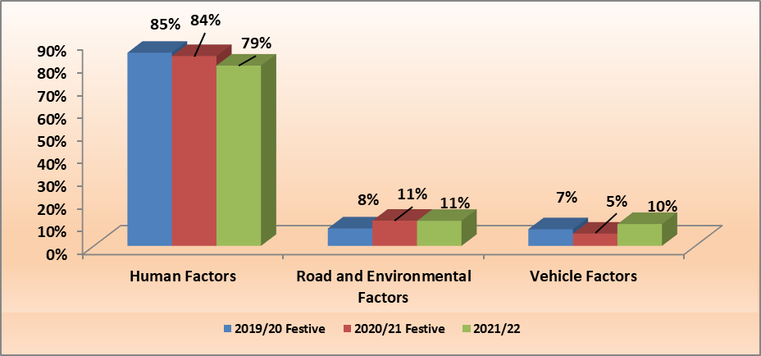
Percentage distribution for contributory factors

Slide 40
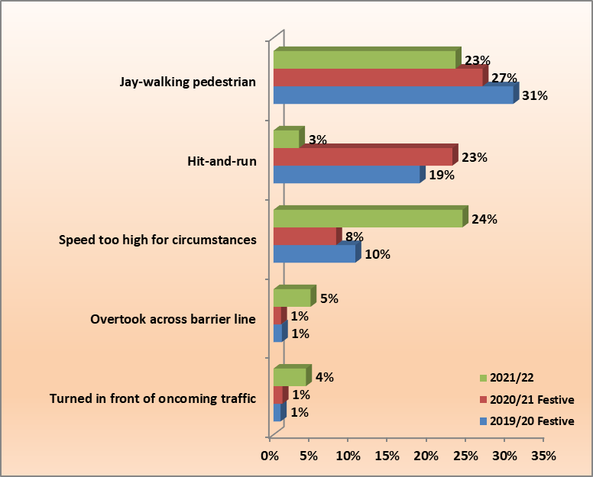
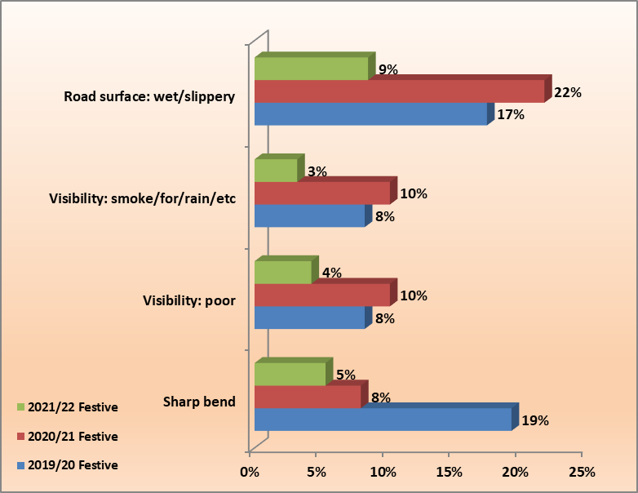
Percentage distribution for contributory factors
Human
R&E

Slide 41
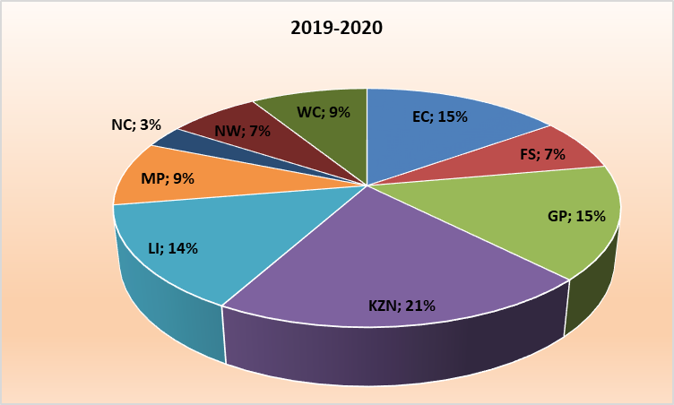
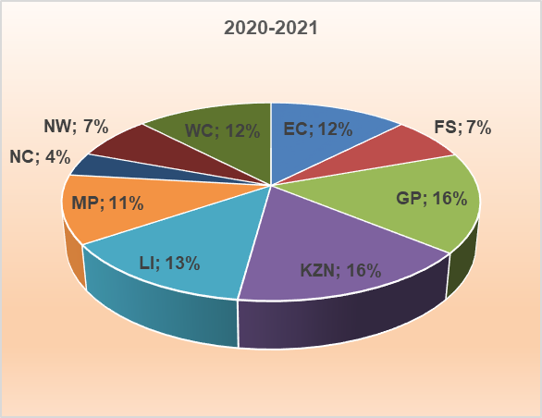
Fatalities distribution per province

Slide 42
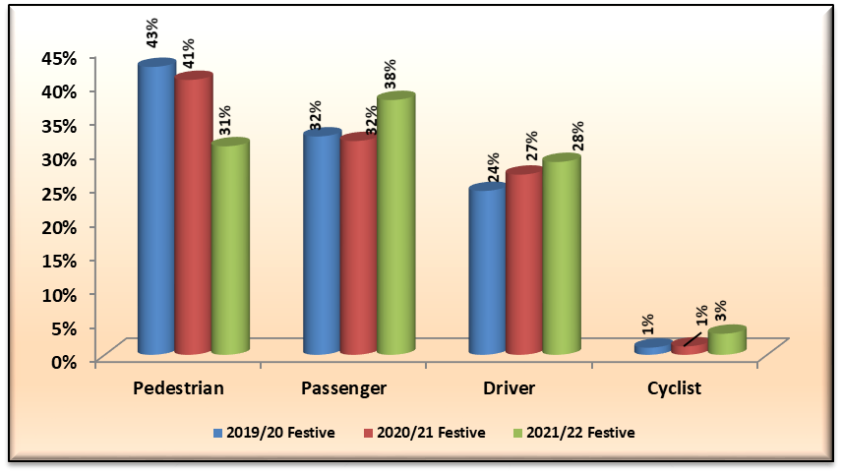
Percentage distribution of fatalities per road user

Slide 43
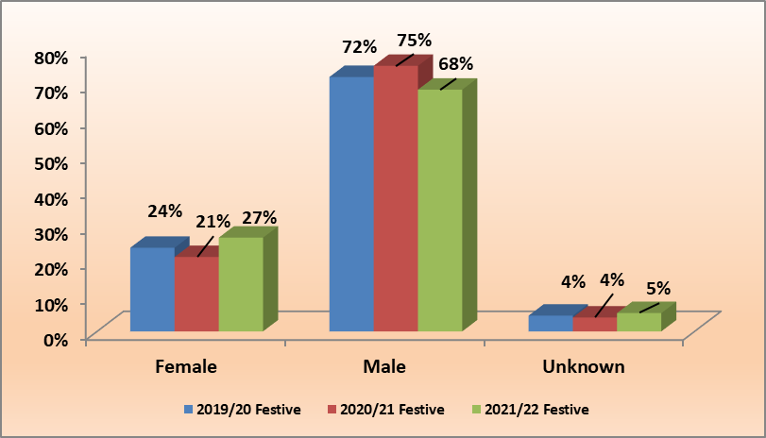
Percentage distribution of fatalities per gender

Slide 44
Fatal Crashes: 1 Dec 2021 to 11 Jan 2022

Slide 45
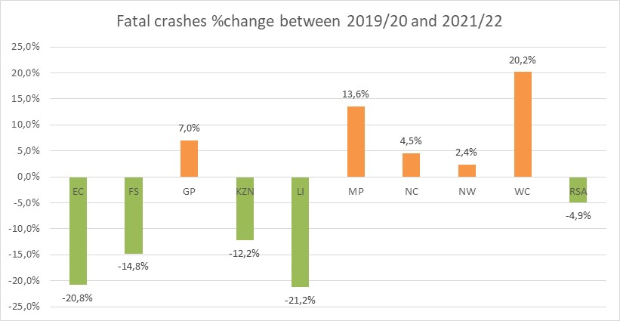
Fatal Crashes per province compared to 2019/20

Slide 46
Crashes: 1 Dec 2021 to 11 Jan 2022

Slide 47
Fatalities: 1 Dec 2021 to 11 Jan 2022

Slide 48
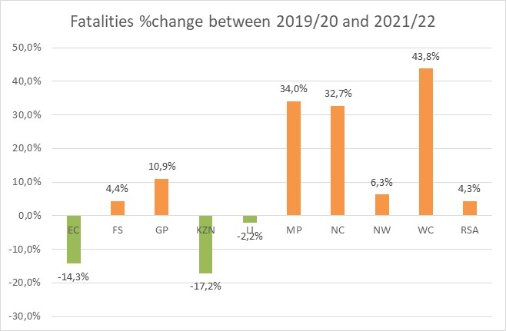
Fatalities per province compared to 2019/20

Slide 49
Fatalities: 1 Dec 2021 to 11 Jan 2022

Slide 50
Overall performance…

Slide 51
Presentation Content
Road Safety Interventions
Law Enforcement Interventions
Vehicle and Driver population
Overall Festive Season Statistics
Major Crashes
Discussion

Slide 52
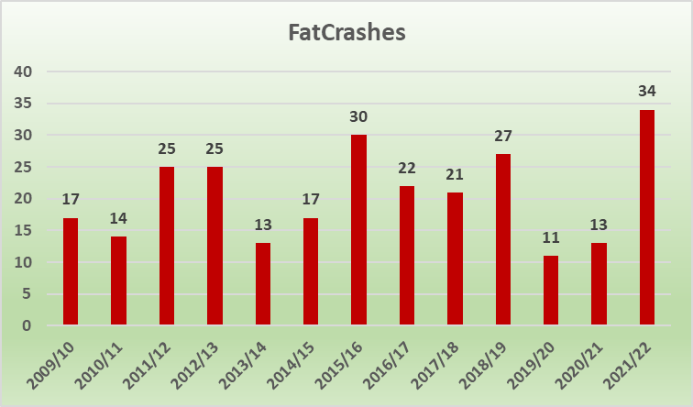
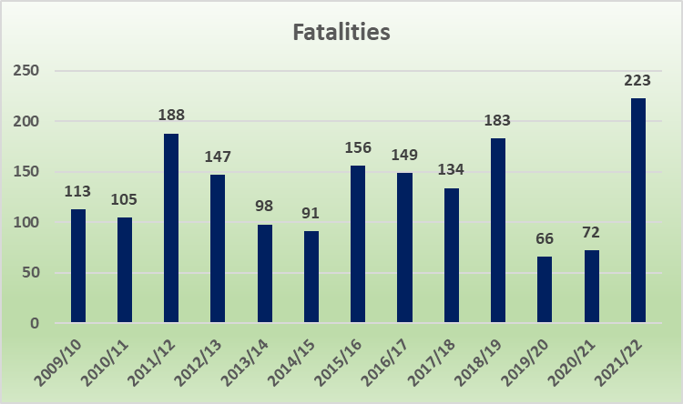
Major Crashes

Slide 53
Major Crashes

Slide 54
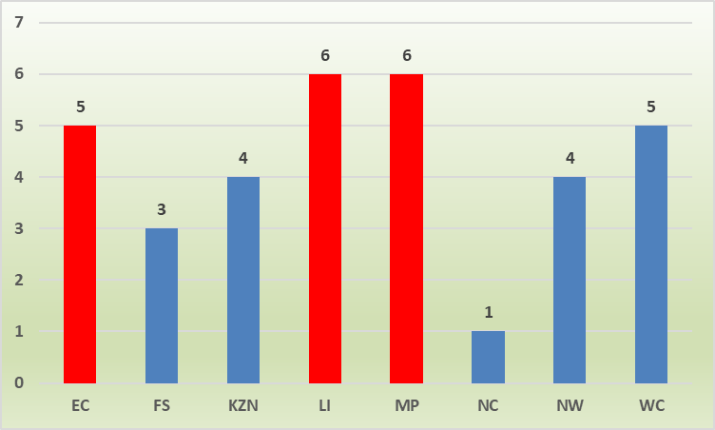
Major crashes per province

Slide 55
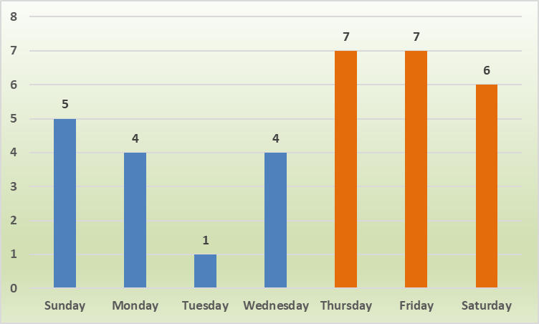
Major crashes per day of the week

Slide 56
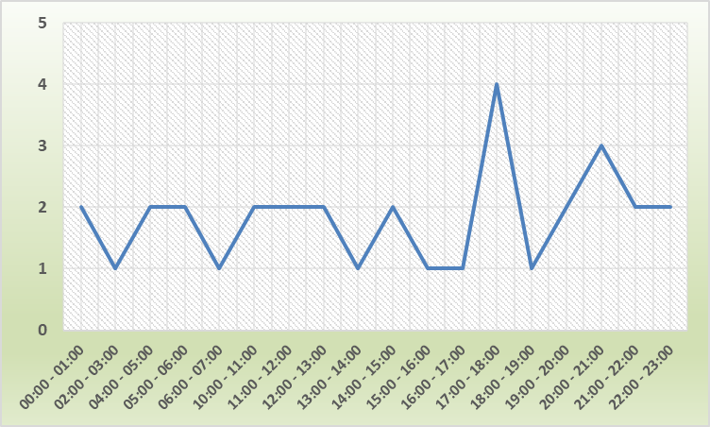
Major crashes per time of day: 2021/22

Slide 57
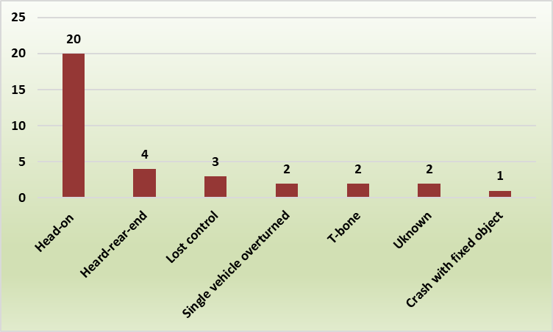
Crash type in major crashes: 2021/22

Slide 58
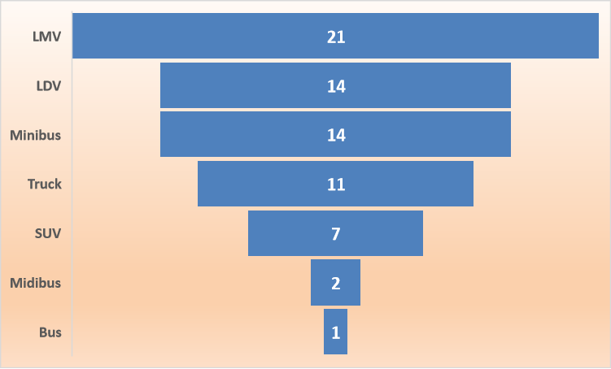
Crash vehicle type involved in major crashes: 2021/22

Slide 59
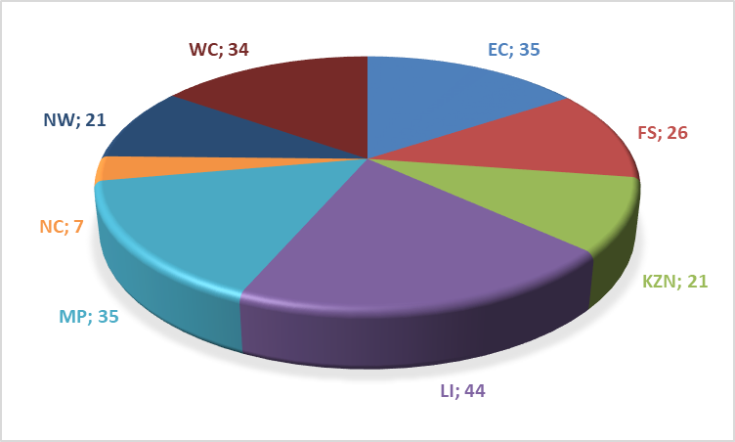
Number of fatalities per province: 2021/22

Slide 60
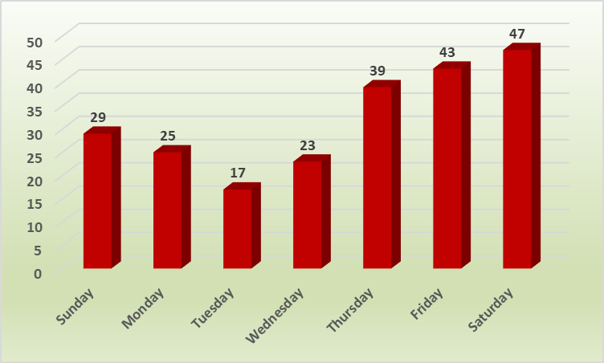
Number of fatalities per day of week: 2021/22

Slide 61
Number of major crashes per province and road

Slide 62
Number of fatalities for major crashes per province and road
Most fatalities were recorded for LI on the N1
WC recorded 23 fatalities (R61)
EC recorded 19 fatalities (N1)

Slide 63
My friends, love is better than anger. Hope is better than fear. Optimism is better than despair. So let us be loving, hopeful and optimistic. And we'll change the world.
Jack Layton

Slide 64
Presentation Content
Road Safety Interventions
Law Enforcement Interventions
Vehicle and Driver population
Overall Festive Season Statistics
Major Crashes
Discussion

