Slide 1
Health promotion within the NHI – a prerequisite to its success
Prof Melvyn Freeman
Prof Charles Parry
Ms Jane Simmonds
Alcohol, Tobacco & Other Drug Research Unit (ATODRU)
South African Medical Research Council (SAMRC)
Presentation to Parliamentary Portfolio Committee 9 February 2022

Slide 2

Outline
Why NHI must have a clear focus on health promotion/prevention of illness
Crisis of NCDs
Focus on NCD risk factors
Fewer people with NCDs would have reduced Covid-19 deaths
Economic benefits of interventions for health services and the economy
Health in all policies approach
The NHI Bill and health promotion
Proposals for revised legislation
Example: NHI and health promotion in Thailand
Conclusion

Slide 3
NHI must include health promotion
NHI will to a very large extent flourish or flounder on whether the numbers of people that will require health care can be kept to numbers where it is possible to provide good quality care to all that need it
Simple fact: “the more people that require care, and particularly care for chronic conditions, the more strain there will be on the NHI fund”
  Keeping numbers of people needing health care down is thus central to the survival of the NHI fund/sustainability of NHI
Current health trends show increases in a range of critical diseases and their risk factors, and these must be urgently reversed, or at least substantially reduced, to give NHI a real fighting chance

Slide 4
NHI must invest in health promotion
It IS possible to prevent illness through evidence-based and cost-effective interventions
However, reducing the numbers needing health care is complex and requires approaches that actively promote the health and well-being of citizens through a range of health and multi-sectoral interventions.
This will require investment in health promotion as a vital element of NHI

Slide 5
Preventing both communicable and non-communicable Diseases
Prevention needed to reduce the numbers of people that develop communicable diseases such as HIV, TB and Covid-19 but also NCDs such as cancer, diabetes, heart disease, lung disease and mental disorders
In this presentation we focus primarily on the neglected areas of NCDs where there are known preventable risk factors and evidence based public health interventions to combat them
Overwhelming and broad consensus, including from UN General Assembly is that to comprehensively address NCD mortality and morbidity, a “Health-in-all-policies”, “Whole-of-government” and “Whole-of- society” approach is needed

Slide 6
The Crisis of NCDs
From in-depth analysis of health and risk factor trends in South Africa conducted within the SAMRC and elsewhere, there is an alarming rise in the incidence and prevalence particularly of NCDs and their risk factors
If South Africa is serious about wanting to avert a major mortality crisis, we either:
  need to urgently and dramatically reverse current trends by improving the health of the population
  or we will have to extensively expand health services (even substantially beyond population growth) over the next decades
Following are just a few examples of health trends that show why prevention is not negotiable for the success of the NHI

Slide 7
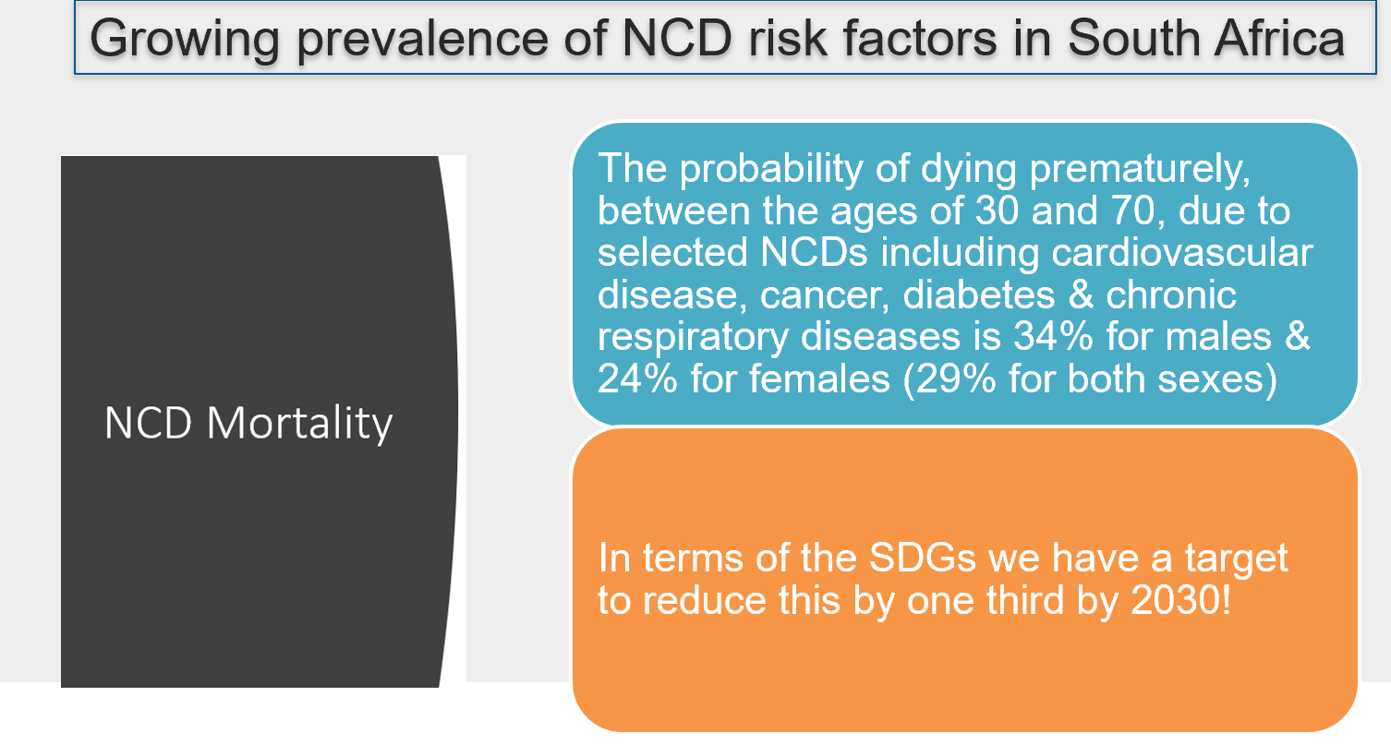
NCDs in South Africa

Slide 8
Deaths from communicable diseases (orange), NCDs (Blue) and non-natural causes (grey)

Slide 9
Increase in hypertension 1998,2008,2016
Statistics South Africa. Demographic and Health Survey 2016. Key indicator report, 2017

Slide 10
Statistics South Africa. Demographic and Health Survey 2016. Key indicator report, 2017

Slide 11
Why focus on NCD risk factors?
Exact extent to which modifiable risk factors could prevent NCDs in South Africa has not been calculated, however the WHO in the region of the Americas (PAHO) estimated that 80% of all heart disease, stroke, and type 2 diabetes and over 40% of cancer is preventable through multi-sectoral action
Given that many of the countries in the PAHO region share socio-economic similarities with South Africa, analogous figures are probable in South Africa too

Slide 12
NCDs and Covid-19
Lower prevalence of NCDs (underlying health conditions) in the current context would have reduced numbers of people with Covid-19 and mortality from it
From every point of view, fewer people with NCDs is good for the country
Achieving this is possible with sufficient commitment and evidence-based interventions

Slide 13
Reducing risk factors would significantly reduce morbidity and mortality
While health behaviours and choices are practiced by individuals, these are usually driven by forces that lie outside their direct control.
Behaviour change involves a complex set of interventions that go beyond the individual and involve cultural, social and economic factors, including commercial determinants of ill-health
Need to tackle both proximal and more distal causes of ill health

Slide 14
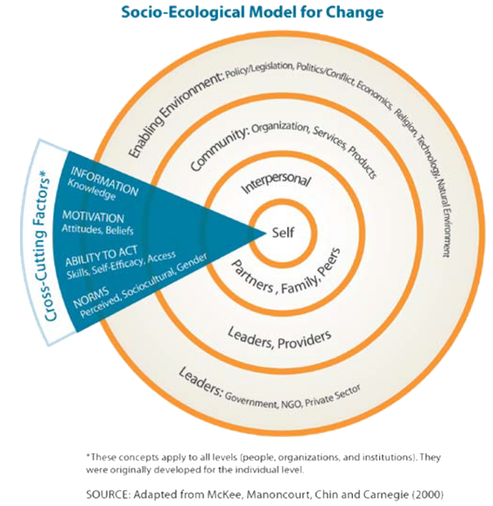
Social behaviour change communication

Slide 15
Economic benefits
WHO’s global business case for NCDs shows that if low and low-middle income countries put in place the most cost-effective interventions for NCDs, most of which are promotive/preventive, by 2030 they will see a return of around R100 ($7) per person for every Rand (dollar) invested
While accurate costing of diseases and the longer-term implications of not preventing diseases, including the proportion of cost from preventable diseases, is unknown, it is estimated that for diabetes alone, in 2018, the public sector costs of diagnosed patients was approximately R2.7 bn and would be R21.8 bn if both diagnosed and undiagnosed patients are considered.

Slide 16
Economic benefits
Unhealthy people place an unnecessary burden on health services:
Moderate obesity is associated with an 11% ↑ in healthcare costs & severe obesity with a 23% ↑
In real terms, it is estimated that the 2030 cost of all Type 2 Diabetes Mellites cases will increase to R35.1 bn. Such increases are simply not sustainable for the NHI – especially as diabetes is only one of several growing NCDs
It has been estimated that the economic cost due to productivity losses arising from absenteeism, lack of presenteeism and early retirement due to ill health in South Africa, largely from NCDs, equated to a total of 6.7% of GDP in 2015 and is expected to increase to 7.0% of GDP by 2030

Slide 17

THE WHO has identified 5 major risk factors to be addressed to reverse the growing burden of disease from NCDs
diet (poor eating habits),
tobacco use
alcohol abuse
physical inactivity
air pollution
For each of these we know a lot of how to change patterns, but we lack commitment and resources to do it

Slide 18
The NHI Bill
The NHI Bill, as well as the Memorandum of Objectives and the Department of Health pamphlet explaining NHI, all mention the importance of prevention and promotion
However, this is not translated into concrete proposals of what will be done within the NHI context to achieve this.
Section 37(1) of the Bill refers to health promotion being managed as part of the contracting unit that manages primary health care services, and Section 57.4(1) considers the need for purchasing healthcare service benefits, including health promotion.
The conceptualization of prevention and promotion is extremely narrow and may merely translate into education and information programmes that are not evidence-based and that most health promotion experts regard as a waste of time and resources

Slide 19
It is critical that health promotion within the NHI Fund is:-
  1. Multi-sectoral
  2. Evidence-based and
  3. Adequately resourced in order to make a real difference

Slide 20
Earlier nhi documentation - National Health Commission
In 2017 the Department of Health circulated a document “NHI Implementation: Institutions, bodies and commissions that must be established” for public comment
This document stated that “promoting health and preventing illness is central to NHI as well as to social and economic growth and development in South Africa”
It further stated that a structure that would deal with determinants of health, including its social determinants, would be set up as part of NHI
It was proposed that a National Health Commission (NHCom) would be established with the primary objective and purpose being to “address the social determinants of health through a multi-sectoral and development approach involving key government departments and non-state actors”
This commission would “co-ordinate key sectors in implementing ‘a health in all policies’ and an all inclusive approach to the prevention and control of NCDs, including mental health”

Slide 21
What happened to this structure and this thinking?
In later iterations of what the NHI would be comprised of and what it would do, particularly in the Bill published for comment, this proposal, which could be extremely important to reducing numbers needing health care, has completely disappeared.
If not changed this omission may well prove the Achilles heel of the NHI

Slide 22
Research for evidence based interventions
To ensure that interventions are evidence-based and do not merely waste resources, far more research on health promotion is required’
  This needs to be fed into NHI structures so that resources are channeled into interventions that reduce the health care costs of the NHI fund
  Should be paid for from resources committed by the NHI Fund to the National Health Commission or a Health Promotion Foundation
  SAMRC would be more than keen to play a role in conducting research in collaboration with the NHI structures

Slide 23
Our specific proposals for the NHI to be included in the NHI legislation
• A percentage of the NHI fund, minimum of 2%, must be earmarked in the legislation for health promotion from the NHI fund. (See next slide for comparisons).
2% would translate into around R8billion, which would be a fair allocation for the amount of savings it would bring.
• A multi-sectoral structure such as a National Health Commission or National Health Promotion Foundation must be established as part of the NHI, and funded by the NHI Fund, to promote health and ensure that fewer people require curative health care.

Slide 25
Research the key to effective interventions
Research concerns that need to be addressed include:
What health promotion works globally and can this be extrapolated to South Africa? If not, why not and what would work instead?
What are the “best buys” for health promotion in South Africa? [The WHO “best buys” for prevention of NCDs are not based on studies that have been done in LMICs. Mainly the research studies have been done in more developed countries and extrapolated as if they apply equally to LMICs. Other studies have pointed to the poor evidence available even for what are commonly considered good health promotion interventions]
What health promotion innovations could be introduced in South Africa that have not been tried elsewhere in the world?
Demonstration projects with thorough evaluation of what works and why.
Health promotion initiatives that are introduced must be thoroughly evaluated for both health and cost benefits.

Slide 26
NHI and health promotion in Thailand
When Thailand started their NHI, they simultaneously established Thai-Health to focus on promotion and prevention issues. This has contributed significantly to the success of their NHI
Its focus is on the major NCD risk factors, i.e. tobacco, alcohol, physical activity and diet. However, where poverty, for example, is considered to be impeding people’s ability to eat healthy foods, the structure allows them to involve Ministries that can assist, for example the Ministries of Treasury, Agriculture and Trade and Industry.

Slide 27

Thailand health improvement
For a population of around 69 million, the amount allocated to the Foundation is around US$120 million (R1.8 billion). This translates to a per capita expenditure of around $1.7 (R25) per annum
Using the resources allocated, Thai- Health managed to
  reduce tobacco smoking from 22.5% of the population in 2001 to 18.2% in 2014
  reduce the annual per capita alcohol consumption from 8.1 litres in 2005 to 6.9 litres in 2014
  contribute to the reduction in traffic accidents by 31% and road injury deaths by 10%
  between 2004 and 2009
  increase the percentage of the adult population doing at least 150 minutes of moderate intensity exercise or 75 minute intensive exercise per week from 66.3% in 2012 to 72.9% in 2017

Slide 28
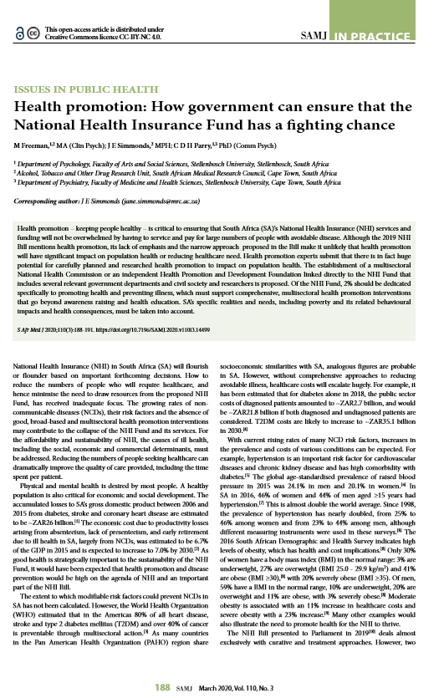
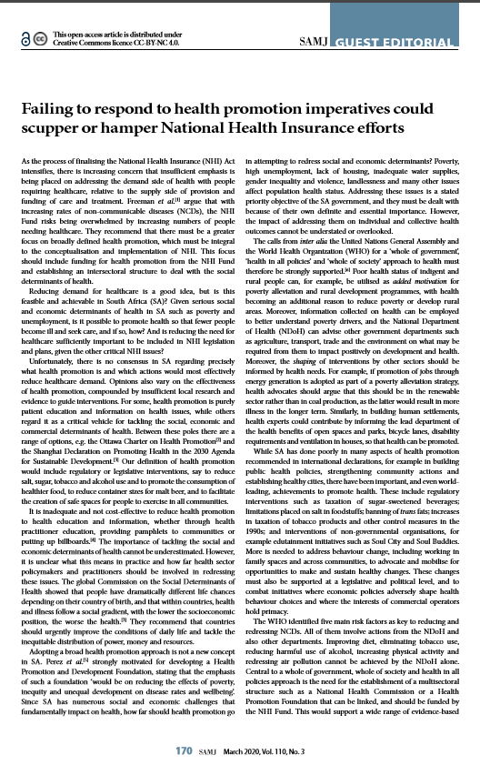

Slide 29
conclusion
NHI legislation (and SA) can:
  EITHER plan to care for more and more ill people over the next few years as the numbers needing care increases beyond population growth - and in all likelihood fail to be able to provide the resources needed
  OR it can put significant focus and resources into promotion of health and the prevention of illness and thereby make the NHI sustainable in the longer term.
In particular the NHI legislation must:-
  Establish a National Health Commission (NHC) or Health Promotion Foundation (HPF) as part of its structures
  Legislate that at least 2% of the NHI fund must be dedicated to health promotion/prevention activities (probably through the MHC/HPF)

