Slide 1
STUDENT REPRESENTATIVE COUNCIL BLOEMFONTEIN CAMPUS

Slide 2
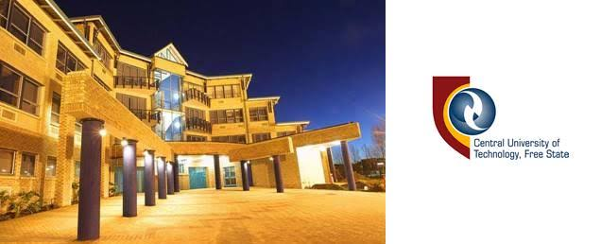

Slide 3
SUCCESSES OF BLOEM CAMPUS SRC
80% of Bloemfontein campus SRC is graduating and all of them have been accepted under postgraduate studies.
We have successfully run our legacy project called meals on wheels.
We have acquired Macdonald Scholarships for 5 students under hunger alleviation program.
We championed the Data bundles increase.
We have recruited students from botshabelo to Venda and most of them were accepted and have successfully registered.
I as the president formed part of the delegation of CFO to Cape Town, when we addressed the debt they owe to the institution.

Slide 4
RESIDENCES
Residence Maintenance is the Problem to Res Students
Most of RES Students are admitted but fail to register
Some wardens are not cooperative to the SRC residence and Accommodation Officer
We are also facing wardens that claims Residences are full but when we check Residences like Emzini under Eendrag are not yet full
Accredited accommodations are exploiting students and are under poor maintenance
The institution did not accredit more residences that can accommodate the entire CUT Student Populace at Bloem.
ALL RESIDENCES ARE NOT NAMED WITH AFRICAN NAMES, WE CALL FOR EQUITY IN NAMING OF OUR RESIDENCES.

Slide 5
ACADEMICS
CHALLENGES FACED BY STUDENTS
The students are faced with issues of incorrect marks which are not fixed due to selfish and incompetent lectures who failed to verify marks before sending marks to AGU and also failure of AGU to Adjust marks.
Students are also faced with delayed re-assessments marks and consequently they will miss special exams opportunity due to its closing date on the 10th of February.
We also have the problem of pending disciplinary hearings of academic dishonesty, whereby students are not told that they plagiarize they only saw during the release of marks.

Slide 6
ACADEMICS CONTINUED
We have the problem of AGU declining the special assessments applications without factual reasoning.
We have a problem of registrations due to senior students not being auto promoted by AGU, as a result they can not register.
We have a problem of late flagging of results, which affects BED graduates, because they can not register for SACE and JOBS.
Graduation lists are not published its preliminary list.
HODs are refusing to accept students due to quota full after their admission, but HEDA & DVC of Teaching & Learning indicating that quotas are not full.
Lastly we are currently experiencing delayments of data bundles disbursement

Slide 7
FINANCES
CHALLENGS OF FINANCE DEPARTMENT
Lack of information sharing from the office of CFO to the SRC
Lack of accessibility of strategic offices
Currently we are faced with students who receives massages from NSFAS that they must settle their loans, whereas they were not using nsfas.
We have outstanding allowances that are not paid to students till today
We have bursaries that we do not know their criteria and policies due to lack of information from Finance department.
We have students who can not acquire their qualifications due to templates that are not sent to NSFAS.
We experience Problems of migration of students from ITS sytem to Fundi System.

Slide 8
END OF PRESENTATION……….
THANK YOU!
SRC PRESIDENT BLOEMFONTEIN CAMPUS
BONGANI MATTHEWS BOLAWA

