Slide 1
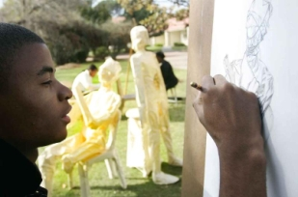
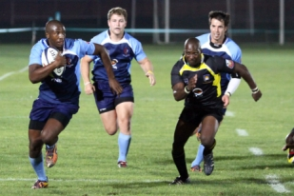
PORTFOLIO COMMITTEE ON HIGHER EDUCATION, SCIENCE AND INNOVATION– PRESENTATION PRESENTER: Mr. S Masoeu Chairperson of IF
www.cut.ac.za
Thinking Beyond

Slide 2
FUNTION OF IF
PROGRESS
Supporting Diversity & Inclusion in the Workplace
Enforcing policies on race and gender equity
Participating in the selection of candidates for senior management positions
Perform such functions as determined by the council.
Ensuring that the transformation plan is implemented and Monitor progress on implementation.
Oversight –allocated responsibilities by council .
CHALLENGES /RECOMMENDATIONS
Ensuring Regulation & Compliance.

Slide 3
Overview of the state of governance
CHALLENGES
Resignation of previous council members(Establish the root cause to ensure that this is managed well in the future)
Mutual separation of VC (Unclear reasons given )
Council Role (Council should play its strategic role and allow management to be operational)
RECOMMANDATIONS
Revaluating current operating models.
Communicate clear messages.
Intervention of IoDSA will Bring improvements .

Slide 4
Overview of the state of Management
Numerous acting positions - Uncertainty about the Future and unable to take decisive decisions.
Managers are acting without a comprehensive vision of how and why changes are being made.
There are consequences to all this uncertainties. Examples
poor management
unclear Operational practices
poor communication
lack of equal opportunities
bullying and harassment
Unresolved workplace issues

Slide 5
holistic overview of the state of affairs of the University including challenges experienced by workers and students.
Challenges Students The have been challenges with NSFAS for the past years but the reason are always not clear what is the problem and this affect efficient running of the institution including Registrations and assessments. Workers inconsistent application of fairness - CUT does not have Policy on promotion for Support Staff which is demoralizing the moral of workers in General but have Promotion policy for Academic Staff . Acting positions within the institution (Acting Appointment/Interim Appointment) Numerous acting positions within the institution which brings instability within the university . position filled on a temporary basis to replace a regular unclassified employee on leave(AA). Position filled on a temporary basis while a search(recruitment process) is being conducted (IA). The university takes long to fill positions.

Slide 6
General observations
Lack of communication Managing Communication Between different stakeholders . Poor Quality of newly Developed infrastructure
Safety and security, including policies and measures put in place to curb the incidences of gender-based violence

Slide 7
THANK YOU

