Slide 2
The NHI must be a one-tier system for it to achieve universal healthcare coverage. There mustn’t be any form of provision in the Bill that allows the users of healthcare to be classified according to their economic state. There must not be gold, silver or platinum-like medical aids do. We feel that Chapter 2 of the NHI is compromising. It allows that basic cover to be for all but those who want a top-up option to still be accommodated. We feel it’s a socialist approach. It contradicts one of its principles. Lives of all South Africans must be equal irrespective of race, class, gender, religion, nationality or socioeconomic standing

Slide 3
The pool of funds that is going to be collected by the NHI must be monitored through oversight committees that will be watchdogs. They must be autonomous, independent and they should not report to the minister. This is informed by the fact that the Bill in its current form, the minister is NHI and can decide who serves and who doesn’t and can overrule the Boards. The risks that exist and are open to looting and corruption are immense because the opportunities associated with NHI are too much.

Slide 4
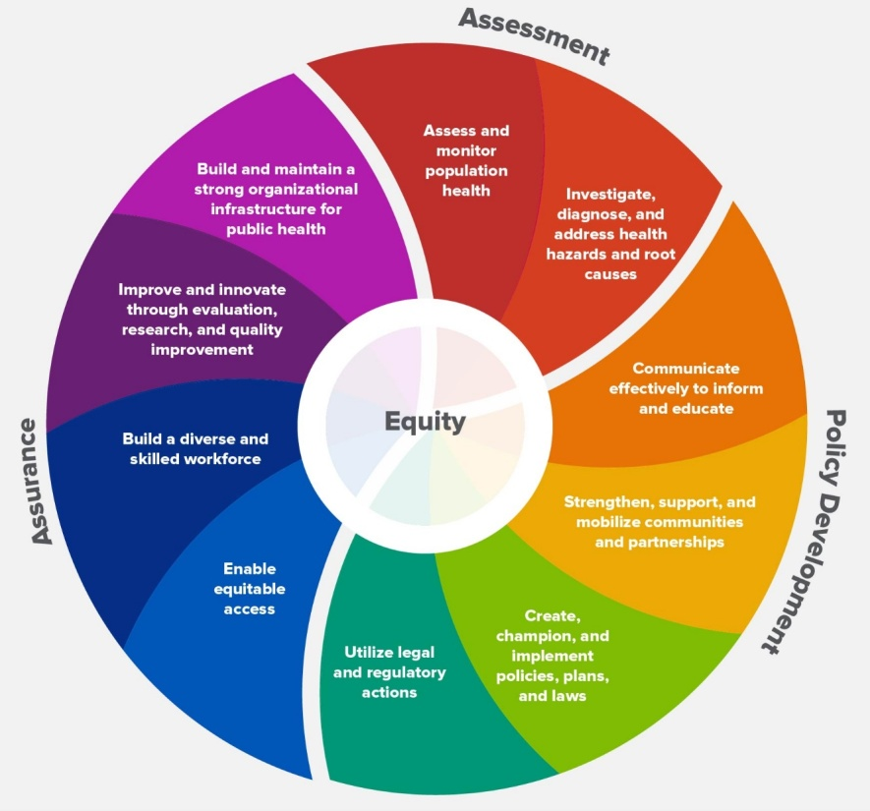
The NHI must not be a disguised method of privatizing South African healthcare. It must remain the sole responsibility of public health. It must be managed and controlled by public health. Healthcare is not for profits and therefore, tiptoeing around the private healthcare sector should be discouraged at all costs. External private service providers are made too comfortable in the Bill. Their operations are enhanced. We are not going to support the NHI in those sections that are giving service providers more solidified operations.

Slide 5
The NHI must be bold to state that when it’s implemented, we must have a clear pathway of phasing out medical aids. The NHI must seek to offer a comprehensive, equal service to all. If we are leaving medical aids, we are going back to our first non-negotiable of having a two-tier system. Phasing out of medical aids as primary service providers must be achieved. The eradication of elites forming their fund and disguising it as things that are not covered by NHI must be rejected.

Slide 6
The involvement of young healthcare professionals in the planning and oversight committees as well as Boards is non-negotiable. We must also include women. The legacy of the NHI will live for the next 30 years and they will need to be able to explain it and improve it. Majority of healthcare providers are young and female. We feel they are deliberately excluded in decision making bodies.

Slide 7
We feel the contracting of service providers must allow a platform to welcome new players and give more space for upcoming nurses and doctors. The NHI must not focus on making the big groups richer. The Fund must also develop and incubate healthcare professionals to become healthcare service providers. We feel the Bill is currently silent on that.

Slide 8
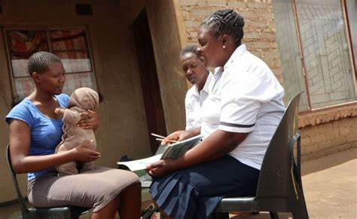
The inclusion of CHWs. The regulation, accreditation of their training, practice and recognition as well as their formalized employment is important and we will not compromise on that.

Slide 9
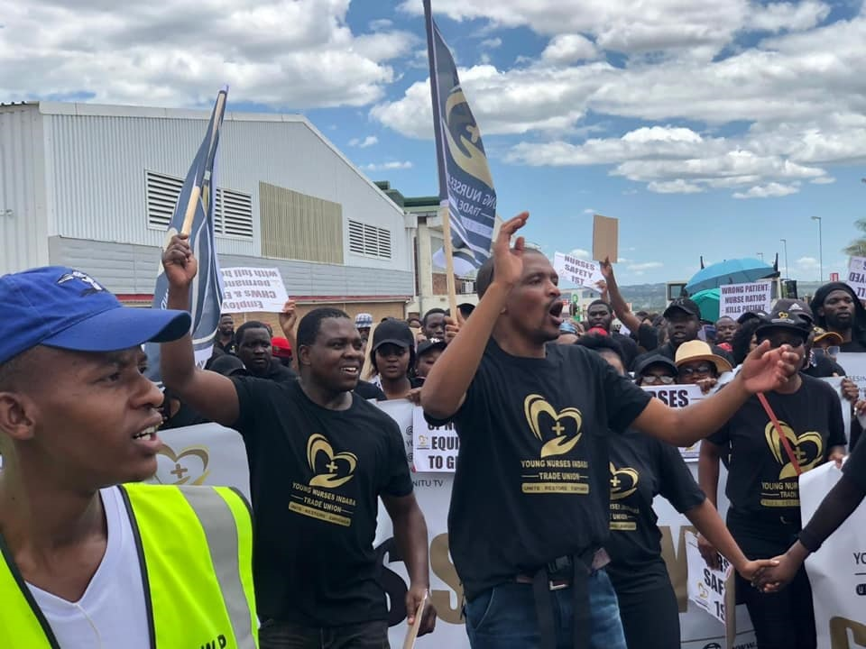
The continued exploitation under the disguise of EPWP in health is a stumbling block. Those people are taken into the health system for a long period but they are never employed. It’s said they are getting experience but what must they do with it? The NHI must address this.

Slide 10
Equal access to comprehensive healthcare for all citizens and all who live in the country must be mandatory. As the current system continues as is, it doesn’t provide such. The NHI is not speaking about how we are going to address healthcare in rural areas. If this is not done, then there is no point to NHI

Slide 11
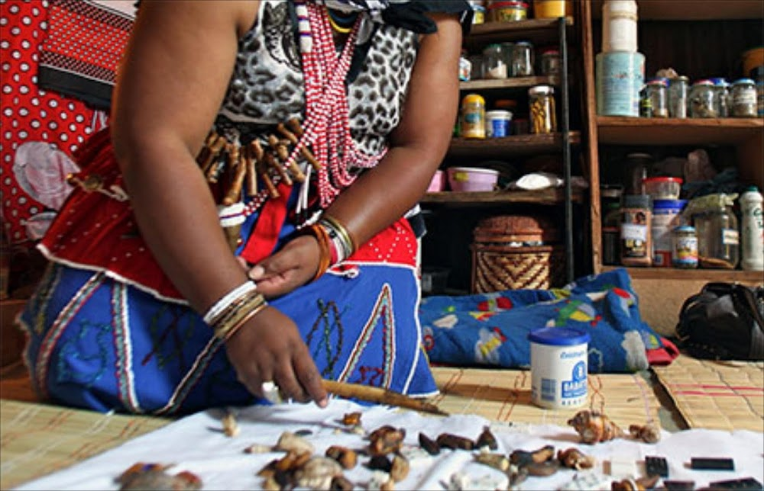
Majority of South Africans are black people of indigenous origins with deep-rooted cultural and traditional beliefs. The NHI and health system can’t mimic that of European descent alone. Include traditional healers in the NHI.

Slide 12
End

