Slide 1
FY2021/22 QUARTER 1 & 2
ORGANISATIONAL PERFORMANCE REPORT
Presentation to Portfolio Committee
8th February 2022

Slide 2
CONTENTS
Environmental Analysis & Outlook
Quarter 1 & 2 Performance Against Tourism Sector Recovery Plan & FY21/22 APP
Financial Performance
Governance & Compliance
Quarter 3 Outlook
Annexure: Detailed Organisational Performance Report by Programme
Quarter 1: April to June 2021
Quarter 2: July to September 2021

Slide 3
Environmental Analysis & Outlook
Quarter 1 & 2 Performance Against Tourism Sector Recovery Plan & FY21/22 APP
Financial Performance
Governance & Compliance
Quarter 3 Outlook
Annexure: Detailed Organisational Performance Report by Programme

Slide 4
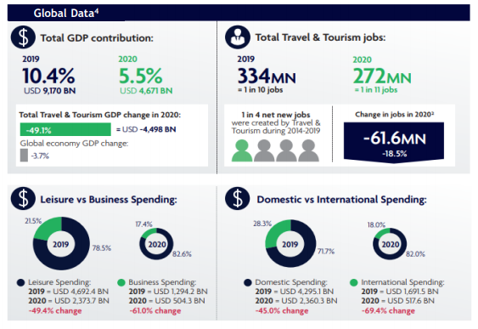
GLOBAL
TOURISM PERFORMANCE
Source: WTTC Travel and Tourism Economic Impact Report, 2021
The devastating impact that the COVID-19 pandemic has had on travel & tourism globally is outlined in the World Travel & Tourism Council’s (WTTC) latest Travel & Tourism Economic Impact Report. Global travel & tourism contribution to GDP contracted by a staggering 49%, equivalent to USD 4.5 billion, whereas global GDP contracted by a mere -3.7%. 61 million jobs loss in the tourism sector although previous survey based estimates cited 121 million potential job losses in travel & tourism during 2020. The industry’s contribution to Africa’s GDP in 2020 was also close to half of 2019 levels representing 3.7% of GDP in 2020 versus 6.9% in 2019. The leisure sector suffered slightly less (-49%) than business spending (-61%).

Slide 5
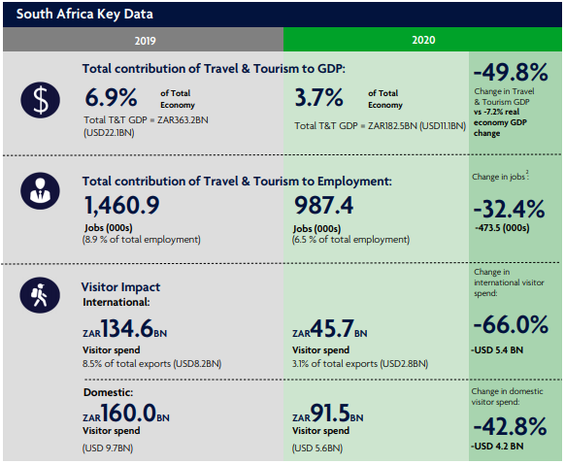
GLOBAL TOURISM PERFORMANCE
Source: WTTC Travel and Tourism Economic Impact Report, 2021

Slide 6
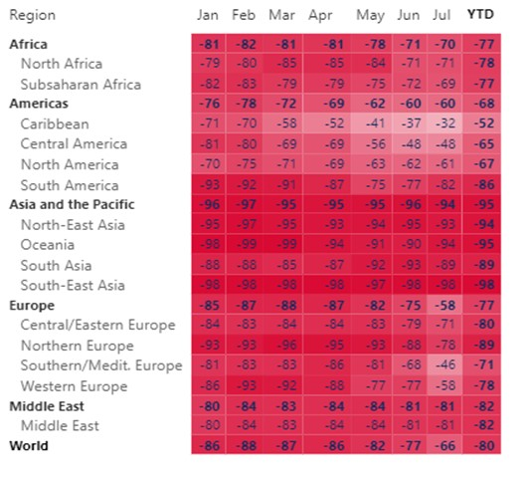
GLOBAL TOURISM PERFORMANCE
International Tourist Arrivals
Global travel is still 80% below what it was in the first seven months of 2019.
America is recovering the fastest than any other region. It is now 68% lower than usual. South America within the region is struggling.
Europe and Africa are 2nd with their recovery at 77%. North Europe uptake is relatively slow.
Asia and the Pacific is the lowest recovering market.
Source: UNWTO Tourism Recovery Tracker, 2021

Slide 7
GLOBAL TOURISM PERFORMANCE
REST OF THE WORLD
2021
JAN - JULY
-55.6%
Tourist arrivals from the rest of the world decreased by -81.8% in June 2021 compared to the same period in 2019. All markets recorded a decline from January to April 2021 due to the impact of COVID-19 pandemic.
INTERNATIONAL
TOURIST ARRIVALS (Mn)
10.9
ANNUAL TARGET
International tourist arrivals declined by
-85.9%
1.1
Actual : Jan - July
North America
-55.6%
Europe
-92.6%
in the period January to July 2021 compared to the previous period in 2019.
The required growth rate to reach the annual target is
AFRICA
-94.3%
Central & South America
-78.9%
All markets recorded declined in July 2021.
Asia
6.9%
-88.4%
Australasia
-97.4%

Slide 8
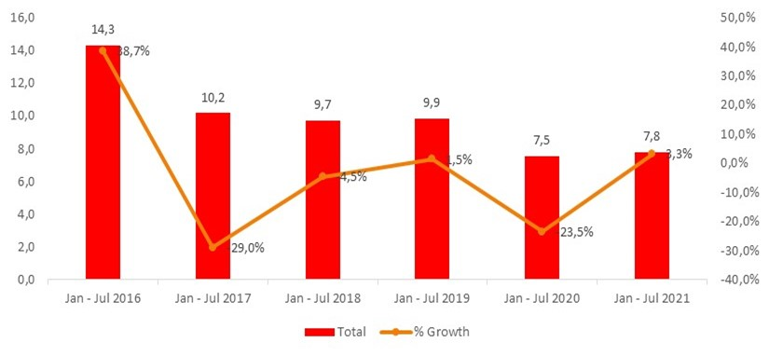
DOMESTIC TOURISM PERFORMANCE
The rise of the pandemic’s third wave and subsequent travel restrictions predictably resulted in a drop in domestic day trips, air travel, road travel and accommodation occupancy rates. Indications are, however, that these activities started recovering in August, and will likely continue to improve as restrictions are lowered and infections remain low.
A total of 7.8 million overnight domestic tourism trips were taken in South Africa. This was an increase of 3.3% compared to 2020. Although the first two months were below those of 2020 levels, there is was an increase in the number of trips, in 2021, the least number of trips were taken in July.

Slide 9
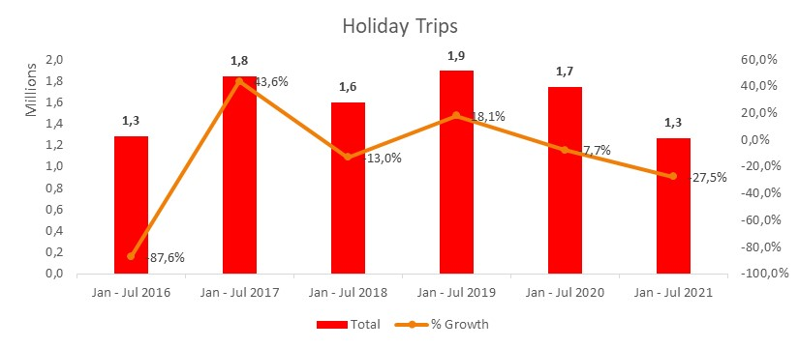
DOMESTIC TOURISM PERFORMANCE
A total of close to 1.3 million domestic holiday trips were recorded. This was 27.5% lower compared to 2020. Trips taken in February spiked, went down again in March and April and went up again during June, July recorded the least amount of holiday trips in 2021.

Slide 10
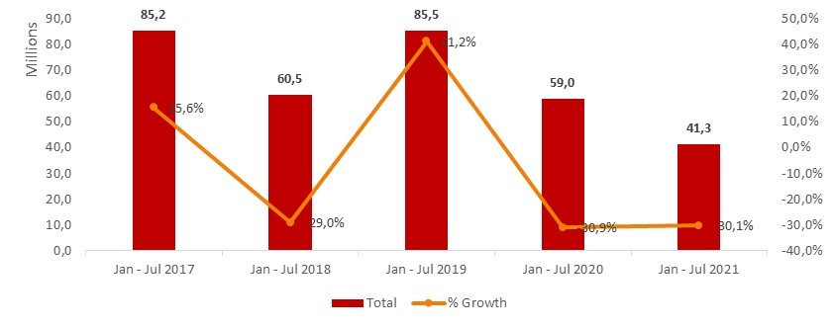
DOMESTIC TOURISM PERFORMANCE
Domestic tourism same day trips decreased and were 30.1% less compared to 2020, to reach a total of 41.3 million trips. There was a constant flow of trips taken for the first 6 months of 2021, with July recording the least.

Slide 11
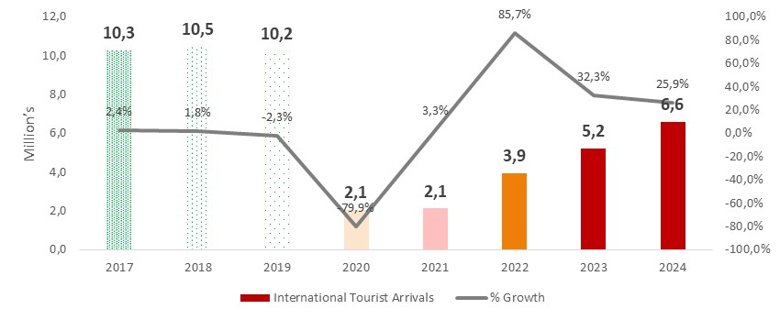
OUTLOOK FOR THE SECTOR
Although there is greater uncertainty in the outlook, early predictions show that South Africa international tourist arrivals are no longer expected to be regained by 2024. Pre-COVID estimates projected that the size of tourism would have been 13 – 14 million by 2024.
Source: Oxford Economics Econometrics Model

Slide 12
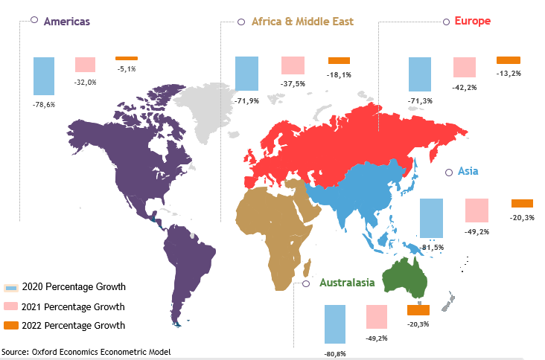
OUTLOOK FOR THE SECTOR

Slide 13
COVID-19 & VACCINATION ROLLOUT
Selected International Markets
North American key markets have had advanced vaccine rollout efforts. While the US vaccine rate, although relatively high, has slowed to some extent, Canada has surpassed hypothetical herd immunity. In addition, Canada has very low weekly new case rates. This is not true for the United States who are experiencing a weekly new case rate > 150 per 100,000
Domestic Market
South Africa, within a third wave of infections during July 2021, was experiencing relatively high weekly new case rates, > 130 new cases per 100 000 people per week.
The vaccine roll-out is progressing steadily.
Regional Markets
Most African source markets have relatively lower weekly new case rates with notable exceptions being Botswana, Eswatini and Namibia.
The former having the highest new case rate of all our source markets, that is > 370.
In Europe, most key source markets are making positive progress in moving towards herd immunity vaccination levels. Weekly new caseloads have all but stabilised at lower risk levels for most of the European nations. Exclusions, however, are the United Kingdom, Spain and Netherlands. Despite high vaccination levels, these countries are experiencing increasing weekly new COVID-19 cases likely associated with the rapid spread of new corona virus variants.

Slide 14
Environmental Analysis & Outlook
Quarter 1 & 2 Performance Against Tourism Sector Recovery Plan & FY21/22 APP
Financial Performance
Governance & Compliance
Quarter 3 Outlook
Annexure: Detailed Organisational Performance Report by Programme
14

Slide 15
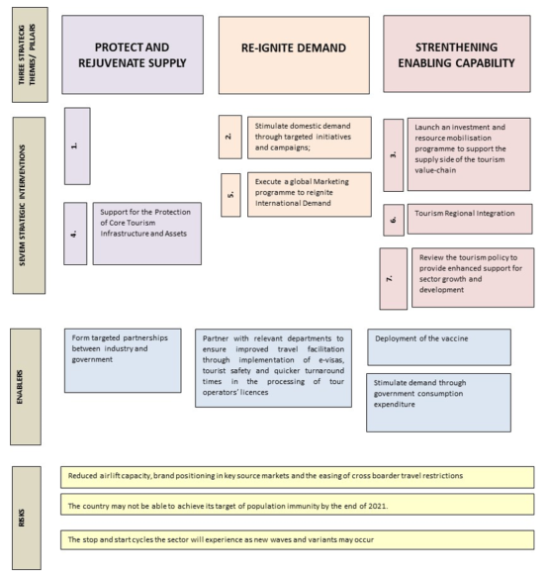
TOURISM SECTOR RECOVERY PLAN
Role of SA Tourism
Implement Recovery Plan:
Implement norms and standards for safe operations across the value chain to enable safe travel and rebuild traveller confidence;
Stimulate domestic demand through targeted initiatives and campaigns;
Strengthen the supply-side through resource mobilisation and investment facilitation;
Support for the protection of core tourism infrastructure and assets;
Execute a global marketing programme to reignite international demand;
Tourism regional integration; and
Review the tourism policy to provide enhanced support for sector growth and development.

Slide 16
STRATEGIC PROJECTS DRIVING TOURISM SECTOR RECOVERY PLAN
Stimulating domestic demand through targeted initiatives and campaigns
PRIORITY PROJECT | STATUS
Quarterly Sector Engagements | The Quarterly Stakeholder Engagement Programme was held as planned in quarters 1 and 2 with various activities led by different business units.
Business Events hosted in VTSDs | Each province has identified three towns thus the project will be implemented in 27 towns across the country. The SANCB, through consultations with the National Associations in the focus groups, hosted engagements with the provincial and city Convention Bureaus to determine the criteria for the National Association Project. Infrastructure assessments and site inspections were conducted of VTSDs in all 9 provinces. The Girls and Boys Friendly Society (GBFS) Annual Conference was hosted at the Gariep Dam, Free State, from 30th September to 2nd October 2021.
Lilizela Awards | The primary aim of this event is to acknowledge the many tourism businesses that closed down due to the unfortunate economic conditions brought about by the COVID-19 pandemic. The format will be to sensitively share the stories of those products who have remained resilient. This event is scheduled for later in the year. A concept has been drafted to host a variation hybrid event for Lilizela. The proposed hybrid event will focus on success stories within the tourism industry in recognition of the industry. By the end of quarter 2, project planning was on track to host the event in November 2021. However, by end January 2022 it was confirmed that the event would not be held.

Slide 17
STRATEGIC PROJECTS DRIVING TOURISM SECTOR RECOVERY PLAN
Stimulating domestic demand through targeted initiatives and campaigns
PRIORITY PROJECT | STATUS
Domestic deal-driven campaign | The Easter and Winter deal-driven campaigns in June were the main drivers for domestic holiday trips in Quarter 1. During Quarter 2, Travel Week and the always on digital campaign greatly assisted in driving conversion and the domestic numbers in the quarter.
Enterprise & Supplier Development | The E&SD programme has the objective of contributing to the development, sustainability, financial and operational independence of the identified beneficiaries, so that they are mainstreamed in the tourism sector. The programme will assist enterprises and suppliers with access to markets, access to funding, access to business support and training & development as well as developing a cohort of competent and fully market ready Destination Marketing Companies (DMCs), Professional Conference Organisers (PCOs), Quality Assurance Assessors and service providers that form part of the SA Tourism procurement value chain. Enterprise and supplier development programme was launched at the stakeholder engagement session held on 29th June 2021. 50 SMMEs were enrolled as part of the Basic Quality Verification Programme.

Slide 18
STRATEGIC PROJECTS DRIVING TOURISM SECTOR RECOVERY PLAN
Executing a global marketing programme to reignite international demand
PRIORITY PROJECT | STATUS
Africa’s Travel & Tourism Summit | SA Tourism delivered Africa’s Travel and Tourism Summit on behalf of the Department of Tourism. The African Travel and Tourism Summit was held on 20 and 21 September 2021, in a hybrid format, featuring physical locations in Johannesburg, Durban and Lagos. An SMME workshop took place on 19 September 2021 in the build-up to the Summit. The Summit aimed to position South Africa and the rest of the African continent as a renewed and revitalised tourism destination. The primary focus of the Summit was to engage our continental and global partners in reigniting the tourism economy through meaningful conversation and collaborative outcomes.
World Expo 2020 Dubai | SA Tourism was requested to lead and coordinate tourism’s participation at the World Expo 2020 in the United Emirates. The project launched in October 2021.
Regional Brand Campaign | During Quarter 1, SA Tourism developed and launched the new regional brand campaign, Come Journey with Us, which is geared towards regional conversion.

Slide 19
STRATEGIC PROJECTS DRIVING TOURISM SECTOR RECOVERY PLAN
Executing a global marketing programme to reignite international demand
PRIORITY PROJECT | STATUS
Global Brand Campaign | The campaign serves to reposition South Africa as a tourism destination, domestically and internationally, in a “post-COVID” era (the new tourism normal) and drive tourism growth over the next 5 to 10 years. The campaign comprises leisure, business events, lifestyle and cultural tourism across domestic, regional and international markets. It leverages the current tourism offering while projecting the tourism proposition of the future. The Global Brand Campaign was launched on 26th September 2021.
Global Advocacy Programme | The project is focused on addressing real and/or perceived barriers to travel to South Africa and is a shared priority for SA Tourism, the Department of Tourism and Tourism Business Council of South Africa. The tender has been evaluated and awarded in Quarter 2.
International Engagements | A programme for international engagements has been developed that creates opportunities for the Minster to engage international media and trade as part of promoting destination SA and indicating that SA is open for business. Source markets prioritised include Africa, the Americas, Europe, China, and India.

Slide 20
QUARTERLY UPDATE ON BIDS SECURED FOR DESTINATION SA
BID SECURED | YEAR | SIZE OF EVENT | GEOGRAPHIC LOCATION OF EVENT
 |  |  | PROVINCE | TOWN
QUARTER 1
Annual Meeting of the International Association of Judges | 2024 | 300 | WC | Cape Town
The LGBT+ Travel Symposium | 2022 | 250 | GP | Krugersdorp
International Conference of the Human Resource Division | 2022 | 170 | NW | Potchefstroom
Unisa Regional Meeting – World Federation of International Music Competitions | 2022 | 60 | GP | Tshwane
International Conference of the African Marine Waste Network | 2022 | 500 | EC | Gqeberha
Microsoft EMEA Club 2020 Winners | 2022 | 700 | WC | Cape Town
Conference on Technology and Instrumentation in Particle Physics | 2023 | 300 | WC | Cape Town
International Congress of Biochemistry Molecular Biology | 2027 | 1500 | WC | Cape Town
ESSENCE International Conference | 2023 | 600 | WC | Cape Town

Slide 21
QUARTERLY UPDATE ON BIDS SECURED FOR DESTINATION SA
BID SECURED | YEAR | SIZE OF EVENT | GEOGRAPHIC LOCATION OF EVENT
 |  |  | PROVINCE | TOWN
QUARTER 2
International Conference on Indigenous Astronomy | 2022 | 100 | NW | Mahikeng
African Regional Students Conference of the Institute of Human Settlement Practitioners | 2021 | 250 | EC | Alice
Hepatopancreaticobiliary Association of Southern Africa Regional Conference | 2021 | 120 | WC | Franschhoek
Federation of Africa University Sports General Assembly and Strategic Dialogue | 2023 | 200 | GP | Johannesburg
International Symposium on Morphological Sciences Conference | 2023 | 400 | WC | Cape Town
International Conference on Information Fusion | 2021 | 200 | NW | Rustenburg

Slide 22
QUARTERLY UPDATE ON GRADING INCENTIVE PROGRAMME
NUMBER OF ENTERPRRISES ENROLLED IN PROGRAMME | GEOGRAPHIC LOCATION
 | PROVINCE |  | TOWNS
QUARTER 1
105 | Eastern Cape | Addo, Aliwal North, Cala, Cape St Francis, Chintsa East, East London, Fort Beaufort, Graaff-Reinet, Grahamstown, Jeffreys Bay, Kenton on Sea, King William’s Town, Kirkwood, Loerie, Maclear, Matatiele, Middelburg, Mqanduli, Mthatha, Oyster Bay, Port Elizabeth, Port St Johns, Queenstown, Storms River, Sunland, Thornhil, Tsolo, Uitenhage and Willowmore
28 | Free State | Bloemfontein, Clarens, Ficksburg, Fouriesburg, Gariepdam, Kroonstad, Oranjeville, Phuthaditjhaba, Springfontein, Thaba Nchu, Welkom, and Windburg
84 | Gauteng | Benoni, Centurion, Fourways, Germiston, Johannesburg, Kempton Park, Krugersdorp, Lanseria, Melrose Estate, Midrand, Mogale City, Montana,Muldersdrift, Parktown, Pretoria, Pretoria Central, Pretoria North, Randburg, Roodepoort, Sandton, Sedibeng, Soweto, Springs, Taung, Vanderbijl Park, Vereeniging and Westonaria
106 | KwaZulu-Natal | Amanzimtoti, Ballito, Bayala, Bergville, Bluff, Durban, Cato Ridge, Durban, Eshowe, Hilton, Himeville, Hluhluwe, Kingsburgh, Kokstad, La Lucia, Ladysmith, Magudu, Mahlabathini, Margate, Mkuze, Mtubatuba, Mtunzini, Newcastle, Nongoma, Nottingham Road Nquthu, Pennington, Pietermaritzburg, Pongola, Ramsgate, Richards Bay, Rosetta, South Broom, St Lucia, Trafalgar, Umhlanga Rocks, Umkomaas, Umtentweni, Umzimkulu, Uvongo, Vryheid, Westville, Winterton and Zimbali

Slide 23
QUARTERLY UPDATE ON GRADING INCENTIVE PROGRAMME
NUMBER OF ENTERPRRISES ENROLLED IN PROGRAMME | GEOGRAPHIC LOCATION
 | PROVINCE | TOWNS
QUARTER 1 cntd
35 | Limpopo | Bela-Bela, Giyani, Hoedspruit, Jane Furse, Lephalale, Louis Trichardt, Mamaila, Mokopane, Northam, Nzhelele, Phalaborwa, Polokwane, Thabazimbi, Thohoyandou, Trichardtsdal, and Tzaneen
54 | Mpumalanga | Chrissiesmeer, Delmas, Dullstroom, Emalahleni, Ermelo, Hazyview, Hectorspruit, Komatipoort, Kruger National Park, Lydenburg, Machadodorp, Malelane, Marloth Park, Mbombela, Middelburg, Nelspruit, Sabie, Secunda, Skukuza, Standerton White River, and Witbank
37 | North West | Brits, Hartbeespoort Dam, Klerksdorp, Koster, Lichtenburg, Mahikeng, Matlosana City, Mmakau, Moses Kotane, Orkney, Parys, Potchefstroom, Pudimoe, Rivesrdale, Ventersdorp, Vryburg and Zeerust
18 | Northern Cape | Douglas, Keimoes, Kimberley, Port Nolloth, Postmasburg, Springbok and Upington
177 | Western Cape | Beaufort West, Bellville, Blouberg, Caledon, Cape Town, Ceres, Citrusdal, Clanwilliam, Darling, Elgin, Fish Hoek, Franschhoek, Gansbaai, George, Gordons Bay, Groot Brakrivier, Hermanus, Hout Bay, Kleinmond, Knysna, Kuilsriver, Laingsburg, Montagu, Mossel Bay, Napier, Oudtshoorn, Paarl, Paternoster, Pinelands, Plattekloof, Plettenberg Bay, Port Owen, Veldrift, Prince Albert, Rawsonville, Robertson, Saldanha Bay, Sedgefield, Simon's Town, Simonstown, Somerset Hill, Somerset West, Stellenbosch, Struisbaai, Swellendam, Tulbagh, Vredendal, Wellington, Wilderness and Worcester
GRAND TOTAL OF 644 FOR Q1

Slide 24
QUARTERLY UPDATE ON GRADING INCENTIVE PROGRAMME
NUMBER OF ENTERPRRISES ENROLLED IN PROGRAMME | GEOGRAPHIC LOCATION
 | PROVINCE | TOWN
QUARTER 2
199 | For the period under review, SA Tourism migrated to the new Grading Management System (TQIT). Currently the data processing is being finalised to ensure a seamless migration to the new system. Completion of this process will enable the recording, monitoring and reporting of the number of enterprises which have benefitted from the Tourism Incentive Programme (TIP). The data verification process is at an advanced stages thus the number of enterprises enrolled in the programme is estimated at 199 (for the month of September, as there was no system functionality for July and August to process TIP applications).

Slide 25
INDUSTRY & GOVERNMENT RELATIONS
Q1
Engagement with Provincial Tourism Authorities (PTAs), following the conclusion of the collaborative MOUs and Cabinet’s approval of the Tourism Sector Recovery Plan. MOUs have been concluded and will inform the provincial implementation plans focusing on delivering shared priorities in support of the Tourism Sector Recovery Plan.
First quarterly industry stakeholder engagement session with TBCSA, ASATA and the Department of Tourism, held on 29th June 2021. The engagement outlined SA Tourism’s plans for the financial year ahead, within the context of the risk-adjusted strategy.
SA Tourism participated in the City Economic Development Managers Forum (CEDMF), convened by National Treasury. The forum, which meets monthly, was constituted in April 2020 in response to the current economic crisis to support the eight metropolitan municipalities in their economic response and recovery planning.
Coastal Marine Tourism (CMT) held their delivery meeting and presented key projects which are part of the Operation Phakisa’s Oceans Economy Programme. SA Tourism is mandated to lead with marketing programmes focusing on this initiative.
In support of the air routes recovery, SA Tourism assisted the DT with a proposal around key air routes for recovery.
SA Tourism supported the Deputy Minister during his visit to the districts of uMkhanyakude and iLembe in KZN and engaged with both trade and media.

Slide 26
INDUSTRY & GOVERNMENT RELATIONS
Q2
Convened engagement with Heads of Missions: Algeria, Argentina, Cuba, Canada, Guinea Bissau, Mali, Hungary, Palestine, Sri Lanka and Tanzania on 5 July 2021.
Engagement with SABC on 7 July 2021 to discuss partnership and areas of collaboration.
Participated in the TBCSA industry engagement on 8 July 2021 to discuss feedback and update to the industry regarding COVID-19 related matters including what TBCSA is currently doing regarding the unfavourable travel advisories from South Africa’s major inbound source markets.
Engagement with Board Chairpersons of SA Tourism and TBCSA on 14 July 2021 to discuss mutual priorities and areas of partnership, including the MOU.
Convened engagement with SANParks on 13 September with Board Chairpersons to discuss possible collaboration and partnership.
Held engagement with ACSA on 14 July and 4 August 2021 to discuss shared priorities and areas of collaboration.
Participated in the Department of Tourism, Department of Home Affairs, Department of Transport, SA Tourism and TBCSA Technical Committee meeting on 18 August 2021, facilitated by the Department of Tourism, in pursuit of the implementation of the Tourism Sector Recovery Plan.
Convened CEO and CMO Joint Forum with Provincial Tourism Authorities on 23 August 2021 to discuss collaboration on the World Tourism Day, Global Advocacy Campaign, Global Brand Campaign, and World Expo Dubai 2020.
Convened engagement with Airbnb regarding their possible participation in Africa’s Travel and Tourism Summit held on 31 August 2021.

Slide 27
HUMAN CAPITAL MANAGEMENT
Appointment of Key Staff as at 31st December 2021
Head: Risk Management commenced duty on 1 March 2021
Head: Supply Chain Management commenced duty on 1 July 2021
General Manager: ICT commenced duty on 6 December 2021
Recruitment underway as at 31st December 2021
General Manager: Strategic events
General Manager: Global PR & Communications
Trade Relations Manager West Coast – USA
Trade Relations Manager East Coast – USA
Hub Heads: Central Europe, South Europe, UK & Ireland
Administrative Coordinator: USA
Finance & Admin Manager: USA
Manager: Office of the CEO
Senior Corporate Legal Specialist

Slide 28
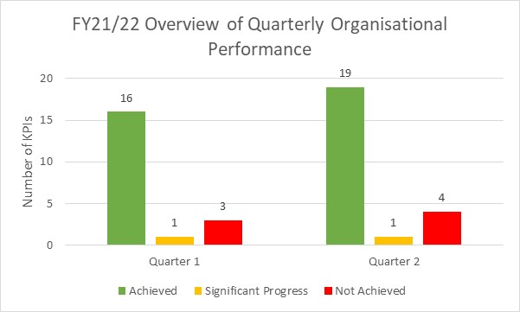
FY21/22 QUARTERS 1 & 2 APP PERFORMANCE
SA Tourism’s performance for Quarter 1:
SA Tourism’s performance for Quarter 2:
80%
(16)
5%
(1)
15%
(3)
79% (19)
4%
(1)
17% (4)

Slide 29
ORGANISATIONAL PERFORMANCE AGAINST APP: QUARTER 1
Achievements within core programmes include:
Programme 2
Published the third volume of The Road to Recovery Report.
Programme 3
Implemented the Easter domestic deal-driven campaign.
Developed and launched the new regional brand campaign, Come Journey with Us.
Programme 4
Global business events campaign content brief has been developed and approved.
Domestic business events campaign content brief has been developed and approved.
25 bid submissions were achieved.
Infrastructure assessments and site inspections were conducted of VTSDs in all 9 provinces.
A concept has been drafted to host a variation hybrid event for Lilizela. The proposed hybrid event will focus on success stories within the tourism industry in recognition of the industry.
Programme 5
4 577 establishments were graded & 105 428 rooms were graded.
E&SD Programme launched.
The Arabian Travel Market was held from 24 to 26 May 2021. The total number of seats allocated to SA Tourism was 28 of which 11 were dedicated to SMMEs. The target is 25% of total seats (7 seats) with an achievement of 39%.
50 SMMEs were enrolled as part of the Basic Quality Verification Programme.

Slide 30
AREAS OF UNDER-PERFORMANCE: QUARTER 1
PROGRAMME | QUARTERLY TARGET | PROGRESS AGAINST QUARTERLY TARGET | REASONS FOR DEVIATION | CORRECTIVE MEASURES
2 | B2B and B2C portal supported: User acceptance testing | None. | No further progress has been made as the project has come to a halt pending the outcome of a forensic Investigation related to the supplier who built the B2B and B2C portal. | The investigation has been finalised and the Board will advise on the way forward.
2 | Number of reports assessing performance of tourism sector produced | The quarterly report has been produced but has not been published. | The report has been produced and is undergoing the internal approval process. | The report will be published in July 2021.

Slide 31
AREAS OF UNDER-PERFORMANCE: QUARTER 1
PROGRAMME | QUARTERLY TARGET | PROGRESS AGAINST QUARTERLY TARGET | REASONS FOR DEVIATION | CORRECTIVE MEASURES
3 | Global tourism brand campaign implemented | The annual global tourism brand campaign has been conceptualised but not launched. | Due to the third wave of the COVID-19 pandemic, the launch was not feasible. | A recommendation will be made to hold the launch in September 2021.
4 | Indaba and Meetings Africa hosted | In Quarter 1, submission to have a hybrid Africa Travel and Tourism Conference was approved instead of the Indaba and Meetings Africa hybrid. The proposed date for this hybrid event was moved from July 2021 to September 2021 given the projected impact of the third wave. | Given the fluid environment created by the pandemic and three different waves that South Africa has experienced, hosting tradeshows is a challenge. | SA Tourism thus introduced a different viable platform which will still create market access and fulfil the objectives of both Meetings Africa and Africa’s Travel Indaba.

Slide 32
ORGANISATIONAL PERFORMANCE AGAINST APP: QUARTER 2
Achievements within core programmes include:
Programme 2
45% implementation of MOUs with Provincial Tourism Authorities.
Conducted SA Tourism Reputation Index survey to establish new baseline.
Published the annual tourism sector performance report.
Programme 3
The Winter Deal Driven Campaign and Travel Week Campaign were implemented.
Phase 1 of the regional brand campaign was implemented.
The Global Brand Campaign was launched at MINMEC on 26th September 2021.
The World Expo 2020 Dubai concept has been revised in line with feedback from stakeholders. The project team has completed a site inspection in Dubai. Preparation is on track for the tourism activation.
Programme 4
The global and domestic business events campaigns was launched on SANCB Facebook social media platform and the SAACI social media platform including Facebook, Twitter, Instagram and LinkedIn.
25 bid submissions were achieved.
As the national business event piloted in VTSD, the Girls and Boys Friendly Society (GBFS) Annual Conference was hosted at the Gariep Dam, Free State, from 30th September to 2nd October 2021.
The Africa Travel and Tourism Summit was held as a hybrid event on 19th to 21st September 2021.
The proposed hybrid event will focus on success stories within the tourism industry in recognition of the industry.
Programme 5
The NPS improvement plan was developed and approved.
4735 establishments were graded. In addition, 101 322 rooms were graded.
SMMEs were onboarded for a number of E&SD initiatives led by SA Tourism including BRICS India Trade Fair, Africa’s Travel and Tourism Summit and WTM London.
The Basic Quality Verification programme study to establish the baseline has been completed.

Slide 33
AREAS OF UNDER-PERFORMANCE: QUARTER 2
PROGRAMME | QUARTERLY TARGET | PROGRESS AGAINST QUARTERLY TARGET | REASONS FOR DEVIATION | CORRECTIVE MEASURES
1 | 40% ICT, TE, TGCSA, NCB business processes automated | TGCSA business processes are 100% automated as per the requirements provided for the new grading system to replace QiT. The new system was live and communicated to establishments on the 28th September. | The remainder of the business processes to be automated has a risk of not being met this fiscal. The scope of work needed to deliver on this target was understated and subsequently led to the incorrect scoping of work with the project team and service provider. | A project team will be assembled to manage project delivery. The approach will then be presented to the project committee for adoption.
2 | Go-live and support (B2B and B2C portals) | None. | No further progress has been made as the project has come to a halt pending the outcome of a forensic Investigation related to the supplier who built the B2B and B2C portal. | Forensic investigation concluded. The Board will advise on the way forward.

Slide 34
AREAS OF UNDER-PERFORMANCE: QUARTER 2
PROGRAMME | QUARTERLY TARGET | PROGRESS AGAINST QUARTERLY TARGET | REASONS FOR DEVIATION | CORRECTIVE MEASURES
3 | Implementation of annual campaign (global tourism brand campaign) | The Global Brand Campaign was launched at MINMEC on 26th September 2021. | As the launch of the campaign was deferred from Quarter 1 to Quarter 2, the roll-out of the campaign was moved from Quarter 2 to Quarter 3. | As the launch of the campaign was deferred from Quarter 1 to Quarter 2, the roll-out of the campaign was moved to Quarter 2 to Quarter 3 and continue in Quarter 4.
4 | 1 national business event piloted in VTSD | The Girls and Boys Friendly Society (GBFS) Annual Conference was hosted at the Gariep Dam, Free State, from 30th September to 2nd October 2021. | Collaboration with the Free State Provincial Tourism Authority and the Girls and Boys Friendly Society led to the successful planning and hosting of the event. | The event commenced on 30th September and concluded on 2nd October 2021 thus spanning two quarters. Events for Quarters 3 and 4 will be hosted prior to the end of each quarter.
5 | 25% of total seats for SMME participants | No trade shows were held during Quarter 2. | There were no trade shows held during Quarter 2, thus SA Tourism could not allocate seats to SMMEs. SA Tourism however had an SMME day at ATTS. | The allocation of seats to SMMEs will be prioritised during Quarter 3 with the country at risk-adjusted strategy level 1.

Slide 35
Environmental Analysis & Outlook
Quarter 1 & 2 Performance Against Tourism Sector Recovery Plan & FY21/22 APP
Financial Performance
Governance & Compliance
Quarter 3 Outlook
Annexure: Detailed Organisational Performance Report by Programme
35

Slide 36
Statement of Financial Performance- Revenue
South African Tourism accrued R 521.6 million during quarter 1 of the financial year. The accrued amount represents
37% of projected income for the 2021/22 financial year. A total of R 518.8 million was received from the National Department of Tourism.
PROGRAMME |  | APP ANNUAL BUDGET R'000 | INCOME FORECAST BY 30 JUNE 2021 R'000 | REVENUE R'000 | % OF ACTUAL INCOME ON ANNUAL BUDGET | % OF ACTUAL INCOME ON FORECAST INCOME TO DATE | REASONS FOR VARIANCES
 | Transfers from the Department of Tourism | 1 297 038 | 518 816 | 518 816 | 40% | 100% | South African Tourism received R 518.8 million from the Department of Tourism to invest in marketing South Africa as a leisure and business tourism destination.
 | TOMSA Voluntary levies | 50 000 | 12 500 | - | - | - | South African Tourism and Tourism Business Council advanced approval stage. Voluntary TOMSA transfers between South African Tourism and TBCSA will only take place once the agreement is duly signed.
 | Grading Fees | 12 239 | 3 060 | 2 216 | 18% | 72% | Grading revenue is driven by the number of graded establishments. Revenue accrued during quarter 1 of the financial year was R 2.2 million.
 | Sundry revenue | 58 345 | 6 212 | 809 | 1% | 13% | South African Tourism receives exhibition income from exhibitors who participates in its Africa's Travel Indaba ( ATI) which takes place in the first quarter of a financial year. The impact of the pandemic and associated led to the cancellation of ATI in the current quarter. This strategic platform will be replaced by Africa's Travel and Trade Summit ( ATTS) in quarter 2. ATTS will be a hybrid event in order to ensure compliance with applicable COVID protocols.
 | Total | 1 417 622 | 540 588 | 521 840 | 37% | 97%
36

Slide 37
Statement of Financial Performance- Revenue
South African Tourism accrued R 611.2 million during quarter 2 of the financial year. The accrued amount represents 43% of projected income for the 2021/22 financial year. A total of R 605.3 million was received from the Department of Tourism.
PROGRAMME |  | APP ANNUAL BUDGET R'000 | INCOME FORECAST BY 30 SEPTEMBER 2021 R'000 | REVENUE R'000 | % OF ACTUAL INCOME ON ANNUAL BUDGET | % OF ACTUAL INCOME ON FORECAST INCOME TO DATE | REASONS FOR VARIANCES
 | Transfers From the Department of Tourism | 1 297 038 | 605 285 | 605 285 | 47% | 100% | South Afrrican Tourism received a cumulative transfer of R 605.3 million from the Department of Tourism.
 | TOMSA Voluntary levies | 50 000 | 25 000 | - | - | - | Voluntary TOMSA transfer is dependent on a signed agreement being in place between Tourism Business Council of South Africa and South African Tourism.
 | Grading Fees | 12 239 | 6 120 | 4 609 | 38% | 75% | Grading fees is driven by the number of graded establishment and as a result a cumulative amount of R 4,6 million was generated during the period under review.
 | Sundry revenue | 58 345 | 12 424 | 1 397 | 2% | 11% | The incremental increase from Quarter 1 is due to the participation in strategic platforms.
 | Total | 1 417 622 | 648 829 | 611 291 | 43% | 94%
37

Slide 38
Statement of Financial Performance- Expenditure per programme
South African Tourism spent R 253,7 million during quarter 1 of the financial year on projects aimed marketing South Africa as a leisure and tourism destination. This amount accounted for 18% of the entity’s total annual budget for the 2021/22 financial year.
38

Slide 39
Statement of Financial Performance- Expenditure per programme
South African Tourism spent R 488,6 million during quarter 2 of the financial year on projects aimed marketing South Africa as a leisure and tourism destination. This amount accounted for 34% of the entity’s total annual budget for the 2021/22 financial year.
39

Slide 40
Statement of Financial Performance- Economic classification
40

Slide 41
Statement of Financial Position
A review of South African Tourism Statement of Financial Position indicates that the entity is solvent as total assets of R 1.4 billion exceed total liabilities of R 171 million.
South African Tourism has a positive liquidity ratio as its current assets of R1.34 billion are greater than current liabilities of R 141 million. The entity is therefore able to meet all its short-term obligations as and when they become due.
41

Slide 42
Environmental Analysis & Outlook
Quarter 1 & 2 Performance Against Tourism Sector Recovery Plan & FY21/22 APP
Financial Performance
Governance & Compliance
Quarter 3 Outlook
Annexure: Detailed Organisational Performance Report by Programme
42

Slide 43
GOVERNANCE & COMPLIANCE
South African Tourism strives to comply with laws and regulations to ensure that operational, financial efficiency and objectivity are at reasonable and acceptable levels.
Assurance on compliance with systems of internal control and their effectiveness is obtained through regular management reviews, self-control -assessment, internal audit reviews, compliance risk management and testing of certain aspects of the internal financial controls by external auditors during the course of their statutory examinations.
A policy universe is maintained, and compliance therewith is monitored on an ongoing basis. A policy review project is underway to ensure that all policies are relevant and in harmony with the legislative and regulatory prescripts.
SA Tourism was compliant in all matters relating to the PFMA for the quarter ending 30 September 2021.

Slide 44
BOARD MEETINGS
Name | Number of Meetings | Date of Meeting | Attendance | Key Agenda Items
QUARTER 1
Board | 2 | 29 April 2021 | 11/12 | 2021/Quarter 4 Performance Report Revised Delegations of Authority Privacy Policies Internal Audit Coverage Plan FY21/22 Risk Management Policy Termination of Country Office Leases Annual Procurement Plan North Europe Media Contracts
 |  | 28 May 2021 | 10/12 | Draft Annual Financial Statements Draft Annual Performance Report

Slide 45
BOARD MEETINGS
Name | Number of Meetings | Date of Meeting | Attendance | Key Agenda Items
QUARTER 2
Board | 5 | 29 July 2021 | 11/12 | 2021/22 Quarter 1 Performance Report Amendments to the Annual Procurement Plan Tourism Execution Brand Development Strategy Tourism Execution Partnerships Agreements: UK, Germany & Australia Cost of Living Adjustments & Performance Incentives Board Charter Board Committee Re-composition Round robin resolution Impact of riots on tourism sector
 |  | 15 September 2021 – Special Board meeting with Minister | 10/12 | Mandate & Strategy Governance matters Key decisions for operational continuity Key priority projects Update eon 20/21 audit outcome Update on forensic investigation Proposed Minister’s meet and greet with SAT staff
 |  | 19 August 2021 | 10/11 | Forensic investigation report
 |  | 3 September 2021 | 6/12 | Presentation of Board Evaluation Report
 |  | 22 September 2021 | 9/12 | Global Brand Campaign Netherlands contract Appointment of Global Advocacy Programme agency Amendments to Delegations of Authority Africa’s Travel and Tourism Summit update TBCSA MOU

Slide 46
COMMITTEE MEETINGS
Name | Number of Meetings | Date of Meeting | Attendance | Key Agenda Items
QUARTER 1
Human Capital & Remuneration Committee | 2 | 15 April 2021 | 3/5 | Capacity and capability requirements Angola office closure Human Capital Update Report
 |  | 29 June 2021 | 4/5 | Capacity and capability requirements
QUARTER 2
Human Capital & Remuneration Committee | 1 | 6 July 2021 | 5/5 | Cost of Living Adjustments & Performance Incentives Human Capital Update Report

Slide 47
COMMITTEE MEETINGS
Name | Number of Meetings | Date of Meeting | Attendance | Key Agenda Items
QUARTER 1
Marketing & Commercial Committee | 2 | 19 April 2021 | 5/5 | Africa Tourism Conference 2021 North Europe contract (Ogilvy Social Lab) Market prioritisation investment framework Netflix content collaboration Strategic Project 2021/22
 |  | 7 May 2021 | 3/5 | Africa Tourism Conference 2021 Strategic partnerships Dubai World Expo 2020
QUARTER 2
Marketing & Commercial Committee | 2 | 16 July 2021 | 5/5 | Committee reflections on riots Tourism Execution Business Development Strategy Tourism Execution partnership agreements: UK, Germany and Australia Lilizela Tourism Awards 2021 Dubai World Expo 2020 (2021) Global Advocacy Campaign Brand innovation projects Africa’s Travel and Tourism Conference 2021 SANCB Update Report
 |  | 10 August 2021 – Extended special meeting | 4/5 | Global Brand Campaign – The Big Idea Dubai Expo update Global Advocacy Programme update

Slide 48
COMMITTEE MEETINGS
Name | Number of Meetings | Date of Meeting | Attendance | Key Agenda Items
QUARTER 1
Audit & Risk Committee | 2 | 20 April 2021 | 4/5 | 2021 Quarter 4 performance & finance report Privacy policies Amendment to audit strategy Risk management policy EPMO update report Termination of country office lease Litigation report
 |  | 21 May 2021 | 3/5 | 2020/21 draft financial statements 2020/21 draft annual report Risk appetite and tolerance framework
QUARTER 2
Audit & Risk Committee | 3 | 20 July 2021 | 5/5 | 2020/21 Quarter 1 performance & finance report 2020/21 annual report Amendment to the 2021/22 annual procurement plan DigiTech report Internal Audit Risk management Litigation report Finance and supply chain management report
 |  | 27 July 2021 | 5/5 | AGSA report on annual financial statements and management report
 |  | 30 August 2021 | 5/5 | 2020/21 management report

Slide 49
COMMITTEE MEETINGS
Name | Number of Meetings | Date of Meeting | Attendance | Key Agenda Items
QUARTER 1
TGCSA Awards Committee | 1 | 19 April 2021 | 3/5 | Divisional Operational Plan 2021/22 Contractual dispute with grading assessors Draft policy on quality assurance framework Basic quality verification project Quality protection Quality assurance and development
QUARTER 2
TGCSA Awards Committee | 1 | 5 July 2021 | 3/5 | New grading system Contractual dispute with grading assessors Quality assessment and assessor report Tourism value chain audit Dispensation report Universal accessibility Tourism incentive programme Market access facilitation – speed marketing Quality assurance, training and development projects Accrediting TGCSA as a training provider Brand and marketing Quality protection report

Slide 50
Environmental Analysis & Outlook
Quarter 1 & 2 Performance Against Tourism Sector Recovery Plan & FY21/22 APP
Financial Performance
Governance & Compliance
Quarter 3 Outlook
Annexure: Detailed Organisational Performance Report by Programme
50

Slide 51
OVERVIEW OF QUARTER 3 APP TARGETS
Programme 2: Business Enablement
65% implementation of MOUs with Provincial Tourism Authorities
1 tourism sector performance report
Sector engagement
Programme 3: Leisure Tourism
1 domestic deal-driven campaign
Implementation of regional campaign
Implementation of global brand campaign
Tourism activation at the World Expo 2020 Dubai
Programme 4: Business Events
Defining targets on basis of baseline arising from Business Events Brand Strength Index
Global business events campaign implemented
Domestic business events campaign implemented
13 bid submissions
1 national business event piloted in VTSD
National Lilizela Awards hosted
Programme5: Tourist Experience
NPS improvement plan implemented
4 345 graded establishments
E&SD Programme implemented
25% of total seats for SMME participants
Study to establish baseline for BQV Programme

Slide 52
INTERNATIONAL STAKEHOLDER ENGAGEMENT
REGION | ENGAGEMENT | OBJECTIVE
Americas | Stakeholder lobbying roadshows in the US and Canada in October 2021. IMEX America 8 – 10 November 2021 (MICE) | Interactions to reignite the market and deliver confidence messaging in relation to SA’s vaccine rollout. Interactions with international associations and decision makers to consider South Africa as a Business Events Destination.
Europe | Global Trade Platforms including: WTM London: 1 - 3 November 2021 IBTM World Spain: 30 November - 2 December 2021 Fitur Spain: 19 - 23 January 2022 ITB Berlin: 09 - 13 March 2022 | Stakeholder lobbying on Europe and red listing of SA and to address other key barrier issues.

Slide 53
Thank You.

Slide 54
Environmental Analysis & Outlook
Quarter 1 & 2 Performance Against Tourism Sector Recovery Plan & FY21/22
Financial Performance
Governance & Compliance
Quarter 3 Outlook
Annexure: Detailed Organisational Performance Report by Programme

Slide 55
FY2021/22 QUARTER 1 & 2: PERFORMANCE RESULTS
PROGRAMME 1: |  | Corporate Support
OUTCOME |  | Achieve good corporate and cooperative governance
OUTPUT | OUTPUT INDICATORS | 2021/22 ANNUAL TARGET | QUARTERLY TARGETS | PROGRESS AGAINST QUARTERLY OR ANNUAL TARGET | VARIANCE | ATTRIBUTES TO SUCCESS / REASONS FOR DEVIATION | CORRECTIVE MEASURES
2.1. Internal control | Percentage implementation of valid internal and external audit recommendations | 100% implementation of valid audit recommendations | Q1: -
 |  |  | Q2: -
 |  |  | Q3:-
 |  |  | Q4: 100% implementation of valid audit recommendations
2.2. Financial management | Payment of compliant invoices within 30 days from date of receipt | 100% | Q1: 100% | 100% | - | Payments processed timeously to obtain a payables payment period calculated to be 11 days. | None required.
 |  |  | Q2: 100% | 100% | - | Payments processed timeously to obtain a payables payment period calculated at 22 days. Internal controls are in place to track the timeous payment of invoices. | None required.
 |  |  | Q3: 100%
 |  |  | Q4: 100%

Slide 56
FY2021/22 QUARTER 1 & 2: PERFORMANCE RESULTS
PROGRAMME 1: |  | Corporate Support
OUTCOME |  | Achieve good corporate and cooperative governance
OUTPUT | OUTPUT INDICATORS | 2021/22 ANNUAL TARGET | QUARTERLY TARGETS | PROGRESS AGAINST QUARTERLY OR ANNUAL TARGET | VARIANCE | ATTRIBUTES TO SUCCESS / REASONS FOR DEVIATION | CORRECTIVE MEASURES
2.3. Business process automation | Identified business processes automated | ICT, TE, CMO, TGCSA, NCB business processes automated | Q1: Testing processes concluded in Q4 20/21 | All supply chain management processes that were concluded in FY20/21 Q4 have been tested in FY21/22 Q1, namely budget control; tender management, contract management, supplier management and procurement. | - | A project plan has been developed and approved which guides the day to day activities of this project. In addition, project management methodology is applied to this project to ensure delivery as planned. | None required.
 |  |  | Q2: 40% ICT, TE, CMO, TGCSA, NCB business processes automated | TGCSA business processes are 100% automated as per the requirements provided for the new grading system to replace QiT. The new system was live and communicated to establishments on the 28th September. | -80% | The remainder of the business processes to be automated has a risk of not being met this fiscal. The scope of work needed to deliver on this target was understated and subsequently led to the incorrect scoping of work with the project team and service provider. | A project team will be assembled to manage project delivery. The approach will then be presented to the project committee for adoption.
 |  |  | Q3: 80% ICT, TE, CMO, TGCSA, NCB business processes automated
 |  |  | Q4: 100% ICT, TE, CMO, TGCSA, NCB business processes automated

Slide 57
FY2021/22 QUARTER 1 & 2: PERFORMANCE RESULTS
PROGRAMME 1: |  | Corporate Support
OUTCOME |  | Achieve good corporate and cooperative governance
OUTPUT | OUTPUT INDICATORS | 2021/22 ANNUAL TARGET | QUARTERLY TARGETS | PROGRESS AGAINST QUARTERLY OR ANNUAL TARGET | VARIANCE | ATTRIBUTES TO SUCCESS / REASONS FOR DEVIATION | CORRECTIVE MEASURES
2.4. Human resources management and development | Staff engagement score | 3.4 Staff engagement score | Q1: - | Not due this quarter. However, progress may be reported as follows: Considering that the organisation has increased engagement year on year, the organisation continues to learn from previous engagement approaches. These learnings serve to further increase engagement in the new fiscal.
 |  |  | Q2:- | High level engagement survey results have been discussed with several business units.
 |  |  | Q3:-
 |  |  | Q4: 3.4 Staff engagement score

Slide 58
FY2021/22 QUARTER 1 & 2: PERFORMANCE RESULTS
PROGRAMME 1: |  | Corporate Support
OUTCOME |  | Achieve good corporate and cooperative governance
OUTPUT | OUTPUT INDICATORS | 2021/22 ANNUAL TARGET | QUARTERLY TARGETS | PROGRESS AGAINST QUARTERLY OR ANNUAL TARGET | VARIANCE | ATTRIBUTES TO SUCCESS / REASONS FOR DEVIATION | CORRECTIVE MEASURES
2.4. Human resources management and development | Implementation of Employment Equity Plan: Percentage of women in South African Tourism | 60% | Q1: 60% | 66% | 10% | Where recruitment has been approved by the Board, given that there is a moratorium on recruitment, there has been a targeted recruitment drive that focuses on ensuring equity targets are maintained. | None required.
 |  |  | Q2: 60% | 64% | 7% | Targeted recruitment on all vacancies in line with Employment Equity Plan has assisted with the performance against this target. | None required.
 |  |  | Q3: 60%
 |  |  | Q4: 60%
 | Percentage of women in senior and top management positions | 50% | Q1: 50% | 61% | 22% | Where recruitment has been approved by the Board, given that there is a moratorium on recruitment, there has been a targeted recruitment drive that focuses on ensuring equity targets are maintained. | None required.
 |  |  | Q2: 50% | 73% | 46% | Targeted recruitment on all vacancies in line with Employment Equity Plan has assisted with the performance against this target. | None required.
 |  |  | Q3: 50%
 |  |  | Q4: 50%

Slide 59
FY2021/22 QUARTER 1 & 2: PERFORMANCE RESULTS
PROGRAMME 1: |  | Corporate Support
OUTCOME |  | Achieve good corporate and cooperative governance
OUTPUT | OUTPUT INDICATORS | 2021/22 ANNUAL TARGET | QUARTERLY TARGETS | PROGRESS AGAINST QUARTERLY OR ANNUAL TARGET | VARIANCE | ATTRIBUTES TO SUCCESS / REASONS FOR DEVIATION | CORRECTIVE MEASURES
2.4. Human resources management and development | Percentage of people with disabilities employed | 2% | Q1: 2% | 2% | - | Where recruitment has been approved by the Board, given that there is a moratorium on recruitment, there has been a targeted recruitment drive that focuses on ensuring equity targets are maintained. | None required.
 |  |  | Q2: 2% | 2% | - | The interns with disability recruitment drive has assisted in maintaining the current level of performance. | None required.
 |  |  | Q3: 2%
 |  |  | Q4: 2%
 | Maintain at least 60% Black people (Africans, Coloureds and Indians) across all occupational levels | 60% | Q1: 60% | 75% | 25% | Where recruitment has been approved by the Board, given that there is a moratorium on recruitment, there has been a targeted recruitment drive that focuses on ensuring equity targets are maintained. | None required.
 |  |  | Q2: 60% | 76% | 27% | The targeted recruitment approach ensures that equity targets are maintained. | None required.
 |  |  | Q3: 60%
 |  |  | Q4: 60%

Slide 60
FY2021/22 QUARTER 1 & 2: PERFORMANCE RESULTS
PROGRAMME 2 |  | Business Enablement
OUTCOME |  | Achieve good corporate and cooperative governance
OUTPUT | OUTPUT INDICATORS | 2021/22 ANNUAL TARGET | QUARTERLY TARGETS | PROGRESS AGAINST QUARTERLY OR ANNUAL TARGET | VARIANCE | ATTRIBUTES TO SUCCESS / REASONS FOR DEVIATION | CORRECTIVE MEASURES
2.5. Stakeholder relations | Percentage of approved MOUs with provinces implemented | 100% approved MOUs with provinces implemented | Q1: -
 |  |  | Q2: 30% approved MOUs with provinces implemented | MOUs with Provincial Tourism Authorities have been concluded. The activity plan includes 38 action items of which 45% (17) were implemented in Quarter 2. | 50% | Working in partnership with Provincial Tourism Authorities on strategic initiatives has assisted with the implementation of the MOUs. | None required.
 |  |  | Q3: 65% approved MOUs with provinces implemented
 |  |  | Q4: 100% approved MOUs with provinces implemented
2.6. Industry engagement | B2B and B2C portal supported | Go-Live and support B2B and B2C portals | Q1: User Acceptance Testing | None. | -100% | No further progress has been made as the project has come to a halt pending the outcome of a forensic Investigation related to the supplier who built the B2B and B2C portal. | The investigation has been finalised and the Board will advise on the way forward.
 |  |  | Q2: Go-Live and Support | None | -100% | No further progress has been made as the project has come to a halt pending the outcome of a forensic Investigation related to the supplier who built the B2B and B2C portal. | The investigation has been finalised and the Board will advise on the way forward.
 |  |  | Q3: Support B2B and B2C portals
 |  |  | Q4: Support B2B and B2C portals

Slide 61
FY2021/22 QUARTER 1 & 2: PERFORMANCE RESULTS
PROGRAMME 2 |  | Business Enablement
OUTCOME |  | Achieve good corporate and cooperative governance
OUTPUT | OUTPUT INDICATORS | 2021/22 ANNUAL TARGET | QUARTERLY TARGETS | PROGRESS AGAINST QUARTERLY OR ANNUAL TARGET | VARIANCE | ATTRIBUTES TO SUCCESS / REASONS FOR DEVIATION | CORRECTIVE MEASURES
2.6. Industry engagement | SA Tourism Reputation Index | Conduct survey to establish new baseline | Q1: -
 |  |  | Q2: Conduct survey to establish new baseline | The survey to establish the baseline has been conducted. The report with results of the survey has been approved. | - | Advance planning led to the achievement of the target. | None required.
 |  |  | Q3:-
 |  |  | Q4: -
2.7. Thought leadership/ Analytics and Insights | Number of reports assessing performance of tourism sector produced | 4 tourism sector performance reports | Q1: 1 tourism sector performance report | The quarterly report has been produced but has not been published. | -10% | The report has been produced and is undergoing the internal approval process. | The report will be published in July 2021.
 |  |  | Q2: 1 tourism sector performance report | The annual tourism sector performance report has been produced and published on 17th September 2021. | - | Availability of internal capability to analyse available travel data. | None required.
 |  |  | Q3: 1 tourism sector performance report
 |  |  | Q4: 1 tourism sector performance report

Slide 62
FY2021/22 QUARTER 1 & 2: PERFORMANCE RESULTS
PROGRAMME 2 |  | Business Enablement
OUTCOME |  | Achieve good corporate and cooperative governance
OUTPUT | OUTPUT INDICATORS | 2021/22 ANNUAL TARGET | QUARTERLY TARGETS | PROGRESS AGAINST QUARTERLY OR ANNUAL TARGET | VARIANCE | ATTRIBUTES TO SUCCESS / REASONS FOR DEVIATION | CORRECTIVE MEASURES
2.7. Thought leadership/ Analytics and Insights | Number of sector engagements | 4 sector engagements | Q1: 1 sector engagement | 1 sector engagement conducted | - | Prioritisation of stakeholder engagement in support of the Tourism Sector Recovery Plan. | None required.
 |  |  | Q2: 1 sector engagement | 1 sector engagement conducted | - | Collaborative approach undertaken across the organisation led to the hosting of stakeholder engagement activities in support of the Tourism Sector Recovery Plan. | None required.
 |  |  | Q3: 1 sector engagement
 |  |  | Q4: 1 sector engagement

Slide 63
FY2021/22 QUARTER 1 & 2: PERFORMANCE RESULTS
PROGRAMME 3 |  | Leisure Tourism Marketing
OUTCOME |  | Increase the tourism sectors contribution to inclusive economic growth
OUTPUT | OUTPUT INDICATORS | 2021/22 ANNUAL TARGET | QUARTERLY TARGETS | PROGRESS AGAINST QUARTERLY OR ANNUAL TARGET | VARIANCE | ATTRIBUTES TO SUCCESS / REASONS FOR DEVIATION | CORRECTIVE MEASURES
1.1. International tourist arrivals | Number of international tourist arrivals | 2.6 million | Q1: -
 |  |  | Q2:-
 |  |  | Q3:-
 |  |  | Q4: 2.6 million
1.2. Regional tourist arrivals | Number of regional tourist arrivals | 2.0 million | Q1: -
 |  |  | Q2:-
 |  |  | Q3:-
 |  |  | Q4: 2.0 million
1.3. Domestic holiday trips | Number of domestic holiday trips | 3.1 million | Q1: -
 |  |  | Q2:-
 |  |  | Q3:-
 |  |  | Q4: 3.1 million
1.4. Domestic holiday spend | Rand value of domestic holiday direct spend | R10.1 bn | Q1: -
 |  |  | Q2:-
 |  |  | Q3:-
 |  |  | Q4: R10.1bn
1.5. Domestic day trips | Number of day trips | 116.1 million | Q1: -
 |  |  | Q2:-
 |  |  | Q3:-
 |  |  | Q4: 116.1 million
1.6. Destination brand strength | Brand strength index (leisure) | 39.9 | Q1: -
 |  |  | Q2:-
 |  |  | Q3:-
 |  |  | Q4: 39.9

Slide 64
FY2021/22 QUARTER 1 & 2: PERFORMANCE RESULTS
PROGRAMME 3 |  | Leisure Tourism Marketing
OUTCOME |  | Increase the tourism sectors contribution to inclusive economic growth
OUTPUT | OUTPUT INDICATORS | 2021/22 ANNUAL TARGET | QUARTERLY TARGETS | PROGRESS AGAINST QUARTERLY OR ANNUAL TARGET | VARIANCE | ATTRIBUTES TO SUCCESS / REASONS FOR DEVIATION | CORRECTIVE MEASURES
1.7. Domestic marketing campaigns | Number of domestic deal-driven campaigns implemented | 4 domestic deal-driven campaigns implemented | Q1: 1 domestic deal-driven campaign | Easter domestic deal driven campaign implemented | - | SA Tourism maintained an Always On approach after the Easter campaign on social media, which yielded a reach of 978 851. | None required.
 |  |  | Q2: 1 domestic deal-driven campaign | The Winter Deal Driven Campaign and Travel Week Campaign were implemented. | 100% | Thorough pre-planning for the campaigns that included extensive engagements with trade as well as the utilisation of mailers led to the performance reported. SA Tourism entered into a new distribution channel partnership with Waze Navigation which led to the execution of new and innovative initiatives for the campaigns, making this platform relevant in increasing awareness of tourism products. | None required.
 |  |  | Q3: 1 domestic deal-driven campaign
 |  |  | Q4: 1 domestic deal-driven campaign

Slide 65
FY2021/22 QUARTER 1 & 2: PERFORMANCE RESULTS
PROGRAMME 3 |  | Leisure Tourism Marketing
OUTCOME |  | Increase the tourism sectors contribution to inclusive economic growth
OUTPUT | OUTPUT INDICATORS | 2021/22 ANNUAL TARGET | QUARTERLY TARGETS | PROGRESS AGAINST QUARTERLY OR ANNUAL TARGET | VARIANCE | ATTRIBUTES TO SUCCESS / REASONS FOR DEVIATION | CORRECTIVE MEASURES
1.7. Domestic marketing campaigns | Number of digital engagements - domestic | 481 720 | Q1: - | Not due this quarter. However, progress towards the annual target is 142 875. |  | SA Tourism maintained an Always On approach after the Easter campaign on social media, which yielded 14 767 digital engagements. The Easter DDC and related activations were initiatives identified to drive digital engagements. | None required.
 |  |  | Q2:-
 |  |  | Q3:-
 |  |  | Q4: 481 720

Slide 66
FY2021/22 QUARTER 1 & 2: PERFORMANCE RESULTS
PROGRAMME 3 |  | Leisure Tourism Marketing
OUTCOME |  | Increase the tourism sectors contribution to inclusive economic growth
OUTPUT | OUTPUT INDICATORS | 2021/22 ANNUAL TARGET | QUARTERLY TARGETS | PROGRESS AGAINST QUARTERLY OR ANNUAL TARGET | VARIANCE | ATTRIBUTES TO SUCCESS / REASONS FOR DEVIATION | CORRECTIVE MEASURES
1.8. Regional marketing campaign | New regional brand campaign implemented | 1 regional brand campaign implemented | Q1: 1 regional campaign launched | 1 new regional brand campaign developed and launched | - | The Easter Deals Driven Campaign was leveraged to activate the Come Journey with Us brand campaign in-market. | None required.
 |  |  | Q2: Implementation of regional campaign | Phase 1 of the regional brand campaign was implemented. | - | Successful implementation was due to the collaboration with various partners and stakeholders. | None required.
 |  |  | Q3: Implementation of regional campaign
 |  |  | Q4: Implementation of regional campaign
 | Number of digital engagements - regional | 85.7m | Q1: - | Not due this quarter, however, progress towards the annual target is 136,3m. | - | The target was based on the 2019 baseline. However, given the impact of the restrictions in relation to the pandemic, there has been a significant shift by consumers towards digital and social media platforms. | None required.
 |  |  | Q2:-
 |  |  | Q3:-
 |  |  | Q4: 85.7m

Slide 67
FY2021/22 QUARTER 1 & 2: PERFORMANCE RESULTS
PROGRAMME 3 |  | Leisure Tourism Marketing
OUTCOME |  | Increase the tourism sectors contribution to inclusive economic growth
OUTPUT | OUTPUT INDICATORS | 2021/22 ANNUAL TARGET | QUARTERLY TARGETS | PROGRESS AGAINST QUARTERLY OR ANNUAL TARGET | VARIANCE | ATTRIBUTES TO SUCCESS / REASONS FOR DEVIATION | CORRECTIVE MEASURES
1.9. Global tourism brand campaign | Global tourism brand campaign implemented | 1 Annual campaign launched and global roll-out | Q1: 1 Annual campaign launched | The annual global tourism brand campaign has been conceptualised but not launched. | -60% | Due to the third wave of the COVID-19 pandemic, the launch was not feasible. | A recommendation will be made to hold the launch in September 2021.
 |  |  | Q2: Implementation of annual campaign | The Global Brand Campaign was launched at MINMEC on 26th September 2021. | -100% | As the launch of the campaign was deferred from Quarter 1 to Quarter 2, the roll-out of the campaign was moved from Quarter 2 to Quarter 3. | The roll-out of the campaign will commence in Quarter 3 and continue in Quarter 4.
 |  |  | Q3: Implementation of annual campaign
 |  |  | Q4: Implementation of annual campaign

Slide 68
FY2021/22 QUARTER 1 & 2: PERFORMANCE RESULTS
PROGRAMME 3 |  | Leisure Tourism Marketing
OUTCOME |  | Increase the tourism sectors contribution to inclusive economic growth
OUTPUT | OUTPUT INDICATORS | 2021/22 ANNUAL TARGET | QUARTERLY TARGETS | PROGRESS AGAINST QUARTERLY OR ANNUAL TARGET | VARIANCE | ATTRIBUTES TO SUCCESS / REASONS FOR DEVIATION | CORRECTIVE MEASURES
1.9. Global tourism brand campaign | Tourism activation at the World Expo 2020 in Dubai | Tourism activation at the World Expo 2020 in Dubai implemented | Q1: - | Not due this quarter, however, progress towards the Quarter 2 target is as follows: Concept has been developed and presented to stakeholders. | - | None. | None required.
 |  |  | Q2: Preparations for tourism activation at the World Expo 2020 in Dubai | The concept has been revised in line with feedback from stakeholders. The project team has completed a site inspection in Dubai. Preparation is on track for the tourism activation. | - | Timeous planning and stakeholder consultation on the proposed tourism activation as well as a collaborative effort between national and provincial government. | None required.
 |  |  | Q3: Tourism activation at the World Expo 2020 in Dubai implemented
 |  |  | Q4: Tourism activation at the World Expo 2020 in Dubai implemented

Slide 69
FY2021/22 QUARTER 1 & 2: PERFORMANCE RESULTS
PROGRAMME 4 |  | Business Events
OUTCOME |  | Increase the tourism sectors contribution to inclusive economic growth
OUTPUT | OUTPUT INDICATORS | 2021/22 ANNUAL TARGET | QUARTERLY TARGETS | PROGRESS AGAINST QUARTERLY OR ANNUAL TARGET | VARIANCE | ATTRIBUTES TO SUCCESS / REASONS FOR DEVIATION | CORRECTIVE MEASURES
1.10. Business Events Destination brand strength | Business Events brand strength index | Baseline determined in 2021/22 | Q1: - | Not due this quarter, however, progress may be reported as follows: Business Events brand strength index brief has been finalised. Procurement of a service provider is underway. | - | None. | None required.
 |  |  | Q2:- | Not due this quarter, however, progress may be reported as follows: The Business Events Brand Equity Study tender was issued and closed on 23 September 2021. Evaluation is currently underway. | - | None. | None required.
 |  |  | Q3: Study conducted and baseline determined
 |  |  | Q4: Targets to be defined once baseline determined – for inclusion in 2022/23 APP

Slide 70
FY2021/22 QUARTER 1 & 2: PERFORMANCE RESULTS
PROGRAMME 4 |  | Business Events
OUTCOME |  | Increase the tourism sectors contribution to inclusive economic growth
OUTPUT | OUTPUT INDICATORS | 2021/22 ANNUAL TARGET | QUARTERLY TARGETS | PROGRESS AGAINST QUARTERLY OR ANNUAL TARGET | VARIANCE | ATTRIBUTES TO SUCCESS / REASONS FOR DEVIATION | CORRECTIVE MEASURES
1.11. Positioning South Africa as a business events destination | Global business events campaign implemented | 1 global business events campaign | Q1: Development of content brief and first review and revert | Content brief has been developed and approved. | - | Collaboration between business units. | None required.
 |  |  | Q2: 1 global business events campaign launched | The global business events campaign was launched on SANCB Facebook social media platform and the SAACI social media platform including Facebook, Twitter, Instagram and LinkedIn. | - | Collaboration between business units to ensure organisation-wide approach aligned with the strategic focus on destination marketing and branding. | None required.
 |  |  | Q3: 1 global business events campaign implemented
 |  |  | Q4: 1 global business events campaign implemented

Slide 71
FY2021/22 QUARTER 1 & 2: PERFORMANCE RESULTS
PROGRAMME 4 |  | Business Events
OUTCOME |  | Increase the tourism sectors contribution to inclusive economic growth
OUTPUT | OUTPUT INDICATORS | 2021/22 ANNUAL TARGET | QUARTERLY TARGETS | PROGRESS AGAINST QUARTERLY OR ANNUAL TARGET | VARIANCE | ATTRIBUTES TO SUCCESS / REASONS FOR DEVIATION | CORRECTIVE MEASURES
1.11. Positioning South Africa as a business events destination | Domestic business events campaign implemented | 1 domestic business events campaign | Q1: Development of content brief and first review and revert | Content brief has been developed and approved. | - | Collaboration between business units. | None required.
 |  |  | Q2: 1 domestic business events campaign launched | The domestic business events campaign was launched on SANCB Facebook social media platform and the SAACI social media platforms including Facebook, Twitter, Instagram and LinkedIn. | - | Collaboration between business units to ensure organisation-wide approach aligned with the strategic focus on destination marketing and branding. | None required.
 |  |  | Q3: 1 domestic business events campaign implemented
 |  |  | Q4: 1 domestic business events campaign implemented

Slide 72
FY2021/22 QUARTER 1 & 2: PERFORMANCE RESULTS
PROGRAMME 4 |  | Business Events
OUTCOME |  | Increase the tourism sectors contribution to inclusive economic growth
OUTPUT | OUTPUT INDICATORS | 2021/22 ANNUAL TARGET | QUARTERLY TARGETS | PROGRESS AGAINST QUARTERLY OR ANNUAL TARGET | VARIANCE | ATTRIBUTES TO SUCCESS / REASONS FOR DEVIATION | CORRECTIVE MEASURES
1.12. Bid support for international business events | Number of bid submissions | 77 bid submissions . | Q1: 25 bid submissions | 25 bid submissions achieved | - | Leads generated were successfully converted into bid submissions. | None required.
 |  |  | Q2: 25 bid submissions | 25 bid submissions achieved | - | Closer collaboration between the business development and sales teams to ensure that leads are successfully generated into bid opportunities.
 |  |  | Q3: 13 bid submissions
 |  |  | Q4: 14 bid submissions

Slide 73
FY2021/22 QUARTER 1 & 2: PERFORMANCE RESULTS
PROGRAMME 4 |  | Business Events
OUTCOME |  | Increase the tourism sectors contribution to inclusive economic growth
OUTPUT | OUTPUT INDICATORS | 2021/22 ANNUAL TARGET | QUARTERLY TARGETS | PROGRESS AGAINST QUARTERLY OR ANNUAL TARGET | VARIANCE | ATTRIBUTES TO SUCCESS / REASONS FOR DEVIATION | CORRECTIVE MEASURES
1.13. National business events hosted in VTSDs | Number of national business events hosted in VTSDs | 3 national business events to be piloted in VTSD | Q1: Infrastructure and supplier assessment conducted in VTSD in preparation for the event hosting pilot | Infrastructure assessments and site inspections conducted of VTSDs in all 9 provinces. Assessment reports drafted for the VTSDs. | - | Coordinated efforts between the Provincial Convention Bureaus, Provincial Tourism Authorities and the Local Tourism Authorities. | None required.
 |  |  | Q2: 1 national business event piloted in VTSD | The Girls and Boys Friendly Society (GBFS) Annual Conference was hosted at the Gariep Dam, Free State, from 30th September to 2nd October 2021. | -66% | Collaboration with the Free State Provincial Tourism Authority and the Girls and Boys Friendly Society led to the successful planning and hosting of the event. | The event commenced on 30th September and concluded on 2nd October 2021 thus spanning two quarters. Events for Quarters 3 and 4 will be hosted prior to the end of each quarter.
 |  |  | Q3: 1 national business event piloted in VTSD
 |  |  | Q4: 1 national business event piloted in VTSD

Slide 74
FY2021/22 QUARTER 1 & 2: PERFORMANCE RESULTS
PROGRAMME 4 |  | Business Events
OUTCOME |  | Increase the tourism sectors contribution to inclusive economic growth
OUTPUT | OUTPUT INDICATORS | 2021/22 ANNUAL TARGET | QUARTERLY TARGETS | PROGRESS AGAINST QUARTERLY OR ANNUAL TARGET | VARIANCE | ATTRIBUTES TO SUCCESS / REASONS FOR DEVIATION | CORRECTIVE MEASURES
1.14. Business events hosted | Indaba and Meetings Africa hosted | Hosting of Indaba and Meetings Africa in a hybrid format | Q1: Hosting of Indaba and Meetings Africa in a hybrid format | In Quarter 1, submission to have a hybrid Africa Travel and Tourism Conference was approved instead of the Indaba and Meetings Africa hybrid. The proposed date for this hybrid event was moved from July 2021 to September 2021 given the projected impact of the third wave. | -100% | Given the fluid environment created by the pandemic and three different waves that South Africa has experienced, hosting tradeshows is a challenge. | SA Tourism thus introduced a different viable platform which will still create market access and fulfil the objectives of both Meetings Africa and Africa’s Travel Indaba.
 |  |  | Q2:- | Africa Travel and Tourism Summit was held as a hybrid event on 19th to 21st September 2021. | - | Collaboration across all business units within SA Tourism led to a successful event. | None required.
 |  |  | Q3:-
 |  |  | Q4: -

Slide 75
FY2021/22 QUARTER 1 & 2: PERFORMANCE RESULTS
PROGRAMME 4 |  | Business Events
OUTCOME |  | Increase the tourism sectors contribution to inclusive economic growth
OUTPUT | OUTPUT INDICATORS | 2021/22 ANNUAL TARGET | QUARTERLY TARGETS | PROGRESS AGAINST QUARTERLY OR ANNUAL TARGET | VARIANCE | ATTRIBUTES TO SUCCESS / REASONS FOR DEVIATION | CORRECTIVE MEASURES
1.15. Strategic platforms hosted | Lilizela Awards hosted | Hosting of Lilizela Awards in a hybrid format | Q1: - | Not due this quarter, however, progress may be reported as follows: a concept has been drafted to host a variation hybrid event for Lilizela. The proposed hybrid event will focus on success stories within the tourism industry in recognition of the industry. | The normal annual Lilizela Awards may not be hosted. It is proposed that a variation of the event be held. | The rationale for variation in the concept is that Lilizela is an awards ceremony and given the impact of the pandemic on the sector, this traditional approach may not be feasible. | SA Tourism is considering hosting a variation of the Lilizela Tourism Awards Programme in Quarter 3.
 |  |  | Q2:- | Not due this quarter, however, progress may be reported as follows: Project planning on track for hosting the event in November 2021. | - | - | None required.
 |  |  | Q3: National Lilizela Awards hosted
 |  |  | Q4: -

Slide 76
FY2021/22 QUARTER 1 & 2: PERFORMANCE RESULTS
PROGRAMME 5 |  | Tourist Experience
OUTCOME |  | Increase the tourism sectors contribution to inclusive economic growth
OUTPUT | OUTPUT INDICATORS | 2021/22 ANNUAL TARGET | QUARTERLY TARGETS | PROGRESS AGAINST QUARTERLY OR ANNUAL TARGET | VARIANCE | ATTRIBUTES TO SUCCESS / REASONS FOR DEVIATION | CORRECTIVE MEASURES
1.16. Quality assured visitor services | Net Promoter Score improvement plan implemented | NPS improvement plan implemented | Q1: - | Not due this quarter, however, progress may be reported as follows: the project scoping has been finalised and procurement of a service provider is underway. | - | None. | None required.
 |  |  | Q2: NPS improvement plan developed | The NPS improvement plan was developed and approved. | - | Advance planning to develop and approve the NPS improvement plan. | None required.
 |  |  | Q3: NPS improvement plan implemented
 |  |  | Q4: NPS improvement plan implemented

Slide 77
FY2021/22 QUARTER 1 & 2: PERFORMANCE RESULTS
PROGRAMME 5 |  | Tourist Experience
OUTCOME |  | Increase the tourism sectors contribution to inclusive economic growth
OUTPUT | OUTPUT INDICATORS | 2021/22 ANNUAL TARGET | QUARTERLY TARGETS | PROGRESS AGAINST QUARTERLY OR ANNUAL TARGET | VARIANCE | ATTRIBUTES TO SUCCESS / REASONS FOR DEVIATION | CORRECTIVE MEASURES
1.17. Accommodation establishments graded | Number of graded establishments | 4 707 | Q1: 3 621 | 4 577 establishments were graded. In addition, 105 428 rooms were graded. | 26% | The extension of the grading period impacts the number of graded establishments and rooms. | None required.
 |  |  | Q2: 3 983 | 4735 establishments were graded. In addition, 101 322 rooms were graded. | 19% | Implementation of the TGCSA Database research to ascertain an accurate landscape of grading establishments and rooms (operational members) assisted with the performance against the target. | None required.
 |  |  | Q3: 4 345
 |  |  | Q4: 4 707

Slide 78
FY2021/22 QUARTER 1 & 2: PERFORMANCE RESULTS
PROGRAMME 5 |  | Tourist Experience
OUTCOME |  | Increase the tourism sectors contribution to inclusive economic growth
OUTPUT | OUTPUT INDICATORS | 2021/22 ANNUAL TARGET | QUARTERLY TARGETS | PROGRESS AGAINST QUARTERLY OR ANNUAL TARGET | VARIANCE | ATTRIBUTES TO SUCCESS / REASONS FOR DEVIATION | CORRECTIVE MEASURES
1.18. Enterprise and supplier development | E&SD programme implemented | E&SD programme developed and thereafter implemented | Q1: E&SD programme launched | E&SD Programme launched as part of the Quarter 1 stakeholder engagement session. | - | None. | None required.
 |  |  | Q2: Onboarding of SMMEs onto E&SD programme | SMMEs were onboarded for a number of E&SD initiatives led by SA Tourism including BRICS India Trade Fair, Africa’s Travel and Tourism Summit and WTM London. | - | Prioritisation of SMMEs in various initiatives led to the achievement of this target. | None required.
 |  |  | Q3: E&SD programme implemented
 |  |  | Q4: E&SD programme implemented

Slide 79
FY2021/22 QUARTER 1 & 2: PERFORMANCE RESULTS
PROGRAMME 5 |  | Tourist Experience
OUTCOME |  | Increase the tourism sectors contribution to inclusive economic growth
OUTPUT | OUTPUT INDICATORS | 2021/22 ANNUAL TARGET | QUARTERLY TARGETS | PROGRESS AGAINST QUARTERLY OR ANNUAL TARGET | VARIANCE | ATTRIBUTES TO SUCCESS / REASONS FOR DEVIATION | CORRECTIVE MEASURES
1.18. Enterprise and supplier development | Percentage of total seats at SA Tourism tradeshow platforms dedicated for SMME participants | 25% of total seats at SA Tourism tradeshow platforms dedicated for SMME participants | Q1: 25% of total seats for SMME participants | The Arabian Travel Market was held from 24 to 26 May 2021. The total number of seats allocated to SA Tourism was 28 of which 11 were dedicated to SMMEs. The target is 25% of total seats (7 seats) with an achievement of 39%. | 56% | The additional seats was due to additional seats allocated to SA Tourism. | None required.
 |  |  | Q2: 25% of total seats for SMME participants | No trade shows were held during Quarter 2. | -100% | There were no trade shows held during Quarter 2, thus SA Tourism could not allocate seats to SMMEs. SA Tourism however had an SMME day at ATTS. | The allocation of seats to SMMEs will be prioritised during Quarter 3 with the country at risk-adjusted strategy level 1.
 |  |  | Q3: 25% of total seats for SMME participants
 |  |  | Q4: 25% of total seats for SMME participants

Slide 80
FY2021/22 QUARTER 1 & 2: PERFORMANCE RESULTS
PROGRAMME 5 |  | Tourist Experience
OUTCOME |  | Increase the tourism sectors contribution to inclusive economic growth
OUTPUT | OUTPUT INDICATORS | 2021/22 ANNUAL TARGET | QUARTERLY TARGETS | PROGRESS AGAINST QUARTERLY OR ANNUAL TARGET | VARIANCE | ATTRIBUTES TO SUCCESS / REASONS FOR DEVIATION | CORRECTIVE MEASURES
1.18. Enterprise and supplier development | Basic Quality Verification programme to support new accommodation entrants implemented | Baseline established Targets for 2022/23-2024/25 defined | Q1: - | Not due this quarter, however, progress may be reported as follows: 50 SMMEs were enrolled as part of the programme. | - | None. | None required.
 |  |  | Q2: Study conducted to establish baseline | The study to establish the baseline has been completed. | - | The successful implementation of the Basic Quality Verification pilot programme has contributed to the completion of the baseline study. | None required.
 |  |  | Q3: Baseline established Targets for 2022/23-2024/25 defined
 |  |  | Q4: -

Slide 81
FY2021/22 QUARTER 1 & 2: PERFORMANCE RESULTS
PROGRAMME 5 |  | Tourist Experience
OUTCOME |  | Increase the tourism sectors contribution to inclusive economic growth
OUTPUT | OUTPUT INDICATORS | 2021/22 ANNUAL TARGET | QUARTERLY TARGETS | PROGRESS AGAINST QUARTERLY OR ANNUAL TARGET | VARIANCE | ATTRIBUTES TO SUCCESS / REASONS FOR DEVIATION | CORRECTIVE MEASURES
1.18. Enterprise and supplier development | Percentage of qualifying expenditure achieved on procurement from B-BBEE contributor status levels 1-5 | 100% procurement from B-BBEE contributor status levels 1-5 | Q1: -
 |  |  | Q2:-
 |  |  | Q3:-
 |  |  | Q4: 100% procurement from B-BBEE contributor status levels 1-5
 | Minimum percentage expenditure achieved on procurement of goods and services from targeted groups | 30% SMME | Q1: -
 |  |  | Q2:-
 |  |  | Q3:-
 |  |  | Q4: 30% SMME
 |  | 40% Women-owned | Q1: -
 |  |  | Q2:-
 |  |  | Q3:-
 |  |  | Q4: 40% Women-owned
 |  | 30% Youth-owned | Q1: -
 |  |  | Q2:-
 |  |  | Q3:-
 |  |  | Q4: 30% Youth-owned
 |  | 7% PWD-owned | Q1: -
 |  |  | Q2:-
 |  |  | Q3:-
 |  |  | Q4: 7% PWD-owned

Slide 82
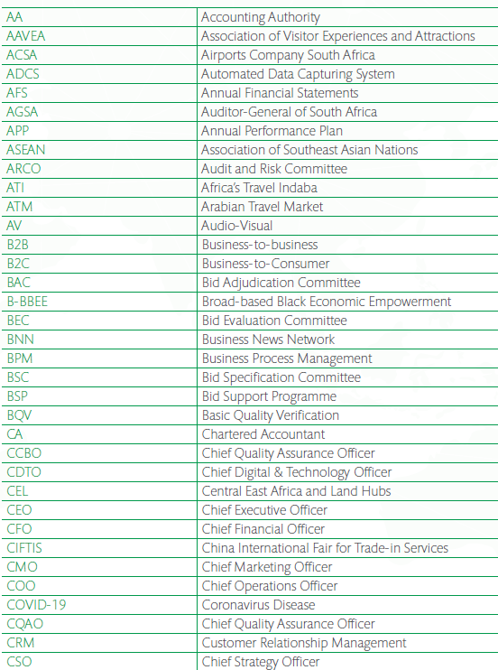
ABBREVIATIONS & ACRONYMS

Slide 83
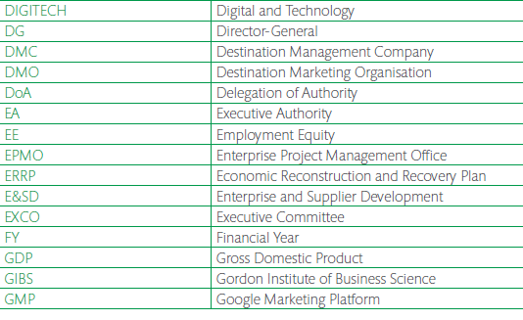
ABBREVIATIONS & ACRONYMS

Slide 84
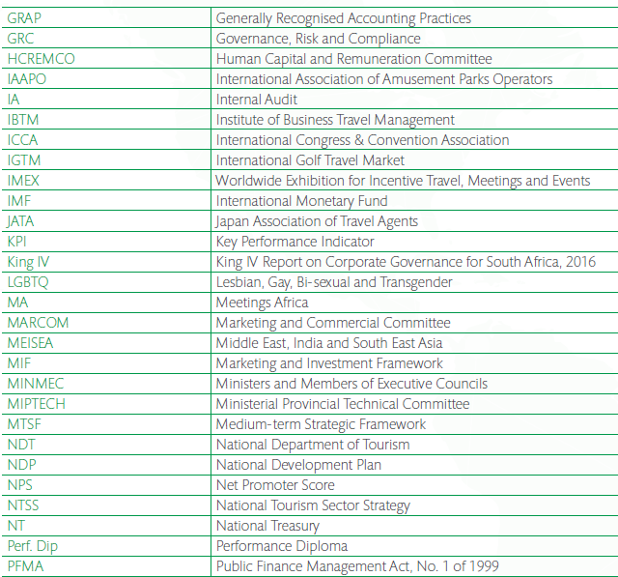
ABBREVIATIONS & ACRONYMS

Slide 85
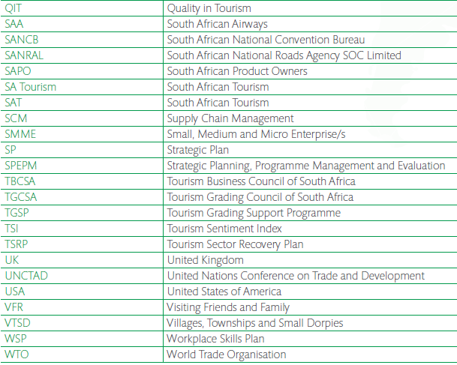
ABBREVIATIONS & ACRONYMS

