Slide 1
Oral Submission to Parliament on the NHI Bill 8th of February 2022

Slide 2
Contents
1. Who is People’s Health Movement South Africa
2. What we like about the Bill
3. Areas of concern
4. Conclusion

Slide 3
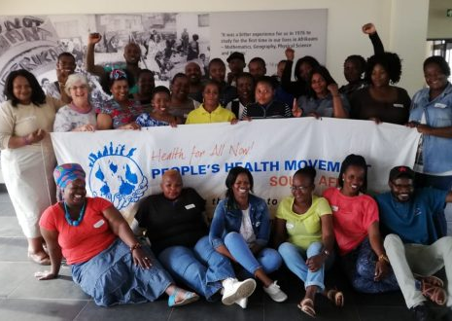
Who are we?
The South African Chapter of the global People’s Health Movement (PHM)
Started in South Africa in 2003
A national network of over 10 000
Grassroots health activists,
Community Health Workers,
Health Committee members,
Public Sector Health Professionals,
Civil society organizations and
Academics
Operate with a small secretariat supporting active volunteers

Slide 4
What we do
Vaccine Literacy training for over 1200 people: mainly
Community Health Workers,
Health Committee members
Communities leaders across the country
Health advocacy
Support the TRIPS waiver
Liquor Bill
South African People’s Health University
Food gardens and access to healthy food
Support CHW as agents of change through training
Support community participation in the health system

Slide 5
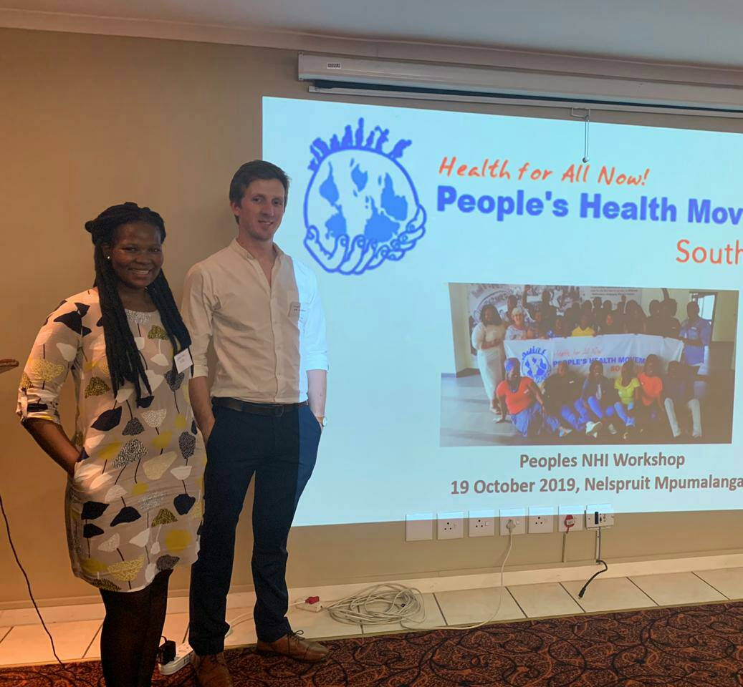
NHI Education workshops
Some of our trained partners have made submission to the NHI Bill. (WPF and Klipfontein Sub)
SSoweto, Khayelitsha, Tulbugh, Jan Kempdorp, Mthatha, and Mahikeng
over 500 Community leaders, CHW’s etc trained on NHI Bill

Slide 6
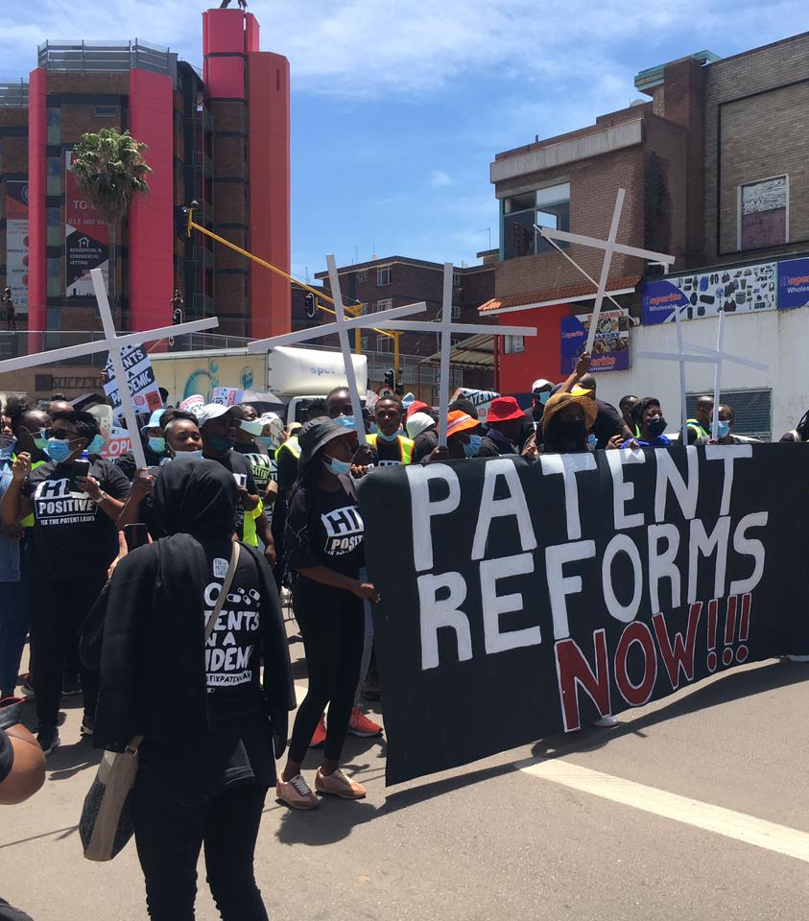
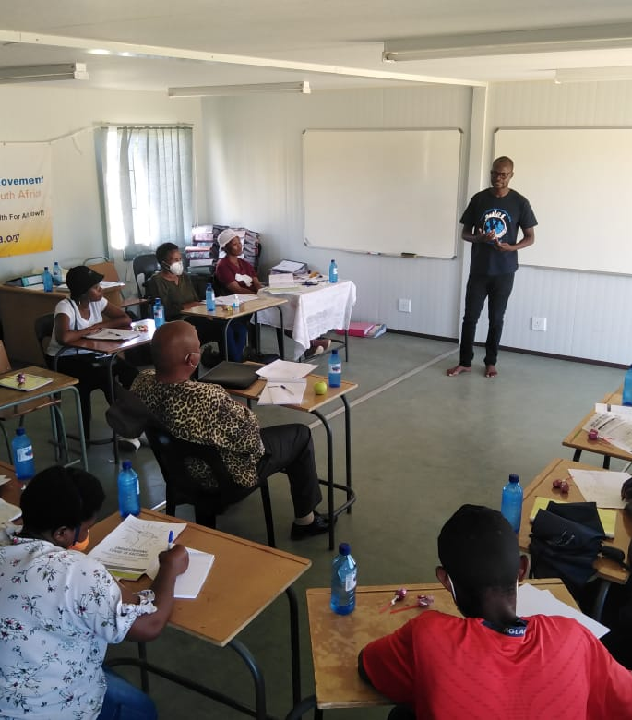
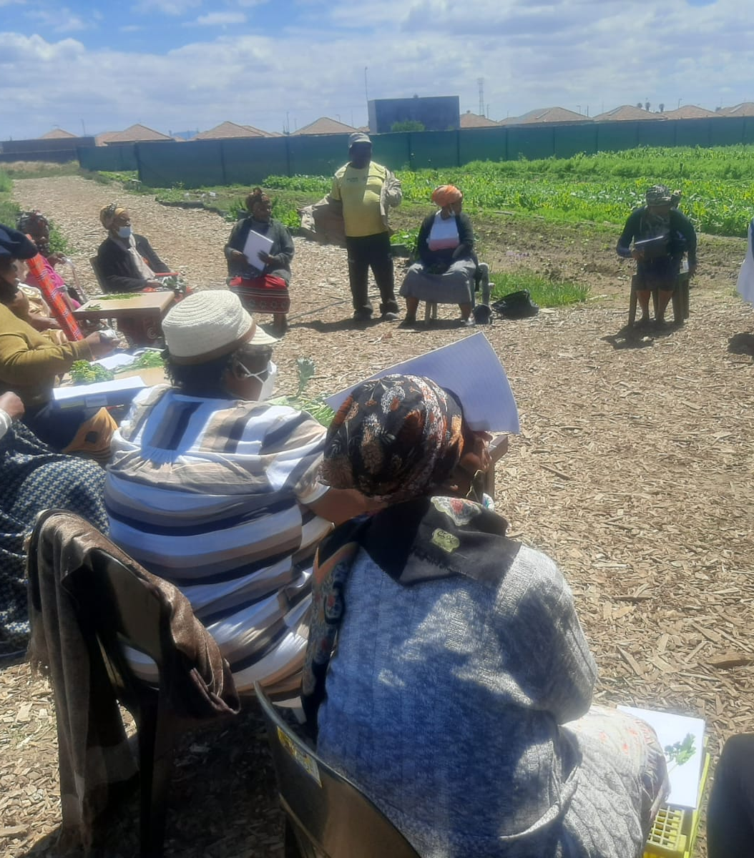
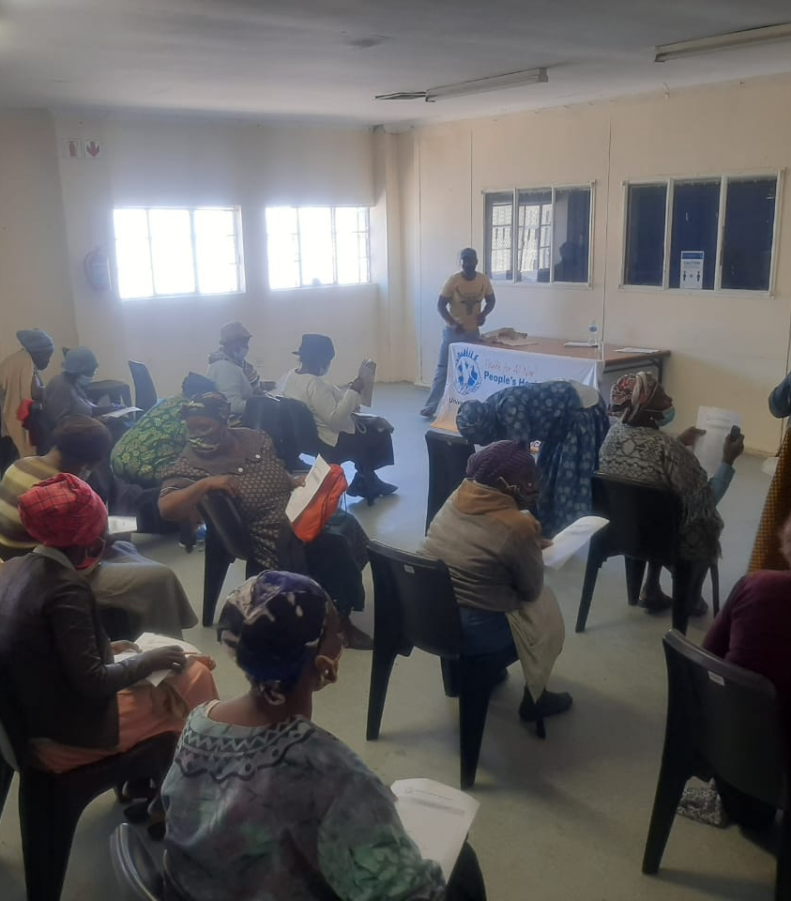

Slide 7
What we believe in together
PHM values
Social justice & Social solidarity
Everyone has a Right to Health
Equity
Health as a public good
People over profit
Strong Public health system
Values PHM believes in are the values the NHI Bill tries to achieve

Slide 8
What we like about the NHI Bill
It is It establishes the NHI fund as a single payer for health care
It clarifies the need to make healthcare free at the point of delivery
It proposes progressive reallocation of funds from medical scheme tax credits towards funding the NHI
It promotes the establishment of a national health system that encompasses private & public providers as specified in the National Health Act.
It demonstrates a commitment to access to health care as a right.
Notes:
Single payer is critical because it makes possible the “equitable and fair distribution and use of health care services”, a key purpose of the Act (Chapter 1).
The Bill specifies the NHI fund as a single payer in 3 places:
1. Under ‘The purpose and application of the act’ in Chapter 1, point 2(a) [page 7 of the Bill],
2. The notice to amend the Competition Act of 1998 in Chapter 11, Section 58 [p 35], and again
3. In ‘Addressing the barriers to access’ under ‘Structural challenges to the health system’ in “Schedule: Repeal and Amendment of Legislation Affected by Act” [p 47].
By specifying healthcare free at the point of delivery with no need for co-payment it protects the poor from sinking further into poverty.
Shifting funds from medical scheme tax credits is a pro-poor measure that promotes equity and social solidarity.
National health system: The Bill does not actually establish a national health system, but mentions it repeatedly, referring to the National Health Act. A key objective of the National Act is to establish a National Health System that “encompasses public & private providers” and “provides in an equitable manner the population of the Republic with the best possible health services that available resources can afford.”
The commitment to access to health care as a human right is not spelled out, but this is clearly stated in the Constitution and runs like a thread through the NHI Bill.

Slide 9
Areas of Concern - Context
The South African health crisis has been present for decades:
large disease burden due to unequal access to goods & services necessary for good health (SDH)
fragmented, inequitable health services: private-public, urban-rural
those who need the most health care have the least access to it
poor governance and accountability across state sectors & in the private sector
Notes:
The COVID-19 pandemic exposed and deepened the structural causes of the crisis. See: https://aidc.org.za/the-coronavirus-crisis-and-the-struggle-for-health/

Slide 10
Areas of concern - Overview
Lack of detail about upgrading the public health sector
The possibility of exacerbating inequality
Failure to distinguish between Primary Health Care and Primary Care
Lack of adequate mechanisms for civil society engagement and no accountability in the NHI committee structures
Lack of emphasis on capacitating the Public Health System through a pro-public NHI
The possibility that “Universal Health Coverage” could be reinterpreted corporate private health care industry to facilitate profiteering from the NHI Fund
The narrow focus on UHC potentially weakening action on the social determinants of health
The level of control over the NHI Fund vested in the Minister of Health
Notes:
Without a well functioning public health care system the NHI cannot succeed.
The most recent report of the Office of Health Standards Compliance (OHSC) found that that only a small fraction of public health facilities surveyed met meet the norms and standards required for NHI certification [see: ohsc.org.za/wp-content/uploads/OHSC-2016-17-ANNUAL-INSPECTION-REPORT-FINAL.pdf]. It is therefore imperative to fix and upgrade the broken public sector to the level required for NHI accreditation. The Bill gives no detail of how to do this.
The possibility of exacerbating inequality:
Private facilities are not only more likely to get accreditation but also overwhelmingly urban-based, thus increasing both urban-rural and private-public inequality.
Furthermore, registration for the benefits of the NHI must be done at an accredited health facility, which then issues the user with a registration number and physical evidence of membership, and maintains a register of all users and their dependents. This poses yet another risk that those already marginalised from access to care (rural populations, disabled, elderly) will be further disadvantaged. Facilities that already lack staff, medicines and equipment will not find it easy to register users as smoothly as those facilities already functioning at a much higher level of efficiency. Many public sector facilities lack easy internet access.
There is a possibility that people living in some areas will not have access to NHI-funded health care at all.

Slide 11
1. Fixing the public sector
Successful NHI requires well-functioning public health care system
20+ years of public sector austerity, understaffing of many public and rural health care facilities makes accreditation unlikely
Office of Health Standards Compliance (OHSC)’s most recent report shows a small fraction of public health facilities surveyed meet required norms & standards for certification.
Resulting in
private facilities more likely to get accreditation; and
accreditation will be overwhelmingly urban-based accreditation,
increasing both urban-rural and private-public inequality.
As it stands now people in some areas will NOT have access to NHI-funded health care at all.
INSTEAD - we must therefore:
Fix and upgrade the broken public sector to enable NHI accreditation

Slide 12
2. Risk of exacerbating and entrenching inequality
Spatial inequality
Uneven geographic distribution of clinics makes registration difficult for rural populations, the elderly and disabled people
Unequal distribution of funding for public vs. private providers
Poor infrastructure makes it difficult to register as a designated provider
Difficult for public facilities to register as designated provider without upgrades/investment in facilities, thereby limiting the share of NHI funds going public facilities
Inequality within the health workforce
Without an explicit commitment to regularising the work of community health workers, the NHI will not address the poor wages and insecure conditions of service of these workers who are the “footsoldiers” of the PHC system
Unequal decision-making powers
NHI decision-making arrangements marginalise civil society organisations and risk further marginalising public participation and oversight in health governance at national level

Slide 13
3. The Bill confuses Primary Health Care with Primary Care
Primary Care (PC) is about the provision of excellent and appropriate health care services to everyone.
Equitable access to quality health care is essential but insufficient for promoting people’s health.
The NHI Bill seeks to provide these services through Universal Health Coverage (UHC).
However, even the best health services can not address the root causes of ill health.
Primary Health Care is a broad, developmental approach to health that goes beyond the health system
PHC emphasises compressive services by the health sector, but also addresses the factors that cause poor health
PHC relies on collaborative action across state sectors to deal with the root causes of ill health & reduce the burden of disease — the health system, and therefore the NHI, can’t do this on its own
PHC emphasises meaningful community participation in issues related to health (including in the planning, provision and evaluation of health services).
PHC recognises that Health for All is unachievable within the unfair current global economic order that entrenches inequality within and between countries.
Notes:
Comprehensive primary health care includes health promotion, disease prevention, curative care, rehabilitation and palliation.
The distinction between PC & PHC is well recognised. Ref: https://europepmc.org/backend/ptpmcrender.fcgi?accid=PMC6976192&blobtype=pdf
Why this is important in the context of the NHI?:
Community participation
helps to optimise health interventions at the organizational, community, and individual levels to improve public health.
It helps in priority setting as well as in the development of organisational relationships and trust.
It also engenders a sense of ownership within the community.
Health services become responsive to local needs, with more effective use of resources and better health outcomes.
Community-based health workers and properly functioning health committees play crucial roles in facilitating community participation.
[Ref accessible here: https://journals.plos.org/plosone/article?id=10.1371/journal.pone.0216112
Intersectoral action to address crucial SDH
could reduce the burden of maternal and child deaths by half — there is good evidence for this. [Kuruvilla, S., Schweitzer, J. et al. (2014). Success factors for reducing maternal and child mortality. Bulletin of the World Health Organization, 92(7), 533–544. http://doi.org/10.2471/BLT.14.138131]
This would lighten the burden on the health service enormously and free up resources for key programmes and demands on the NHIF.
Notable common intersectoral actions include expanding water and sanitation provision; improving education; adequate housing; reducing socio-economic inequality; promoting gender equality; and involving women in policy formulation and programme implementation.
Furthermore, the global ecological crisis threatens to overwhelm all efforts to deal with the SDH unless we make rapid progress. The Department of Health should therefore advocate strongly for collaborative action on the SDH by other sectors.

Slide 14
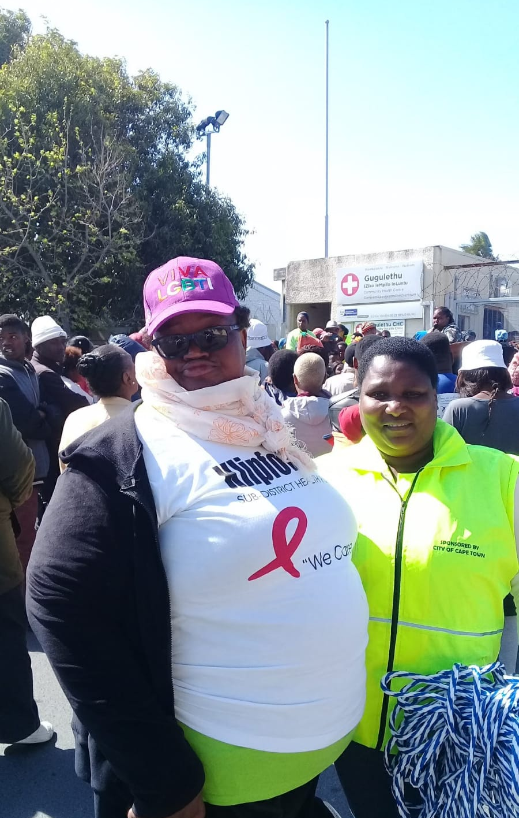
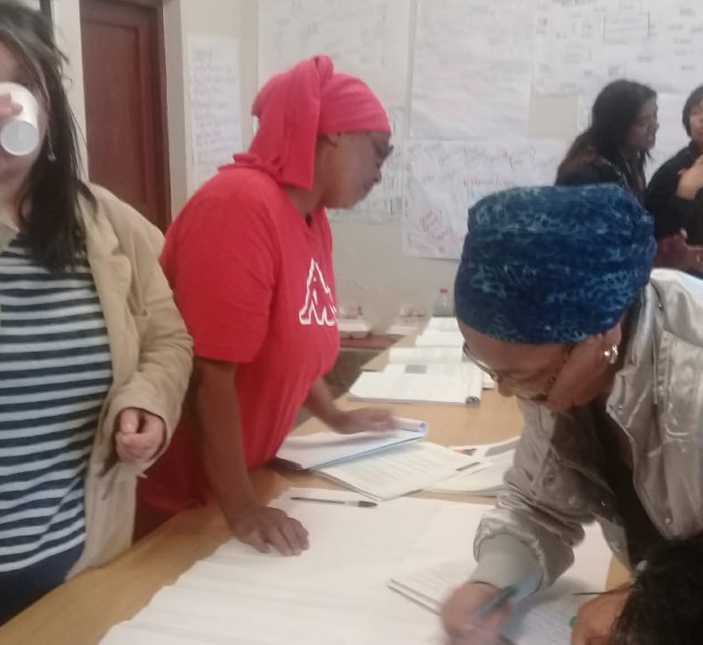
4. Democratising NHI Structures
Participation is a key element of the Right to Health
The NHI Act provides for limited inclusion of civil society and the public in NHI decision-making.
Participation in the Stakeholder Advisory Committee is insufficient to ensure adequate community voice.
Stakeholder consultation should not become a rubber stamping process.
The participatory structures of the NHA (clinical committees, hospital boards, DHCs, PHCs) have no place in the NHI Act.
Explicit processes to identify and manage conflicts of interest, financial or otherwise.
Notes:
Participation is a key element of the Right to Health
South Africa’s White Paper on the Transformation of the Health Services in 1997 argued in its mission statement that it was essential “to obtain the active participation and involvement of all sectors of South African society in health and health-related activities.”
The National Health Act recognises in its preamble that the purpose of the act is to “establish a health system …. which encourages participation.”
South Africa is a party to the ICESCR in terms of which the Right to Health is framed in General Comment 14 as “an inclusive right extending not only to timely and appropriate health care but also to the underlying determinants of health” in which “a further important aspect is the participation of the population in all health-related decision-making at the community, national and international levels.”
To realise the objectives of the NHI (Universal access, PHC, prioritisation of community needs), there has to be effective community participation – particularly in the Benefits Advisory Committee and Pricing Advisory Committee
This will achieve
Accountabilty
Better alignment of benefits to community need
Avoidance of dominance of hospicentric curative care
Counterbalance to the influence of the private sector in shaping benefits package to their interests
Participation in the Stakeholder Advisory Committee is necessary but insufficient:
Advisory committees have limited powers
The White Paper refers to “mechanisms for the participation of the people in the National Health System will be established at all levels” being part of the necessary “democratisation of South African society” – this is far more than just advising
The National health Act recognises the obligation of the National Department to “promote community participation in the planning, provision and evaluation of health” – this is far more than just advising.
Stakeholder consultation should not become a rubber stamping process
Clear terms of governance and lines of accountability to the Stakeholders Advisory Committee should be included within the NHI to ensure the Minister of Health and related officials are mandated to engage with this body and ensure that the recommendations are not ignored.
The participatory structures of the National Health Act are ignored
The NHA creates provision for community participation in health services through the establishment of Hospital Boards and Clinic committees; Clinic committees are meant to include community representatives able to express the voice of local communities in relation to the health system.
This is consistent with the PHC approach and the direction of the White Paper which states that the health system should “Establish structures to promote community participation at the community, participation at the national, provincial and district levels.”
The NHA also provides for consultative structures at District and provincial levels in the form of Health Councils.
Notwithstanding the limitations of these structures having little teeth or clear roles, they are completely invisible in the NHI Act – meaning what little voice there is for communities to influence health service delivery is completely excluded from the NHI
Identifying and managing Conflict of Interest
The private sector and the pharmaceutical/hospital industry will always ultimately have different unerlying interests to the public sector, even if short-term convergence can be induced through payment arrangements.
If ignored or left to its own devices, the private sector will gravitate to protecting and promoting its own interests by virtue of the nature of the market.
If the NHI Is to be pro-public, it must remain committed to a principle of independence from individual benefit.
This is with a Rights-based health system – we cannot achieve Universal Health Coverage if NHI structures afford private sector interest groups disproportionate influence. This has been the experience of other countries seeking to implement NHI based UHC without careful attention to regulation of the private sector.

Slide 15
5. Building and capacitating the Public Health System through a pro-public NHI
Evidence:
only a publicly funded and publicly administered health system can sustainable, reliably and equitably deliver health care to populations most at need.
Danger for NHI
powerful private hospital groups to benefit from NHI contracts and resources which could have been used to upgrade and staff public facilities to fulfil the same functions
Recommendations
NHI should use it’s purchasing power to specifically and consciously capacitate the public sector
Any private hospital contracts should only be entered into temporarily, and with public sector capacitation as a key principle.
Eg skills transfer to public sector workers & ensuring that the private contracts are not entered into if a public facility is able to perform the same service.
Private hospital providers should be measured against their ability to constructively interface with and capacitate the public health sector as a criteria against which their future eligibility for NHI contracting is measured.
Notes:
Con

Slide 16
6. The Bill is not clear on its interpretation of Universal Health Coverage
UHC implies that
all people and communities have ready access to the promotive, preventive, curative, rehabilitative and palliative health services they need (equitable access)
that the services are of sufficient quality (effective); and
that the use of these services does not expose them to financial hardship (affordable) (WHO 2018).
This is in line with the founding principle in the Constitution that “all citizens are equally entitled to the rights, privileges and benefits of citizenship.”
The Bill states clearly in “Addressing the barriers to access” under ‘Structural challenges to the health system’ in “Schedule: Repeal and Amendment of Legislation Affected by Act”:
“health care should be seen as a social investment and not be subject to trading as a commodity. The universal health coverage system is a reflection of the kind of society we wish to live in: one based on the values of social solidarity, equity, justice and fairness.”[2.4; p 48]
Notes:
UHC ref: WHO (2018) Universal Health Coverage. Accessible at: http://www.who.int/healthsystems/universal_health_coverage/en/.
There is a broad global consensus that UHC has the potential to enhance equitable access to comprehensive health care with financial protection, and it is central to the third Sustainable Development Goal (SDG) which focuses on health.
Progress towards UHC entails overcoming barriers to access including out-of-pocket expenses, large distances to health facilities; lack of staff in the public sector; geographic maldistribution of health care providers with concentration in large urban areas; and fragmented funding and risk pools. Section 2.2 (p 47) outlines a set of reforms to address these barriers to access.
The purpose of these reforms is to
‘Ensure consistency with the global vision that health care should be seen as a social investment and not be subject to trading as a commodity. The universal health coverage system is a reflection of the kind of society we wish to live in: one based on the values of social solidarity, equity, justice and fairness”
This understanding of health as a social investment and a common good rather than a marketable commodity, and of UHC as a means of building a society based on the values of social solidarity, equity, and justice, recognises the principle of health as a fundamental human right. As mentioned in the Bill, achieving UHC will require public financing based on social solidarity — where young, relatively wealthy and healthy citizens cross- subsidise the elderly, poor and less healthy through a progressive tax-based single payer system.
However, some contest this meaning of UHC. Powerful, well-funded corporate groupings with vested interests in the highly profitable private sector and free-market fundamentalists argue that “coverage” in UHC allows for scheme-based insurance models with voluntary prepayment and a range of financing mechanisms that inevitably discriminate against the poor and least healthy. They have mounted vociferous and possibly well-coordinated media campaigns hostile to the NHI project. Common campaign themes include resistance to the single payer system and arguments for expanded private sector and scheme-based involvement in health service delivery. They present little, if any, evidence that substantial private sector involvement facilitates progress towards equitable health systems and social solidarity. On the contrary, a substantial body of empirical evidence shows that, to realise its objectives of universality, equity and (particularly in the South African context) social solidarity, attempts to achieve UHC must, from the start, address the needs of the entire population and the whole health system (Kutzin).6

Slide 17
6. The Bill is not clear on its interpretation of Universal Health Coverage
In the Bill, achieving UHC will require public financing based on social solidarity
A substantial body of empirical evidence favours this approach
However, powerful vested interests in the corporate private sector contest this meaning of UHC:
they resist single-payer in favour of scheme-based insurance models with voluntary prepayment
such schemes discriminate against the poor, particularly when they favour the rich, as they do in South Africa
they also create groups with vested interests that will resist any future attempts to promote equity
Therefore, incremental approaches are unlikely to work: powerful groups will oppose future changes
To realise its objectives of universality, equity and social solidarity, attempts to achieve UHC must, from the start, address the needs of the entire population and the whole health system (Kutzin)
Notes:
Social solidarity: where young, relatively wealthy and healthy citizens cross-subsidise the elderly, poor and less healthy through a progressive tax-based single payer system.
However, some contest this meaning of UHC. Powerful, well-funded corporate groupings with vested interests in the highly profitable private sector, and free-market fundamentalists argue that "coverage" in UHC allows for scheme-based insurance models with voluntary prepayment and a range of financing mechanisms that inevitably discriminate against the poor and least healthy.
They have mounted vociferous and possibly well-coordinated media campaigns hostile to the NHI project. Common campaign themes include resistance to the single payer system and arguments for expanded private sector and scheme-based involvement in health service delivery. They present little, if any, evidence that substantial private sector involvement facilitates progress towards equitable health systems and social solidarity.
On the contrary, a substantial body of empirical evidence shows that, to realise its objectives of universality, equity and (particularly in the South African context) social solidarity, attempts to achieve UHC must, from the start, address the needs of the entire population and the whole health system
(Kutzin: — https://www.ncbi.nlm.nih.gov/pmc/articles/PMC3738310/). Kutzin is a health economist in the department of health systems financing at the WHO.

Slide 18
7. A narrow focus on UHC may weaken action on the social determinants of health: (PHC and prevention)
There is a risk that the state will narrow its focus to UHC (SDG 3.8) and neglect the importance of dealing with the root causes of ill health through intersectoral action to address unequal access to the social determinants of health.
These include the elimination of poverty (SDG 1), adequate food and nutrition (SDG 2), quality education (SDG 4), gender equality (SDG 5), water and sanitation (SDG 6), the reduction of inequality (SDG 10), promotion of environmentally responsible consumption and production patterns (SDG 12), and mitigation of climate change (SDG 13). While some of these goals rely on other sectors, the state has shown little evidence of its ability to promote intersectoral action.
This calls for all state sectors to be involved, BUT
unless leadership for intersectoral action emerges from the Presidency, the DoH must assume leadership and advocate for this

Slide 19
Conclusion
NHI in its current form represents an alternative funding model for healthcare in South Africa.
For this funding model to result in a new health system which is based on the principles of Primary Health Care; is equitable, delivers quality care and is community focused will require a much broader reimagining of our interventions in the social determinants of health and our health services.
To build this vision of health and healthcare in South Africa will require the involvement of a broad range of role players from community health committees and social movements to clinicians, academics and public health specialists.
To made this vision reality we call on stopping austerity budgeting for Health – health is a socio-economic investment and not a cost to society.
We call for a transparent, democratic and accountable process as we collectively embark on constructing this new vision for health in South Africa.

