Slide 1
Standing Committee of Finance Briefing
INDEPENDENT REGULATORY BOARD FOR AUDITORS (IRBA)
Briefing by the Minister of Finance on Audit Action Plans for the Finance Portfolio

Slide 2
Content
Part 1 – Annual Report 2021
Key audit outcomes
Irregular expenditure
Governance
Part 2 – Other strategic highlights
Role of Auditors and Audit Regulators
Refocused 5-year strategy (2021-2025)

Slide 3
Annual report 2021
Part 1

Slide 4
Annual Report 2021 - Key audit outcomes
Unqualified audit report for 11 consecutive years
Unmodified audit report on the 2020/2021 financial statements
No material findings on predetermined objectives
Finding on Compliance with laws and regulations (Irregular expenditure)

Slide 5
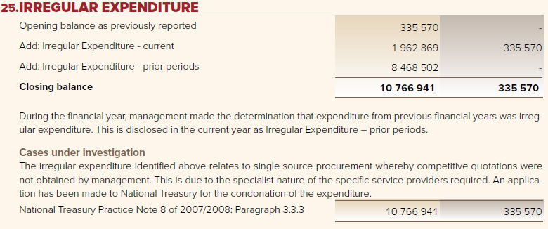
Annual Report 2021 – Irregular Expenditure
Disclosure note 25 per the 2021 Financial statements:

Slide 6
Annual Report 2021 – Irregular Expenditure…
AGSA raised a non-compliance to supply chain process in 2020 of R335 570 but did not modify its opinion as it was considered immaterial
However, retrospectively the IRBA reviewed previous financials from 2014 onwards and self-declared an amount of just below R11 million arising from a similar procurement practice and disclosed same in the 2021 Financial statements:
Context: The Irregular expenditure relates mostly to procurement of specialist investigators for high-profile matters, in which it had historically proven difficult to obtain three quotations due to the scarcity of independent experts; skill-set is highly specialised
The IRBA has procured specialist investigator services through single source motivation for several years, with no findings from the AGSA, until the 2019/2020 audit, directly related to the interpretation and implementation of a National Treasury (NT) Instruction Note 3 of 2016/2017

Slide 7
Annual Report 2021 – Irregular Expenditure…
IRBA Board and Acting CEO has subsequently investigated the matter in early 2021
Given there was no fraud, corruption or criminal conduct and no material loss to the IRBA identified, the Board approved the removal of the irregular expenditure in the 2021/2022 financial statements [In terms of paragraph 44 (c) of The Irregular Expenditure Framework]
Going forward the IRBA will not use single source procurement, but will instead appoint a panel of various experts on which to draw for specialised investigations
Where a high-profile investigation matter requires a specific expert investigator skill-set, the IRBA will apply to NT in advance for any such deviation
One such deviation has already been granted in a high-profile investigation matter
The IRBA has been prudent in declaring and disclosing possible irregular expenditure and has implemented the necessary controls to mitigate possible future irregular expenditure
The former CEOs and former Director: Operations (CFO) have since left the employ of the IRBA and new/additional staff were appointed to strengthen the SCM Unit

Slide 8
Annual Report 2021 – Governance
Minister Mboweni dissolved the IRBA Board of Directors in January 2021
Minister appoints a Caretaker Board for 3 months
New CEO leaves the IRBA after seven months
Caretaker Board appoints an Acting CEO in February 2021
Minister appointed new Board in June 2021
Board approves Refocused Five-year Strategy
President signs into law the Auditing Profession Amendment Act in April 2021 strengthening the governance, independence and enforcement powers of the IRBA
International Forum of Independent Audit Regulators (IFIAR) comprising independent regulators from 54 countries appoints the IRBA as a Board member and Chairperson of its Audit and Finance Committee
Board actively recruiting a new CEO

Slide 9
OTHER STRATEGIC highlights
Part 2

Slide 10
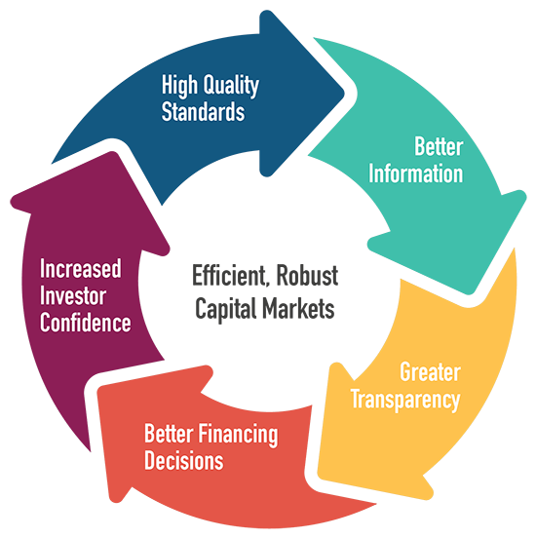
The role of auditors
By promoting integrity in financial reporting and building a basis for providing confidence,
auditors reduce financing costs and contribute to the efficiency of capital markets, thereby promoting economic growth.

Slide 11
The role of the audit regulator
To create an ethical, value-driven financial sector that encourages investment, confidence and protects the financial interests of the public

Slide 12
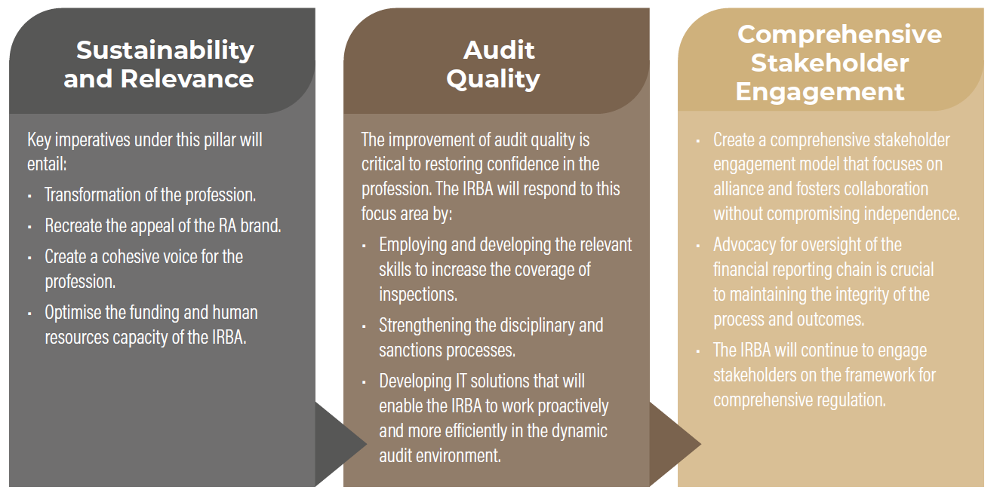
Overview of Refocused 5-year Strategy
Redefined strategic focus areas:

Slide 13
Overview of Refocused 5-year Strategy…
Key restoring confidence projects (RC2.0):
RC2.0
2021-2025
(Strategy backed)
Financial Reporting and Governance Eco-System Gaps (Outside Mandate)
Auditing Profession – Gaps (Within Mandate)
IRBA Gaps (Internal)

Slide 14
Thank you
Independent Regulatory Board for Auditors (IRBA)
Switchboard: +27 (0)87 940 8800
Email: inagy@irba.co.za

