Slide 1
SUPPORTED EMPLOYMENT ENTERPRISES(SEE)
Quarter 1
2021/22 impact analysis report
February 2022

Slide 2
TABLE OF CONTENTS
1. Overall performance during quarter 1
2. Q1 Performance Remedial Action
3. Impact analysis report
4. REVENUE vs EXPENDITURE
5. Summary of Q1 financial performance

Slide 3
1. SEE OVERALL PERFORMANCE
Implication: ACHIEVED
Performance Indicator is on track or reflects complete implementation. Target achieved
100% + Complete
Implication: NOT ACHIEVED
Performance Indicator behind schedule. Target not achieved
0% - 99% Complete

Slide 4
1.1 PERFORMANCE PER STRATEGIC OBJECTIVE
PRIORITY 2: Economic Transformation and Job Creation
PURPOSE | Annual Planned Indicators | Indicators with targets reporting in quarter | Achieved | Not Achieved | Overall Achievement %
Provide work opportunities for People with Disabilities | 3 | 2 | 0 | 2
Total number of Indicators | 3 | 2 | 0 | 2
Overall Performance |  |  |  |  | 0%

Slide 5
2. Performance vs Indicators and remedial action
OUTPUT INDICATOR | PLANNED TARGET | ACTUAL ACHIEVEMENT | REASON FOR VARIANCES | REMEDIAL ACTION
Priority: Economic Transformation and Job Creation Purpose: Provide work opportunities for People with Disabilities
Number of additional persons with disabilities employed in the SEE factories by the end of March | 0 | N/A | N/A | N/A
% annual increase of sales revenue from goods and services by the end of March | 1.25% | Not Achieved, Generated sales revenue for Q1 is R1 049 560.79 which is a negative growth in sales of 95% in comparison to previous quarter sales of R20 457 296.31 | Delays in orders placed by the Western Cape Department of health under the contract. | Expedite orders received from Western Cape Health worth R22 227 295.01
Number of customer agreements entered into annually | 1 | Not Achieved, no customer agreements were signed in quarter 1. | Delays in finalising a customer agreement with the North West Department of Education has led to no customer agreements being signed by the end of quarter 1. | Expedite the conclusion and signing of the customer agreement with the North West Department of Education

Slide 6
3. IMPACT ANALYSIS: FACTORY EMPLOYEES
Province | Factory | PWDs as at 31/03/2021 | PWDs additional work opportunities as at 30/06/2021 | Terminations as at 30/06/2021 | Total
Free State | Bloemfontein | 59 | 0 | 0 | 59
KZN | Durban | 82 | 0 | 1 death | 81
 | Pietermaritzburg | 61 | 0 | 1 resigned | 60
Eastern Cape | East London | 68 | 1 (transfer from PTA) | 0 | 69
 | Port Elizabeth | 71 | 0 | 1 termination | 70
Northern cape | Kimberley | 68 | 0 | 0 | 68
Western cape | Ndabeni | 153 |  | 2 death & retire | 151
 | Epping | 110 | 3 (replacements) | 1 transfer | 112
North West | Potchefstroom | 42 | 0 | 0 | 42
31 | Seshego | 35 | 0 | 0 | 35
Gauteng | Pretoria | 104 | 0 | 2 | 102
 | Rand | 105 | 0 | 1 resigned | 104
 | Springfield | 78 | 0 | 1 resigned | 77
TOTAL |  | 1036 |  |  | 1030

Slide 7
IMPACT ANALYSIS: EE PROFILE
PROVINCE81 | FACTORY | RACE |  |  |  | GENDER |  | TOTAL
 |  | AFRICAN | COLOURED | INDIAN | WHITE | FEMALE | MALE
Free State | Bloemfontein | 32 | 0 | 0 | 27 | 23 | 36 | 59
KZN | Durban | 37 | 5 | 6 | 33 | 23 | 58 | 81
 | Pietermaritzburg | 39 | 1 | 4 | 16 | 25 | 35 | 60
Eastern Cape | East London | 43 | 8 | 1 | 17 | 21 | 48 | 69
 | Port Elizabeth | 28 | 16 | 1 | 25 | 30 | 40 | 70
Northern cape | Kimberley | 30 | 28 | 1 | 9 | 24 | 44 | 68
Western cape | Ndabeni | 39 | 44 | 0 | 68 | 61 | 90 | 151
 | Epping | 47 | 60 | 1 | 4 | 32 | 80 | 112
North West | Potchefstroom | 25 | 5 | 0 | 12 | 21 | 21 | 42
Limpopo | Seshego | 35 | 0 | 0 | 0 | 20 | 15 | 35
Gauteng | Pretoria | 65 | 2 | 0 | 35 | 39 | 63 | 102
 | Rand | 57 | 14 | 0 | 33 | 62 | 42 | 104
 | Springfield | 40 | 13 | 0 | 24 | 21 | 56 | 77
TOTAL |  |  |  |  |  |  |  | 1030

Slide 8
IMPACT ANALYSIS :SALES REPORT
PROVINCE | FACTORY | Sales Order Value
Free State | Bloemfontein | -
KZN | Durban | -
 | Pietermaritzburg | -
Eastern Cape | East London | R 63 826.00
 | Port Elizabeth | R 513 154.40
Northern cape | Kimberley | -
Western cape | N’dabeni | R 207 538.73
 | Epping | -
North West | Potchefstroom | R 23 400.00
Limpopo | Seshego | R 170 221.87
Gauteng | Pretoria | R 36 276.93
 | Rand | R 379 465.62
 | Springfield | R 206 480.06
TOTAL |  | R 1 049 560.79

Slide 9
IMPACT ANALYSIS: PRODUCTION OF GOODS & SERVICES
Province | Factory | No. of orders received | Units to be produced | Units completed | Units dispatched | Timeframe in days | Sales realised
W/C | NDAB | 2 | 6300 | 5158 | 100 | 46 | 1822583
KZN | DBN | 0 | 0 | 0 | 0 | n/a | 0
FS | BLF | 2 | 10000 | 1510 | 0 | 4 | 1313,65c
NC | KIMBL | 1 | 16000 | 4322 | 0 | 20 | 0
GP | SPRINGF | 18 | 504 | 491 | 42 | 16 | 64286,13c
NW | POTCH | 5 | 12121 | 118 | 118 | 60 | 23400
KZN | PMB | 1 | 10000 | 1493 | 0 | 2 | 746800
GP | RAND | 4 | 33484 | 1096 | 1096 | 60 | 379465,62c
GP | PTA | 2 | 5100 | 1800 | 0 | 15 | 36276,93
WC | EPP | 2 | 27 | 27 | 7 | 4 | 8777
EC | EL | 2 | 16000 | 12300 | 12300 | 14 | 1324956
EC | PE | 5 | 25850 | 3750 | 3750 | 30 | 691035
LIMPOPO | SESHEGO | 3 | 20233 | 4618 | 0 | 5 | 107221,87c

Slide 10
IMPACT ANALYSIS ON THE PROCUREMENT OF RAW MATERIALS
Province | Factory | Material Procured | PO Date | Amount
W/C | NDAB | THINNERS LACQUER GRADE A | 27/04/2021 | R4 552.00
W/C | EPPING | OMEGA FULL SHELLS LEXUS-HB | 27/05/2021 | R34 250.00
NC | KIMBL | CHIPBOARDS VARIOUS SIZES | 13/05/2021 | R10 999.99
NW | POTCH | GAS ARGOSHIELD& ACETYLENE | 24/06/2021 | R2 947.46
GP | RAND | VARIOUS ZIPS |  | R24 972.00
GP | PTA | STEEL ROUND TUBING | 20/05/2021 | R6 492.00
EC | EL | FABRIC POLY/COT | 30/04/2021 | R1 194 935.72
 |  |  | TOTAL | R1 279 149.17

Slide 11
IMPACT ANALYSIS: OPS INVOICE PROCESSED
Province | Factory | Invoices Number | Invoiced Date | Amount
Free State | Bloemfontein | SEE ATTACHED DETAILED SPREADSHEET. |  | R2 018 274
Eastern Cape | East London |  |  | R3 697 614
 | Port Elizabeth |  |  | R4 031 163
Western Cape | Epping |  |  | R375 119
 | Ndabeni |  |  | R6 535 119
Gauteng | Springfield |  |  | R507 162
 | Rand |  |  | R9 503 769
 | Pretoria |  |  | R4 360 234
Limpopo | Seshego |  |  | R 520 325
Northern Cape | Kimberly |  |  | R5 836 913
North West | Potchefstroom |  |  | R437 687
Kwa Zulu Natal | Pietermaritzburg |  |  | R3 027 560

Slide 12
IMPACT ANALYSIS: INVOICE PROCESSED
Province | Factory | Invoices Number | Invoiced Date | Amount
Free State | Bloemfontein | SEE ATTACHED DETAILED SPREADSHEET. |  | -1 313.65
Eastern Cape | East London |  |  | 63 826
 | Port Elizabeth |  |  | 105 859
Western Cape | Epping |  |  | 0.00
 | Ndabeni |  |  | 207 539
Gauteng | Springfield |  |  | 64 286
 | Rand |  |  | 379 466
 | Pretoria |  |  | 36 277
Limpopo | Seshego |  |  | 170 222
Northern Cape | Kimberly |  |  | 0.00
North West | Potchefstroom |  |  | 23 400
Kwa Zulu Natal | Pietermaritzburg |  |  | 0.00

Slide 13
IMPACT ANALYSIS: ACHIEVED SALES VS TARGETED
Targeted Sales Value | R3.5million
Actual Achieved Sales Value | R1 049 560.79

Slide 14
IMPACT ANALYSIS: MAJOR SALES PER CUSTOMER
Customer | Sales Excluding VAT
TYGERBERG LAUNDRY Total | R 536 729.63
BEAUFORT WEST HOSPITAL Total | R 268 908.00
DEPT OF LABOUR POLOKWANE Total | R 170 221.87
LENASIA SOUTH HOSPITAL Total | R 136 040.68
DEPT OF LABOUR PRETORIA Total | R 121 000.00
CCMA Total | R 74 421.56
STIKLAND HOSPITAL Total | R 66 228.28
GREY HIGH SCHOOL Total | R 65 217.00
GROOTE SCHUUR HOSPITAL Total | R 63 826.00
VALKENBURG HOSPITAL Total | R 49 053.66

Slide 15
IMPACT ANALYSIS: NUMBER OF SIGNED CUSTOMER AGREEMENTS
No | Customer Name | Type of Contract | Start Date | Expiry Date | Duration (Years) | Estimated Contract Value | Total value of orders received to date | Product Category
1 | National Department of Health | MoU (Main) | 01 February 2020 | 01 February 2025 | 5 | On request | R0.00 | Hospital Linen
 | Department of Basic Education | MoU (Main) | 17 February 2020 | 17 February 2023 | 3 | On request | R0.00 | School Furniture
2 | Western Cape Department of Health | Awarded:Tender | 01 September 2020 | 01 September 2023 | 3 | R126million | R48million | Hospital Linen
 | Gauteng Department of Health | MoU (Participation) | 29 October 2020 | 01 February 2025 | 4 | On request | R2million | Hospital Linen

Slide 16
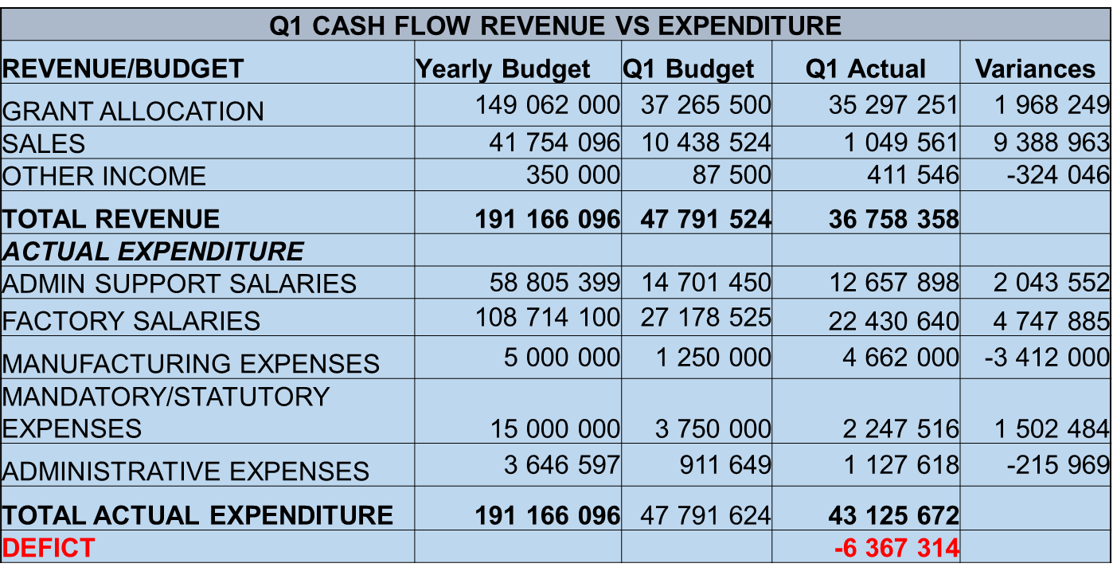
4. REVENUE vs EXPENDITURE
Grant allocation to be reviewed based on drawdown
Sales recorded on previous orders
Mandatory expenses - electricity still to be claimed from DEL

Slide 17
5. Summary of 2020/2021 FINANCIAL PERFORMANCE
DESCRIPTION | SUMMARY OF FINANACIAL PERFORMANCE
 | ACTUAL | BUDGET | VARIANCE | %
REVENUE | 1 049 560 | 10 438 524 | -9 388 964 | -90%
VARIABLE COST (COS) | -953 174 | -9 755 630 | 8 802 456 | -90%
GROSS CONTRIBUTION | 96 386 | 682 894
CONTRIBUTION MARGIN % | 9.18% | 6.54%
MANUFACTURING COSTS | -5 732 635 | -25 014 544 | 19 281 909 | -77%
GROSS PROFIT/ (LOSS) | -5 636 249 | -24 331 650
OTHER INCOME | 35 708 798 | 40 371 750 | -4 662 952 | -12%
OPERATIONAL COST | -36 642 250 | -16 040 100 | 7 944 252 | -50%
OPERATING NET PROFIT/(LOSS)* | -6 569 701 | -
*Above represent accounting profit/loss in terms of accounting framework/principles
Under collection on Sales – possible downwards budget review in Sept.
Operational Cost higher – review spending required
Q1 performance realised loss

