Slide 1
REPORT ON ESTABLISHMENT OF MUNICIPAL COUNCILS / COMMITTEES
STATUS OF MUNICIPALITIES UNDER SECTION 139 INTERVENTION PRE- AND POST LOCAL GOVERNMENT ELECTIONS
STATUS ON ONCE-OFF GRATUITY PAYMENT
PORTFOLIO COMMITTEE MEETING – 1 FEBRUARY 2022
BY DG A WILLIAMSON: 01 FEBRUARY 2022

Slide 2
Presentation outline
Progress made on establishment of municipal councils and respective committees.
Update on municipalities under Section 139 interventions pre- and post Local Government Elections (LGE).
Status of once-off gratuity payments to non-returning Councilors.

Slide 3
ESTABLISHMENT OF MUNICIPAL COUNCILS AND COUNCIL COMMITTEES

Slide 4
municipal councils established
PERSENTAGE: Out of 257 Councils, 256 Councils have been established (99.6%)
NO. | PROVINCE | LOCALS / METRO ESTABLISHMENT | DISTRICTS ESTABLISHMENT | COMMENTS
1. | Eastern Cape | All 31 locals and 2 Metros are established (100%) | All the 6 district municipalities have established their councils within fourteen (14) days after the last siting of their local municipalities. The last district to sit was Alfred Nzo District municipality which set on the 01 December 2021. | Out of 39 Councils 100% are established
2. | Free State | All locals & the Metro are established. (100%) | All Districts have been established. | Out of 23 Councils 100% are established
3. | Gauteng | All locals & the Metros are established. (100%) | The two District Councils have been established | Out of 3 Metro’s, two districts and 6 local Councils – 100% are established
4. | KwaZulu-Natal | All local municipal Councils established (100%) | All District Councils are established | Out of 54 Councils 100% are established. Political intervention was sought in Ray Nkonyeni and the Mayor was elected on 28 January 2022
5. | Limpopo | All Local Councils are established (100%) | All the District Councils are established. | Out of 27 Councils – 100% are established
6. | Mpumalanga | All local municipal Councils established (100%) | All Districts Councils are established | Out of 20 Councils 100% are established

Slide 5
municipal councils established
NO. | PROVINCE | LOCALS / METRO ESTABLISHMENT | DISTRICTS ESTABLISHMENT | COMMENTS
7. | North West | All the Local Municipal Councils established. (100%) | All district municipalities established | Out 22 of Councils 100% are established
8. | Northern Cape | All locals are established, except for Kai Garib LM (ZF Mgcawu District). (97%) | All District Councils are established | Out of 31 Councils 97% are established. Due to the passing of a ward councillor in the Kai Garib LM a vacancy has been declared and by elections are planned for 02 February 2022 The vacancy has created a tie 9/9 in Council. Council resolved to defer election of office bearers until by elections are held.
9. | Western Cape | All Locals and the Metro have been established.(100%) | All Districts have been established | Out of 29 Councils 100% are established.

Slide 6
council committees established
NO. | PROVINCE | STATUS RE ESTABLISHMENT OF SECTION 79, SECTION 80, MAYORAL COMMITTEES, EXECUTIVE COMMITTEE, MPAC’S | NAMES OF MUNICIPALITES WHERE COUNCIL COMMITTEES HAVE NOT BEEN ESTABLISHED | COMMENTS
1. | Eastern Cape | Some municipalities in the province have established their Section 79, 80, EXCO, MAYCO but others have not | Dr. Beyers Naude LM has not yet established Standing Committees. Section 79 Committees have not yet been established in the following: Ndlambe LM, Alfred Nzo DM, Umzimvubu LM, Enoch Mgijima LM, and Walter Sisulu LM. | Political Challenges are prevalent in most of these municipalities, and they are the cause of these delays.
2. | Free State | Out of 23 FS municipalities (including the Metro and districts), 16 municipalities have been established whilst 7 municipalities of which have not established all council committees. | Tokologo – no committees established Thabo Mofutsanyana - no committees established Nketoana – no committees established political issues sighted Phumelela – no committees established Maluti-A-Phofung – no committees established Fezile Dabi – no committees established | Political challenges. COGTA Finance undertaking visits to municipalities affected by non-establishment of council committees.
3. | Gauteng | All the Council Committees established in the 2 Metros, 6 Local Councils and 2 District Councils. In Jo’burg Metro 16 out of 17 Chairpersons of section 79 Committees have been elected | All Councils established Council Committees | N/A
4. | KwaZulu-Natal | All Council Committees established | Only Ray Nkonyeni has not established council committees due to challenges with election of the Mayor which was resolved through intervention by the MEC | N/A
5. | Limpopo | All the Council Committees established | All Council committees established in the 27 Councils | N/A

Slide 7
council committees established
NO. | PROVINCE | STATUS RE ESTABLISHMENT OF SECTION 79, SECTION 80, MAYORAL COMMITTEES, EXECUTIVE COMMITTEE, MPAC’S | NAMES OF MUNICIPALITES WHERE COUNCIL COMMITTEES HAVE NOT BEEN ESTABLISHED | COMMENTS
6. | Mpumalanga | 17 of 20 municipalities established s79 committees 16 of 20 municipalities established s80 committees 18 of 20 municipalities established Mayoral Committees | S79 Committees not established in Mkhondo; Lekwa & Ehlanzeni. S80 Committees not established in Mkhondo; Lekwa; Victor Khanye; Ehlanzeni. Mayoral Committees not established in Mkhondo & Lekwa | Establishment of oversight committees were delayed due to lack of Council meetings. MEC has intervened to fast track the process for establishment of oversight committees
7. | North West | All 22 local and district municipalities have established oversight committees | All Councils established oversight committees. | N/A
8. | Northern Cape | 14 local municipalities out of 25 (56%) have completed the election of Council Committees. All district municipalities have established oversight committees | 12 local municipalities out of 26 (46%) have NOT concluded the process as at 28/01/2022: Karoo Hoogland, Richtersveld, Phokwane, Dikgatlong, Tsantsabane, Kai Garib, Thembelihle, Siyathemba, Siyancuma, Renosterberg, Gamagara & Joe Morolong | .N/A
9. | Western Cape | All required oversight committees have been established. (except for those municipalities that have less that 9 councilors) | All Councils established oversight committees. | DLG will commence with the capacitation of councilors in their roles and responsibility and other functions once the SALGA orientation has ben concluded.

Slide 8
INTERVENTIONS MANAGEMENT PRE- AND POST LOCAL GOVERNMENT ELECTIONS (LGE)

Slide 9
PRIOR LGE – interventions management activities
Thirty-two (32) municipalities across the country were subjected to interventions with KwaZulu Natal leading by 10 municipalities and Limpopo the least by 1 municipality prior local government elections.
NW terminated all four (4) discretionary interventions post LGE but invoked mandatary interventions on all four plus an additional three municipalities. To that effect, seven (7) municipalities are under mandatory intervention by imposition of Mandatory Financial Recovery Plan (MFRP).
Other interventions terminated are six (6) municipalities by operation of law:
Lekwa LM and Tswaing LM - dissolution of municipal councils).
Nquthu LM and Emadlangeni LM - lack of approval or disapproval within 180 days by NCoP.
Kannaland LM and OR Tambo DM- High Court judgements on different grounds

Slide 10
PRIOR LGE – interventions management activities

Slide 11
POST LGE – intervention management activities
Post LGE thirty-one (31) are currently under intervention with majority intervened in terms of S139 (5) read together with MFMA – Imposition MFRP.
KZN and Limpopo retained all discretionary interventions and developed Municipal Support and Interventions Plans (MSIP) for implementation by current councils.
NW converted all discretionary interventions into Mandatory interventions in line with assessment and circular dealing with transitional measures post elections.
KZN and NW remain leading with number of municipalities under intervention.
09 of 31 municipalities, Emfuleni, Lekwa, Govern Bheki, Westrand, Inkosi Langalibalele; Mtubatuba; Msunduzi, Abaqulusi & Beaufort LMs West are hung councils (possible instability of municipal councils).
The Constitution state circumstances for termination of intervention, where municipal councils were dissolved for both discretionary and mandatory intervention. This provision supplemented by Section 148 of MFMA with regard to termination of mandatory intervention.

Slide 12
POST LGE – intervention management activities
COGTA, NT, & SALGA developed circular on transitional measures posts elections including interventions management to guide provinces and municipalities on processes and procedures for interventions be dealt with.
Experiences and challenges on intervention management were include amongst others-
Premature termination of interventions without proper assessment of impact of the intervention.
Lack of sustainable exist strategy.
Lack of post intervention support and monitoring (154 support by provinces and national or issuing of directive to municipalities).
Abruptly / Premature termination of interventions.
Termination of intervention on the eve or immediately after local government elections.

Slide 13
POST LGE – intervention management activities
Termination of intervention on the eve or immediately after local government elections.
MSA state that a municipality comprises of three elements, municipal councils, administration and community. The intent of interventions is to address shortcomings and shortfalls in the execution of executive obligations aimed at providing services to the communities and for the municipality to execute obligations assigned in terms of legislation.
Rational for continuation of interventions-
Implementation of MFRP
Assessment of impact of interventions to inform development of MSIP (discretionary interventions).
PEC to consider outcome of assessments and identify appropriate mode of intervention and support where required.
Proper hand over, information sharing and exchange between councils and intervention team.
Adoption MSIP and MFRP for implementation by Municipal Councils.
Continuous monitoring and support of municipalities.

Slide 14
POST LGE – intervention management activities
Generally, local government elections doesn’t automatically terminate an interventions, as it was the norm, except under circumstance mentioned above and in in line with circular on transitional measures for interventions management.
Discretionary Interventions
Discretionary Intervention must only end if the municipality is able and willing to fulfil the executive obligation in terms of legislation or the Constitution that gave rise to the intervention. | Intervention must continue to be in operation and effective upon the newly declared municipal council, until such time that the reasons that necessitated the intervention have been resolved. Province may conduct an impact assessment to evaluate progress and identify obstacles that impede effective implementation of the intervention in a municipality. PEC must identify an appropriate form of intervention for implementation, depending on the outcome of the assessment. Development and implement Municipal Support and Intervention Plans
Mandatory Interventions
Mandatory intervention must end when the crisis in the municipality’s financial affairs has been resolved and the municipality’s ability to meet its obligations to provide basic services or its financial commitments is secured. S148 of MFMA | Municipality must continue to implement mandatory municipal financial recovery plan. Principles and provision of implementation of MFMA are applicable

Slide 15
Transitional ACTIVITIES – intervention management

Slide 16
TRANSITION ACTIVITIES – intervention management
NO. | PROVINCE | PRIOR LGE | HUNG COUNCIL |  | TERMINATED |  | CONDITIONS FOR TERMINATION | INTERVENTIONS MANAGEMENT POST LGE
 |  |  | Yes | No | Yes | No
1 | Eastern Cape – 4 municipalities | Enoch Mgijima LM Discretionary & Mandatory Intervention S139 (1)( b) &(5) |  | √ |  | √ | Mandatory intervention must end when the crisis in the municipality’s financial affairs has been resolved and the municipality’s ability to meet its obligations to provide basic services or its financial commitments is secured. S148 of MFMA | Active Province directed by High Court to impose financial recovery plan Municipality must continue to implement mandatory municipal financial recovery plan.
 |  | Amathole LM Mandatory Intervention S139 (1)(5)(a) |  | √ |  | √ | Same as above | Active Municipality must continue to implement mandatory municipal financial recovery plan.
 |  | Makana LM Mandatory Intervention S139 (1)(5)(a) |  | √ |  | √ | Applicants to litigations are in agreement that state of affairs of municipalities has improved. Mandatory intervention must end when the crisis in the municipality’s financial affairs has been resolved and the municipality’s ability to meet its obligations to provide basic services or its financial commitments is secured. S148 MFMA. | Active, Municipality must continue to mandatory implement municipal financial recovery plan.
 |  | OR Tambo DM Mandatory Intervention S139 (1)(5)(a) |  | √ | √ |  | Court Judgement that intervention revoked for procedural reasons | Terminated. Province & National CoGTA supported by relevant stakeholders to develop MSIP for implementation by municipality.

Slide 17
TRANSITION ACTIVITIES – intervention management
NO. | PROVINCE | PRIOR LGE | HUNG COUNCIL |  | TERMINATED |  | CONDITIONS FOR TERMINATION | INTERVENTIONS MANAGEMENT POST LGE
 |  |  | Yes | No | Yes | No
2. | Free State – 1 municipality | Mangaung Metro Mandatory Intervention S139(5)(a) and (c) of the Constitution |  | √ |  | √ | Principles for termination are the same for mandatory interventions – S 148 (2) MFMA provisions | Active Municipality must continue to implement mandatory municipal financial recovery plan (MFRP).
3. | Gauteng – 2 municipalities | Emfuleni LM Mandatory Intervention S139(1)(b) and (5) of the Constitution | √ |  |  | √ | Same as above | Active Municipality must continue to implement mandatory municipal financial recovery plan (MFRP).
 |  | Westrand DM Mandatory Intervention S139(5)(a) of the Constitution |  | √ |  | √ | Same as above . | Active Municipality must continue to implement mandatory municipal financial recovery plan (MFRP).

Slide 18
TRANSITION ACTIVITIES – intervention management
NO. | PROVINCE | PRIOR LGE | HUNG COUNCIL |  | TERMINATED |  | CONDITIONS FOR TERMINATION | INTERVENTIONS MANAGEMENT POST LGE
 |  |  | Yes | No | Yes | No
4. | Limpopo – 1 municipality | Mogalakwena LM Discretionary Intervention S139(1)(b) of the Constitution | √ |  |  | √ | Intervention must only end if the municipality is able and willing to fulfil the executive obligation in terms of legislation or the Constitution that gave rise to the intervention. | Intervention must continue to be in operation and effective upon the newly declared municipal council, until such time that the reasons that necessitated the intervention have been resolved. Province may conduct an impact assessment to evaluate progress and identify obstacles that impede effective implementation of the intervention in a municipality. PEC must identify an appropriate form of intervention for implementation, depending on the outcome of the assessment.
5. | Kwa Zulu Natal – 10 municipalities | uMzinyathi DM Discretionary Intervention S139(1)(b) of the Constitution |  | √ |  | √ | Same as above | Same as above
 |  | Mpofana LM Discretionary Intervention S139(1)(b) of the Constitution |  | √ |  | √ | Same as above | Same as above

Slide 19
TRANSITION ACTIVITIES – intervention management
NO. | PROVINCE | PRIOR LGE | HUNG COUNCIL |  | TERMINATED |  | CONDITIONS FOR TERMINATION | INTERVENTIONS MANAGEMENT POST LGE
 |  |  | Yes | No | Yes | No
5. | Kwa Zulu Natal – 10 municipalities | Inkosi Langalibalele LM Discretionary Intervention S139(1)(b) of the Constitution | √ |  |  | √ | Principles for discretionary interventions are applicable | Principles for discretionary interventions are applicable
 |  | Abaqulusi LM Discretionary Intervention S139(1)(b) of the Constitution |  | √ |  | √ | Principles for discretionary interventions are applicable | Principles for discretionary interventions are applicable
 |  | Mtubatuba LM Discretionary Intervention S139(1)(b) of the Constitution | √ |  |  | √ | Principles for discretionary interventions are applicable | Principles for discretionary interventions are applicable
 |  | uThukela DM Discretionary Intervention S139(1)(b) of the Constitution |  | √ |  | √ | Principles for discretionary interventions are applicable | Principles for discretionary interventions are applicable

Slide 20
TRANSITION ACTIVITIES – intervention management
NO. | PROVINCE | PRIOR LGE | HUNG COUNCIL |  | TERMINATED |  | CONDITIONS FOR TERMINATION | INTERVENTIONS MANAGEMENT POST LGE
 |  |  | Yes | No | Yes | No
6. | Mpumalanga – 5 municipalities | Emalahleni LM Mandatory Intervention S139(1)(5) of the Constitution |  | √ |  | √ | Mandatory intervention must end when: Crisis in the municipality’s financial affairs has been resolved and The municipality’s ability to meet its obligations to provide basic services or its financial commitments is secured. (S148) (2) MFMA. | Intervention continue to be effective upon the new municipal council for implementation of Mandatory Financial Recovery Plan.
 |  | Govan Mbeki LM Mandatory Intervention S139(1)(5) of the Constitution |  | √ |  | √ | Same as above | Same as above
 |  | Msukaligwa LM Mandatory Intervention S139(1)(5) of the Constitution |  | √ |  | √ | Same as above | Same as above
 |  | Thaba Cheui LM Mandatory Intervention S139(1)(5) of the Constitution |  | √ |  | √ | Same as above | Same as above

Slide 21
TRANSITION ACTIVITIES – intervention management
NO. | PROVINCE | PRIOR LGE | HUNG COUNCIL |  | TERMINATED |  | CONDITIONS FOR TERMINATION POST LGE | INTERVENTIONS MANAGEMENT POST LGE
 |  |  | Yes | No | Yes | No
6. | Mpumalanga – 5 municipalities | Lekwa LM Mandatory Intervention S139(7) of the Constitution read with MFMA Dissolution of municipal Council | √ |  |  | √ | Principles for discretionary interventions are applicable | Principles for discretionary interventions are applicable
7. | Northern Cape – 2 municipalities | Phokwane LM Mandatory Intervention S139(5) of the Constitution |  | √ |  | √ | Principles for discretionary interventions are applicable | Principles for discretionary interventions are applicable
 |  | Renosterberg LM Mandatory Intervention S139(5) of the Constitution |  | √ |  | √ | Principles for discretionary interventions are applicable | Principles for discretionary interventions are applicable

Slide 22
TRANSITION ACTIVITIES – intervention management
NO. | PROVINCE | PRIOR LGE | HUNG COUNCIL |  | TERMINATED |  | CONDITIONS FOR TERMINATION POST LGE | INTERVENTIONS MANAGEMENT POST LGE
 |  |  | Yes | No | Yes | No
8. | North West – 4 municipalities | Madibeng LM Discretionary Intervention S139(1) (b) of the Constitution |  |  | √ |  | Discretionary intervention terminated by PEC | Active, PEC converted discretionary intervention into mandatory intervention by imposing mandatory financial recovery plan. MFMA provisions for mandatory intervention are applicable.
 |  | JB Marks LM Discretionary Intervention S139(1) (b) of the Constitution | √ |  | √ |  | Same as above | Terminated
 |  | Ramotshere LM Discretionary Intervention S139(1) (b) of the Constitution |  | √ | √ |  | Same as Above | Active, PEC converted discretionary intervention into mandatory intervention by imposing mandatory financial recovery plan. MFMA provisions for mandatory intervention are applicable.
 |  | Tswaing LM Discretionary Intervention S139(1) (c) of the Constitution |  | √ | √ |  | Dissolution terminated by operation of law post LGE. | Active, PEC introduced mandatory intervention by imposing mandatory financial recovery plan. MFMA provisions for mandatory intervention are applicable.

Slide 23
TRANSITION ACTIVITIES – intervention management
NO. | PROVINCE | PRIOR LGE | HUNG COUNCIL |  | TERMINATED |  | CONDITIONS FOR TERMINATION POST LGE | INTERVENTIONS MANAGEMENT POST LGE
 |  |  | Yes | No | Yes | No
8. | North West - 5 municipalities | Ditsobotla LM Discretionary Intervention S139(1)(b) of the Constitution | √ |  |  | √ | Discretionary intervention terminated by PEC . | Active, PEC converted discretionary intervention into mandatory intervention by imposing mandatory financial recovery plan. MFMA provisions for mandatory intervention are applicable.
 |  | Kgetleng Rivier LM Mandatory Intervention S139(5) (a) of the Constitution |  | √ | N/A | N/A |  | Active, PEC introduced mandatory intervention by imposing mandatory financial recovery plan. MFMA provisions for mandatory intervention are applicable.
 |  | Naledi LM Mandatory Intervention S139(5) (a) of the Constitution |  | √ | N/A | N/A |  | Active, PEC introduced mandatory intervention by imposing mandatory financial recovery plan. MFMA provisions for mandatory intervention are applicable.
 |  | DR RSM DM Mandatory Intervention S139(5) (a) of the Constitution |  | √ | N/A | N/A |  | Active, PEC introduced mandatory intervention by imposing mandatory financial recovery plan. MFMA provisions for mandatory intervention are applicable.

Slide 24
TRANSITION ACTIVITIES – intervention management
NO. | PROVINCE | PRIOR LGE | HUNG COUNCIL |  | TERMINATED |  | CONDITIONS FOR TERMINATION POST LGE | INTERVENTIONS MANAGEMENT POST LGE
 |  |  | Yes | No | Yes | No
8. | North West – 5 municipalities | Ditsobotla LM Discretionary Intervention S139(1)(b) of the Constitution | √ |  |  | √ | Discretionary intervention terminated by PEC . | Active, PEC converted discretionary intervention into mandatory intervention by imposing mandatory financial recovery plan. MFMA provisions for mandatory intervention are applicable.
9. | Western Cape –3 municipalities | Kannaland LM S139(1)(5) of the Constitution | √ |  |  | √ | Terminated by High Court on procedural requirements. | Province developed Municipal Support and Intervention Plan for implementation by the municipality.
 |  | Central Karoo DM S139(4) of the Constitution |  | √ | √ |  | Mandatory intervention must end when the crisis in the municipality’s financial affairs has been resolved and the municipality’s ability to meet its obligations to provide basic services or its financial commitments is secured. S148(2) MFMA. | Active, Intervention continue to be effective upon the new municipal council for implementation of Mandatory Financial Recovery Plan.
 |  | Beaufort West LM S139(5)(a) of the Constitution | √ |  | √ |  | Mandatory intervention must end when the crisis in the municipality’s financial affairs has been resolved and the municipality’s ability to meet its obligations to provide basic services or its financial commitments is secured. S148(2) MFMA. | Active, Intervention continue to be effective upon the new municipal council for implementation of Mandatory Financial Recovery Plan.

Slide 25
STATUS OF PAYMENT OF ONCE-OFF GRATUITY TO NON RETURNING COUNCILORS

Slide 26
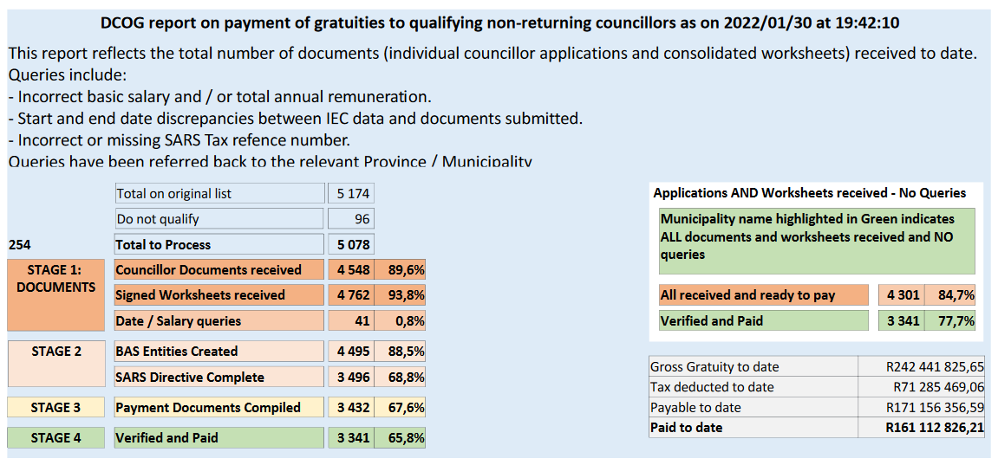
Report of once-off gratuity

Slide 27
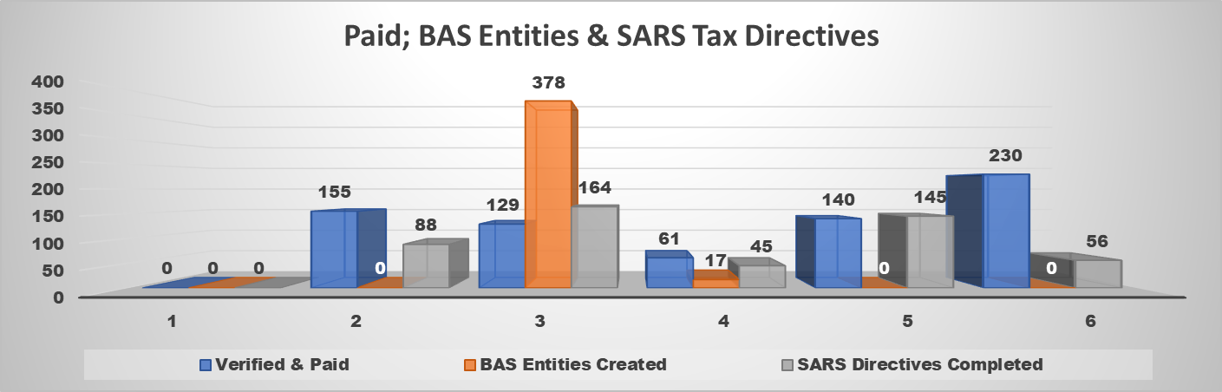
BAS ENTITIES; SARS DIRECTIVES and paid

Slide 28
Municipalities’ Compliance of submissions

Slide 29
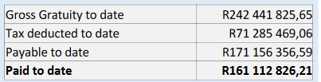
KEY OUTCOMES AND CHALLENGES IDENTIFIED
The following key outcomes and challenges have been identified:
Key Outcomes on transactions to be processed (5 078)
Councillors documents received to date 90% (4 548).
Municipalities Worksheets received to date 94% (4 762).
Registration of Banking details into BAS to date 89% (4 495).
SARS Tax Directives to date 68% (3 440).
Batches Verified and Paid to date 66% (3 341). Gross Gratuity 242,442 million out of R350 million which represent 69%.
Challenges
Network connectivity outage from the SITA site (Since our last meeting we lost three full days due to outages). With this we have lost 9% of production on average of 150 payments per day. (Dates are: 17; 24 & 25 Jan 2022)
Queries referred back to municipalities for accurate details due to:
Incorrect basic salary and / or total annual remuneration.
Start and end date discrepancies between IEC data and documents submitted.
Incorrect or missing SARS Tax refence number.

Slide 30
SUPPORTING ACTIONS IDENTIFIED
The following key support actions have been identified:
Once-Off Gratuity Pay-out Certificates are issued and communicated to municipalities and councillors.
Weekly communication progress reports through provinces to municipalities is ongoing.
SALGA is assist and intervened by engaging municipalities to expedite submission of outstanding documents.
Provincial HODs - Commitment to avail officials to assist with the payments process has materialized.

Slide 31
Recommendations
It is recommended that the Portfolio Committee for CoGTA notes:
Progress made on establishment of municipal councils and respective committees.
Status of interventions management pre- and post LGE.
Progress made and challenges encountered towards payment of once-off gratuity to former Councilors.

Slide 32
THANK YOU!!!

