Slide 1
NHI
Solidarity Feedback
Connie Mulder | 28 January 2022

Slide 2
UNAFFORDABLE
2019 Report by Prof Jannie Rossouw (Wits) and Mike Holland
2021 Report by Solidarity Research Institute to update fiscal situation
No full cost in 2015 and 2017 white papers
2010 Prices have to be adjusted
Sustained low economic growth & no fiscal capacity
NHI cost estimates
White paper
R256b
SRI Report
R394b
Funding gap estimates:
Between R33b (Treasury) to R226b (Prof Rossouw)
DIE VOORLEGGING SE OPSKRIF
www.solidariteit.co.za

Slide 3
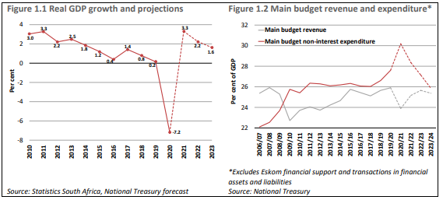
UNAFFORDABLE
2017 White Paper needs 3,5%
DIE VOORLEGGING SE OPSKRIF
www.solidariteit.co.za

Slide 4
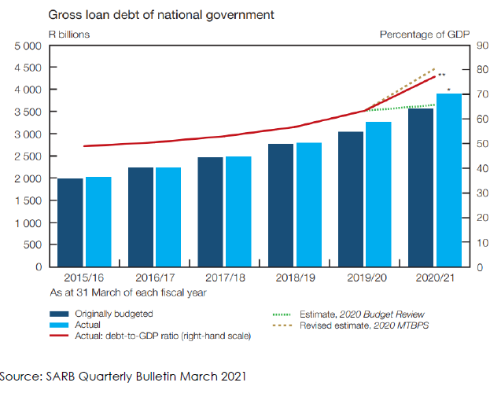
UNAFFORDABLE
OECD Recommends 30% - 50%
DIE VOORLEGGING SE OPSKRIF
www.solidariteit.co.za

Slide 5
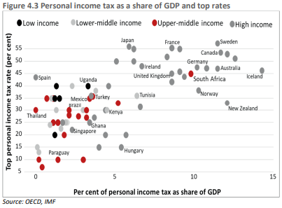
UNAFFORDABLE
• An income tax surcharge of 20%.
• A VAT increase from 15% to 20%.
• A payroll tax of 5,5%.
• Increasing corporate income tax from 28% to 42%
• A combination of these.
DIE VOORLEGGING SE OPSKRIF
www.solidariteit.co.za

Slide 6
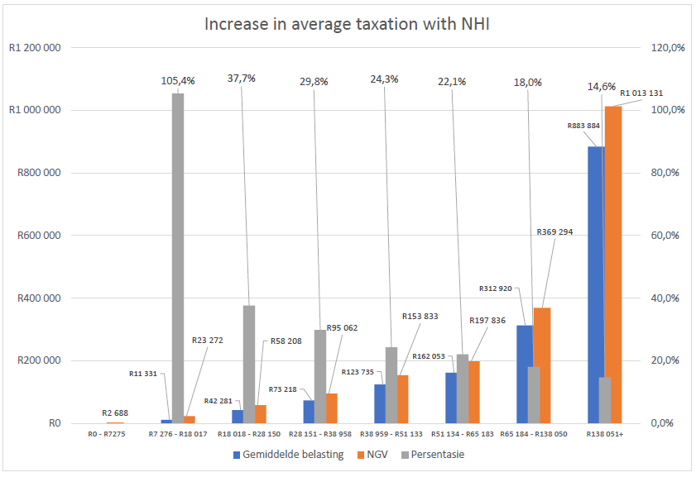
UNAFFORDABLE
DIE VOORLEGGING SE OPSKRIF
www.solidariteit.co.za

Slide 7
UNNECESSARY
2019 Report by Prof Alex van den Heever (Wits)
Findings:
NHI not thought through
No evidence for public purpose
Not Rational
Not evaluated for feasibility
Significant risk without obvious benefit
Misdiagnose problems
Ignore easier and more viable reforms
DIE VOORLEGGING SE OPSKRIF
www.solidariteit.co.za

Slide 8
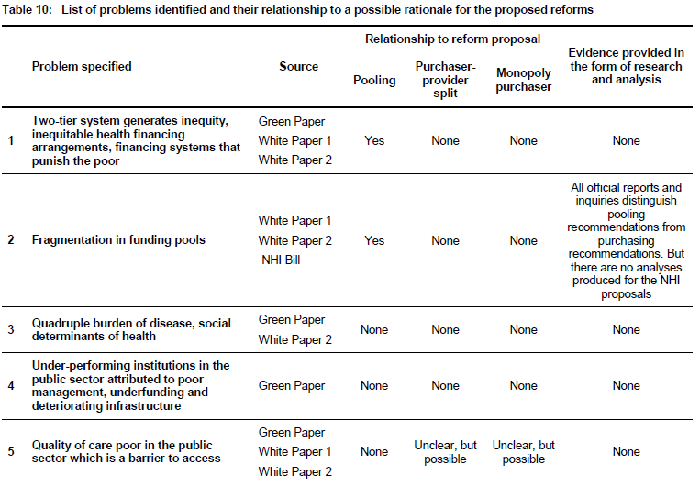
UNNECESSARY
DIE VOORLEGGING SE OPSKRIF
www.solidariteit.co.za

Slide 9
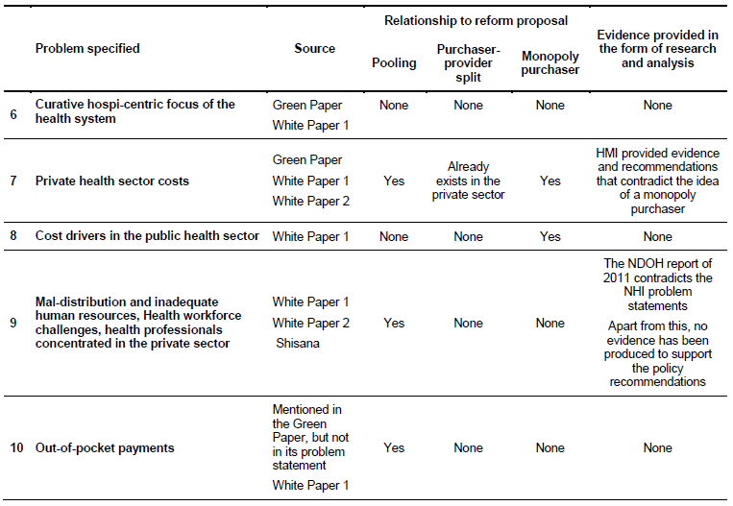
UNNECESSARY
DIE VOORLEGGING SE OPSKRIF
www.solidariteit.co.za

Slide 10
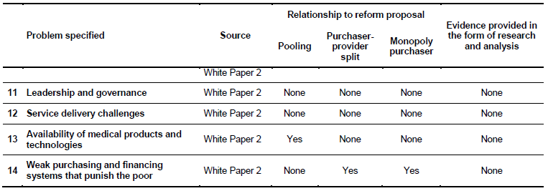
UNNECESSARY
DIE VOORLEGGING SE OPSKRIF
www.solidariteit.co.za

Slide 11
UNNECESSARY
DIE VOORLEGGING SE OPSKRIF
www.solidariteit.co.za

Slide 12
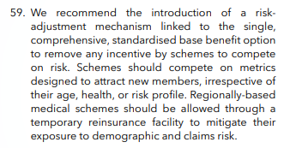
UNNECESSARY
Health Market Inquiry – Competition Commission - 2019
The 1995 NHI Committee of Inquiry into National Health Insurance
The Taylor Committee of Inquiry into Comprehensive Social Security of 2002
The NDOH’s consultation document of 2002 based on the Taylor Committee of
Inquiry
Ministerial Task Team on Social Health Insurance in 2005
DIE VOORLEGGING SE OPSKRIF
www.solidariteit.co.za

Slide 13
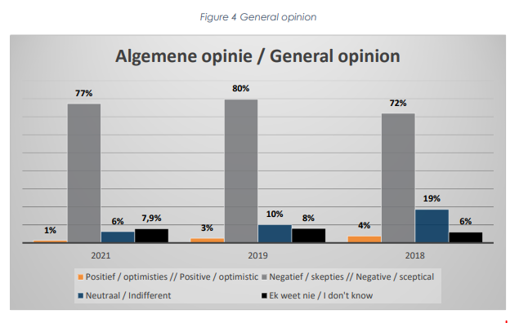
UNWORKABLE
Solidarity Research Institute survey in 2018, 2019 and 2021 (n = 1410)
DIE VOORLEGGING SE OPSKRIF
www.solidariteit.co.za

Slide 14
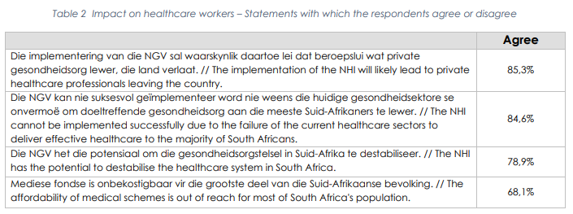
UNWORKABLE
Solidarity Research Institute survey in 2018, 2019 and 2021 (n = 1410)
DIE VOORLEGGING SE OPSKRIF
www.solidariteit.co.za

Slide 15
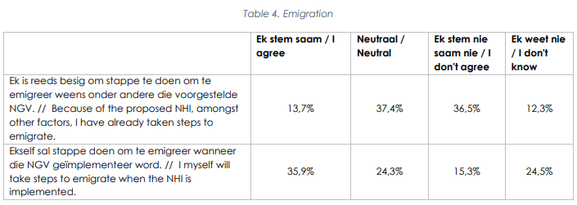
UNWORKABLE
Solidarity Research Institute survey in 2018, 2019 and 2021 (n = 1410)
DIE VOORLEGGING SE OPSKRIF
www.solidariteit.co.za

Slide 16
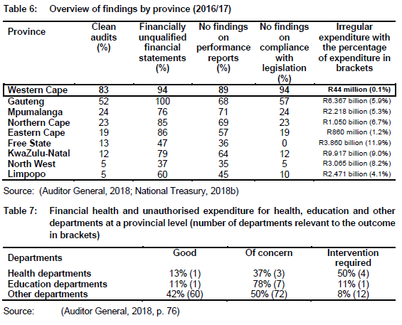
ALTERNATIVES
DIE VOORLEGGING SE OPSKRIF
www.solidariteit.co.za

Slide 17
www.solidariteit.co.za

