Slide 1
Standing Committee on Education
25 January 2022

Slide 2
Vision
Vision
Quality Education
for every child
in every classroom
in every school in the province.
Caring
Competence
Accountability
Integrity
Innovation
Responsiveness

Slide 3
INTRODUCTION
The presentation will in broad cover the following topics:
NSC 2021
School Readiness for 2022
Admissions 2022
Learner wellness and support

Slide 4
SCHOOL READINESS

Slide 5
SCHOOL IMPROVEMENT PLANS (SIPs)
All schools who have achieved less that 60% in the NSC exams are required to develop an intervention plan.
Schools who have achieved less that 70% in the NSC exams
Year | Number of schools
2020 | 52
2021 | 40
Year | Number of schools
2020 | 112
2021 | 98

Slide 6
SCHOOLS PERFORMING BELOW 60% IN NSC
Head of Education issues a letter to the school indicating their unfavourable pass rate.
District Director, Head of Curriculum and Circuit Manager analyse the results of the schools.
School Management Team is called in to explain their results once they have analysed the results.
SMT present their Intervention Plan in the School Improvement Plan(SIP).
Agreement is reached between the district and the school on monitoring of the intervention plan.
School is included in the District Improvement Plan (DIP)
At the quarterly Exco visits to districts, the District responds on the monitoring of the schools below 70%.

Slide 7
LEARNER TRANSPORT SYSTEM (LTS)

Slide 8
LEARNER TRANSPORT SCHEME (LTS) – part 1
LEGAL & POLICY CONTEXT:
1. LTS POLICY:
Learners in rural areas who reside 5 or more kilometres from their nearest schools
qualify for learner transport.
2. LTS STANDARD OPERATIONAL PROCEDURES (SOP)
Guidelines on the management of LTS at schools, Districts and Head Office.
SCOPE AND SCALE OF SERVICE
581 LTS routes, 60 972 learners transported, 463 Primary and Secondary schools.
FINANCIAL PROVISION
2021/22 Budget: R456 million; Expenditure on 31 December 2021: R347 million.
DELIVERY HIGHLIGHTS
All targeted learners are transported.
11 new LTS route applications were received and processed for January 2022.
A total of 455 LTS applications were received and processed for January 2022, representing 6656 learners.

Slide 9
LEARNER TRANSPORT SCEMES (LTS) – part 2
RISKS
Availability of sufficient funding;
Petrol price hikes;
unpredictability of bid prices;
Road conditions;
Safety and roadworthiness of vehicles.
INNOVATIONS AND EFFICIENCY PROGRAMS
GIS system with GPS coordinates,
CEMIS database for learners and approved LTS vehicles.
FUTURE OUTLOOK
Electronic LTS applications via CEMIS from school level;
Closer working relationship with the Department of Transport and Public Works.

Slide 10
LEARNING & TEACHING SUPPORT MATERIAL (LTSM)

Slide 11
LEARNING & TEACHING SUPPORT MATERIAL (LTSM) – part 1
LEGAL AND POLICY CONTENT
Framework for the supply and management of learning and teaching support material (LTSM)supplied to schools.
This framework regulates the management and retrieval of textbooks at schools.
SCOPE AND SCALE OF SERVICE
Supply and delivery of textbooks to schools - all public schools are invited to participate in online ordering of textbooks on annual basis (May to June).
Supply and delivery of stationery items to non-section 21 schools.
Oversee the delivery of workbooks to schools.
FINANCIAL PROVISION
2021/22 Budget: R157 million. Expenditure on 31 December 2021: R92 647 million.
DELIVERY HIGHLIGHTS
488 176 textbooks ordered and delivered to schools by 3 December 2021.
Stationery items ordered and delivered to schools by 10 December 2021.
Orders received for new schools and for curriculum changes delivered to schools by 10 December 2021.

Slide 12
LEARNING & TEACHING SUPPORT MATERIAL – part 2
INNOVATIONS AND EFFICIENCY PROGRAMS
CEMIS ordering systems;
Tracking system for requisition progress;
Term contract with Publishers – improved delivery time frames and economy of scales.
FUTURE OUTLOOK
E-books.
Further CEMIS ordering system development and improvements.

Slide 13
BURGLARIES/VANDALISM

Slide 14
BURGLARIES/VANDALISM
The Table provides information on the cases of burglaries or vandalism at schools during the festive season.
Burglary & vandalism per District | Incidents
Cape Winelands | 9
Metro North | 6
Metro East | 2
Eden & Central Karoo | 10
Metro Central | 5
West Coast | 2
Overberg | 0
Metro South | 0
TOTAL | 34

Slide 15
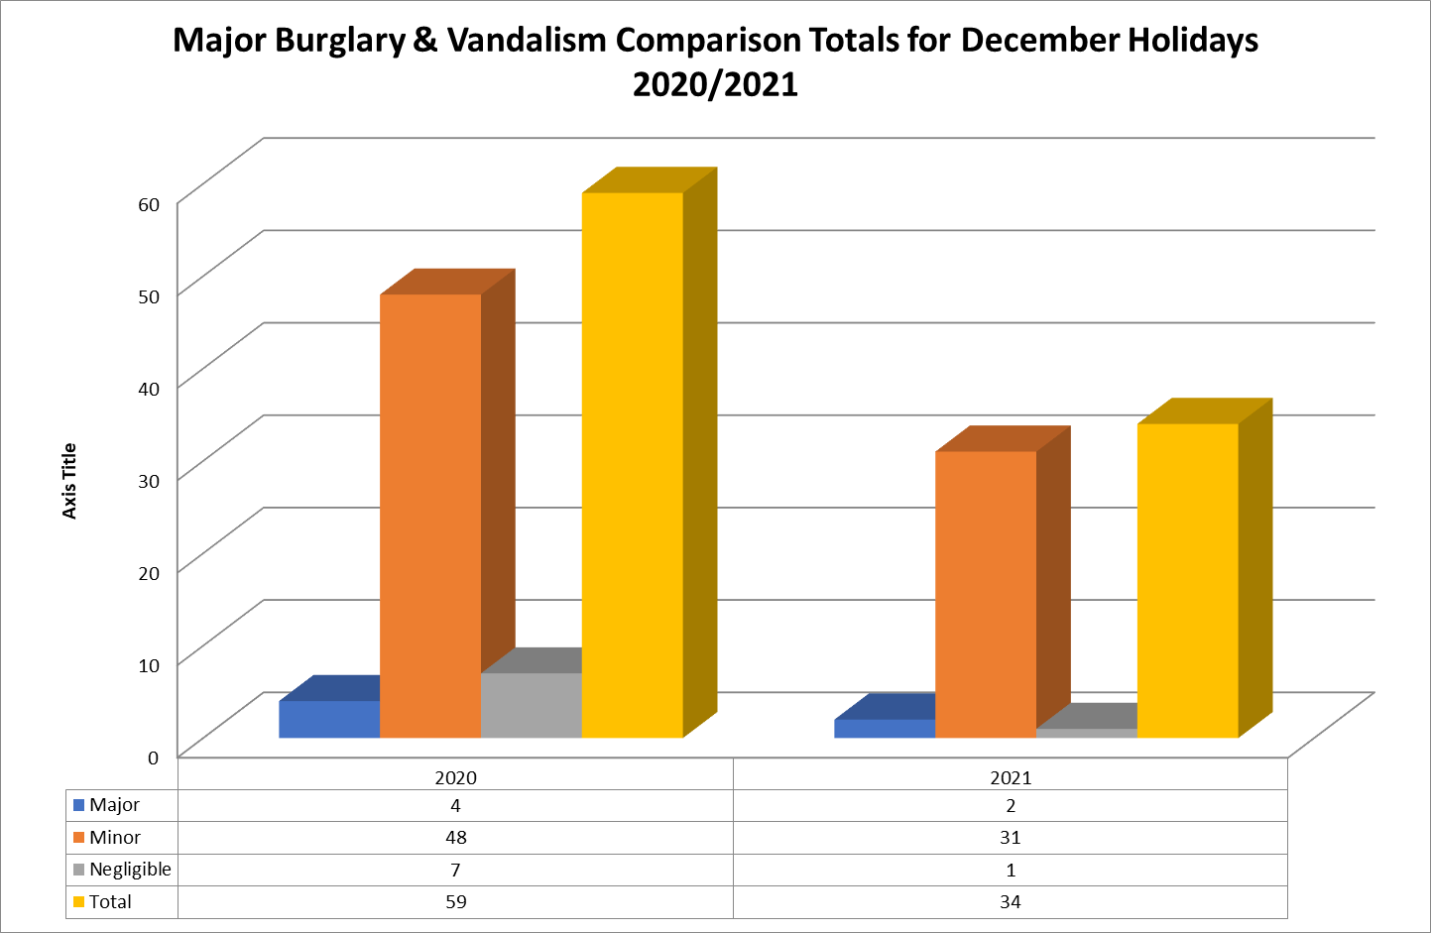
COMPARISON: DEC 2020 vs DEC 2021

Slide 16
LEARNER ADMISSIONS 2022

Slide 17
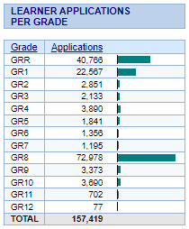
SAMI STATS ON 25 JUNE 2021 (UNIQUE LEARNERS)
SAMI: Registration 28 Feb-28 March 2021.
Deadline extended with another week.
LEARNER APPLICATIONS
CAPTURED BY...
Parent | 120,275
School | 37,144
TOTAL | 157,419

Slide 18
LEARNER ADMISSIONS 2022
Placements confirmed before/on 25 June 2021 | 72 913
Further confirmations | 50 600
Total placement confirmations by 7 July 2021 | 123 513
Unplaced learners (excl Gr R) on 7 July 2021 | 33 906
Total unique applications | 157 419

Slide 19
UNPLACED LEARNERS AT 20 JANUARY 2022
DISTRICT | GR1 | GR2 | GR3 | GR4 | GR5 | GR6 | GR7 | GR8 | GR9 | GR10 | GR11 | GR12 | GR1 - GR12
CW | 0 | 1 | 1 | 1 | 3 | 5 | 1 | 26 | 4 | 5 | 2 | 0 | 49
ECK | 4 | 22 | 16 | 13 | 11 | 11 | 4 | 47 | 32 | 30 | 7 | 5 | 202
MCED | 12 | 6 | 17 | 10 | 4 | 7 | 8 | 554 | 42 | 27 | 8 | 2 | 697
MEED | 283 | 86 | 62 | 95 | 43 | 34 | 12 | 356 | 61 | 84 | 29 | 3 | 1,148
MNED | 69 | 21 | 23 | 46 | 42 | 32 | 30 | 376 | 81 | 130 | 75 | 4 | 929
MSED | 29 | 6 | 5 | 4 | 6 | 5 | 3 | 800 | 162 | 198 | 36 | 3 | 1,257
OED | 5 | 1 | 0 | 0 | 0 | 1 | 0 | 47 | 6 | 2 | 3 | 1 | 66
WC.ED | 37 | 14 | 10 | 7 | 16 | 10 | 10 | 96 | 57 | 54 | 13 | 3 | 327
TOTAL | 439 | 157 | 134 | 176 | 125 | 105 | 68 | 2,302 | 445 | 530 | 173 | 21 | 4,675
Inter-Grade learners: 1 934 Only the essential learners will be placed.
PS. These learners are currently at WCED schools. They have applied to other WCED schools. These are regarded as transfers to schools.
Gr 1 & 8 : 2 741
These learners must be placed. Entry points to PS and HS respectively.

Slide 20
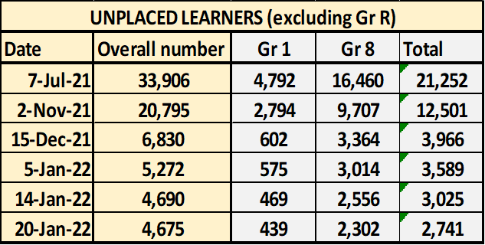
WCED EFFORTS TO PLACE LEARNERS
An Admission Team was established at Head Office
8 District Admission Teams established.
All Teams focused on placements during the fourth quarter 2021
Teams resolved 29 231 placement cases since 7 July 2021, plus 472 Gr placements.

Slide 21
HOT-SPOT AREAS
Hotspot areas:
Mitchell’s Plain
Eerste River
Mfuleni
Nomzamo/Strand
Delft
Du Noon/Milnerton
Vredenburg
Hermanus
Grabouw

Slide 22
THREE CATEGORIES OF LEARNERS FOR PLACEMENT
1. In-time applications
UNPLACED LEARNERS
2. Late applications (2021)
3. New applications 2022
The in-time applications are steadily dropping.
The late applications are increasing. The reason is that applications were made at schools in December 2021, but the applications have only been placed on SAMI this year.
New applications will continue to increase.

Slide 23
WCED ATTEMPTS TO DEAL WITH ACCOMMODATION NEEDS
Additional mobile units
173 units approved for implementation by DTPW
Undertaking was that 105 would have been completed by Dec/Jan 2022 and remaining 68 by Apr 2022.
On 17 January 2022, only 34 units have been completed.
Unused/under-utilized vacant classrooms
97 vacant classrooms have been identified at schools in the province for learner placement.
Some of these classrooms will have to be repaired for use.
The AO has approved funds to be transferred to do repairs to 32 vandalized classrooms over the summer school holidays.
4 628 have been accommodated in these classrooms.

Slide 24
RISKS
Mobiles not being placed.
Learners who have not applied for space/accommodation (Gr 1 and Gr 8) for 2022.
New arrivals in 2022.
Possible full (100%) return of learners to school.
Because there is a need for everybody in districts to be involved in trying to resolve unplaced learners, key district staff are distracted from attending/delivering other critical educational matters.
Platooning poses certain safety risks, and it also impedes on the requisite teaching time for learners

Slide 25
CONSIDERATIONS FOR FUTURE MANAGEMENT OF ADMISSIONS
We will amend SAMI to reflect different categories of applications:
  Gr R
  Grades 1 & 8 as entry grades into Primary and High School respectively
  Transfers
Unlock the possibility of mobile rentals

Slide 26
LEARNER WELLNESS

Slide 27
LEARNER SUPPORT/COVID READINESS
The District requested all schools, teachers and learners to complete questionnaires to determine support needed.
Learners are supported: face-to-face or virtually. A psychologists or social worker supports learners either individually or in groups. School counsellors at our schools of skills also provide support to learners.
The WCED Learner Support Pathway to guide support rendered to learners affected by, for example, either illness, anxiety or grief.
PPE materials to the value of R19m have been procured centrally for 873 schools who indicated in a survey the need for top-ups. Delivery started in the 4th quarter and is still in process. This is an ongoing project to support schools unable to purchase their own stock.
Schools have also been advised to budget for PPE materials from their Norms and Standards funding.
Screening of all learners upon entry to school facilities will continue.
Any learner displaying symptoms will be confined to an isolation facility and the parents contacted to collect the child.

Slide 28
WCED Wellness and Psycho-social Support
The WCED has a wellness and psycho-social support strategy, which was adapted especially for use during the Covid-19 period to be responsive to the increased need for psycho-social support.
There is a provincial psycho-social task team that has been established.
Cooperation with two sister departments (Health & DSD).
Learners received psycho-social interventions which included bereavement counselling, interventions for depression and suicidal ideation, trauma, mental health screening and wellness promotion sessions.
Training on emotional first aid/trauma-informed schools was provided to teachers.
Grade 12/matric learners were found to be particularly vulnerable due to the high stakes examination they would be writing at the end of the year and were a particular focus for psycho-social interventions.

Slide 29
GRADE 12 SUPPORT
The Specialised Support teams in districts proactively engaged with Grade 12 learners as they prepared for exams. This included:
  Self-care and mindfulness sessions with groups of matric learners
  Group psycho-social support sessions
  Individual counselling sessions, when required
  Motivational talks
  Study skills sessions
  Psycho-social support sessions with parents focusing on communication, realistic expectations and goal-setting, and supporting a Grade 12 learner at home
Various partners (NGOs & Universities) have assisted.
The WCED’s placed useful resources regarding psycho-social support and promotion of well-being on the WCED’s ePortal.
Districts distributed relevant pamphlets and other resources to schools.
Growth Mindset (T2P) was also offered to Matrics.

Slide 30
PSYCHO-SOCIAL SUPPORT PATHWAY
LEVELS OF SUPPORT
LOW LEVEL SUPPORT
MODERATE LEVEL SUPPORT
HIGH LEVEL SUPPORT
Individual or Group Counselling/therapy/ psycho-educational assessment
Referral to DOH e.g.psychiatric services, medication
Referral to DSD e.g. child protection services
School Psycho-social Plans
Psychologist/Social Worker consultation
Case discussions
Community services
Life Skills/Orientation incl. relevant Covid-19 information
Trauma-sensitive/ Wellness tips
Growth mindset &
Classroom emotional /sensory regulation/body-based support strategies
Online psycho-social support
Violence Prevention Initiative
+
NSNP
+
School Enrichment
+
DCAS after-school projects
+
EWP

