Slide 1
SUBMISSION ON NATIONAL HEALTH INSURANCE BILL
presented by the
SA FEDERATION FOR MENTAL HEALTH

Slide 2
INTRODUCTION TO SAFMH
NGO (national office in JHB and 17 Mental Health Societies across SA)
In existence for 100 years and one of the largest mental health organisation in SA
Work with government, NGOs and other national and international partners
Main focus areas are Awareness, Advocacy, Human Rights, Capacity Building

Slide 3
Presentation Outline
Brief background on mental health in South Africa
Our requests for the NHI
Our requests in more detail
Expected outcomes of our requests
Q&A

Slide 4
Background
Universal Health Coverage strives for accessible, timely, quality healthcare for all without anyone suffering undue financial repercussions
MENTAL HEALTH IS HEALTH
9.5 million people are living with a mental, neurological or substance use disorder in SA
27% of the population are estimated to be risky alcohol and substance users
< 1 in 10 people living with a mental health condition in SA receive the care they need

Slide 5
Our Requests
A medium-term conditional grant for earmarked investments in the mental health system in advance of a fully implemented NHI as recommended in the investment case report
Invest and monitor this grant wisely into contextually-relevant, evidence based mental health services for population mental health. This specifically includes:
Intersectoral Community-based mental health services,
Expanded Primary Health Care mental services,
Prevention and promotion interventions
To work with other government departments, to ensure that their policies and budgets augment the NHI mental health benefit packages for successful implementation

Slide 6
1. Medium-term conditional grant for mental health care and services
Address past injustices | Scale up for the future
15 year conditional grant to allow for bridge-funding to support adaptation of services, capacitation of provinces, see returns on investments (ROIs); >15 years, no longer needed
Specific costs and ROIs: refer to the Mental Health Investment Case Report (MHICR)
Recommendation: DoH to undertake an explicit priority setting exercise for the NHI packages of care to review which packages and benefits are included & the reasons for inclusion
This should be informed by a needs-based approach (e.g. burden of disease, treatment gap, inclusivity etc)
Notes:
We advocate for the Department of Health to undertake an explicit priority setting exercise for the NHI packages of care which have been comprehensively drafted within the South African Mental Health Investment Case, receiving specialist clinical inout. We recommend that DoH and the Committee establish a process with key stakeholders where they review and interrogate what these packages and the potential benefits, placing equal consideration for both the burden and disability imposed by diagnosable mental illnesseses, our human rights obligations and the sociodemographic conditions which place particular groups at heightened risk of deteroration in their mental health, in and across the country . This has been acknowledged in the development of the Mental Health Investment case, with a Delphi study having been undertaken to identify mental health priorities across a range of research, government and NGO level stakeholders representing service-users towards broad participatory consensus building on national priorities. Outcomes of the consolidated global and local evidence ultimately demonstrated strong synergies.
At present, our largely implicit approach to priority setting means that decisions are made on a discretionary basis by managers, professionals, and other health personnel functioning within a fixed budgetary allowance.
Explicit priority-setting will allow decisions related to the amounts and types of resources to be made available, eligible populations, and specific rules for allocation informed by economic analysis to maximise value and to achieve social goals
including service users

Slide 7
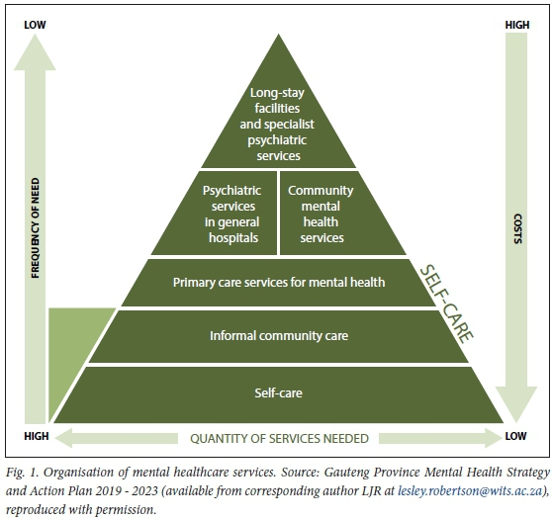
2. Invest in mental health services for maximum population mental health
Intersectoral community-based mental health services
Expanded Primary Health Care services
Prevention and promotion interventions

Slide 8
2. Invest in mental health services for maximum population mental health
Recommendation: NHI recognises Community-based mental health services, Primary Health Care, Prevention and promotion as ‘essential mental health services’
Recommendation: NGO personnel, and traditional healers be included in the definition of ‘health care services provider’
Recommendation: Accountability & Transparency
Recommendation: Increased capturing of mental health data

Slide 9
2a. Intersectoral community mental
health services
Examples: Residential and day care services, psychosocial and rehabilitation services, mental health literacy and awareness services, medication adherence support services
Recommendation: Such services acknowledged in the NHI Bill for consistent funding
Recommendation: Revise the current licensing regulations of mental health NGOs to be more user-friendly and financially viable
Recommendation: Develop, implement, up-scale a standardised package of community person-centred care Psychosocial rehabilitation services (PSR)

Slide 10
2a. Community-mental health in
practice: Cape Mental Health
Psychosocial rehabilitation services adopts a bio-psycho-social approach, providing a continuum of care from hospital to community
Funded by Western Cape DoH
Fountain House: community-
based rehabilitation centre
Rainbow: 26 PSR support groups
Outcome: decrease in the rate
of hospital recidivism for people with mental illness

Slide 11
2b. Expanded Primary Health Care
Mental Health
PHC = “foundational building block of the health system”
But mental health service delivery is still heavily hospicentric = limited access for many & inefficiencies in resource use
Recommendation: Provisions made to ensure that primary health care is recognised as the key level of mental health service provision in which mental health is fully integrated
Integrate existing evidence (e.g. PRIME study and use of task-sharing)
Strengthen PHC services
Recommendation: More clarity about the reimbursement mechanisms for PHC services & accreditation processes

Slide 12
2c. Prevention and Promotion
Interventions
Investing in promotion and preventative care = more socioeconomic returns; less healthcare sector burdens. This is key during childhood & adolescence
Recommendation: A universal school social and emotional learning (SEL) programme for school-going children aged 12-17 years. To be co-financed with DoE
Long-term benefits: improved emotional & social functioning; academic performance
Universal SEL programme more effective than targeted interventions for population health
In general, want more health promotion services to be offered within the NHI
Recommendation: Include performance-based financing for preventative services

Slide 13
Collaboration with other
Government Departments
This is needed to close gaps in mental health care in the country. For example:
DoE: fund and monitor the social and emotional learning (SEL)
DoSD: cover the subsidies paid to people living in community-based facilities & management of substance-use rehabilitation centers
DoHS: provide housing needs for mental health care users living interdependently
The MHICR provides guidance about these collaborations, including costs carried by each dept. over the 15-year period

Slide 14
To Recap
1. For mental health to be a priority package within the NHI and receive a conditional grant to earmark capital bridge-funding for over a 15-year period to scale up sufficiently
2. Funding and investment go towards community-based mental health services, PHC and promotion and prevention services
3. Efforts to be supplemented by other national and provincial governmental departments

Slide 15
Expected Outcomes
Health gains:
2.2 million years of healthy life restored
44,000 deaths avoided
The universal school SEL programme avert >415,000 cases & >89,000 healthy life years gained
Economic gains:
~R124.5 billion over the 15-year scale-up period
Human Rights gains:
Accessibility: ~fivefold increase in the number of persons in need who receive care
Government work to address the wrongs of the past (e.g. Life Esidemeni) & invest in human-rights based mental health care

Slide 16
Thank you!
SAFMH Contact Details:
T: 011 781 1852
F: 086 558 6909
info@safmh.org
www.safmh.org
@safmh
The-South-African-Federation-for-Mental-Health

