Slide 1
amandla.mobi
2021 MTBPS and Adjustments Appropriation Bill

Slide 2
*Please note that this presentation is comprised of recorded testimony from the public.
Time stamps are provided in the presentation, and the actual recordings will be played during the public hearing on 10 December 2021.

Slide 3
Pietermaritzburg Pensioners Forum
(Old age grant)
Video testimony will be played:

Slide 4
Child Support Grant beneficiaries
Video testimony will be played:

Slide 5
R350 SRD grant recipients
Video testimony will be played:

Slide 6
Tax The Rich
Video testimony will be played:

Slide 7
The messages collected are from members of the amandla.mobi community who support various of o our campaigns targeted at the budget; both the main budget speech and the MTBPS.
The following are the various campaigns:

Slide 8
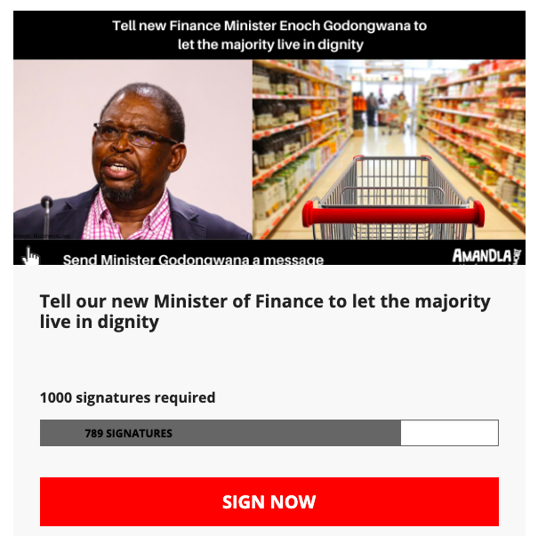
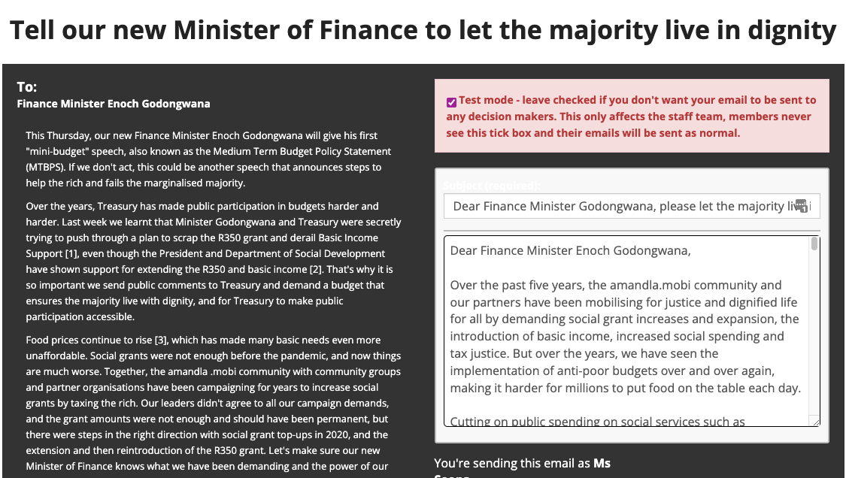
Tell or new Minister of Finance to let the majority live in dignity

Slide 9
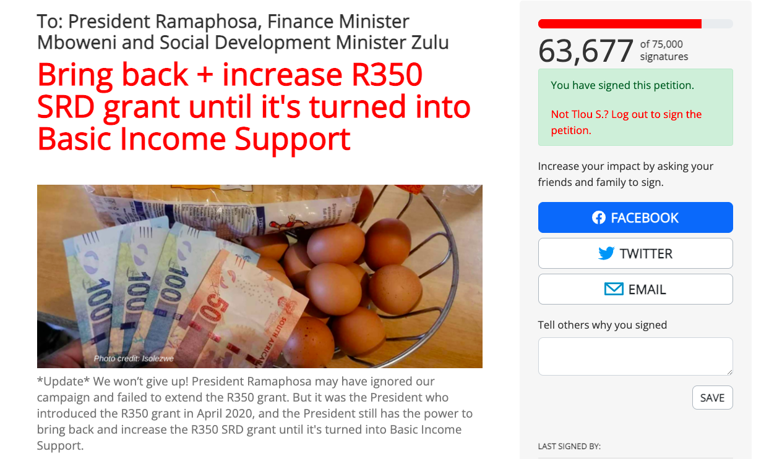
Bring back + increase R350 SRD grant until it’s turned into Basic Income Support

Slide 10
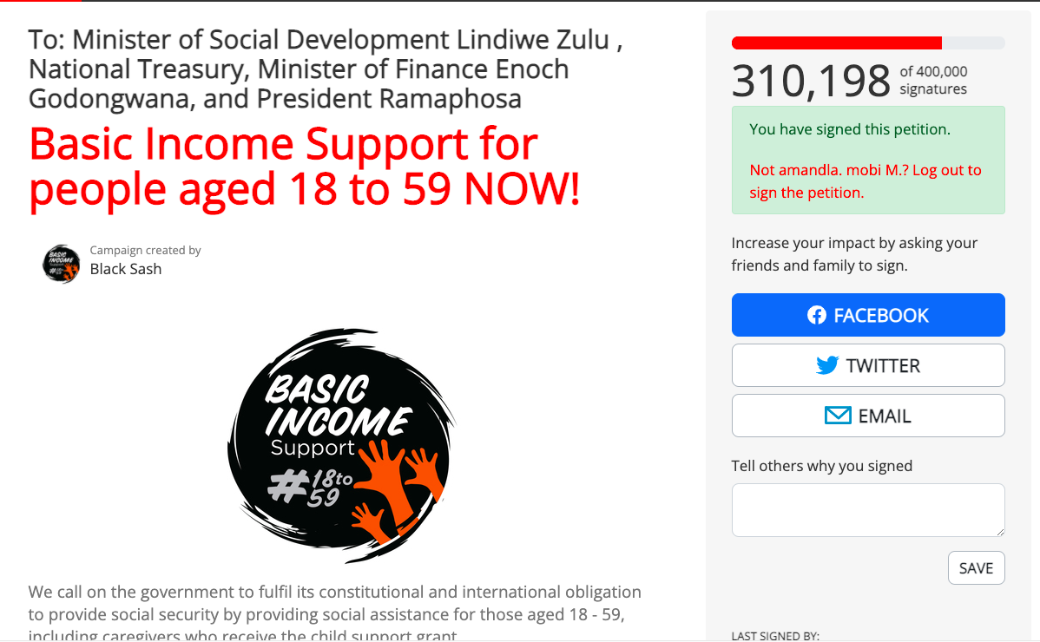
Basic Income Support for people aged 18 to 59 NOW!

Slide 11
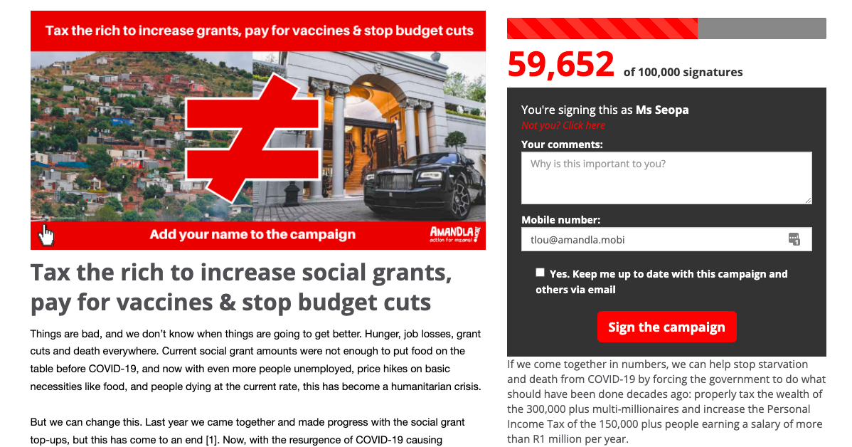
Tax the rich to increase social grants, pay for vaccines & stop budget cuts

